Slide 1
CRYSTAL ARTHROPATHIES
Syokau Ilovi
csilovi@uonbi. ac.ke
Department of Clinical Medicine & Therapeutics

Slide 2
Outline
Gout
  Introduction
  Pathogenesis/ Aetiology/ Risk factors
  Clinical Presentation
  Treatment
Pseudogout

Slide 3
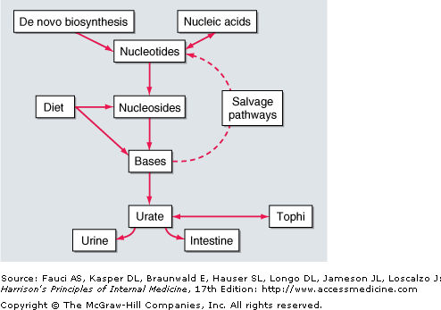
Gout- Pathophysiology (1)

Slide 4
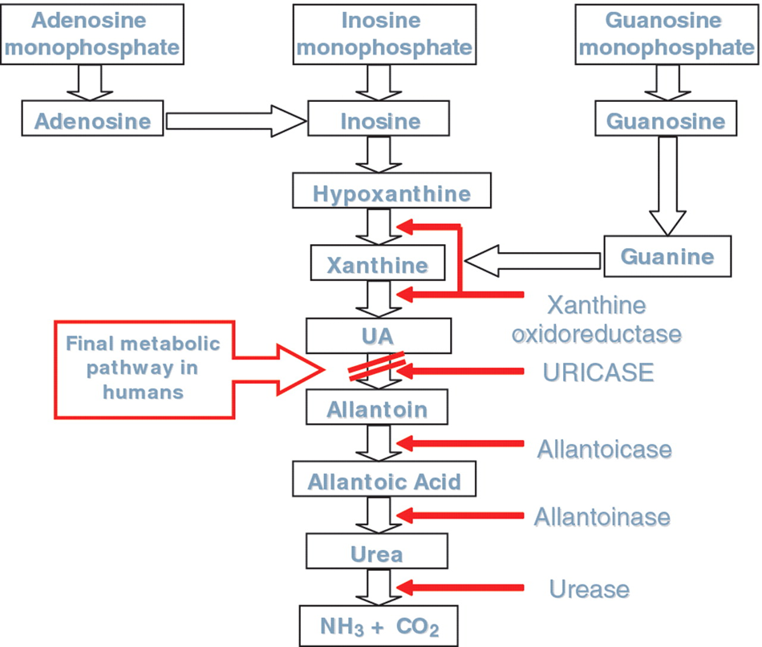
Gout- Pathophysiology (2)

Slide 5
Gout- Pathophysiology (3)
Metabolic disease most often affecting middle-aged to elderly men and postmenopausal women.
It is the result of an increased body pool of urate with hyperuricemia. (overproduction of uric acid, undersecretion of uric acid)
Characterized by:
  episodic acute and chronic arthritis, due to deposition of Monosodium Urate (MSU) crystals in joints
  connective tissue tophi
  deposition in kidney interstitium or uric acid- causes nephrolithiasis .

Slide 6
Acute and Chronic Arthritis (1)
Acute arthritis is the most frequent early clinical manifestation of gout.
Usually, only one joint is affected initially
Polyarticular acute gout can occur in subsequent episodes.
The metatarsophalangeal joint of the first toe is often involved- Podagra
Can also affect tarsal joints, ankles, and knees.
The first episode of acute gouty arthritis frequently begins at night with dramatic joint pain and swelling.

Slide 7
Acute and Chronic Arthritis (2)
Joints rapidly become warm, red, and tender, with a clinical appearance that often mimics cellulitis.
Early attacks tend to subside spontaneously within 3–10 days, and most patients have intervals of varying length with no residual symptoms until the next episode.
Several events may precipitate acute gouty arthritis: dietary excess, trauma, surgery, excessive ethanol ingestion, hypouricemic therapy, and serious medical illnesses such as myocardial infarction and stroke.
Women represent only 5–20% of all patients with gout.
Premenopausal gout is rare; it is seen mostly in individuals with a strong family history of gout or renal disease.

Slide 8
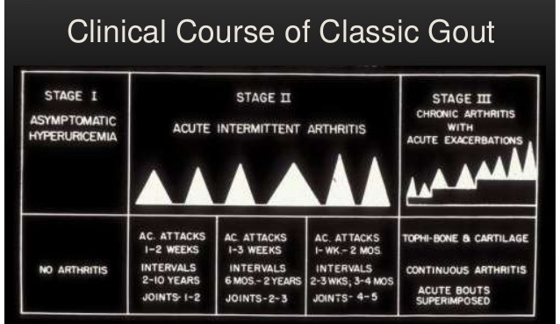

Slide 9
Laboratory Diagnosis(1)
Even if the clinical appearance strongly suggests gout, the diagnosis should be confirmed by needle aspiration of acutely or chronically involved joints or tophaceous deposits.
DDx- Acute septic arthritis, crystalline-associated arthropathies, and psoriatic arthritis.
During acute gouty attacks, strongly birefringent needle-shaped MSU crystals with negative elongation are typically seen both intracellularly and extracellularly.
Synovial fluid cell counts are elevated from 2000 to 60,000/L.
Bacterial infection can coexist with urate crystals in synovial fluid; if there is any suspicion of septic arthritis, joint fluid must also be cultured.

Slide 10
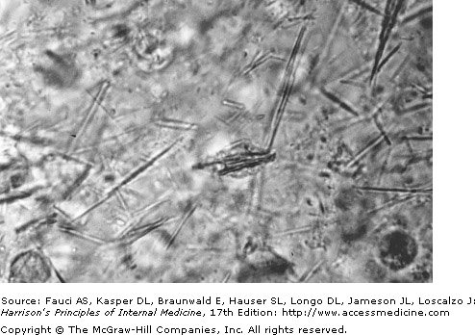
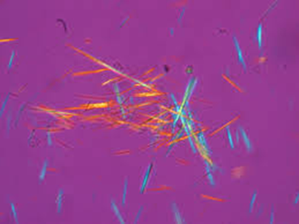
Laboratory Diagnosis(2)

Slide 11
Laboratory Diagnosis(3)
MSU crystals can also often be demonstrated in the first metatarsophalangeal joint and in knees not acutely involved with gout.
Arthrocentesis of these joints is a useful technique to establish the diagnosis of gout between attacks.
Serum uric acid levels can be normal or low at the time of the acute attack, as inflammatory cytokines can be uricosuric and effective initiation of hypouricemic therapy can precipitate attacks. This limits the value of serum uric acid determinations for the diagnosis of gout.
Nevertheless, serum urate levels are almost always elevated at some time and are important to use to follow the course of hypouricemic therapy.

Slide 12
Laboratory Diagnosis(4)
A 24-h urine collection for uric acid can, in some cases, be useful in assessing the risk of stones, in elucidating overproduction or underexcretion of uric acid, and in deciding if it might be appropriate to use a uricosuric therapy.
Excretion of >800 mg of uric acid per 24 h on a regular diet suggests that causes of overproduction of purine should be considered.
Urinalysis, U/E/Cr , TBC, WBC
Radiographic Features:
Early in the disease radiographic studies may only confirm clinically evident swelling.
Advanced chronic tophaceous gout- Cystic changes, well-defined erosions with sclerotic margins (often with overhanging bony edges), and soft tissue masses.

Slide 13
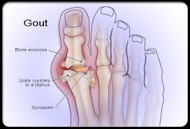
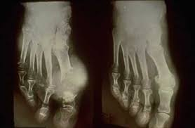
Gout Joint Damage

Slide 14
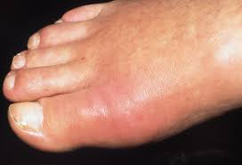
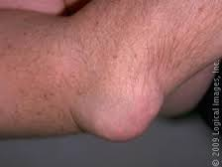
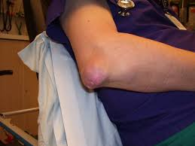

Slide 15
Gout: Treatment(1)
Acute Gouty Arthritis
NSAIDS- Reduce pain and inflammation
Intraarticular glucocorticoids- used in monoarticular gout-anti-inflammatory
Oral glucocorticoids (prednisone, 30–50 mg/d)- polyarticular gout.
Colchicine- Given over several days with subsequent tapering.
  The drug must be stopped promptly at the first sign of loose stools, and symptomatic treatment must be given for the diarrhea.
  Avoid in elderly and CKD

Slide 16
Gout: Treatment(2)
Hypouricemic Therapy- Prevents further attacks
Ultimate control of gout requires correction of the basic underlying defect, the hyperuricemia.
Goal- normalize serum uric acid to <300–360 mol/L (5.0–6.0 mg/dL) to prevent recurrent gouty attacks and eliminate tophaceous deposits.
Long-term hypouricemic drugs
Lifestyle modification- Weight loss, low-purine diet, increase in liquid intake, limitation of ethanol use, and avoidance of diuretics such as Thiazides
Decision to initiate hypouricemic therapy is usually made taking into consideration the number of acute attacks (urate lowering may be cost effective after two attacks), serum uric acid levels [progression is more rapid in patients with serum uric acid >535 mol/L (>9.0 mg/dL)], patient's willingness to commit to lifelong therapy, or presence of uric acid stones.

Slide 17
Gout: Treatment(3)
Urate-lowering therapy should be initiated in any patient who already has tophi or chronic gouty arthritis.
Uricosuric agents, such as probenecid, can be used in patients with good renal function who underexcrete uric acid, with <600 mg in a 24-h urine sample. Urine volume must be maintained by ingestion of 1500 mL of water every day.
Avoid Probenecid in patients with serum creatinine levels of >177 mol/L (2.0 mg/dL).
  Use Allopurinol, Fenofibrate.
  Losartan has also mild uricosuric effects- Anti-Hypertensive of choice in out
The xanthine oxidase inhibitor allopurinol is by far the most commonly used hypouricemic agent and is the best drug to lower serum urate in overproducers, urate stone formers, and patients with renal disease.
Colchicine prophylaxis is usually continued, along with the hypouricemic therapy, until the patient is normouricemic and without gouty attacks for 6 months or as long as tophi are present.
New urate-lowering drug- xanthine oxidase inhibitor, febuxostat

Slide 18
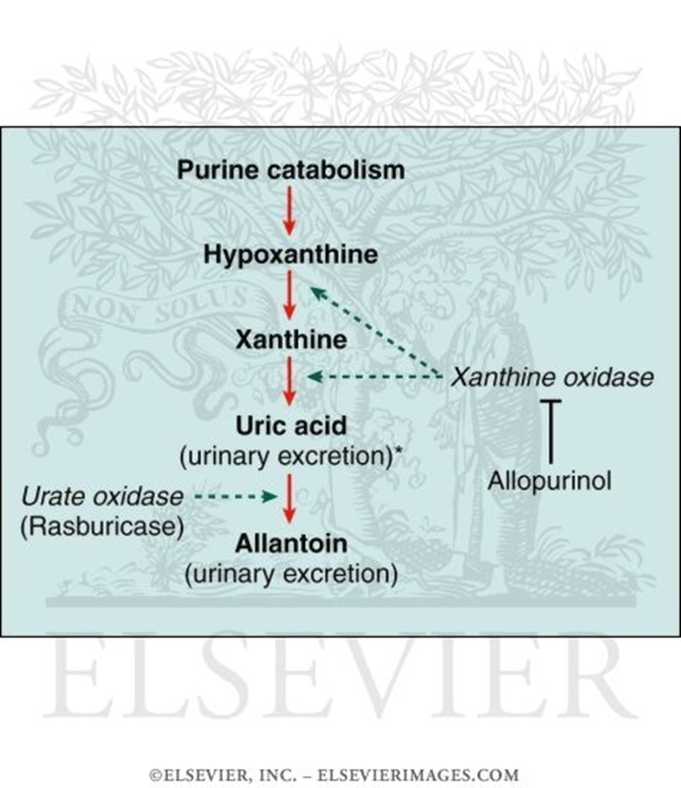
Gout: Treatment(4)

Slide 19
Calcium Pyrophosphate Deposition (CPPD)
(formerly called Pseudogout)
Pseudogout crystals (CPP) are rod-shaped with blunt ends and are positively birefringent. Thus, pseudogout crystals are blue when aligned parallel to the slow ray of the compensator and yellow when they are perpendicular.

Slide 20
