Slide 1

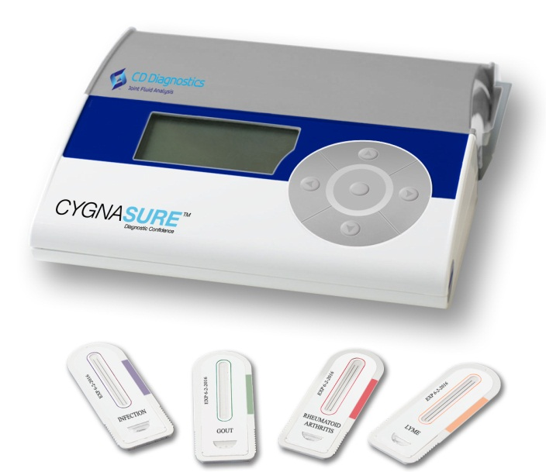

www.cddiagnostics.com

Slide 2
Management Team
CEO | Rick Birkmeyer, Ph. D. -Founder and CEO of Strategic Diagnostics, Inc. (Nasdaq: SDIX) -Obtained funding, 12 corp partnerships, 6 strategic acquisitions -DIF Venture Board, DEDO Venture Board, 4 Corporate Boards
VP Marketing, Co-Founder | Mike Behr -20 years in orthopaedic industry -J&J, Zimmer (Sales & Marketing)
Chief Scientific Officer, Co-Founder | Carl Deirmengian, M.D. -Practicing Orthopedic surgeon -Princeton University, Harvard Medical School
VP Corporate Development | ******* -Co-Founder SDIX -Investment consultant for Delaware Innovation Fund
VP Research & Development | ***** -direct involvement in the development of 15 FDA approved products -has been awarded four U.S. patents and has two pending applications.

Slide 3
CD Diagnostics
Strategic Focus
Our mission is to be the leader in joint fluid analysis by providing analytical tools which will facilitate informed decisions in patient care. We will bring these analytical tools to market through corporate partnerships.

Slide 4
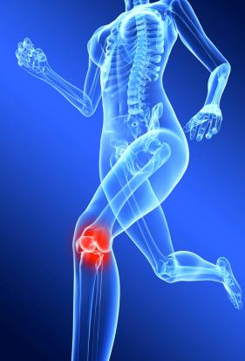
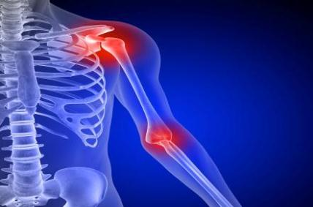
Joint Pain
Many causes of joint pain
frequently misdiagnosed
Unnecessary medical
expenses

Slide 5
USA Patients with Joint Disease
38.5 million total
100+ million with joint pain in 2009
www.cdc.gov

Slide 6
USA Testing Points
Ambulatory care visits and hospitalizations
40 million+ for all joint pain
17.4 million total for joint disease
www.cdc.gov

Slide 7
USA Test Market Potential
51.1 million tests for patients with joint disease
(Excluding negative results)

Slide 8
Global Test Market Potential
224.03 million tests for patients with joint disease
(Excluding negative results)

Slide 9
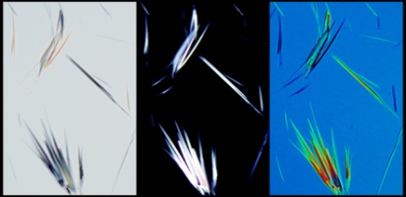
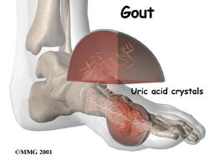
Current Diagnostics
Blood Tests
  CRP, ESR
  Uric Acid
  Rheumatoid Antibody
  Lyme Antibody
Joint Tests
  Formation of crystals
  White Blood Cell Count
  Gram Stain/Culture

Slide 10
Current Diagnostics
There are currently NO approved
analytic assays of synovial fluid for
the diagnosis of joint disease

Slide 11
Clinical Utility
Differentiation of chronic joint diseases will lead to a specific therapeutic pathway more quickly.
Prevent secondary complications
Expedite decision regarding joint revision surgery or treatment pathway

Slide 12

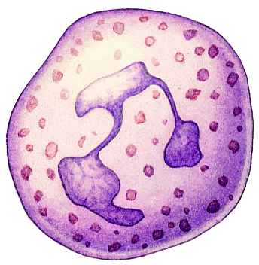

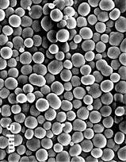
Biomarkers
White Blood Cells
Bacteria
Crystals
Poly debris

Slide 13
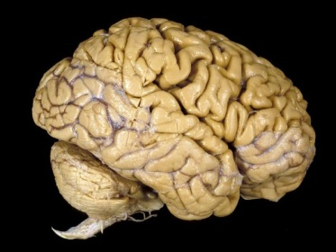
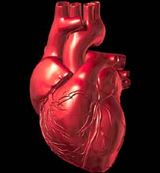
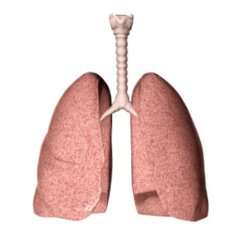

Why Test Joint Fluid?
Concentration
No Confounders
Local test
Serum Test
Dilution
Other Biomarkers

Slide 14
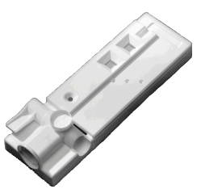
Core Technology
Immunoassay
Immunoassay characteristics
  Easy-to-Use
  Accurate Results On-Site
  Inexpensive
Applied to Joint Fluid Analysis
  Replaces ambiguous and inaccurate methods
  Enables Rapid Analysis not Currently Possible

Slide 15

Intellectual Property
USPTO
Office of Public Records
Document Services Division
USPTO# 7598080
“Diagnostic Assay for the source of inflammation”
  Issued 10/6/2009
Continuations
US20090318301
  Filed 8/28/2009
  Amended 9/1/2011
13/231,647
  Filed 9/13/2011
13/231,665
  Filed 9/13/2011
Provisionals
Pseudogout 61/590,248
Rheumatoid Arthritis 61/590,246
Osteoarthritis 61/590,244
Gout 61/590,240
Infection 61/590,234

Slide 16
Corporate Partnering
CD Diagnostics Core Strengths
Synergistic Partner
Market Leader
Complimentary Products
GMP Manufacturing
Immunoassay Development
Market
Leadership

Slide 17

Proof of Concept
First study
  Patient data
  Compared Gout to Infection
  Defined a genetic signature in
  joint fluid
Second study
  Patient data
  Confirmation of first study
  Compared infection to aseptic
  loosening
Third study
  Patient data
  Multiple clinical symptoms
  Elisa Testing

Slide 18
Technical & Clinical Milestones
Milestone | Infection-Joint
Selection of Biomarkers Patent filed | April 2012
Lab Developed Test | August 2012
Investigational Use Kit | January 2013
510(k) Approval | November 2013

Slide 19
Commercialization Process
Laboratory Developed Test
Regulated by CLIA
No FDA Approval
Can be reimbursed
Can promote for detection
Advertising not restricted
Investigational Use Only Kit
Generation of data
Results can be used by clinicians as adjunct
Charge buyer

Slide 20
Funding
Angel Funding $1.5 million
State Grant
State of Delaware $ .5 million additional $ .5 million available

Slide 21
Corporate Partner Deals
  Company A
    Infection Joint ($2.9 Million milestone payments)
    Infection Native ($1.75 Million milestone payments)
    Metal-metal
    Metal-allergy
  Company B
    Osteoarthritis
  Company C
    Rheumatoid Arthritis

Slide 22
Preferred Round
$1.6 Million conversion of notes
$1.1 Million Corporate Partner
$2.0 Million new money

