Slide 1
FORENSIC BALLISTIC INVESTIGATIONS
Presented to: Dr Okemwa
By Michael .L. Safari
H31/7161/2005
On 10/9/2009

Slide 2
GUN SHOT A middle aged shopkeeper has been shot dead in bundled armed robbery. Several witnesses have good descriptions of the robbers ,enabling police to arrest two suspects within a matter of hours. A 0.22 calibre hunting riffle was found at the home of one suspect. What forensic ballistic investigations should be performed and what will they aim to demonstrate?

Slide 3
Terms Of Reference
Ballistics: the science or art of designing and accelerating projectiles so as to achieve a desired performance.
Forensic ballistics: entails examination of bullets and firearms in an attempt to identify particular weapons used in a crime, via indicative signs left behind, which can be used to deduce specific facts, eventually track down whoever used it.
Calibre: with respect to firearms, as a measure of the inside diameter of the barrel in inches (or hundredths of an inch) or in millimeters.
Rifling : is the process of making grooves in gun barrels that imparts a spin to the projectile increasing accuracy and range. Bullets fired from rifled weapons acquire a distinct signature of grooves, scratches, and indentations which are of value for matching a fired projectile to a firearm.
Gunshot residue (GSR) composed of burnt and un-burnt particles from the explosive primer, the propellant, as well as components from the bullet, the cartridge case and the firearm used. Other names, such as cartridge discharge residue (CDR),firearm discharge residue (FDR). The chemical elements present,mainly lead styphnate, barium nitrate, and antimony sulfide.

Slide 8
Investigations
Crime Scene Investigation (CSI)
Suspect
Victims Body
Bullet
Gun and parts of the gun
Comparative Studies

Slide 9
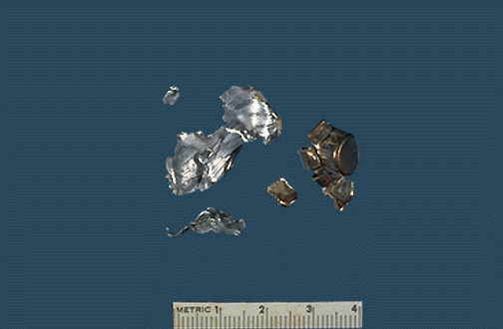
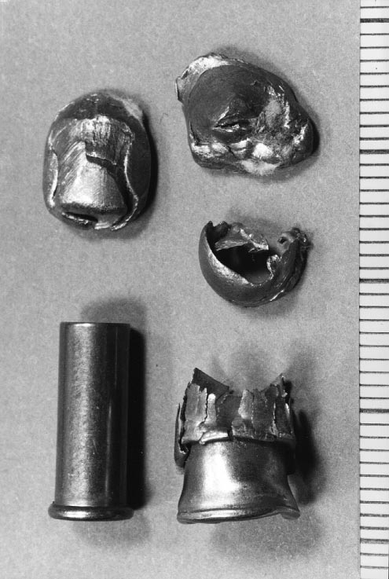
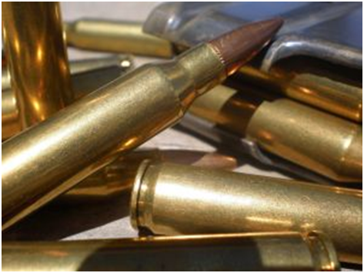
At the Site
Spent Cartridges/Shell Casings
Used Bullets.
Damage to the surrounding physical structures by bullets.
Unused bullets.

Slide 10
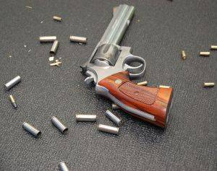
Evidence is collected in special evidence collection bags i.e bagged and tagged.

Slide 11
Suspect
Gun powder residue on the suspects hands (test discussed later)
Bullets present on the suspects.
Positive test would demonstrate firing of firearm.

Slide 12
Victims Body
Clothing and Gun Shot Wound site(s) examined for range determination:
1 )Gun Shot Residues(GSR):Powder blast presence and pattern indicate distance from which bullet was discharged on the victim.
2) Burns/Tattooing: around the entry wound due to muzzle flash as in a victim shot with gun contacting skin.
Wounds Gunshot Wounds(GSW) are typically classified as Contact ,
Intermediate range, Distant range an also as Penetrating or Perforating.
- entry and exit: determine direction of bullet contact initially and final exteriorisation from the body where applicable
Bullet trajectory and tract within the body: hunting rifles bullets, use the hydraulic pressure of the tissue to expand in diameter, limiting penetration, increasing tissue damage along their path.
Causes of death following GSW include: exsanguinations, hypoxia caused by pneumothorax, heart failure and brain damage.

Slide 13
Blackening due to close range firing

Slide 14
Entrance wounds
Contact wounds ; GSR on the clothing, skin, and muzzle imprint, or laceration of the skin from effects of gases. (Cohle et al, 1987).
Intermediate, or close-range, may show a wide zone of GSR stippling, but lack a muzzle imprint and laceration. The area of stippling will depend upon the distance from the muzzle. (Denton et al, 2006)
Distant range wounds lack GSR stippling ,usually exhibit a hole roughly the caliber of the projectile fired.
Alizarin red S stain used in microscopic tissue sections to determine the presence of barium as part of GSR
Burn injury at the entrance site with close contact range is typically a minor component of the tissue injury, but some coagulative necrosis does occur

Slide 15
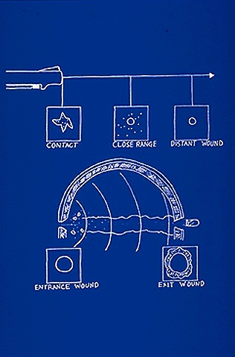
Illustration: Basic differences between the skin appearance of a contact, close (intermediate), and distant (in determinant) range gunshot wound. The appearance of the wounding characteristics in the skull is shown in the lower diagram in which there is beveling of the skull outward away from the direction of origin of the bullet.

Slide 16
High Velocity Bullets. Bullets @ > 2600 fps, such as the .223, 22-250, .
243/6mm, .270, .308, 30-06, follow a lower arc to reach target.
Useful range can be upward of 200 yards.
Referred to as "flatter" trajectories.
With higher velocities, bullets go much further before gravity and air resistance cause them to fall below the initial line of sight.
Bullets follow a parabolic arc ,bullet shape and the spin from rifling also influence the trajectory slightly by reducing air resistance and stabilizing bullet orientation.

Slide 17
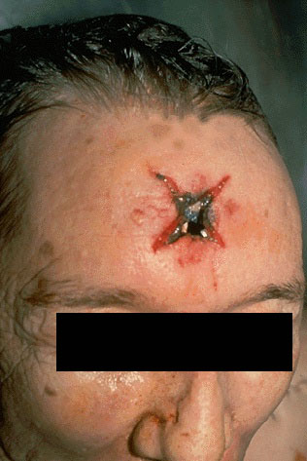
Contact gunshot entrance wound. Barrel contacts the skin, the gases released by the fired bullet go into subcutaneous tissue and cause the star-shaped laceration. Note also the grey-black discoloration from the GSR, as well as the faint abrasion ring.

Slide 18
The abrasion ring, and a very clear muzzle imprint, are seen in this contact range gunshot wound.

Slide 19
An abrasion ring, formed when the force of the gases entering below the skin blow the skin surface back against the muzzle of the gun, is seen here in this contact range gunshot wound to the right temple. [Image contributed by University of Utah]

Slide 20
Contact Range gunshot entrance wound with grey-black discoloration from the burned powder. [Image contributed by University of Utah]

Slide 21
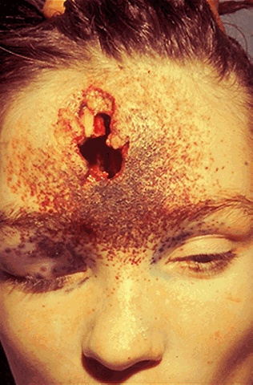
Powder tattooing is seen in this intermediate range gunshot wound. The actual entrance site is somewhat irregular, because the bullet can tumble in flight.

Slide 22
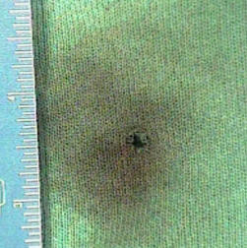
A Entrance Wound of fire arm on the back
Visible gunshot residues around bullet entrance hole in clothing

Slide 23
This is an intermediate range gunshot entrance wound in which there is powder "tattooing" around the entrance site

Slide 24
Histologic examination of the entrance wound site on the skin demonstrates black gunshot residue and coagulative necrosis.

Slide 25
Bullet Tracks
Deformation, fragmentation of the bullet or secondary targets such as bone, is due to the amount of kinetic energy imparted to tissues, as well as tissue characteristics affect patterns of tissue injury.
The higher the specific gravity of tissue, the greater the damage.
Elasticity reduces damage, lung tissue of low density and high elasticity is damaged less than muscle with higher density but some elasticity. Liver, spleen, and brain have no elasticity and are easily injured, as is adipose tissue.
Fluid-filled organs (bladder, heart, great vessels, bowel) can burst because of pressure waves generated.
Bone; fragmentation of bone and/or bullet, with numerous secondary missiles formed, each producing additional wounding.
Formation of a temporary cavity can exert pressure waves and shearing forces, which can rupture blood vessels leading to extravasations.
The extracellular tissue matrix can be disrupted.
Within the cranial cavity, formation of a temporary cavity is restricted, and pressure waves can damage tissues via contusion away from the permanent bullet track. These intracranial pressure effects most immediately affect the brain stem, while edema and neocortical effects may develop over days to weeks.
(Jandial et al, 2008)

Slide 26
This is the bullet track in clay of a .38 caliber round, demonstrating that the wound track is much larger than .38 inches

Slide 27
Entrance wounds into skull bone typically produces beveling, or coning, of the bone at the surface away from the weapon on the inner table. In thin areas such as the temple, this may not be observed. (Sternum, iliac crest, scapula, rib cf.)
These observations may permit determination of the direction of fire. A small, dense projectile may "punch out" a rounded portion of cranium, while a larger projectile may produce circumferential fractures that radiate outward from the point of entrance.
(Jandial et al, 2008)

Slide 28
The surface of the skull demonstrates the heavy GSR in this contact range entrance wound, as well as radiating fracture lines. The direction of fire was thus toward the back of this picture.

Slide 29
Exit wounds
Most bullets are designed to hit the target without exiting, however ,an exit wound could be present. This may be due to the use of a projectile more powerful than necessary, or the projectile may strike an area (such as an extremity) with minimal tissue.
Generally larger than entrance wounds, due to the bullet expanding or tumbling on its axis.
Exit wounds either do not exhibit GSR or far less than entrance wounds.
Bullet Fragmentation may produce secondary missiles, 1or > , may have exit wounds. The bullet path may be altered by striking bone or other firm tissues, such that the bullet track may not be linear.
Scanning electron microscopy of exit wounds shows irregular lacerations with protruding collagen fibers, but relatively undamaged papillae. (Torre, 1986)

Slide 30
Exit wound on the chest
Slit-like exit wound.
The projectile: deformed ,flattened while traversing body,
a laceration upon exit. There is no powder or soot visible in this exit

Slide 31
entrance at the left and an exit at the right.

Slide 32
Imaging Studies
Imaging Studies: x-ray to establish presence of
radio-opaque bullet fragments
X-ray of the head. Several heavily deformed metal-dense
fragments in the frontal sinus and under the skin; left: antero-posterior
view, right: side view

Slide 33
Types of Bullets
Lead soft-point, boat-tailed,
copper-jacketed bullets
modern bullets
.270 ammunition, Left to Right: 100-grain (6.5 g) – Hollow Point 115-grain (7.5 g) – FMJBT(full metal jacket boat tailed) 130-grain (8.4 g) – Soft point 150-grain (9.7 g) – round nose.
.303 inch (7.7 mm) centrefire, FMJ rimmed ammunition

Slide 34
GUN SHOT RESIDUE(GSR)
2 Main Types of laboratory analysis:
Atomic Absorption (AA) Analysis consist of cotton swabs in tubes and a reagent. Reagent put on the cotton swabs and rubbed on the suspected shooter's hand, and sent for the lab analysis.
The Scanning Electron Microscope SEM examination consist of metal discs (1/8" stub, 1/2" face) with adhesive that are dabbed on the hands. Adhesive picks up the GSR. The metal discs are then sent for laboratory analysis.
NB Visible stains do not appear on the hands. Data is obtained only by laboratory examination.
Others:
Modified Griess test: combination of diphenylamine, ethyl centralite and nitrodiphenylamine, is typically found only in explosive mixtures
Burleson’s new test: uses solid phase micro-extraction combined with gas chromatography, focuses on chemical compounds present in that ejected material.
Sodium Rhodizonate test

Slide 36
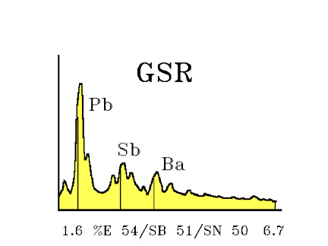
Gun Shot Residue(GSR)
Scanning electron microscopy: shows GSR within collagen fibrils. Wound appears abraded, with loss of the papillary pattern and laceration of basement membrane (Torre et al, 1986).
Detected by using scanning electron microscopy
coupled with energy-dispersive x-ray microanalysis
to demonstrate the characteristic elemental pattern of the primer residue
with lead, antimony, and barium, typical for many cartridges

Slide 37
Residue particle -- about 15 times smaller than the width of a human hair been magnified 200 times with a digital microscope.

Slide 38
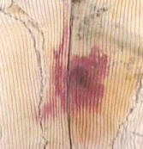
Griess Test; pink seen on the shirt is a very heavy deposit of lead residue

Slide 39
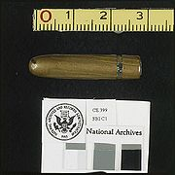
Bullet
Retrieved from the body/crime site:examined for grooves due to rifling as in this case of the .22 calibre hunting rifle.
NB. Comparison studies.
Controversial bullet from the John F. Kennedy assassination

Slide 40
Gun
Functionality demonstrates a specific gun is capable of being fired, and if so whether it could fire the bullets found at the scene. The ballistics expert checks the firing pin, the safety mechanism and the pull on the trigger. This helps establish, if a suspect was capable of using the weapon at the scene.
Identification Numbers
Serial numbers stamped on their surface. This can be detected using ultrasound, chemical etching or magnetization procedures. ID numbers, can trace point of sale and possibly the current owner.
Finger prints of the suspect
Presence would indicate contact and handling of the gun
NB. Comparison studies:

Slide 42
Fingerprints

Slide 43
Comparative Studies:
Involve
Functional Firearm in this case .22 calibre hunting rifle from the suspect.
Spent Cartridges/Bullet Casings and Unused Bullets at the from the site.
Retrieved bullet or fragments from the victim if present.
Test fired bullets and cartridges using the functional gun.
Studies are then performed on gun parts, bullets and cartridges

Slide 44
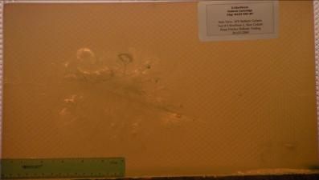
Functional rifle and bullets
Gelatin testing: bullet is fired into Ballistic gelatin closely simulates the density and viscosity of human and animal muscle tissue. Bullets intended for hunting rifles are also commonly tested in ballistic gelatin.
Body models in forensic ballistics: reconstruction of a gunshot injury can be reproduced simply and economically, without coming into conflict with ethical guidelines.

Slide 45
Functional rifle and bullets cont’d
Bullets: Identification of a bullet is made became possible by rifling causing the fired bullets to have distinctive grooves, indentations and scratches upon them unique to the weapon that fired them.

Slide 46
Bore of a rifled fire arm

Slide 47
Functional Hunting Rifle and Bullet Casings
When you pull the trigger on a gun, the firing pin strikes the bullet to set off the gunpowder. That leaves a mark on the casing as unique as a fingerprint--no two guns strike the bullet in exactly the same way.
Procedure for comparative studies entails:
1 For Bullets; firing a bullet or bullets from the same hunting rifle gun and comparison with the bullet(s) retrieved from the crime seen for grooves that matching the rifling of the hunting rifle barrel using a Comparison Microscope.
2 For Casings; firing a bullet or bullets from the same hunting rifle gun and comparing the indentation on the casings with that of crime scene spent cartridges which will match.

Slide 48
Firing pin marks of crime and test cartridge

Slide 49
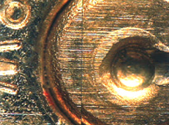
Firing pin marks of crime and test cartridge

Slide 50
Comparison Microscope

Slide 51
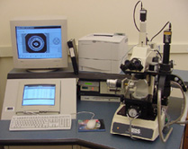
Integrated Ballistic Identification System (IBIS)
a computerized digital imaging system which captures digital photographs
of fired bullets and cartridge cases.
These images are stored in a database and are electronically compared to one another

Slide 52
Comparison of striations between crime and test bullet
surface of lead bullets fired at high velocity may melt due to hot gases behind and friction with the bore.
Because copper has a higher melting point, greater specific heat capacity,hardness,
copper jacketed bullets allow greater muzzle velocities.

Slide 53
Types of Bullets
ACC – Remington Accelerator [2] (see sabot)
AP – Armor Piercing (has a steel or other hard metal core)
BBWC – Bevel Base Wadcutter
BEB – Brass Enclosed Base
Blitz – Sierra BlitzKing
Bt – Boat-tail
BtHP – Boat-tail Hollow Point
CB – Cast Bullet
CL, C-L – Remington Core-Lokt
DEWC – Double Ended Wadcutter
DU – Depleted Uranium
EVO, FTX – Hornady LEVERevolution Flex Tip eXpanding
FMJ – Full Metal Jacket
FMC – Full Metal Case
FN – Flat Nose
FP – Flat Point
FST – Winchester Fail Safe Talon
GC – Gas Check
GD – Speer Gold Dot
GDHP – Speer Gold Dot Hollow Point
GS – Remington Golden Saber
HBWC – Hollow Base Wadcutter
HC – Hard Cast
HP – Hollow Point
HPJ – High Performance Jacketed
HS – Federal Hydra-Shok
HST – Federal Hi-Shok Two
J – Jacketed
FP – Jacketed Flat Point JHC – Jacketed Hollow Cavity
JHP – Jacketed Hollow Point
JHP/sabot – Jacketed Hollow Point/sabot
JSP – Jacketed Soft Point
L – Lead
L-C – Lead Combat
L-T – Lead Target
LFN – Long Flat Nose
LFP – Lead Flat Point
LHP – Lead Hollow Point
LRN – Lead Round Nose
LSWC – Lead Semiwadcutter
LSWC-GC – Lead Semiwadcutter Gas Checked
LWC – Lead Wadcutter
LTC – Lead Truncated Cone
MC – Metal Cased
MHP – Match Hollow Point
MK – Sierra MatchKing
MRWC – Mid-Range Wadcutter
NP – Nosler Partition
OTM – Open Tip Match
OWC – Ogival Wadcutter [3]
PB – Lead Bullet
PB – Parabellum
PL – Remington Power-Lokt
PSP – Plated Soft Point

Slide 54
references
Forensic Science International Journal
Indian Journal of Forensic Pathology
University Of Utah Forensic Pathology Review
Forensic Pathology by Vincent J.M. DiMaio, M.D., Dominick DiMaio, Dominick J. Di Maio
Forensic Pathology: Principles and Practice- by David Dolinak, Evan W Matshes, Emma O Lew
Forensic Medicine: Clinical and Pathological - by Jason Payne James, Anthony Busuttil

