Slide 1
The fallopian tube as origin of ovarian cancer: Change of diagnostic and preventive strategies
PRIYANKA SINGH PANWAR
H31/42209/2017
MBChB Level IV

Slide 2
OBJECTIVES
Summarise the findings
Describe the relevance of the information to our practice at KNH

Slide 3
summary
Ovarian cancer is the leading cause of gynaecologic cancer deaths in the world, and its prevention and early diagnosis remains the key to its treatment, especially for high‐grade serous carcinoma (HGSC) as it has a poor prognosis.
Ovarian cancer is the third commonest cause of cancer death from gynaecologic tumours in Kenya.
Early disease causes minimal, nonspecific, or no symptoms therefore, most patients are diagnosed when the disease is at an advanced stage.
Evidence has shown that HGSC originates from fallopian tube secretory cells through serous tubal intraepithelial carcinoma (STIC).

Slide 4
HISTORY
Ovarian cancer had initially been believed to arise from ovarian surface epithelial cells.
However, this concept has changed in HGSC which has become a major histological subtype of ovarian cancer in the past two decades.
It all began with the discovery of the BRCA1 and BRCA2 tumour suppressor genes (Approximately 5%‐10% of ovarian cancers are attributed to inherited germline mutations of susceptible genes, and about 90% of such cases involve mutations of BRCA1 or BRCA2 genes.).
Mutation carriers have an increased risk of ovarian cancer, at 40%‐60% at the age of 70 years.

Slide 5
At the beginning of 2000, there were several reports of epithelial abnormalities of the fallopian tubes in RRSO (Risk‐reducing bilateral salpingo‐oophorectomy) specimens, called serous tubal intraepithelial carcinoma (STIC).
In 2005, the Sectioning and Extensively Examining the FIMbriated end of the fallopian tube (SEE‐FIM) protocol was introduced by the Brigham and Women's Hospital group for routine analysis of fallopian tubes of women with BRCA mutations or with a family history of breast and/or ovarian cancer.
This protocol triggered increased reports of STIC or early serous carcinoma; approximately 2% of the cases with RRSO had such early lesions, mainly in the fimbriae of the fallopian tubes.
Detecting precancerous or early serous carcinoma in the fallopian tubes of BRCA mutation carriers led to the hypothesis that serous carcinoma in the ovary or other pelvic sites originates from the fallopian tubes.

Slide 6
Supporting this hypothesis, approximately 50% of patients with HGSC were found to have co‐existing STIC (serous tubal intraepithelial carcinoma) when the SEE‐FIM protocol was applied.
Subsequent studies reported a varied frequency (20%‐60%) of this association, but this inconsistency may be due to the difficulty of identifying intact fallopian tubes likely being involved in ovarian masses.
The most striking findings for the linkage of STIC and serous carcinoma are common somatic mutations in TP53, as well as other molecular markers, such as elevated stathmin 1, shortened telomeres, and cyclin E amplification, shared with these lesions.

Slide 7
RRSO has been proposed to reduce the subsequent occurrence of serous carcinoma in high‐risk patients with BRCA mutations (RRSO has therefore been recommended for women with hereditary ovarian cancer syndrome at age 35‐40 years for BRCA1 mutation carriers and at age 40‐45 years for BRCA2 carriers).
However, there is no management strategy for isolated precursors detected at RRSO, and the role of subsequent surgery or chemotherapy in preventing serous carcinoma remains unclear.
Surgical menopause due to RRSO provides a variety of problems related to patients’ quality of life, and the risks and benefits of hormone replacement are under investigation, especially for women without a previous history of breast cancer.
An additional surgical option, salpingectomy with delayed oophorectomy, has been proposed to prevent surgical menopause.

Slide 8
Significant efforts have been made to diagnose ovarian cancer earlier in the course of cancer development, classically using transvaginal ultrasonography with CA‐125 as a serum marker, but there is no definitive screening approach that reduces ovarian cancer mortality.

Slide 9
BROAD SPECTRUM OF TUBAL PRECURSOR LESIONS
STIC and serous carcinoma have frequent p53 mutations and, therefore, exhibit p53 overexpression on immunohistochemistry.
However, it was reported that small segments of strongly p53‐positive cells were commonly observed in fimbriae, irrespective of BRCA status, called the “p53 signature”.
Careful histochemical analysis showed that the p53 signature is predominant in the fimbriated end, especially in nonciliated (secretory) cells, and p53 signature is more frequently present in association with STIC.
The p53 signature was frequently associated with γ‐H2AX staining, histochemical evidence of double‐strand DNA breakage, indicating that it is initiated by DNA damage.
Thus, the p53 signature might be a reactive change in response to genotoxic circumstances, such as by exposure to oxidants in follicular fluid in the post ovulation period.
Approximately 50% of p53 signatures are known to have gene mutations in p53, similar or identical to those observed in STIC.
Thus, such genotoxic circumstances in fimbriae may induce not only up‐regulation but genetic mutations in p53, the latter of which may cause progression to STIC.

Slide 10
In two types of tubal epithelial cells, so‐called secretory and ciliated cells, the former are less matured and thought to be vulnerable to transformation, and, in fact, secretory cells were proven to be the most susceptible to DNA damage in vitro.
The proliferative activity of the p53 signature has been demonstrated to be low.
This is consistent with the fact that DNA damage facilitates ATM/ATR‐regulated signaling pathways that result in cell cycle arrest.
However, once the p53 signature progresses to STIC, it acquires high‐growth proliferative activity with high Ki‐67 or MIB1 expression and cytologic atypia, as well as loss of cellular polarity.
Of particular interest is that transitional lesions between the p53 signature and STIC are often found, with intermediate proliferative and morphological characteristics, called serous intraepithelial lesions (STILs).
The presence of these transitional lesions may further suggest that the p53 signature is a precursor of STIC.

Slide 11
A candidate precursor of the p53 signature has also been proposed, named secretory cell outgrowth (SCOUT), and is usually located at more proximal sites of the tube than the p53 signature.
SCOUT is defined as consisting of a row of at least 30 secretory epithelial cells with a pseudostratified benign appearance and low proliferative activity that is not interrupted by ciliated differentiation.
SCOUT does not usually display alterations in p53, either by immunostaining or p53 sequence analysis.
Continuity of SCOUT, p53 signature, and serous carcinoma can, on occasion, be demonstrated and shown to share identical p53 mutations.
Thus, SCOUT may be a potential precursor of the p53 signature, and the p53 signature may be a subset of SCOUTs.

Slide 12
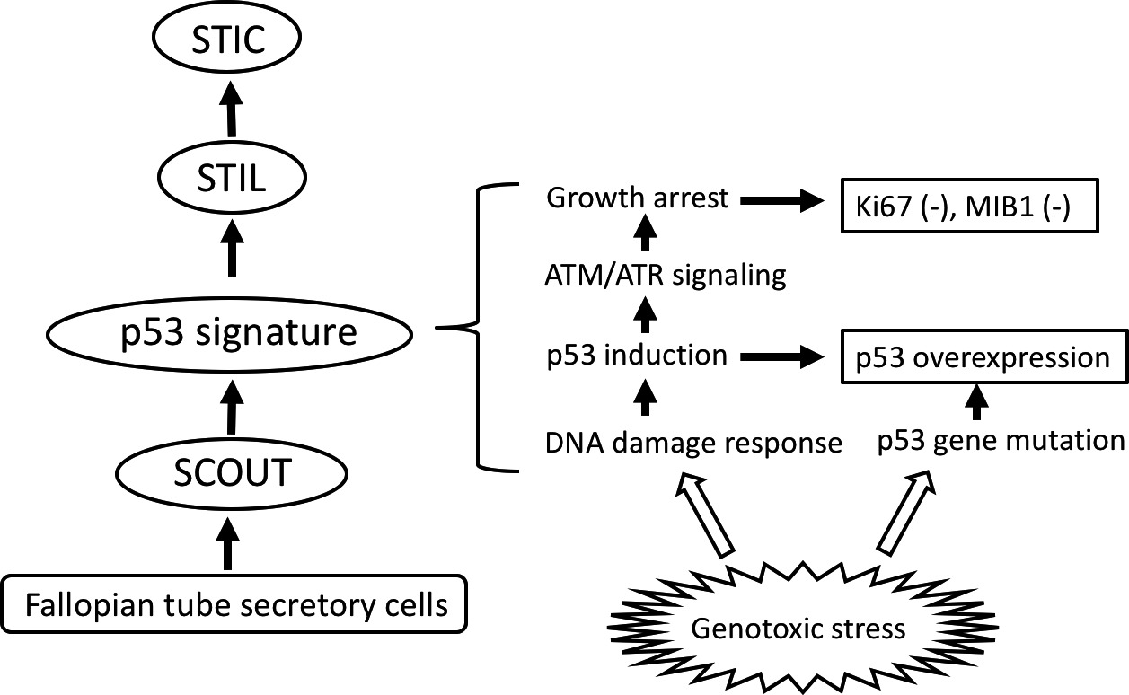

Slide 13
Several genetic studies have been performed to clarify the molecular relationship between tubal precursor lesions and HGSC.
The initial laser‐captured microdissection analysis followed by target sequencing of p53 indicated that 57% of p53 signatures had p53 gene mutations, most of which were missense mutations, while all STICs and all STIC/ovarian cancer pairs shared identical p53 mutations.
Subsequent studies, however, showed that p53 mutations were detected in all HGSCs analyzed, and the identical mutations were detected in most, but not all, STICs and concurrent HGSCs.
Recent comprehensive genomic analysis by next‐generation sequencing provided striking evidence that the p53 signature or STIC had the ancestral clone for the observed cancers.

Slide 14
The majority of tumour‐specific alterations in ovarian cancers were commonly present in STICs, including those affecting TP53, BRCA1, BRCA2, or PTEN.
Ovarian cancers contained additional genetic changes, indicating that tubal precursor lesions represented daughter clones of the ovarian cancers.
Evolutionary analyses reveal that p53 signatures and STICs are precursors of ovarian carcinoma and identify a window of 7 years between development of a STIC and initiation of ovarian carcinoma, with metastases following rapidly thereafter.

Slide 15
IDENTIFICATION OF DRIVER MUTATIONS FOR SEROUS CARCINOGENESIS
To clarify the molecular mechanisms through which serous carcinoma develops from the fallopian tubes, comprehensive genomic analyses of HGSC have been performed, as the Cancer Genome Atlas (TCGA).
This analysis found that TP53 mutation was highly prevalent (96%).
The pathway analyses showed that RB‐related (67%) and RAS/PI3K‐related (45%) signaling pathways were activated, and homologous recombination defects (HRDs) were observed in up to 49% of cases, via BRCA1 promoter hypermethylation and silencing, as well as its germline and somatic mutations.
These findings indicate that the mutational spectrum marks HGSC as completely distinct from other histological subtypes of ovarian cancer, with extremely high TP53 mutations and frequent HRDs.

Slide 16
Taken together, the mouse or in vitro carcinogenesis models support the concept that a total of 3 genetic hits are required for the development of HGSC from FTSECs, in which TP53 mutation is indispensable and the additional 2 hits, including BRCA mutation (or HRD), PI3K‐APT, Ras‐MAPK signaling, or c‐Myc amplification (overexpression), confer the serous carcinoma phenotype.

Slide 17
STRATEGY TO PREVENT OVARIAN CANCER IN HIGH‐RISK POPULATIONS
Oral contraceptives have been known to have a preventive effect on ovarian cancer occurrence in BRCA1/2 carriers.
The precise mechanism by which OCs have protective effects remains unclear, but may be at least partly due to inhibition of ovulation that may reduce the opportunity for fimbriae to contact the ovarian surface in every menstrual cycle.
RRSO has been established as protective surgery against ovarian cancer in the high‐risk population with BRCA1 or BRCA2 mutations.

Slide 18
In contrast to these protective benefits, RRSO is associated with surgical menopause, generating various long‐term health problems, as well as unfavourable symptoms with climacteric disorders, including sexual dysfunction and vasomotor symptoms, making women reluctant to pursue surgery.
Studies on quality of life demonstrated the benefit of hormone replacement therapy (HRT) for BRCA mutation carriers after RRSO, with fewer endocrine symptoms and better sexual functioning, as well as decreased bone diseases.
The breast cancer risk by taking HRT after RRSO is a great concern for BRCA mutation carriers who have not yet developed it.
Accumulating evidence has shown that breast cancer risk reduction after RRSO is not changed by HRT.
The formulation of HRT may affect the risk of breast cancer; oestrogen‐replacement therapy may be preferred over progestin‐containing regimens.
A definitive conclusion about the risk and benefit of HRT in high‐risk patients will be reached only through well‐designed, long‐term studies.

Slide 19
Studies on bilateral salpingectomy (without oophorectomy) may offer a reduced risk of ovarian cancer in BRCA1 or BRCA2 mutation carriers are still ongoing.

Slide 20
HOW TO DEAL WITH ISOLATED STIC DETECTED AT RRSO?
The incidence of STIC in high‐risk patients who undergo RRSO has been reported to be approximately 2%.
Approximately 10% of the patients who underwent peritoneal cytology examination had positive cytology.
Most were started on chemotherapy
Three (4.5%) of 67 patients with follow‐up records showed subsequent primary peritoneal cancer during the follow‐up period.

Slide 21
The clinical significance of positive peritoneal cytology at RRSO also remains unclear, and it has not been determined whether positive cytology is associated with a higher risk of subsequent peritoneal cancer.
Furthermore, there is insufficient evidence that surgical staging or postoperative chemotherapy for patients with isolated STIC at RRSO decreases the occurrence of peritoneal cancer.
There is thus no established management concept for high‐risk patients with isolated STIC after RRSO.
It has been noted that patients with incidental STIC are more likely to develop peritoneal cancer compared to those with benign findings at RRSO.
Therefore, BRCA mutation carriers with incidental STIC after RRSO should be carefully followed‐up, at least by more frequent examination with CA‐125 and imaging by ultrasonography/CT.

Slide 22
CAN OPPORTUNISTIC SALPINGECTOMY REDUCE THE RISK OF OVARIAN CANCER?
Based on the accumulating evidence of the tubal origin of ovarian cancer, opportunistic salpingectomy or tubal ligation in the low‐risk population may reduce the incidence of this type of tumour.

Slide 23
HOW IS THIS RELEVANT TO US AT KNH?

Slide 24
Ovarian cancer is the third commonest cause of cancer death from gynaecologic tumours in Kenya.
Early disease causes minimal, nonspecific, or no symptoms therefore, most patients are diagnosed when the disease is at an advanced stage.
It is therefore important to create awareness and implement screening tests for early diagnosis of the condition.
Survival at 2 yrs from diagnosis was 50% as per the Kaplan-Meier time survival estimate – even with chemotherapy being used.
Early diagnosis and prevention help reduce the financial burden as a result of treatment.

Slide 25
references
https://onlinelibrary.wiley.com/doi/full/10.1002/cam4.2725
https://profiles.uonbi.ac.ke/sgichuhi/publications/ovarian-cancer-kenyatta-national-hospital-kenya-characteristics-and-management

