Slide 3
OBJECTIVES FOR THE LECTURE
Identify the processes for homeostasis of blood glucose
Define DM
Classify DM and characteristics Signs and symptoms of DM
List the tests for diagnosis of DM with interpretation
Hypoglycemia

Slide 4
ORGANS INVOLVED IN GLUCOSE METABOLISM
GIT- absorption
SYSTEMIC-CIRCULATION- transportation
LIVER- storage, Glycogenesis, gluconeogenesis, ketogenesis, glycogenolysis
PERIPHERAL TISSUES-metabolism, muscle glycogen
ADIPOSE TISSUE- metabolism, storage
KIDNEYS- excretion, reabsorption
ENDOCRINE SYSTEM- homeostasis

Slide 5
Insulin
Following absorption of glucose from the GIT, the rise in blood glucose levels stimulate the secretion of insulin from the pancreatic islets cells.
• Glucose is transported into the β-cells and its metabolism results in the production of ATP.
The increased ATP leads to the closure of ATP sensitive K-channels in the cell membrane, preventing potassium efflux, leading to depolarization of the β-cell.
• The cell depolarisation causes a rapid influx of calcium which in turn stimulates the release of insulin.

Slide 6
• β-cell express insulin receptors; thus insulin acts back on the β-cell that produed it (autocrine action) to enhance transcription and translation of genes including insulin itself as well as components of insulin secretory pathway.
Insulin is synthesized in the β-cells of the islets of Langerhans as preproinsulin, which is rapidly cleaved to proinsulin.
• The proinsulin is stored in the secretory granules of the Golgi complex, where proteolytic cleavage to insulin and a biologically inactive connecting peptide (C-peptide) occurs.

Slide 7
Metabolic actions of Insulin
1. Promotes glucose uptake
In the muscle and adipose tissue, insulin causes glucose transporting channels to move from the cytosol to the cell membrane, to facilitate glucose uptake by these cells. Once inside the cells, glucose is immediately phosphorylated and converted to glycogen.
2. Promotes glycolysis

Slide 8
Cont….Metabolic actions of Insulin
3. Increases glycogen synthesis
In the liver promotes glucose uptake by stimulating its storage as glycogen. This is achieved by activating glycogen synthase, the enzyme that catalyses glycogen synthesis, while simultaneously deactivating glycogen phosphorylase, an enzyme that facilitates glycogen breakdown
4. Increases triglyceride synthesis

Slide 9
COUNTER-REGULATORY HORMONES
These are hormones released when blood glucose levels fall, and are there, along with lack of insulin, to ensure maintenance of a normal glucose level in the face of food deprivation. Their actions are in many respects opposite that of insulin.

Slide 10
ORGANS INVOLVED IN GLUCOSE METABOLISM
GIT- absorption
SYSTEMIC-CIRCULATION- transportation
LIVER- storage, Glycogenesis, gluconeogenesis, ketogenesis, glycogenolysis
PERIPHERAL TISSUES-metabolism, muscle glycogen
ADIPOSE TISSUE- metabolism, storage
KIDNEYS- excretion, reabsorption
ENDOCRINE SYSTEM- homeostasis

Slide 11
HORMONES INVOLVED IN GLUCOSE METABOLISM
1. Reduction in the levels of blood glucose
  INSULIN-- beta cells of islet of Langerhans of the pancreas
2. COUNTER REGULATORY HORMONES-
Catecholamines—epinephrine--adrenal medulla
Glucagon--alpha cells of the pancreas

Slide 12
1.Glucagon
A hormone secreted by the α-cell of the pancreatic islets..
first hormone to be released when glucose levels fall.
It primarily acts on the liver, where it stimulates both glycogenolysis and gluconeogenesis.
Regulation of secretion:
i. Low blood glucose is the primary stimuli for glucagon release.
ii. Protein-derived amino acids stimulate both insulin and glucagon. The glucagon effectively antagonises insulin and prevents hypoglycaemia that would otherwise result from an insulin secretory response to the protein meal .
iii. Adrenalin and noradrenalin produced by the sympathetic innervation of the pancreas stimulates release of glucagon in anticipation of increased glucose demands .

Slide 13
2.Adrenaline
from the adrenal medulla that counteracts hypoglycaemia by:
i. activating glycogenolysis in muscle and liver
ii. stimulating adipocyte lipolysis (via lipase)
iii directly inhibiting insulin release.
This ensures blood glucose remains high in cases of emergency with increased energy demands.
• release is triggered by lower blood glucose levels than occur during normal fasting and so is only required for emergency correction of hypoglycaemia.
phaeocromocytoma frequently lead to hyperglycaemia.

Slide 14
3. Cortisol
A steroid hormone released from the adrenal cortex in response to ACTH.
It promotes protein catabolism in order to provide substrate for gluconeogenesis. By activating the gluconeogenic enzymes in the liver, it ensures that alanine delivered to the liver from the muscle is efficiently converted to glucose.
Patients with Cushing`s syndrome have increased cortisol which may cause hyperglycaemia

Slide 15
4.Growth Hormone
hormone from the anterior pituitary.
It promotes lipolysis (hydrolysis of triglycerides to free fatty acids and glycerol) in adipose tissue, thereby providing an alternative fuel to glucose.
In chronic starvation, GH limits muscle protein breakdown by promoting use of fatty acids derived from fat stores as an energy alternative
•Fasting stimulates release of GH, and glucose administration lowers GH (except in acromegaly).

Slide 16
Other Hormones
• Somatostatin from the δ-cells of the pancreatic islets. Not directly involved in carbohydrate metabolism but inhibits GH release. It also inhibits the release of both insulin and glucagon.
• Thyroxine from the thyroid gland also not directly involved but is known to stimulate glycogenolysis

Slide 17
TERMS AND PATHWAYS
METABOLIC PROCESSES WHICH CONTROL Carbohydrate METABOLISM
REDUCTION IN GLUCOSE LEVELS
Insulin and its action:
Glycogenesis- Glu- →glycogen
Glycolysis -- Glu→lactate/pyruvate
TCA cycle/Kreb cycle --ATP
Electron transport chain in the mitochondria (oxidative phosphoration- →ATP--reduced cofactors. NADH, GTP, H₂O, CO)
Protein synthesis- CHO- →proteins
Lipogenesis- →CHO - →lipids

Slide 18
TERMS AND PATHWAYS
METABOLIC PROCESSES WHICH CONTROL CHO METABOLISM
2. INCREASE IN GLUCOSE LEVELS
Gluconeogenesis- →aa/lactate/glycerol- →glucose
  Glucagon
  cortisol
Gycogenolysis- →glycogen →glucose
  Glucagon
  Catecholamines
  GH

Slide 19
Cont…..INCREASE IN BLOOD SUGAR
Lipolysis- →lipids- →glycerol- →glu plus FAs- →acetyl Co- →TCA compounds →ATP
  Glucagon, Catecholamines, GH
Acetyl Co - →ketone bodies (Glucagon)
  (Liver)
  Beta hydroxy butyric acid
  Acetone--FRUITY BREATH
  Acetoacetic acid →SUCCINATE- →TCA- →ATP

Slide 20
CAUSES OF HYPERGLYCAEMIA
• Diabetes mellitus
• Increased counter-regulatory hormones; Cushing`s syndrome, Acromegaly. Thyrotoxicosis, Pheocromocytoma
• Stress-related;Infection, Trauma, Cerebrovascular accident
• Pancreas; Glucagonoma, Pancreatitis
• Drugs; Steroids, Thiazides
Secondary causes of diabetes are rare (less then 20%of cases) but are important to exclude in the evaluation of newly diagnosed DM.

Slide 21
Diabetes Mellitus
A state of chronic hyperglycaemia (excess glucose) caused by a defect in insulin secretion, action or both, that results in various metabolic disturbances

Slide 22
CLASSIFICATION OF DM
1. Insulin Dependent DM (IDDM) -TYPE 1 /Juvenile on set of Diabetes (JOD)
  1A: Immune mediated
  1 B: Idiopathic
2. Non -Insulin Dependent DM- NIDDM/adult onset/ TYPE 11
3. Gestational DM
4. Other causes/secondary of DM e.g endocrinopathies

Slide 23
CHARACTERISTICS OF TYPE I
TYPE I (20%)
Low or absolute lack of insulin
Need insulin to sustain life
Onset predominately in the youth (<30 years of age)
Associated with Human Leucocyte Associated Antigen (HLA)
  Major Histocompatible Complex (MHC)
  Chromosome 6
    Gene DQ/DR and alleles
      DR3/DR4---14X
      DR4---7X

Slide 24
CHARACTERISTICS OF TYPE 1
Abnormal immune response
  Islet cell antibodies (ICA)
Only partially genetic (>40%) of monozygotic twins are concordant
Non identical twins ---(5%)
Weight is low
Rapid onset
Prone to ketosis
  Diabetic Keto-acidosis (DKA)
Viral infections (Coxsackie's B, mumps, rubella)

Slide 25
CHARACTERISTICS OF TYPE II
Type II (70-80%)- Commonest
Insulin levels may be within reference ranges, elevated, or decreased
Not insulin dependent but insulin may be used in severe cases
Onset predominately after the age of 40 years but could occur at any age
60% are obese

Slide 26
CHARACTERISTICS OF TYPE II
Hyper insulinism and insulin resistance are present in some patients
Strongly genetic
  100% in monozygote twins
Slow on set
stress and infection can lead to HYPEROSMOTIC NON KETOTIC COMA (HONK)

Slide 27
EXPLANATION OF CAUSES OF TYPE II DM
EXPLANATION OF INSULIN RESISTANCE
Abnormal insulin molecule
Abnormal receptors
Lack of receptors
Abnormal H-R complexes
Defective translational mechanisms
Insensitivity of insulin to receptors

Slide 28
Differences Between Type 1 and Type 2 DM
 | Type 1 DM | TYPE 2 DM
Prevalence | Less common, 5 to 10% of all cases. | Very common in adults 90% of all cases.
Age of onset | Juvenile | Maturity onset >40years
Presentation | Acute (days to weeks) | Gradual (months to years)
Insulin | Absolute lack | Relative (Insulin resistance
Physique | Usually lean | Often obese (central obesity)
Islets | Inflamed or destroyed | Near normal appearance
Ketosis | Typical (DKA | Can occur (HONK coma)
Etiology | Autoimmune disease Antibodies can be detected in serum before onset of diabetes. HLA association (DR3or4) Viral association (coxsackievirus) | Strong genetic component Aggravated by obesity. Gene defect of the β-cell secretory apparatus (glucokinase and sulphonylurea receptor SUR) Thrifty gene-link with low birth

Slide 29
3.Gestational diabetes mellitus
• During pregnancy, the pancreatic function might not be sufficient to overcome both the insulin resistance created by the anti-insulin hormones secreted by the placenta (oestrogen, prolactin, human placental lactogen, cortisol and progesterone).
• Diabetic patients who become pregnant do not have gestational diabetes but have “diabetes mellitus and pregnancy” and should be treated accordingly, before, during and after pregnancy.
Risk Factors;
Family history of diabetes in a first degree relative
Obesity
Advance maternal age
Previous adverse pregnancies e.g.still birth,macrosomia.
Screening is recommended between 24-28 weeks:

Slide 30
3. GESTATIONAL DM
Glucose intolerance in pregnancy
Returns to normal after pregnancy
Increased risk of DM later in life
Poor pregnancy outcome if not managed properly or diagnosed early
Usually have big babies

Slide 31
4. DM ASSOCIATED WITH OTHER CONDITIONS/SECONDARY DM
Pancreatitis, pancreatectomy
Acromegaly - ↑GH
Cushing's syndrome- ↑ACTH, ↑Cortisol
Pheochromocytoma- ↑Catecholamines
Thyrotoxicosis- ↑T3/↑T4
Glucagonoma- ↑Glucagon
Drugs e.g steroids

Slide 32
Symptoms
1.POLYURIA: Excessive secretion of urine- OSMOTIC DIURESIS
2.POLYDIPSIA: Excessive thirst (↑ plasma osmolality /hypovolaemia)
3.POLYPHAGIA: excessive intake of food (lack of glucose in the cells)
4.NOCTURNAL ENURESIS: urinary incontinence at night (first sign in the children)

Slide 33
Clinical symptoms cont.
5. FATIGUE: lack of glucose in the cells
6. PRURITIS AND VAGINITIS: itching of vulvae and vagina- (infection in pregnancy)
7. RECURRENT BLURRED VISION: retinopathy
8. PERSISTENT GLUCOSURIA:IN PREGNANCY: Antenatal clinic/GDM
9. WEIGHT LOSS- Type I DM
10. FRUITY BREATH: KETOSIS- ACETONE IN BREATH

Slide 34
Clinical symptoms cont.
11. COMA: Hyperosmolar non-ketotic coma (HONK) -Type II DM/Diabetic Ketoacidosis (DKA)
12. NOTE THAT MANY PATIENTS ESPECIALLY WITH TYPE II DM DO NOT HAVE THE CLASSICAL SYMPTOMS

Slide 35
USES OF BIOCHEMICAL TESTS IN MANAGEMENT OF DM
1.Diagnosis
2.Monitoring for glyceamic control
3.Detection and management of complications:
  Acute
  chronic

Slide 36
1. DIAGNOSIS OF DM AND THE CAUSES OF DM
1. Random Blood Sugar (RBS)
2. Fasting Blood Sugar (FBS) fast over night for about 8-16 hours

Slide 37
Diagnosis cont.
4. Oral Glucose Tolerance Test (OGTT)
  2-hour (FBS, 2hrs)
  Full OGTT- 2hrs
  Extended OGTT 3hrs or more
4. Intravenous Glucose tolerance test (IVGTT) – rarely done
5. HbA1C= >6.5%

Slide 38
CRITERIA FOR DIAGNOSIS OF DM
1). Symptoms of DM + RBS of
> or = 11.1 mmol/l
(3Ps + weight - Type I)
  Reference rage for Random plasma blood sugar (3.2-7.8 mmol/l)

Slide 39
CRITERIA FOR DIAGNOSIS OF DM
2). Fasting plasma sugar (FBS): >7.0 mmol/l after 8-16 hours of fasting- Repeat if clinically indicated
  Reference ranges for Fasting plasma blood sugar (3.2-6.1 mmol/l)
  Impaired fasting glucose 5.6-7.0 mMol/l.

Slide 40
CRITERIA FOR DIAGNOSIS OF DM
3). OGTT
WHO Criteria:
  FBS = > 7.0 mmol/l
  2-hour plasma glucose levels of > 11.1 mmol/l
4. HbA1C : >6.5%

Slide 41
Diagnosis cont.-additional tests
3. Endocrinopathies: *Hormones
A) Insulin
  C-peptide
  Proinsulin
Interpretation:
  Low in Type I DM
  Variable levels in Type II DM

Slide 42
Diagnosis cont.
B. ↑GH- Acromegaly/giagantism
C) ↑ACTH, ↑Cortisol- Cushing’s syndrome
D) ↑Glucagon- glucagonoma
E) VMA- Vanillyl mandellic acid (↑Catecholamines)- Pheochromocytoma (PCC)
E) ↓TSH, ↑T4/↑T3- Hyperthyroidism
  Increased absorption of glucose

Slide 43
Tests for diagnosis
4. Islet cell antibodies (ICA)- Type I DM
  Also insulin auto antibodies and GAD65.
5. Glycated haemoglobin (HbA₁C)
    Future use for > 6.5%
    Can predict the average levels of glucose over a period of time
    RBS levels

Slide 44
Other indicators for glucose intolerance
1. Urine analysis -glucose (glucosuria) in urine- (dipsticks)
2. Ketone bodies
  Urine – ketonuria
  Blood- ketonemia

Slide 45
2. DM curve
Academic since diagnosis can be made with levels of :
RBS -.11.1 mmol/l and FBS-.> or =7.0 mmol/l

Slide 46
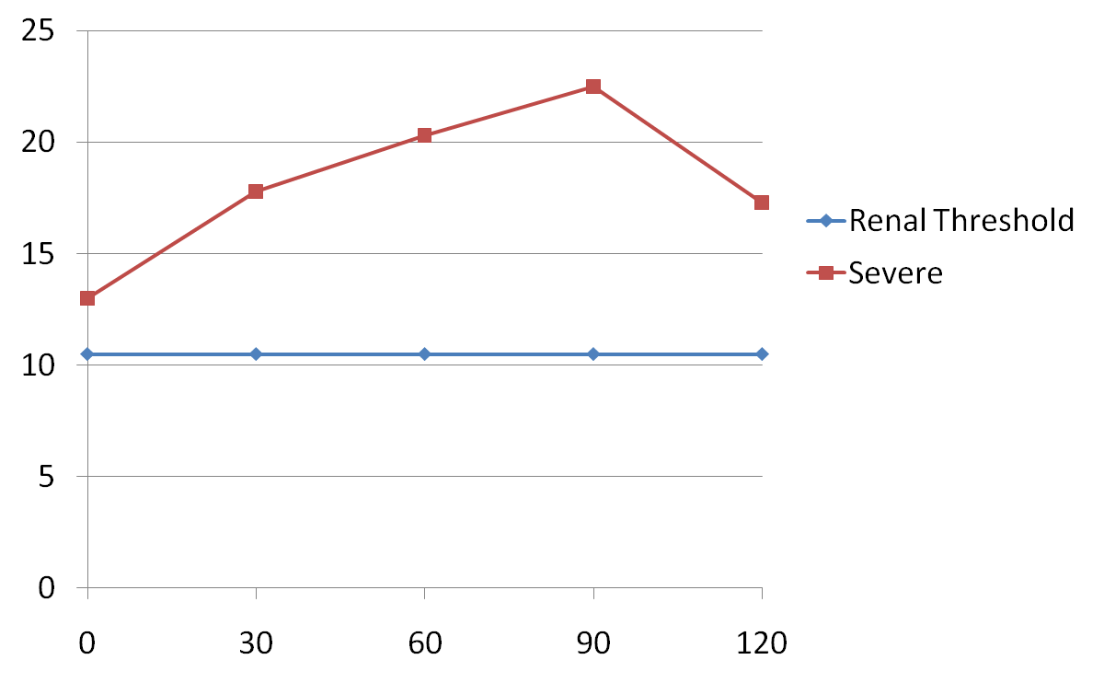
DAIBETIC CURVE (SEVERE)
Blood Glucose
(mmol/L)
Time (Minutes)

Slide 47
2. DIABETIC CURVE
Glucosuria- Sugar in urine from trace to ++++ during the test
FBS >7.0 mmol/l
Ketonuria (ketone bodies in urine)
Glucose levels > 11.1 mmol/l at 2 hr
Or least one point on the curve > 11.1 mmol/l

Slide 48
2. DIABETIC CURVE
SEEN IN:
DM (TYPE 1 AND TYPE 11)
GDM but the diagnostic levels are lower
Severe:
  Acromegaly
  Cushing's syndrome
  PCC
  Glucagonoma
  Hyperthyroidism

Slide 49
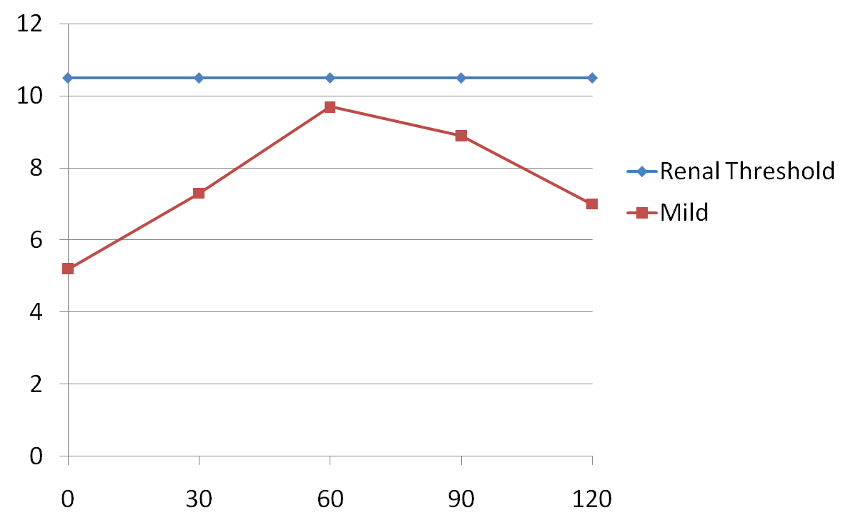
3. IMPAIRED GLUCOSE TOLERANCE (MILD)
Blood Glucose
(mmol/L)
Time (Minutes)

Slide 50
3. IMPAIRED GLUCOSE TOLERANCE (MILD DM)
Trace to + sugar in urine
FBS < 7.0 mmol/l
2-hour plasma glucose levels of 7.8- 11.0 mmol/l
Further testing might be required
MILD:
  Pre-diabetic state
  Acromegaly
  Cushing's syndrome
  glucagonoma
  PCC
  Hyperthyroidism

Slide 51
4. NON-DIABETIC MELLITURIA (EXCRETION OF SUGAR IN URINE): RENAL GLUCOSURIA
Defects of proximal tubules- inability to absorbed glucose
Commonly observed in non-diabetic patients (1/500)
Diagnosis requires:
  Detection of glucose in urine
  Elevated levels of glucose in blood above the renal threshold >10.0 mmol/l) are not observed

Slide 52
MODIFIED OGTT -for Pregnant Patients
• A 100grams is given instead of 75 grams and plasma glucose is measured, before and at hourly intervals for 3 hours.
Done after screening for DM at 24-28 weeks: 50gm of glucose given orally regardless of time of last meal. Glucose is measured after one hour. Patients with ≥7.7mmol/l should have OGTT done
Gestational diabetes is diagnosed if at least two of the following four cut off values are exceeded:-
• fasting >5.3 mmol/l
• one hr >10 mmol/l
• two hrs > 8.6 mmol/l
• three hrs > 7.8 mmol/l
• The normal fasting levels are lower in pregnancy due to the constant fetal siphoning of glucose and gluconeogenic amino acids.
while the post glucose levels are higher due to the anti insulin effect of human placental lactogen (HPL) and other anti-insulin hormones.

Slide 53
1. MONITORING FOR GLYCAEMIC CONTROL
1. Random glucose levels
2. Glycated proteins
a) HbA1c -Glycated Hb, glycosylated Hb, Glucoheamoglobin--long-term control--3 months
  (Normal levels: 4-6%) : control <7.0%
b) glycated albumin -
  Short time control of 2 weeks

Slide 54
1. MONITORING FOR GLYCAEMIC CONTROL
3. FBS
4. Microalbumin/protein in urine-either using dipstick urine or 24 hour urine collection.
  Renal dysfunction

Slide 56
HYPOGLYCEMIA

Slide 57
Objectives for the lecture
Definition of hypoglycaemia
Signs and symptoms of hypoglycaemia
Importance of ketone bodies
Causes of hypoglycaemia
Biochemical diagnosis of hypoglycaemia

Slide 58
Definition
Definition: Glucose levels of < 2.2 mmol/l on at least two occasions.
LABORATORY BASED DIAGNOSIS

Slide 59
WHIPPLE'S TRIAD
Low blood sugar X2
Typical symptoms of hypoglycaemia
3. Alleviated by Adm. of glucose

Slide 60
FACTORS TO CONSIDER WHEN DX OF HYPOGLYCAEMIA
Need to repeat glucose levels to make sure that the value are corrects, and glucometer is working properly
Compare value in the central lab for final diagnosis
Ensure proper specimen collection, transportation and storage of specimen in case it is not estimated straight away

Slide 61
SPECIMENS USED IN GLUCOSE ESTIMATION
Urine- not used for diagnosis of hypoglycaemia
Cerebrospinal fluid (CSF)
Blood
  Whole blood
  Capillary
  Serum- not used often
  Plasma
    Preservative (EDTA +Fluoride)
      Ethylene diamine tetra acetic acid = anticoagulant

Slide 62
Causes of hypoglycaemia
CAUSES
  a) Fasting
  b) After a stimuli (reactive)
    Sometimes after a meal
      Postprandial

Slide 63
CLINICAL FEATURES OF HYPOGLYCAEMIA
a) Dysfunctional nervous system NEUROGLYCOPENIA
b) Effects of CATECHOLAMINE RELEASE in response to the low levels of glucose
c) GLUCAGON manifestation

Slide 64
CLINICAL FEATURES OF HYPOGLYCAEMIA
a) Dysfunctional nervous system NEUROGLYCOPENIA
b) Effects of CATECHOLAMINE RELEASE in response to the low levels of glucose
c) GLUCAGON manifestation

