Slide 2
OBJECTIVES FOR THE LECTURE
Identify the processes for homeostasis of blood glucose
Define DM
Classify DM and characteristics Signs and symptoms of DM
List the tests for diagnosis of DM with interpretation
Hypoglycemia

Slide 3
ORGANS INVOLVED IN GLUCOSE METABOLISM
GIT- absorption
SYSTEMIC-CIRCULATION- transportation
LIVER- storage, Glycogenesis, gluconeogenesis, ketogenesis, glycogenolysis
PERIPHERAL TISSUES-metabolism, muscle glycogen
ADIPOSE TISSUE- metabolism, storage
KIDNEYS- excretion, reabsorption
ENDOCRINE SYSTEM- homeostasis

Slide 4
Insulin
Following absorption of glucose from the GIT, the rise in blood glucose levels stimulate the secretion of insulin from the pancreatic islets cells.
• Glucose is transported into the β-cells and its metabolism results in the production of ATP.
The increased ATP leads to the closure of ATP sensitive K-channels in the cell membrane, preventing potassium efflux, leading to depolarization of the β-cell.
• The cell depolarisation causes a rapid influx of calcium which in turn stimulates the release of insulin.

Slide 5
• Insulin is synthesized in the β-cells of the islets of Langerhans as preproinsulin, which is rapidly cleaved to proinsulin.
• The proinsulin is stored in the secretory granules of the Golgi complex, where proteolytic cleavage to insulin and a biologically inactive connecting peptide (C-peptide) occurs.

Slide 6
Metabolic actions of Insulin
1. Promotes glucose uptake
In the muscle and adipose tissue, insulin causes glucose transporting channels to move from the cytosol to the cell membrane, to facilitate glucose uptake by these cells. Once inside the cells, glucose is immediately phosphorylated and converted to glycogen.
2. Promotes glycolysis

Slide 7
Cont….Metabolic actions of Insulin
3. Increases glycogen synthesis
In the liver promotes glucose uptake by stimulating its storage as glycogen. This is achieved by activating glycogen synthase, the enzyme that catalyses glycogen synthesis, while simultaneously deactivating glycogen phosphorylase, an enzyme that facilitates glycogen breakdown
4. Increases triglyceride synthesis

Slide 8
COUNTER-REGULATORY HORMONES
These are hormones released when blood glucose levels fall, and are there, along with lack of insulin, to ensure maintenance of a normal glucose level in the face of food deprivation. Their actions are in many respects opposite that of insulin.

Slide 9
HORMONES INVOLVED IN GLUCOSE METABOLISM
1. Reduction in the levels of blood glucose
  INSULIN-- beta cells of islet of Langerhans of the pancreas
2. COUNTER REGULATORY HORMONES-
Catecholamines—epinephrine--adrenal medulla
Glucagon--alpha cells of the pancreas

Slide 10
1.Glucagon
A hormone secreted by the α-cell of the pancreatic islets..
first hormone to be released when glucose levels fall.
It primarily acts on the liver, where it stimulates both glycogenolysis and gluconeogenesis.
Regulation of secretion:
i. Low blood glucose is the primary stimuli for glucagon release.
ii. Protein-derived amino acids stimulate both insulin and glucagon. The glucagon effectively antagonises insulin and prevents hypoglycaemia that would otherwise result from an insulin secretory response to the protein meal .
iii. Adrenalin and noradrenalin produced by the sympathetic innervation of the pancreas stimulates release of glucagon in anticipation of increased glucose demands .

Slide 11
2.Adrenaline
from the adrenal medulla that counteracts hypoglycaemia by:
i. activating glycogenolysis in muscle and liver
ii. stimulating adipocyte lipolysis (via lipase)
iii directly inhibiting insulin release.
This ensures blood glucose remains high in cases of emergency with increased energy demands.
• release is triggered by lower blood glucose levels than occur during normal fasting and so is only required for emergency correction of hypoglycaemia.
phaeocromocytoma frequently lead to hyperglycaemia.

Slide 12
3. Cortisol
A steroid hormone released from the adrenal cortex in response to ACTH.
It promotes protein catabolism in order to provide substrate for gluconeogenesis. By activating the gluconeogenic enzymes in the liver, it ensures that alanine delivered to the liver from the muscle is efficiently converted to glucose.
Patients with Cushing`s syndrome have increased cortisol which may cause hyperglycaemia

Slide 13
4.Growth Hormone
hormone from the anterior pituitary.
It promotes lipolysis (hydrolysis of triglycerides to free fatty acids and glycerol) in adipose tissue, thereby providing an alternative fuel to glucose.
In chronic starvation, GH limits muscle protein breakdown by promoting use of fatty acids derived from fat stores as an energy alternative
•Fasting stimulates release of GH, and glucose administration lowers GH (except in acromegaly).

Slide 14
Other Hormones
• Somatostatin from the δ-cells of the pancreatic islets. Not directly involved in carbohydrate metabolism but inhibits GH release. It also inhibits the release of both insulin and glucagon.
• Thyroxine from the thyroid gland also not directly involved but is known to stimulate glycogenolysis

Slide 15
TERMS AND PATHWAYS
METABOLIC PROCESSES WHICH CONTROL Carbohydrate METABOLISM
REDUCTION IN GLUCOSE LEVELS
Insulin and its action:
Glycogenesis- Glu- →glycogen
Glycolysis -- Glu→lactate/pyruvate
TCA cycle/Kreb cycle --ATP
Electron transport chain in the mitochondria (oxidative phosphoration- →ATP--reduced cofactors. NADH, GTP, H₂O, CO)
Protein synthesis- CHO- →proteins
Lipogenesis- →CHO - →lipids

Slide 16
TERMS AND PATHWAYS
METABOLIC PROCESSES WHICH CONTROL CHO METABOLISM
2. INCREASE IN GLUCOSE LEVELS
Gluconeogenesis- →aa/lactate/glycerol- →glucose
  Glucagon
  cortisol
Gycogenolysis- →glycogen →glucose
  Glucagon
  Catecholamines
  GH

Slide 17
Cont…..INCREASE IN BLOOD SUGAR
Lipolysis- →lipids- →glycerol- →glu plus FAs- →acetyl Co- →TCA compounds →ATP
  Glucagon, Catecholamines, GH
Acetyl Co - →ketone bodies (Glucagon)
  (Liver)
  Beta hydroxy butyric acid
  Acetone--FRUITY BREATH
  Acetoacetic acid →SUCCINATE- →TCA- →ATP

Slide 18
CAUSES OF HYPERGLYCAEMIA
• Diabetes mellitus
• Increased counter-regulatory hormones; Cushing`s syndrome, Acromegaly. Thyrotoxicosis, Pheocromocytoma
• Stress-related;Infection, Trauma, Cerebrovascular accident
• Pancreas; Glucagonoma, Pancreatitis
• Drugs; Steroids, Thiazides
Secondary causes of diabetes are rare (less then 20%of cases) but are important to exclude in the evaluation of newly diagnosed DM.

Slide 19
Diabetes Mellitus
A state of chronic hyperglycaemia (excess glucose) caused by a defect in insulin secretion, action or both, that results in various metabolic disturbances

Slide 20
CLASSIFICATION OF DM
1. Insulin Dependent DM (IDDM) -TYPE 1 /Juvenile on set of Diabetes (JOD)
  1A: Immune mediated
  1 B: Idiopathic
2. Non -Insulin Dependent DM- NIDDM/adult onset/ TYPE 11
3. Gestational DM
4. Other causes/secondary of DM e.g endocrinopathies

Slide 21
CHARACTERISTICS OF TYPE I
TYPE I (20%)
Low or absolute lack of insulin
Need insulin to sustain life
Onset predominately in the youth (<30 years of age)
Associated with Human Leucocyte Associated Antigen (HLA)
  Major Histocompatible Complex (MHC)
  Chromosome 6
    Gene DQ/DR and alleles
      DR3/DR4---14X
      DR4---7X

Slide 22
CHARACTERISTICS OF TYPE 1
Abnormal immune response
  Islet cell antibodies (ICA)
Only partially genetic (>40%) of monozygotic twins are concordant
Non identical twins ---(5%)
Weight is low
Rapid onset
Prone to ketosis
  Diabetic Keto-acidosis (DKA)
Viral infections (Coxsackie's B, mumps, rubella)

Slide 23
CHARACTERISTICS OF TYPE II
Type II (70-80%)- Commonest
Insulin levels may be within reference ranges, elevated, or decreased
Not insulin dependent but insulin may be used in severe cases
Onset predominately after the age of 40 years but could occur at any age
60% are obese

Slide 24
CHARACTERISTICS OF TYPE II
Hyper insulinism and insulin resistance are present in some patients
Strongly genetic
  100% in monozygote twins
Slow on set
stress and infection can lead to HYPEROSMOTIC NON KETOTIC COMA (HONK)

Slide 25
EXPLANATION OF CAUSES OF TYPE II DM
EXPLANATION OF INSULIN RESISTANCE
Abnormal insulin molecule
Abnormal receptors
Lack of receptors
Abnormal H-R complexes
Defective translational mechanisms
Insensitivity of insulin to receptors

Slide 26
Differences Between Type 1 and Type 2 DM
 | Type 1 DM | TYPE 2 DM
Prevalence | Less common, 5 to 10% of all cases. | Very common in adults 90% of all cases.
Age of onset | Juvenile | Maturity onset >40years
Presentation | Acute (days to weeks) | Gradual (months to years)
Insulin | Absolute lack | Relative (Insulin resistance
Physique | Usually lean | Often obese (central obesity)
Islets | Inflamed or destroyed | Near normal appearance
Ketosis | Typical (DKA | Can occur (HONK coma)
Etiology | Autoimmune disease Antibodies can be detected in serum before onset of diabetes. HLA association (DR3or4) Viral association (coxsackievirus) | Strong genetic component Aggravated by obesity. Gene defect of the β-cell secretory apparatus (glucokinase and sulphonylurea receptor SUR) Thrifty gene-link with low birth

Slide 27
3.Gestational diabetes mellitus
• During pregnancy, the pancreatic function might not be sufficient to overcome both the insulin resistance created by the anti-insulin hormones secreted by the placenta (oestrogen, prolactin, human placental lactogen, cortisol and progesterone).
• Diabetic patients who become pregnant do not have gestational diabetes but have “diabetes mellitus and pregnancy” and should be treated accordingly, before, during and after pregnancy.
Risk Factors;
Family history of diabetes in a first degree relative
Obesity
Advance maternal age
Previous adverse pregnancies e.g.still birth,macrosomia.
Screening is recommended between 24-28 weeks:

Slide 28
3. GESTATIONAL DM
Glucose intolerance in pregnancy
Returns to normal after pregnancy
Increased risk of DM later in life
Poor pregnancy outcome if not managed properly or diagnosed early
Usually have big babies

Slide 29
4. DM ASSOCIATED WITH OTHER CONDITIONS/SECONDARY DM
Pancreatitis, pancreatectomy
Acromegaly - ↑GH
Cushing's syndrome- ↑ACTH, ↑Cortisol
Pheochromocytoma- ↑Catecholamines
Thyrotoxicosis- ↑T3/↑T4
Glucagonoma- ↑Glucagon
Drugs e.g steroids

Slide 30
Symptoms of DM
1.POLYURIA: Excessive secretion of urine- OSMOTIC DIURESIS
2.POLYDIPSIA: Excessive thirst (↑ plasma osmolality /hypovolaemia)
3.POLYPHAGIA: excessive intake of food (lack of glucose in the cells)
4.NOCTURNAL ENURESIS: urinary incontinence at night (first sign in the children)

Slide 31
Clinical symptoms cont.
5. FATIGUE: lack of glucose in the cells
6. PRURITIS AND VAGINITIS: itching of vulvae and vagina- (infection in pregnancy)
7. RECURRENT BLURRED VISION: retinopathy
8. PERSISTENT GLUCOSURIA:IN PREGNANCY: Antenatal clinic/GDM
9. WEIGHT LOSS- Type I DM
10. FRUITY BREATH: KETOSIS- ACETONE IN BREATH

Slide 32
Clinical symptoms cont.
11. COMA: Hyperosmolar non-ketotic coma (HONK) -Type II DM/Diabetic Ketoacidosis (DKA)
12. NOTE THAT MANY PATIENTS ESPECIALLY WITH TYPE II DM DO NOT HAVE THE CLASSICAL SYMPTOMS

Slide 33
KETONE BODIES
• acetoacetic acid, β-hydroxybutyric acid and acetone (acetone is formed spontaneously from acetoacetate and cannot be further metabolized).
• Ketones are formed in liver mitochondria during the fasting state when insulin levels are low.
They are derived from βoxidation of free fatty acids.

Slide 34
Peripheral tissue like heart and muscle convert ketone bodies to acetyl CoA which can enter the Krebs cycle and provide an alternative source of fuel to glucose in times of food deprivation.
• Insulin blocks ketogenesis by two mechanisms
i. Inhibits fatty acid release from the adipocytes.
ii. Blocks entry of fatty acids into the liver mitochondria by boosting the levels of malonyl CoA. This prevents the liver from oxidizing the fatty acids it has just synthesized

Slide 35
USES OF BIOCHEMICAL TESTS IN MANAGEMENT OF DM
1.Diagnosis
2.Monitoring for glyceamic control
3.Detection and management of complications:
  Acute
  chronic

Slide 36
1. DIAGNOSIS OF DM AND THE CAUSES OF DM
1. Random Blood Sugar (RBS)
2. Fasting Blood Sugar (FBS) fast over night for about 8-16 hours

Slide 37
Diagnosis cont.
4. Oral Glucose Tolerance Test (OGTT)
  Full OGTT- 2hrs
  Extended OGTT 3hrs or more
4. Intravenous Glucose tolerance test (IVGTT) – rarely done
5. HbA1C= >6.5%

Slide 38
CRITERIA FOR DIAGNOSIS OF DM
1). Symptoms of DM + RBS of
> or = 11.1 mmol/l
(3Ps + weight loss - Type I)
  Reference rage for Random plasma blood sugar (3.2-7.8 mmol/l)

Slide 39
CRITERIA FOR DIAGNOSIS OF DM
2). Fasting plasma sugar (FBS): >7.0 mmol/l after 8-16 hours of fasting- Repeat if clinically indicated
  Reference ranges for Fasting plasma blood sugar (3.2-6.1 mmol/l)
  Impaired fasting glucose 5.6-7.0 mMol/l.

Slide 40
CRITERIA FOR DIAGNOSIS OF DM
3). OGTT
WHO Criteria:
  FBS = > 7.0 mmol/l
  2-hour plasma glucose levels of > 11.1 mmol/l
4. HbA1C : >6.5%

Slide 41
Diagnosis cont.-additional tests
3. Endocrinopathies: *Hormones
↑GH- Acromegaly/giagantism
↑ACTH, ↑Cortisol- Cushing’s syndrome
↑Glucagon- glucagonoma
VMA- Vanillyl mandellic acid (↑Catecholamines)- Pheochromocytoma (PCC)
↓TSH, ↑T4/↑T3- Hyperthyroidism
  Increased absorption of glucose

Slide 42
4. Insulin
  C-peptide (formed during conversion of proinsulin to insulin)
  Proinsulin
  Interpretation:
  Low in Type I DM
  Variable levels in Type II DM

Slide 43
Tests for diagnosis
5. Islet cell antibodies (ICA)- Type I DM
.
  Also insulin auto antibodies and GAD65.
  Islet-cell (IA2), anti-GAD65, and anti-insulin autoantibodies can be present in early type 1 but not type 2 DM.

Slide 44
Other indicators for glucose intolerance
1. Urine analysis -glucose (glucosuria) in urine- (dipsticks)
2. Ketone bodies
  Urine – ketonuria
  Blood- ketonemia

Slide 45
OGTT Protocol
The patient should have a normal mixed diet for the previous three days prior to the test.
The patient is fasted overnight(8-16hrs) and blood is drawn for glucose measurement(FBS) before 75 grams is administered orally in 200ml of water.
Blood glucose is measured every thirty minutes for two hours. Subjects should rest during the test and should not smoke or eat.
• Glucose is drawn into sodium fluoride tubes (grey top).

Slide 46
In normal subjects, plasma glucose rises and returns to the fasting level by two hours.
Plasma Glucose > 11.1 mmol/l at two hours confirms diabetes mellitus.
If the two hour value lies between 7.8 and 11.1 mmol/l the patient is labeled as impaired glucose tolerant (IGT).
• Patients with a fasting glucose levels between normal and diabetic (5.6 and 7 mmol/l according to the ADA) are labeled as impaired fasting glucose (IFG). This is analogues to impaired glucose tolerance

Slide 47
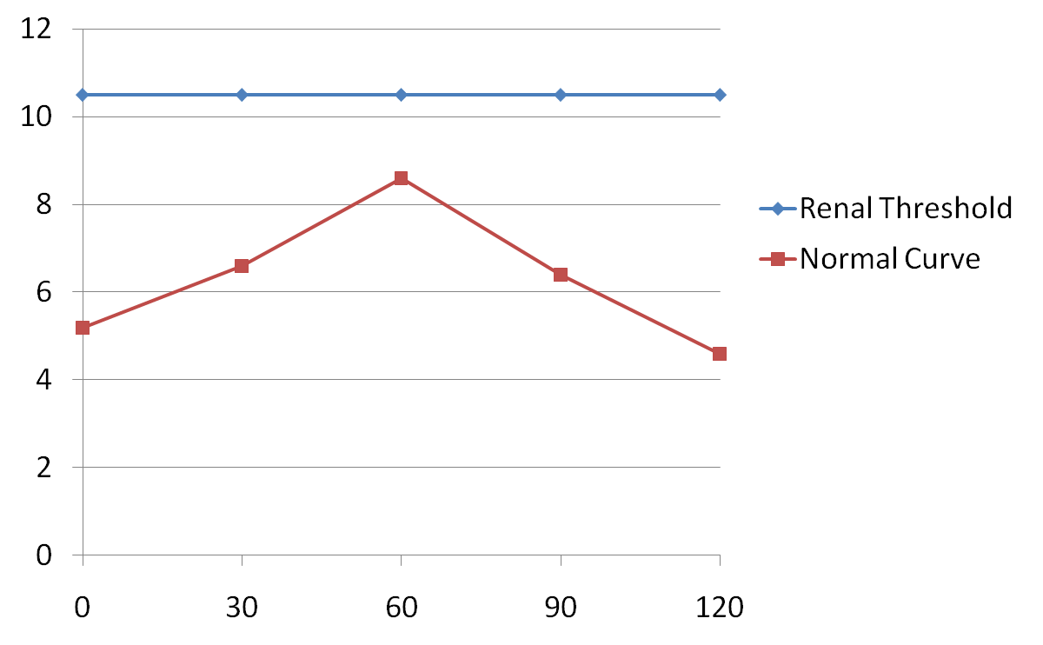
1. NORMAL CURVE
Blood Glucose
(Mmol/L)
Time (Minutes)

Slide 48
1. Normal curve: Response to glucose load CONT.
No Glucosuria/No glycosuria
FBS levels are within reference ranges (3.2-6.1 mmol/l)
No ketonuria

Slide 49
2 .IMPAIRED GLUCOSE TOLERANCE (MILD DM)
Trace to + sugar in urine
FBS < 7.0 mmol/l
2-hour plasma glucose levels of 7.8- 11.0 mmol/l
Further testing might be required
MILD:
  Pre-diabetic state
  Acromegaly
  Cushing's syndrome
  glucagonoma
  Pheochromcytoma
  Hyperthyroidism

Slide 50
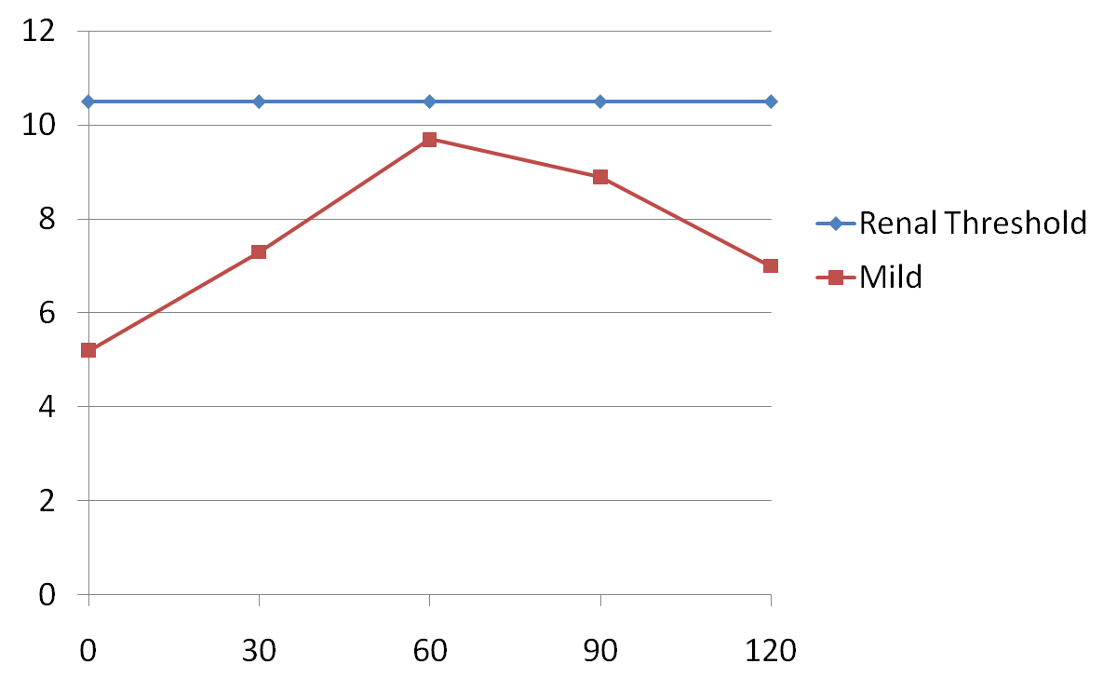
2. IMPAIRED GLUCOSE TOLERANCE (MILD)
Blood Glucose
(mmol/L)
Time (Minutes)

Slide 51
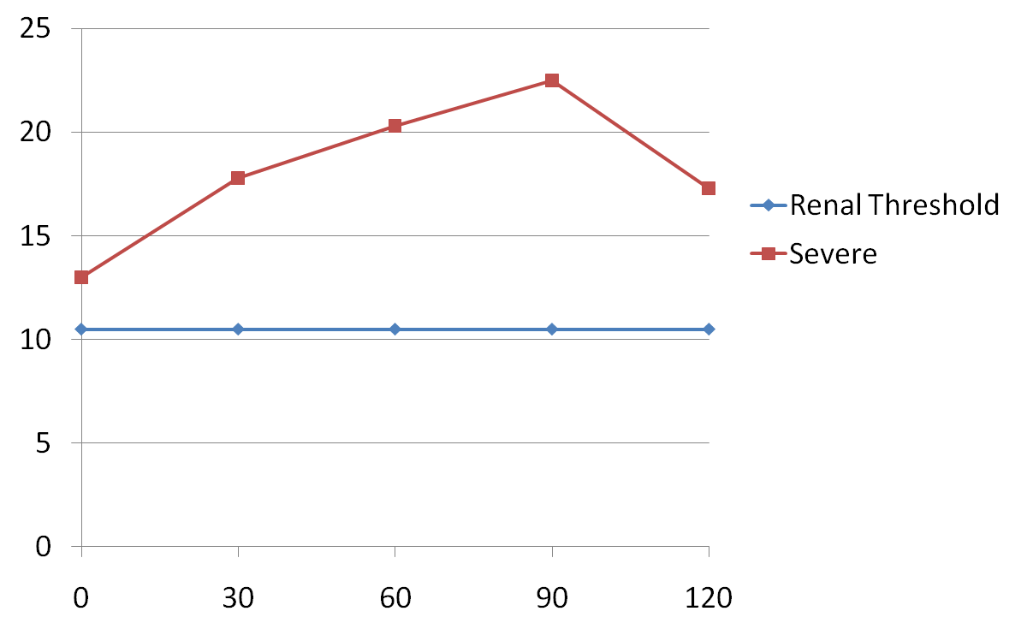
3.DIABETIC CURVE
Blood Glucose
(mmol/L)
Time (Minutes)

Slide 52
2. DIABETIC CURVE
Glucosuria- Sugar in urine from trace to ++++ during the test
FBS >7.0 mmol/l
Ketonuria (ketone bodies in urine)
Glucose levels > 11.1 mmol/l at 2 hr
Or least one point on the curve > 11.1 mmol/l

Slide 53
2. DIABETIC CURVE
SEEN IN:
DM (TYPE 1 AND TYPE 11)
GDM but the diagnostic levels are lower
Severe:
  Acromegaly
  Cushing's syndrome
  PCC
  Glucagonoma
  Hyperthyroidism

Slide 54
3. IMPAIRED GLUCOSE TOLERANCE (MILD DM)
Trace to + sugar in urine
FBS < 7.0 mmol/l
2-hour plasma glucose levels of 7.8- 11.0 mmol/l
Further testing might be required
MILD:
  Pre-diabetic state
  Acromegaly
  Cushing's syndrome
  glucagonoma
  PCC
  Hyperthyroidism

Slide 55
4. NON-DIABETIC MELLITURIA/ RENAL GLUCOSURIA (EXCRETION OF SUGAR IN URINE)
Defects of proximal tubules- inability to absorbed glucose
Commonly observed in non-diabetic patients (1/500)
Diagnosis requires:
  Detection of glucose in urine
  Elevated levels of glucose in blood above the renal threshold >10.0 mmol/l) are not observed

Slide 56
5.Flat curve
Seen in patients with insulinomas

Slide 57
MODIFIED OGTT -for Pregnant Patients
A 100grams is given instead of 75 grams and plasma glucose is measured, before and at hourly intervals for 3 hours.
Done after screening for DM at 24-28 weeks: 50gm of glucose given orally regardless of time of last meal. Glucose is measured after one hour. Patients with ≥7.7mmol/l should have OGTT done
Gestational diabetes is diagnosed if at least two of the following four cut off values are exceeded:-
• fasting >5.3 mmol/l
• one hr >10 mmol/l
• two hrs > 8.6 mmol/l
• three hrs > 7.8 mmol/l
The normal fasting levels are lower in pregnancy due to the constant fetal siphoning of glucose and gluconeogenic amino acids.
while the post glucose levels are higher due to the anti insulin effect of human placental lactogen (HPL) and other anti-insulin hormones.

Slide 58
Tests for MONITORING FOR GLYCAEMIC CONTROL
1. Random glucose levels
2. Glycated proteins
a) HbA1c -Glycated Hb, glycosylated Hb, Glucoheamoglobin--long-term control--3 months
  (Normal levels: 4-6%) : control <7.0%
b) glycated albumin -
  Short time control of 2 weeks

Slide 59
HbA1C and Fructosamine
Haemoglobin is glycosylated during red cell circulation when glucose attaches to the N terminal end of the β- globin chain at a rate proportional to the blood glucose concentration at that time.
• Spuriously low values can be seen in chronic haemolysis, and in patients with conditions like sickle cell disease and G6PD deficiency. Fructosamine is a better test in such conditions.
• Fructosamine is the glycosylation of albumin. It has a shorter half life( 2- 3 wks).
These two methods can be used for long term monitoring of glucose control (HbA1c- 2 to 4 months and fructosamine,

Slide 60
Cont…..MONITORING FOR GLYCAEMIC CONTROL
3. FBS

Slide 61
Complications of Diabetes
1.Acute complications –DKA,HONK/HHS and hypoglycemia
2. Long term complications-Nephropathy, retinopathy, neuropathy, atherosclerosis and gangrene foot.

Slide 62
DIABETIC KETOACIDOSIS (DKA)
This is the hallmark of Insulin dependent diabetes mellitus (Type1), characterized by hyperglycaemia, hyperosmolarity, low pH, ketonuria and ketonemia.
•Can develop in diabetics as a result of insufficient/ interruption of insulin therapy.
Can also be precipitated by severe physical stress (trauma , infection) resulting in the production of the counter regulatory hormones like cortisol.

Slide 63
2. BIOCHEMICAL TEST IN ASSESSMENT OF ACUTE COMPLICATIONS- ACUTE (a)
1a. Diabetic Keto Acidosis (DKA)- Type I DM
  Glucose levels
  Blood/urine ketone bodies
  Blood gases
  pH
- Renal dysfuction:
  Urea/electrolytes/creatinine

Slide 64
HYPEROSMOLAR NON-KETOTIC COMA (HONK)
• This variant of diabetic coma is characterised by severe hyperglycaemia causing dehydration often worse than DKA but without ketoacidosis.
It develops in type two diabetics who have enough insulin to prevent ketone formation.

Slide 65
BIOCHEMICAL TEST IN ASSESSMENT OF ACUTE COMPLICATIOINS – ACUTE
2. Hyperosmolar nonketotic coma (HONK)- Hyperosmolar hyperglycemic state (HHS)Type II DM
  Blood glucose levels-usually very high
  Plasma/urine osmolality
  Ketone bodies- + or absent
  Other tests – U/E/Creatinine as in DKA

Slide 66
BIOCHEMICAL TEST IN ASSESSMENT OF ACUTE COMPLICATIOINS – ACUTE
3. Hypoglycemia
-glucose levels- low glucose levels
-ketones
-plasma osmolality
others as appropriate

Slide 67
Long Term Complications of DM
1. Renal dysfunction/Nephropathy
  Thickening of glomerular capillary basement membrane – Glomerulosclerosis- renal failure
2. Atherosclerosis
  Narrowing of lumen of arteries due to accumulation of lipids- Acute Myocardial infarction (AMI)
3. Gangrene (Diabetic foot)
  Local ischemia due to poor circulation - amputation

Slide 68
Complications cont.
4. Neuropathy
  Diseases of nervous system due de-myelination e.g seen in old men leading to impotence in men/
5. Retinopathy
  Blindness: retinal venous occlusion

Slide 69
b) LONGTERM CONTROL OF COMPLICATIONS- biochemical tests
1. Nephropathy (Diabetic glomerulosclerosis)
  Renal function tests- U/E/Creatinine
  MICROALBUMIN/PROTEINURIA (24 Hours Specimens)
  GFR estimation
  Creatinine clearance using the MDRD formula
  Morning/Random urine samples(Albumin Creatinine Ratio –ACR) mg/mmol
    0-30 normal albumin/Creatinine ratio
    30-300 microalbuminuria
    >300 clinical albuminuria

Slide 70
Nephropathy
This can be detected by the presence of micro-albuminuria.
This is excretion of albumin in amounts too small to be detected by routine dip stick testing.
Micro-albuminuria is defined as excretion of 30 to 300 mg albumin per day and is believed to be an early indicator of kidney involvement.

Slide 71
b) Long term control of complications- biochemical tests
2. Cardiovascular risk
  Plasma lipids-fasting sample
    Total Cholesterol (TC)
    Low Density lipoprotein Cholesterol (LDL-C)
    High Density Lipoprotein Cholesterol (HDL-C)
    Triglyceride (TG)

Slide 72
HYPOGLYCEMIA

Slide 73
Objectives for the lecture
Definition of hypoglycaemia
Signs and symptoms of hypoglycaemia
Importance of ketone bodies
Causes of hypoglycaemia
Biochemical diagnosis of hypoglycaemia

Slide 74
Definition
Definition: Glucose levels of < 2.2 mmol/l on at least two occasions.
LABORATORY BASED DIAGNOSIS

Slide 75
WHIPPLE'S TRIAD –must be present for dx to be made
Low blood sugar X2
Typical symptoms of hypoglycaemia
3. Alleviated by Adm. of glucose

Slide 76
CLINICAL FEATURES OF HYPOGLYCAEMIA
a) Dysfunctional nervous system NEUROGLYCOPENIC symptoms
b) Effects of CATECHOLAMINE RELEASE in response to the low levels of glucose
c) GLUCAGON manifestation

Slide 77
SIGNS AND SYMPTOMS OF HYPOGYCEMIA
a) NEUROGLYCOPENIC MANIFESTATIONS: CNS
Impaired judgement
Anxiety, moodiness
Fatigue
Slurred speech

Slide 78
a) NEUROGLYCOPENIC MANIFESTATIONS: CNS cont.
Blurred vision
Ataxia- (muscular un- co-ordination)
Paraesthesia (numbness)
Headaches/dizziness
Stupor (condition of unconsciousness)
Convulsions 2.2-1.0 mmol/l
Coma <1.0 mmol/l

Slide 79
d) CHRONIC NEUROGLYCOPENIA
Personality changes
Memory loss
Psychosis-detatchment from reality
Dementia-mental deterioration

Slide 80
b) MANIFESTATIONS OF INCREASED CATECHOLAMINES
Tremors
Palpitations/tachycardia
Profuse sweating
Facial flushing
Anxiety
Light headedness

Slide 81
b) MANIFESTATIONS OF INCREASED CATECHOLAMINES
*Shakiness
*Palpitation/tachycardia
*Profuse sweating
Facial flushing
Anxiety
Light headedness

Slide 82
CAUSES OF HYPOGYCEMIA
FASTING HYPOGLYCEMIA
  1. Starvation-
  2. Inadequate food intake
  3. Malabsorption

Slide 83
FASTING
4. Liver dysfunction
- Starvation and malnutrition
-Hepatocellular insuffiency
-1º hepatocellular carcinoma
5. Glycogen storage disease (Type I)- G-6-Phosphatase deficiency

Slide 84
FASTING
6. Critical illness---CACHEXIA
7. Non pancreatic tumours- particularly malignant hepatomas and retroperitoneal sarcomas. Such tumors secrete insulin-like growth factor 2 (IGF-2), which, at high concentrations, cross-reacts with the insulin receptor
-Mesenchymal tumours
-Adrenal tumours
  Increased glucose utilization
  Depletion of glycogen
  Blunted counter regulatory response

Slide 85
FASTING
8. ENDOCRINE
A) Insulinoma
B) ACTH…. Cortisol deficiency/ A.P/Adrenal cortical insufficiency
C) Glucagon deficiency
D) GH deficiency
E) Hypothyroidism

Slide 86
FASTING
8. Drugs e.g. alcohol, excessive intake of hypoglycaemic agents e.g insulin, oral hypoglyceamic drugs
9. Liver poisons e.g. mushrooms, chloroform
10. Organ failure-- e.g. kidney
-Kidney responsible for excretion of insulin .
-End stage renal failure

Slide 87
CAUSES OF HYPOGLYCEMIA IN DIABETIC PATIENTS
  Common in patients on insulin therapy
  Insufficient CHO in take
  Excessive adm. of insulin or hypoglycaemic drugs
  Strenuous exercises without CHO intake
  Excessive alcohol intake
COULD BE FATAL

Slide 88
B. REACTIVE HYPOGLYCEMIA
(1-3 hours after a meal)
POSSIBLE CAUSES OF REACTIVE HYPOGLYCEMIA
Rapid absorption of ingested carbohydrate can cause excessive insulin release, and overshoot hypoglycaemia.
Particularly common following gastric bypass surgery.
Can also occur following abrupt termination of high glucose content parenteral feeds
or dialysis against a high glucose dialysate.
  ↑ Insulin production
  Inhibition of gycogenolysis
  ↓Gluconeogenesis

Slide 89
Pathology of reactive hypoglycaemia
Post gastrectomy - dumping syndrome –
  Rapid emptying GIT,
  Increase Insulin release
  Hypoglycaemia- 90-150 min later
Idiopathic

Slide 90
Pathology of reactive hypoglycaemia
Pre-diabetic with abnormal insulin release
Abnormal insulin release:
  After an intravenous glucose load
  Abrupt discontinuation of parenteral nutrition
  Rapid absorption of glucose in GIT

Slide 91
Tests for Dx and Mx of hypoglycaemia cont.
Hormonal assays
  Pituitary –low ACTH and cortisol(low) Secondary adrenocorticol insufficiency
  Adrenal cortex—cortisol (low): Addison’s disease

Slide 92
Tests for Dx and Mx of hypoglycaemia.
Random blood sugar especially when the symptoms are there
Fasting blood sugar
  This could be done over a period of time
Insulin levels
Pro insulin levels- not routinely done
C-peptide levels

Slide 93
Tests for Dx and Mx of hypoglycaemia cont.
OGTT over a long period of time (6hrs)- reactive hypoglycaemia- not used often
OGTT- Flat curve in patients with insulinoma/malabsorption

Slide 94
Tests for Dx and Mx of hypoglycaemia cont.
  Pancreatic—Glucagon (low)
    alpha Islet cell of Langerhans deficiency
  Thyroid—hypothyroidism
    Primary : ↑ TSH ↓T4/↓T3
    Secondary ↓TSH ↓T4/↓T3

Slide 95
Test for Dx and Mx of hypoglycemia cont.
Drugs/poisons- alcohol, salicylates
Function tests of the affected organs e.g.
  LIVER- LFTs/Alfa Feto Protein for Ca. Liver
  -KIDNEY- Renal function tests (U/E/Creatinine)

Slide 96
CAUSES OF HYPOGLYCAEMIA IN NEONATES AND CHILDREN
Low birth weight /small for gestational age-low glycogen reserves in liver
Hyperinsulinism in neonates whose mothers are diabetics-babies have islet cellhyperplasia
Hyperinsulinism in children (Nesidioblastosis)
Drug induced e.g insulin or hypoglycaemic agents
Endocrine deficiencies-hypopituitarism

Slide 97
CAUSES OF HYPOGLYCAEMIA IN CHILDREN
Inborn errors of metabolism-e.g galactosemia
  Enzyme deficiency
Starvation/malnutrition/severe disease
Diarrhoea and vomiting
Others

