Slide 1
ACID BASE CHEMISTRY

Slide 2
Acid base balance and acid base status.
Acid base balance involves an accounting of the carbonic and non carbonic and conjugate bases in terms of input ( intake plus metabolic production)and output (excretion plus metabolic conversion) over a given time interval.
The acid-base status of the body fluids is assessed by measurements of total CO2, plasma pH and PCO2,because the bicarbonate /carbonic acid system is the most important buffering system of the plasma.

Slide 3
Acid base parameters –Definitions and abbreviations
Acids are chemical substances that donate protons (H⁺ ions) in solutions.
Bases are substances that accept protons.
Strong acids readily gives hydrogen ions( H⁺) ,whereas strong bases readily accept H⁺.

Slide 4
pH and pK
pH of a solution is described as negative logarithm of the hydrogen ion activity (pH=-log a H⁺).
Thus pH is a dimensionless quantity such that a decrease of one pH unit represents a tenfold increase in the H ⁺activity.
The average pH of blood (7.40) corresponds to a hydrogen ion concentration of 40 nmol/l.
Acidity of blood is expressed as nanomoles per liter(nmol/l).

Slide 5
Relationship of pH to hydrogen ion concentration. A broken line is drawn to emphasize the (approximate) linear relationship btw hydrogen ion concentration and pH over the pH range of 7.2 t0 7.5.

Slide 6
The pK (also pK’ and pKa) represents the negative logarithm of the ionization constant of a weak acid (Ka).
That is the pK is the pH at which an acid is half dissociated, existing as equal proportions of acid and conjugate base.
Thus acids has pK values <7.0 ,whereas bases have pK values >7.0.
The lower the pK, the stronger the acid and the higher the pK, the stronger the conjugate base.
E.g the pK of lactic acid is 3.5 and is 9.5 for the ammonium ion NH4⁻ .

Slide 7
The pH of the plasma may be considered to be a function of two independent variables:
The PCO2,which is regulated by the lungs and represents the acid component of the carbonic acid/bicarbonate buffer system and
The concentration of the titratable base, which is regulated by the kidneys.
The plasma bicarbonate concentration is generally taken as a measure of the base excess or deficit in plasma and ECF

Slide 8
Bicarbonate and dissolved CO2
Bicarbonate
Second largest fraction (after Cl⁻) of plasma anions.
The analyte measured in plasma is total CO2,which includes bicarbonate and dissolved CO2 (dCO2).
The dCO2 is defined to include both the undissociated carbonic acid and physically dissolved free CO2.
At the pH of the blood the amount of dissolved CO2 is 700 to 1000 times greater than the amount of carbonic acid and therefore cdCo2,is the term used to express their combined concentration .
This cdCO2 value is used in the Henderson-Hasselbach equation , to calculate the total bicarbonate concentration.

Slide 9
Henderson-Hasselbach equation
Aids in understanding pH regulation of the body fluids as it relates to the compensatory mechanisms of the body in acid base disturbances.
It follows then that any change in the concentration of either bicarbonate or dissolved CO2 must be acccampanied by a change in pH.
Clinically: metabolic disturbances of acid base balance are classified as primary disturbances in cHCO3⁻.
Respiratory disturbances are classified as primary disturbances in cdCO2.

Slide 10
PH= 6.1+ log10 [HCO3-]
0.03 X pCo2
Where
0.03 is the henry’s law constant for solubility of co2 in blood
pH is the acidity in the blood
[HCO₃⁻] is the concentration of bicarbonate in the blood
p_{CO2} is the partial pressure of carbon dioxide in the arterial blood

Slide 11
Buffer systems and there role in regulating the pH of body fluids.
A buffer is a mixture of a weak acid and and a salt of its conjugate base that resists changes in pH when a strong acid or base is added to the solution.
If the concentrations of the acid and base components of a buffer are equal the pH will equal the pK.
Buffers are also more effective at higher concentration ,so that a 10 mmol/l buffer solution is more efffective than a 1.0mmol/l solution.

Slide 12
Examples of physiologic buffer solutions
Bicarbonate/carbonic buffer solution.
Phosphate buffer solution
Plasma protein and hemoglobin buffer solution.

Slide 13
Action of buffer in the regulation of body pH- the bicarbonate buffer system
If a strong acid is added to a solution containing HCO3⁻ and H2CO3 ,the H⁺ will react with HCO3⁻ to form more H2CO3 and subsequently CO2 and H2O.
The hydrogen ions are thereby bound, and the increase in the H⁺ concentration will be minimal.
The buffer systems of most physiological interest in connection with regulation of the pH of body fluids are those of plasma and erythrocytes.

Slide 14
Phosphate buffer system
Phosphates are major ions in intracellular fluid and in collecting tubules of kidneys
Important buffer in ICF and in urine.
When pH decreases, monohydrogen phosphate ion acts as H+ acceptor
When pH increases, dihydrogen phosphate ion donates H+

Slide 15
Protein Buffer system
- proteins have carboxyl & amino groups
When pH increases, the carboxyl group can dissociate & release H+. Histidine in Hb & cysteine are effective buffers.
When pH decreases, amino group acts as a H+ acceptor. Limited to free amino acids & the terminal amino acid of protein.
Affects both ICF & ECF.
Intracellular Hb buffer system rapidly affects ECF pH

Slide 16
Respiratory mechanism in the regulation of Acid-Base balance.
Respiratory mechanism contributes to the maintenance of normal body pH through elimination or retention of CO2 in metabolic acidosis and alkalosis respectively.
Diffusion of O2 and CO2 across alveolar and cell membrane is governed by gradients in the in the partial presssure of each gas.

Slide 17
Respiratory response to Acid-Base perturbations
Most metabolic acid-base disorders develop slowly.
Respiratory system responds immediately to a change in acid base status
E.g in the early stages of metabolic acidosis, plasma pH decreases, but because H⁺ ions equilibrate rather slowly across the blood brain barrier, the pH in CSF remains nearly normal.
However because peripheral chemoreceptors are stimulated by the decreased plasma pH, hyperventillation occurs ,and plasma PCO2 decrease.
When this occurs the PCO₂ of CSF decreases immediately because CO2 equilibrates rapidly across the blood brain barrier leading to a rise in the pH of of the CSF.
This will inhibit the central chemoreceptors .
But as plasma bicarbonate gradually falls because of acidosis bicarbonate concentration and pH in CSF will also fall over several hours.
At this point stimulation of respiration becomes maximal as both the central and peripheral chemoreceptors are maximally stimulated.

Slide 18
Renal mechanisms in the regulation of Acid-Base balance.
The average pH of plasma and the glomerular filtrate is 7.4 whereas the average urinary pH is 6.0 (Reflecting the renal excretion of non volatile acids produced by metabolic processes).
The various function of the kidney respond to different alterations of acid base status;
In acidosis the excretion of acid is increased and base is conserved, in alkalosis the opposite occurs.
The pH of the urine changes correspondingly and may vary in random specimens from pH 4.5 to 8.0.
This ability to excrete variable amounts of acid or base makes the kidney the final defense mechanism against changes in the body pH.

Slide 19
Renal excretion of acid and conservation of HCO3⁻ions occur through several mechanisms, including;
The Na⁺ H⁺exchanger
Production of ammonia and excretion of NH4⁻
Reclamation of HCO3⁻

Slide 20
Na⁺ H⁺exchanger
In the renal tubules the Na* H* exchanger extrudes H* ions into the tubular fluid in exchange for Na* ions.
Na⁺ H⁺ exchange is enhanced in states of acidosis and inhibited in alkalotic states.
Potassium ions compete with hydrogen ions in the renal tubular Na⁺H⁺ exchanger.
If the intracellular K⁺ concentration of renal tubular cells is high more K⁺ and less H⁺ are exchanged for Na*.
As a result the urine becomes less acidic thereby increasing the acidity of body fluids.
If K* is depleted more H* ions are exchanged for Na* and the urine becomes more acidic and the body fluids more alkaline.
Hyperkaleamia contributes to acidosis and hypokalaemia to alkalosis.

Slide 21
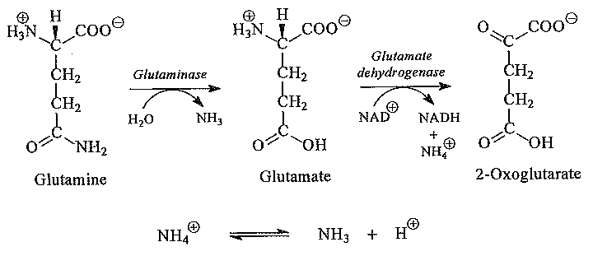
Renal production of amonia and excretion of ammonium ions
Renal tubular cells are able to generate ammonia from glutamine and other amino acids derived from muscles and liver cells according to this reaction:

Slide 22
The ammonium ions produced dissociates into ammonia and hydrogen ions to a degree dependent on the pH.
At N blood pH, the ratio of NH4*to NH3* is about 100:1
Ammonia is a gas and diffuses readily across the cell membrane into the tubular lumen, where it combines with hydrogen ions to form ammonium ions.
At the acid pH of urine, the equilibrium btw NH4* and NH3* shifts to the left strongly favoring the formation of ammonium.
The NH4*formed in the tubular lumen cannot easily cross cell membranes and thus is trapped in the tubular urine and excreted with anions such as phosphate ,chloride or sulphate.
In N Individuals NH4* production in the tubular lumen accounts for the excretion of 60% of the hydrogen ions associated with nonvolatile acids.

Slide 23
Excretion of H*as H2PO4
H* secreted into the tubular lumen by the Na*H* exchanger may also react with HPO4* to form H2PO4* .
This process depends on the amount of phosphate filtered by the glomeruli and the pH of urine.
Under normal physiological conditions 30mmol of H* is excreted per day as H2PO4*and this amount account for 90% of the titratable acidity of urine.
Acidaemia increases phosphate excretion and thus provides additional buffer for reaction with H*.

Slide 24
Excretion of other acids
Strong acids such as sulphuric acid,hydrochloric acids and phosphoric acids are fully ionized at the pH of urine and are excreted only after the H* derived from these acids reacts with a buffer base.
Excretions of anions of this acids is accompanied by the simultaneous removal of an equal amount of cations e.g Na and K to provide electrochemical balance.

Slide 25
Reclamation of filtered bicarbonate
The unmodified glomerular filtrate has the same concentration of HCO3* as does plasma however with increasing acidification of the proximal tubular urine the HCO3* concentration decreases. This results in decrease in urinary pH.
The H* excreted reacts with HCO3* to form H2CO3 and subsequently CO2 and H2O (catalysed by carbonic anhydrase in the brush border of the proximal tubular cells.)
This increase of urinary CO2 courses it to diffuse across the tubular wall into the tubular cell where it reacts with H2O in the presence of cytoplasmic carbonic anhydrase in the tubular cells to form H2CO3 and subsequently H* and HCO3.

Slide 26
Thus reclamation of bicarbonate is diffusion of CO2 into tubular cells and its subsequent conversion to HCO3*.
The increase in HCO3 helps to maintain or restore a normal pH in the general circulation.
Normally 90% of the filtered HCO3 is reclaimed in the proximal tubule, and the extent of HCO3 reclamation parallels Na absorption.
When plasma HCO3 concentration increases above 28 mmol/l,the capacity of the proximal and distal tubules to reclaim is exceeded and HCO3 is excreted in the urine .
The process of bicarbonate reclamation is enhanced in acidosis(as a result of increase in Na H* exchange) and decreases in alkalosis.
In this way the kidney in acidosis or alkalosis support the other compensatory mechanisms to restore the normal cHCO3*/cdCO2 ratio.

Slide 27
Conditions associated with abnormal acid-base status and abnormal electrolyte of the blood.
Acid –base disturbances are classified as:
Metabolic acidosis
Metabolic alkalosis
Respiratory acidosis
Respiratory alkalosis

Slide 29
REMEMBER!
Acidosis can only occur when:
There is increased addition of acid
Decreased elimination of acid
Increase loss of base.
Alkalosis occurs only by:
Increase addition of base
Decrease elimination of base
Increase loss of acid

Slide 30
Metabolic acidosis
It’s a primary reduction in HCO3- typically with compensatory reduction Pco2
pH may be markedly low or slightly subnormal.
Its categorized as high or normal anion gap.
High anion gap is caused by accumulation of ketones and lactic acid, renal failure, and drug or toxin ingestion
Normal anion gap is caused by GI and renal HCO3-loss.

Slide 31
High anion gap
Ketoacidosis e.g. dka, chronic alcoholism, undernutrition, fasting.
Lactic acidosis : due physiologic processes e.g. shock, primary hypoxia due to lung disorders, seizures or due to exogenous toxins e.g. carbon monoxide, cyanide, iron, isoniazid,toluene
Renal failure
Rhabdomyolysis
Toxins metabolized to acids e.g. alcohol, methanol, ethylene glycol, paraldehyde,salicylates

Slide 32
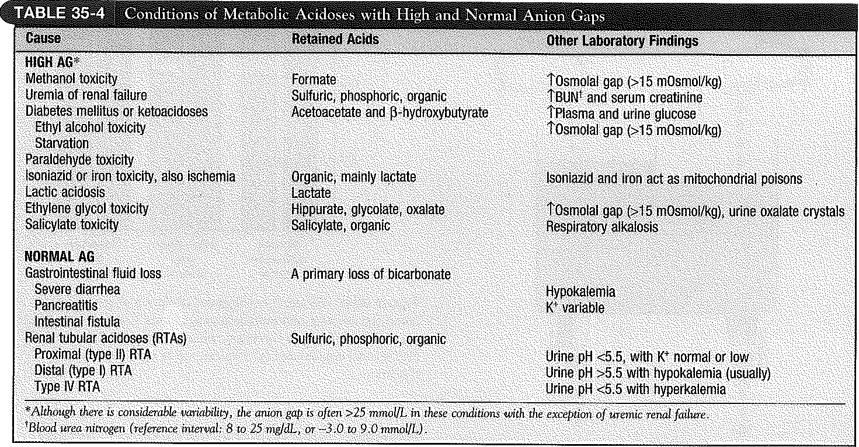

Slide 33
Metabolic alkalosis
It’s a primary increase in serum bicarbonate (HCO3-) either by H+ loss or gain of HCO3-.
It manifests as alkalemia pH >7.40
As a compensatory mechanism it leads to alveolar hypoventilation with a rise in arterial co2 tension which diminishes change in pH.
Its measured with ABG and serum electrolytes
Volume depletion and hypokalemia are the most common stimuli for increased HCO3- reabsorption

Slide 34
Metabolic alkalosis
It’s a primary increase in serum bicarbonate (HCO3-) either by H+ loss or gain of HCO3-.
It manifests as alkalemia pH >7.40
As a compensatory mechanism it leads to alveolar hypoventilation with a rise in arterial co2 tension which diminishes change in pH.
Its measured with ABG and serum electrolytes
Volume depletion and hypokalemia are the most common stimuli for increased HCO3- reabsorption

Slide 35
causes
Loss of gastric secretions- vomiting, NG suctions
Loss of colonic secretions- congenital chloridorrhea, villous adenoma.
Cystic fibrosis.
Exogenous alkali administration e.g. sodium bicarbonate therapy
Milk- alkali syndrome e.g. use of antacids

Slide 37
Respiratory acidosis
It’s a primary increase in Pco2 with or without compensatory increase in HCO3-.
It results from accumulation in CO2 (hypercapnia) due to decrease in respiratory rate, respiratory volume (hypoventilation) or both.
ph is usually low but may be normal.
Its caused by pulmonary, cns and iatrogenic conditions

Slide 38
CAUSES
CNS – involves impaired respiratory drive e.g. due to toxins (narcotics, barbiturates, benzodiazepines), cns disease(encephalitis, brainstem disease, trauma
Obstructive, restrictive and parenchymal pulmonary disorders e.g. asthma, COPD, sleep apnea, airway edema.
Neuromascular disease ALS, diaphragm dysfunction and paralysis, Guillain –Barre’ syndrome, myasthenia gravis, muscular dystrophy, botulism

Slide 40
Respiratory alkalosis
Its due to alveolar hyperventilation which leads to decreased partial pressure of arterial co2(Paco2) .
This in turn increases the ratio of bicarbonate conc to Paco2
It can be acute or chronic . In acute the Paco2 level is below the lower limit of normal and serum pH is alkalemic.
In chronic the Paco2 is below the lower limit of normal but pH is relatively normal or near normal.

