Slide 1
Ocular manifestations in HIV
Lily Nyamai-Kanyata
(MBChB,Mmed,FEACO)
Notes:
Experience in the ccc clinic

Slide 2
Overview
Why is it important to know about manifestations of HIV in the eye
What are the common manifestations of HIV
What to do with HIV patients to minimize eye disease
Importance of an eye evaluation for every PLHIVA
Notes:
By the end of this lecture you should be able

Slide 3
Holistic and Systematic Approach
Holistic approach
Notes:
I suggest a systemic approach to a PHIVA.
Avoid compartmentalizing a patient depending on the department you are rotating and look at a patient as a whole.

Slide 4
Push In the right direction
Notes:
As I was preparing this lecture I was going through one of my best sites for anything in medicine, emedicine and I came across this.
One of the baseline investigations is an ophthalmologic exam for patients in the west.
And I thought how far are we from achieving this?
I felt challenged as an ophthalmologist, not in a bid to increase my consultation fee but to improve care.

Slide 5
What is the magnitude?
Notes:
HIV and AIDS is a condition regardless of the discipline you pursue in medicine you have to know well.
Most of the people infected with HIV live in our part of the world.
And most deaths do occur in SSA as well.
In 2007, there were 33 million people worldwide with HIV/AIDS, 2.7 million people newly infected with HIV, 2 million death. Ninety-five per cent of infections and deaths occurred in developing countries.

Slide 6
What is the magnitude?
It is estimated that more than 70% of adult AIDS patients will experience an ocular complication at some point of the disease.
31% prevalence in ocular manifestations(Remezo et al, dissertation 2016)
SSA still has a great burden of patients not on HAART
Notes:
The eye fits into this equation in that at any one time, a PLHIV has a 70% chance of developing an ocular complication of HIV in their lifetime.
A cross-sectional study done by Remezo et al in the HIV clinic in Burundi found a 30% of the patients attending the HIV clinic had an ocular complication some of which were blinding.
It is therefore wise that when you will be working in the CCC, then, you should make sure the patients are screened for eye disease.
There is a move to make this part of the guidelines if it is not.
The classic papers of the ocular manifestation were written before the era of HAART.
As much as HAART has become more available, compared to other parts of the world, westill have the greatest burden of patients not on HAART.

Slide 7
Why should PHIVA undergo routine ophthalmologic examinations?
Proper diagnosis and treatment may help to maintain vision and prolong life
Some retinal OI may have a rapid and devastating course.
Notes:
Ocular involvement of HIV and AIDS can be visually devastating and even life threatening.
During my last year of residency, there was a young woman of 33 who was battling with CMV retinitis, a visually debilitating condition we will discuss in this lecture series. She was working as a clerk, was a the family’s sole bread winner and single mother. One eye was blind and the other severely impaired and we battled for months trying to save that one eye from becoming blind. Unfortunately we lost that battle and I shudder to think of what happened to her.

Slide 8
CD 4 T-cell categorization of ocular manifestations
CD4⁺ T-cell count below 500/mL is associated with Kaposi sarcoma, lymphoma, and tuberculosis
CD4⁺ T-cell count below 250/mL is associated with pneumocystosis and toxoplasmosis
Notes:
You have to know and practice HIV medicine well.
Many of the ocular manifestations are closely related to the CD4 T cell count.
Most manifestations occur with lower CD4 Tcell counts.
The HIV guidelines and the CCC approach is aimed at keeping CD4 T cells as high as possible and reducing viral load as it saves the patient manifesting the complications of HIV/AIDS

Slide 9
CD4⁺ T-cell categorization of ocular manifestations
CD4⁺ T-cell count less than 100/mL is associated with the following: Same suspects in neurological complications
Retinal or conjunctival microvasculopathy
Cytomegalovirus (CMV) retinitis
Varicella-zoster virus (VZV) retinitis
Mycobacterium avium complex infection
Cryptococcosis
Microsporidiosis
HIV encephalopathy
Progressive multifocal leukoencephalopathy
Notes:
With low CD4 tcell counts ocular manifestations also have neorological complications.

Slide 10
Anatomic Categorization of Ocular Manifestations
Orbital and adnexal findings: include tumors of the periocular tissues and external infections.
Anterior segment manifestations consist of keratitis, keratoconjunctivitis sicca, iridocyclitis, and other complications.
Posterior segment findings include a HIV associated retinopathy and a number of opportunistic infections (OI) of the retina and choroid.
neuro-ophthalmic manifestations, such as visual field defects, papilledema, and diplopia.
Involving more than one region
Notes:
I find it easier to categorize the ocular involvement of HIV in an anatomic organization as I examine patients using this approach and therefore find it easier to pick up signs.
You can you an external to internal approach –orbital and adnexal, anterior segment, posterior segment and lastly neoro-ophthalmic manifestations
We will go through some cases to illustrate these ocular manifestations and for the manifestations I do not have cases, we will illustrate what to look for and briefly how these conditions are managed.

Slide 11
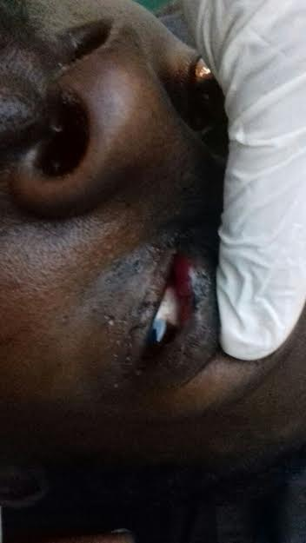
Adnexal Manifestations(eyelid, the conjunctiva, and the lacrimal drainage system)
Kaposi`s sarcoma
Kaposi sarcoma is a spindle-cell tumor thought to be derived from endothelial cell lineage.
most common malignancy seen in HIV-infected patients
CD4 tcell<500/ml
Notes:
Kaposi sarcoma is a spindle-cell tumor thought to be derived from endothelial cell lineage.
Case of a young man who presented with a pigmented lid Mass that was plaque like.
The mass extended subconjunctivally as a subconjunctival mass
On investigation was found to have HIV with a CD4 t cell count of about 200 cells/ml.
We referred him to the comprehensive care clinic for further evaluation.

Slide 12
Adnexal Manifestations- Kaposi Sarcoma
Treatment options
Regression in patients on HAART
Chemotherapy –systemic and intra-leision
Radiation
Excision
Notes:
He was started on HAART and is still on followup in the occuloplastic clinic.

Slide 13
Adnexal Manifestations(eyelid, the conjunctiva, and the lacrimal drainage system)
Herpes Zoster Ophthalmicus
Reactivation of latent varicella zoster virus in the ophthalmic division of the trigeminal nerve
Unilateral painful skin rash in a dermatomal distribution
Notes:
HZO has an anatomical
Reactivation of latent varicella zoster virus in the ophthalmic division of the trigeminal nerve
Clinical signs consist of Unilateral painful skin rash in a dermatomal distribution of the trigeminal nerve shared by the eye and ocular adnexa.
The ophthalmic division branches into the lacrimal, nasociliary and frontal nerves.
Involvement of the frontal nerve is common.
When the nasociliary nerve is affected, the patients may present with vesicles at the tip of the nose, known as Hutchinson`s sign. Studies have shown ophthalmic involvement in 99% of patients with this sign
then
In HZO it is important to look for Cornea epithelial defects, decreased corneal sensation,
HZO iritis is frequently associated with high intraocular pressure.
HZO may be associated with keratitis, scleritis, uveitis, retinitis or encephalitis.(
Oral acyclovir 800 mg po five times daily for 7 to 10 days is the standard treatment

Slide 14
Herpes Zoster Ophthalmicus
Herpes zoster Ophthalmicus
Dentritic corneal ulcer in Nasociliary involvment
Ophthalmic division: lacrimal, nasociliary and frontal
Hutchinson’s sign- nasociliary branch involved
Vesicles at the tip of the nose, look for corneal epithelial defects
Treatment: acyclovir
Notes:
The ophthalmic division branches into the lacrimal, nasociliary and frontal nerves.
Involvement of the frontal nerve is common.
When the nasociliary nerve is affected, the patients may present with vesicles at the tip of the nose, known as Hutchinson`s sign.
Studies have shown ophthalmic involvement in 99% of patients with this sign
then
In HZO whether the tip of the nose is involved or not but more so when it is,it is important to look for Cornea epithelial defects, decreased corneal sensation,
HZO iritis is frequently associated with high intraocular pressure.
HZO may be associated with keratitis, scleritis, uveitis, retinitis or encephalitis.
Oral acyclovir 800 mg po five times daily for 7 to 10 days is the standard treatment
The above is an illustration of a dentritic corneal ulcer that stains with flourescein.

Slide 15
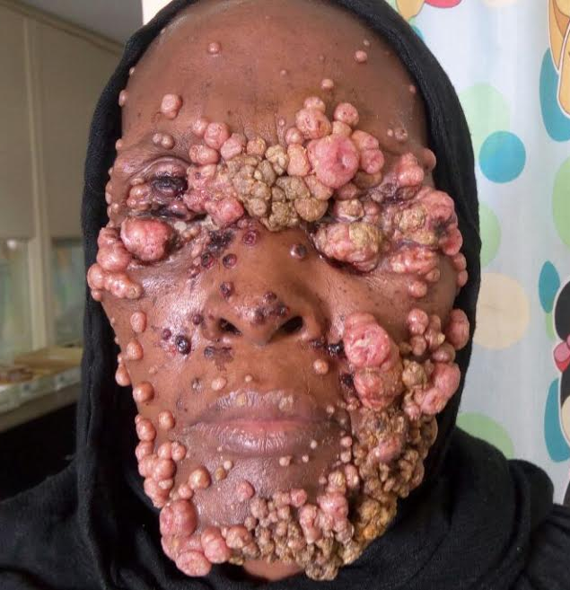
Adnexal Manifestations(eyelid, the conjunctiva, and the lacrimal drainage system)
Moluscum Contagiosum
Cause: DNA poxvirus ,molluscum contagiosum virus (MCV).
HIV patients: common, large leisions ,numerous and more rapidly growing.
Pearly dome shaped umbilicated skin leisons
self limited but may require treatment if numerous and symptomatic (e.g conjunctivitis )
Treatment options: curretage (scapping off) and cauterizing with phenol, cryotherapy, medical therapy(salicylic acid), immonotherapy and laser
Notes:
It is caused by a DNA poxvirus called the molluscum contagiosum virus (MCV).
The patient presents with Pearly, umbilicated,dome shaped lesions that
Are usually self limited but may require treatment if numerous and symptomatic (e.g conjunctivitis)
In HIV patients like in the case we have illustrated, the leisions are large, numerous and more rapidly growing.
This HIV infected woman, had CD 4 T cell count of less than 50
She was being treated for other opportunistic infections and she presented to us with moluscum lesions.
We admitted her to try and excise some of the leisons but of course there was the dilema of extensive damage and loss to the skin
We usually perform curretage (scapping off) and cauterising with phenol
Other options include cryotherapy
Check out medical therapy like salicylic acid, immonotherapy and laser

Slide 16
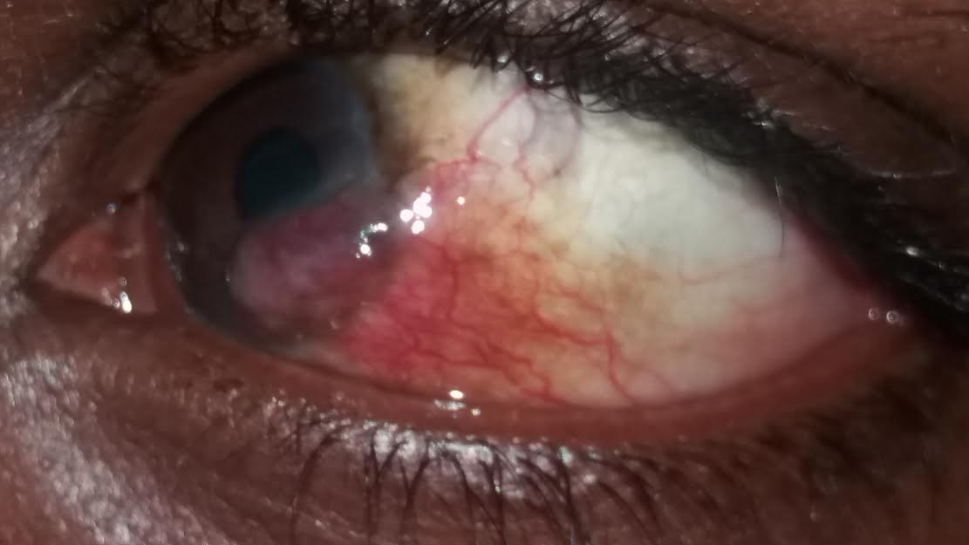
Adnexal Manifestations
Conjunctival squamous-cell carcinoma
Thought to be a rare tumour
Early presentation is an inter-palpebral mass: gelatinous,fungating, leucoplakic, pigmented
Feeder vessel
Notes:
Research in whatever field you pursue.
Conjunctival squamous cell ca is condition that was thought to be rare.
With more recent and local data it has been shown not to be so rare esp in SSA with the era of HIV and AIDS.
You need to observe HIV patients for lesions of the conjunctiva and my advice is that if you see any, please promptly refer to an ophthalmologist before the lesion turns from this to

Slide 17
Adnexal Manifestations
Conjunctival Squamous Cell Carcinoma
Diagnosis: preferably excision biopsy with margin for histology
Treatment mainly surgical
Notes:
To THIS!!!
This patient presented to us with a history of a mass that had rapidly increased in size over the last four months
On examination he has a nodular conjunctival mass arising for the limbal conjunctiva with ulcerations and necrotic areas.
He still had vision though reduced compared the contralateral eye.
We scheduled him for a an incision biopsy.
This leison has already extended widely and may require even exenterating to secure a margin.
Treatment for such huge leisons in is a dilema
The treatment for squamous cell carcinoma is mainly surgical excision.

Slide 18
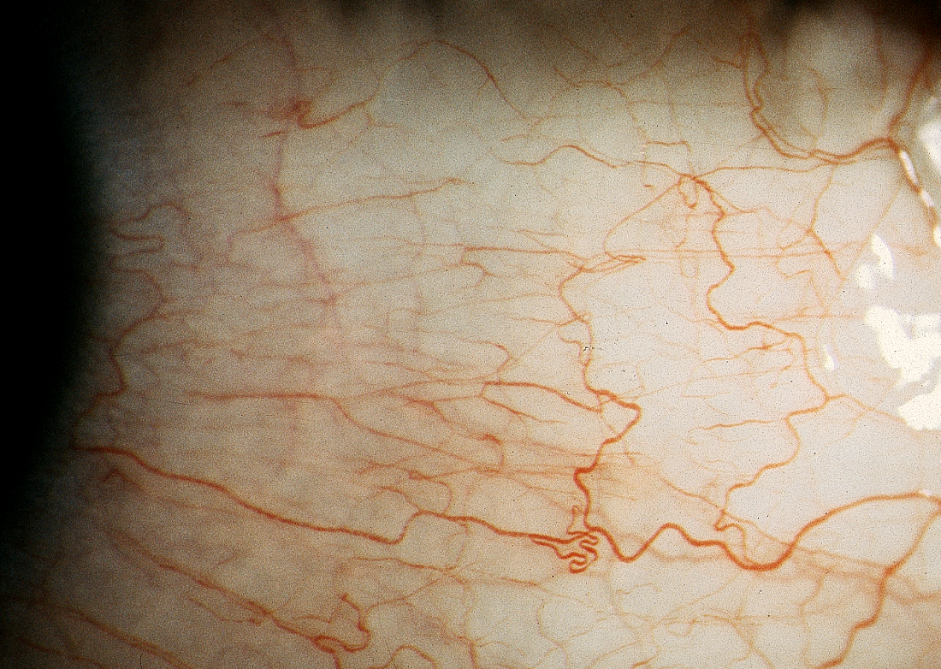
Adnexal Manifestations- Conjunctival Microvasculopathy
Common (HIV / AIDS)
No known adverse effects?
segmental dilation
microaneurysms
sludging
comma-shaped fragments
asymptomatic microvascular changes correlated with retinal microvasculopathy
Cause?deposition of immune complexes related to HIV or the direct infection of HIV in the conjunctival vascular endothelium.

Slide 19
Orbital Manifestations- Orbital cellulitis
Orbital cellulitis
Organisms: Aspergillus, Rhizopus arrhizus, Toxoplasma gondii and Pneumocystis carinii.
Children may present with recurrent episodes of orbital/peri-orbital cellulitis
Notes:
Orbital cellulitis occurs more frequently in PLHIVA particularly in children and you must rule out HIV infection in children with recurrent orbital cellulitis and sinusitis

Slide 20
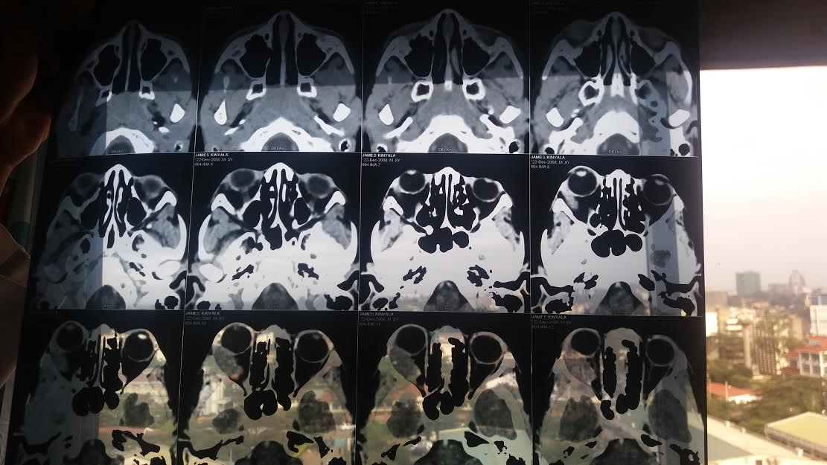
Orbital Manifestations- Tumors
Primary non-Hodgkin`s lymphoma (NHL) of the orbit and ocular adnexa
Rare disease.
Homogeneous isodense orbital mass molding around the lateral ocular surface
Mold, no bone erosion
Notes:
The most common presentation of intraocular lymphoma is decreased vision with nonresolving uveitis.
In this case the patient presented to us with a proptosis and decreased vision that was progressive.
The CT scan showed a well-defined, lobulated or nodular, homogeneous masses of relatively high density and sharp margins. The Mass molded itself to preexisting structures without eroding the bone
Diagnosis is often based on obtaining an intraocular biopsy specimen so we scheduled the patient for this.
Optimal management is not yet realized.
We scheduled the patient for Chemoradiation which is the most effective treatment, but significant ocular and cerebral morbidity is associated with its use.
It is however important to note that ocular lymphoma can be either intraocular or orbital and adnexal.

Slide 21
Anterior Segment Disease
more than 50% of HIV infected patients have anterior segment manifestations.
Keratitis, keratoconjunctivitis sicca and iridocyclitis, most common complications of ant seg disease
Notes:
Collectively, anterior segment disease makes the most common ocular manifestations.

Slide 22
Anterior Segment Disease-Herpes Simplex Keratitis
In AIDS Longer course of disease and increased rate of recurrences.
Treat with topical acyclovir, oral acyclovir
Notes:
Both people with HiV and no HIV experience HSV keratitis.
In AIDS the course of disease is longer and there is an increased rate of recurrences.
Treat with topical acyclovir, oral acyclovir

Slide 23
Bacterial and Fungal Corneal Infections
Bacterial and fungal infections are generally more severe in HIV infected patients
Spontaneous fungal keratitis
Notes:
The occurrence of bacterial and fungal keratitis are generally more severe in HIV infected patients.
The same applies to bacterial and fungal keratitis only there are more spontaneous cases of fungal keratitis compared to the general population

Slide 24
Keratoconjuctivitis Sicca
A.k.a dry eye syndrome, which results from deficiency of any of the tear film layers
A case control study done in KNH in 2015 showed 30.2% of PLHIVA in KNH had DES
Symptoms: foreign body sensations, photophobia and decreased visual acuity.
Cause:destruction of lacrimal glands and inflammation mediated by the HIV virus.
Treatment is lubricants

Slide 25
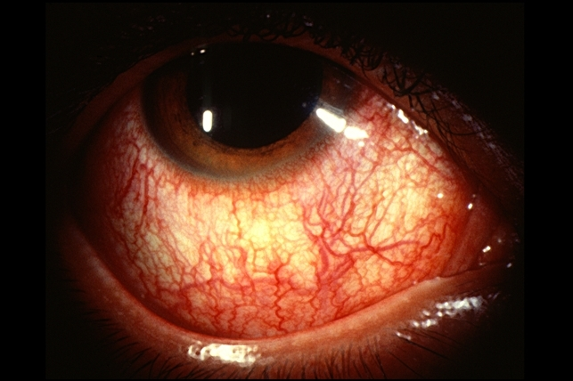
Iridocyclitis/uveatis
photophobia and red eye.
Same symptoms manifest in anterior or posterior segment disease.
Proper eye examination
Infections: syphilis, toxoplasmosis
Medications: rifabutin and cidofovir
Immune recovery uveatis
Reiter`s syndrome, classic triad of arthritis, urethritis, and conjunctivitis.
Treat cause , steroids
Notes:
Inflammation of the uvea tract.
Every week, I get a patient in the general clinical with a painful red eye who has HIV.
Please refer such patients as they may get severe ocular complications from the uveatis.
This diagnosis is more difficult to diagnose and treat
The causes of uveatis could be idiopathic, infectious, mecications, immune recovery uveatis
Reiter`s syndrome, which is defined by the classic triad of arthritis, urethritis, and conjunctivitis is more common in HIV

Slide 26
Retinal Microvasculopathy
Most common ocular manifestation (AIDS)-70%
Patho-mechanism:
- deposition (HIV-related immune complexes)
- direct infection (vascular endothelium)
- increased plasma viscosity
- combination?
Presentaton: Assymptomatic,Cotton wool spots, intraretinal haemorrhages, retinal microaneurysms
Marker for severely compromised immune status:
- inversely related to CD4+ cell count
(≈ 50% of patients with CD4+ ≤ 50 cells/µl)
- risk of opportunistic infections, 3/12 follow up!
Notes:
Microvascular changes in the retina are the most common retinal manifestations of HIV infection.
They are usually asymptomatic and transient and occur in up to 70% of AIDS patients at some point of the disease.
The patients present with HIV retinopathy may have cotton-wool spots (CWS) in the retina, intraretinal hemorrhages, and retinal microaneurysms, especially when CD4+ T lymphocyte count is below 100 cells/mm3.
Forty five percent of the patients with HIV related retinopathy have CD+ cell counts below 50 cells/mm3.

Slide 27
Retinal Microvasculopathy
Different from CMV: do no affect visual acuity, CWS are smaller, do not progress and resolve
AIDS patients with CWS should have close follow up.
Notes:
CWS, however, tend to be smaller, do not progress, are not characteristically associated with retinal hemorrhage and resolve over weeks to months
AIDS patients with CWS should have close follow up.
Branch retinal artery and retinal vein obstructions have been seen in HIV infected patients.

Slide 28
Infectious Retinitis
Most common: Syphilis, candida, varicella-zoster, toxoplasmosis, herpes simplex and cytomegalovirus (CMV) retinitis are most common ones.
Course of disease is longer in AIDS patients, and higher rate of recurrences.
Notes:
Syphilis, candida, varicella-zoster, toxoplasmosis, herpes simplex and cytomegalovirus retinitis are among the most common infectious agents.
Although these infectious may also occur in immunocompetent hosts, the course tends to be longer in AIDS patients, and the rate of recurrences is also higher.

Slide 29
OPPORTUNISTIC INFECTIONS (RETINA)
Cytomegalovirus (HCMV retinitis)
Herpes simplex virus (ARN)
Varizella zoster virus (ARN, PORN)
Treponema pallidum (chorio-retinitis)
Candida albicans (endophthalmitis)
Staph. aureus … (endophthalmitis)

Slide 30
Varicella Zoster Virus
Varicella zoster virus associated with acute retinal necrosis (ARN)
Presentation: peripheral retinal whitening, intraretinal hemorrhages, rapidly progressing necrosis,
Complication:Retinal detachment with proliferative vitreoretinopathy,
involvement of the other eye may also occur.(58, 59)
Notes:
Varicella zoster virus has been associated with acute retinal necrosis, which affects 1–4% of HIV infected patients. It is characterized by peripheral retinal whitening, often accompanied by intraretinal hemorrhages associated with rapidly progressing necrosis over several days. Multifocal lesions are commonly seen. Retinal detachment with proliferative vitreoretinopathy as well as the involvement of the other eye may also occur.(58, 59)

Slide 31
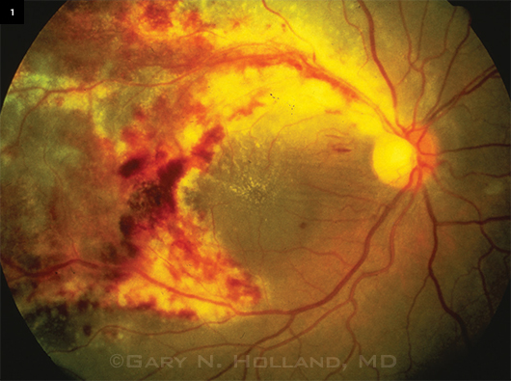
Cytomegalovirus(CMV) Retinitis
CMV retinitis is the most common intraocular infection related to HIV infection
beta subgroup of herpes viruses (Herpes viridae)
CD4 tcell count 50 less
Infection is usually subclinical in immunocompetent hosts
In PLHIVA, CMV may lead to several complications
Notes:
Cytomegalovirus (CMV) retinitis is the most common intraocular infection related to HIV infection
Infection with CMV is usually subclinical in immunocompetent hosts but may lead to complications in HIV patients.
They may present with progressive loss of vision and blindness

Slide 32
CMV retinitis
Symptoms: reduced V.V, floaters, scotoma
Signs:yellow white retinal lesions, retinal hemorrhages
Complications: retinal detachment
intravenous (IV), oral, and intravitreal medications

Slide 33
CMV Retinitis
Intravenous (IV), oral, and intravitreal medications.
1. Oral valganciclovir
2. Intravenous ganciclovir
3. Intravenous foscarnet
4. Intravenous Cidofovir
5. Intraocular ganciclovir device

Slide 34
CMV retinitis
The game changer HAART
decrease in the incidence and prevalence of CMV retinitis after the advent of HAART.
Fewer relapses
Decreased progression, increased remission,
Close followup because relapse may occur.

Slide 35
Neuro-Ophthalmic Manifestations of HIV Infection
Include: optic neuropathies, Nerve palsies, optic neuritis, homonymous hemianopia and nystagmus, papilloedema
Optic neuropathies related compression,infiltration, infection, vaso occlusion or inflammation.
Nerve palsies: Cryptococcal meningitis and intracerebral toxoplasma cysts
Multiple Sclerosis: optic neuritis
SOL ,Progressive multifocal leukoencephalopathy- homonymous hemianopia and nystagmus
Herpes virus may present with papilledema and extraocular muscle palsies.
Inv: Lumbar puncture, MRI
Notes:
The neurologic complications may include optic neuropathies, Nerve palsies, optic neuritis, homonymous hemianopia and nystagmus, papilloedema
Depending on where the lesion is.
Point is, fundoscopy is aninvaluable work up for a patient with neurological manifestations of HIV

Slide 36
Role of highly active antiretroviral therapy (HAART),
dramatically improved the prognosis of HIV infection.
Spontaneus resolution
substantial intraocular inflammation in patients with healed cytomegalovirus retinitis receiving HAART has been reported, which is known as immune recovery uveitis.
Notes:
HAART has become or available, however, we are living in the part of the world where compared to other regions it still remains relatively inaccessible.
However, it has dramatically improved the prognosis of HIV infection.

Slide 37
Summary
PLHIVA deserve an opthalmologic review
Know and practice your HIV medicine well
If in doubt refer or call the ophthalmologist

Slide 38
References
http://www.djo.harvard.edu/site.php?url=/physicians/oa/674

Slide 39
Thank you for being such a wonderful audience

