Slide 1
BASIC OCULAR ANATOMY AND PHYSIOLOGY

Slide 2
TOPICS
ORBIT
EXTRA-OCULAR MUSCLES (EOMS)
OCULAR ADNEXA
LACRIMAL SYSTEM AND TEAR FILM
EXTERNAL ANATOMY
INTERNAL ANATOMY

Slide 3
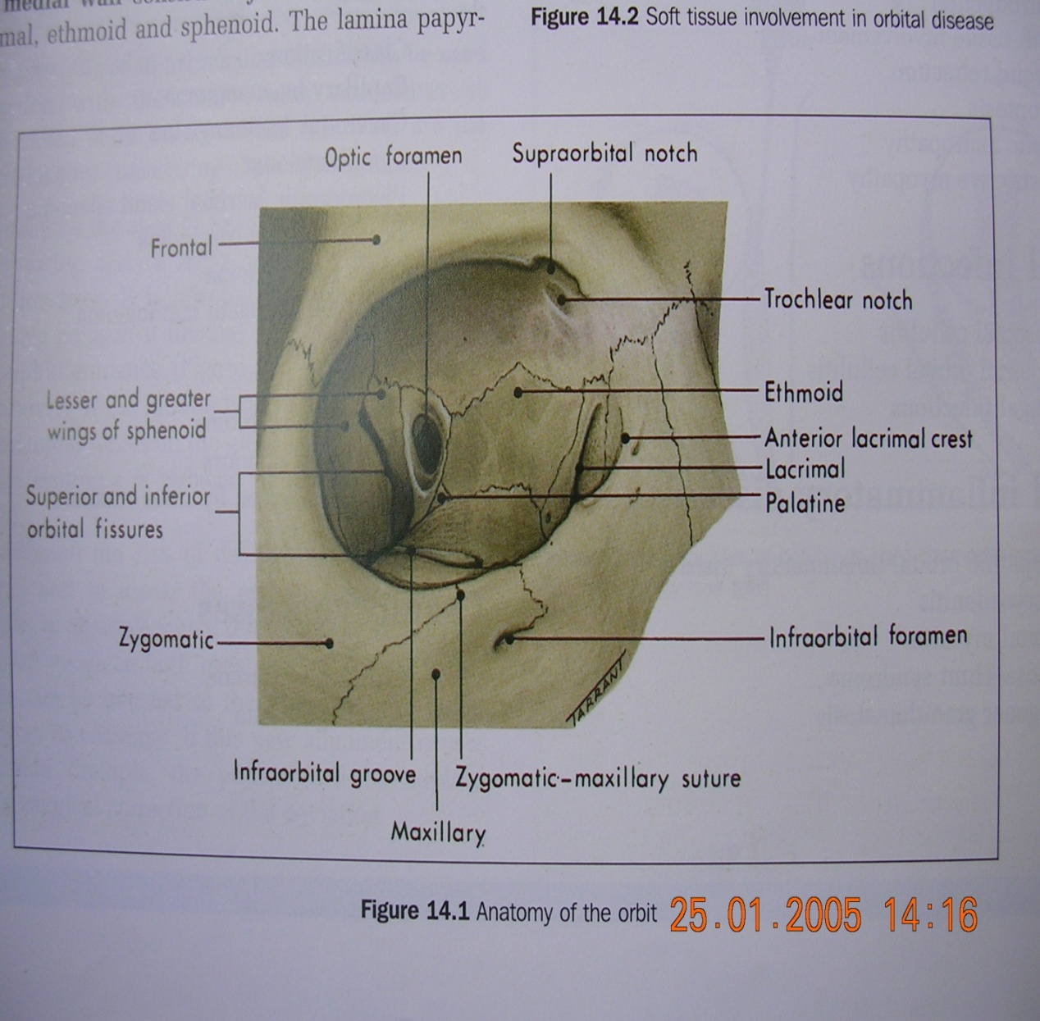
ORBIT
ORBIT
Volume 30cm³
4 Walls
7 Bones:
  Frontal
  Ethmoid
  Lacrimal
  Palatine
  Maxillary
  Zygomatic
  Sphenoid

Slide 4
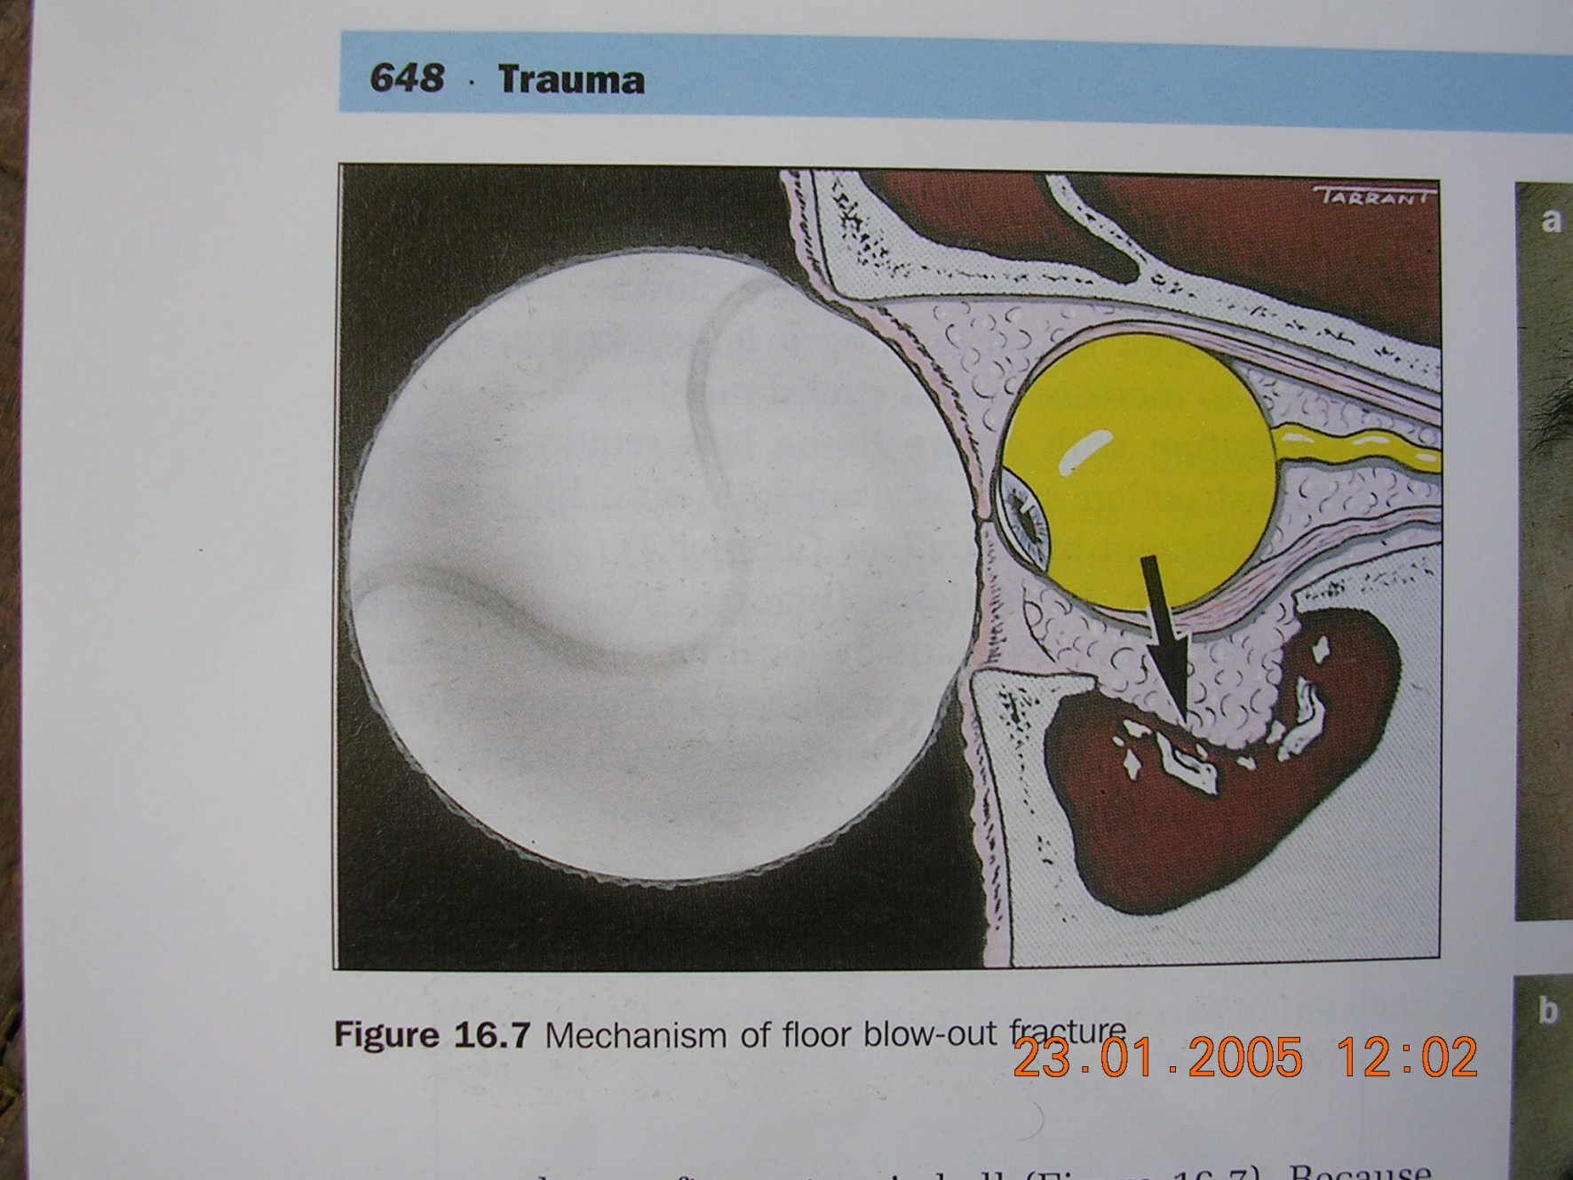
BLUNT TRAUMA TO THE ORBIT

Slide 5
CONT.
Thin walls especially medial wall and floor.
Orbit lined by periorbita, continues anteriorly as tough orbital septum which is attached to the orbital rims & lids → protects orbital structures from external lid injuries and infections
Protects eye & supporting structures
Contents:
  Eyeball
  EOMs
  Nerves
  Blood vessels
  LPS
  Lacrimal gland and sac
  Orbital fat

Slide 6
WALLS OF THE ORBIT
Lateral Wall: Greater Z
  Greater wing of the sphenoid
  Zygomatic
Roof: Front-Less
  Frontal
  Lesser wing of the sphenoid
Floor: PalM-Z
  Palatine
  Maxillary
  Zygomatic
Medial Wall: ELMS
  Ethmoid
  Lacrimal
  Maxillary
  Sphenoid

Slide 7
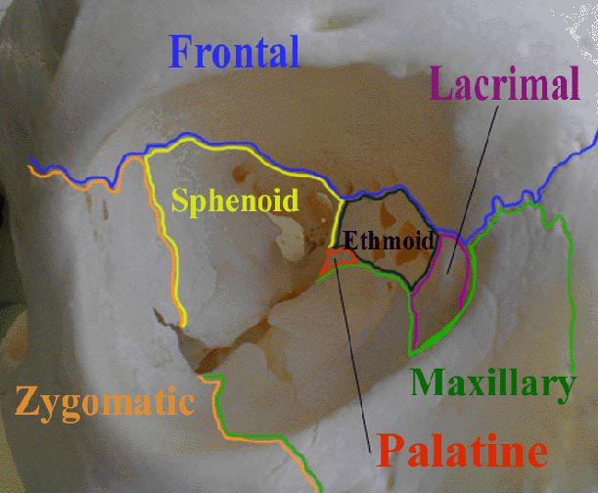

Slide 8
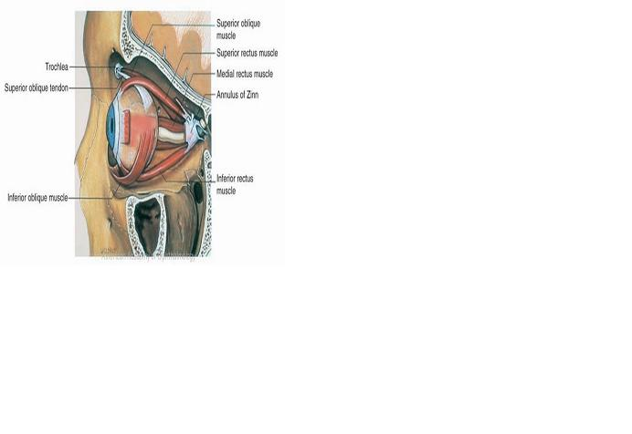
EXTRAOCULAR MUSCLES

Slide 9
EXTRA-OCULAR MUSCLES(EOMS)
Origin → tendinous ring at the apex of orbit except inferior oblique (floor of orbit)
Insertion → eyeball
6 EOMs move the eyeball
  4 Recti (Lateral, medial, superior & inferior)
  2 obliques (superior & inferior)
Action:
  Horizontal muscles → adduction & abduction
  Vertical muscles → elevation and depression in abduction
  Obliques → intorsion and extorsion, elevation and depression in adduction.
Nerve supply – CN III, IV, VI.
LR₆SO₄

Slide 10
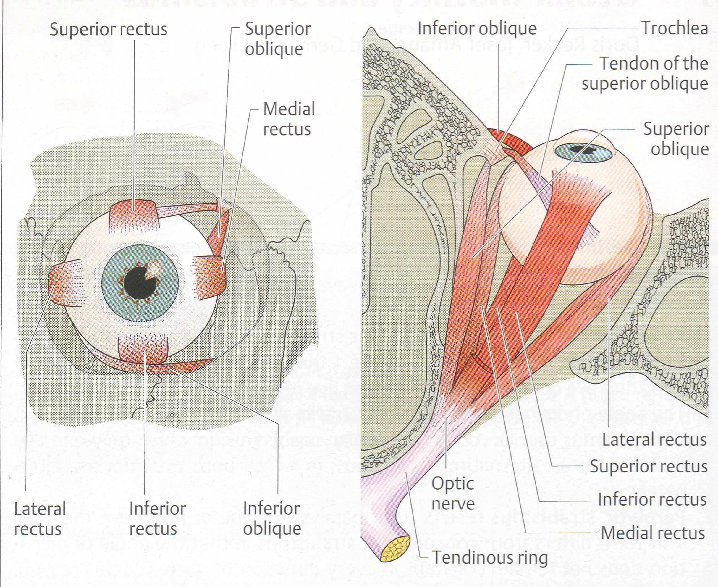

Slide 11
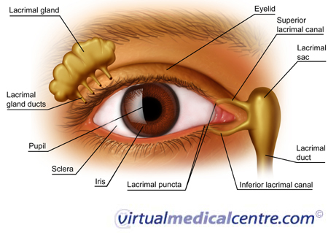
OCULAR ADNEXA
Eyebrows
Eyelids
Lateral & medial canthus
Conjunctiva
Caruncle
Lacrimal System

Slide 12
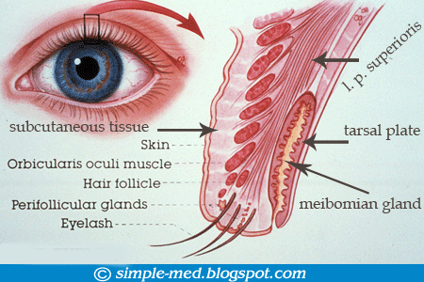
ANATOMY OF EYELIDS/ TARSAL PLATES
4 BASIC LAYERS
Skin (thinnest) → anteriorly
Muscles:
  Orbicularis Oculi
  Levator Palpebrae Superioris (LPS)
  Muller‘s muscle
Tarsal plate → tough collagenous layer that houses the meibomian gland
Tarsal conjuctiva → epithelial lining that is reflected on the globe via the fornices.

Slide 13
FUNCTIONS OF THE EYELIDS
Mechanical protection to the anterior globe.
Spread of the tear film over the conjunctiva and cornea with each blink.
Contains the meibomian oil glands, which provide the lipid component of the tear film → lubrication
Prevent drying of the eyes
Contain the puncta through which the tears flow into the lacrimal drainage system.
Cleaning away debris
Cosmesis

Slide 14
CONT.
  LPS → elevates upper lid; innervation oculomotor nerve; damage or weakening results in ptosis.
Mullers → support, elevation to upper lid; sympathetic innervation
Orbicularis → closure of eyelids; facial nerve
Tarsus → fibrous tissue; form and stability to upper lid (orbital septum)
Eyelashes → protect eyes from small foreign objects
Glands→ contribute to the tear film; protects & lubricates

Slide 15
EYELID MARGIN
Eyelashes:
  2 to 3 rows
  Direction?
  Protection?
Glands of Zeiss → Modified sebaceous glands
Glands of Moll → Apocrine sweat glands

Slide 16
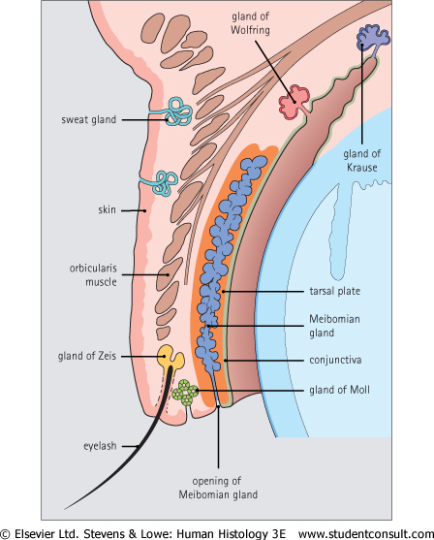
GLANDS OF THE EYE AND ADNEXA
Lacrimal gland
Accesory lacrimal glands → Glands of Krause & Wolfring
Goblet cells & Glands of Henle‘
Glands of moll and zeiss
Meibomian glands

Slide 17
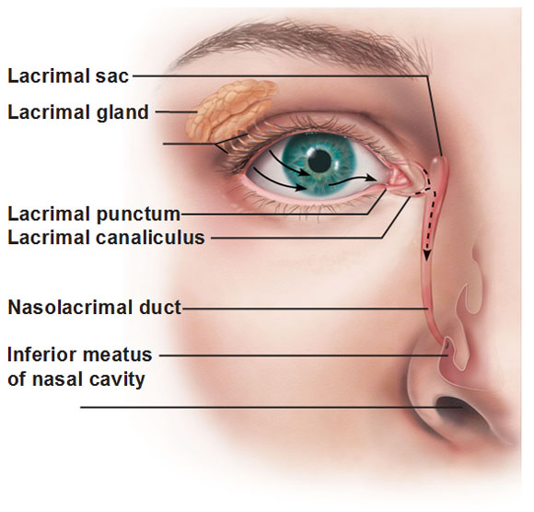
LACRIMAL SYSTEM
Main Lacrimal gland → reflex tearing
Accessory lacrimal glands → basal tear secretion

Slide 18
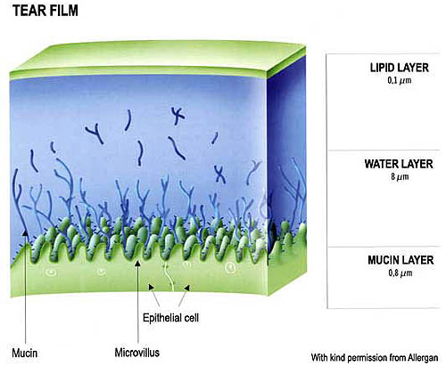
TEAR FILM
Tears form a film over the eyeball that:
  Keeps the cornea and conjunctiva moist & lubricated
  Produces a smooth optical surface
  Provides oxygen and other nutrients
  Protects → immunoglobulins, lactoferrin, lysozymes

Slide 19
CONT.
Layers of the tear film:
  Oily layer: stabilizes tear film (from meibomian gland)
  Aqueous layer: provides moisture and nutrition for the cornea and protective elements (from accessory lacrimal glands)
  Mucin layer: surfactant (from goblet cells in the conjunctiva)
Tear film is renewed by each blink
Deficient tear film → drying of cornea

Slide 20
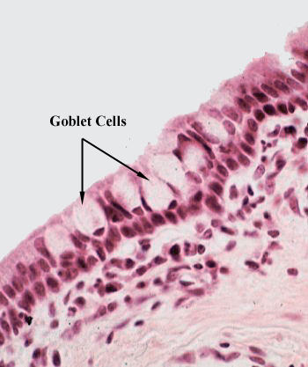
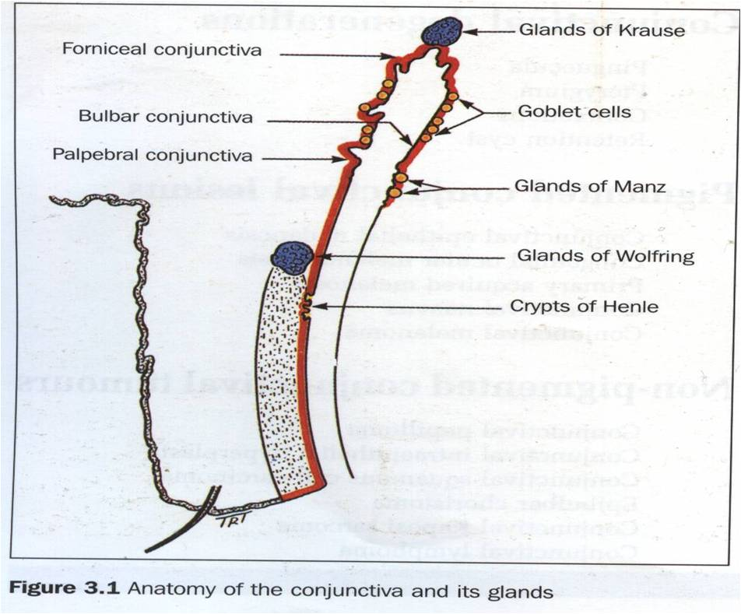

Slide 21
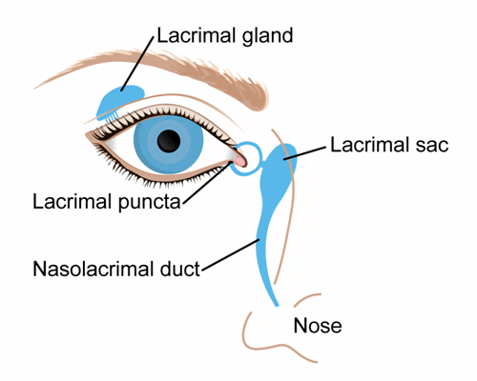
THE LACRIMAL DRAINAGE SYSTEM
Tears drain into the upper and lower puncta → lacrimal sac via the upper and lower cancaliculi
They form a common canaliculus before entering the lacrimal sac.
The nasolacrimal duct passes from the sac to the nose.
Orbicularis oculi muscle → pump mechanism

Slide 22
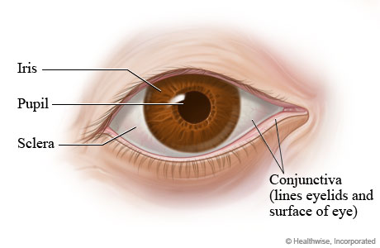
CONJUNCTIVA

Slide 23
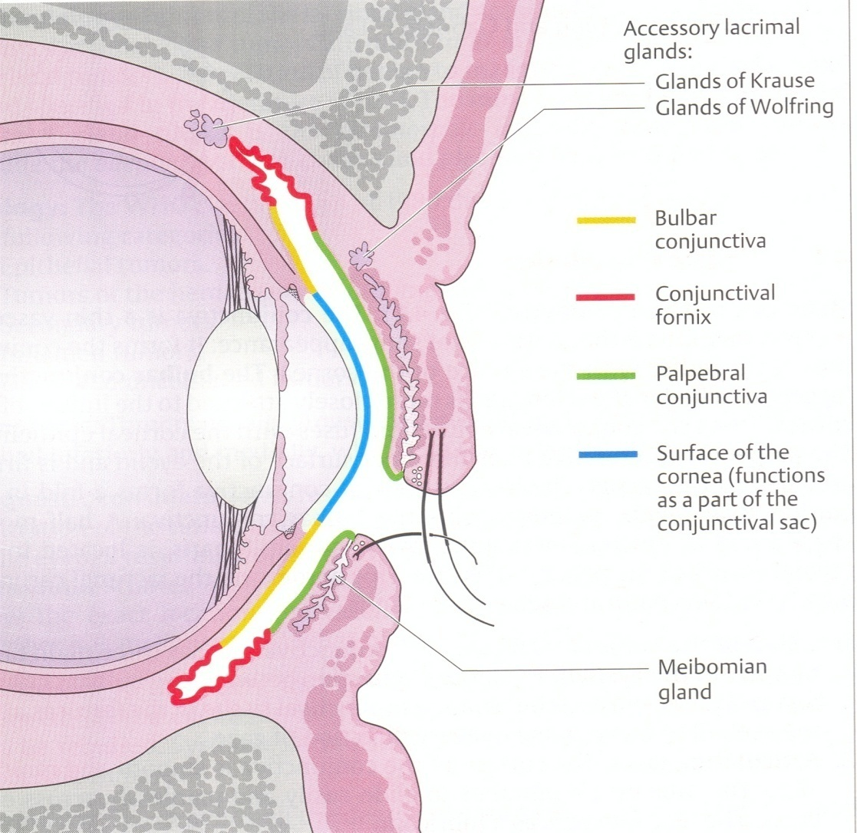
CONJUNCTIVA
3 Geographical zones:
  Bulbar - overlies sclera anteriorly
  inserts at limbus
  Tarsal – lines posterior surface of eyelids
  Fornices – lid recesses
Functions:
Motility
Lubrication
Protection

Slide 24
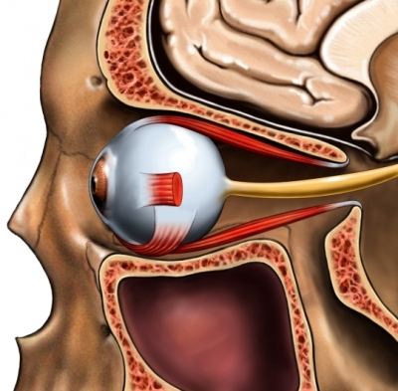
EXTERNAL ANATOMY OF EYEBALL
Roughly a sphere
2.5 cm in diameter
6.0 cc in volume
Location → Anterior bony orbit
Support → Tenon’s capsule

Slide 25
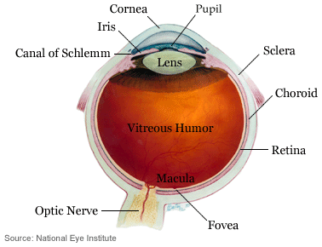
ANTERIOR/POSTERIOR SEGMENT

Slide 26
SEGMENTS OF THE EYE
Anterior Segment:
Conjunctiva
Cornea
Sclera
Anterior chamber
Iris
Pupil
Lens
Posterior Segment:
Vitreous chamber
Retina
Choroid
Optic nerve head

Slide 27
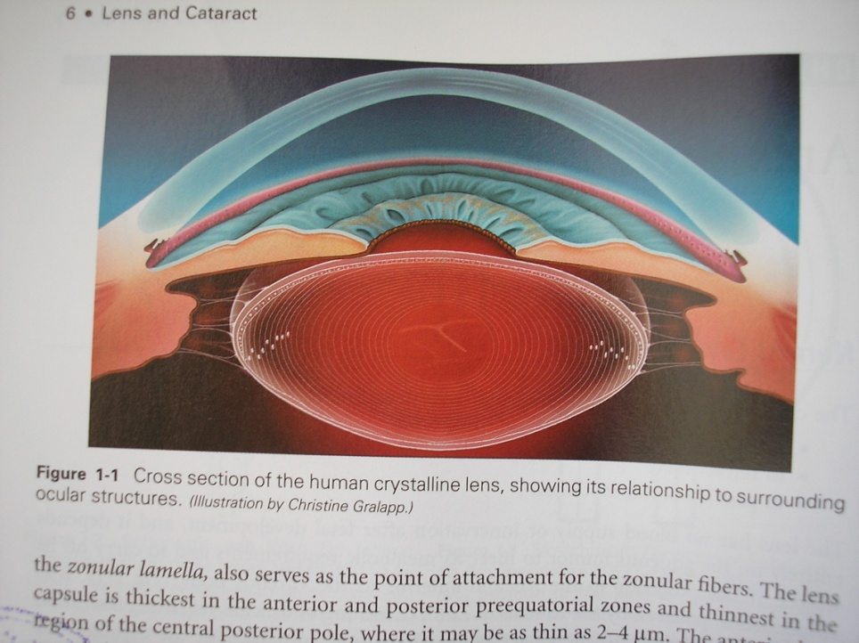
CORNEA
Clear, transparent, smooth, curved
11-12 mm diameter
0.5mm thick centrally, 1.0mm peripherally
Functions:
  Refractive surface- main refractive element of the eye
  Protective interface
  Contain intraocular pressure

Slide 28
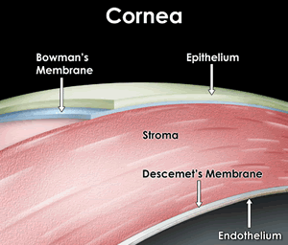
LAYERS OF THE CORNEA
Epithelium
Bowman’s membrane
Stroma
Dua’s layer
Descemet’s membrane
Endothelium

Slide 29
SCLERA
White, firm fibrous supporting tissue.
Covers the posterior four fifths of the surface of the globe
Thickness varies ( 0.3-1mm)
Apertures posteriorly to allow nerves and blood vessels
Protects intraocular contents

Slide 30
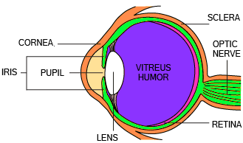
INTERNAL ANATOMY OF EYEBALL
Anterior chamber
Uveal tract
Lens
Vitreous
Retina

Slide 31
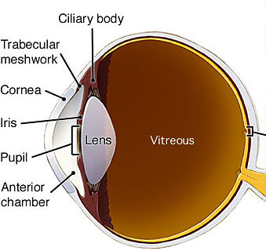
ANTERIOR CHAMBER
Space posterior to cornea and anterior to iris.
Contains aqueous fluid:
  Produced by ciliary body
  Drains through the trabecular meshwork
  Optically clear
Functions:
  Maintenance of IOP
  Nutrition to cornea and lens
  Lymphatic drainage

Slide 32
LENS
Clear, transparent crystalline like tissue
Posterior to pupil and iris, anterior to vitreous
Suspended by zonules from ciliary body
Avascular
Provides adjustable part of eye’s refractive power

Slide 33
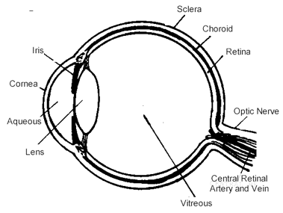
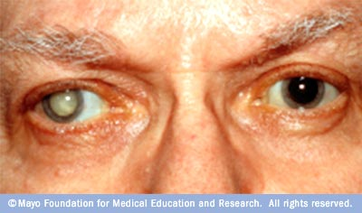
`

Slide 34
POSTERIOR SEGMENT

Slide 35
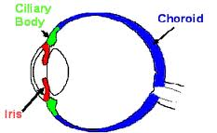
UVEA (UVEAL TRACT)
Three structures:
  Iris
  Ciliary body
  Choroid
Contains melanin.

Slide 36
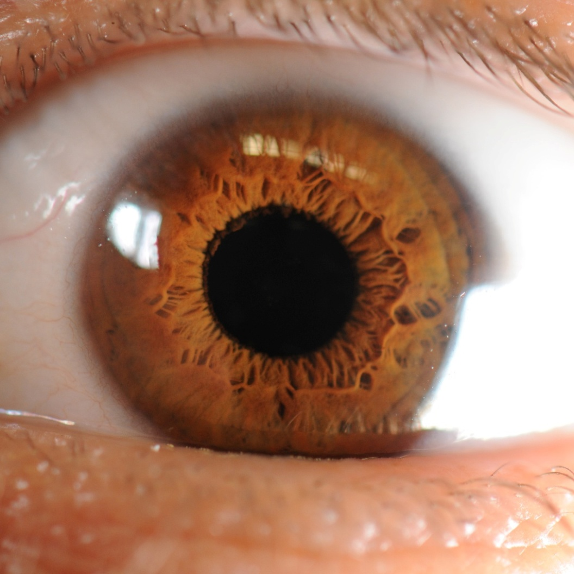
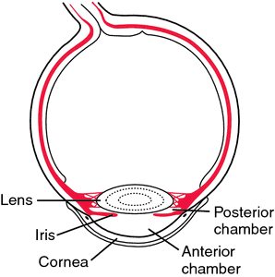
IRIS
Diaphragm between anterior and posterior chamber with a central hole → pupil
Muscles:
  Sphincter pupillae: Parasympathetic innervaton; constricts the pupil → miosis
  Dilator pupillae: Sympathetic innervation; dilates the pupil → mydriasis
Regulates amount of light that gets into the eye.

Slide 37
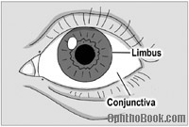
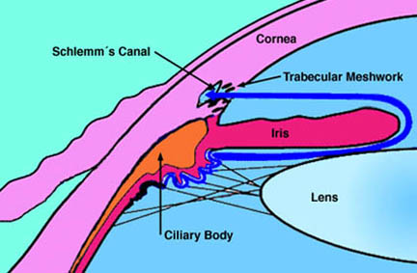
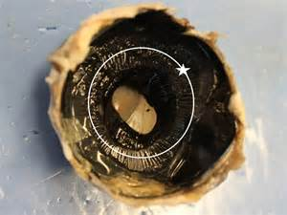
CILIARY BODY
A circumferential, ring-like structure
Lines interior surface of sclera just behind limbus
Functions:
  Accommodation
  Aqueous humour production

Slide 38
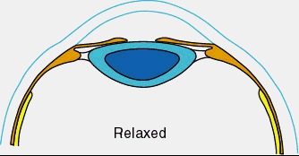
MECHANISM OF ACCOMMODATION
Ciliary muscle contraction (Parasympathetic) →
Slackening of zonules → Changes in lens surface curvature →
Lens thickness ↑ →
Pupillary constriction& convergence

Slide 39
PRESBYOPIA
Ag- related loss in accommodative ability which results in a complete loss in accommodative ability by about 50 years of age.

Slide 40
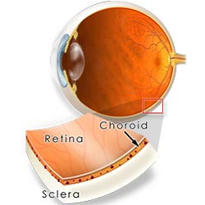
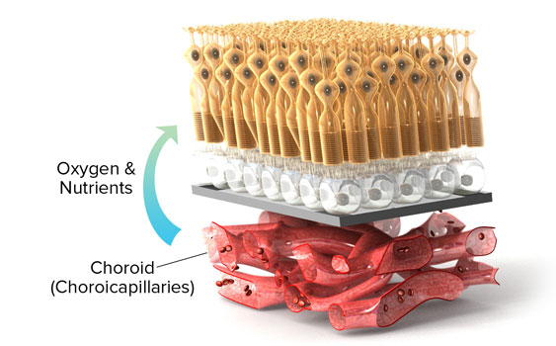
CHOROID
Vascular layer between retina & sclera
Meshwork of blood vessels → outer arteries & veins; inner choriocapillaries
Blood from ciliary arteries – branches of Ophthalmic Artery
Main functions:
  Blood supply to outer layers of retina, sole supply to fovea
  Nutrition
  Thermoregulation
Common site of occular metastasis

Slide 41
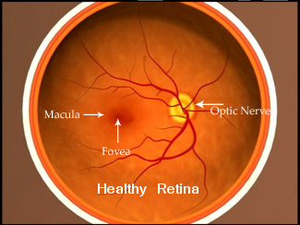
RETINA AND OPTIC NERVE HEAD
Retina & optic nerve originate as outgrowths of the developing brain.
Retina:
  Considered part of the CNS and is actually brain tissue.
  It is the only part of the CNS that can be visualized non-invasively.
Innermost layer.
Highly specialised tissue: Transforms light energy into electrical energy
Blood supply:
  Outer layers (RPE, rods & cones) → choroid.
  Inner layers → central retinal artery

Slide 42
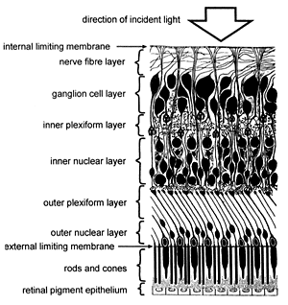
10 LAYERS RETINA
Divided into the neurosensory retina and the pigmented layer of the retina (retinal pigment epithelium)

Slide 43
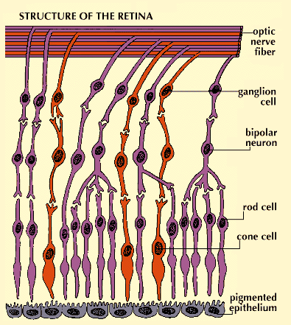
RETINA CELLS
Photoreceptor cells: rod and con.
Rods (scotopic vision):
  function mainly in dim light
  provide black-and-white vision
Cones (photopic vision):
  support daytime vision
  the perception of color
Offices: Mesopic vision

Slide 44
FOVEA
Sharp central vision
Less sensitive to light because of its lack of rods
Despite occupying about 0.01% of the visual field, about 10% of axons in the optic nerve are devoted to the fovea

Slide 45
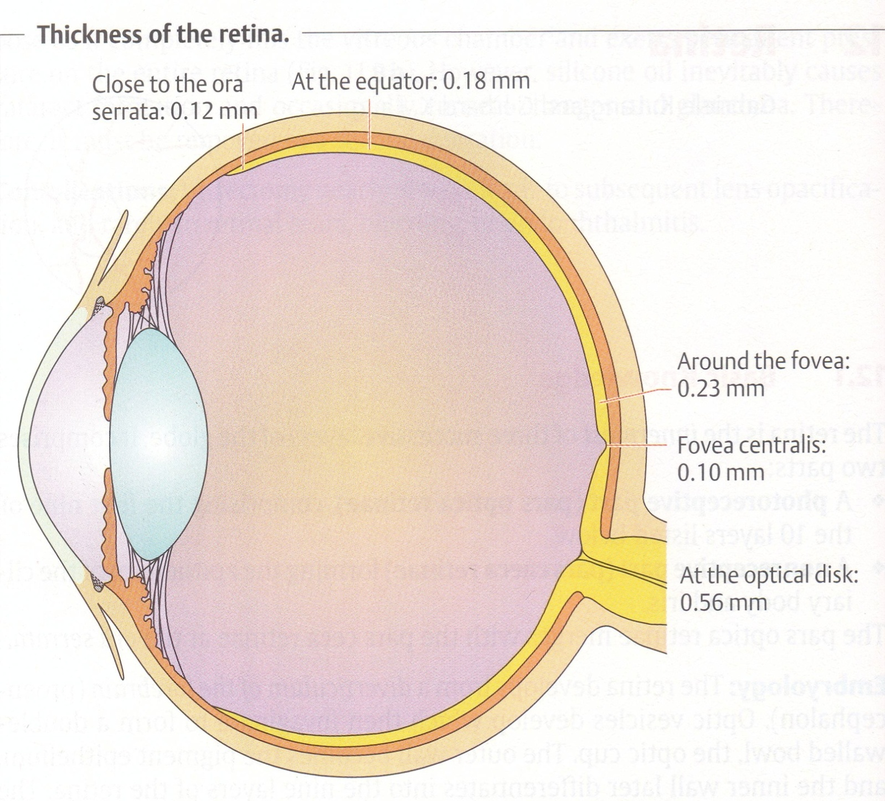

Slide 46
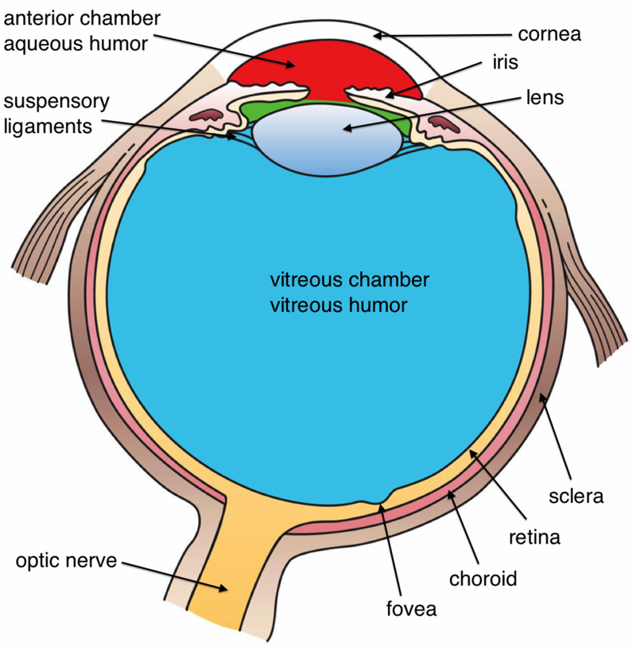
VITREOUS CHAMBER

Slide 47
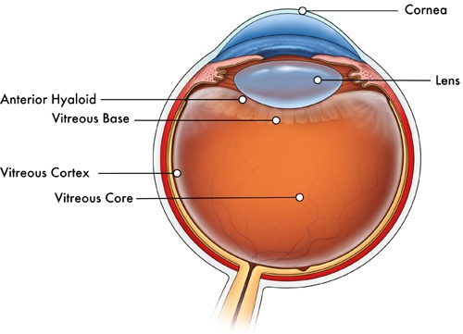
CONT.
Largest tissue of eyeball (4cc)
Fills space between lens & retina
Optically clear, jelly like
Composition:
  98% water
  2% collagen & hyaluronic acid

Slide 48
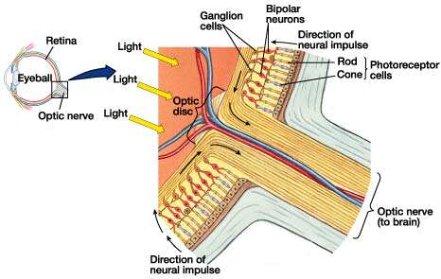
OPTIC NERVE

Slide 49
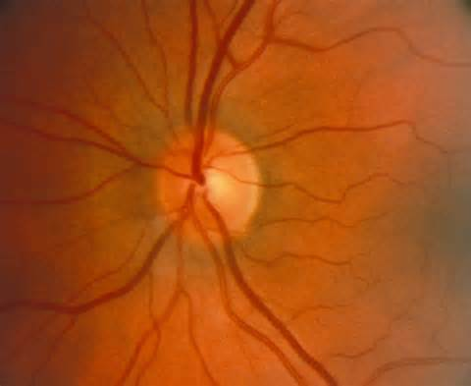
Optic Nerve Head

Slide 50
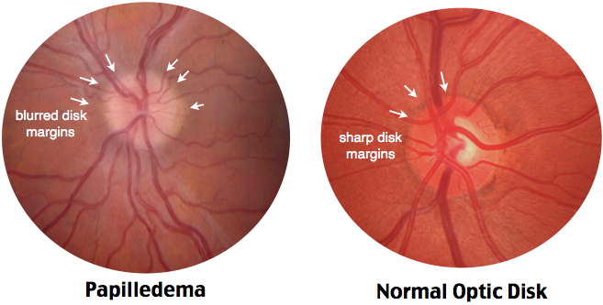
PAPILLOEDEMA

Slide 51
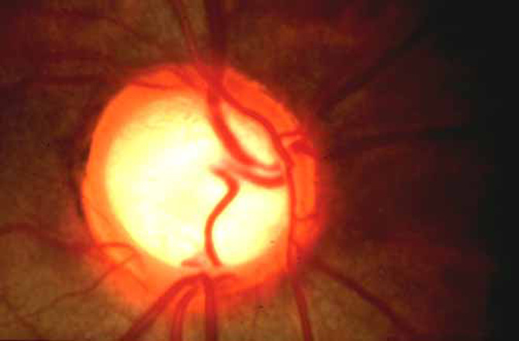
GLAUCOMA

Slide 52
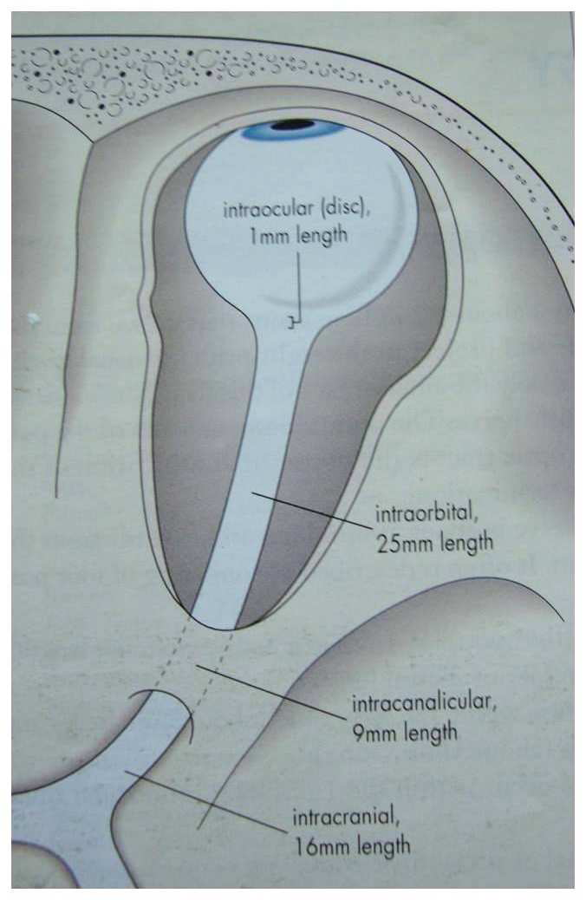
OPTIC NERVE
Axons of ganglion cells between globe & Lateral geniculate body (LGB).
Carries afferent visual and pupillary fibres.
4 parts:
  Intraocular
  Orbital
  Intra-canalicular
  Intracranial

Slide 53
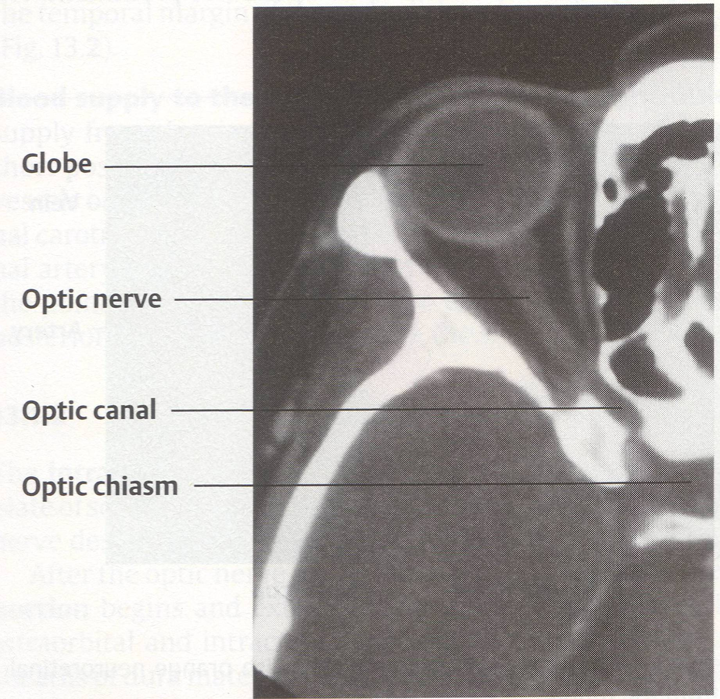
Optic Nerve

Slide 54
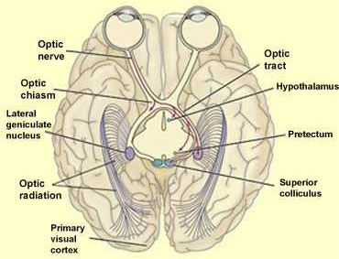
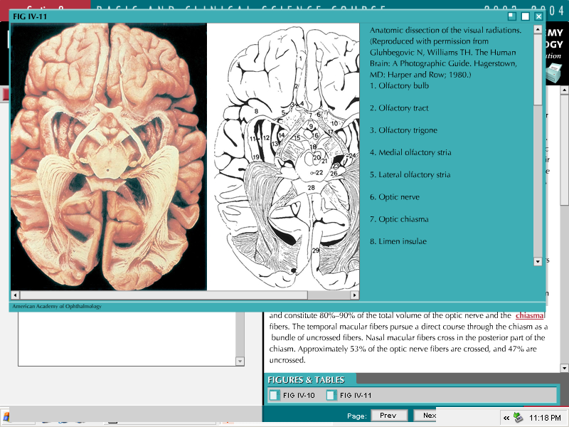

Slide 55
BLOOD-OCULAR BARRIERS
Include:
  Blood - aqueous barrier
  Blood - retina barrier

Slide 56
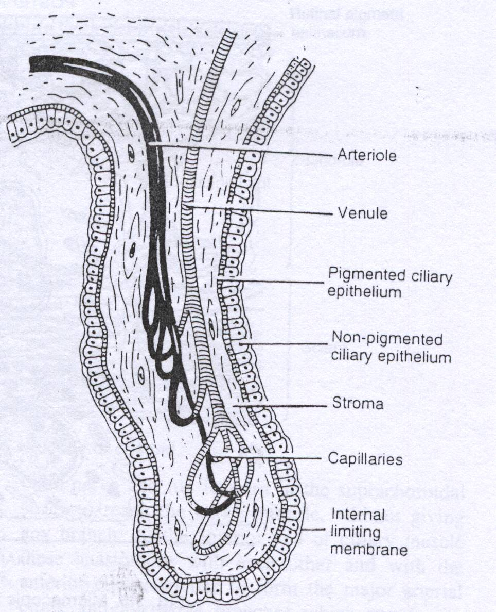
BLOOD-AQUEOUS BARRIER
Non-pigmented cilliary epithelium → tight junctions
Non-fenestrated iris capillaries.

Slide 57
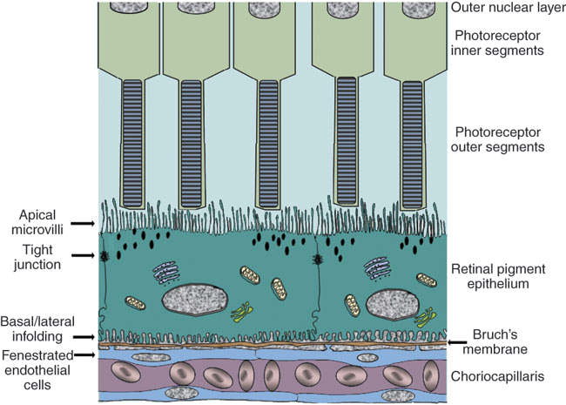
BLOOD-RETINA BARRIER (BRB)
Retinal Pigment Epithelium (RPE) → tight junctions
Capillary endothelium → non-fenestrated; preventing passage of large molecules from choriocapillaries into the retina

Slide 58
CONT.
Essential to maintaining the eye as a privileged site
Essential for normal visual function
Alterations of the BRB play a crucial role in the development of retinal diseases
  Diabetic retinopathy → inner BRB
  Age related macular degeneration → outer BRB

Slide 59
IMMUNE PRIVILEGE OF THE EYE
The inner eye represents an immune privileged space which is disconnected from the immune system of the blood stream.
The immune privilege is supported by the RPE in two ways.
  First, it represents a mechanical and tight barrier which separates the inner space of the eye from the blood stream.
  Second, the RPE is able to communicate with the immune system in order to silence immune reaction in the healthy eye or, on the other hand, to activate the immune system in the case of disease.

Slide 60
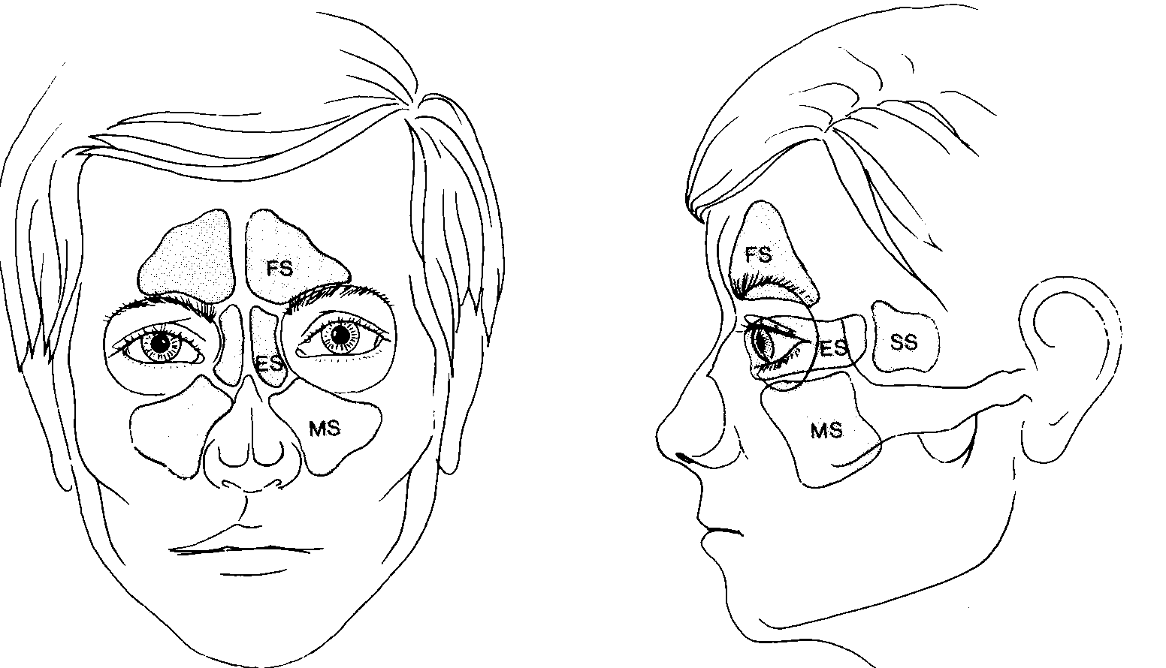
SINUSES

Slide 61
CONT.
Ethmoid sinus:
  Lateral wall very thin i.e. lamina papyracea
  Orbital cellulitis → mostly from ethmoidal sinusitis (l. papyracea)
Maxillary sinus:
  Floor → Maxillary alveolar process, thin bone separating from roots of molars
    Oro-dental fistulae after extraction
    Roots of first molars get exposed
  Tumour result in proptosis with upward displacement
  Blow out fracture → damage infra-orbital nerve→ hypo-aesthesia of cheek
Sphenoid sinus:
  Closely related to optic nerve.
  Sinusitis→ retro-bulbar neuritis→ sudden visual loss

Slide 62
SUMMARY
Ocular Adnexa:
  Eyelids
  Eyebrows
  Conjunctiva
  Lacrimal System
External Anatomy
  Orbit
  Optic nerve
  Extra ocular muscles
Internal Anatomy:
  3 Coats:
    Sclera, Uvea, Retina
  Anterior chamber and aqueous humour
  Lens
  Posterior chamber
    Vitreous

Slide 63
RECAP

Slide 64
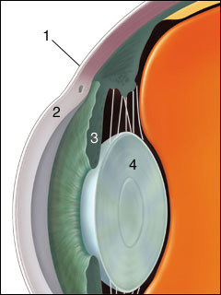
1 → Bulbar conjunctiva
2 → Cornea
3 → Iris
4 → Lens

Slide 65

1 → Epithelium membrane
2 → Bowman’s membrane
3 → Stroma
4 → Descemet’s membrane
5 → Endothelial membrane

Slide 66


Slide 67


CORNEAL ULCER
Break in epithelial surface.
Absent epithelium → uptake of fluorescein by stroma

Slide 68

1 → Cornea
2 → Aqueous humor
3 → Iris
4 → Lens
5 → Choroid
6 → Cilliary body
7 → Optical nerve

Slide 69

CATARACT
Any opacification of the lens
A normal lens is clear
A cataract makes the lens change color to creamish or whitish

Slide 70




CATARACT OR NOT?

Slide 71



Slide 72


Slide 73

RETINAL DETACHMENT
Separation of sensory retina from retinal pigment epithelium by sub-retinal fluid

