Slide 1
PREVENTION OF CHILDHOOD BLINDNESS PROF.M. SAJABI MASINDE 10 JUNE 2016

Slide 2
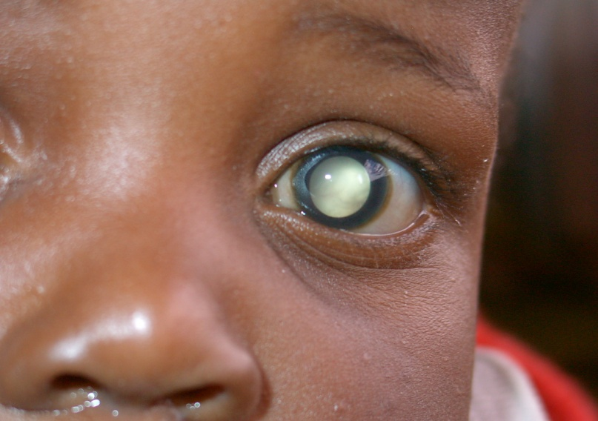
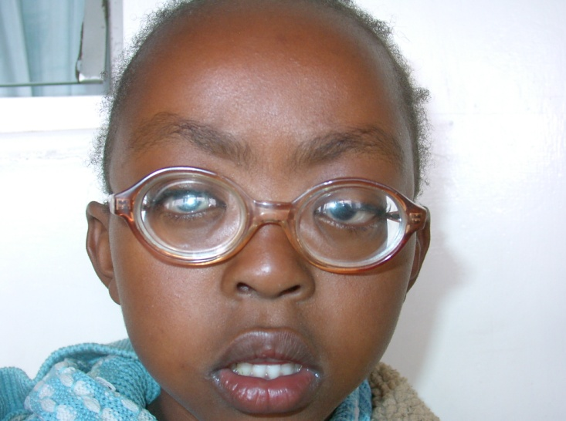
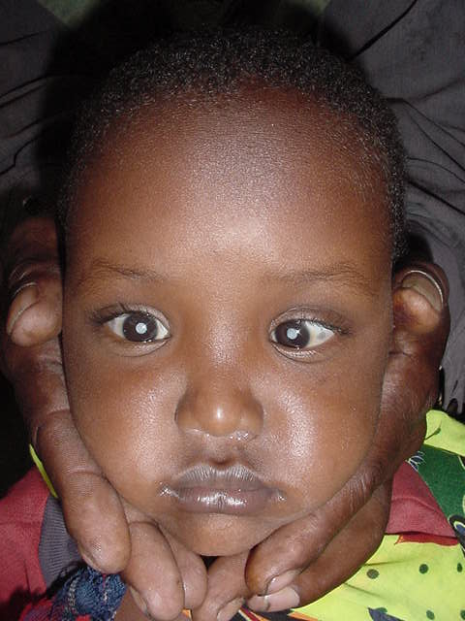
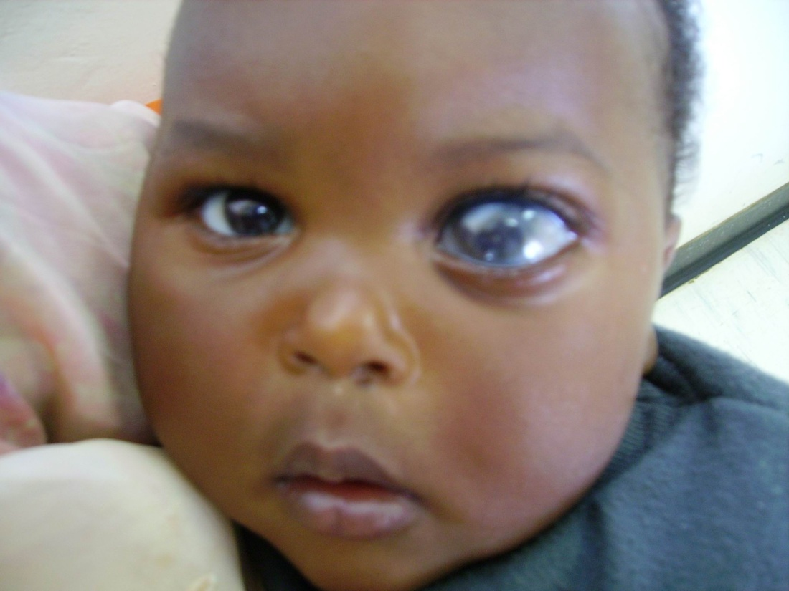
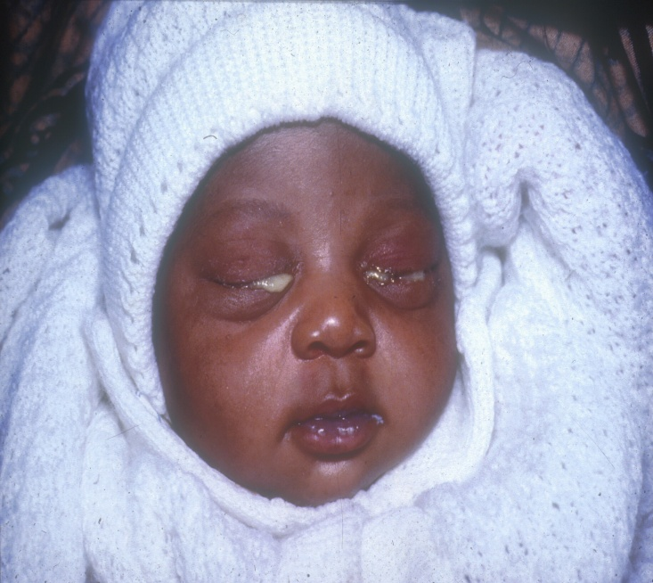
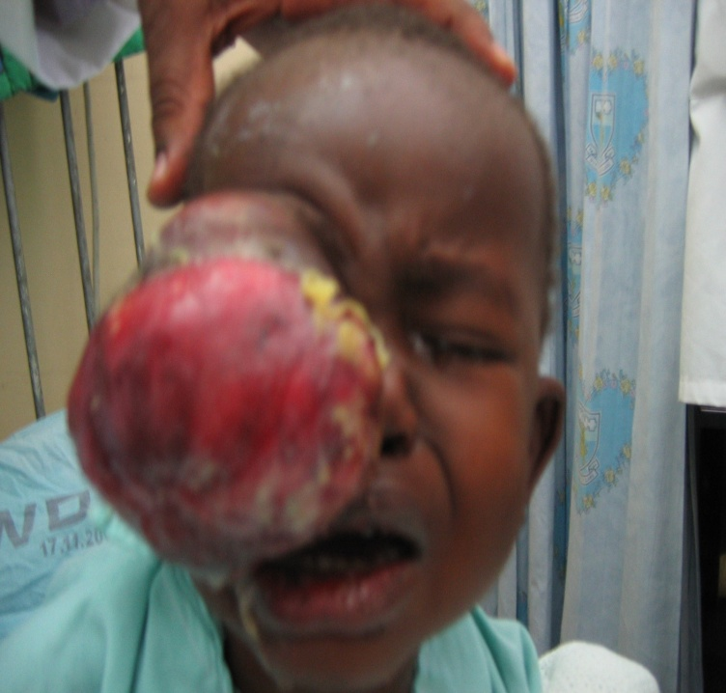
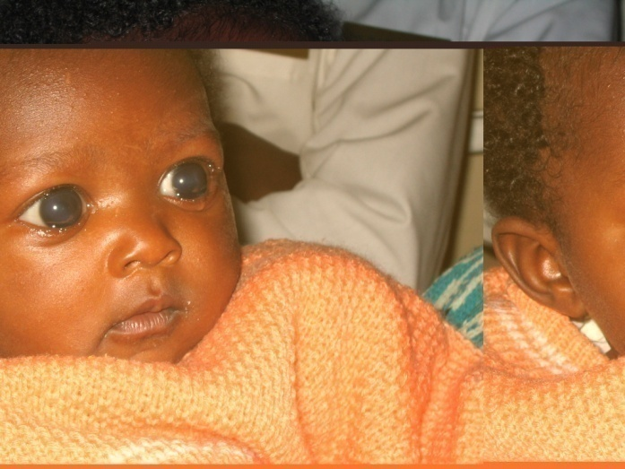
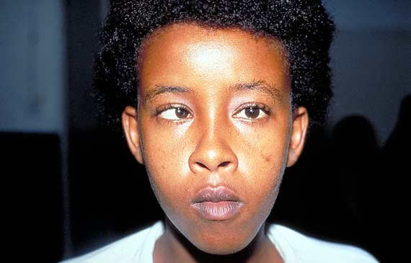

Slide 3
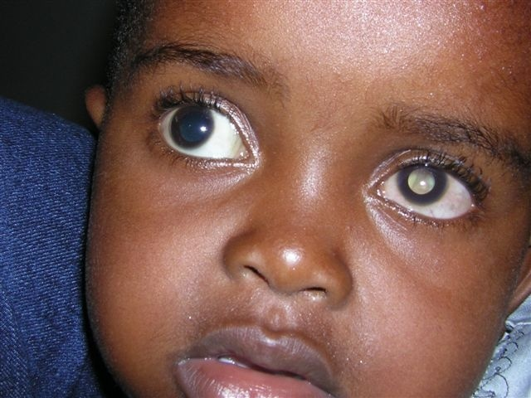
INTRODUCTION: A CHILD;
Is a precious resource of a family,
Represents the family's future and hopes
A child whose blindness could have been prevented or cured is a great disaster

Slide 4
Childhood blindness- WHO Definitions
Childhood: 0-15 YRS (WHO)
0-16 YRS (UNICEF)
Blindness: BCVA <3/60 in the better eye or central field <10º
Blindness from any cause occurring in a person aged 15 yrs or less

Slide 5
Childhood blindness
About 1.5 million children are blind worldwide( 20% live in Sub-Saharan Africa & 50% in Asia
Occurs in 5 - 10/10,000 children Globally
About 500,000 children become blind every year
One Child becomes blind every minute
Half (50%) of them die within one or two years of becoming blind

Slide 6
Childhood blindness Prevention? WHY a priority
Large number of “blind person years” (75 million blind person yrs)
Causes are many & different from those of adults
Most of the causes are avoidable (70 to 80%)
Blinding conditions are also causes of child mortality
Examination and assessment is challenging
Requires specific management expertise
Irreversible amblyopia if treatment is delayed

Slide 7
Childhood Blindness – V2020 Global Initiative
Goal:
To reduce childhood blindness from 10/10,000 Children to 4/10,000 Children by the year 2020
Key elements
-Strategies for disease control
-Human resource need & development
-Infrastructure/technology needs & development

Slide 8
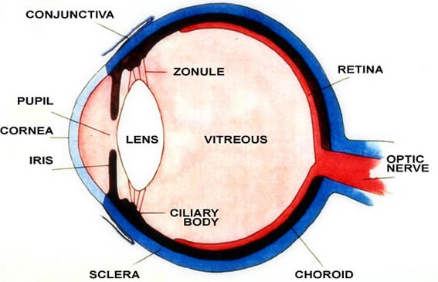
THE EYE

Slide 9
Visual Development
At birth vision is poor, but develops rapidly with optimal/undisturbed visual inputs
Blink reflex to bright light –days after birth
6/52 – mother/ baby eye contact
2-3/12 – interested with bright objects
development & maturation of visual function occurs from birth & complete by 9 years.

Slide 10
Signs of poor visual development
Wandering eye movements
Lack of response to familiar object & faces
Staring at bright lights
Forceful rubbing of eyes
Nystagmus or “shaking eyes”
Sunken eye appearance

Slide 11
Major causes of childhood blindness
Corneal blindness due to:-
a) VAD -Nutritional & Measles
b) HTEM
c) Corneal ulcers
d) Neonatal conjunctivitis

Slide 12
Causes of Childhood blindness ct
2. Congenital/paediatric glaucomas
3. Paediatric Cataracts
4. Retinoblastoma
5. Retinopathy Of Prematurity (ROP)
6. Uncorrected high Refractive Errors
7.Squints & Amblyopia
8. Cerebral visual impairment

Slide 13
1.CORNEAL SCARS –VAD why children are at risk (6 months to 6 yrs)
Vitamin A Liver stores relatively low at birth
Breast milk supplies adequate retinol for 6 months
High requirement because of growth
High rate of infection and diarrhoea after weaning
Measles infection after the age of 6 months
Totally dependant on adults

Slide 14
Clinical presentation of VAD

Slide 15
Prevention of VAD
Breast feeding
Prophylactic vitamin A every 6/12
Supplement feeding of infants with green yellow leafy vegetables & proteins
Measles immunization
avoid use of HTEM
Food fortification
Family planning

Slide 16
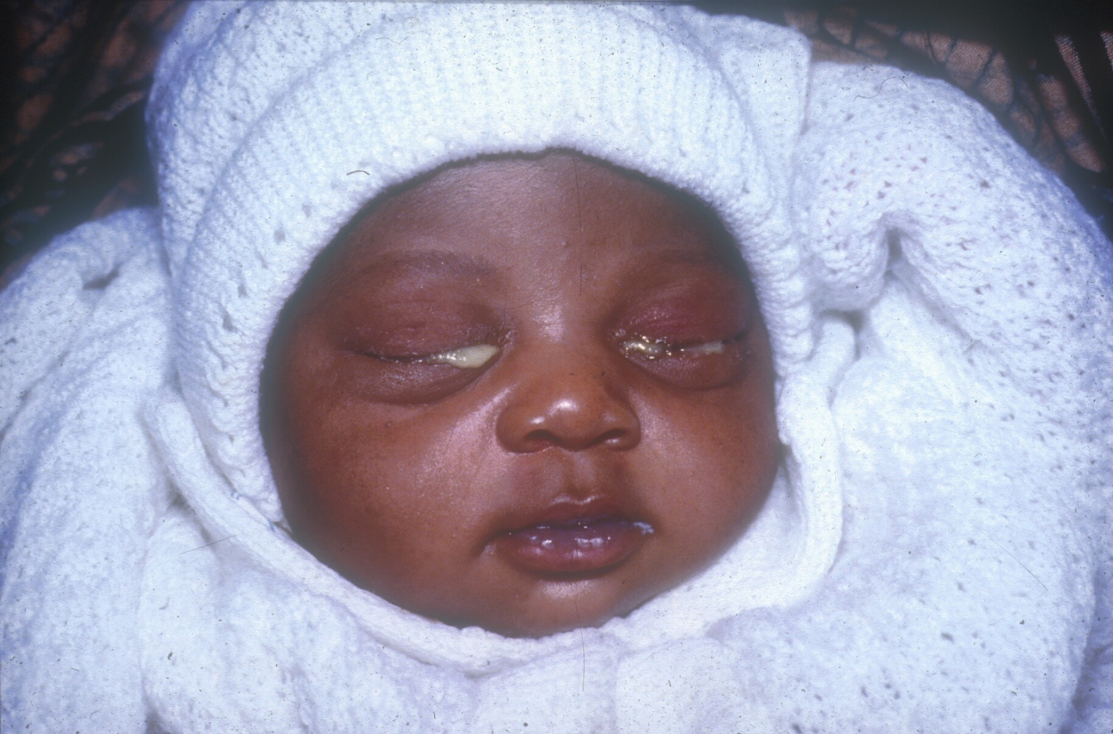
CORNEAL SCARS: 2. Neonatal conjunctivitis

Slide 17
Prevention of Neonatal Conjunctivitis
Early identification & treatment of mothers in 3rd trimester of pregnancy
Antenatal screening of high risk women
Ocular prophylaxis
Ensure aseptic delivery
Early detection, referral & appropriate treatment of newborn conjunctivitis

Slide 18
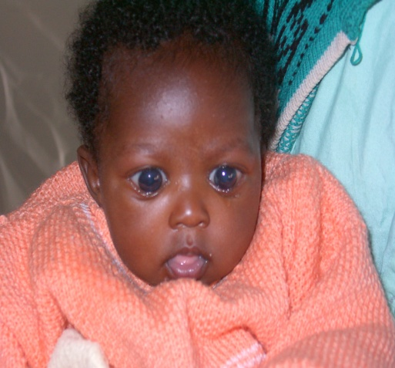
3. CONGENITAL GLAUCOMA
Childhood glaucoma can affect one or both eyes and can
-present at birth [congenital]
-develop during childhood
NB-Before age 3 yrs a child’s eye is capable of stretching if eye pressure rises BUPHTHALMOS or OX eye

Slide 19
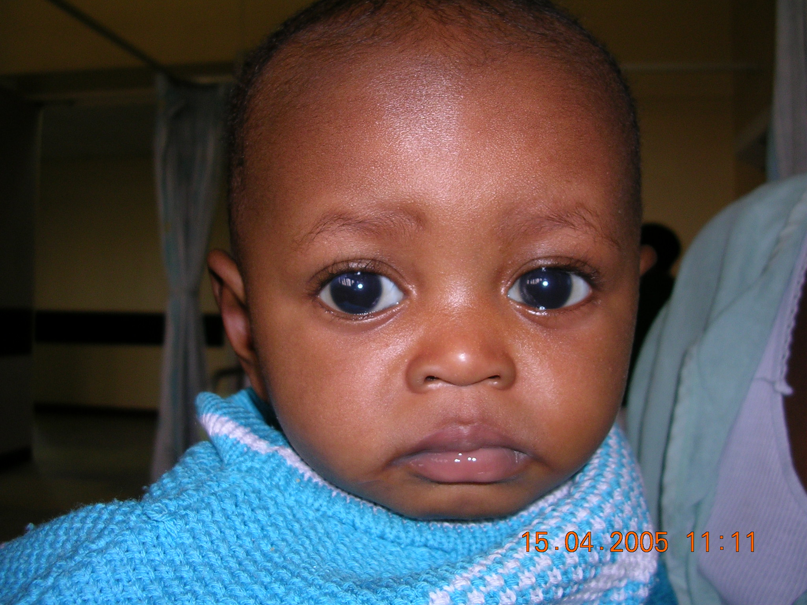

Slide 20
Symphtoms & signs
Excessive tearing
Photophobia
Blepharospasms
Clouding of cornea +/- increase in cornea & eyeball size
Red eye, poor vision in older children

Slide 21
How should we treat GLAUCOMA
Early detection & referal
Glaucoma surgery
Longterm follow-up to monitor:
Vision, IOP, Cornea size & clarity, refraction, Fundoscopy, surgical site
Visual Rehabilitation

Slide 22
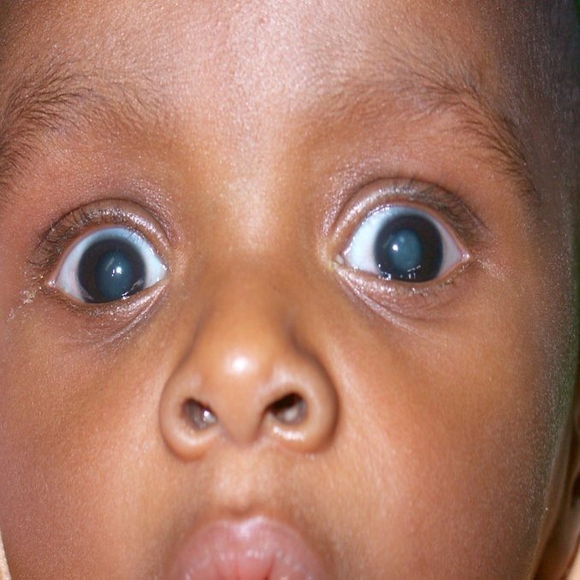
4. CONGENITAL CATARACT
Causes: -Congenital- INFECTIONS
-HEREDITARY
-METABOLIC
-50% idiopathic
-Trauma
Symptoms:
Poor vision, Can affect one or both eyes
Signs:- white pupil reflex (LEUCOKORIA)
-May have other abnormalities

Slide 23
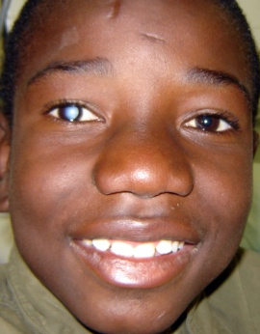
MANAGEMENT OF CONGENITAL CATARACT
Immunization --rubella
Early detection
early referral
Early Surgery
Early visual rehabilitation

Slide 24
5. RETINOBLASTOMA –cancer of the eye
Causes: may be inherited or sporadic
Can affect one or both eyes and children below 5 years
Signs and symptoms: white pupil reflex (LEUCOKORIA), poor vision, squint.
If not treated early it may grow very big and even cause death
Action: Refer IMMEDIATELY

Slide 25
RETINOBLASTOMA

Slide 26
D/DX OF LEUCOKORIA
Cataract
Retinoblastoma
Retina detachment from any cause
Persistent hypo plastic primary vitreous (PHPV)
Retinopathy of prematurity
Coloboma of the choroid
Toxocara endophthalmitis/granulomas
Endophthalmitis –intra ocular infection (bacteria, fungi)
Coats disease

Slide 27
6. Refractive errors

Slide 28
Refractive error
Definition: poor vision due to defect in focusing mechanism of the eye
which can be corrected with spectacles or contact lenses
Types: Myopia, Hypermetropia, astigmatism, presbyopia
Signs and symptoms: Poor vision, Itchy, teary eyes, headache, Unusual behaviour- “Squinting”.

Slide 29
Refractive errors
Treatment - Child will benefit from spectacles
If not treated early
-Poor performance.
- May develop “lazy eyes” -Amblyopia

Slide 30
7. SQUINTS & AMBLYOPIA

Slide 31
Causes & Mx of SQUINTS
Defn : misaligned eyes
Causes:
Sensory factors - Any form of eye disease which interferes with vision
Motor factors – Muscles & nerves
Central factors
NB: refer all children presenting with squint for further evaluation & management

Slide 32
8. CEREBRAL VISUAL IMPAIRMENT
Defn: Visual impairment involving the posterior visual pathway and can be associated with cerebral palsy
Causes; birth asphyxia, trauma, brain infections, hydrocephalus, epilepsy, etc
Prevention: good management of labour &
early ,appropriate mx of childhood infections

Slide 33
8. Retinopathy Of Prematurity
Retinopathy in preterm infants< 1500gm or born before 34 wks gestation
Child becomes blind before 6 months of age (3.5-18% blindness) from retina detachment
Severe, progressive visual impairment in others
The child remains blind the rest of their life.
Effective and safe prophylactic treatment is available (laser Px)
There is no DISEASE AT BIRTH !!

Slide 34
Prevention of ROP – Early screening of Preterm babies
Whom to screen-
Any baby you call “preterm” should be screened, irrespective of other criteria
Birth weight: < 1700 gms
Gestational age < 34-35 weeks When to Screen: “Day -- 30 strategy”
One eye examination should be definitely over before day 30 of life of the premature infant. Day 20 for very preterms (<30weeks)

Slide 35
Saving the sight of one blind child =
operating on 10 elderly people with cataract
in terms of “blind person years” saved

Slide 36
Healthy eyes
Regular eye checks,
from day one of life
Immunization
Healthy diet
Antenatal care
Face washing

Slide 37
