Slide 1
FRACTURES OF THE SHOULDER, HUMERUS & ELBOW
DR KINGORI

Slide 2
The shoulder includes the proximal humerus, the clavicle and the scapula, and their connections to each other, to the sternum (clavicle), and to the thoracic rib cage (scapula).
Together, these elements form the most mobile joint in the human body
This mobility leaves the shoulder prone to injury

Slide 4
Clavicle Fractures
-Clavicle fractures are among the most common injuries, accounting for one in 20 adult fractures.
-The injury usually is caused by a fall on the lateral shoulder or, less commonly, by a direct blow or by falling on an outstretched arm.
-Clavicle fractures usually can be diagnosed by careful inspection and palpation.
- Acute complications are uncommon, although pneumothorax, hemothorax, and injuries to the brachial plexus or subclavian vessels have been reported.

Slide 5
A routine anteroposterior view x-ray usually is the only radiograph needed to confirm the fracture.
Non- displaced fractures, however, may be difficult to detect on an anteroposterior view, particularly in children.
In such cases, a 20- degree (Zanca view) or 45-degree cephalic tilt view usually demonstrates the fracture.

Slide 6
Clavicle fractures → Allman classification
Group 1 (middle one third of the clavicle)
is the most common type of fracture .
-represents 80 percent of clavicle fracture
-treated conservatively with an arm sling for comfort, even if significant displacement is present.

Slide 7
Group 2 (lateral one third of the clavicle)
-Non- displaced fractures usually can be treated conservatively.
-Displaced fractures generally require operative treatment because they are unstable and have a high incidence of nonunion.

Slide 8
group 3 fractures (medial one third of the clavicle).
-Displaced fractures have a fairly high rate of significant intrathoracic or neurovascular injury that may require emergency surgery.
-Nondisplaced fractures without associated injuries can be treated conservatively with a sling for comfort.

Slide 9
Fractures of the humerus
Fractures of the humerus are common and may result from injury. Usually result from falls or direct trauma
However they may be pathological fractures e.g. due to osteoporosis, particularly in the elderly.

Slide 10
CLASSIFICATION
Classification of humeral fractures is difficult. One method is to classify them as:
Proximal humeral fractures.
Humeral shaft fractures.
Distal humeral fractures

Slide 11
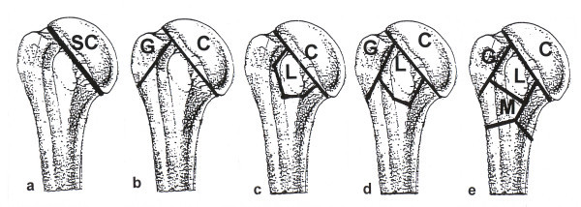
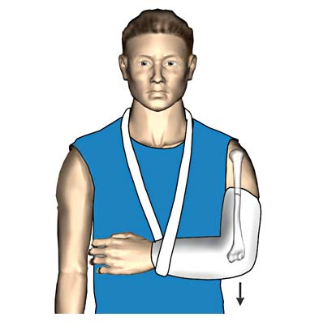
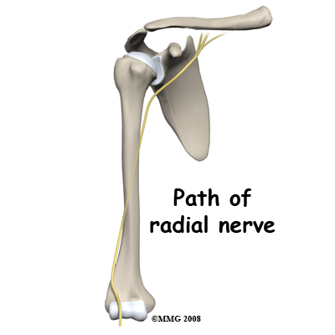

Slide 12
Proximal humeral fractures
Age group affected
Middle age/elderly are most commonly affected.
In younger people, the same injury mechanism can cause fracture with coexisting shoulder dislocation.
In younger age groups, trauma is likely to be of higher energy and resulting injury more serious.
Presentation
History of trauma.
Pain, loss of shoulder/arm function, swelling and bruising.

Slide 13
Classification
Neer classification: based on the 4 usual cleavage lines (the articular segment or head, the lesser tuberosity, the greater tuberosity and the surgical neck/shaft).
Two-part, three-part and four-part fractures can occur.
Surgical neck fractures are the most common type of proximal humeral fracture.

Slide 14
Most fractures are extra-articular and minimally displaced.
Up to 85% of proximal humeral fractures can be treated non-operatively. This involves the use of a sling or a shoulder immobiliser.
If displaced, surgery may be needed.
Surgery involves either closed reduction with percutaneous fixation, open reduction and internal fixation, or proximal humeral head replacement.

Slide 15
Humeral shaft fractures
Causes- Usually direct trauma or torsion injury to an upper limb. Occasionally, a fall on to an outstretched abducted arm.
Presentation
History of trauma.
Arm pain, swelling and deformity.
Assessment
Neurovascular examination should be performed. Particular attention should be paid to radial nerve assessment.
Investigations
AP and lateral X-rays of the humerus.
Include views of the shoulder and the elbow.

Slide 16
Location - proximal, middle, distal
Type of fracture line - transverse, oblique, spiral, comminuted, segmental.
Open or closed

Slide 17
Treatment
Most can be treated non-operatively in a
-hanging arm cast
coaptation splint (a splint from the axilla to the nape of the neck with a stirrup around the elbow)
followed by a functional arm brace after 3 weeks.

Slide 18
Mildly displaced/overlapping humeral shaft fractures may be treated by closed reduction and long arm splint from shoulder to wrist.
After any humeral closed reduction, neurovascular assessment and X-rays should be repeated.
Surgical fixation may be needed if the fracture is segmental or if there is vascular compromise. This involves open reduction and the use of plates and screws or intramedullary fixation/nailing.
Radial nerve injury, which may only be temporary, is a risk in any operative procedure.

Slide 19
Distal humerous-Most are intra-articular- ORIF
Scapular fractures
- Body-Direct blow – conservative treatment
- Glenoid surface- intra-articular- ORIF

Slide 20
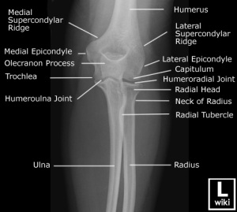
Fractures around the elbow
Injuries to the elbow are common, usually occur secondary to indirect trauma and are often accompanied by injury to shoulder or wrist joints

Slide 21
Radial head and neck fractures
These are most commonly caused by a fall on to an outstretched arm.
Radial head fracture is the more common in adults, whereas radial neck fractures occur more commonly in children
The patient presents with swelling over the lateral elbow with limited range of motion
The most reliable clinical sign is point tenderness over the radial head.

Slide 22
AP and lateral X-ray views of the elbow are usually sufficient
Complex fractures require open reduction and internal fixation.
Conservative treatment-Immobilise the elbow in a long arm POP with the elbow at 90°.
In children it Can be difficult to diagnose, as radial head ossification does not occur until age 4
Ultrasound or MRI scanning may be needed to confirm the diagnosis.

Slide 23
Olecranon fractures

Slide 24
Olecranon fractures
olecranon fractures usually follow a direct blow to the point of the elbow and are often comminuted.
The patient presents with swelling and tenderness over the olecranon and limited range of motion.
True lateral X-ray of the elbow should reveal the fracture.
displaced fractures require surgery. Conservative treatment-Immobilise the elbow in a long arm POP with the elbow at 90°.

Slide 25
Fractures of the coronoid process

Slide 26
Fractures of the coronoid process
these fractures are associated with elbow dislocation in about 40% of cases
Patients present with tenderness over the antecubital fossa and swelling about the elbow.
Lateral X-ray of the elbow should demonstrate a coronoid fracture.
Non-displaced fractures should be immobilised in a long arm posterior splint with the elbow at 90° and the forearm in full supination.
Displaced fractures or those involving >50% of process need surgery

Slide 28
Fractures of the distal humerus
Supracondylar/transcondylar - most are extension-type injuries from a fall on to an outstretched arm.
Transcondylar fractures are more common in the elderly.
Supracondylar fractures are more common in children.
The patient usually presents with elbow swelling and pain.

Slide 29
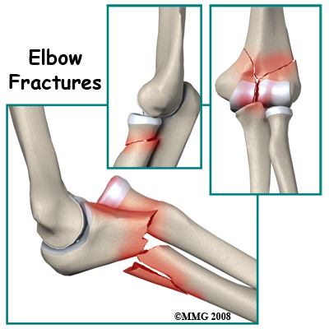

Slide 30
Investigation-AP and lateral X-rays of the elbow.
All but non-displaced or minimally displaced fractures without neural or vascular involvement should be referred for surgical repair
Immobilise the elbow in a long arm posterior splint with the elbow at 90° to the forearm in neutral rotation.
Check distal pulses after the splint has been applied and, if absent, extend the elbow to the point where pulses return

Slide 32
condylar fractures
Lateral condyle fractures are more common than medial.
Patients usually present with swelling, limited range of movement and tenderness over the injured condyle.
AP and lateral X-rays reveal a widened intercondylar distance and there may be displaced fracture fragments
Displaced fractures require surgical correction.
Undisplaced fractures can be treated with a long arm POP with the elbow at 90°.

