Slide 1
Chronic granulomatous bone infection
Bacteria
Fungus
Virus
microbes

Slide 2
CHRONIC INFLAMMATION
simultaneous destruction and inflammation plus attempt at healing.
Conditions favoring process
Persistent infection by certain microorganisms
Prolonged exposure to antigens (exogenous / endogenous)
impaired Local or general body defense
Autoimmune diseases
Tissue destruction and granuloma formation

Slide 3
following ways results in chronic inflammation
acute inflammation progression if the original stimulus persists,
repeated episodes of acute inflammation,
De novo if the causative agent produces only a mild acute response. eg tubercle

Slide 4
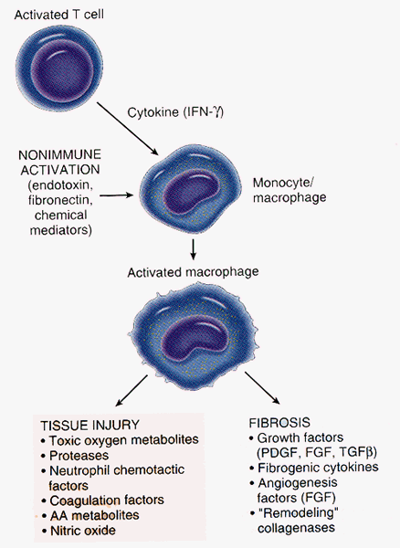
Note that the activated macrophage releases products that are similar to those released by PMN’s

Slide 6
GENERAL FEATURES OF CHRONIC INFLAMMATION
• Acute inflammation
• Demolition phase
• Healing-repair & regeneration
• Immune response
The hallmark of chronic inflammation
Presence of mononuclear inflammatory cells
evidence of healing (scarring, fibroblast proliferation, angioblast proliferation).

Slide 7
3 classes -well recognised, recent, uncertain
chronic Granulomatous infection

Slide 8
Well recognised
mycobacteria: tubercle, leprosis,MOTT
Bacteria: brucella,norcardia,actinomyce
Spirochetes: T pallidum
Fungi: madura mycetome
Parasites: hydatid

Slide 9
Others microbes
Recent recongnised
actinomyce
Suspected
CMV

Slide 10
Histo-pathogenesis
Granulomatous lesion; microbe centrally located
Caseating or non-caseating
Cause – persistent non degradable material
-due to inefficient phagocytosis,
- inheritable NADPH
Cellular immunity orchestrates granuloma formation

Slide 11
Tissue involved
Bone marrow-long bones, vertebrae,etc
Joints- synovium , discs
Tendons and synovium
Prosthetic joints eg knee joint

Slide 12
Innoculation routes
Haematogenous
Contiguous from infected node
Trauma- accidents, surgical, thorn pricks etc
Chronic ulcerations extending to the bones
Vertical transmission through placenta

Slide 13
Chronic pathology developed
Prolonged disease process, swelling and bone destruction,
Sinus formation
Joint deformities and instability
Pathological fractures
Spine column deformities
Spinal cord and peripheral nerves compression

Slide 14
Clinical features
Chronic bone and joint pain
Deformities –localized or gross( LLD, Kyphoscoliosis
Joint ankylosis and sublaxation/dislocation
Sensorimotor deficits
Chronic sinus
Psychological trauma/ social seggregation

Slide 15
Diferrential diagnosis
Tumors
Chronic pyogenic osteomyelitis
Metabolic conditions egg gout
Foreign bodies

Slide 16
diagnosis

Slide 17
investigations
Imaging- x-ray, CT scan, MRI
Microscopy- special staining
Hiostopathology- granulomatous lesion
Culture
Serology eg brucella, VDRL
PCR amplification
Gas-phase chromatography
Cytochrome C reductions assay for NADH deficiecy

Slide 18
Specialsed imaging

Slide 19
antimicrobial treatment
Cure rate is poor
Treatment is prolonged( months to years)
Multi-agent may be required eg tuberculosis
Optimum duration not defined

Slide 20
Surgical treatment
Debridement and drainage
Excision athroplasty
Arthrodesis
Staged arthroplasty
Amputation of limbs/excision of dispensable bone
Spinal cord and nerves decompression
Spinal column reconstruction and stabilization

Slide 21
Specific infections
overviews

Slide 22
Bone tuberculosis
Almost always haematogenous
Commonly affect children
Extremities long bones and vertebra frequent sites
Often spread to contiguous synovial joints & intervetebra discs
Sequestration and formation of involucrum rare

Slide 23
Skeleton distribution

Slide 24
Kyphotic deformity

Slide 25
Humerous pathological fracture

Slide 26
Tb hand

Slide 27
Septic interphalageal joint

Slide 28
Nb 5th digit

Slide 29
Tendon tuberculosis

Slide 30
Synovial joint

Slide 31
Hip tuberculosis

Slide 32
Tb spine presentation
MUSCLE SPASM
KHPHUS – GIBBOUS
TENDERNESS
STIFFNESS
PARA VERTEBRAL ABSCESS
NEUROLOGICAL – WEAKNESS
PARAPLEGIA

Slide 33
Xray features of tb spine
DISC NOT INVOLVED PRIMARILY
NARROWING OF DISC SPACE
BONE DESTRUCTION
USUALLY TWO ADJACENT VERTEBRAE
MAY SHOW SKIP LESIONS
PARA VERTEBRAL ABSCESS
KHYPUS
CT/MYELOGRAM/MRI IN PARAPLEGIA

Slide 34
Potts disease surgical treatment

Slide 35
brucelosis
MILK AND MILK PRODUCTS
BACK PAIN AND STIFFNESS
MUSCLE SPASM
FEVER – MILD
SACRO-ILIAC JOINT
LESS DESTRUCTIVE OF TB
BRUCELLA TITRE
ANTIBIOTICS
e.g. SEPTRIN - OXYTETRACYCLINE

Slide 36
Fungal infection
Rare
Innoculation ussally contingous
Haematogenous occasional
Common organism: coccidioidomycosis , actinomycosis, blastomycosis, cryptococcosis, and sporotrichosis

Slide 37
Fungal infection
CHRONIC – VERY LOW GRADE
FEET – FARMERS – THORNS
SLOW DESTRUCTION
SINUSES – GRANULES
SECONDARY BACTERIAL INFECTION
RESISTANT TO CHEMOTHERAPY
NEEDS SURGICAL DEBRIDEMENT
IF ADVANCED MAY NEED AMPUTATION

Slide 38
Madura foot

Slide 39
x ray

Slide 40
Ct scan of foot fungal infection

Slide 41
Pelvic fungal infection

Slide 42
Syphilis bone infection
Congenital or acquired
Usually haematogenous
Acquired syphilis- involves the long tubular bones, the skull, and the vertebrae
Bone lesion – osteochondritis ,and periostitis/saber shin
Silver stain demonstrates the spirochetes

Slide 43
syphylis
SPIROCHETE
TREPONEMA PALLIDUM
CONGENITAL SYPHILIS – COMMONEST
CHRONIC OSTEOCHONDRITIS
PERIOSTEITIS
OSTEITIS
TIBIA LESABRE TIBIA

Slide 44
Hydatid disease
50% occurs in Spine
scoleces are localized in the bone.
Cysts within the bone may remain asymptomatic for years.
Osseous tissue limits the expansion of hydatid cyst.
Cysts spread slowly in medullary cavity eroding the bony trabeculae.
surgical excision and protection/albendazole

Slide 45
Parasitic bone infestation

Slide 46
unresearchable

