Slide 1
ANKLE DISORDERS
BY: DR. SITATI
DATE: 31st/10/2016

Slide 2
OUTLINE
ANATOMY AND RADIOGRAPHY
EVALUATION OF ANKLE COMPLAINTS
OTTAWA ANKLE RULES
FRACTURES
SPRAIN
INSTABILITY
IMPINGEMENT
ARTHRITIS

Slide 3
ANATOMY
A modified synovial hinge joint
Nerve supply
Blood supply

Slide 4
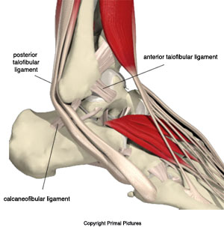
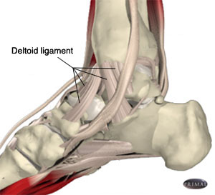
Lateral Ankle Ligaments
Medial Ankle Ligaments
CFL = Calcaneofibular ligament
PTFL = Posterior talofibular ligament
ATFL = Anterior talofibular ligament
Deltoid Ligament
Notes:
CFL = Calcaneofibular ligament
PTFL = Posterior talofibular ligament
ATFL = Anterior talofibular ligament
Deltoid ligament covers the medial ankle and is comprised of:
posterior tibiotalar ligament
tibiocalcaneal ligament
tibionavicular ligament
anterior tibiotalar ligament
Peroneus Longus and Brevis Tendons run over the PTFL
https://www.northcoastfootcare.com/footcare-info/foot-anatomy.html

Slide 5
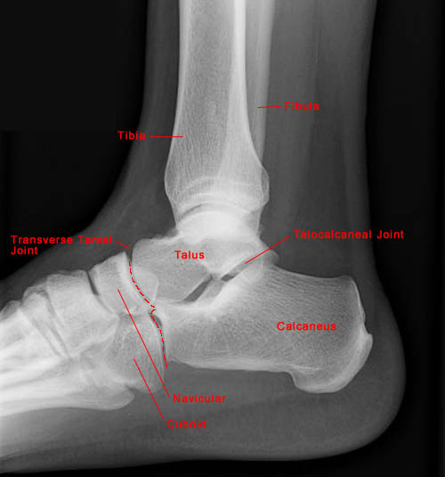
LATERAL VIEW

Slide 6
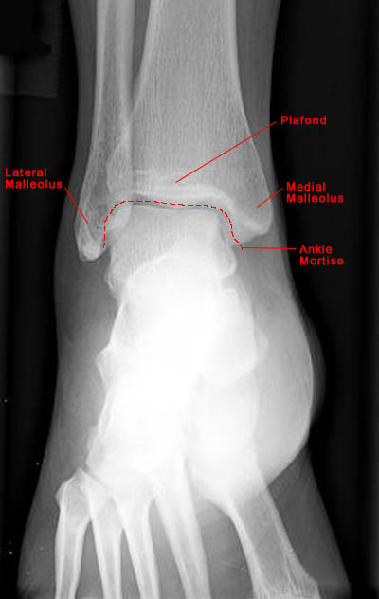
AP VIEW

Slide 7
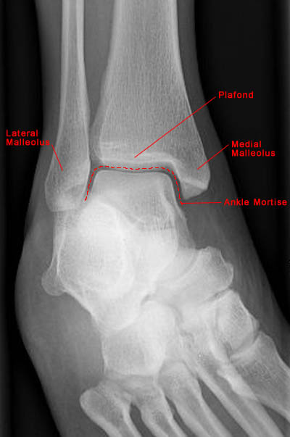
MORTISE VIEW

Slide 8
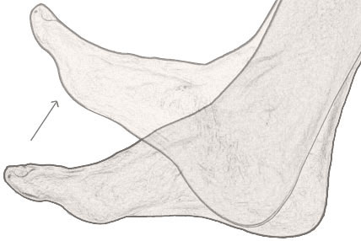
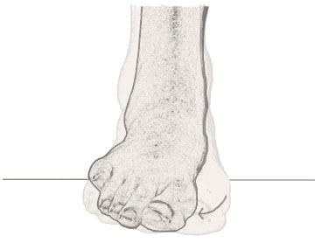
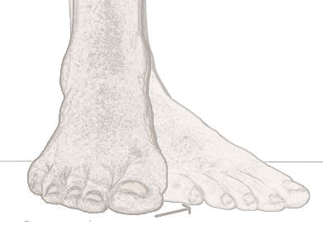
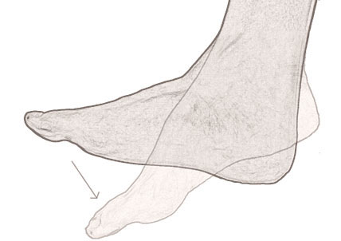
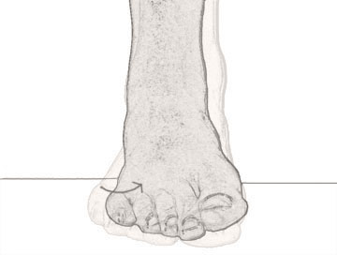
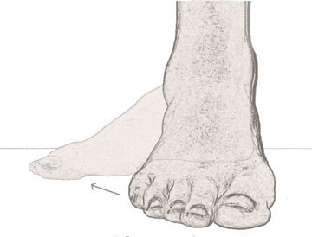
ANKLE MOVEMENTS
Dorsi-flexion
Eversion
Adduction
Plantar-flexion
Inversion
Abduction

Slide 9
EVALUATION OF ANKLE COMPLAINTS
History
  Ask about pain, swelling, mechanism of injury, effect on standing/walking, prior injury and Rx.
Physical examination (LOOK, FEEL, MOVE)
  Neurovascular status examination
    Pulses: Dorsalis pedis
  Special tests:
    Anterior drawers test (for ankle)
    Talar tilt
    Squeeze test.

Slide 10
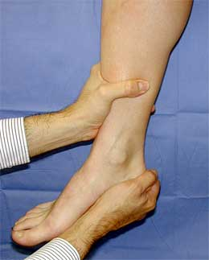
ANTERIOR DRAWER TEST
(ATFL → ANTERIOR TALO-FIBULAR LIGAMENT)

Slide 11
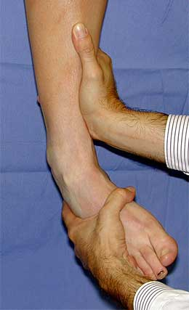
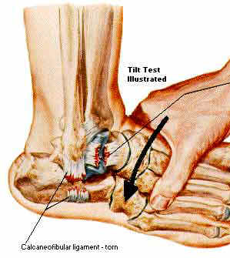
TALAR TILT - ATFL/CFL

Slide 12
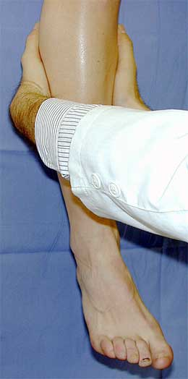
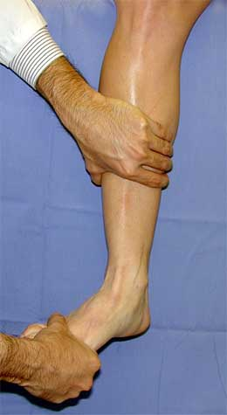
SYNDEMOSIS INJURY
EXTERNAL ROTATION TEST
SQUEEZE TEST

Slide 13
DO ANKLE SPRAINS NEED X-RAYS?
OTTAWA ANKLE RULES
If any of the 5 positive, get x-rays:
  Inability to bear weight initially and in the ER later on.
  TTP (Tenderness To Palpation) over posterior medial malleolus
  TTP over posterior lateral malleolus
  TTP over 5th Metatarsal base
  TTP over Navicular bone (mid foot area)

Slide 14
ANKLE CONDITIONS
FRACTURES
SPRAIN
INSTABILITY
IMPINGEMENT
OSTEOCHONDRITIS DISSECANS OF TALUS
ARTHRITIS

Slide 15
ANKLE FRACTURES
DANIS-WEBER CLASSIFICATION
[LEVEL OF THE FIBULAR FRACTURE IN RELATIONSHIP TO THE SYNDESMOSIS (A,B,C)]

Slide 16
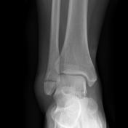
TYPE A (BELOW THE LEVEL OF THE SYNDESMOSIS)

Slide 17
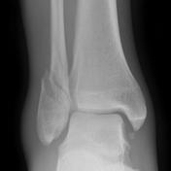
TYPE B (AT THE LEVEL OF THE SYNDESMOSIS)

Slide 18
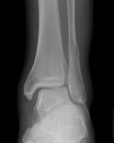
TYPE C (ABOVE THE LEVEL OF THE SYNDESMOSIS)

Slide 19
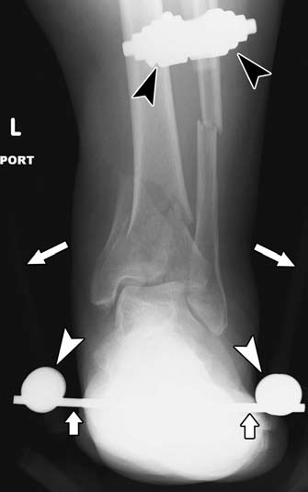
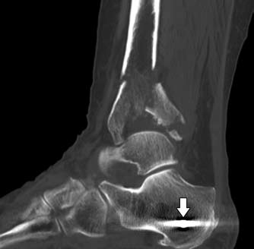
PILON FRACTURE
TRAUMA!!

Slide 20
CONT.
Fractures of the tibial pilon are injuries than involve the ceiling or top of the ankle joint. These are distinguished from “ankle fractures” which involve the sides or malleoli at the ankle joint. Tibial pilon fractures are usually the result of high energy trauma. Typical mechanisms of injury are falls from height (for example, falls from a ladder, roof, or building), motor vehicle crashes, or motorcycle crashes. Sometimes they occur from other activities such as snow skiing.
Pilon fractures refer to any tibial fracture that involves the distal articular plafond and are typically the result of an axial loading force

Slide 21
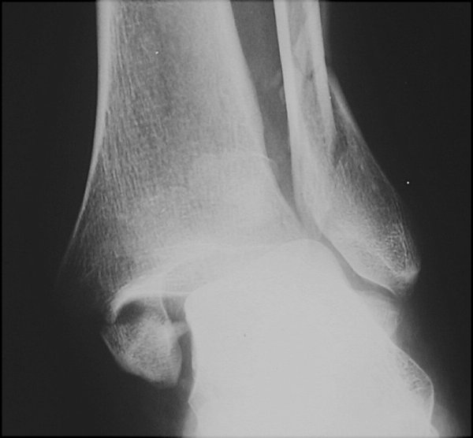
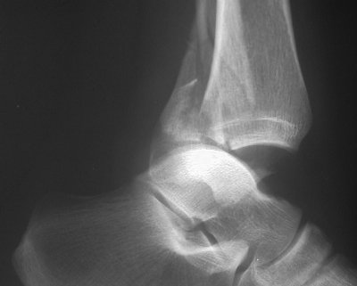
TRIMALLEOLAR FRACTURE
Can be caused by talar eversion and posterior displacement
Also known as a Henderson fracture

Slide 22
TREATMENT
Undisplaced fractures: Non weight bearing below knee backslab .
Displaced fractures: reduction ASAP.
Indications for ORlF:
  all fracture-dislocations
  all type C fractures
  trimalleolar (lateral, medial, posterior) fractures
  failure to achieve or maintain closed reduction

Slide 23
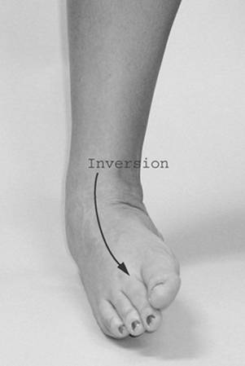
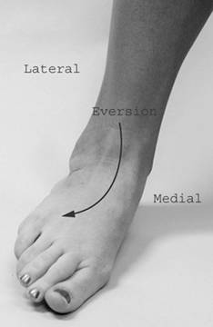
ANKLE SPRAIN
  Single most common injury in athletics caused by sudden inversion or eversion moments

Slide 24
GRADES OF SPRAINS
Signs of Injury
  Grade 1
    Mild pain and disability; weight bearing is minimally impaired; point tenderness over ligaments and no laxity
  Grade 2
    Feel or hear pop or snap; moderate pain w/ difficulty bearing weight; tenderness and edema
    Positive talar tilt and anterior drawer tests
    Possible tearing of ligaments
  Grade 3
    Severe pain, swelling, hemarthrosis, discoloration
    Unable to bear weight
    Positive talar tilt and anterior drawer
    Instability due to complete ligamentous rupture

Slide 25
TREATMENT (R.I.C.E)
Rest
Ice
Compression
Elevation
Begin weight bearing as soon as tolerated
Return to participation should be gradual and dictated by healing process

Slide 26
ANKLE INSTABILITY
Repeated acute inversion injuries/laxity
Presentation with pain and instability
Diagnosis: tenderness, +ve anterior drawers
Imaging: stress X-rays, MRI
Treatment:
  Conservative → physiotherapy, splints
    Avoid stairs
    NSAIDs
  Surgical → primary repair/reconstructive procedures

Slide 27
ANKLE IMPINGEMENT
Repeated sporting dorsiflexion injuries
Presentation with anterior ankle pain
Diagnosis: clinical anterior tenderness and ± anterior osteophytes on X-rays
Treatment
  Conservative: activity modification/NSAIDs
  Surgical: open/arthroscopic decompression

Slide 28
ANKLE ARTHRITIS
Post-traumatic: associated with displaced intra-articular fractures.
Inflammatory: Rheumatoid Arthritis
Degenerative: relatively uncommon; associated with old age.
Presentation with pain, swelling, stiffness, limited mobility, limping.

Slide 29
ANKLE ARTHRITIS
Diagnosis: clinical swelling, tenderness, ↓ROM
Imaging: X-rays, bone scan to assess surrounding joints
Treatment
  Conservative: NSAIDs, walking stick, weight reduction and activity modification.
  Surgical: ankle arthrodesis; ankle replacement

Slide 30
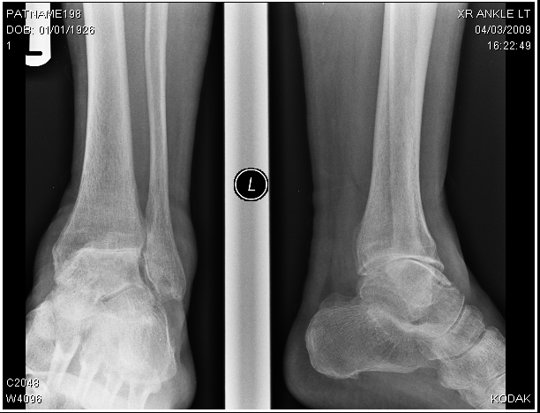
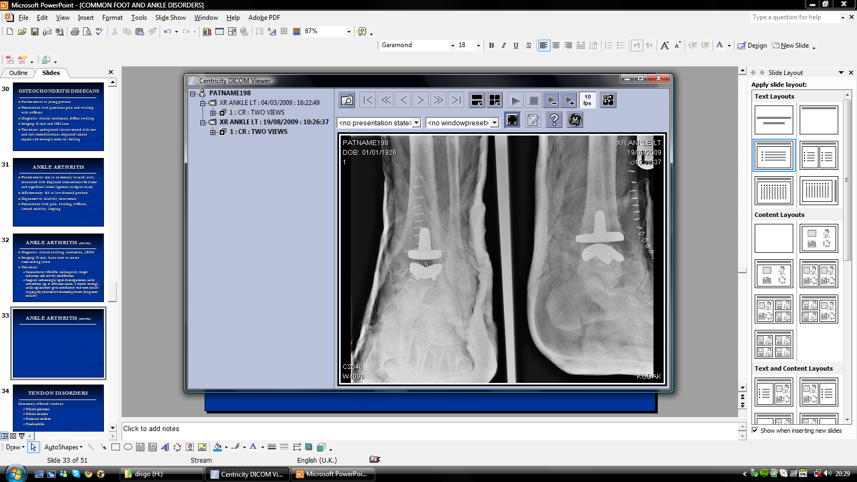
ANKLE ARTHRITIS

Slide 31
THE END

