Slide 1
Lower Extremity Trauma
Femur Fractures
Patella Fractures
Knee Dislocations
Tibia Fractures
Ankle Fractures

Slide 2
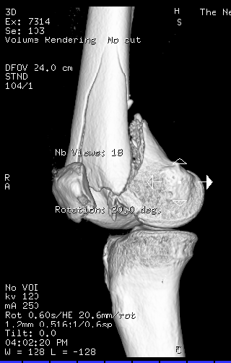
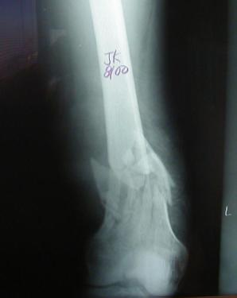
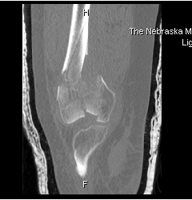
Distal Femur Fractures
Distal Metaphyseal Fractures
Look for intra-articular involvement
Plain films
CT

Slide 3
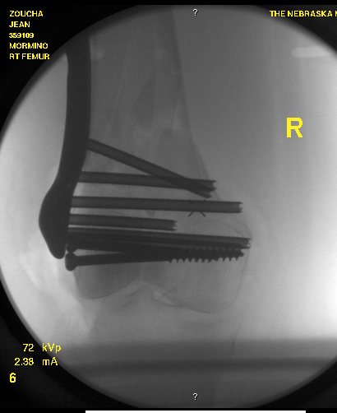
Distal Femur Fractures
Treatment:
  Retrograde IM Nail
  ORIF open vs. MIPO
  Above depends on fracture type, bone quality, and fracture location

Slide 4
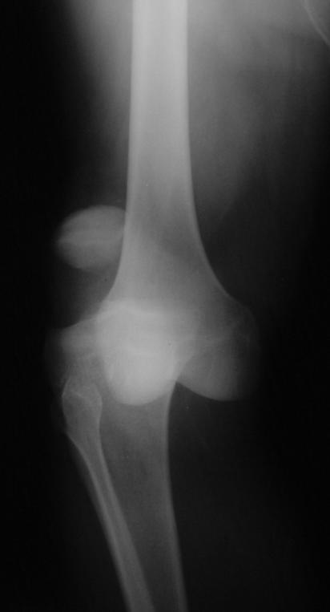
Knee Dislocations
High association of injuries
  Ligamentous Injury
    ACL, PCL, Posterolateral Corner
    LCL, MCL
  Vascular Injury
    Intimal tear vs. Disruption
    Obtain ABI’s → (+) → Arteriogram
    Vascular surgery consult with repair within 6hrs
  Peroneal >> Tibial N. injury

Slide 5
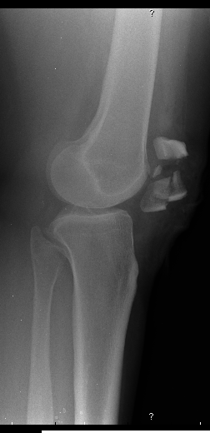
Patella Fractures
History
  MVA, fall onto knee, eccentric loading
Physical Exam
  Ability to perform straight leg raise against gravity (ie, extensor mechanism still intact?)
  Pain, swelling, contusions, lacerations and/or abrasions at the site of injury
  Palpable defect

Slide 6
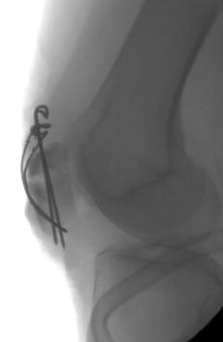
Patella Fractures
Radiographs
  AP/Lateral/Skyline views
Treatment
  ORIF if ext mechanism is incompetent
  Non-operative treatment with brace if ext mechanism remains intact

Slide 7
Tibia Fractures
Proximal Tibia Fractures (Tibial Plateau)
Tibial Shaft Fractures
Distal Tibia Fractures (Tibial Pilon/Plafond)

Slide 8
Tibial Plateau Fractures
MVA, fall from height, sporting injuries
Mechanism and energy of injury plays a major role in determining orthopedic care
Examine soft tissues, neurologic exam (peroneal N.), vascular exam (esp with medial plateau injuries)
Be aware for compartment syndrome
Check for knee ligamentous instability

Slide 9
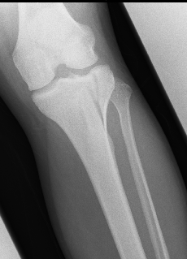
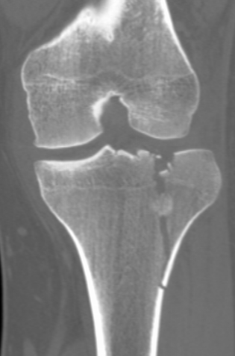
Tibial Plateau Fractures
Xrays: AP/Lateral +/- traction films
CT scan (after ex-fix if appropriate)

Slide 10
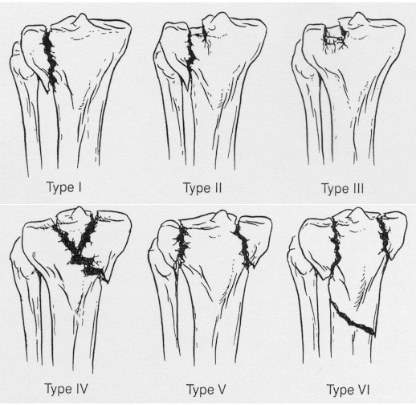
Schatzker Classification of Plateau Fxs
Lower Energy
Higher Energy

Slide 11
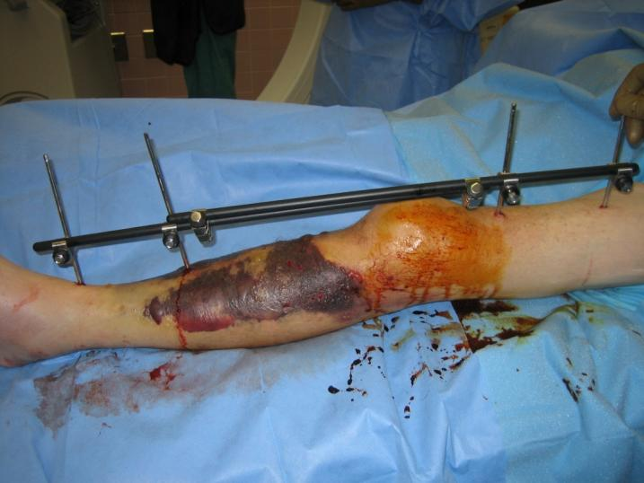
Tibial Plateau Fractures
Treatment
  Spanning External Fixator may be appropriate for temporary stabilization and to allow for resolution of soft tissue injuries
Insert blister
Pics of ex-fix here

Slide 12
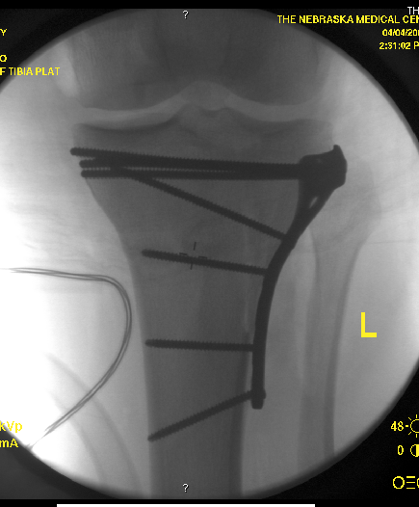
Tibial Plateau Fractures
Treatment
  Definitive ORIF for patients with varus/valgus instability, >5mm articular stepoff
  Non-operative in non-displaced stable fractures or patients with poor surgical risks

Slide 13
Tibial Shaft Fractures
Mechanism of Injury
  Can occur in lower energy, torsion type injury (e.g.,soccer )
  More common with higher energy direct force (e.g., car bumper)
  Open fractures of the tibia are more common than in any other long bone

Slide 14
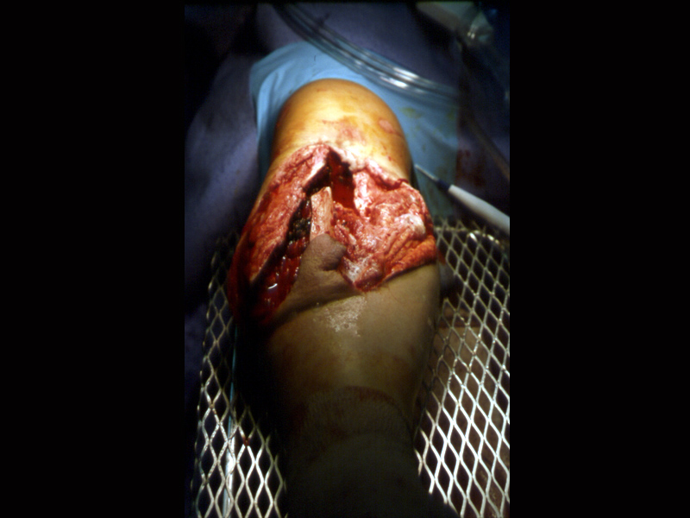
Tibial Shaft Fractures
Open Tibia Fx
Priorities
  ABC’S
  Associated Injuries
  Tetanus
  Antibiotics
  Fixation

Slide 15
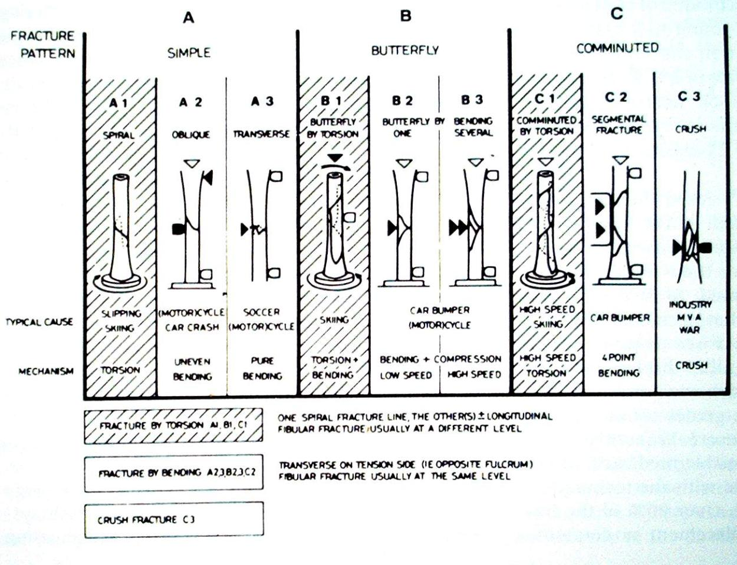
Johner and Wruh’s Classification

Slide 16
Tibial Shaft Fractures
Gustilo and Anderson Classification of Open Fx
  Grade 1
    <1cm, minimal muscle contusion, usually inside out mechanism
  Grade 2
    1-10cm, extensive soft tissue damage
  Grade 3
    3a: >10cm, adequate bone coverage
    3b: >10cm, periosteal stripping requiring flap advancement or free flap
    3c: vascular injury requiring repair

Slide 17
Tibial Shaft Fractures
Tscherne Classification of Soft Tissue Injury
  Grade 0- negligible soft tissue injury
  Grade 1- superficial abrasion or contusion
  Grade 2- deep contusion from direct trauma
  Grade 3- Extensive contusion and crush injury with possible severe muscle injury

Slide 18
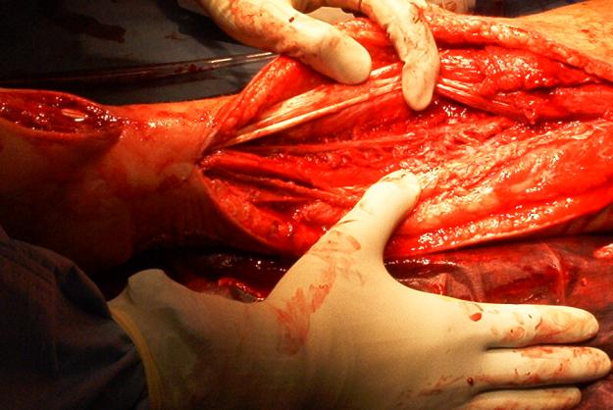
Tibial Shaft Fractures
Management of Open Fx Soft Tissues
  ER: initial evaluation → wound covered with sterile dressing and leg splinted, tetanus prophylaxis and appropriate antibiotics
  OR: Thorough I&D undertaken within 6 hours with serial debridements as warranted followed by definitive soft tissue cover

Slide 19
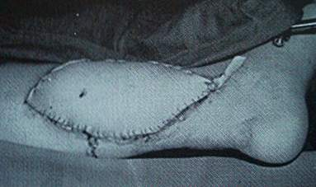
Tibial Shaft Fractures
Definitive Soft Tissue Coverage
  Proximal third tibia fractures can be covered with gastrocnemius rotation flap
  Middle third tibia fractures can be covered with soleus rotation flap
  Distal third fractures usually require free flap for coverage

Slide 20
Tibial Shaft Fractures
Treatment Options
  IM Nail
  ORIF with Plates
  External Fixation
  Cast or Cast-Brace

Slide 21
Tibial Shaft Fractures
Advantages of IM nailing
  Lower non-union rate
  Smaller incisions
  Earlier weightbearing and function
  Single surgery

Slide 22
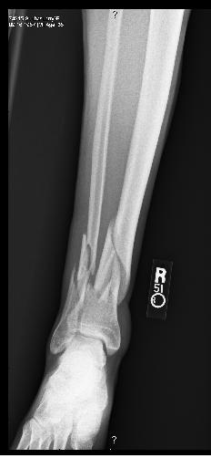
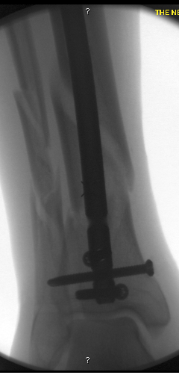
Tibial Shaft Fractures
IM nailing of distal and proximal fx
  Can be done but requires additional planning, special nails, and advanced techniques

Slide 23
Tibial Pilon Fractures
Fractures involving distal tibia metaphysis and into the ankle joint
Soft tissue management is key!
Often occurs from fall from height or high energy injuries in MVA
“Excellent” results are rare, “Fair to Good” is the norm outcome
Multiple potential complications

Slide 24
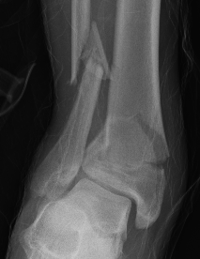
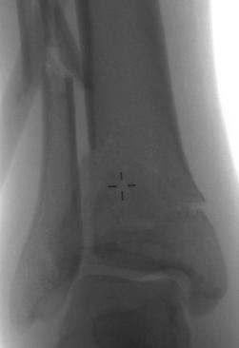
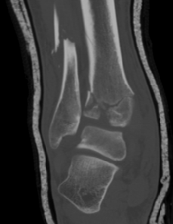
Tibial Pilon Fractures
Initial Evaluation
  Plain films, CT scan
  Spanning External Fixator
  Delayed Definitive Care to protect soft tissues and allow for soft tissue swelling to resolve

Slide 25
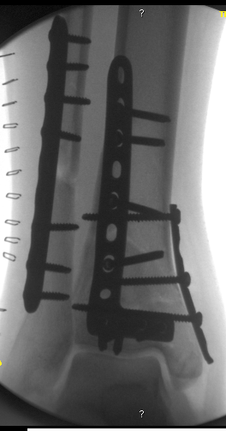
Tibial Pilon Fractures
Treatment Goals
  Restore Articular Surface
  Minimize Soft Tissue Injury
  Establish Length
  Avoid Varus Collapse
Treatment Options
  IM nail with limited ORIF
  ORIF
  External Fixator

Slide 26
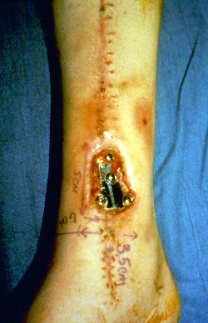
Tibial Pilon Fractures
Complications
  Mal or Non-union (Varus)
  Soft Tissue Complications
  Infection
  Potential Amputation
  Osteoarthritis esp intraarticular

Slide 27
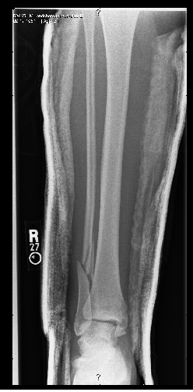
Ankle Fractures
Most common weight-bearing skeletal injury
Incidence of ankle fractures has doubled since the 1960’s
Highest incidence in elderly women
  Unimalleolar 68%
  Bimalleolar 25%
  Trimalleolar 7%
  Open 2%

Slide 28
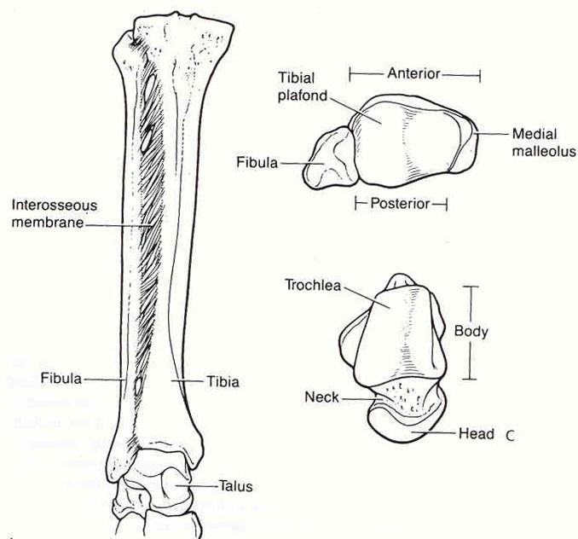
Osseous Anatomy

Slide 29
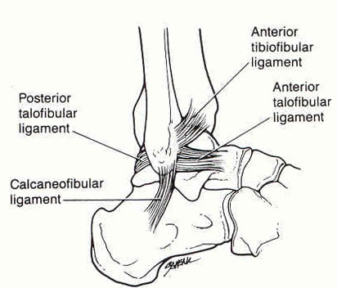
Lateral Ligamentous Anatomy

Slide 30
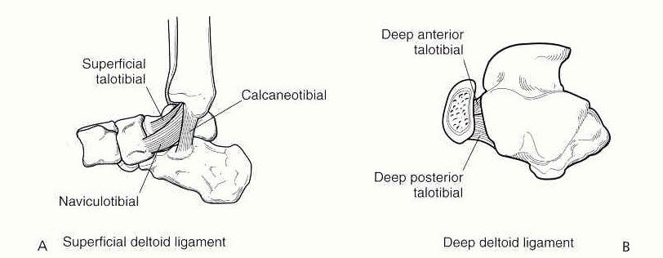
Medial Ligamentous Anatomy

Slide 31
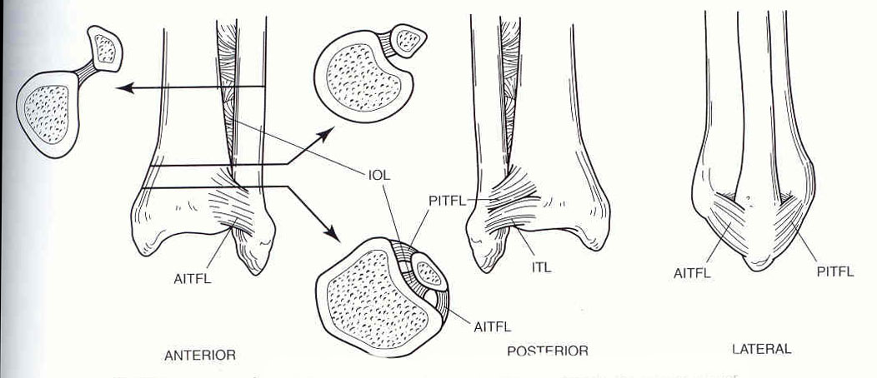
Syndesmosis Anatomy

Slide 32
Ankle Fractures
History
  Mechanism of injury
  Time elapsed since the injury
  Soft-tissue injury
  Has the patient ambulated on the ankle?
  Patient’s age / bone quality
  Associated injuries
  Comorbidities (DM, smoking)

Slide 33
Ankle Fractures
Physical Exam
  Neurovascular exam
  Note obvious deformities
  Pain over the medial or lateral malleoli
  Palpation of ligaments about the ankle
  Palpation of proximal fibula, lateral process of talus, base of 5th MT
  Examine the hindfoot and forefoot

Slide 34
Ankle Fractures
Radiographic Studies
  AP, Lateral, Mortise of Ankle (Weight Bearing if possible)
  AP, Lateral of Knee (Maissaneve injury)
  AP, Lateral, Oblique of Foot (if painful)

Slide 35
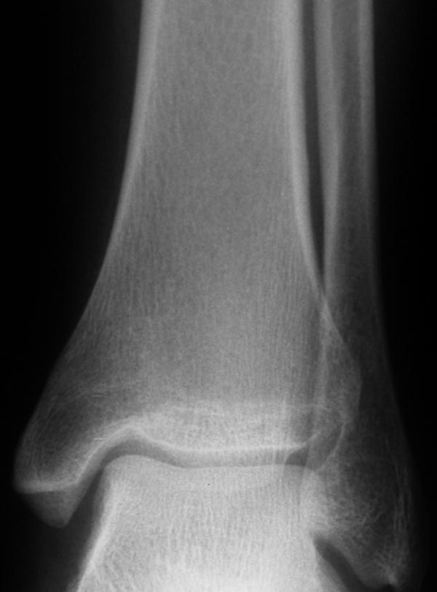
Ankle Fractures
AP Ankle
  Tibiofibular overlap
    <10mm is abnormal and implies syndesmotic injury
  Tibiofibular clear space
    >5mm is abnormal - implies syndesmotic injury
  Talar tilt
    >2mm is considered abnormal

Slide 36
Ankle Fractures
Ankle Mortise View
  Foot is internally rotated and AP projection is performed
  Abnormal findings:
    Medial joint space widening
    Talocural angle <8 or >15 degrees (compare to normal side)
    Tibia/fibula overlap <1mm

Slide 37
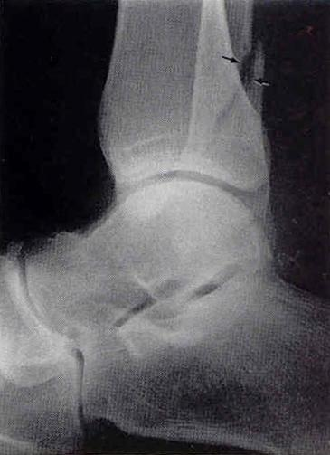
Ankle Fractures
Lateral View
  Posterior malleolar fractures
  Anterior/posterior subluxation of the talus under the tibia
  Displacement/Shortening of distal fibula
  Associated injuries

Slide 38
Ankle Fractures
Classification Systems (Lauge-Hansen)
  Based on cadaveric study
  First word refers to position of foot at time of injury
  Second word refers to force applied to foot relative to tibia at time of injury

Slide 39
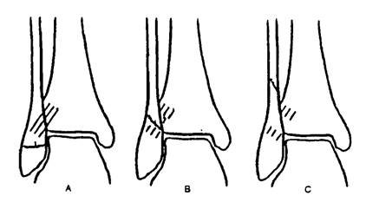
Ankle Fractures
Classification Systems (Weber-Danis)
  A: Fibula Fracture distal to mortise
  B: Fibula Fracture at the level of the mortise
  C: Fibula Fracture proximal to mortise

Slide 40
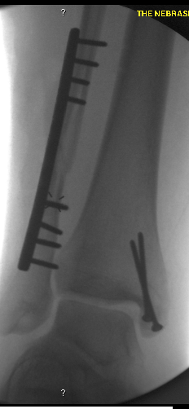
Ankle Fractures
ORIF:
  Fibula
    Lag Screw if possible + Plate
    Confirm length/rotation
  Medial Malleolus
    Open reduce
    4-0 cancellous screws vs. tension band
  Posterior Malleolus
    Fix if >30% of articular surface
  Syndesmosis
    Stress after fixation
    Fix with 3 or 4 cortex screws

