Slide 1
PRINCIPLES OF FRACTURE MANAGEMENT
BY: DR. BWANA OMBACHI
LECTURER, CONSULTANT SPINE AND ORTHOPAEDIC SURGEON
UNIVERSITY OF NAIROBI

Slide 2
INTRODUCTION TO FRACTURES
A fracture is a complete or incomplete break or crack in the continuity of a bone
Classification by quality of bone in relation to load:
Traumatic fractures (#): secondary to application of excessive force to normal bone wither directly or indirectly
Fatigue/ stress fractures: secondary to chronic repetitive forces none of which would be enough to break the bone on their own e.g. March fracture of the 2nd & 3rd metatarsal heads
Pathological fractures: produced when strength of bone is reduced by disease
Partial/ Green – stick fractures: because bones in children esp. < 10 years are very flexible

Slide 3
OPEN/ COMPOUND & CLOSED FRACTURES
Open # can communicate with the outside in 3 ways:
  Trauma directly damaging skin & breaks bone: outside – in injury
  Bone breaks & pierces through skin: inside – out injury
  Injury to skin which becomes necrotic & sloughs off exposing bone

Slide 4
GUSTILO & ANDERSONS CLASSIFICATION
Type 1 #: Low energy injury; Wound <1cm in length often from an inside – out injury
Type 2 #: More energy adsorption; Wound > 1cm
Type 3 #: High energy injury (high – velocity gun shots, motorcycle accidents etc.); Extensive wounds >10cm with significant # fragment comminution, soft tissue injury (STI) & periosteal stripping.
  Type 3A: don’t require major reconstructive surgery to provide skin coverage
  Type 3 B: require reconstructive procedures due to soft tissue defects
  Type 3C: involve vascular compromise and require reconstruction.

Slide 5
SUMMARY OF PRINCIPLES OF MANAGEMENT
EARLY FRACTURE CARE AND RESUSCITATION
REDUCTION
IMMOBILIZATION
REHABILITATION

Slide 6
CONT.
The three fundamental principles of fracture treatment are:
  Reduction
  Immobilization and
  Preservation of function
Management can be:
  Early
  Definitive

Slide 7
GOAL OF FRACTURE MANAGEMENT
The goal of # management is to ensure the patient survives any life threatening condition and the involved limb segment returns to its maximal function possible.
This is accomplished by
  Resuscitation of the patient
  Obtaining and maintaining reduction of the fracture
  Immobilization with techniques that allow the fracture to heal and that provide the patient with functional aftercare
Reduction and Immobilization is achieved by either non - operative or operative means

Slide 8
EARLY MANAGEMENT: SCENE OF ACCIDENT (INITIAL MANAGEMENT)
Ensure that the Airway is clear with cervical spine control. Check whether the patient is Breathing.
Circulation: Control external hemorrhage, by covering any wound with a clean dressing.
  Hemorrhage hardly ever demands a tourniquet for its control. Only profuse pulsatile (arterial) bleeding that persists despite firm pressure over the wound may require tourniquet.
Disability: Immobilization of fractured limb by traction to the limb or bandaging limb to normal one or to the chest
Immobilize the spine if injury suspected
Exposure: 30% of patients with an open # have other life – threatening injuries

Slide 9
EARLY MANAGEMENT (HOSPITAL):
RESUSCITATION
Before definitive treatment, FIRST AID TREATMENT (Advanced Trauma Life Support (ATLS) principles), CLINICAL ASSESSMENT to R/O associated injuries or complications, and RESUSCITATION is necessary.
Time must be spent on resuscitation and dealing with any other life-threatening injuries before definitive treatment for the fracture is begun

Slide 10
CONT.
Assess the neurovascular status of the limb
Relieve pain
IV antibiotics: 70% of open # are contaminated with bacteria at the time of injury
  Give antibiotics foe 48 – 72 hours post – injury & 48 – 72 hours each time a further procedure is performed
  Cephalosporins (+ aminoglycoside → Type II & III) (+ Penicillin → if a farmyard injury to cover for C. perfringens)
Tetanus prophylaxis: toxoid for the previously immunized; human antiserum is not
Swab wound
Photograph: to prevent reopening for examination
Cover wound & X – ray

Slide 11
EARLY MANAGEMENT: LOCAL FRACTURE MANAGEMENT
The general aim of early fracture management is to:
  Control hemorrhage,
  Provide pain relief,
  Prevent ischemia - reperfusion injury &
  Remove potential sources of contamination (foreign body and non - viable tissues)

Slide 12
DEFINITIVE OF CLOSED FRACTURES:
REDUCTION
Reducing a # involves trying to return the bones to near their original position as possible.
Qualified by the words ‘if necessary’.
For many fractures, reduction is unnecessary, either because there is no displacement or because the displacement is immaterial to the final result
METHODS OF REDUCTION:
Closed manipulation
Mechanical traction with or without manipulation
  Skin Traction
  Skeletal Traction
Operative manipulation

Slide 13
CLOSED MANIPULATION
This is the standard initial method of reducing most common fractures.
It is usually carried out under GA, but local or regional anesthesia is sometimes appropriate.
The technique is simply to grasp the fragments through the soft tissues, to dis - impact them if necessary, and then to adjust them as nearly as possible to their correct position.

Slide 14
ADVANTAGES & DISADVANTAGES OF CLOSED REDUCTION
Advantages: Minimizes damage to blood supply & soft tissues
Disadvantages:
  Relies on soft tissue attachments to reduce the fragments
  Rarely adequate for intra – articular #
  In children, lack of ossification makes checking closed reduction impossible

Slide 15
MECHANICAL TRACTION
When the contraction of large muscles exerts a strong displacing force, some mechanical aid may be necessary to draw the fragments out to the normal length of the bone.
Imperfect apposition may often be accepted, whereas mal - alignment of more than a few degrees must usually be corrected.
Traction may be applied either by weights or by a screw device, and the aim may be to gain full reduction rapidly at one sitting with anesthesia, or to rely upon gradual reduction by prolonged traction without anesthesia
Indications:
  #s of the shaft of the femur
  Certain types of # or displacement of the cervical spine e.g. odontoid peg #s

Slide 16
OPERATIVE MANIPULATIONS/ OPEN REDUCTION
When an acceptable reduction cannot be obtained, or maintained, by these conservative methods, the fragments are reduced under direct vision at open operation.
Operative reduction may also be required for some fractures involving articular surfaces, or when the fracture is complicated by damage to a nerve or artery.
When operative reduction is resorted to, the opportunity should always be taken to fix the fragments internally to ensure that the position is maintained.

Slide 17
INDICATIONS OF OPEN REDUCTION
Some # involving articular surfaces: important to achieve perfect reduction to avoid arthritis
When the # is complicated by damage to a nerve or artery
Open #: the wound needs opening up & washing out
Grossly unstable: internal fixation provides stability, allowing the patient to mobilize

Slide 18
ADVANTAGES & DISADVANTAGES OF OPEN REDUCTION
Advantages: allows wounds to be cleaned & fragments to be reduced exactly
Disadvantages:
  Risks damage to the blood supply of the bone
  Incision must be extensile
  Soft tissue cover must be possible

Slide 19
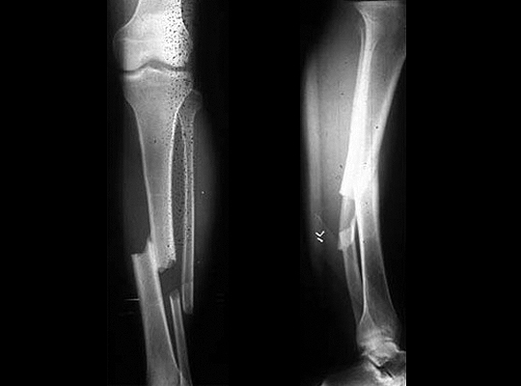
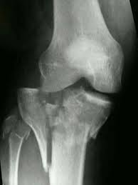
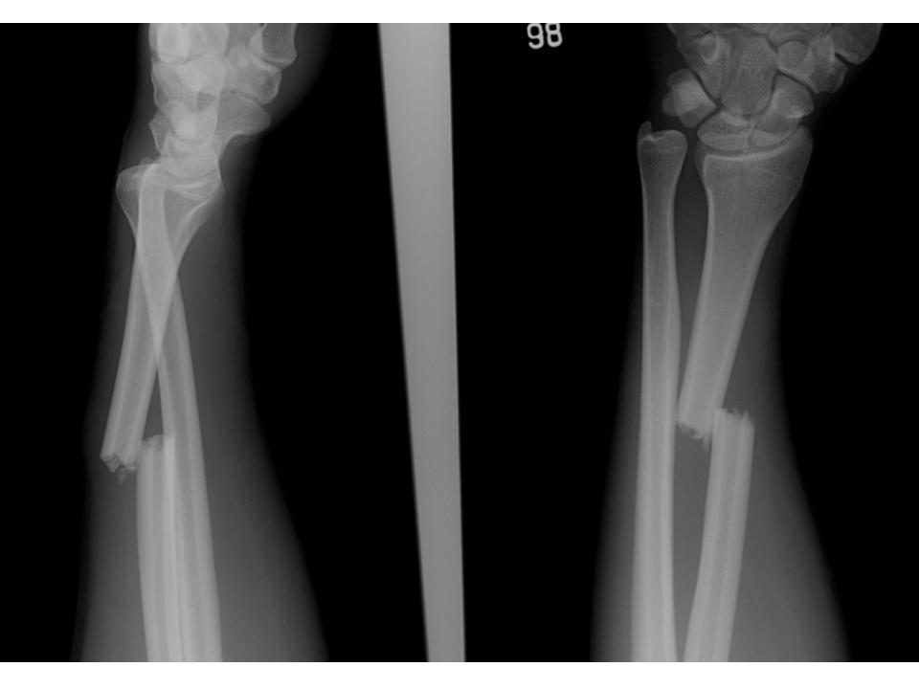
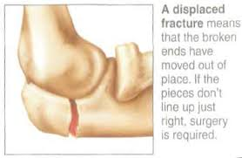

Slide 20
DEFINITIVE TREATMENT OF CLOSED FRACTURES:
IMMOBILISATION
Reduction should be maintained to optimize the conditions for fracture union and minimize potential complications. This however must also be a qualified by the words ‘if necessary’
INDICATIONS FOR IMMOBILISATION:
Relieve pain.
Prevent displacement or angulation of the fragments
Prevent movement that might interfere with union

Slide 21
METHODS OF IMMOBILISATION
Plaster of Paris (POP) cast or other external splint
Continuous traction
External fixation
Internal fixation.

Slide 22
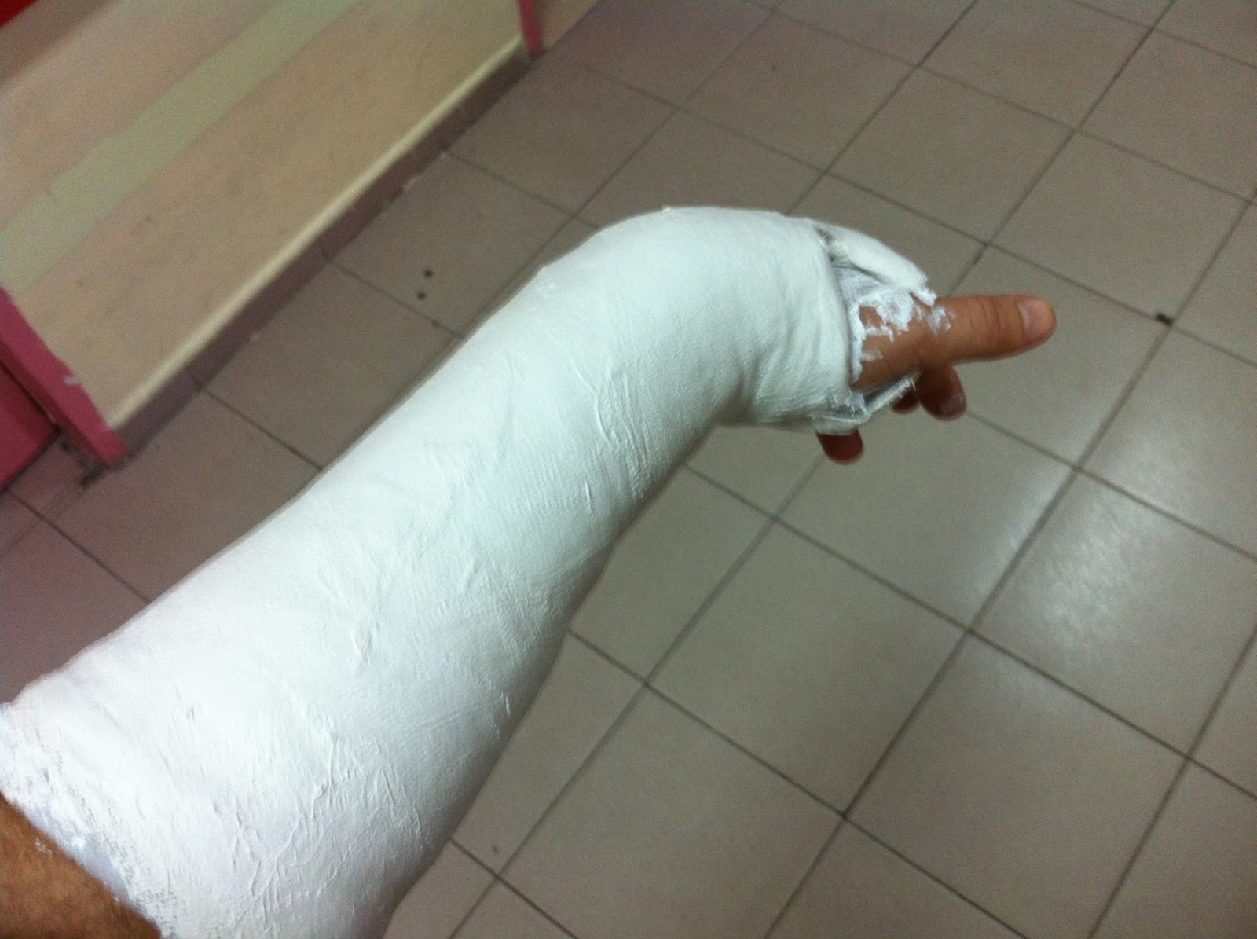
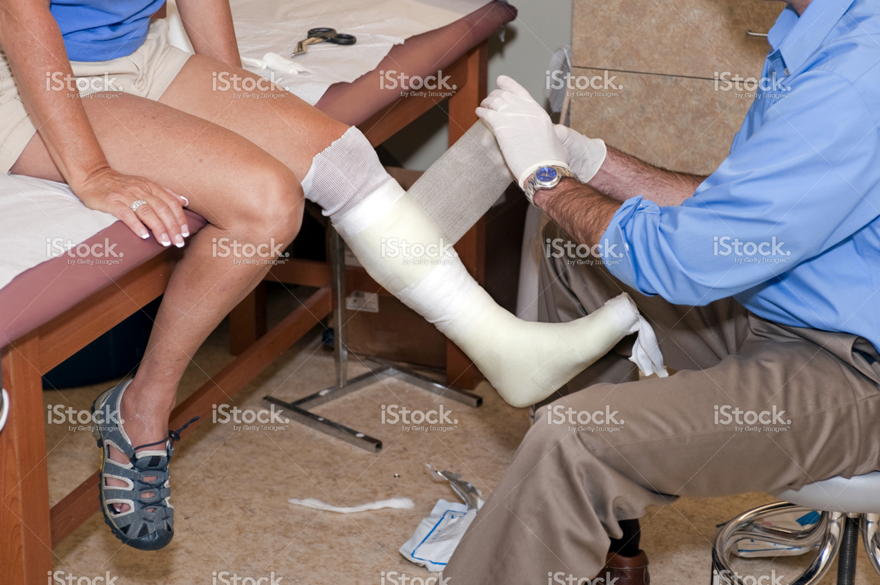
PLASTER OF PARIS/ FIBREGLASS

Slide 23
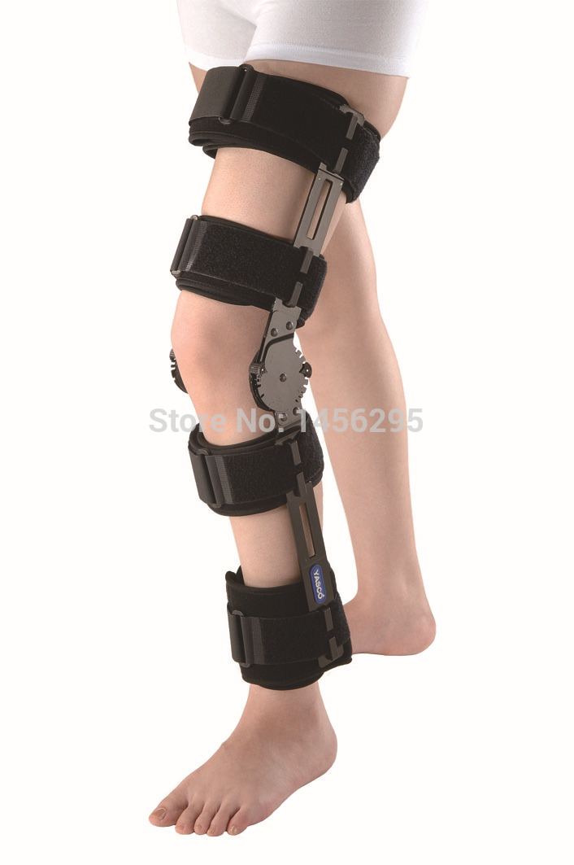
EXTERNAL SPLINTAGE

Slide 24
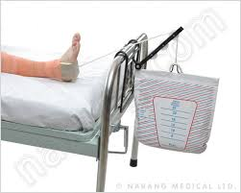
CONTINUOUS TRACTION (SKIN TRACTION)

Slide 25
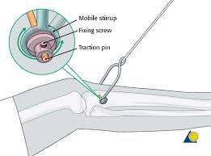
CONTINUOUS TRACTION
(SKELETAL TRACTION)

Slide 26
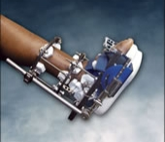
EXTERNAL FIXATION

Slide 27
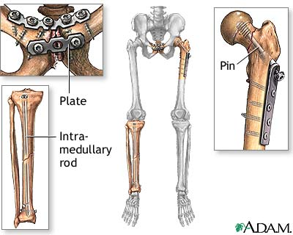
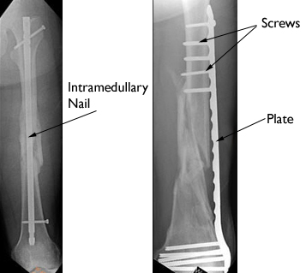
INTERNAL FIXATION

Slide 28
REHABILITATION
Improved results in the treatment of fractures owe much to rehabilitation
Reduction is often unnecessary; immobilization is often unnecessary; rehabilitation is always essential.
Rehabilitation should begin as soon as the fracture comes under definitive treatment. Its purpose is twofold:
  To preserve function so far as possible while the fracture is uniting and
  To restore function to normal when the fracture is united.
The two essential methods of rehabilitation are:
  Active use (encourage patients to help themselves)
  Active exercises.
Patients should, ideally, be under the supervision of a physiotherapist throughout the whole duration of treatment.

Slide 29
MANAGEMENT OF OPEN FRACTURES
An open (compound) fracture always demands urgent attention in a properly equipped operation theatre.
The sooner the wound can be dealt with adequately the smaller is the risk of infection arising from contaminating organisms.

Slide 30
PRINCIPLES OF MANAGEMENT OF OPEN FRACTURES
Infection Prevention:
  Wound debridement
  Antibiotic prophylaxis
Fracture Stabilization
Early Wound Cover
Rehabilitation

Slide 31
INFECTION PREVENTION
Broad Spectrum intravenous Antibiotics on earliest encounter
Surgical Debridement

Slide 32
SURGICAL DEBRIDEMENT
Wound extension: Enlarging the skin wound, to display clearly the extent of the underlying damage.
Wound excision: Clean the wound and remove all dead and de - vitalized tissue and all extraneous material, leaving healthy well vascularized tissues that ward off infection from the organisms that will inevitably remain even after the most meticulous cleansing.
Excise obviously dead tissues that increase the risk of infection by gas-forming organisms (gas gangrene). Dead muscle can be recognized by:
  Purplish color
  Mushy consistency
  Failure to contract when stimulated
  Failure to bleed when cut

Slide 33
CONT.
Wound cleansing: Flush with copious quantities of water or saline to remove as completely as possible all contaminating dirt. At the same time any pieces of foreign matter such as shreds of clothing are picked out with forceps.
For type II/III # → irrigate with 5 – 10L of NS +/- water & H₂0₂
Remove bone fragments that are small and completely unattached but large fragments retaining some soft-tissue attachments, should be preserved.

Slide 34
CONT.
Damage to a major blood vessel is dealt with, according to circumstances, by ligation, suturing or vein grafting.
Severed nerve trunks &: It is best to leave them alone. If the wound is absolutely clean & no dissection is required, they can be tacked lightly & sutured, to facilitate later definitive repair.
Only when a wound is of a cleanly incised type, very recent, and without any sign of contamination, may immediate suture be considered.
Repeat debridement at 48 hour intervals until the wound is clean.

Slide 35
OPEN FRACTURE STABILIZATION
If there is no obvious contamination & the time lapse is < 8hours, open # up to type IIIA can be treated as for closed injuries i.e.:
  External fixation (for not more than 2 weeks)
  Splints, casts & traction (can be used in stable type I #)
  Intramedullary nailing (Type I#)
  Plates & screws (useful in displaced metaphyseal or intra – articular #s & #s of smaller tubular bones

Slide 36
CONT.
For open fractures there should be a greater reluctance to resort to operative methods of fixation, especially if there seems to be a serious risk of infection; if internal fixation is indicated the metals should be placed away from the wound.
Fractures that are unstable and unsuitable for treatment by traction or by simple splintage alone, should be treated by external fixation, pins inserted into the bone fragments and fixed to a rigid external bar rather than internal fixation.

Slide 37
AFTER CARE
The limb is elevated & its circulation carefully monitored
Antibiotic cover
If the wound has been left open, it is inspected at 2 – 3 days & covered appropriately

Slide 38
COVERAGE & CLOSURE OF THE WOUND
Primary Closure (suturing skin directly → type I wound)
Delayed Primary Closure
Secondary Closure
Skin Grafting/ flaps
Mobilization of grafts Skin / Muscle

Slide 39
CONT.
A small uncontaminated Type I wound may (after debridement) be sutured, provided this can be done without tension
All other wounds must be left open until dangers of tension & infection have passed
The wound is lightly packed with sterile gauze & inspected after 2 days
If it is clean, it is sutured (delayed 1º closure) or skin grafted. The wound must be covered in 5 – 7 days unless there is infection.

Slide 40
REHABILITATION
As in closed fractures

Slide 41
MODIFIED BY EFFIE NAILA
PERFECTION IS ATTAINED BY SLOW DEGREES.IT REQUIRES THE HAND OF TIME.
***END***
#JesusOverEverything

