Slide 1
BONE DYSPLASIA
TERMINOLOGY
IDENTIFICATION
WORK UP
TREATMENT AND FOLLOW UP

Slide 2
DEFINITION
Dys- abnormal
Plasis- moulding
Micromelia – short limbs
Rhizomelia – short proximal portion of limb
Mesomelia – short intermediate portion
Acromelia – short distal portion
Para axial hemelia – complete or partial defect of limb
Oligodactyly – reduced number

Slide 3
TERMS MEANING
Dysplasia: describes a generalized developmental disorder of bone or cartilage
Dysostosis: denotes changes affecting a single bone or segment of the skeleton.
Malformation: refers to a primary abnormality of development.
Deformity: A change in structure of a previously normal bone.
Short Stature: Height that is at the lower end of the normal range for a person’s normal peers.
Hypoplasia – underdeveloped bone.
Synostosis – fusion of the bones

Slide 4
INTRODUCTION
Dysplasia is generalised skeletal abnormalities
Classified on clinical, radiological and molecular criteria and sometimes histology of cartilage.
Notes:
Dys-plasia – abnormal – growth
Developmental problems: Specific areas – achondroplasia and hypochondroplasia; severe – Dgyvve-Melchior-Clausen and dysteosclerosis

Slide 5
OVERVIEW
>450 different dysplasias, >220 genes
Incidence 1/5000 live births
10-15 % IUFD
30-40 % die in infancy
~100 have prenatal onset
Remainder presenting in infancy or age 2-3years
In some, features disappear with time before adulthood

Slide 6
BONE GROWTH AND DEVELOPMENT
Osteogenesis at 6-7 weeks gestation
Postnatal endochondral ossification.
Cartilage first is converted to bone.
Intra-membranous ossification.
Direct formation of the bone from the mesenchyme
Occurs in flat bones e.g. periosteum, skull part of the clavicle.

Slide 7
ZONES OF TUBULAR BONES

Slide 8
THE DEVELOPING BONE
Blood supply
Epiphyseal/Metaphyseal arteries
Medullary blood supply
Perichondrial blood supply
Infancy: transphyseal
-Physis
Multiple zones
Rapidly dividing
Not yet calcified

Slide 9
ETIOLOGY OF DYSPLASIA
Genetics
Endocrine (GH, Thyroxine, estrogen)
Metabolic (lipids, Carbohydrates, amino acids)
Environment (multifactorial)
Infection (TORCHES)
Placental dysfunction

Slide 10
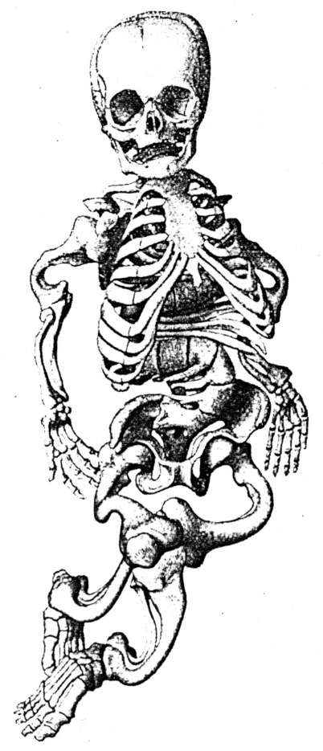
PATHOGENESIS
molecular genetic causes
Abnormal biochemical characteristics of essential bone components: collagen, glykosaminoglycans, hydroxyapatite
CHANGES IN SHAPE ,STRENGTH, AND STRUCTURE OF SKELETON
Functional adaptation of bones (Frost 1995: Utah paradigma of bone physiology)
Teratogenic influence in critical sensitive periods of ontogenesis 6-7weeks of gestation
Hormonal, metabolic
& enzymatic disorders

Slide 11
GENERALIZED BONE DISEASE PRESENTATION
Defects of tubular bone and spine STRUCTURE
Abnormal growth of cartilage and fibrous component
Defects in diaphysis cortical density and metaphyseal modelling
Dysostosis, ( abnormality of individual bones singly or in combination) - craniofacial ,predominant axial involvement ,predominant extremities

Slide 12
WHY DIAGNOSIS?
Predict adult height
Assess risk of inheritance
Possible prenatal diagnosis in future pregnancy

Slide 13
PARENTS GENETIC INFLUENCE
Parents give 2 groups of genes
A: Child’s final height
B. The rate of maturation, the age of puberty and the age of skeletal maturation
the rate of maturation,
the age of puberty and
the age of cessation of growth

Slide 14
Dysplasia/dwarfs

Slide 15
HOW TO MAKE DIAGNOSIS
History
Perinatal history; drugs?
Physical examination
Stature of the patient
Imaging
Biochemistry
Molecular (genetic)
Histology of cartilage (autopsy – femur, live – iliac crest)

Slide 16
HISTORY
Relatives with similar bone abnormality
Pregnancy
Other infants death
Birth weight and cranio-caudal length
Pain, neurological deficit, delayed milestones

Slide 17
INTRA-UTERINE U/S EXAMINATION

Slide 19
ASSESSMENT II – GENERAL EXAMINATION
General examination: facial features, hair quality, dental health, nails
Systemic features: renal problems, cardiac abnormalities
Neurological examination,
Notes:
Abnormal hair and susceptibility to infections – Cartilage-hair hypoplasia syndrome/McKusick Metaphyseal dysplasia
Renal problems – Schimke immuno osseus dysplasia; with asphyxiating thoracic dysplasia – Jeune or ATD syndrome
Developmental problems: Specific areas – achondroplasia and hypochondroplasia; severe – Dgyvve-Melchior-Clausen and dysteosclerosis
Congenital heart disease, polydactyly and dystrophic nails – Chondroectodermal dysplasia (Ellis van Creveld (EvC) syndrome
Nail patella syndrome – dystrophic nails, absent patella, short stature, bilateral iliac horns
Ear cysts and hitchhiker thumb – Diastrophic dysplasia

Slide 20
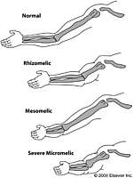
ASSESSMENT I – PHYSICAL EXAMINATION
Upper/lower segment ratio:
1.7 new-born
1.0 ages 2-8yrs
0.95 adult
Sitting height: ascertains truncal shortening
Limb lengths:
Rhizomelia (humerus and femur)
Mesomelia (radius, ulna, tibia and fibula)
Acromelia (Hands and feet)
Body asymmetry
Spine: assess for scoliosis, kyphosis and lordosis
Normal
Rhizomelic
Mesomelic
Micromelic
Notes:
Body asymmetry – ichtyosis, one sided body hypoplasia, clubbed feet, scoliosis, laryngeal stenosis, stippling of ankles and knees, elevated plasma sterol – Chondyplasia punctata (Conradi Hunerman type)

Slide 22
SEGMENT MEASUREMENT
Height measurement
Whole Height – lower segment = upper segment
Arm span length
Head circumference
Plot on disorder specific growth charts

Slide 23
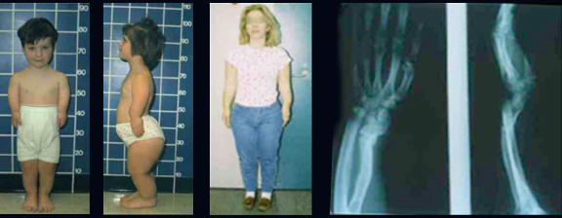
PROPORTION ESTIMATES
NOTE WHERE FINGERS REACH

Slide 24
POST-NATAL RADIOLOGY ASSESSMENT

Slide 25
anatomy

Slide 26
Structure evaluation

Slide 27
Shape assesment

Slide 28
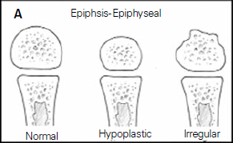
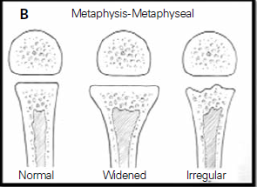
PICTORIAL PRESENTATION OF DISORDERS
Epiphyseal dysplasia
Metaphyseal dysplasia

Slide 29
VERTEBRAL ABNORAMLITIS
Vertebral (spondylo) abnormalities
Combinations:
Spondylo-epiphyseal dysplasia (SED)
Spondylo-metaphyseal dysplasia (SMD)
Metaphyseal-epiphyseal dysplasia (MED)
Spondylo-epiphyseal-metaphyseal dysplasia (SEMD)
Notes:
SEMD – Pseudoachondroplasia (PSACH)

Slide 30
Various shapes

Slide 32
Sum of body parts

Slide 33
shape

Slide 34
ANCILLARY CLINICAL FEATURES
Progressive deafness due to ear infection
Trunk muscle hypotonic
Myopia and retinal detachment
Dental malocclusion, teeth crowding and deformities
Respiratory failure due to small lungs, and chest volume.

Slide 35
OTHER INVESTIGATIONS
Laboratory: T cell dysfunction, neutropenia
biochemical: Serum alkaline phosphatase, urine phosphyrylenthanolamine, lysozyme for storage disease
Enzyme levels in leucocytes and fibroblasts
Genetic constitution

Slide 36
TREATMENT

Slide 37
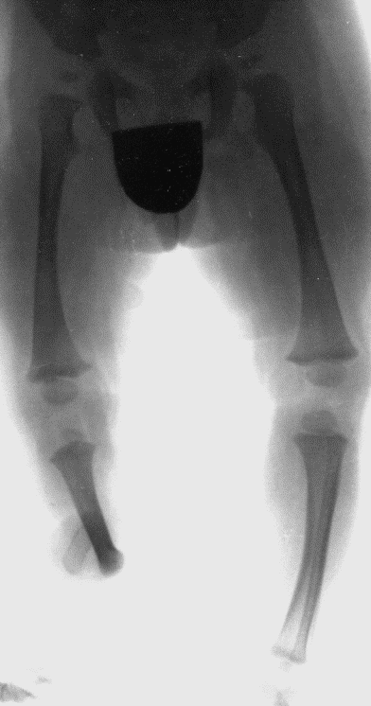
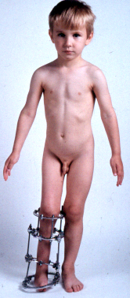
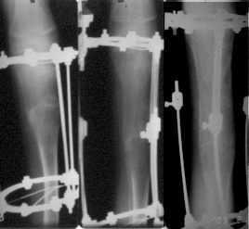
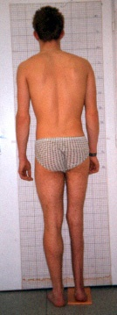
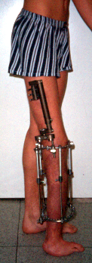
Results of comprehensive treatment
35. Limb hypoplasia-reduction defects group: Fibular hemimelia
Predicted shortening
25-30 cm
+ 8 cm
+ 18 cm
Result of lengthening: 26 cm

Slide 38
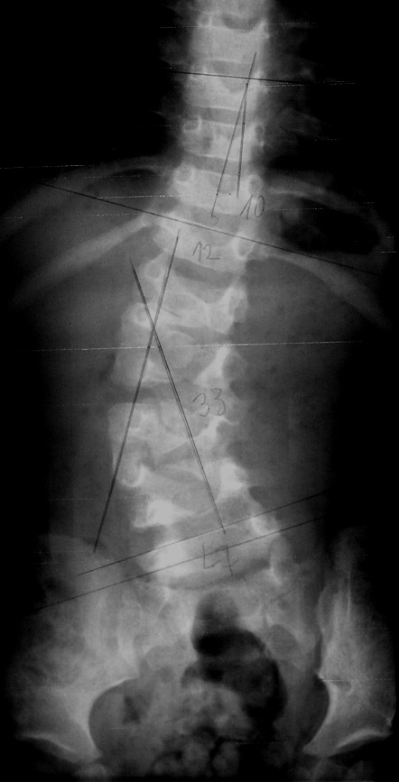
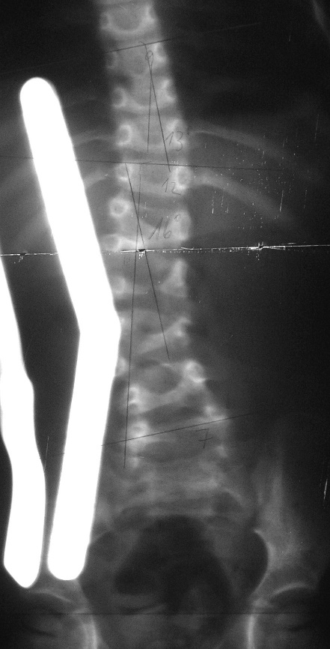
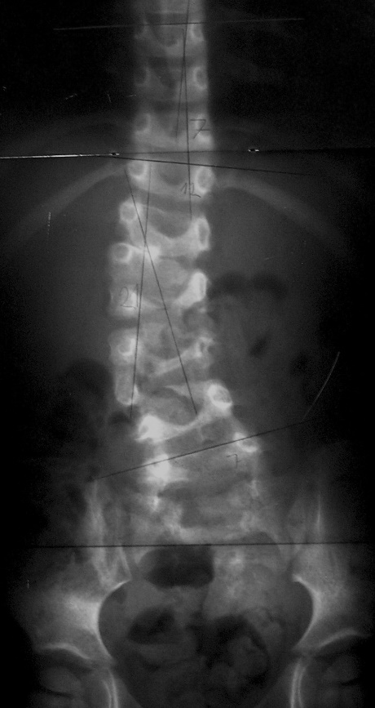
Results of orthotic treatment
Hemivertebra L2 & L5 on the right side
The special brace with regulated bending pre-stressing, regime 23 hours. After 20 months of bracing correction of Cobb´s angle was 12°.
Bone remodeling laws are true for physeal growth of congenital wedge and hemiwedge vertebrae, too.
T12 - 33°- L7
2 yrs.
T12 - 21°- L7

Slide 39
FOLLOW UP
Major system failures
Pathological fractures
Degenerative joint diseases
Malignant transformation
Social segregation
Psychological trauma

Slide 40
SUMMARY
Morphology is sum total of the following
Genetic defects
Mechanical stimuli
Functional adaptation
Determine the final shape of bones.

Slide 41
DIAGNOSIS
Based on:
Clinical
Anthropological
Radiological/ dual energy densitometry – DXA during growth period
Laboratory examination
Genetic (including molecular genetic)

Slide 42
COMPREHENSIVE CARE GOALS
The aim of comprehensive care is a dignified, meaningful and satisfying life and to help them to incorporate themselves into society as individuals who can achieve their highest potential.

Slide 43
Happy dwarfs

