Slide 1
OSTEOARTHRITIS
BY: DR. FRED SITATI CONSULTANT ORTHOPEDIC SURGEON & LECTURER UON

Slide 2
OUTLINE
Introduction
Definition
Classification
Pathogenesis
Clinical presentation
Investigations
Treatment

Slide 3
1. INTRODUCTION
OA is derived from the Greek words:
  osteo- → meaning "of the bone“
  arthr- →meaning "joint", and
  itis- → the meaning of which has come to be associated with inflammation
Synonyms: Degenerative arthritis, Degenerative Joint Disease, Osteoarthrosis

Slide 4
2. DEFINITION
A chronic, non – inflammatory, degenerative, post – middle age disease of synovial joints characterized by articular surface wear, formation of new bone (attempts to repair → osteophyte growth) & capsular fibrosis.
It is a clinical syndrome of joint pain accompanied by varying degrees of functional limitation and reduced quality of life.

Slide 5
INCIDENCE
OA is the MC joint disease
There is increased prevalence with increasing age:
  35% of 30 year olds
  85% of 80 year olds

Slide 6
3. CLASSIFICATION
Primary (no underlying cause)
  Likely genetic.
  This type is MC in women and increases in incidence with age.
Secondary: there is a clear predisposing factor
  Infection (septic arthritis)

Slide 7
SECONDARY CAUSES OF OA
Congenital
  Developmental dysplasias of the hip
    Congenital Hip Dislocation
  Perthe’s disease: Rare disease in which there is segmental, avascular necrosis of the femoral head of unknown etiology
  Slipped Upper Femoral Epiphysis (SUFE): structural failure through the growth plate of an immature hip
Acquired
  Trauma
  Infection → septic arthritis
  Avascular necrosis
  Inflammatory arthritis
  Neuropathic → Charcot joints
  Metabolic e.g. Paget’s disease, gout, hemochromatosis
  Iatrogenic → post – surgery e.g. meniscectomy

Slide 8
4. PATHOGENESIS
The initiating event is disparity between stress applied to articular cartilage and strength of articular cartilage
Histologically, the weight bearing cartilage surface degenerates and eventually wears away completely, exposing the sub - chondral bone which becomes eburnated.
Cysts occur because of micro - fracture of the articular surface & new bone laid down (sclerosis) in the surrounding bone.
Disorganized new bone is produced at the margins of joints (osteophytes) as the disease progresses
The synovial lining becomes thickened and inflamed, often producing excess synovial fluid (an effusion)

Slide 9
RISK FACTORS
Being overweight
Getting older
Injuring a joint
Occupation: repetitive knee bending
Females > males
Genetics

Slide 10
MORPHOLOGY
Articular cartilage → increased water content, decreased proteoglycans, collagen orientation lost, and loss of chondrocytes
Synovium → increasingly thick and vascular
Bones → sclerotic edges and bone cysts form in late stages
Capsule → fibrosis
Synovial fluid → decreased level of hyaluronan and lubricin
Progressive softening and disintegration of articular cartilage
New growth of cartilage and bone at the joint margins (osteophytes)
Capsular fibrosis

Slide 11
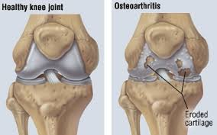
CONT.

Slide 12
5. CLINICAL PRESENTATION
Age group: over 40 yrs
Pain:
  Aching or burning in nature and localized to the joint but may be referred to the joint below e.g. pain in the hip can, classically, be referred to the knee
  Gradually increasing, asymmetrical joint pain over several years
  The pain is worse after activity and is relieves by rest
  Night pain is a feature in progressive disease

Slide 13
CONT.
Stiffness, swelling, deformity (bow legs or knock knees), weakness (usually 2⁰ to wasting)
Inability to do certain activities
Crepitus → gritty like sensation
Flare-ups and remissions may occur.

Slide 14
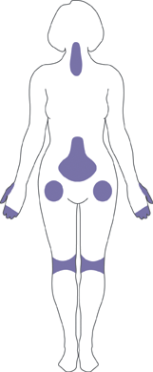
JOINT INVOLVEMENT
Any joint can be affected most commonly:
  Knee, hip, hands (often the 1st CMC joint), fingers (DIP joint)
Less common sites:
  Spine, shoulder, elbow, wrist and ankle

Slide 15
PHYSICAL EXAMINATION
Look for:
  a limp, use of a stick, deformity, previous scars, redness, swelling and wasting of muscles on inspection
Palpate for an effusion, joint line tenderness and crepitus (cracking noise in severe cases)
Range of movement (diminished and there may be a fixed flexion deformity)
Examine the joints above and below
Classic features of OA:
  Herberden’s nodes of the DIP joint
  Baker’s cyst behind the knee
  Bouchard’s nodes at the PIP joint

Slide 16
6. INVESTIGATIONS
Imaging
Plain radiography: views weight bearing
Laboratory: cannot help to make a diagnosis but help to rule out other causes of similar symptoms; All lab tests are therefore normal

Slide 17
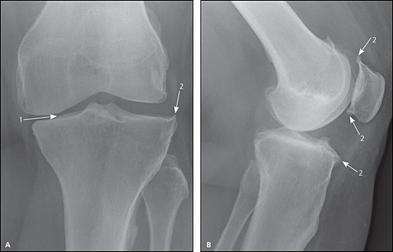
OSTEOARTHRITIS
X-RAY CHANGES
Radiograph of the knee showing
joint space narrowing
(2) osteophyte formation

Slide 18
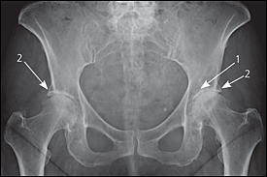
CONT.
Radiograph of the hips showing
joint space narrowing and
(2) osteophyte formation

Slide 19
X – RAY FEATURES
1. JOINT SPACE NARROWING
2. SUB – CHONDRAL SCLEROSIS
3. SUB – CHONDRAL CYSTS
5. DEFORMITY
4. OSTEOPHYTES

Slide 20
LAB TESTS
No specific lab test to diagnose OA.
Normal CBC/FHG and ESR
Negative RF and ANA

Slide 21
DIAGNOSIS
Based on:
Symptoms (history)
Signs (examination)
X ray

Slide 22
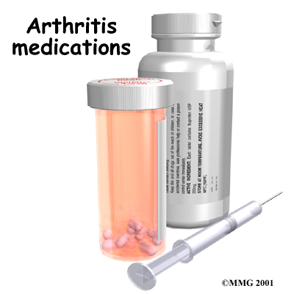
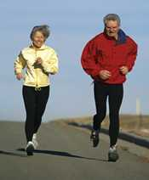
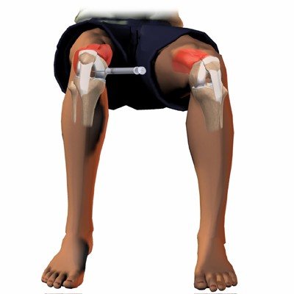
7. TREATMENT OPTIONS (OA): NON-OPERATIVE
Activity Modification
Weight Loss
Cane/walker
Physiotherapy
Medications:
  NSAIDs → Ibuprofen, diclofenac, aceclofenac
  COX-2 Inhibitors → esp., in PUD
  Nutritional supplements → contain chondroitin sulfate
Injections (intra - lesional):
  Corticosteroid
  Visco - supplementation

Slide 23
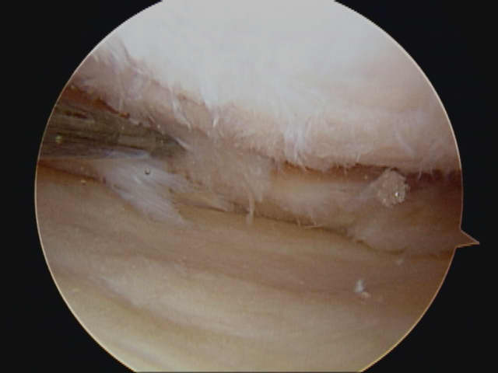
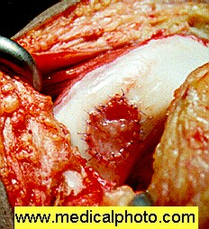
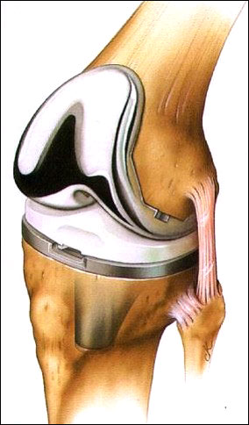
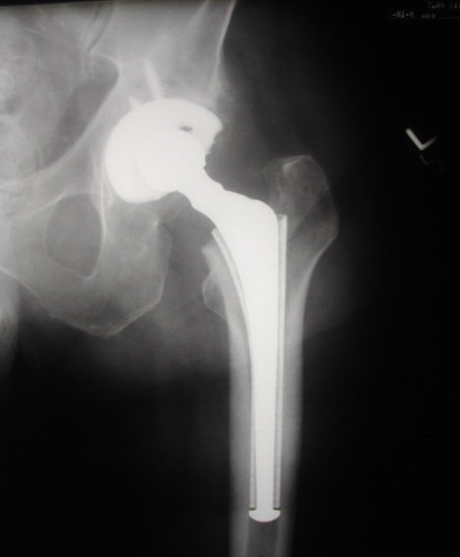
OPERATIVE TREATMENT OPTIONS
Joint preserving operations
  Arthroscopy
  Cartilage transplantation
Arthroplasty/ Joint replacement Options:
  Total joint Arthroplasty
  High tibial osteotomy
  Joint fusion

Slide 24
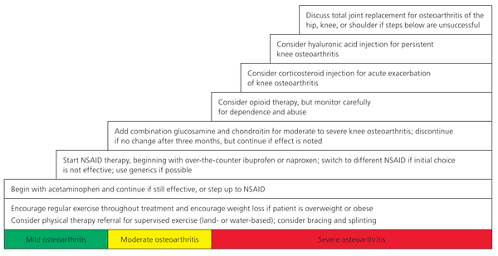
STEPPED OA TREATMENT

