Slide 1
INTRODUCTION TO BONE TUMORS
Dr F.C SITATI
LECTURER, ORTHO DEPT

Slide 2
OBJECTIVES
Primary and Secondary Bone Tumors
WHO Classification: Musculoskeletal Tumors
Enneking Staging of Tumors
Clinical Presentation
Tumor work up for secondary Bone Tumors
Principles of Tumor Biopsy

Slide 3
Classification of Bone tumors · Primary
Primary – 5%: usually solitary site
o Definition: tumors of mesenchymal origin arising in bone
o Routes of spread: hematogenous (lung, liver, bone)

Slide 4
Classification of Bone tumors · Secondary
Secondary 95%: usually multiple sites
Malignancies originating from distant organs
Most frequent = carcinomas – malignant epithelial tumors of viscera
Most frequent primaries: lung, breast, prostate, GI, kidney and thyroid
Bones affected: pelvis, vertebrae, proximal femur and humerus.

Slide 5
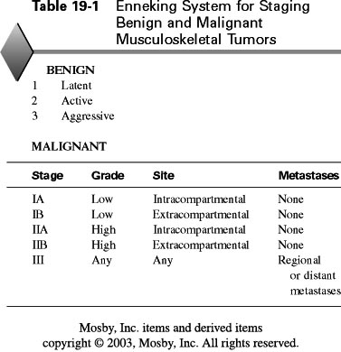

Slide 6
Enneking Staging system
Why stage:
1.treatment decision
2. Comparison purposes with other treatment methods.

Slide 7
WHO classification of musculoskeletal tumours
Cell type | Benign | Malignant
Bone | Osteoid osteoma | osteosarcoma
Cartilage | Chondroma Osteochondroma | chondrosarcoma
Fibrous tissue | Fibroma | Fibrosarcoma
Vessels | Hemangioma | Angiosarcoma
Uncertain | Giant cell tumor | Malignant giant cell tumor
Notochordal |  | Chordoma

Slide 8
Clinical features
The clinical features of bone tumours are
non-specific, thus delay in diagnosis.
Pain
Swelling
General discomfort
Limited mobility
Spontaneous fracture
General symptoms: fever, exhaustion & loss of weight.

Slide 9
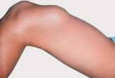
Osteochondroma.
Hard, smooth, nodular swelling of the distal femur
Skin and soft tissues are easily movable and the knee joint is freely mobile.

Slide 10
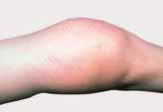
Osteosarcoma,
causing swelling in the distal femur.
Soft tissues poorly movable, consistency
ranging from tough to hard, hyperthermia of the skin and marked veins.

Slide 11
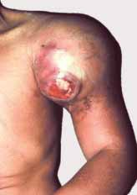
Ewing sarcoma of the proximal humerus,
presenting as tightly elastic, tense, ulcerated lesion with shining skin, on a grey-white background.

Slide 12
Tumour Workup: Secondary bone tumors
Clinical examination (age, sex, site and past history)
  Thyroid
  Breasts
  Chest
  Liver
  Kidney
  Rectal (prostate & rectal tumours)

Slide 13
Tumour Workup: Secondary bone tumors
Bloods
  FBC (leukaemic cells etc)
  ESR (often elevated)
  Biochemistry (Ca++, PO4, liver enzymes and Alkaline Phosphatase) -> mets
  Acid Phosphatase (prostate and increased with metastatic deposits)
  Thyroid function tests
  PSA
  Serum Protein Electrophoresis (Myeloma)
Urinalysis
Urine Bence-Jones (myeloma)
Xray affected region
CXR
Abdominal ultrasound
Bone scan -> other sites
MRI -> soft tissue extent and association with nerves and vessels
CT of lesion and chest (-> staging)
Angiography -> tumour blood supply and relationship to major vessels
Biopsy

Slide 14
Biopsy of Bone Tumours
Principles:
Should know probable diagnosis and stage of tumour before biopsy as it is the last step in the staging of the patient
Performed by the surgeon who will perform the definitive surgery
Meticulous haemostasis to avoid tracking haematomas
Send samples for microbiological analysis also

Slide 15
TREATMENT
Surgery; Amputation / endoprosthesis / palliative
Chemotherapy
Radiotherapy

Slide 16
The end

