Slide 1
BONE DYSPLASIA
PART 2

Slide 2
Measurement of height
Growth velocity is a more useful observation then actual height.
Because of seasonal variations in growth rate velocity must be assessed over a whole year.

Slide 3
Assessment III - Radiology
Skeletal survey:
Skull AP & Lateral
Spine AP & Lateral
Pelvis AP
4 Limbs AP, occasional lateral Knee (assessment of patella)
Hands
Feet

Slide 10
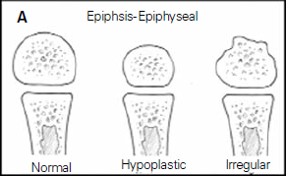
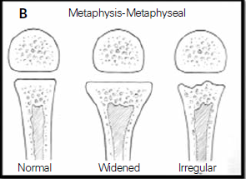
Radiological assessment II
Epiphyseal dysplasia
Metaphyseal dysplasia

Slide 11
Radiological assessment III
Vertebral (spondylo) abnormalities
Combinations:
Spondylo-epiphyseal dysplasia (SED)
Spondylo-metaphyseal dysplasia (SMD)
Metaphyseal-epiphyseal dysplasia (MED)
Spondylo-epiphyseal-metaphyseal dysplasia (SEMD)
Notes:
SEMD – Pseudoachondroplasia (PSACH)

Slide 12
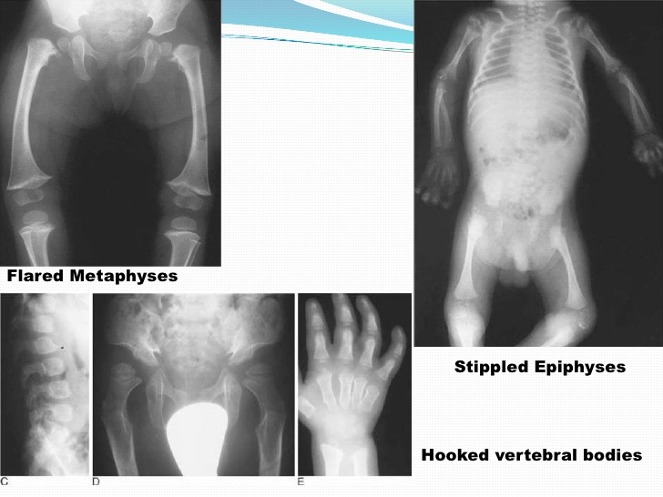

Slide 14
Others complication
Progressive deafness due to ear infection
Trunk muscle hypotonic
Myopia and retinal detachment
Dental malocclusion , teeth crowding and deformities
Respiratory failure due to small lungs, and chest volume

Slide 15
Other investigation
Laboratory: T cell dysfunction, neutropenia
biochemical: serum akaline phosphatase
urine phosphyrylenthanomine
lysozyme for storage disease
Genetic constitution

Slide 16
treatment
Prenatal detection-caeserian section
Post-natal-prevent orthopaedic and neurological complication due to joint instability ,cord compression long bone deformity
Neonate – appropriate resucitation
Obstructive sleep apnoea- adenectomy, weight reduction, tracheostomy

Slide 17
Treat cont
Hormonal recombinant replacement
Bisphonates for OI

Slide 18
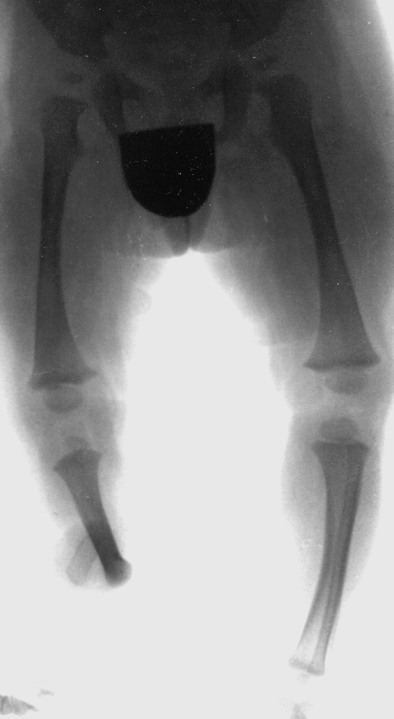
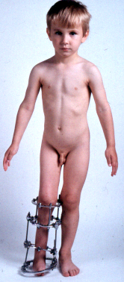
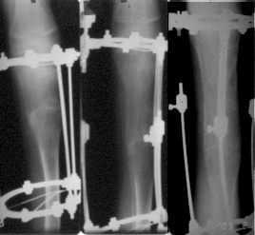
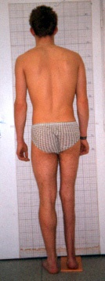
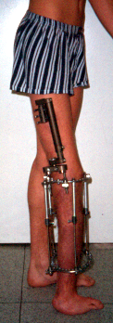
Results of comprehensive treatment
35. Limb hypoplasia-reduction defects group: Fibular hemimelia
Predicted shortening
25-30 cm
+ 8 cm
+ 18 cm
Result of lengthening: 26 cm

Slide 19
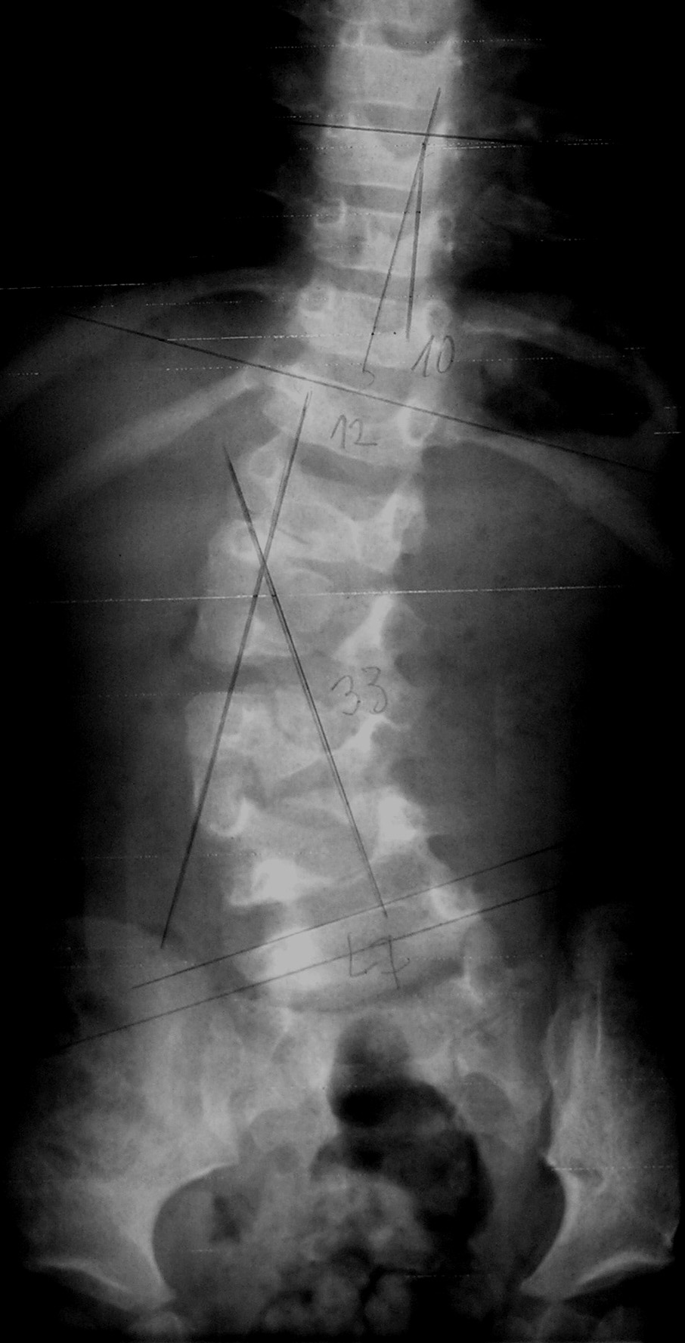
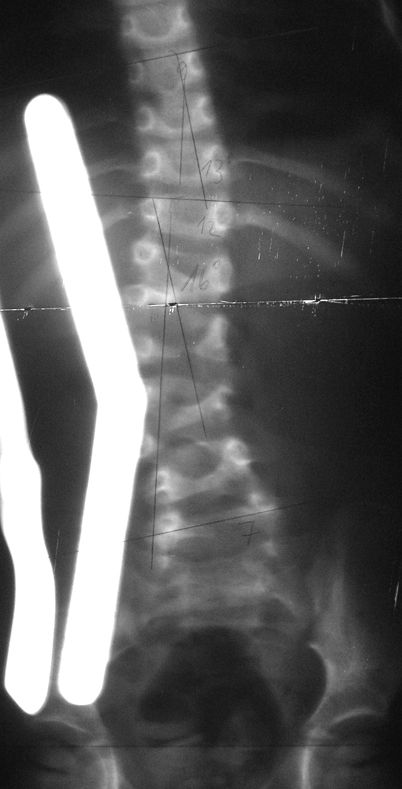
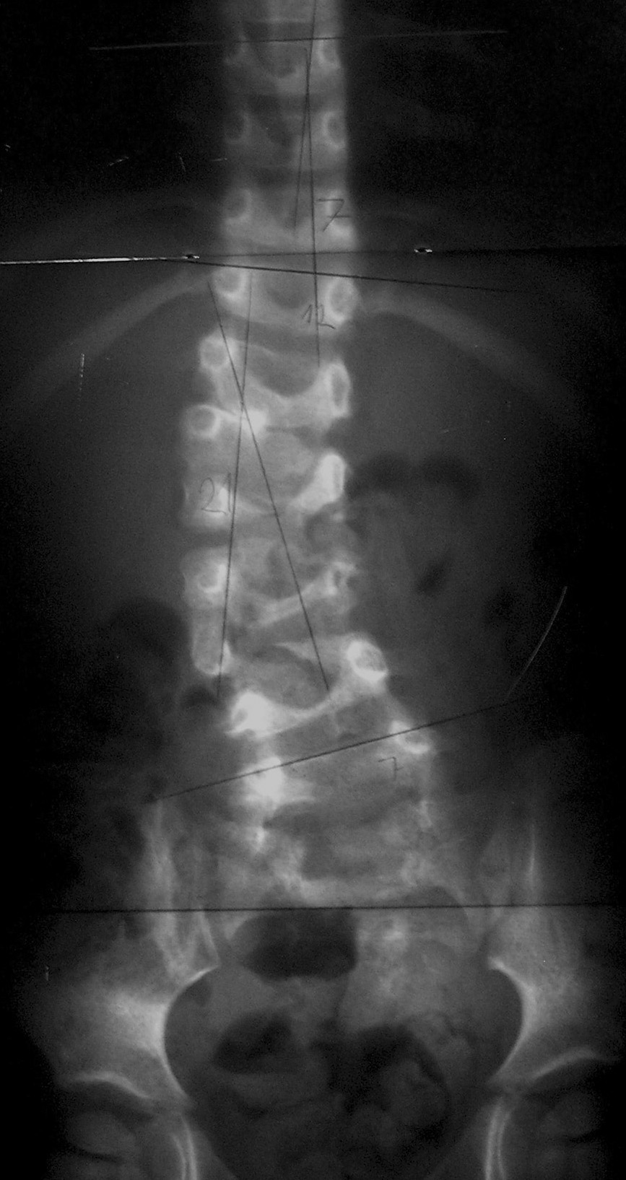
Results of orthotic treatment
Hemivertebra L2 & L5 on the right side
The special brace with regulated bending pre-stressing, regime 23 hours. After 20 months of bracing correction of Cobb´s angle was 12°.
Bone remodeling laws are true for physeal growth of congenital wedge and hemiwedge vertebrae, too.
T12 - 33°- L7
2 yrs.
T12 - 21°- L7

Slide 20
Thoracolumber kyphosis- brace
Progressive kphosis with neurological deficit -fusion
Laminectomy – lumber canal stesosis
Bone marrow transplant for the immune deficit

Slide 21
Follow-up
Major system failures eg resp
Pathological fractures
Degenerative joint diseases
Malignant transformation
Social segregation
Psychological trauma

Slide 22
Conclusion morphology
genetic defects,
mechanical stimuli and
functional adaptation
determine the final shape of bones.

Slide 23
diagnosis
based on:
clinical,
anthropological,
genetic (including molecular genetic) radiological examination together with laboratory examination and
dual energy densitometry - DXA

Slide 24
radiological
Radiological diagnostics is possible only in growth period.
Diagnosis of joint systemic disorders is necessary as soon as possible

Slide 25
Comprehensive care
The aim of comprehensive care is a dignified,
meaningful and satisfying life and
help them to incorporate themselves into society as individuals who can achieve their highest potential.

