Slide 1
EPISTAXIS
DR J. AYUGI

Slide 2
DEFINITION
Acute hemorrhage from the nostril, nasal cavity, or nasopharynx.

Slide 3
Introduction
One of the most common ENT emergency
Male to female ratio 1.6:1
Higher incidence in older patients
Clinically- bleeding either from the lateral nasal wall or from the septum.

Slide 4
Lateral nasal wall bleeding is usually seen from the region of the sphenopalatine artery
Septal bleeding is usually from the anterior region.
Most cases are minor but can be life threatening e.g. in elderly

Slide 5
Minor epistaxis usually originates from the anterior nasal septum
Is often the result of minor trauma to the septal mucosa.
Children- A result of nose picking
Adults- A result of desiccation of the mucosa.

Slide 6
VASCULAR ANATOMY OF THE NOSE
The nasal mucosa has a rich arborizing network of submucosal vessels.
Arterial blood supply from internal and external carotid arteries.
Confluence of the two systems occurs particularly at the caudal end of the septum.
A number of arteries anastomose with each other- Little's area.

Slide 7
The anterior septal plexus is termed Little's area or Kiesselbach's plexus
Is a confluence of
  Septal branch of sphenopalatine (Ext. Carotid artery)
  Septal branch of superior labial artery (Ext. Carotid artery)
  Greater palatine artery (Ext. Carotid artery)
  Anterior ethmoidal (Int. Carotid artery)
This is the site of most anterior epistaxis

Slide 8
Retrocullumellar vein runs 2mm parallel and behind the collumellar
  Is superficial
  Is a common reason for venous bleeding in children
Venous epistaxis from retrocolumelar vein tends to occur in subjects <35yrs
Venous epistaxis usually short lived

Slide 9
Woodruffs plexus is a plexus of vessels lying inferior to the posterior end of the inferior turbinate.
  It is a frequent site of adult epistaxis.
  It causes a venous posterior bleed.
70% of the bleeding occurs from the septum

Slide 10
Fig 1: Vascular supply of the nasal septum

Slide 11
Fig 2: Vascular supply of the lateral nasal wall

Slide 12
AETIOLOGY
Primary and Secondary epistaxis
70 - 80% of all cases are idiopathic : Primary epistaxis.
Standardised description:
  Anterior: Bleeding from a source anterior to the plane of the piriform aperture (anterior septum, vestibular skin, mucocutanoeus junction.)
  Posterior: Bleeding posterior to the piriform aperture
May be multifactorial, with each factor playing a minor role.

Slide 13
LOCAL CAUSES
Trauma
  Nose picking, facial trauma, RTA, fracture base of skull.
Idiopathic (from Little’s area)
Inflammatory
  Rhinitis ( infective, allergic), Sinusitis, Specific nasal infections (bacterial, fungal, TB)
Anatomical/ structural deformities of the nose
    congenital or acquired
    deviated nasal septum
    Nasal spur
    Hypertrophied or rotated turbinates ( paradoxical) drying, crusting, bleeding

Slide 14
Neoplastic (Benign or malignant)
    in the nose or paranasal sinuses and postnasal space tumours
    Juvenile angiofibroma (exclusively in the adolescent males, recurrent and severe episodes of epistaxis. Never biopsy since patient will bleed excessively)
    Aneurysms of internal carotid artery
Enviromental;
    high altitude
    air conditioning
    toxic or chemical irritant
    Cold winter weather

Slide 15
Foreign bodies;
    Unilateral, purulent nasal discharge and bleeding.
    Usually in children or the mentally retarded
Iatrogenic;
    excessive prescription of intranasal topical steroids
    can lead to changes in mucosa and bleeding
    After nasal surgery. (septoplasty, FESS)

Slide 16
GENERAL CAUSES
Hypertension - associated with local factors
  elderly; arteriosclerostic vessels do not contract well and the nasal mucosa becomes atrophic hence dries up and cracks easily and vessels may rupture especially during a hypertensive episodes
Blood dyscrasias
  vary in ability to cause epistaxis
  usually diagnosed in early life by excessive bleeding after minor trauma.
  Deficiency of factors VIII (Heamophilia A), (Heamophilia B). Factor IX
  Von willebrands factor VII impaired PLT adhesiveness.
  Leukemia, lymphomas, Idiopathic thrombocytopenic purpura ITP, ossler Rendeu weber syndrome.
Alcohol abuse - poor diet especially Vitamin C, K deficiency
Parenchymal liver damage ( deceased fibrinogen and prothrombin)

Slide 17
Pregnancy especially folic acid deficiency ( decreased platelets)
Drugs (anticoagulants, aspirin, Nsaids, CAF, carbenicillin).
Systemic toxic agents- phosphorous, mercury.
Infectious diseases ( Typhoid, rheumatic fever, whooping cough)
Cardiovascular disorders ( MS, CHD, CCF, COA)
Immuno-suppresion. (HIV)
Allergic diseases
Malnutrition

Slide 18
CLINICAL PRESENTATION
Sudden onset
Occasionally preceding headache
May be unilateral,
Smell of blood in the throat, trickling in the throat
Swallow and vomit fresh blood
Anxiety (increased PR, BP) increased bleeding
Elderly decompensate very fast (hypovoleamic shock)

Slide 19
MANAGEMENT
1. Medical history
2. Physical examination
3. Laboratory investigations
4. Radiological investigations
5. EUA/ Endoscopy

Slide 20
GENERAL MANAGEMENT
ABC
  Depends on the degree of haemorrhage,
  site (ant, post),
  Age of patient,
  hx of precipitating factors.
An accurate patient history (location, duration and frequency), trauma, nasal blockage, rhinorrhea.
Family history, drug history, tobacco and alcohol usage
History of prior bleeding is important, general state of the patient (eg shock)
Blood for GXM, coagulopathy

Slide 21
Assessment of blood loss
Class I 10-15% of total blood volume (minimal blood loss <700ml)
Class II 15-30%
Class III 30-40%
Class IV >40% (>2000ml)

Slide 22
Rules of fluid replacement:
  Crystalloid fluid= 3:1
  Colloids fluids= 1:1
The patient is evaluated in the seated position,
Adequate light suction anaesthetic solution,
Packing materials and cautery.
Topical vasoconstrictor and anaesthetic agent. (oxymetazoline and xylocaine)
Most bleeding sites are anterior and accessible to local treatment.
Bleeding sites that are not visible on anterior rhinoscopy most likely from posterior ( sphenopalatine artery)

Slide 23
Trivial haemorhrage- first aid measures.
Mild-moderate ( patient may develop shock)
Main aim is to stop haemorrhage.
Firm pressure to the nostrils 5-10 mins seated upright, head facing downwards.
Advice the patient to breath thru the mouth.
Arrange for good light, nasal cannula and suction machine.
anaesthetic agent + vasoconstrictor in solution

Slide 24
NON-SURGICAL MANAGEMENT
Anterior nasal packing
Posterior nasal packing
Local cautery with silver nitrate
Endoscopic guided cautery
Posterior packing

Slide 25
Nasal packing
Anterior- ribbon gauze impregnated with petroleum jelly or bismuth iodoform paraffin paste (BIPP).
Left in situ for 24 to 72 hrs.
Complications include sinusitis, septal perforation, alar necrosis and hypoxia.
There are special nasal tampons and ballon catheters.
Posterior- Under GA preferably. Can also use foleys catheter
Hot water irrigation at 50 degrees (activates clotting system)
Systemic medications- Tranexamic acid , inhibits fibrinolysis

Slide 26
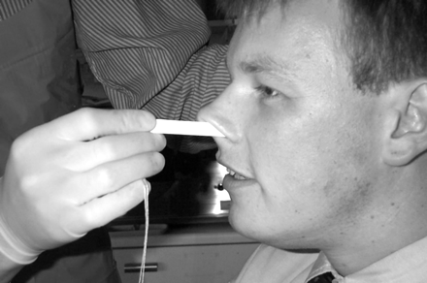

Slide 27
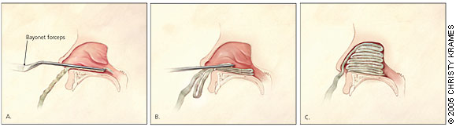

Slide 28
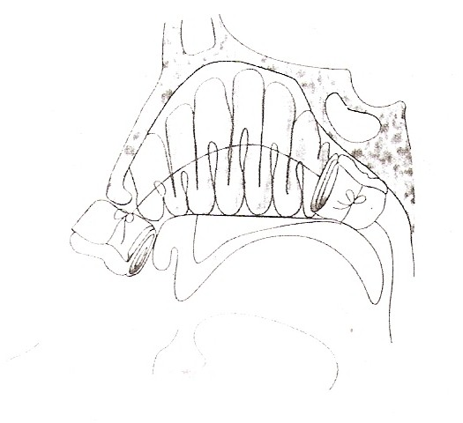

Slide 29
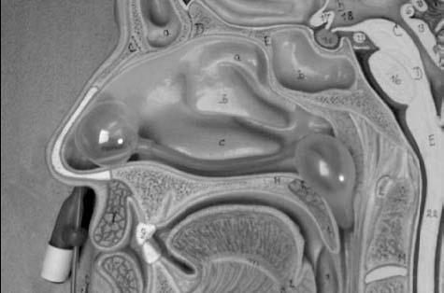

Slide 30
SURGICAL MANAGEMENT
In cases of intractable bleeding ligation of arteries is performed
  Sphenopalatine artery
  Maxillary Artery
  External carotid artery
  Ant and Posterior ethmoids.
Embolization with the use of polyvinyl alcohol foam

Slide 31
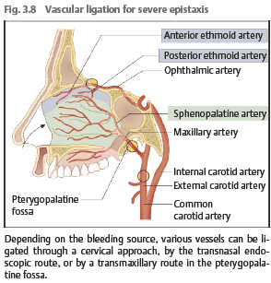

Slide 32
