Slide 1
DISORDERS OF THE TONSILS & ADENOIDS
BY: DR. CATHERINE IRUNGU
DATE: 25th/11/2016

Slide 2
INTRODUCTION
Tonsil and adenoid infection are very common in childhood.
Adenoid - Tonsil Surgery (ATS) is the most commonly performed procedure in the history of surgery.
For airborne antigens, the adenoids and tonsils are the 1st site of immunological contact.
The tonsils are most immunologically active at 4 – 10 years whereas, the adenoids are at 2 – 5 years.

Slide 3
ANATOMY
A tonsil is any collection of lymphoid tissue with no afferent vessels but has efferent vessels, unlike a lymph node.
There are 3 main groups of lymphatic tissue in the head & neck:
WALDEYER’S RING
TRANSITIONAL LYMPHATICS
CERVICAL LYMPH NODES

Slide 4
WALDEYER’S RINGS
This is a ring of lymphoid tissue that is integral to immunoglobulin immunity.
Composed of:
Adenoids/ Pharyngeal tonsils
Are found on the posterior wall & roof of the naso - pharynx.
These CANNOT be seen from the oral cavity since the palate covers them. They can only be seen through the nasal cavity using endoscopy.
Tubal/ Eustachian tonsils
Are found at the pharyngeal opening of the ET.
Palatine tonsils
Embedded in the lateral wall of the oral pharynx on either side between the pillars of the fauces.
Lingual tonsils
Lie at the base of the tongue just anterior to the epiglottis

Slide 5
BACTERIA & VIRUSES COMMONLY CUTURED FROM TONSILS & ADENOIDS
BACTERIA:
1. Aerobic
Group A beta – hemolytic Streptococci
Groups B, C & G (especially in the first year of life)
H. influenza, S. pneumoniae, M. catarrhalis, Staphylococci, Neisseriae, Mycobacteria.
2. Aerobic
Peptostreptococci & Actinomyces
NOTE: THE RATIO OF ANAEROBIC TO AEROBIC MICRO - ORGANISMS IS 10: 1. THE LATTER ARE HOWEVER NOT AS INFECTIOUS AS THE FORMER.
VIRUSES:
EBV
Adenovirus
Influenza A & B
Herpes simplex virus

Slide 6
PHARYNGITIS
Inflammation of the oro - pharyngeal mucosa which is composed of:
Soft palate
Palatine tonsils
Base of tongue
Posterior pharyngeal wall
70% of infections are viral and 30% are bacterial.
CLINICAL PRESENTATION:
Odynophagia
Dysphagia
Tonsillar enlargement
Exudates & petechiae
Fever
Lymphadenopathy

Slide 7
ADENOTONSILLAR DISEASE INCLUDES:
Adenoid infections
Adenoid hypertrophy
Tonsillar infections
Tonsillar hypertrophy
Neoplasia

Slide 8
ADENOID INFECTIONS & HYPERTROPHY

Slide 9
1. ACUTE ADENOIDITIS
Characterized by
Purulent rhinorrhea
Nasal obstruction & mouth breathing
Snoring
Fever
Recurrent otitis media (ROM)
Rhino – sinusitits
Consider GERD in a child < 2 years with recurrent infection

Slide 10
2. CHRONIC ADENOIDITIS
This occurs if symptoms persist for > 14 days.
It is characterized by
Persistent rhinorrhea
Post – nasal drip
Malodrous breath/ halitosis
Persistent or recurrent otitis media (OM)

Slide 11
2. OBSTRUCTIVE ADENOID HYPERPLASIA (TRIAD)
OBSTRUCTIVE ADENOID HYPERPLASIAS
1. HYPO - NASAL SPEECH
2. CHRONIC NASAL OBSTRUCTION
(MOUTH - BREATHING & SNORING)
3. PERSISTENT RHINORRHEA

Slide 12
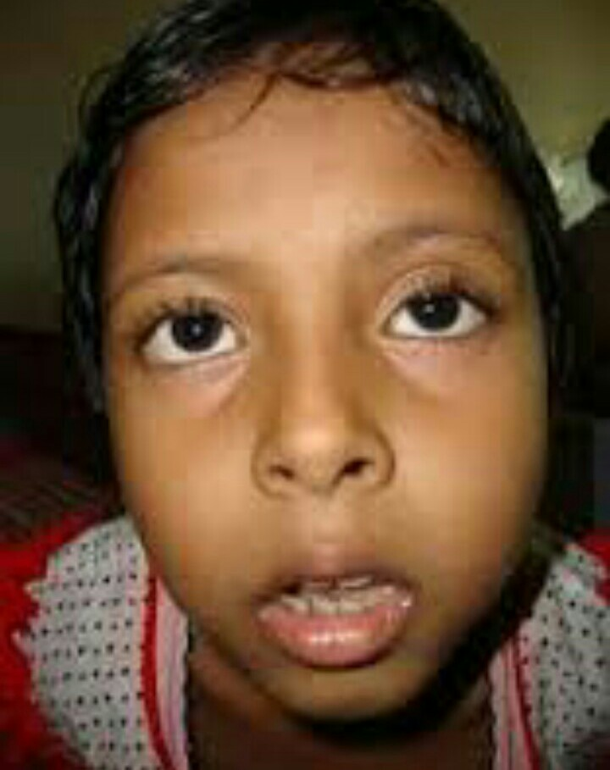
ADENOID FACIES
Long, open – mouthed dull face
Hyper-somnolence
Mouth breathing
Under - developed nostrils
Since the child becomes an obligate mouth breather
Hypo - gnathic maxilla
High arched palate
Short upper lip
Prominent crowded upper teeth

Slide 13
PATHOLOGICAL EFFECTS OF ADENOID HYPERTROPHY
Snoring
Craniofacial malformations
Rhinorrhea (sinusitis)
Recurrent otitis media
Otitis media with effusion (OME)
Affects hearing
Recurrent URTIs
Change in child’s play habit

Slide 14
UPPER AIRWAY OBSTRUCTION (UAO) MANIFESTATION
Snoring and mouth breathing
Sleep apnea
Daytime hyper - somnolence
Behavioral disturbances
Pulmonary hypertension and cor pulmonale
Failure to thrive
Due to poor appetite and resulting delayed milestones
Enuresis
Sleep too deeply when they get to sleep
Hyper - nasal/ hypo - nasal speech

Slide 15
TONSILLAR INFECTIONS & HYPERTROPHY

Slide 16
ACUTE TONSILLITIS
This acute inflammation of the palatine tonsils usually due to Streptococcal or less commonly, to viral infection
CLINICAL PRESENTATION
Sore throat & pain most marked when swallowing (dysphagia) & referred to the ears (tympanic branch of the glossopharyngeal nerve)
High fever, malaise & headache
O/E
Tender lymphadenopathy
Erythema with a purulent exudate
White membrane → thin, non – confluent & confined to the tonsil (peels away without bleeding)
Compare with diphtheria*

Slide 17
PERI - TONSILLAR ABSCESS
Swelling superior to the tonsil accompanied by tender lymphadenopathy
The uvula is displaced to opposite side
MANAGEMENT:
Needle aspiration → 90%
If it is a frank abscess
Incision & drainage
If recurrence occurs after needle aspiration
Hydration
Antibiotics
Steroids
PROGNOSIS
There is a 20% chance of recurrence after 1st episode and a 50% chance after the 2nd episode
Interval tonsillectomy is indicated in repeat abscess.

Slide 18
UNILATERAL TONSILLAR ENLARGEMENT
It is often due to asymmetric anatomic position of tonsils.
Atypical infections involved:
Mycobacteria
Fungi
Chronic actinomycosis
R/O neoplastic disease in the following cases:
Change in voice (hot potato voice)
New – onset snoring
Dysphagia
Neck – lymphadenopathy
Excision biopsy (tonsillectomy)
Histology
Cultures for aerobic, anaerobic and fungal organisms
Imaging (before surgery)→
Extension beyond tonsillar capsule
If neoplastic disease, it may probably be: Squamous Cell Carcinoma or Lymphoma.

Slide 19
HEMORRHAGIC TONSILLITIS
Recurrent bleeding from prominent vessels in chronic tonsillitis
It can be diffuse parenchymal bleeding
Locally controlled in most patients
Younger patients taken to theatre because of poor co - operation
Tonsillectomy indicated if recurrent, anemic or not responsive to local control
Rule out bleeding diathesis.

Slide 20
CHRONIC TONSILLITIS
Chronic sore throat
Mal - odrous breath
Excessive tonsillar debris (tonsilloliths)
Peri – tonsillar erythema
Persistent tender cervical lymphadenopathy
Common in: GERD, allergic pharyngitis

Slide 21
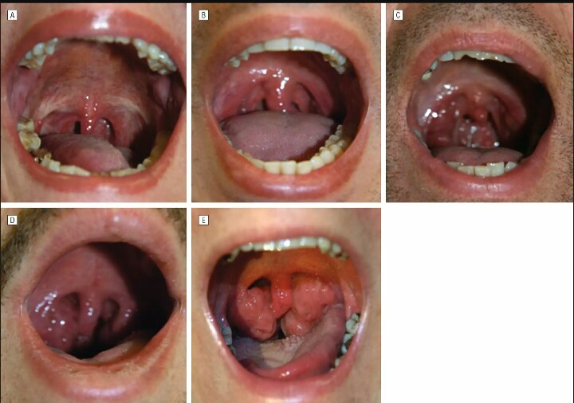
OBSTRUCTIVE TONSILLAR DISEASE
CLINICAL FEATURES
Muffled voice
Hyper - nasality
Dysphagia
Snoring / sleep disturbance
Changes in craniofacial skeleton
GRADING OF THE SIZE OF TONSILS
Grade A → Tonsils in fossa (0)
Grade B → Tonsils less than 25% (+1)
Grade C → Tonsils less than 50% (+2)
Grade D → Tonsils less than 75% (+3)
Grade E → Tonsils greater than 75% (+4)
KISSING TONSILS

Slide 22
NEOPLASMS/ MASSES
CONGENITAL
Teratoma
Hemangioma
Lymphangioma
Cystic hygroma
BENIGN
Lipoma
Fibroma
MALIGNANT
Unilateral, fast enlargement, cervical LN+
Most common: lymphoma
Metastases → from other primaries e.g. melanoma, lung.

Slide 23
COMPLICATIONS OF TONSILLITIS
LOCAL
Laryngeal edema → UAO
Abscesses
Peri - tonsillar abscess
Para - pharyngeal abscess
Retro - pharyngeal abscess
Suppurative adenitis
Acute Otitis Media (AOM)
Chronic tonsillitis
GENERAL
Septicemia (the tonsils are a very vascular area)
Febrile convulsions (absolute indication for surgery)
Meningitis
AGN
ARF
Guttate psoriasis

Slide 24
ASSESSMENT
Clinical history
Snoring, recurrent URTI, sore throat
Clinical examination
External exam face
craniofacial anomalies, adenoid facies
Crowded teeth; small nose; stained teeth; white, flaky and dry lips
Stigmata of allergy: Dark circles around the eye, crease on nose etc.
Anterior rhino – scopy
Use a torch
Assess for patency
Use metal spatula to block either nostrils (younger children)
Ask plder children to breathe heavily
Posterior rhino – scopy
Use endoscope

Slide 25
CONT.
Oral cavity and oropharynx → tonsillitis, PTA
Nose → rhinorrhea, HIT
Ear → AOM, OME, retraction of tympanic membrane
Neck → obvious masses, LN
Chest → heart murmur, symptoms of RHD, congenital heart diseases
Abdomen → Splenomegaly

Slide 26
CLINICAL FEATURES
Pyrexia, malaise, headache, sore throat, dry throat, thirst.
Voice change → hot potato, saliva accumulation
Otalgia → referred pain, AOM, OME.
Odynophagia, dysphagia
Symptom duration 5 – 6 days

Slide 27
INVESTIGATION
History and Physical examination
FBC
Neutrophilia → Acute bacterial
Monocytosis → TB
Lymphocytosis → viral
Throat swab → microscopy, culture & sensitivity
Throat swabs are frequently contaminated by oral flora therefore not routinely
Serologic tests
If an immuno - deficient syndrome is suspected e.g. Hypo – gammaglobulinemia.
NOTE: In SCD, adeno - tonsillar disease should be treated as an emergency. This is because, infection can predispose the patient to dehydration, acidosis and hypoxia, all of which can precipitate a sickling crisis.

Slide 28
DIFFERENTIALS
Scarlet fever
Diphtheria
The membrane is dirty grey, thick & tough; it bleeds if peeled away.
Diphtheria is uncommon due to immunization
Infectious mononucleosis
This is associated with micro - petechiae of the soft palate; atypical lymphocytes on smear and a positive monospot test.
Leukemia
Agranulocytosis
Atypical mycobacteria, fungi, actinomycosis
Vincent’s angina/ Trench mouth
Characterizes by superficial, painful ulcers with erythematous borders
Malignancies
Fungi, syphilitic gumma, TB, leprosy, leishmaniasis
Crohn’s disease

Slide 29
SEQUELAE
Upper airway obstruction (UAO)
Para - nasal sinus disease
Craniofacial malformations
Otologic disease (Otitis)
Cardiac disease

Slide 30
1. UAO
Increased PCO2 → Decreased PO2 → Reflex VC in pulmonary circulation in response to relative hypoxia → Pulmonary HTN → Cor pulmonale.
Adeno - tonsillar disease is common in children after otitis media
In children presenting for adeno - tonsillar surgery, Pulmonary HTN is most common.

Slide 31
TREATMENT
Medical
Rest, rehydrate, analgesics → sufficient in mild cases
Benzyl penicillin IV/ IM then continue with oral penicillin V
OR erythromycin, sulphonamides (for community acquired adeno - tonsillar disease)
Resistant cases → consider clindamycin, ciprofloxacin +/- metronidazole (anaerobic)
Surgical (recurrent disease)
Tonsillectomy & Adenoidectomy (T & A)

Slide 32
HIGH RISK GROUPS AFTER SURGERY (ADMIT AND MONITOR FOR 24 HOURS POST - OP)
< 3 years old
Severe Obstructive Sleep Apnea (OSA)
Bleeding disorders e.g. hemophilia, VWD, on warfarin
ISS
High dose steroids, HIV, congenital
Infections
Fever
Malnutrition < 80% of expected weight for age
Cor – pulmonale
An episode or previous history

Slide 33
2. PARANASAL SINUS DISEASE (IMAGING)
Maxillary sinusitis can result.
Plain X ray: (Water’s view)
Maxillary sinusitis
Fluid level & a meniscus in the affected maxillary sinus
CT scan
Enlarged turbinates
Opacification in the affected sinus

Slide 34
3. CRANIOFACIAL MALFORMATIONS
Long, open – mouthed dull face
Hyper-somnolence
Chronic mouth breathing
Under - developed nostrils
Since the child becomes an obligate mouth breather
Micro - gnathia
High arched palate
Short upper lip
Prominent crowded upper teeth

Slide 35
4. OTITIS
This is inflammation of the middle ear
Classification:
Acute otitis media (AOM)
Usually a bacterial infection accompanied by a viral URTI; rapid onset of signs & symptoms
Recurrent AOM
AOM for 3 or more months in 6 months or for 4 or more months in 1 year
Otitis Media with Effusion (OME)
Painless hearing loss and intermittent purulent ear drainage that follows AOM or arises without prior to AOM
Chronic OME
Persistent otorrhea present for > 6 weeks

Slide 36
OTITIS MEDIA WITH EFFUSION
Mechanical obstruction of Eustachian Tube (ET) opening
Chronic AOM causing effusion
Eustachian Tube dysfunction
Air bubble in the middle ear

Slide 37
5. CARDIAC DISEASE ECHOCARDIOGRAM OF OSA
Hypertrophy of right side of heart
Engorged vasculature of pulmonary
Pulmonary HTN

Slide 38
TONSILLECTOMY & ADENOIDECTOMY

Slide 39
RECURRENT ACUTE TONSILLITIS: PARADISE CRITERIA FOR TONSILLECTOMY
MINIMUM FREQUENCY OF SORE THROAT EPISODES:
At least 7 separate episodes in 1 year
At least 5 separate episodes/ yr in 2 years
At least 3 separate episodes/ yr in 3 years
CLINICAL FEATURES
Sore throat plus 1 of the following:
Fever > 38.4ºC
Cervical adenopathy (tender LN)
Tonsillar/ pharyngeal exudate
Culture positive for GAS
TREATMENT
Antibiotics administered in the conventional dosage for proved or suspected streptococcal episodes.
NOTE: REDNESS IN THE PHARYNX MEANS NOTHING IN A CHILD IN THE ABSENCE OF AN EXUDATE! DO NOT PRESCRIBE AN ANTIBIOTIC.

Slide 40
AMERICAN ACADEMY OF OTOLARYNGOLOGY GUIDELINES (HNS GUIDELINES)
Absolute indications for surgery:
Enlarged tonsils
Repeat peri - tonsillar abscess
Tonsillitis with febrile convulsions
Tonsils requiring abscess
Relative indications
> 3 infections in a year
Persistent halitosis
Chronic or recurrent tonsillitis in a streptococcal carrier not responding to beta - lactamase resistant antibiotic
Unilateral tonsillar hypertrophy

Slide 41
METHODS USED IN T & A
MOST COMMON
Cold knife
Electro – cautery
OTHERS
Coblation
Harmonic scalpel
Laser

Slide 42
COLD KNIFE
GOLD STANDARD
Less post – operative pain
Post – tonsillectomy hemorrhage less common than electro - cautery
Least expensive
More intra-operative blood loss
Cause bacteremia
Takes longer

Slide 43
ELECTROCAUTERY
Types:
Mono - polar cautery
Bipolar cautery

Slide 44
PERI – OPERATIVE MANAGEMENT
Steroids
Bismuth/ Afrin
Coagulant
Reduces likelihood of post-operative bleeding
Aspiration → death therefore not used in Kenya
Post – operative antibiotics
Post – operative pain control
Paracetamol
Narcotics
NSAIDs
Extremely severe in day 3 → day 7 therefore give tramadol.
Good hydration
Move from liquid to semisolid to solid → as per patient’s ability
Avoid smoking → delays healing and predisposes to infections
Avoid valsalva maneuvers.

Slide 45
CONTRAINDICATIONS
Acute tonsillitis
If elective, postpone until acute tonsillitis resolves.
This prevents super – infection of the surgical wound
Short palate
Don’t remove adenoids in a child with a cleft palate because of the risk of aggravating the velo - pharyngeal incompetence and causing hyper - nasal speech & nasal regurgitation
Bleeding disorder

Slide 46
COMPLICATIONS OF ADENOIDECTOMY
Fever
Vomiting
Dehydration
Airway obstruction
Pulmonary edema
Hemorrhage
Hyper - nasal speech
Velo - pharyngeal incompetence
Dental injury
Burns
Nasopharyngeal stenosis
Atlanto -axial subluxations (Down’s syndrome)

Slide 47
COMPLICATIONS OF TONSILLECTOMY
Hemorrhage
Hyper – nasal speech
Dehydration
Laryngeal edema

Slide 48
TYPED BY EFFIE NAILA
‘WATCH THE WAY YOU TALK. LET NOTHING FOUL & DIRTY COME OUT OF YOUR MOUTH. SAY ONLY WHAT HELPS. LET EACH WORD OF YOURS BE A GIFT’
EPH. 4:29 (THE MESSAGE BIBLE)
JESUS’ WORDS ENCOURAGE US TO SKIP THE RUDE COMEBACKS, STOP BLAMING OTHERS & TO PAUSE BEFORE WE REACT.

