Slide 1
DEMENTIA
What is dementia??

Slide 2
WHAT IS DEMENTIA?
Dementia is a decline in a person’s usual state of functioning.
This could be physical, mental, social or as is normal a combination of all three.
It is most often seen in persons over the age of 65 but can affect anyone of any age.

Slide 3
DEMENTIA
Not one disease
Considered a mental health problem
Described as a collection of symptoms that affects someone’s lifestyle
Symptoms can be from a bunch of disorders.

Slide 4
Types of Dementia
• Cortical Dementia
• Subcortical Dementia
• Progressive Dementia
• Primary Dementia
• Secondary Dementia 1)damage to the brain that affects the cortex of the brain or the outer layer (causes problems with memory, language, thinking, and social behavior 2)dementia that affects parts of the brain below the cortex (causes changes in emotion, and movement) 3)Dementia that only gets worse and starts to affect ones ability to do everyday activities 4)dementia like Alzheimer’s disease and doesn’t result from any other disease 5)dementia that is caused from physical disease or injury (can affect people with other disorders that affect mobility and functions like parkinsons

Slide 5
DEMENTIA
There are several forms of Dementia, the most common Alzheimer’s disease Other forms of Dementia include ---
Vascular dementia
Lewy bodies’ dementia
Huntington’s disease
Korsakoffs desease
Jakob-creutzfeldt desease
Aids related dementia
Multiinfact dementia
And others.

Slide 6
Disorders That Mimic Dementia
• Mental Retardation
• Amnesia
• Delirium
• Normal Aging

Slide 7
DEMENTIA
It is worth bearing in mind that you cannot diagnose correctly between most types of dementia until after death and the brain is looked at in a post mortem.
Because of the high incidents of Alzheimer's most doctors refer to it as a diagnoses of “A dementia of the Alzheimer's type.”

Slide 8
Condition That Can Contribute to Dementia
• Medication
• Nutritional Deﬁciencies
• Infections <meningitis, encephalitis>
• Poisoning
• Brain tumors

Slide 9
DEMENTIA
Most forms of dementia including Alzheimer’s disease are not curable unfortunately.
Not everyone will get dementia but the incidence of it does increase with age
How Common is Dementia???
24.3 million people world wide have dementia
Could jump to as many as 84 million people in 2040

Slide 10
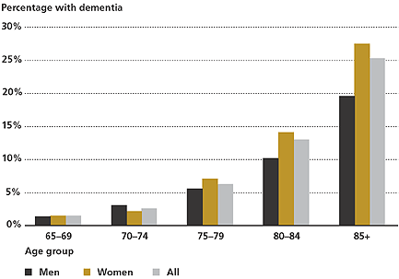
WHO GETS DEMENTIA?

Slide 11
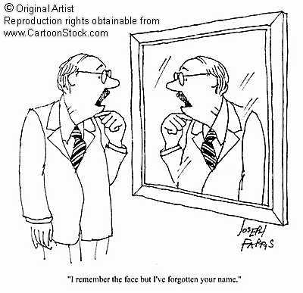
SIGNS AND SYMPTOMS

Slide 12
SIGNS AND SYMPTOMS
The early signs of dementia are very vague, and may not be immediately obvious.
However common symptoms include.---
Progressive and frequent memory loss.
Confusion.
Personality change.
Apathy and withdrawal.
And the loss of the ability to perform everyday tasks.

Slide 13
SIGNS AND SYMPTOMS
As the disease progresses these symptoms become more and more severe and the person becomes completely “lost”, wander some and unable to attend to any of their basic needs including eating, dressing, washing and toileting.

Slide 14
SIGNS AND SYMPTOMS
They will lose their short term memory, and may become more and more agitated and confused.
The diagnosis is poor as there is no known cure but there are medications to help them deal with the symptoms of dementia.

Slide 15
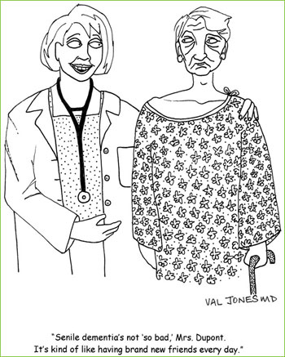

Slide 16
CAUSES OF DEMENTIA
There are many ideas why dementia happens, but no one knows the real cause.
Ideas include---
Hereditary factors
Head injury e.g. stroke or a bleed
Aluminium in the water, Atherstone.
Chromosome as in a gene deficiency
Alcohol as in Korsakoffs
Among others.

Slide 17
PROBLEMS WITH DEMENTIA
Dementia brings many problems and difficulties to both the sufferer and the carer looking after them.
In the early days of the illness the sufferer may have insight and know that some thing is not right with them. They will no doubt be an amount of confusion and short term memory loss this will cause the sufferer to have wandersome behaviour as if they were searching for some thing or some one.

Slide 18
PROBLEMS WITH DEMENTIA
They may show some degree of agitation and delusional thoughts may be evident.
This phase is often referred to as “First stage dementia,” and is some times the most difficult to help with.

Slide 19
PROBLEMS WITH DEMENTIA
As the illness progresses They may lose other functions, such as the ability to eat, drink, use the toilet, wash, dress, mobility issues, to name but a few.
Also they may become depressed, memory and concentration reduces to a minimal amount, and language difficulties emerge either their understanding of other people or making themselves understood to others.

Slide 20
PROBLEMS WITH DEMENTIA
As the brain shuts down, in order to help them make sense of the world around them they may have hallucinations and delusions these can be either visual (more common in Korsakoffs) or auditory.
They will appear to make up stories for their actions (They may fill in the gaps that their brain has, to try and make sense of the world around them) This is some times referred to as “ Confabulation.”

