Slide 1
fro

Slide 2
Chapter Outline
Chapter 15: Personality and Personality Disorders
I. Personality Disorder Diagnosis
II. Personality Disorder Types
III. Treatment of Personality Disorders

Slide 3
Personality Disorders
Longstanding, pervasive, inflexible, extreme, and persistent patterns of behavior and inner experience
Unstable positive sense of self
Unable to sustain close relationships
DSM-5 retains 3-cluster format of the DSM-IV-TR
Alternative DSM-5 Model for Personality Disorders included in the appendix of the DSM-5
Reason changes are being considered and included in appendix:
Half who met diagnostic criteria for one DSM-IV-TR personality disorder met diagnostic criteria for another personality disorder
Some of the DSM-IV-TR personality diagnoses are rare (< 2%)
Many people who seem to have serious personality problems do not fit any of the personality disorder diagnoses
Individuals with a personality disorder can vary a good deal from one another in the nature of their personality traits and the severity of their condition
To capture subsyndromal symptoms better

Slide 4
Personality Disorder Clusters
Three clusters with clinical similarity
Odd/Eccentric
Dramatic/Erratic
Anxious/Fearful

Slide 5
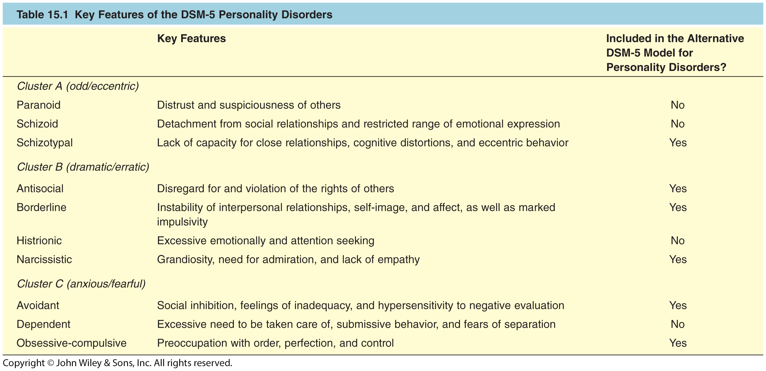
Table 15.1: Key Features of the DSM-5 Personality Disorders

Slide 6
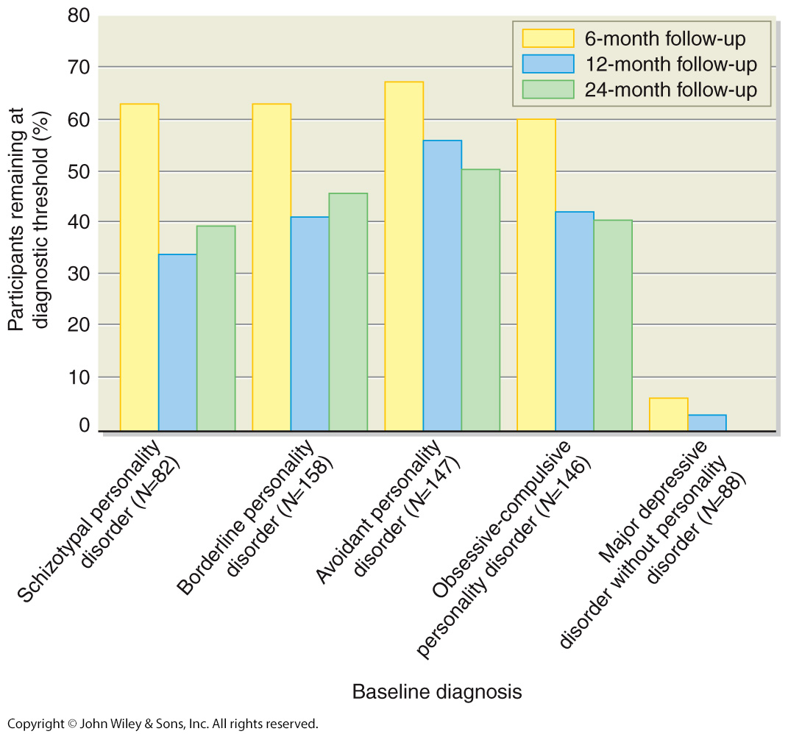
Figure 15.2 Test–Retest Stability for Personality Disorders and Major Depressive Disorder

Slide 7
Common Risk Factors Across the Personality Disorders
Children in the Community Study
Findings suggest disorders related to early adversity (abuse or neglect increase risk)
Unaffected or aversive parenting styles were linked to increased rates of personality disorders
Twin studies suggest moderately high heritability with personality disorders

Slide 8
Odd/Eccentric Cluster
Some similarity to, but less severe than, schizophrenia
Paranoid Personality Disorder
Schizotypal Personality Disorder
Schizoid Personality Disorder

Slide 9
Diagnostic Criteria for: Paranoid Personality Disorder
Presence of four or more of the following signs of distrust and suspiciousness, beginning in early adulthood and shown in many contexts:
Unjustified suspiciousness of being harmed, deceived, or exploited
Unwarranted doubts about the loyalty or trustworthiness of friends or associates
Reluctance to confide in others because of suspiciousness
The tendency to read hidden meanings into the benign actions of others
Bears grudges for perceived wrongs
Angry reactions to perceived attacks on character or reputation
Unwarranted suspiciousness of the fidelity of partner

Slide 10
Diagnostic Criteria for: Schizoid Personality Disorder
Presence of four or more of the following signs of aloofness and flat affect from early adulthood across many contexts:
Lack of desire for or enjoyment of close relationships
Almost always prefers solitude to companionship
Little interest in sex
Few or no pleasurable activities
Lack of friends
Indifference to praise or criticism
Flat affect, emotional detachment

Slide 11
Schizotypal Personality Disorder
Unusual and eccentric thoughts and behaviors (psychoticism), interpersonal detachment, and suspiciousness
Odd beliefs or magical thinking
Telepathic, clairvoyant, ideas of reference
Illusions
Feels the presence of a force or person not actually present
Odd/eccentric behavior or appearance
Wears strange clothes
Talks to self
Affect is flat; aloof from others

Slide 12
Diagnostic Criteria for: Schizotypal Personality Disorder
Presence of five or more of the following signs of unusual thinking, eccentric behavior, and interpersonal deficits from early adulthood across many contexts:
Ideas of reference
Peculiar beliefs or magical thinking, e.g., belief in extrasensory perception
Unusual perceptions, e.g., distorted feelings about one’s body
Peculiar patterns of thought and speech
Suspiciousness or paranoia
Inappropriate or restricted affect
Odd or eccentric behavior or appearance
Lack of close friends
Anxiety around other people that does not diminish with familiarity

Slide 13
Schizotypal Personality Disorder
Similar to schizophrenia
Individuals with schizotypal PD show problems similar to those found in schizophrenia
Highly heritable (~60%)
Cognitive and neuropsychological deficits
Enlarged ventricles
Less temporal gray matter

Slide 14
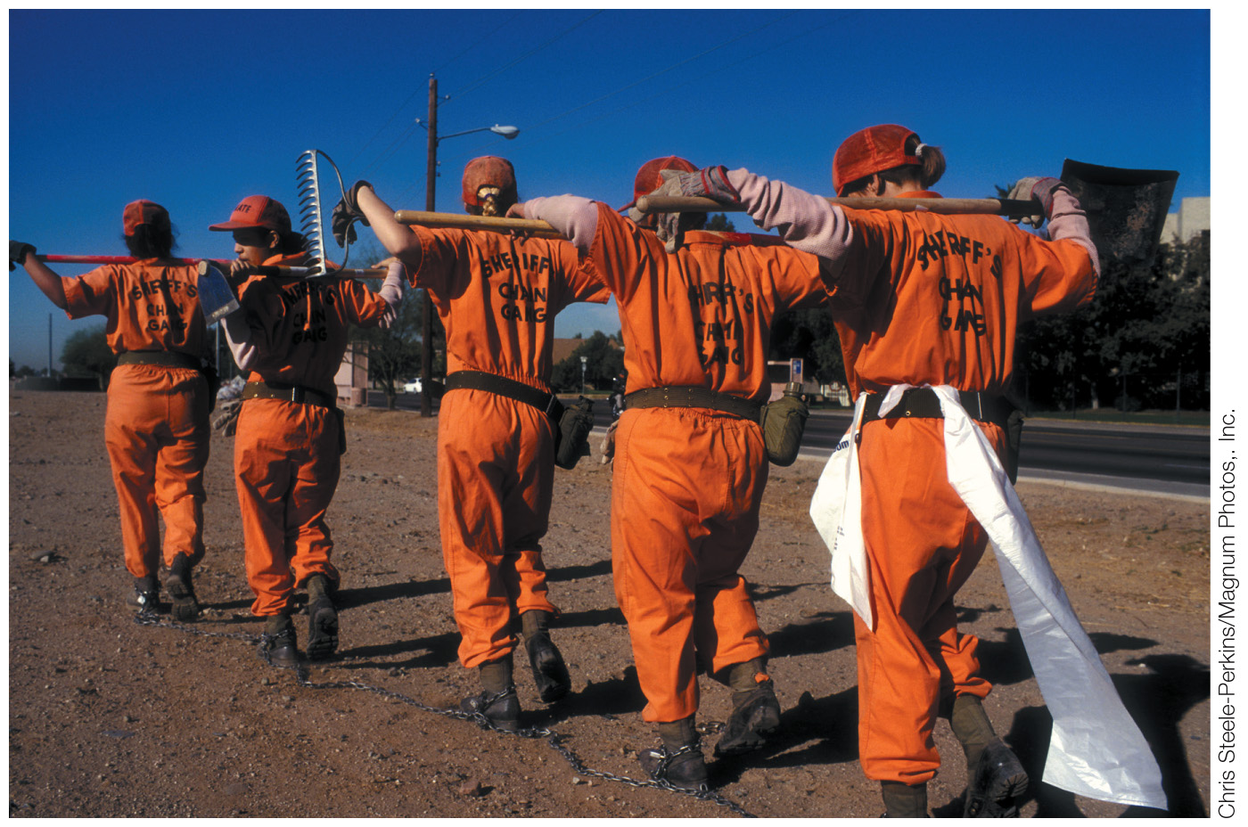
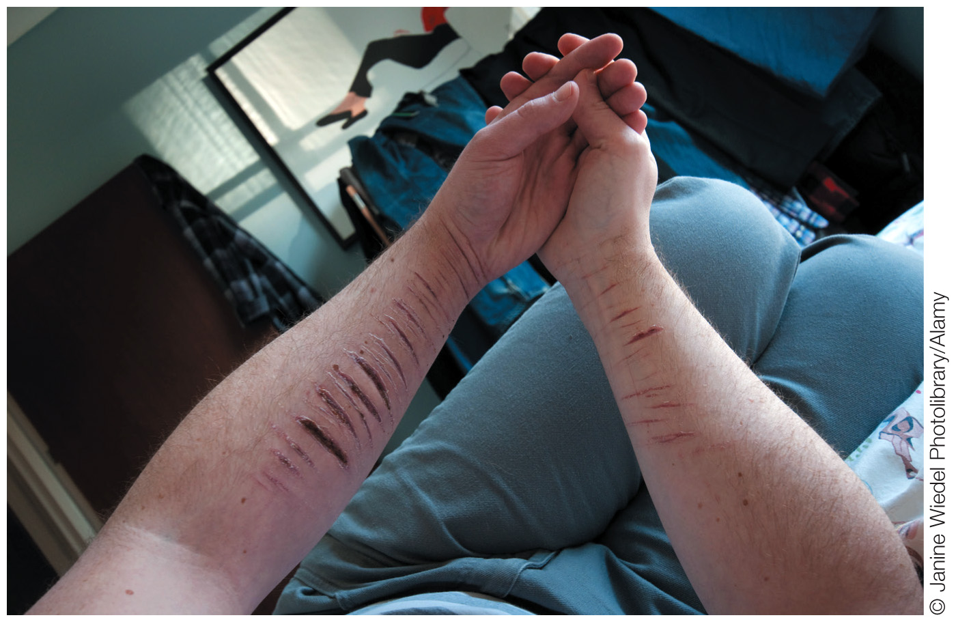
Dramatic/Erratic Cluster
Antisocial Personality Disorder
Borderline Personality Disorder
Histrionic Personality Disorder
Narcissistic Personality Disorder

Slide 15
Antisocial Personality Disorder
Pervasive disregard for the rights of others
Pattern of irresponsible behaviors
Poor work record, breaking laws, being irritable and physically aggressive, defaulting on debts, being reckless and impulsive, neglecting to plan ahead, little regard for truth, and little remorse for misdeeds
Evidence of conduct disorder before age 15
Much more common in men than women
Comorbid substance use very common

Slide 16
Antisocial Personality Disorder
Psychopathy (sociopathy) (Cleckley)
Predates DSM diagnosis
Focuses on internal thoughts and feelings
Poverty of emotion
Negative emotions
Lacks shame, remorse and anxiety; does not learn from mistakes
Positive emotions
Merely an act used to manipulate others; superficially charming
Impulsivity
Behave irresponsibly for thrills
Psychopathy Checklist – revised (Hare) Scale

Slide 17
Diagnostic Criteria for: Antisocial Personality Disorder
Age at least 18
Evidence of conduct disorder before age 15
Pervasive pattern of disregard for the rights of others since the age of 15 as shown by at least three of the following:
1. Repeated law breaking
2. Deceitfulness, lying
3. Impulsivity
4. Irritability and aggressiveness
5. Reckless disregard for own safety and that of others
6. Irresponsibility as seen in unreliable employment or financial history
7. Lack of remorse

Slide 18
Etiology of Antisocial Personality Disorder
Problems with research
Conducted with mostly with criminals
Different measurements (APD vs. psychopathy)
Genetics
Antisocial behavior heritable (40-50%)
Genetic risk for APD, psychopathy, conduct disorder, and substance abuse related
Family environment
Lack of warmth, high negativity, and parental inconsistency predict APD
Poverty, exposure to violence
Family environment interacts with genetics

Slide 19
Etiology of Antisocial Personality Disorder
Fearlessness
Lack of fear or anxiety
Low baseline levels of skin conductance; less reactive to aversive stimuli
Impulsivity
Lack of response to threat when pursuing rewards
Deficits in empathy
Not in tune with the emotional reactions of others

Slide 20
Borderline Personality Disorder (BPD)
Impulsive, self-damaging behaviors
Unstable, stormy, intense relationships
Emotional reactivity
Feelings towards others can change drastically and inexplicably very quickly
Emotions are intense, erratic, shift abruptly—often from passionate idealization to contemptuous anger
Frantic efforts to avoid abandonment
Unstable sense of self
Anger-control problems
Chronic feelings of emptiness
Recurrent suicidal gestures
Transient psychotic or dissociative symptoms

Slide 21
Borderline Personality Disorder (BPD)
Later in life, most no longer meet diagnostic criteria
Cormorbidity high with PTSD, MDD, substance-related, eating disorders, and schizotypal PD
Comorbidity predicts less chance of symptom remission

Slide 22
Diagnostic Criteria for Borderline Personality Disorder
Presence of five or more of the following in many contexts beginning in early adulthood:
Frantic efforts to avoid abandonment
Unstable interpersonal relationships in which others are either idealized or devalued
Unstable sense of self
Self-damaging, impulsive behaviors in at least two areas, such as spending, sex, substance abuse, reckless driving, binge eating
Recurrent suicidal behavior, gestures, or self-injurious behavior (e.g., cutting self)
Chronic feelings of emptiness
Recurrent bouts of intense or poorly controlled anger
During stress, a tendency to experience transient paranoid thoughts and dissociative symptoms

Slide 23
Etiology of Borderline Personality Disorder (BPD): Neurobiological Factors
Genetic component
Highly heritable (60%)
May play a role in impulsivity and emotional dysregulation
Decreased functioning of serotonin system
Increased activation of amygdala

Slide 24
Etiology of Borderline Personality Disorder (BPD): Social Environmental Factors
Parental separation, verbal and emotional abuse during childhood
Linehan’s Diathesis-Stress Theory
Individuals with BPD have difficulty controlling their emotions (emotional dysregulation)
Possible biological diathesis
Family invalidates or discounts emotional experiences and expression
Interaction between extreme emotional reactivity and invalidating family → BPD

Slide 25
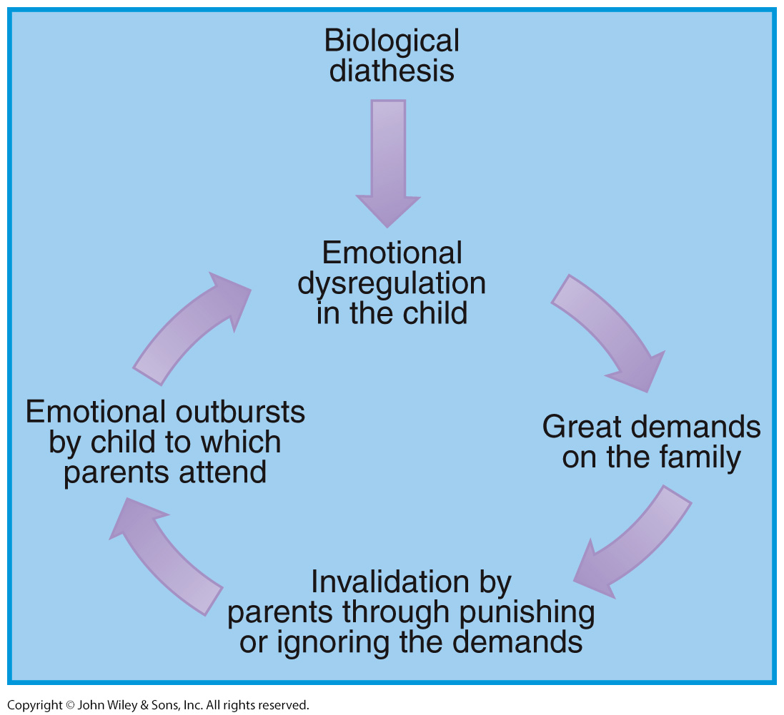
Figure 15.3: Linehan’s Diathesis-Stress Theory of BPD

Slide 26
Diagnostic Criteria: Histrionic Personality Disorder
Presence of five or more of the following signs of excessive emotionality and attention seeking shown in many contexts by early adulthood:
Strong need to be the center of attention
Inappropriate sexually seductive behavior
Rapidly shifting expression of emotions
Use of physical appearance to draw attention to self
Speech that is excessively impressionistic and lacking in detail
Exaggerated, theatrical emotional expression
Overly suggestible
Misreads relationships as more intimate than they are

Slide 27
Narcissistic Personality Disorder
Grandiose view of self
Preoccupied with fantasies of success
Self-centered
Demands constant attention and adulation
Lack of empathy
Feelings of arrogance, envy, entitlement
Sensitive to criticism
Enraged when not admired
Seeks out high-status partners

Slide 28
Diagnostic Criteria for: Narcissistic Personality Disorder
Presence of five or more of the following shown by early adulthood in many contexts:
Grandiose view of one’s importance
Preoccupation with one’s success, brilliance, beauty
Belief that one is special and can be understood only by other high-status people
Extreme need for admiration
Tendency to exploit others
Lack of empathy
Envious of others
Arrogant behavior or attitudes

Slide 29
Etiology of Narcissistic Personality Disorder
Kohut’s Self-Psychology Model
Characteristics mask low self-esteem
In childhood, narcissist valued as a means to increase parent’s own self-esteem
Not valued for his or her own competency and self-worth
Parental emotional coldness and overemphasis on child’s achievements reported by narcissists
Social cognitive model
Narcissist has low self-esteem
Interpersonal relationships are a way to bolster sagging self-esteem rather than increase closeness to others
Lab studies reveal cognitive biases that maintain narcissism

Slide 30
Anxious/Fearful Cluster
Avoidant Personality Disorder
Dependent Personality Disorder
Obsessive Compulsive Personality Disorder

Slide 31
Avoidant Personality Disorder
Fears criticism, rejection, or disapproval
Avoids interpersonal situations
Restrained and inhibited in interpersonal situations
Feelings of inadequacy, inferiority
Avoids taking risks or trying new activities
Does not want to risk embarrassment
High comorbidity with social anxiety disorder
Related to Japanese syndrome called taijin kyofusho (taijin means “interpersonal” and kyofusho means “fear”)
High comorbidity with major depression

Slide 32
Diagnostic Criteria for: Avoidant Personality Disorder
A pervasive pattern of social inhibition, feelings of inadequacy, and hypersensitivity to criticism as shown by four or more of the following starting in early adulthood in many contexts:
Avoidance of occupational activities that involve significant interpersonal contact, because of fears of criticism or disapproval
Unwilling to get involved with people unless certain of being liked
Restrained in intimate relationships because of the fear of being shamed or ridiculed
Preoccupation with being criticized or rejected
Inhibited in new interpersonal situations because of feelings of inadequacy
Views self as socially inept or inferior
Unusually reluctant to try new activities because they may prove embarrassing

Slide 33
Diagnostic Criteria for: Dependent Personality Disorder
An excessive need to be taken care of, as shown by the presence of at least five of the following beginning in early adulthood and shown in many contexts:
Difficulty making decisions without excessive advice and reassurance from others
Need for others to take responsibility for most major areas of life
Difficulty disagreeing with others for fear of losing their support
Difficulty doing things on own because of lack of self-confidence
Doing unpleasant things as a way to obtain the approval and support of others
Feelings of helplessness when alone because of lack of confidence in ability to handle things without others
Urgently seeking new relationship when one ends
Preoccupation with fears of having to take care of self

Slide 34
Obsessive-Compulsive Personality Disorder
A perfectionist
Preoccupied with rules, details, schedules, and organization
Overly focused on work
Little time for leisure, family, and friends
Reluctant to make decisions or delegate
“Control freaks”
Rigid and inflexible, especially morality
OCPD different from OCD
Does not have the obsessions/compulsions of OCD
Most frequently comorbid with Avoidant PD
Very little research into etiology

Slide 35
Diagnostic Criteria for Obsessive-Compulsive Personality Disorder
Intense need for order and control, as shown by the presence of at least four of the following beginning by early adulthood and evidenced in many contexts:
Preoccupation with rules, details, and organization to the extent that the point of an activity is lost
Extreme perfectionism interferes with task completion
Excessive devotion to work to the exclusion of leisure and friendships
Inflexibility about morals and values
Difficulty discarding worthless items
Reluctance to delegate unless others conform to one’s standards
Miserliness
Rigidity and stubbornness

Slide 36
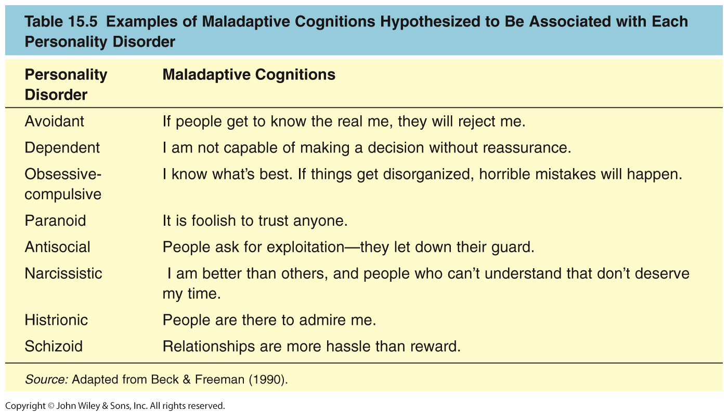
Table 15.5: Maladaptive Cognitions Associated with Personality Disorders

Slide 37
Treatment of Borderline PD
Difficult to treat
Interpersonal problems play out in therapy
Attempts to manipulate therapist
Medications
Antidepressants
Mood stabilizers
Dialectical Behavioral Therapy (Linehan, 1987)
Acceptance and empathy plus CBT
Emotion-regulation techniques
Social skills training
Mentalization-based therapy
Fail to think about their own and other’s feelings
Schema-focused cognitive therapy
Identify maladaptive assumptions that underlie cognitions

Slide 38
Treatment of Schizotypal Personality Disorder, Avoidant Personality Disorder, and Psychopathy
Schizotypal PD: Antipsychotic and antidepressant medications
Avoidant PD: Same treatments as social anxiety disorder
Antidepressant medications
Social skills training
Psychopathy: psychotherapy: either CBT or psychodynamic

Slide 39
COPYRIGHT
Copyright 2015 by John Wiley & Sons, Inc. All rights reserved. No part of the material protected by this copyright may be reproduced or utilized in any form or by any means, electronic or mechanical, including photocopying, recording or by any information storage and retrieval system, without written permission of the copyright owner.

