Slide 1
Dissociative disorders
Level IV
Dr. M. Mathai

Slide 2
Objectives of the lecture
To familiarise the student with some of the less common disorders in psychiatry- Dissociative disorders

Slide 3
Expected Out-put
The student should at the end of the lecture;-
Be able to define dissociative disorders
Classify dissociative disorders under the DSM V classification
Name the important diagnostic criteria of each one of the disorders

Slide 4
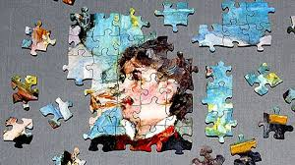
Dissociation

Slide 5
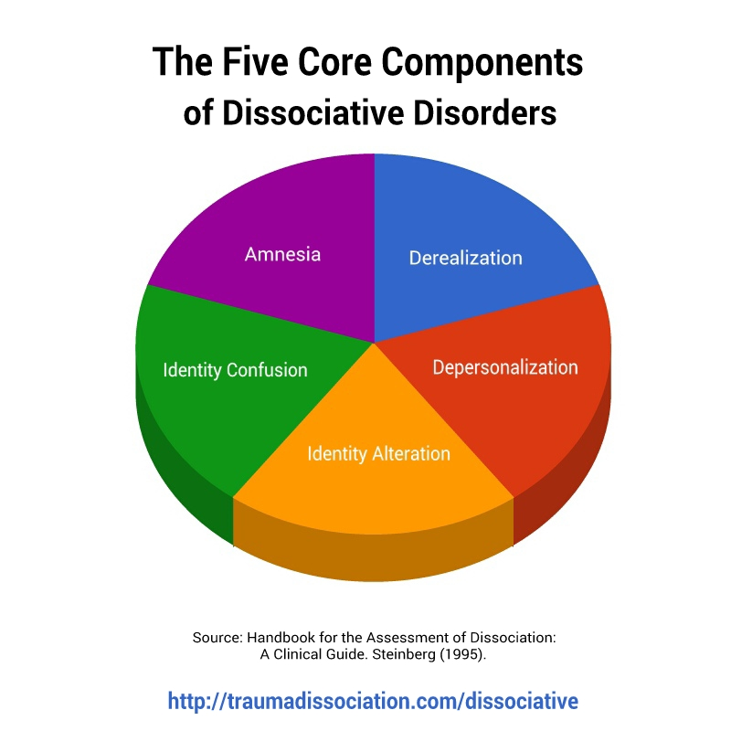
Introduction
Dissociative disorders have been described as disorders in which there is a disruption in the unitary state of self, or disturbances in the experience of self, resulting in a lack of of connection in a person‘s thoughts, memories and feelings, actions or sense of identity

Slide 6
Dissociation
Def:- Dissociation is a mechanism that allows the mind to separate or compartmentalize certain memories or thoughts from normal consciousness. These split-off mental contents are not erased. They may resurface spontaneously or be triggered by objects or events in the person's environment.

Slide 7
DSM V Classification
Dissociative identity Disorder ( Multiple personality Disorder)
Dissociative Amnesia including Dissociative Fugue
Depersonalisation and Derealisation disorder
Other specified dissociative disorders
Unspecified Dissociative disorder

Slide 8

Dissociative identity Disorder
The strange case of Dr. Jekyll and Mr Hyde- Robert L. Stevenson (1886)

Slide 9

DID in Movies
A 2010 Film based on the true story of a 1970 stripper
Frankie- stripper
Alice- White southern woman
9 year old girl genius

Slide 10
Dissociative identity Disorder
1. Two or more distinct identities or personality states are present, each with its own relatively enduring pattern of perceiving, relating to and thinking about the environment and self
2. Amnesia must occur, defined as gaps in the recall of everyday events, important personal information and/or traumatic events

Slide 11
ct
3. The person must be distressed by the disorder or have trouble functioning in one or more major life areas because of the disorder
4. The disturbance is not part of normal cultural or religious practices

Slide 12
5. The symptoms are not due to the direct physiological effects of a substance (such as blackouts or chaotic behavior during alcohol intoxication) or a general medical condition (such as complex partial seizures)
NOTE: DID carries a 70% risk of suicide

Slide 13
Dissociative Amnesia including Dissociative Fugue
DSM V- defining feature as inability to recall important autobiograpical information, usually of a traumatic or stressful nature, that is inconsistent with ordinary forgetting
Overlaps with dissociative fugue- which is described as apparently purposeful travel or bewildered wandering that is associated with autobiographical amnesia

Slide 14
memory disturbances that can occur in dissociative amnesia
  Localized amnesia - (the most common form): failure to recall events during a circumscribed period of time
  Selective amnesia: can recall some, but not all parts of a circumscribed period of time or traumatic event

Slide 15
  Systematized amnesia: loss of memory for a specific category of information
  Continuous amnesia: loss of memory for each new event as it occurs
  Generalized amnesia (rare): acute onset of complete loss of memory for one’s life history

Slide 16
Disociative Disorder cont.
Cognitive functions are preserved (ie. ability to read write speak a language).
Sudden onset and Sudden resolution

Slide 17
Depersonalisation/Derealisation disorder
Depersonalisation
Persistent or recurrent experiences of feeling detached from, and as if one is an outside observer of one‘s mental processes or body (e.g., feeling like one is in a dream)

Slide 18
Derealisation
Derealisation (feelings of unreality so that the environment is experienced as dull, flat and unreal) unaccompanied by depersonalistion
Episodes of derealization may happen during flashbacks
During the experience depersonalisation or derealisation reality testing remains intact.

Slide 19
ct
Causes clinically significant distress or socio-occupational impairment
Does not occur exclusively during the course of another Mental Disorder, substance use or general medical condition

Slide 20
Other Specified Dissociative disorder
Disorders in which the predominant feature is dissociative symptoms that do not meet the criteria for any specific dissociative disorder
Include: Some presentations of DID/MPD
Individuals who have been subjected to forms of brainwashing in captivity
Dissociative trance states and possesion trance states

Slide 21
Current and recurrent symptoms of mixed dissociative symptoms
Due to prolonged intensive persuasion
Acute dissociative symptoms due to acute reaction to stress
Trance state (if not part of a cultural/religious activity)

Slide 22
Aetiology
Dissociative disorders have been shown to be common among people of the same family- implying a possible genetic predisposition
Dissociative states have been found to be closely related to such traumatic experiences as childhood abuse, combat, criminal attacks, brainwashing in hostage situations, or involvement in a natural or man made disaster.

Slide 23
ct
Patients with acute stress disorder, post-traumatic stress disorder (PTSD), or conversion disorder and somatization disorder may develop dissociative symptoms.

Slide 24
Epidemiology
Prevalence of Dissociative disorders is unknown
They have been found to be comonner among women at a ratio of 1: 5
Onset is usually in adulthood or late adolescence
In some cultures dissociative symptoms may ocurr in the context of religious experiences and trance states

Slide 25
Treatment
The treatment for dissociative amnesia is therapy aimed at helping the client/patient restore lost memories as soon as possible. Hypnosis or a medication- Pentothal (thiopental) can sometimes help to restore the memories. Psychotherapy can help an individual deal with the trauma associated with the recalled memories.

Slide 26
Treatment ct
Hypnosis is often used in the treatment of dissociative fugue. Hypnosis can help the client/patient recall his/her true identity and remember the events of the past. Psychotherapy is helpful for the person who has traumatic, past events to resolve.

Slide 27
Treatment ct
Treatment for dissociative identity disorder involves long-term psychotherapy that helps the person merge his/her multiple personalities into one. The trauma of the past has to be explored and resolved with proper emotional expression.

Slide 28
Treatment ct
Treatment for depersonalization disorder is very difficult. However, the condition can improve with a thorough therapeutic exploration of the trauma in the individual's past and the expression of the emotions associated with that trauma

