Slide 1
SLEEP WAKE DISORDERS
DR CATHERINE GITAU

Slide 2
OBJECTIVES
Normal sleep
  Sleep stages
  Sleep cycles
Sleep-wake Disorders
Pharmacotherapy: Sedative – Hypnotics
Psychotherapy: Psychoeducation, CBT
Sleep hygiene

Slide 3
Normal sleep
Sleep is made up of two physiological states:
Non-rapid eye movement (NREM) sleep; Composed of stages 1 through 4.
Most physiological functions are lower than in wakefulness.
Rapid eye movement (REM) sleep; Characterized by high levels of brain activity and physiological activity levels similar to wakefulness. Therefore also referred to as paradoxical sleep.
Occurs approx. 90 minutes after sleep onset in adults.
Notes:
REM latency shortening frequently occurs with depressive disorders and narcolepsy.

Slide 4
Normal Sleep
Stage 1
  Transition to sleep/slow eye movements
  Alpha → Theta on EEG
  Dreaminess, beginning to fall asleep
  Hypnogogic hallucinations
  Approx. 7 minutes to fall asleep, lasts 5-10 mins
  About 5% of our time asleep

Slide 5
Normal Sleep
Stage 2
  Unconscious, but awakened easily
  Heart rate and temp begin to drop
  No eye movements
  Theta Waves on EEG
  Lasts about 20 minutes
  About 50% of our time asleep

Slide 6
Normal Sleep
Stage 3
  Transition from light to deep sleep
  Deep, slow Delta waves emerge
  4-6 % of sleep

Slide 7
Normal Sleep
Stage 4
  Deepest stage of sleep
  Lasts 30 minutes
  May be dreaming
  Parasomnias occur

Slide 8
Normal Sleep
Stage 5
Rapid eye movement (REM) sleep
  Paradoxical- brain most active/muscles paralyzed
  Brain activity most similar to wakefulness
  Dreaming due to increased brain activity
  4 or 5 episodes per night – 20% - 25% of total sleep (in adults)
  Typically enter REM 90 minutes after falling asleep

Slide 9
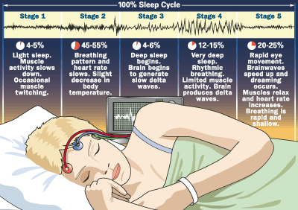

Slide 10
Normal Sleep
Cycles
  Stages do not progress in sequence:
  NREM 1, 2, 3, 4, 3, 2 then REM, back to 2
  Sleep cycles through these stages 4-5 times nightly
  Each cycle 90-120 min
  Each cycle becomes longer
  Long dreams? REM can last up to 1 hr

Slide 11
Sleep regulation
Neurotransmitters play a role in sleep regulation:
Serotonin; Decreased serotonin results in reduced sleep
Norepinephrine; Increase in NE results in reduced sleep
Acetylcholine; Brain acetylcholine involved in REM sleep
Dopamine; Increase in dopamine in the brain tend to produce arousal and wakefulness
Melatonin is a hormone secreted by the pineal gland that regulates the sleep-wake cycle.

Slide 12
Normal Sleep
Circadian Rhythm
  Natural clock is about 25 hrs
  Biological clock based on environmental cues
Sleep “Requirements”:
  Infants: 15-16 hours/day
  Teens: 8-10 hours/day
  Adults: 6-9 hours/day (including elderly)

Slide 13
Sleep-wake disorders
There are 10 disorders or disorder groups according to DSM 5 classification:
Insomnia disorder
Hypersomnolence disorder
Narcolepsy
Breathing-related sleep disorders
Circadian rhythm sleep-wake disorders
Non–rapid eye movement (NREM) sleep arousal disorders
Nightmare disorder
Rapid eye movement (REM) sleep behaviour disorder
Restless legs syndrome
Substance/medication-induced sleep disorder.

Slide 14
Sleep-wake disorders
Core features shared by all these sleep-wake disorders are;
Dissatisfaction regarding the quality, timing, and amount of sleep.
Daytime distress and impairment.

Slide 15
Insomnia Disorder
Diagnostic Criteria
A predominant complaint of dissatisfaction with sleep quantity or quality, associated with one (or more) of the following symptoms:
  Difficulty initiating sleep.
  Difficulty maintaining sleep, characterized by frequent awakenings or problems returning to sleep after awakenings.
  Early-morning awakening with inability to return to sleep.
The sleep disturbance causes clinically significant distress or impairment in social, occupational, educational, academic, behavioural, or other important areas of functioning.
The sleep difficulty occurs at least 3 nights per week.
Notes:
In children, this may manifest as difficulty initiating sleep without caregiver intervention.
In children, this may manifest as difficulty returning to sleep without caregiver intervention.

Slide 16
Insomnia Disorder
The sleep difficulty is present for at least 3 months.
The sleep difficulty occurs despite adequate opportunity for sleep.
The insomnia is not better explained by and does not occur exclusively during the course of another sleep-wake disorder (e.g., narcolepsy, a breathing-related sleep disorder, a circadian rhythm sleep-wake disorder, a parasomnia).
The insomnia is not attributable to the physiological effects of a substance (e.g., a drug of abuse, a medication).
Coexisting mental disorders and medical conditions do not adequately explain the predominant complaint of insomnia.
Notes:
Specify if:
• Episodic: Symptoms last at least 1 month but less than 3 months.
• Persistent: Symptoms last 3 months or longer.
• Recurrent: Two (or more) episodes within the space of 1 year.

Slide 17
Insomnia Disorder
Specify whether:
Episodic: Symptoms last at least 1 month but less than 3 months.
Persistent: Symptoms last 3 months or longer.
Recurrent: Two (or more) episodes within the space of 1 year.
Situational or acute insomnia
40%–50% of individuals with insomnia also present with a comorbid mental disorder.

Slide 18
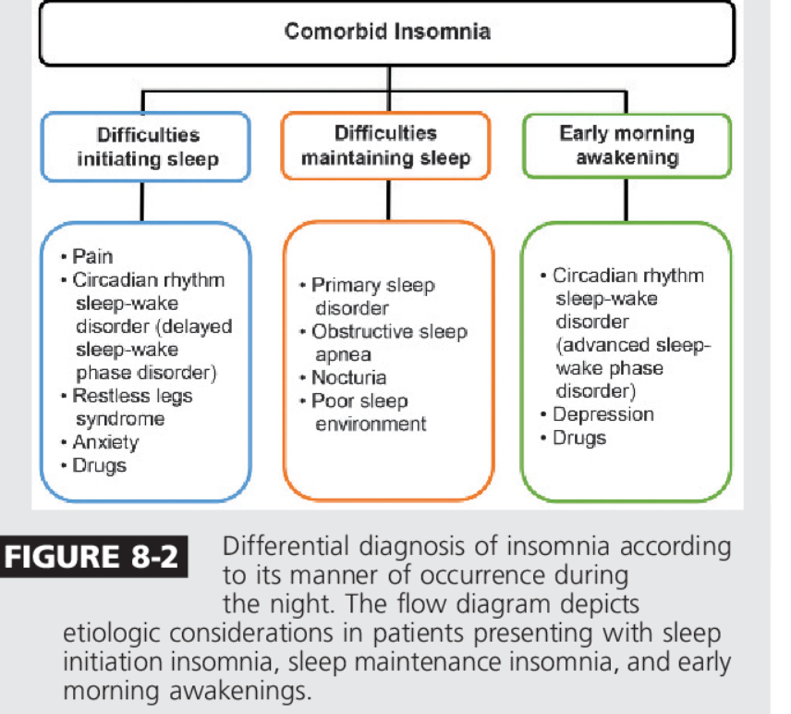
Conditions associated with Insomnia

Slide 19
Insomnia Disorder
May not have PSG evidence
More common in women and elderly
Prevalence 1-10% (25% in elderly)
Sleep hygiene
Sedatives/hypnotics

Slide 20
Hypersomnolence
A. Self-reported excessive sleepiness (hypersomnolence) despite a main sleep period lasting at least 7 hours, with at least one of the following symptoms:
1. Recurrent periods of sleep within the same day.
2. A prolonged main sleep episode of more than 9 hours per day that is nonrestorative.
3. Difficulty being fully awake after abrupt awakening.
B. Occurs at least three times per week, for at least 3 months.
C. There is significant distress or impairment in cognitive, social, occupational, or other important areas of functioning.
D. Not better explained by and does not occur exclusively during the course of another sleep disorder.
E. Not attributable to the physiological effects of a substance.

Slide 21
Hypersomnolence
Risk factors
Environmental
Psychological stress and alcohol use.
Viral infections
Hypersomnolence can also appear within 6–18 months following a head trauma(Masel et al. 2001).
2. Genetic and physiological
Hypersomnolence may be familial, with an autosomal-dominant mode of inheritance.

Slide 22
Hypersomnolence Disorder
Diagnosis
Excessive sleepiness for at least one month i.e., prolonged sleep episodes or naps
Nocturnal polysomnography demonstrates a normal to prolonged sleep duration, short sleep latency, and normal to increased sleep continuity. The distribution of rapid eye movement (REM) sleep is also normal
Comorbid hypersomnolence
Kleine-Levin syndrome
  Adolescent males
  Hypersomnia / hyperphagia / hypersexuality

Slide 23
Hypersomnolence Disorder
Functional Consequences of Hypersomnolence Disorder
The low level of alertness and diminished concentration.
Poor memory during daytime activities.
Distress and dysfunction in work and social relationships.
Prolonged nocturnal sleep and difficulty awakening can result in difficulty in meeting morning obligations, such as arriving at work on time.
Unintentional daytime sleep episodes can be embarrassing and even dangerous, e.g. the individual is driving or operating machinery when the episode occurs.

Slide 24
Narcolepsy
Sleep attacks occur daily at least 3 times per week for ≥ three months
One or both of the following must be present:
  Cataplexy: sudden, reversible loss of muscle tone, may be mistaken for seizure,
  Recurrent intrusions of REM sleep; may include paralysis of voluntary muscles or dreamlike hallucinations
Tetrad of symptoms (20% have all 4)
  1. Sleep paralysis at times of transition to or from sleep
  2. Sleep attacks (10-15 min sleep onset REM)
  3. Cataplexy
  4. Hypnagogic hallucinations

Slide 25
Narcolepsy
Sleep is generally refreshing
However, may also suffer from insomnia
Occurrence: 1: 3000, under- diagnosed
Equal in men and women
Generally begins in late teens or early 20s
Genetic factors; Monozygotic twins are 25%–32% concordant for narcolepsy. The prevalence of narcolepsy is 1%–2% in first-degree relatives.
Reduced levels of neurons that produce hypocretin, i.e., affects appetite and sleep patterns

Slide 26
Narcolepsy
Diagnosis
Functional imaging suggests impaired hypothalamic responses to humorous stimuli.
A sleep-onset REM period during the polysomnography (REM sleep latency less than or equal to 15 minutes) is highly specific.
Additional polysomnographic findings often include frequent arousals, decreased sleep efficiency, and increased stage 1 sleep.
Hypocretin deficiency is demonstrated by measuring CSF hypocretin-1 immunoreactivity

Slide 27
Breathing-Related Sleep Disorder
Sleep disruption, leading to excessive sleepiness or, less commonly, to insomnia, that is judged to be due to abnormalities of ventilation
Apnea; Evidence by polysomnography of 15 or more obstructive apneas
Sleep is not refreshing with daytime sleepiness, fatigue.
Severity:
•Mild: Apnea hypopnea index is less than 15.
• Moderate: Apnea hypopnea index is 15–30.
• Severe: Apnea hypopnea index is greater than 30.
Notes:
The disorder is considered to be more severe when apneas and hypopneas are accompanied by significant oxygen hemoglobin desaturation (e.g., when more than 10% of the sleep time is spent at desaturation levels of less than 90%) or when sleep is severely fragmented as shown by an elevated arousal index (arousal index greater than 30)

Slide 28
Obstructive Sleep Apnea
Prevalence: Obstructive sleep apnea hypopnea is a very common disorder, affecting at least 1%–2% of children, 2%–15% of middle-age adults, and more than 20% of older
Presentation: Snoring/choking/enuresis/reflux/cardiac dysrhythmias
Occlusion of the upper airway (pharynx)

Slide 29
Circadian Rhythm Sleep-Wake Disorders
Conflict in circadian rhythm
Timing of sleep is affected
Shift-work sleep type, delayed sleep phase type (night owls), advanced sleep phase type (morning larks), irregular sleep-wake type (insomnia/napping), Non 24 hr type
Sleep phase adjustment / light therapy

Slide 30
Other sleep d/o
Restless Leg Syndrome
  Deep sensation of creeping or aching inside the legs when lying or sitting producing urge to move them
  Associated w/ renal failure/diabetes/iron def anemia/ peripheral nerve injury
  Affects sleep initiation
  SSRI make it worse
  Tx: L-dopa, ropinirole, pramipexole, clonazepam, ramelteon, zolpidem, eszopiclone

Slide 31
Parasomnias:
Undesired activity/behavior during sleep
Children more often than adults
Specific sleep stages and during transitions from one stage to the next
Recall of episode is poor and awakening the individual is difficult
Examples: Sleepwalking, night terrors, enuresis

Slide 32
Light Sleep Stage Disorders
During stages 1 & 2
Bruxism
  Tooth grinding
  Underlying stress or dental condition
  Side effect of SSRI
  Mouth guard
Sleep talking (somniloquism)
  No tx warranted unless related to other psych d/o

Slide 33
NREM Sleep Disorders
Stages 3 & 4
Sleepwalking (somnambulism)
  During first 3rd of the night and partial emergence from delta sleep
  Accidents can occur
  Hard to arouse and amnestic to event
  Starts in childhood and often resolves by adolescence
  Prevalence 1-5%, although 10-30% of children will have at least one episode
  Tx: Safety

Slide 34
NREM Sleep Disorders
Night Terrors
  Occurs during partial arousal from delta sleep early in the night
  Patients wake abruptly from sleep screaming with tachypnea, tachycardia and sit up in bed.
  Last 1-10 min
  Patients are not alert and are often very difficult to console as well as amnestic to the event
  In children not usually associated with other psychiatric disorders, but in adult can be PTSD
  Prevalence 1-6% children ages 4-12
  Tx: reassurance, stress reduction, hypnotics/sedatives, benzos, SSRIs, TCAs.

Slide 35
REM Sleep Disorders
Nightmare disorder
  Terrifying dreams that are remembered
  No autonomic arousal
  Muscle atonia
  Late in the night
  The individual becomes fully alert on awakening.
  Tx: reduce stress, therapy for anxiety, trauma hx
  Rx: Prazosin, Propranolol

Slide 36
Other Sleep Disorders
Sleep problems related to:
  Psychiatric disorders
  Medical disorders
  Substance use

Slide 37
Psychiatric Disorders and Sleep
Psychotic disorders
  Associated problems w/sleep initiation/maintenance
Mood disorders
  Early morning awakening, decreased delta sleep, decreased REM latency, longer total REM
  Atypical depression: hypersomnia and hyperphagia
  Bipolar: longer total REM during depressed phase and shorter during manic phase
Anxiety disorders
  Disorder most commonly related to insomnia

Slide 38
Medical Conditions and Insomnia
Tx the underlying medical condition:
Pain
Cluster HA
Metabolic disorders
Asthma
GERD
Infections

Slide 39
Substance/Medication Induced Sleep Disorder
Generally if the substance is a CNS depressant, withdrawal = insomnia
If stimulant withdrawal = hypersomnia
Alcohol
  Acute intoxication: drowsiness, reduced REM w/ increased stage 3 & 4, fragmentation of the sleep cycle
  Acute withdrawal: opposite of acute intoxication
  Chronic use: insomnia.
  Caution with treatment due to relapse potential

Slide 40
Treatments for Insomnia

Slide 41
Cognitive Behavioral Therapy (CBT) for Insomnia
Sleep hygiene education
Stimulus control
Sleep restriction therapy
Addresses dysfunctional beliefs and assumptions about sleep and insomnia.

Slide 42
Sleep Hygiene
Attempt to maintain regularity in the sleep–wake cycle timing.
Exercise regularly, but not within a few hours of bedtime.
Develop a relaxing evening routine.
Reserve the bedroom and bed for sleep and sexual activities.
Avoid caffeine after lunchtime.
Avoid alcohol, especially within a few hours of bedtime.
Avoid late heavy meals but consider a small bedtime snack.
Avoid bedroom temperature extremes.
Avoid disruptive noises.
Avoid excessive wakeful time in bed.

Slide 43
Medications used to aid sleep
Benzodiazepines
Benzodiazepine analogs (Non benzodiazepine GABA A receptor agonists)
Antihistamines
Antidepressants
Herbals
Antipsychotics
Mood stabilizers
Blood pressure medications

Slide 44
Class | Agent | Dose (mg) | Half life (h) | Receptor | Year approved | Side effects | Comments
Benzodiazepine
 | Flurazepam | 15–30 | 50–100 | GABA-BZD | 1970 | Dizziness, drowsiness, ataxia, amnesia, falls, gastrointestinal upset | FDA approved for insomnia; abuse potential; rebound insomnia; tolerance and dependence; hangover effect; increased fall risk; cytochrome P450 metabolism
 | Estazolam | 0.5–2 | 10–24 | GABA-BZD | 1980
 | Temazepam | 7.5–30 | 8–25 | GABA-BZD | 1981
 | Triazolam | 0.125–0.25 | 1.5–5.5 | GABA-BZD | 1982
 | Quazepam | 7.5–15 | 39–73 | GABA-BZD | 1985
Sedative-Hypnotics
 | Zolpidem | 5–20 | 2.5–2.8 | GABA-A: alpha-1 | 1993 | Dizziness, drowsiness, amnesia, headache, gastrointestinal upset | For sleep-onset insomnia; risk of dependence & rebound; abuse potential
 | Zaleplon | 5–10 | 1.0 | GABA-A: omega 1 | 1997 | Headache, dizziness, myalgia, amnesia | For sleep-onset insomnia; no tolerance or hangover
 | Eszopiclone | 1–3 | 5–7 | GABA-A | 2004 | Dry mouth, unpleasant taste, dizziness, amnesia, gastrointestinal upset | Studied in elderly; favorable side-effect profile; FDA approved for long-term use
Melatonin receptor agonist | Ramelteon | 8 | 1.5 | MT1, MT2 | 2005 | Fatigue, dizziness, headache, nausea | Studied in elderly; favorable side-effect profile
Antidepressants
 | Trazodone | 50–150 | Early: 3–6 Late: 5–9 | Possible: 5-HT2 | 1981 | Antidepressant, dry mouth, dizziness, headache, nervousness, orthostasis | Not FDA approved for insomnia; primary use: depression
 | Amitriptyline | 10–100 | 12–24 | 5-HT2 noradrenaline | 1961 | Dry mouth, dizziness, QTc prolongation, constipation, orthostasis | Not FDA approved for insomnia; narrow therapeutic window; anticholinergic side-effects; cardiotoxic; overdose potential
 | Doxepin | 75–150 | Early: 17 Late: 52 | Postsynaptic: H1, H2, Alpha-1, 5-HT2, muscarinic | 1969
 | Trimipramine | 25–100 | 11–23 | Postsynaptic: H1, H2, Alpha-1, 5-HT2, muscarinic | 1982
Nonpresecription
 | Diphenhydramine | 25–50 | 2–9 | Antihistamine: H-1 | 1946 | Drowsiness, dry mouth, dizziness, constipation | Not FDA approved for insomnia; anticholinergic side-effects
 | Melatonin | 1–3 | 1–2 | Melatonin |  | Headache, irritability, dizziness | No quality controls; not FDA-regulated
 | Valerian | 400–900 | 1–2 | Possible: GABA-A, adenosine, 5HT-5a |  | Headache, restlessness, gastrointestinal upset | No quality controls; not FDA-regulated

