Slide 1
Feeding and Eating Disorders LECTURE
DR RACHEL KANG’ETHE
CONSULTANT PSYCHIATRIST
SENIOR LECTURER NAIROBI UNIVERSITY

Slide 2
References
Child Psychology and Psychiatry: Frameworks for Practice. Edited by David Skuse, Helen Bruce, Linda Dowdney and David Mrazek: © 2011 John Wiley & Sons, Ltd. Published 2011 by John Wiley & Sons, Ltd. ISBN: 978-0-470-97382-0
Kang’ethe R, et al. Child and Adolescent Psychiatry. In: Njenga FG, editor. Essentials of Clinical Psychiatry in sub-Saharan Africa. Milan: Masson; 2005.
The African textbook of psychiatry and mental health by Ndetei et al 2006

Slide 3
Learning Objectives
Identify types of Feeding and Eating Disorders (FED)
List FEDs delineated in the DSM-V
Describe FEDs DSM-5 diagnostic criteria
Describe clinical features, assessment and treatment strategies for Feeding and Eating Disorders (FED)
Outline components of FEDs treatment plan

Slide 4
Feeding and Eating Disorders (FED): INTRODUCTION

Slide 5
USE OF TERMS
EATING
DIFFICULTY
FEEDING
DISORDER
EATING
DISTRESS
EATING
DISTURBANCE
EATING
DISTURBANCE
EATING
PROBLEM
FEEDING
PROBLEM
FEEDING
DIFFICULTY
FEEDING
DISTURBANCE
EATING
DISORDER

Slide 6
INTRODUCTION
Food is very important in African culture. The Maasai proverb that says – "Happiness is as good as food” - in a way is 'scientific' as eating, releases dopamine in pleasure/ reward centres in our brains, and is one of the great pleasures in life!
Issues to do with food and eating don’t always constitute a feeding and eating disorder.
Once in a while all experience various eating problems such as - bouts of over-or-under-eating.
Food insecurity can also lead to over-consumption in times of plenty.
Fasting part of religious rituals, while "comfort eating" or overeating at times of celebrations may be quite normal!
Such eating problems – not associated with clinically significant functional or developmental impairment don’t constitute FEDS.

Slide 7
WHAT EXACTLY IS A [FED]?
A FED is unhealthy attitude to food, that greatly disrupts thinking and behavior around food, causing great distress and can even be life-threatening.
FED are disturbed eating habits [eg, inadequate/restricted food intake, preoccupation with food, strict dietary rules, excessive food intake, binge eating and altered mealtime behaviors] and
disturbed weight control behaviors [eg, over-exercising, self-induced vomiting or misuse of laxatives, enemas or diuretics] that can ultimately damage the individual's well-being.
These eating habits and behaviors termed ‘disturbed’ when they become harmful through extreme use.
Feeding and Eating Disorders (FED) is diagnosis for people who experience extreme disturbances in their everyday diet along with possible distress or concern about their body weight.

Slide 8
FEEDING AND EATING DISORDERS [FED] DEFINITION:
DSM-5 defines FED as a “[1]. persistent disturbance of eating or eating-related behavior that [2]. results in the altered consumption or absorption of food and that [3]. significantly impairs physical health or psycho-social functioning”.
FEDs are severe psychiatric syndromes that result from sociocultural, psychological and biological factors, which affect children, adolescents and young adults.
FEDs are characterized by a persistent disturbance of eating and eating-related behavior that results in altered consumption or absorption of food and that significantly impairs physical health or psychosocial functioning.
FEDs are associated with psychological suffering, acute and long-term health impairments, a high rate of suicide attempts and increased risk of mortality.

Slide 9
FEEDING AND EATING DISORDERS [FED] - TYPES
FEEDING DISORDERS:
Pica-eating non-nutritive substances
Rumination Disorder-chewing/spitting, re-chewing, regurgitating
Avoidant /Restrictive Food Intake Disorder [ARFID]- failure to meet nutritive needs, dependence on enteral feeds/supplements
Other Feeding Problems in Childhood (non-DSM)-
Selective Eating, Food Phobias, Pervasive Food Refusal,
Food Avoidance Emotional Disorder
EATING DISORDERS:
Anorexia Nervosa [AN], Bulimia Nervosa [BN], Binge eating disorder [BED], Unspecified FED [UFED] and Other Specified FED [OSFED] including - atypical anorexia, atypical bulimia nervosa, sub-threshold binge eating disorder, purging disorder and night eating syndrome

Slide 10
For additional description of FEDs check out: http://www.eatingdisorders.org.au/eating-disorders/ classifying-eating-disorders/dsm-5
Make up your own mnemonic to remember DSM-V Feeding & Eating Disorders, eg,
“Appetite body battles, unspecified or specified are really plenty” – to remember - anorexia nervosa, bulimia nervosa, binge eating disorder, unspecified FEDs, other specified FEDs, avoidance/restrictive FEDs, rumination and pica.

Slide 11
Specific FEEDING AND EATING DISORDERS [FED]

Slide 12
PICA is a FED defined as developmentally inappropriate
persistent ingestion of non-nutritive substances for at least
1 month with benign or life threatening consequences.
Substances ingested vary with age & availability include
paper, soap, cloth, hair, string, soil, chalk, paint, gum,
metal, pebbles, charcoal, ash, clay, starch. Risk of lead
poisoning or intestinal obstruction. Mostly very young
children & those with intellectual disability [0.3-14.4%
with intellectual disabilities affected].
Treatments based on operant conditioning procedures
& teaching caregivers to keep the child’s environment
tidy and removing dangerous substances.

Slide 13
Types of Pica Disorder include:
Amylophagia is excessive consumption of purified starch.
Coprophagy is characterized by eating feces.
Geophagy craving for soil-like substances clay, chalk, soil
Hyalophagia is eating glass objects.
Mucophagia is feeding on mucus of invertebrates/fishes.
Pagophagia: Excessive ice cubes consumption
Self-cannibalism/ autocannibalism is self-eating
Trichophagia is eating hair, mostly one’s own.
Urophagia is the practice of consuming urine.
Xylophagia is consumption of things made of wood eg pencil, etc

Slide 14
Avoidant/Restrictive Food Intake Disorder
Individuals show an apparent lack of interest in eating or food because they are concerned about the aversive consequences. Food avoided based on its sensory characteristics: color, smell, texture, temp, taste.
As a result, significant weight loss occurs & psychosocial function is disturbed.
Affects up to one-third of young children, equally common among boys and girls
Many factors lead to the problem such as family disadvantage, poverty, unemployment, social isolation, parental mental illness and maternal eating disorders (specific risk factor)
Notes:
People may develop this disorder as the result of a conditioned negative response to having an aversive experience while eating, such as choking.
Previously included as a feeding disorder of infancy or early childhood in the DSMIV- TR, this diagnosis is now applicable to individuals of any age who do not have another eating disorder or concurrent medical condition, or who are following culturally prescribed eating restrictions.
As a result of adding this disorder to DSM-5, researchers believe that the frequency of eating disorder “not otherwise specified” will be cut in half, leading to better chances of appropriate diagnosis and treatment

Slide 15
Avoidant/Restrictive Food Intake Disorder characterized by a sudden or marked deceleration of weight gain and slowing or disruption of emotional and social development prior to age 6
DSM5 diagnosis of Avoidant/Restrictive Food Intake Disorder incorporates nutritional complications and acknowledges that feeding disorders are common in certain medical conditions; however, it requires that severity of the eating disturbance exceeds that associated with the condition and specifically excludes children whose primary challenge is a skill deficit
Treatment involves detailed assessment of feeding behavior and parent-child interactions, while allowing parents to play a role in the infant’s recovery

Slide 16
Rumination Disorder
Rumination Disorder is a FED in which the infant or child regurgitates food after it has been swallowed and then either spits it out or re-swallows it.
Five common disturbances include:
(1) delayed or absent development of feeding and eating skills,
(2) difficulty managing or tolerating food or drink
(3) reluctance to eat food based on taste, texture, and other sensory factors,
(4) lack of appetite or interest in food
(5) the use of feeding behaviors to comfort, self-soothe or self-stimulate.

Slide 17
Unspecified Feeding or Eating Disorder (UFED) Formerly Eating Disorder NOS (EDNOS)
Clinically significant distress/impairment but do not meet criteria for other FEDs
May be used when not enough clinical information (ie. emergency room settings)
Atypical presentations

Slide 18
Binge Eating Disorder (BED) – DSM 5
Recurrent episodes of binge eating
Eating definitely more than most people would eat in discrete 2-hour period of time
Sense of lack of control during the episode
Three or more of the following:
Eating much more rapidly than normal
Eating until uncomfortably full
Eating large amounts when not physically hungry
Eating alone because embarrassed by how much eating
Feeling disgusted, depressed, or guilty afterwards
Marked distress regarding binge eating
On average at least once a week for 3 months
No compensatory behaviours such as in bulmia nervosa

Slide 19
Binge Eating Disorder [BED]: Etiology
Etiology - Multifactorial!!!
Lifetime prevalence:
3.5% women
2% men
genetic
Family dynamics
Individual
Temperament
(ie. impulsive)
Societal, cultural
Media factors
biological

Slide 20
Binge Eating Disorder
Similar to bulimia without the compensatory behaviors
Involves periods of eating more than other people would, accompanied by feeling of loss of control
Affects 1.5%-3% of adolescents
Has negative health correlates

Slide 21
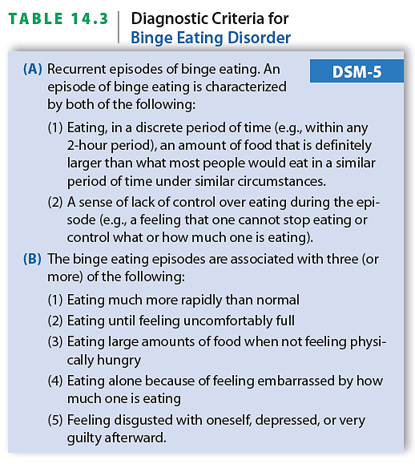
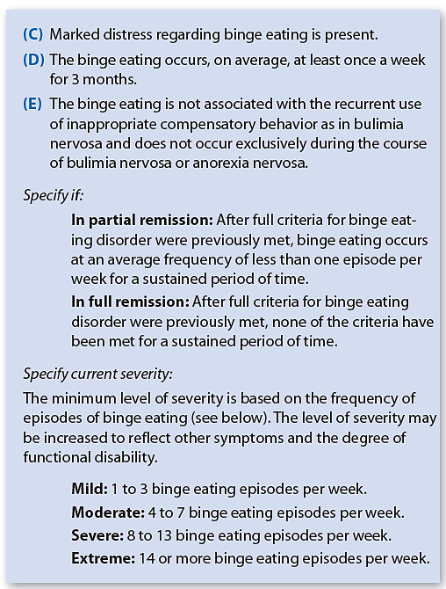
Diagnostic Criteria for Binge Eating Disorder

Slide 22
Treatment of Binge-Eating Disorder
Treatment
Cognitive-behavioral and interpersonal therapy
Antidepressants and other medication

Slide 23
BED: Treatment
Medication
SSRI - high dose reduces binge behavior short-term but doesn’t help weight loss
Topiramate - helps binge reduction & weight loss
Psychotherapy
Therapies either prioritize…Weight loss, Binge-reduction OR relationships, depression etc
Group psychotherapy
Psychosocial Support
Family may need help with co-dependency
Weight loss programs
12-step self-help groups (addressing problem as addiction)
Food Addicts in Recovery Anonymous

Slide 24
Anorexia Nervosa
Characterized by refusal to maintain minimally normal body weight; intense fear of gaining weight; and significant disturbance in perception and experiences of body size
DSM-5 subtypes
Restricting type - individual loses weight through diet, fasting, or excessive exercise
Binge-eating/purging type
Risk Factors
Perfectionism for AN; Athletics; Beginning a diet
Early Puberty; Antecedent illness with weight loss
Failed attempts to lose weight; Discovery purging, fasting or exercising compensates for binging
Family hx of eating disorder, substance abuse or mood disorder

Slide 25
The Impact of Media
90% of all girls ages 3-11 yrs have a Barbie Doll. If Barbie was a real woman, her measurements would be 38-18-33. The body type portrayed in advertising as the ideal is possessed naturally by only 5% of females. The desirable female figure had curves and ample fat until Twiggy and the diet industry came on the scene in 1960’s
Risk factors for AN:
puberty; perfectionistic personality; family h/o affective, OCD, Anxiety disorder; impaired family interactions, stressful life events (e.g., sexual abuse, beginning college, etc.)
Prognostic indicators for AN:
age of onset (12 - 18 is better as prior to 18yr families can mandate treatment; prior to 12yr is bad prognosis); weight at treatment;
bulimic/purging symptoms-worse prognosis (restrictors do better);
chronicity of illness (>6 yrs of illness with little treatment benefit);
repeated hospitalizations; poor social functioning

Slide 26
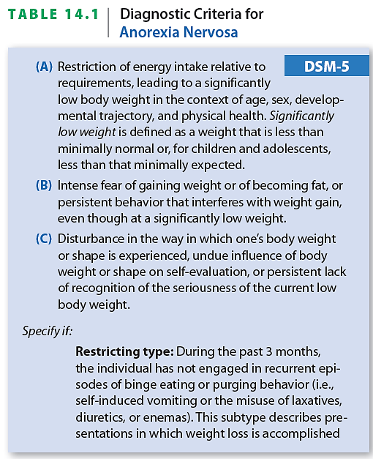
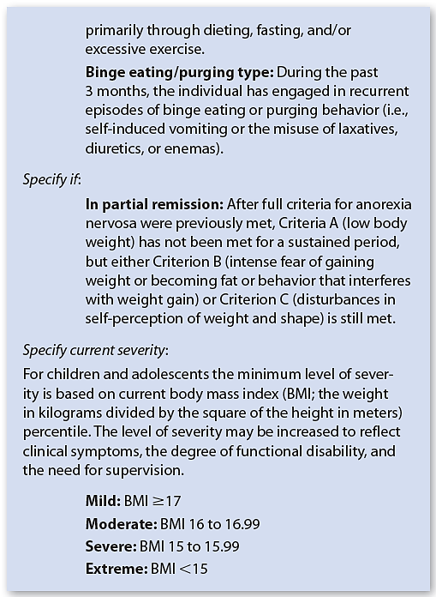
Diagnostic Criteria for Anorexia Nervosa

Slide 27
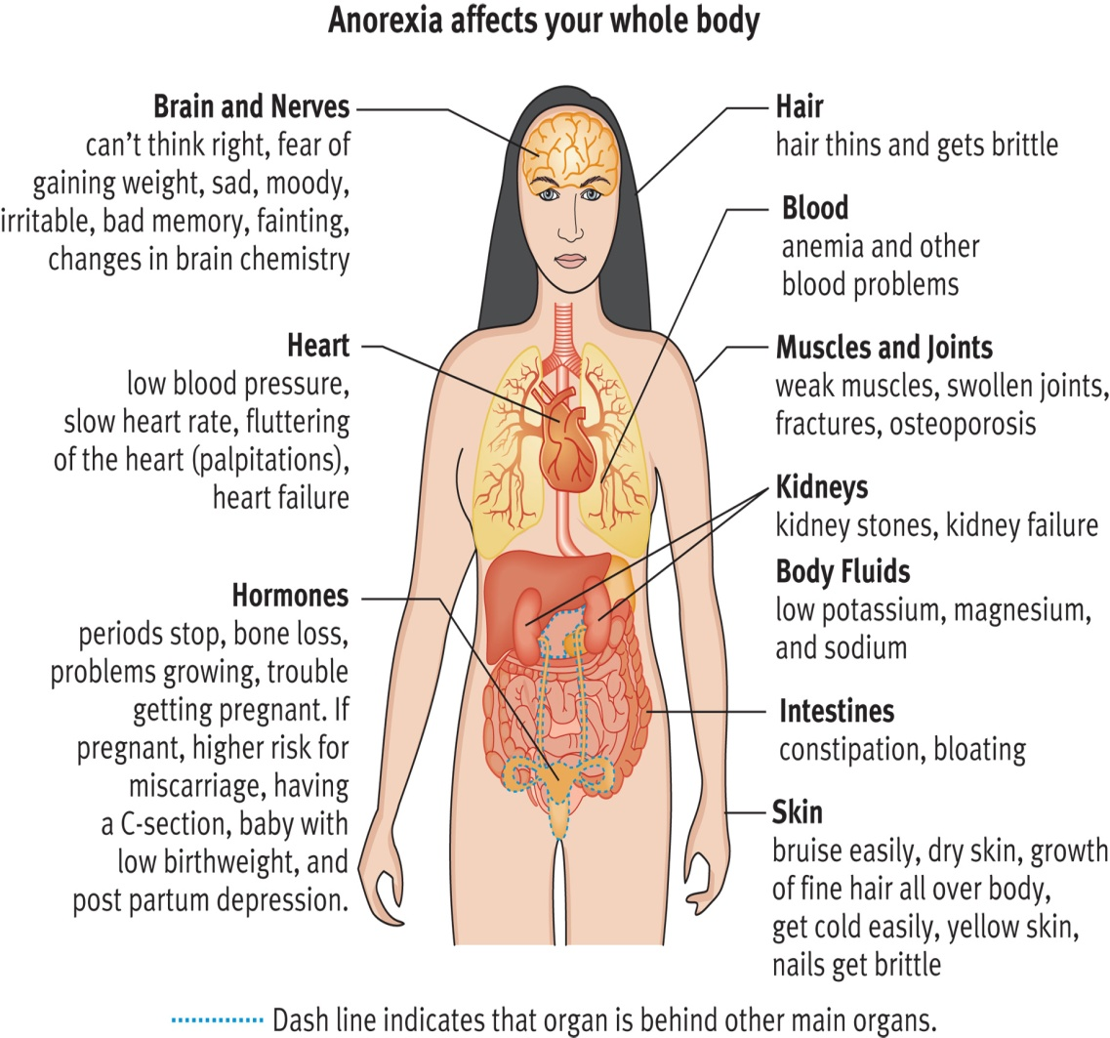
Medical Risks
Death (suicide, starvation, sudden cardiac death)
Hypometabolic state (bradycardia, hypotension, hypothermia)
Orthostasis
Dehydration
Arrhythmia, heart failure, liver failure
Malnourishment
Bone loss
Lanugo
Peripheral edema
Stunted growth
Delayed sexual maturity
Hair loss, brittle hair
Cognitive impairment
Water intoxication
On recovery: Re-feeding syndrome
Cerebral Atrophy. Associated with weight loss but not necessarily with lowest BMI. May improve but do not necessarily return to normal

Slide 28
MEDICAL COMPLICATIONS: UNDERWEIGHT
CVS: ECG (low voltage; sinus bradycardia; T wave inversions: ST depression-electrolyte imbalance: prolonged QTc), dysrhythmias, pericardial effusions – all reversible except following ipecac use
Growth and development: pubertal/growth delay, delayed bone mineral accretion and 1˚ amenorrhoea,.
Dietary deficiencies: calcium, vit D , folate, B12
GIT: delayed gastric emptying, ↓gastric motility, constipation, bloating, abnormal LFTs, hypercholesterolaemia, pancreatitis, superior mesenteric artery syndrome– all reversible
Renal: dehydration, ↓GFR, stones, polyuria, total body Na and K depletion; peripheral edema with refeeding
Haematologic: leukopoenia, anaemia, thrombocytopoenia,
Endocrine: sick euthyroid syndrome, amenorrhoea, osteopenia
Neurologic: cortical atrophy, seizures

Slide 29
DIFFERENTIAL DIAGNOSIS
Schizophrenia, MDD, OCD (ritualistic eating behaviors)
Important associated general medical conditions are: (1) Kleine-Levin Syndrome (hyperphagia, hypersomnia, and irritability seen in adolescents with a self limiting course); and (2) Kluver-Bucy Syndrome (limbic system dysfunction with visual and auditory agnosia, placidity, hyperorality, hypersexuality, hyperphagia, seen in Pick’s Disease, HIV Encephalopathy, Herpes Encephalitis, brain tumors, etc.)
COMORBIDITY
Most with an eating disorder also meet criteria for another psychiatric disorder, commonly MDD or a PD such as Borderline
Rates of OCD in anorexia is about 5x the general population; OCPD found in 30% of parents of anorexics.
Anorectics face an increased risk of depression, anxiety d/o (especially OCD & Social Phobia), and personality d/o (cluster C in anorectic restrictors; cluster B and C in anorectic bulimics)

Slide 30
Comorbidity
Bulimics face an increased risk of depression; anxiety d/o may also be increased
The lifetime prevalence of substance abuse/dependence among bulimics (particularly alcohol and stimulants) is at least 30% (25% among all patients with an eating disorder)
The diagnosis of a personality d/o among bulimics is not uncommon (especially Borderline PD)

Slide 31
HISTORY
Detailed feeding history; duration eating concerns,
Current intake & pattern even fluids, weight / shape cognitions,
Rapidity weight loss - > 1 kg/week serious, menstrual history / pubertal progression, Use laxatives, diuretics etc
Sleep pattern, Activities / exercise, Co-morbid mental illness (anxiety, phobia, OCD, depression), Personality description from relatives, Suicidal ideation, DSH, overdose
Symptoms of hyperthyroidism, dm, malignancy, IBD, etc
Relationships, Family history – ED , mental illness
Female relative of one with an ED is > x4 likely to have BN and > x11 likely to have AN than one with no family history
MEDICAL ASSESSMENT
History/Weight/ BMI/Temp

Slide 32
EXAMINATION
Oversized clothes; Muscle wasting / lack subcutaneous fat, malnutrition, Lanugo, dull thin scalp hair, Dehydration.
Cold extremities, cyanosis. Anaemia. Murmurs, arrythmias,
Signs bingeing / purging: Russell’s sign, palatal scratches / petechiae, dental erosions, parotitis
Vitamin and mineral deficiency: anaemia, dry/sallow skin, carotenaemia , glossitis, lip fissures, bleeding gums, brittle nails, Chvostek’s sign, Trousseau’s sign
Look for signs to possible underlying medical condition
MSE
INVESTIGATIONS
Baseline bloods - clotting, Ca, PO4, Mg, HCO3, iron studies, folate, B12, Vit D, amylase, ESR, CRP,TFTs, lipids, glucose. ECG. Urinalysis
Wrist Xray - Bone age / density

Slide 33
MALNUTRITION IS A MEDICAL EMERGENCY
Treatment of AN must focus on three primary issues:
(1) Restoring weight; (2) modifying distorted eating behavior & (3) addressing psychological/family issues.
Treatment methods typically include nutritional rehabilitation, psychotherapy, and medication.
Often outpatient with intensive day treatment
Hospitalization is typically encouraged when the patient is severely malnourished, dehydrated, suffering from an electrolyte imbalance, or facing other physically threatening complications. And also if outpatient treatment has not been effective, there is a risk of suicide, psychosis is present, or there is a major lack of motivation toward resolving the FED.

Slide 34
Treatment of Anorexia Nervosa
Common treatments
Antidepressants or other medications
Family therapy
Cognitive-behavioral therapy
Multidisciplinary teams ESSENTIAL!
Primary care provider
Psychiatrist
Individual therapist
Family therapist
Nutritionist
Prozac/other SSRI for co-morbid depression or anxiety
Low-dose Zyprexa/Atypical Antipsychotics for near-psychotic thinking characteristic of anorexia, may help with weight gain
CBT & Group psychotherapy mainstay of treatment for AN in both inpatient and outpatient settings.

Slide 35
Family Based Treatment/Maudsley Approach
no-blame approach, family did not cause AN
family best resource to help her/him get better
Empower parents to get young person to eat in order to save their life
Align siblings with the patient for support
“Externalize” the AN/Family Meal/Focus on weight restoration first, then explore the family dynamics and psychological issues that may get in the way of maintaining weight
Prognosis-1/3 recover. 1/3 mild course & 1/3 chronic severe course.
> 3 years of illness: prognosis is poor

Slide 36
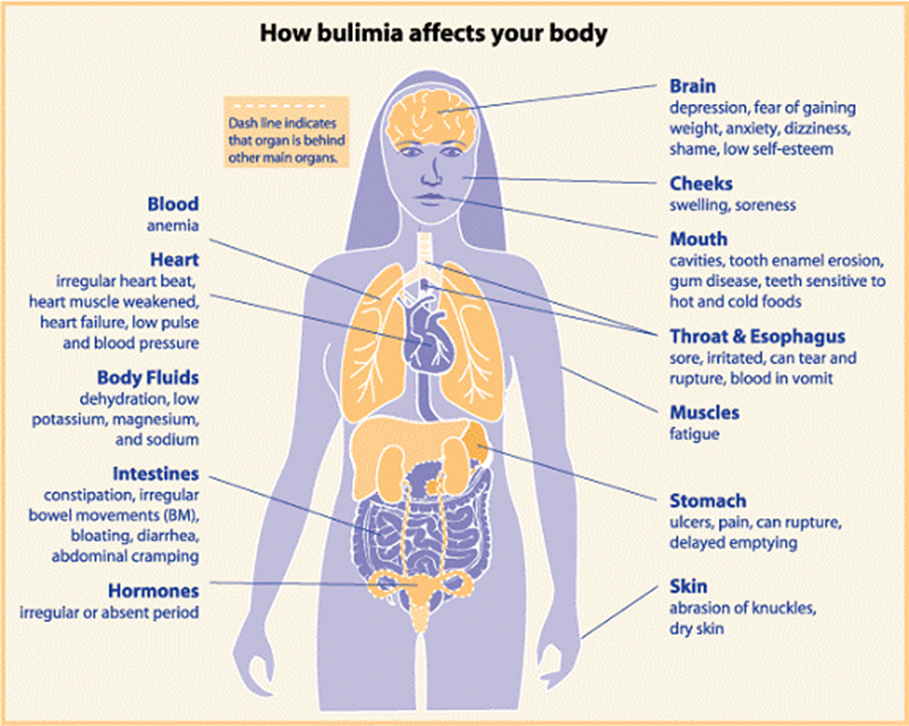
Bulimia Nervosa
Much more common than anorexia
Primary feature is recurrent binge eating
Binges are followed by compensatory behaviors (intended to prevent weight gain) in the form of two subtypes:
Purging
Non-purging

Slide 37
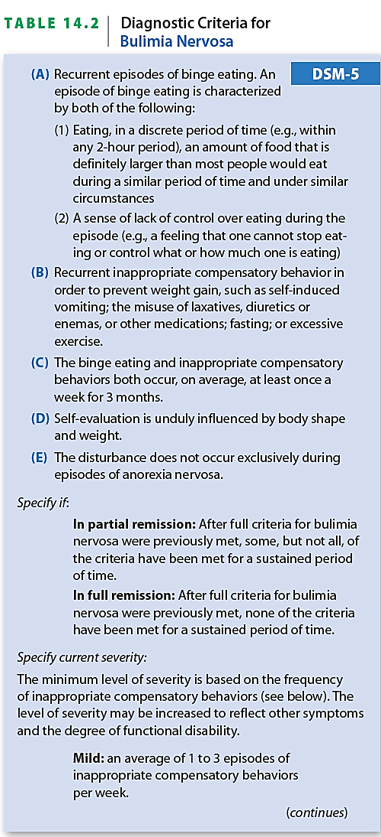
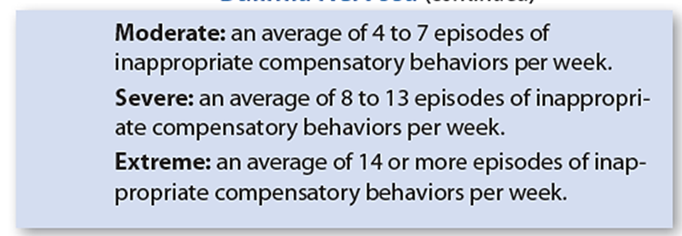
Diagnostic Criteria for Bulimia Nervosa

Slide 38
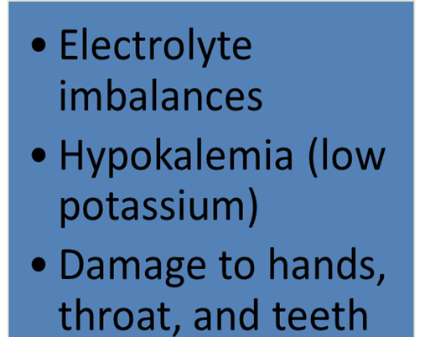
Anorexia vs. Bulimia
Denies abnormal eating behavior
Introverted
Turns away food to cope
Preoccupation with losing more and more weight
Recognizes abnormal eating behavior
Extroverted
Turns to food to cope
Preoccupation with attaining an “ideal, but often unrealistic weight
Medical Complications of Eating Disorders

Slide 39
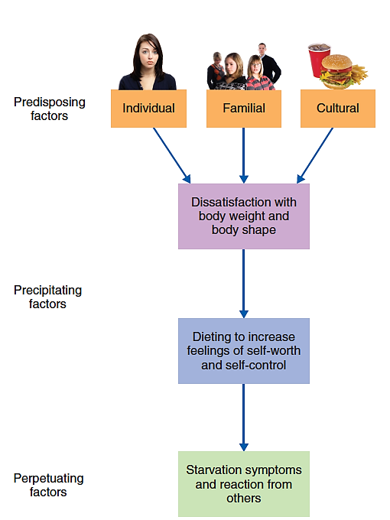
Eating disorders multi-determined
Biological factors
Sociocultural factors
Family influences
Individual risk factors

Slide 40
TREATMENT OF BULIMIA NERVOSA
Multidisciplinary team!!!
Best evidence: CBT + Antidepressant (SSRI)
Adolescents - Family-Based Treatment (FBT) modified for BN (good evidence, but not as good as for AN)
Common treatments
Antidepressants or other medications
Cognitive-behavioral therapy

Slide 41
BN: Risk Factors & Prognosis
Risk Factors for BN:
dieting,
puberty,
transitions (e.g., college, new job, relationship break-up),
various jobs (athletes, actors, models),
anorexia,
impulsivity,
anxiety,
Favorable Prognostic Indicators for BN:
younger age at onset;
higher social class, and
family history of alcohol abuse

Slide 42
ASANTE SANA

