Slide 1
Psychopharmacology
Antidepressant medication

Slide 2
Neurochemistry
Three Main Neurochemicals in Mood Regulation
Serotonin
Noradrenalin
Dopamine
Depression results from a whole range of different
neurochemicals not functioning properly.

Slide 3
Neurochemistry
These 3 neurochemicals are also called monoamines
They innervate similar regions in the brain
The cause of depression may be a mixture of deficient monoamines or circuits that are “out of tune” .
Mono amine hypothesis is that one neurochemical is affected, now increasing emphasis is on receptors and circuits
In some depressions several mono amines are affected
Advances in treatment are focused on other neurochemicals and systems

Slide 4
SEROTONIN PATHWAYS

Slide 5
Noradrenalin Pathway

Slide 6
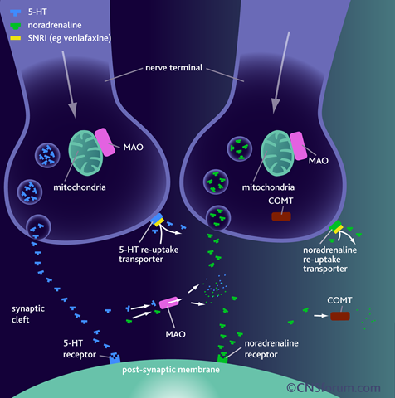

Slide 7
Inter-Neuronal Synapse
Main Action
Presynaptic Release of mono amines
Stimulation of post-synaptic receptors
Controls of neurotransmitters
Presynaptic re-uptake pumps of monoamine
Presynaptic Inhibitor
Inter-neuronal Oxidase enzymes breakdown

Slide 8
Re-uptake Inhibition Tricyclic antidepressants
Tricyclic antidepressant - T.C.A. (1950s)
Three rings in molecules
Inhibit noradrenalin and serotonin reuptake
amitriptyline
More emphasis on Noradrenalin
desipramine, nortriptyline
More emphasis on Serotonin
clomipramine

Slide 9
Tricyclic Antidepressants
Problems
Many side effects due to anticholinergic effects: blurred vision, dry mouth, constipation.
Affects patients ability to tolerate therapeutic doses and compliance is reduced.
Cardio-toxic in overdose.

Slide 10
Tricyclic antidepressants
Anticholinergic effects: dry mouth, blurred vision with difficulty in accomodation, delayed gastric emptying, constipation, sweating, urinary retention, can precipitate narrow angle glaucoma, cognitive impairment and confusional states
Antiadrenergic effects: postural hypotension, fall in elderly, ejaculatory impotence
Antihistaminic effects: sedation, weight gain
Sedation: amytriptyline> imipramine> desipramine> nortriptyline
Seizure on withdrawal
Cardiac tachyarrythmia
Toxic in overdose (Dothiepine most toxic in overdose)

Slide 11
Tricyclic contraindication
Arrythmia (heart block)
Hypomania or mania
Recent myocardial infarction
Severe liver disease

Slide 12
Re-uptake Inhibitors Modern antidepressants
Selective Serotonin Reuptake inhibitors (SSRI)
e.g: fluoxetine, sertraline, citalopram
Selective Noradrenalin Reuptake Inhibitors (NRI)
reboxetine
Serotonin/Noradrenalin Re-uptake Inhibitors (SNRI)
Venlafaxine, duloxetine
Noradrenalin/Dopamine reuptake Inhibitors (NDRI)
Bupropion

Slide 13
Side effects
nausea, vomiting, diarrhea
sexual dysfunction,
headache, weight gain, anxiety, dizziness, dry mouth
trouble sleeping.
Abnormal bleeding:
Use of SSRIs with certain pain relievers (aspirin, ibuprofen, naproxen, and blood thinners such as warfarin may increase the risk of bleeding.

Slide 14
Side effects of SSRIs
Serotonin syndrome
a serious medical condition
anxiety, restlessness, sweating, muscle spasms, shaking, fever, rapid heartbeat, vomiting, and diarrhea.
Can be caused by antidepressants, some pain relievers such as meperidine or tramadol, St. John's wort, medicines used to treat migraine headaches called triptans (tryptamine based drugs), and some street drugs such as cocaine
Suicidal thoughts or behavior: All antidepressants may increase the risk of suicidal thoughts or behavior in children, adolescents, and young adults (18 to 24 years of age).

Slide 15
Multimodal antidepressant
Vortioxetine
is considered a new multimodal antidepressant.
antagonistic properties at 5-HT3A and 5-HT7 receptors,
partial agonistic properties at 5-HT1B receptors,
agonistic properties at 5-HT1A receptors, and
potent inhibition of the serotonin reuptake transporter
effects on numerous serotonin receptors result in regional increases in noradrenaline and dopamine as well as glutamatergic transmission

Slide 16
Mono-amine Oxidase Inhibitors (MAOI)
Block the action of inter-neuronal enzymes that breakdown Noradrenalin and serotonin
This leads to an increase of the monoamines
Older MAOIs are dangerous with drug interactions or foods with tyramine leading to hypertensive crisis
Modern MAOI less risk, moclobemide
Used in depressions not responding to usual treatment.

Slide 17
Treatment of Depression
Ensure adequate dose, compliance and length of time before changing treatment
Continuation:
1st episode for 6 months post recovery
2nd episode for 2 to 3 years
3rd episode 5 years
4th episode justify stopping

Slide 18
Treatment of Depression
Discontinuation:
Slow
Over 4 to 5 weeks
Watch for discontinuation syndrome
Not responding to treatment: Clarify diagnosis
Augmentation: Atypical antipychotic
Lithium
Combined Antidepressant
Electro-convulsive Treatment

Slide 19
Mood Stabilisers
Lithium (li level, Renal, Thyroid)
Valproate (hb wcc, LFT, U&E)
Atypical Psychotic Medication

Slide 20
Physical State
Detailed personal and family history of disorders especially cardiac , diabetes, hyperlipidaemia and neurological disoders.
E.C.G., Blood sugars, lipids, cholesterol before and during treatment – NICE Guidelines.
Dietary advice from the start Monitor weight and Blood Pressure
Regularly review physical state

