Slide 1
Psychopharmacology
Antipsychotic medication

Slide 2
Outline
Describe antipsychotic drugs (APDs)
Types of APDs
Actions
Side effects
Indications
Side effects

Slide 3
Antipsychotic medications
Synonyms
Major Tranquillizers
Neuroleptics
Actions
Antipsychotic
Tranquillize without impairing consciousness
Do not cause paradoxical excitement
Uses
Calming patients whatever the underlying condition
Have been used in psychotic conditions (schizophrenia, mania and depression, delirium)
Note that they are used in mania even without psychotic symptoms
Preventing relapse of schizophrenia
Prophylaxis of bipolar disorders
Use in anxiety disorders not recommended

Slide 4
Schizophrenia
Dopamine hypothesis
Psychogeneic effects of amphetamines
Correlation between clinical potency and D2
Some earlier studies demonstrating increased D2 in post-mortem studies
Dopamine receptors

Slide 5
Clinical Features of schizophrenia
Positive symptoms
Delusions
Hallucinations
Disorganised speech
Catatonia
Negative symptoms
Affective flattening
Alogia
Avolition
Anhedonia
Social withdrawal
Social / occupational dysfunction
Work
Interpersonal relationships
Self care
Mood symptoms
Depression
Hopelessness
Suicidality
Anxiety
Agitation
Hostility
Cognitive deficits
Attention
Memory
Executive functions (eg abstraction)
Comorbid substance abuse
Maguire 2002

Slide 7
DOPAMINE RECEPTORS
Limbic system and neocortex | Mesolimbic and mesocortical pathways
Striatum | Nigro-striatal pathway
Hypothalamus | Tuberfundibular pathway
Brain stem | Chemoreceptor trigger zone

Slide 8
Tubero Infundibular Tract
Hyper prolactinaemia
2ary Amenorrhoea
Gynecomastia
Galactorrhoea
Exclude Other causes eg Macro-adenoma

Slide 9
Nigro striatal Tract
Parkinsonism
Akathisia
Acute Dystonia
Tardive Dyskinesia

Slide 10
Actions APDs on serotonin receptors
Typical
mainly DA D(2/)D(3) receptor antagonists
weaker, if any, potency as 5-HT(2A) receptor antagonists
Atypical
Lesser reduction in dopamine (DA) D(2) D(3)
Extensive blockade of serotonin (5-HT)(2A) receptors
Direct or indirect stimulation of 5HT (1A)
Some atypical APDs are also effective 5-HT(2C) receptor inverse agonists or neutral antagonists, 5-HT(6) or 5-HT(7) receptor antagonists

Slide 11
Significance of action of APD on serotonin receptor
5-HT(2C) receptor antagonism appears to contribute to the weight gain produced by some atypical APDs
Dopaminergic activity may also affect cognition and psychosis via its influence on cortical and limbic pathways.

Slide 12
ATYPICAL ANTIPSYCHOTICS Lower prevalence for EPS side effects Higher affinity for 5HT2A receptors than Dopamine receptors
THEORIES
Lower affinity for Dopamine receptors (but still therapeutic)
Blockade of 5HT2A receptors and its effect on Dopamine
Higher dissociation and less tight binding
Involvement of D4 receptors
Involvement of Muscarinic receptors (anticholinergic effect)

Slide 13
Antipsychotic actions
Typical antipsychotics act on
Dopamine
Acetylcholine muscarinic receptors
Adrenaline/noradrenaline
Histamine
Atypicals act more on 5-HT, D4, D1, muscarinic and alpha adrenergic receptors

Slide 14
Other Receptors
Receptor antagonism | Effects
5HT2c | Increased appetite
M3 | Decrease insulin release
M1, H1, ALPHA 1 | Sedation

Slide 15
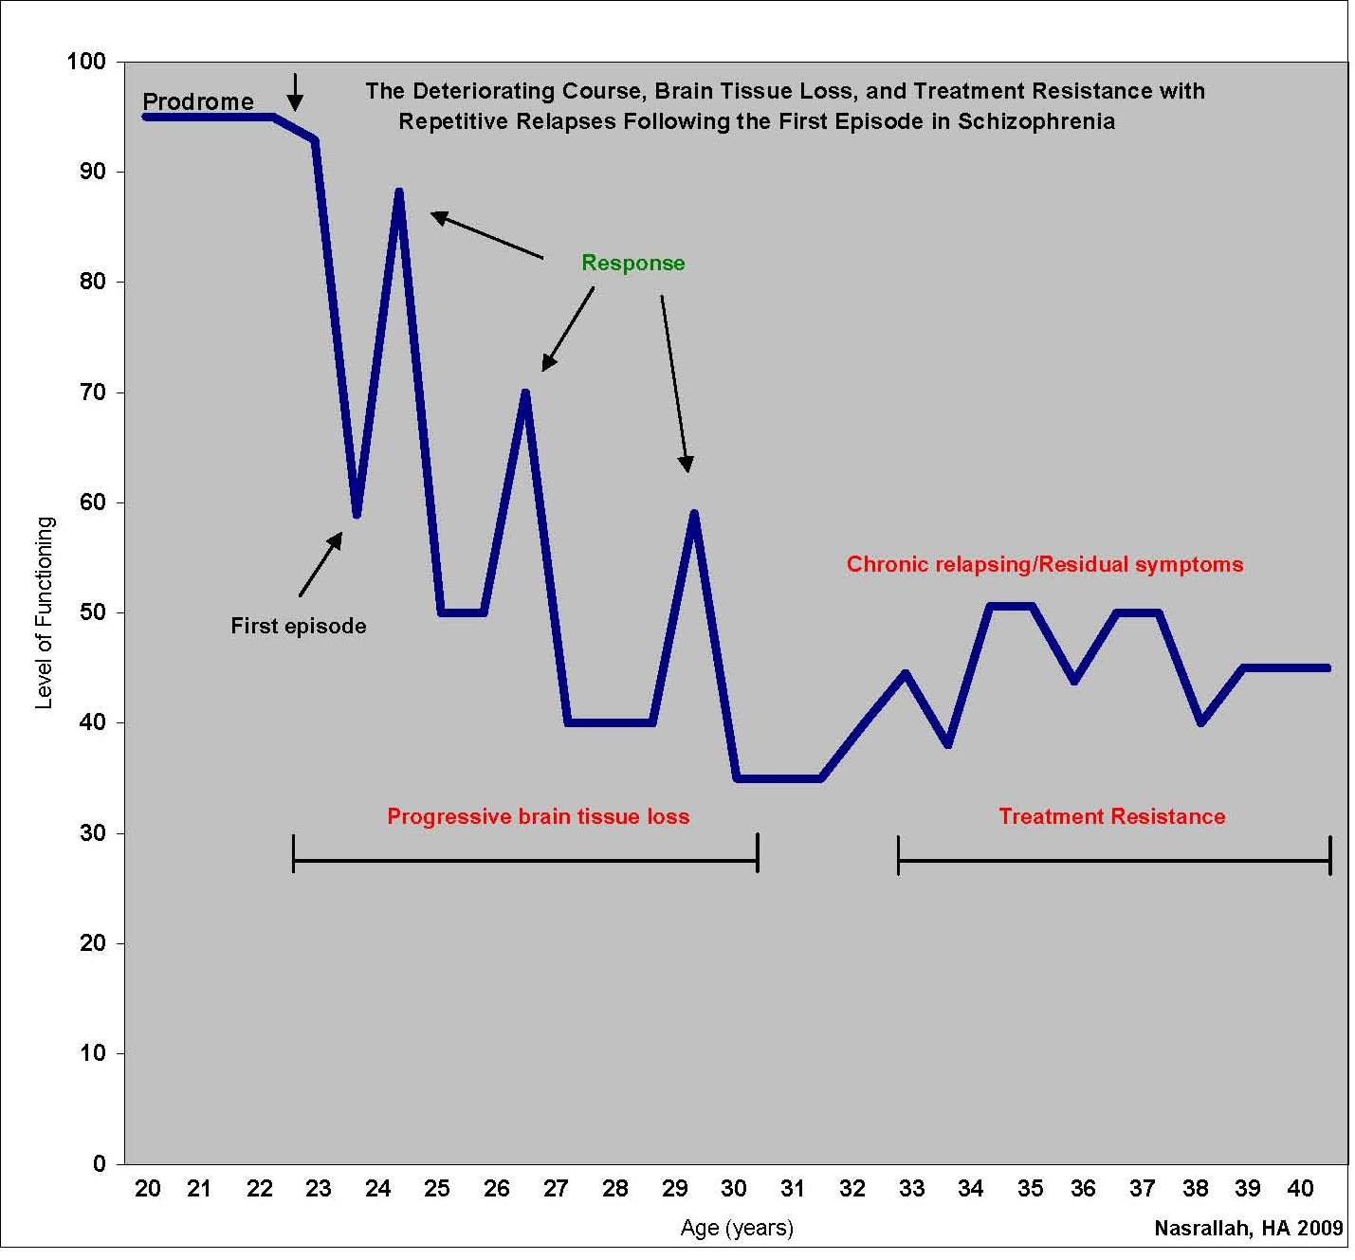
First
Episode
Second
Episode
Third
Episode
Fourth
Episode
Notes:
This slide has been written and collated by the speaker, Prof Nasrallah 2009

Slide 16
Antipsychotics: FGAs oral
Phenothiazines –
Aliphatic: Chlorpromazine, promazine
Piperazine: fluphenazine, trifluoperazine
Piperidines:
Butyrophenones
Haloperidol
Thioxanthines
Flupentixol
Zuclopenthixol
Diphenylbutypiperidines
Pimozide
Sulpiride

Slide 17
Antipsychotics: SGA oral
Amisulpiride
Aripiprazole
Clozapine: used in drug resistance
Olanzapine
Paliperidone
Quetiapine
Risperidone
Sertindole
Ziprasidone
Zotepine

Slide 18
SGA classification 1
Dibenzodiazepine
Clozapine
Thienobenzodiazepine
Olanzapine
Dibenzothiazepine
Quetiapine
Benzisoxazole
Risperidone

Slide 19
SGA classification 2
Dibenzothiepine
Zotepine
Imidazolidinone
Sertindole
Substituted benzamide
Amisulpiride
Benzothiazylpiperazine
Ziprasidone
Dihydrocarbostyril
Aripiprazole

Slide 20
Antipsychotics: depots
Flupentixol decanoate
Fluphenazine decanoate
Haloperidol decanoate
Pipothiazine palmitate
Zuclopenthixol decanoate (depot; acuphase)
Risperidone microspheres
Olanzapine pamoate

Slide 21
New antipsychotics
Asenapine
Bifeprunox
Iloperidone
Paliperidone
Olanzapine pamoate

Slide 22
FGA vs SGA
FGA
Greater propensity to cause
EPS
Hyperprolactinaemia
Tardive dyskinesia
Some SGAs show dose-related EPS, some induce hyperprolactinaemia and some may eventually give rise to tardive dyskinesia
Therefore the main difference is the size of therapeutic index in relation to acute EPS.
Haloperidol < 0.5 mg/day; olanzapine 20 – 40 mg/day

Slide 23
Atypical Antipsychotics
Less E.P.S. Through action on 5HT2a
Helps Negative symptoms ? How
Range of actions on receptors

Slide 24
Indications for Clozapine
Treatment resistance:
Adequate dose
Adequate length of time
Two antipsychotics with at least one
atypical
Informed consent about risks
Compliance with Blood monitoring

Slide 25
Adverse drug reactions
Intolerance
Idiosyncratic reactions
Allergic reactions
Drug interactions

Slide 26
Adverse effects of antipsychotics
Antidoperminergic actions on the
mesolimbic system is linked to the antipsychotic actions
Tuberoinfindibular pathway causes hyperprolactinaemia, since dopamine is a prolactin-inhibitory factor, leading to
Galactorhoea
Gynaecomastia
Menstrual disturbances
Reduced sperm count
Reduced libido

Slide 27
Adverse effects of antipsychotics ...
Antidoperminergic actions on the nigrostriatal pathway lead to
Parkinsonism
Dystonias
Akathisia
Tardive dyskinesia
Antimuscarinic actions
Central: convulsions, pyrexia
Peripheral: dry mouth, blurred vision, urinary retention, constipation, nasal congestion

Slide 28
Adverse effects of antipsychotics
Antiadrenergic actions
postural hypotension,
ejaculatory failure
Antihistaminic actions
Drowsiness
Cardiovascular side effects
Sudden death
CVA
Prolongation of QT interval
Metabolic side effects
Diabetes and hyperlipidaemia
Weight gain

Slide 29
METABOLIC SYNDROME
Medically Healthy
Increased appetite
Weight gain
Increased TG’s
Insulin resistance Hyperinsulinaemia
Beta Cell failure
Diabetes
Cardiovascular events

Slide 30
Adverse effects of antipsychotics
Hepatic side effects
Dermatological side effects
Ocular side effects
Haematological side effects
Neuroleptic malignant syndrome (fever, sweating, rigidity, fluctuating consciousness, tachycardia, fluctuating BP)
Temperature dysregulation
Antipsychotic induced hyponatraemia
Water intoxication
Drug induced syndrome of inappropriate antidiuretic hormone (SIADH) secretion
Severe hyperlipidaemia and/or hyperglycaemia

Slide 31
Principles
Understand the indications
Is medication appropriate?
Know How Medication works
Explain and obtain consent from the patient
Use within recommended doses
Actively pursue side effects
Keep a careful note of prescribing, side effects and results

Slide 32
Special Issues
Pregnancy
Drug/alcohol abuse

