Slide 1
ANXIOLYTICS MEDICATIONS LECTURE
DR RACHEL KANG’ETHE
CONSULTANT PSYCHIATRIST
SENIOR LECTURER NAIROBI UNIVERSITY

Slide 2
REFERENCES:
The African textbook of psychiatry and mental health by Ndetei et al 2006
Kaplan and Saddocks Synopsis Psychiatry : Clinical Psychiatry , 2007

Slide 3
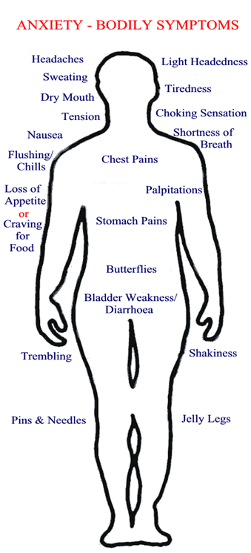
INTRODUCTION
Anxiety – apprehension about a future threat; fear – response to an immediate threat and both involve physiological arousal - ‘fight or flight ‘ reaction , which may save life and increase preparedness, however high anxiety levels distressing and detrimental!
Though it is normal to experience some level of anxiety [feelings of worry, fear and unease] at times, intense or persistent anxiety is indicative of an anxiety disorder.
DSM-5 Anxiety and related disorders: SAD, selective mutism, phobias, agoraphobia; social anxiety, panic, generalized anxiety disorders and OCD, PTSD, somatoform,

Slide 4
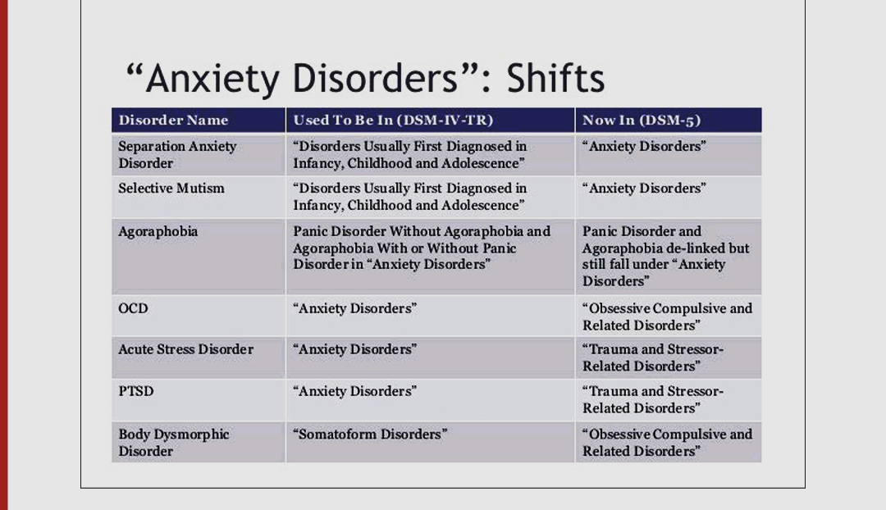

Slide 5
Anxiety and related disorders are common, with lifetime prevalence as high as 31% and often comorbid with other psychiatric and medical conditions.
Cause a significant burden on patients and their family; as associated with substantial functional impairment, increase the comorbid, associated with greater use of health care services and decreased work productivity.
Differential diagnosis and comorbidity: Consider if
  anxiety is due to another medical or psychiatric condition,
  is comorbid with another medical or psychiatric condition or
  is medication-induced or drug-related.
Optimal management requires a good understanding of psychological treatments and pharmacological treatment - the efficacy and side effect profiles of pharmacological agents. Hence this lecture…

Slide 6
Screen
for
anxiety and related symptoms
Biopsychosocial Interventions
•Psychological
and/or
•Pharmacological treatment
Follow-up
Conduct differential diagnosis
Rule out serious medical problems or SUDs which may present as anxiety disorders
Identify specific anxiety or related disorder
Evaluate
•severity
•impairment
•comorbidity
Biopsychosocial investigations (as per patient’s presenting symptoms), eg Bio
•blood count, sugar, lipid, TSH, LFTs, toxicology, [PDT]
What are anxiolytics?
It is increasingly difficult to define specifically, what an anxiolytic is, since classification of anxiety disorders changed and on the other hand most of the medications used to treat different forms of anxiety were first used as antidepressants.

Slide 7
ANXIOLYTICS/ANTI-ANXIETY MEDICATIONS: DEFINITION
Anxiolytics are anti-anxiety medications used to treat anxiety symptoms, without interfering mental or physical function.
TYPES OF MEDICATIONS ARE USED TO TREAT ANXIETY
Selective serotonin reuptake inhibitors SSRIs
Serotonin-norepinephrine reuptake inhibitors (SNRIs)
Tricyclic antidepressants (TCAs)
Benzodiazepines (anxiolytics and/or sedative drugs)
Others
  Beta blockers –reduce physiological symptoms of arousal, so useful for social and performance anxiety,
  Buspirone
  Anticonvulsants
  Antihistamines
  Ramelteon-selective melatonin receptor agonist
  Antipsychotics -as a last resort and in extreme cases antipsychotics

Slide 8
1. SELECTIVE SEROTONIN REUPTAKE INHIBITORS (SSRIs)
SSRIs, though antidepressants also prescribed to treat anxiety disorders are the first-line drug treatment for anxiety.
SSRIs are very effective in reducing anxiety and decreasing anxiety related symptoms associated with perseveration and preoccupation. Some SSRIs for anxiety include: fluoxetine, sertraline, citalopram, escitalopram, fluvoxamine, paroxetine
SSRIs should be started at low doses and gradually titrated to desired effect. SSRIs take effect within 2 to 6 weeks. SSRIs to treat anxiety, taken for up to 12 months then the dosage gradually reduced. SSRIs not habit forming & no dependence.
Carefully monitor for emergence of any agitation or irritability as SSRIs can induce mania in predisposed patients.
Also monitor for any signs of increased suicidal ideation or behaviors.

Slide 9
2. SEROTONIN-NOREPINEPHRINE REUPTAKE INHIBITORS (SNRIs)
  SNRIs [eg duloxetine, venlafaxine ] are another class of antidepressant that treats depression and anxiety.
These medications work by reducing brain's re-absorption of serotonin and norepinephrine.
Like SSRIs, SNRIs can take several weeks to be effective.
3. Tricyclic antidepressants (TCAs) for example - amitriptyline, imipramine
Though TCAs effective in treating anxiety, prescribed less than SSRIs, as they cause more side effects.
However, TCAs may be useful if other medications do not provide relief.

Slide 10
4. BENZODIAZEPINES [BDZs]
Benzodiazepines eg, alprazolam, diazepam are GABA-agonists, CNS depressants, enhance effect of gamma - aminobutyric acid (GABA), reducing brain activity, alleviating anxiety symptoms and encourage relaxation.
BZD effects take place within a few minutes. Though highly effective for short-term issues, they become less effective over time and can be addictive.
So, BZDs used to manage short-term anxiety but due to their addictive risks, not prescribed for continuous use for more than 1 month.
Initially benzodiazepine also prescribed alongside an SSRI for a few weeks until SSRI takes effect.
Better if BZs taken on a daily basis rather than “as needed“, so as to reduce psychological dependence

Slide 11
BENZODIAZEPINES (BZDS) PHARMACOLOGICAL ACTION:
• Reduction of anxiety: At low doses, BZDS are anxiolytic. BZDS reduce anxiety by selectively enhancing GABAergic transmission, thereby inhibiting neuronal circuits in the limbic system of the brain.
• Sedative and hypnotic actions: All BZDS used to treat anxiety have some sedative properties and some produce hypnosis (artificially produced sleep) at higher doses.
• Anterograde amnesia: The temporary impairment of memory with use of BZDS, impairs a person’s ability to learn and form new memories.
• Anticonvulsant: Several BZDS have anticonvulsant activity, so some used to treat epilepsy (status epilepticus) and other seizure disorders.
• Muscle relaxant: At high doses, BZDS relax the spasticity of skeletal muscle, probably by increasing presynaptic inhibition in the spinal cord, where the α2- GABAA receptors are largely located.
BZDs metabolized extensively by CYP450 enzymes and show just small differences in relative anxiolytic, anticonvulsant & sedative properties.

Slide 12
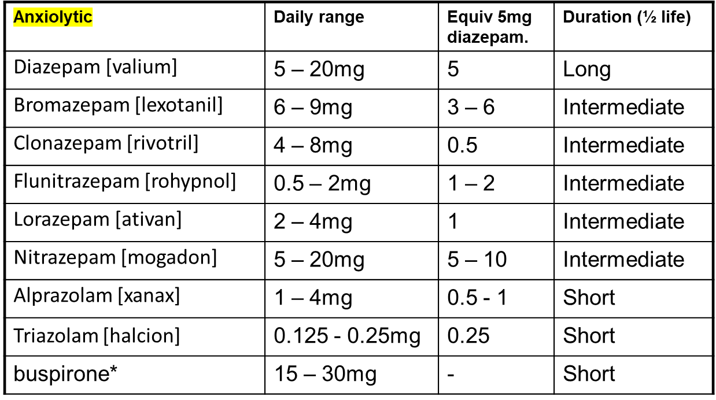
BENZODIAZEPINES [BZDs] PHARMACOKINETICS
Short Acting: 3 - 8 hrs: Alprazolam[xanax], Triazolam[halcion], Midazolam [dormicum]
Intermediate Acting: 10 - 20 hours: Bromazepam[lexotanil], Clonazepam [rivotril] Flunitrazepam[rohypnol], Lorazepam[ativan], Nitrazepam[mogadon]
Long Acting: 1 – 3 days: Chlordiazepozide[librium], Diazepam [valium]

Slide 13
BZDs advantages
SAFE! Very low toxicity, unlike barbiturates or alcohol
Don’t induce metabolic enzymes; don’t accelerate metabolism.
BZDs side effects
Sedation, psychomotor and cognitive impairment, confusion (especially in the elderly), increased appetite/weight gain, alterations in sexual function, some women fail to ovulate, potentiation of other sedatives, dependence and withdrawal
Withdrawal symptoms:
Increased anxiety, sleep #, aches, abrupt cessation> seizures. Short half life benzodiazepines are associated with more acute & intense withdrawal symptoms. Long half life benzodiazepines - milder, more delayed withdrawal
Benzodiazepines should not be ceased abruptly.
Dose reduced by 10-20% per week. Admission for high dose users, history of seizures or psychosis

Slide 14
Overdose Benzodiazepines –
safe in overdose unless mixed with alcohol/CNS depressants.
Symptoms overdose: hypotension, respiratory depression, coma.
Treatment: Supportive. Flumazenil rarely indicated
Benzodiazepine antagonist - Flumazenil is a GABA-receptor antagonist that can rapidly reverse the effects of benzodiazepines.
• (IV) administration only. Onset rapid, duration short, half life 1 hr.
Benzodiazepines key points
Do use in patients with history of substance abuse, severe respiratory distress, performing hazardous tasks
Avoid during pregnancy/lactation if possible
Assess for over sedation. Cease slowly
Monitor elderly (cognition, falls)
Be aware they raise seizure threshold, and
Potentiate CNS depressants (alcohol)

Slide 15
5. Many other medicines may help treat anxiety:
Buspirone anti-anxiety medication may treat short-or-long-term anxiety symptoms, reduces anxiety by stimulating serotonin and dopamine nerve receptors, thereby altering chemical messages nerves receive. Not CNS depressant, no sedation, anti-convulsant or muscle relaxant properties - just anxiolytic. Delayed action 1-2 weeks. Effect reduced if BZDs used last 3/12 . Though works more slowly than BDZs, causes fewer side effects with lower dependency risk.
COMPARISON OF BENZODIAZEPINE & BUSPIRONE
Benzodiazepine
Rapid onset
Can cause sedation
May impair performance
Additive effects with alcohol
May cause dependence & withdrawal
Pharmacokinetic change with age.
Associated with falls in elderly
Buspirone
Delayed onset (can’t be used PRN)
Does not cause sedation
Does not impair performance
No additive effect with alcohol
Non addictive
No pharmacokinetic change with age
Does not cause falls in elderly
Expensive (Not on PBS)

Slide 16
5. Many other medicines may help treat anxiety:
Buspirone
Beta-blockers eg, atenolol, propranolol, are high blood pressure medications, that reduce norepinephrine effects, and so can relieve some of the physical symptoms of anxiety.
Monoamine oxidase inhibitors (MAOIs) eg, - Isocarboxazid, phenelzine, selegiline, tranylcypromine. MAOIs an early antidepressant, is prescribed to treat the symptoms of panic disorder and social phobia.
Anticonvulsants (nonbenzodiazepine) eg, pregabalin, like benzodiazepines, also increases GABA action, and this is its main mechanism for reducing anxiety.
Antihistamines for example, hydroxyzine. Hydroxyzine, an antihistamine that causes sedation, helps treat insomnia caused by anxiety or other medical conditions.
Ramelteon: selective melatonin receptor agonist –non addictive.

Slide 17
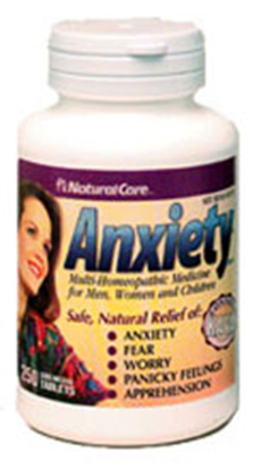

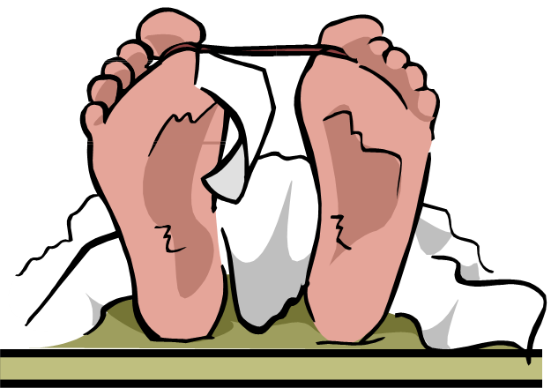


OTHER DRUGS INTERACTIONS WITH ANTI-ANXIETY MEDICATIONS
Combining SSRIs or SNRIs with warfarin, aspirin, nonsteroidal anti-inflammatory or other drugs that affect bleeding may increase likelihood of patients developing upper GIT bleeding.
Buspirone increases warfarin’s effects and may increase the risk of bleeding in patients.
Combining anxiolytics with MAOIs or other drugs that inhibit MAOIs eg, buspirone, linezolid, intravenous methylene blue may lead to confusion, hypertension, tremor, hyperactivity, coma and death. Similar reactions may develop if SSRI/SNRIs combined with other drugs that increase serotonin in the brain.
Combination CNS depressants

Slide 18
TAKE HOME POINTS
First-line anxiolytics - SSRIs and SNRIs. Other options - TCAs, buspirone, moclobemide and extreme cases antipsychotics
BZDs not for routine use. Avoid in pregnancy/lactation if possible
When developing treatment plan – efficacy, adverse effects, interactions, costs and preferences should be considered.
CHECK POINTS WITH PATIENT WITH ANXIETY DISORDER
Step 1 – is patient safe and functional? need hospitalization, further evaluation, increased monitoring at home and/or medications to bring down anxiety to point they can function?
Step 2 – any medical or SUD issues need attention? relationship, job, financial or other problems?
Step3 – consider psychosocial and psychotherapy interventions
Step 4 – If medications option: start low-side effect SSRIs eg, sertraline, citalopram or SNRIs eg venlafaxine and mirtrazapine

Slide 19
ANXIOLYTICS RECOMMENDED
FOR
SPECIFIC ANXIETY AND RELATED DISORDERS

Slide 20
Generalized Anxiety Disorder [GAD] - Pharmacotherapy Recommendations
First-line: escitalopram, sertraline, venlafaxine, duloxetine, agomelatine,
Second-line: Alprazolam, diazepam, buspirone, hydroxyzine, imipramine,
Third-line: Divalproex chrono, trazodone. Adjunctive therapy: quetiapine, aripiprazole, olanzapine, risperidone. Not recommended: Beta blockers
Obsessive–Compulsive Disorder [OCD] - Pharmacotherapy Recommendations
First-line: Escitalopram, fluoxetine, paroxetine, sertraline
Second-line: Citalopram, clomipramine, mirtazapine, venlafaxine XR
Third-line: IV citalopram, duloxetine, phenelzine tranylcypromine
Adjunctive therapy: aripiprazole, risperidone, quetiapine, topiramate, citalopram, haloperidol, mirtazapine, olanzapine, ondansetron, pregabalin,
Not recommended: buspirone, clonazepam, lithium, morphine, clonidine
Recommendations for pharmacotherapy for Social Anxiety Disorder [ SAD]
First-line: Escitalopram, fluvoxamine, paroxetine, pregabalin, sertraline, veniz
Second-line: Alprazolam, bromazepam, citalopram, clonazepam, gabapentin,
3-line: Atomoxetine, clomipramine, divalproex, duloxetine, fluoxetine, mirtazapine, moclobemide, olanzapine, topiramate
Not recommended: buspirone, imipramine, propranolol, quetiapine

Slide 21
Recommendations for pharmacotherapy for PTSD
First-line: Fluoxetine, paroxetine, sertraline, venlafaxine XR
Second-line: Fluvoxamine, mirtazapine, phenelzine
Third-line: Amitriptyline, aripiprazole, buspirone, carbamazepine, duloxetine, escitalopram, imipramine, lamotrigine, memantine, moclobemide, quetiapine, risperidone, topiramate, trazodone
Adjunctive therapy: 2-line: eszopiclone, olanzapine, risperidone 3-line: aripiprazole, clonidine, gabapentin, pregabalin, quetiapine.
Not recommended: Alprazolam, clonazepam, divalproex, olanzapine
Recommendations for pharmacotherapy for panic disorder
First-line: Citalopram, escitalopram, fluoxetine, paroxetine, sertraline, veniz
Second-line: Alprazolam, clomipramine, clonazepam, diazepam, imipramine, lorazepam, mirtazapine, reboxetine
Third-line: Bupropion SR, divalproex, duloxetine, gabapentin, levetiracetam, moclobemide, olanzapine, phenelzine, quetiapine, risperidone,
Adjunctive therapy: alprazolam ODT, clonazepam; aripiprazole, divalproex, olanzapine, pindolol, risperidone
Not recommended: Buspirone, propranolol, tiagabine, trazodone

Slide 22

ASANTE SANA

