Slide 1
Sexual disorders & Psychosexual Therapy
Level V
Dr M. Mathai

Slide 2
Objectives of lecture
To familiarise students with sexual conditions that they may encounter as doctors
Reduce the feelings of embarassment and helplesnness when encountered with this area of human function
Introduce some skills that can be relevant in dealing with sexual disorders

Slide 3
Sexual disorders- intro
DSM IV- looks at Sexual disorders in 3 categories
Sexual dysfunctions- failure of function
Paraphilias- unusual forms of sexual expression
Sexual identity disorders- subjective awareness of sexual self (read up)

Slide 4
Common dysfunctions
Include:
Lack or loss of interest
Sexual aversion
Lack of sexual enjoyment
Failure of genital response- (vaginal dryness in females, erectile failure in men)
Orgasmic dysfunction
Premature ejaculation
Non organic vaginismus
Non organic dyspareunia

Slide 5
Sexual dysfunctions- classifications DSM IV
Sexual desire disorders
Hypoactive sexual desire- persistent or recurrent deficient or abscent sexual fantasies and desire for sexual activity
Sexual aversion disorder- persistent or recurrent extreme aversion to and avoidance of all or almost all genital sexual contact with a sexual partner

Slide 6
Sexual arousal disorder
Female sexual arousal disorder- persistent or recurrent inability to attain, or maintain untill completion of sexual activity, an adequate lubrication-swelling reponse of sexual excitement
Male erectile disorder- persistent or recurrent inability to attain or maintain untill completion of the sexual activity , an adequate erection.

Slide 7
Orgasmic disorders-
Female and Male- persistent or recurrent delay in, or abscence of, orgasm following a normal sexual excitement phase ( in females age, experience and adequacy of sexual stimulation should be taken into account.
Premature ejaculation- persistent or recurrent premature ejaculation with the minimal sexual stimulation before on or shortly after penetration and before the person wishes it

Slide 8
Sexual pain disorders
Dyspareunia not due to general medical condition- persistent or recurrent genital pain associated with sexual intercourse in either male or female
Vaginismus- persistent or recurrent involuntary spasm of the musculature of the outer third of the vagina that interferes with sexual intercourse

Slide 9
Important factors in diagnosis include:
The disturbance causes marked distress or interpersonal difficulty
The disturbance is not accounted for by a general medical condition or the physiological effects of a substance
In some of the dysfunctions factors that affect sexual functioning like age and context of the person‘s life must be taken into account

Slide 10
Subtypes
Lifelong (primary) or Acquired type (secondary)
Generalised or situational
Due to psychological factors or Due to combined factors

Slide 11
Organic sexual dysfunctions
Sexual dysfunctions due to a general medical condition
Substance- induced Sexual dysfunction

Slide 12
II. Paraphilias classifications DSM IV

Slide 13
Normal and abnormal?
There is immense cultural variation in sexual behaviour across culture and times
So what is implied by normality, abnormality, natural or unnatural, immoral sex
How do we decide what is normal sex
The guidelines for determining our normality is based on what friends or relatives reveal as normal and what is depicted in the media

Slide 14
Sexual diversity
Sexual diversity can be viewed as existing in a continuum with the frequency that individuals engage in different types of sexual practices ranging from never to always
Under this understanding of sex there is no normal or abnormal
One can then talk about an individuals behaviour being more or less typical or atypical of the group average to which he/she belongs

Slide 15
Definition
Paraphilias are frequent, intense, sexually arousing fantasies or behaviors that involve inanimate objects, children or nonconsenting adults, or suffering or humiliation of oneself or the partner.

Slide 16
Normality or pervertion?
Some degree of variety in sexual activity is very common in healthy adult sexual relationships and fantasies.
Mutual agreement to engage in noninjurious sexual behaviors of an unusual nature may be part of a loving and caring relationship.
When taken to the extreme, however, such sexual behaviours are

Slide 17
Ct
Partners of people with a paraphilia may feel like an object or as if they are unimportant or unnecessary in the sexual relationship.
Paraphilias cause significant distress and interfere with functioning.
Distress may result from, criminal elements of some paraphilias, other people's reactions or from guilt about doing something socially unacceptable.

Slide 18
DSM IV Classification
Exhibitionism
Fetishism
Froteurism
Pedophilia
Sexual masochisim
Sexual sadism
Transvestic fetishism
Voyeurism
Paraphilias not otherwise specified

Slide 19
DSM IV Classification
Criteria include:
Period- 6 months
Acting on the urges or that the urges cause marked distress or interpersonal difficulties or social-occupational impairment or impairment in other important areas of functioning

Slide 20
Exhibitionism
Recurrent intense sexually arousing fantasies, sexual urges or behaviours to expose ones genitals to strangers
Exhibitionists are usually males who expose their genitals, usually to unsuspecting strangers, and become sexually excited when doing so. The victim is almost always a woman or a child of either sex. Actual sexual contact is almost never sought.
Exhibitionism usually starts when people are in their mid 20s. Most exhibitionists are married, but the marriage is often troubled.

Slide 21
Fetishism
Recurrent intense sexually arousing fantasies, sexual urges or behaviours involving the use of non living objects for sexual satisfaction (does not include sex toys)
People with fetishes may become sexually stimulated and gratified by wearing another person's undergarments, wearing rubber or leather, or holding, rubbing, or smelling objects, such as shoes.
People with this disorder may not be able to function sexually without their fetish. The fetish may replace typical sexual activity with a partner or may be integrated into sexual activity with a willing partner.

Slide 22
Froteurism
Recurrent intense sexually arousing fantasies, sexual urges or behaviours involving touching and rubbing against a non-consenting person

Slide 23
Pedophilia
Recurrent intense sexually arousing fantasies, sexual urges or behaviours involving sexual activity with a prepubescent child or children- generally children under 13 (may not correspond to definition of statutory rape)
The person is at least 16 years and at least 5 years older than the victim
Specifications- attracted to males, females or both
May be limited to incest
May be exclusive type (attracted only to children or non exclusive)

Slide 24
Sexual Masochism and Sadism
Recurrent intense sexually arousing fantasies, sexual urges or behaviours involving the act (real or simulated) of being humiliated, beaten, bound, or otherwise made to suffer
Recurrent intense sexually arousing fantasies, sexual urges or behaviours involving the act (real or simulated) in which the psychological or physical suffering (including humiliation of the vicitm is sexually exciting to the person
Some amount of sadism and masochism is commonly play-acted in healthy sexual relationships, and mutually compatible partners often seek one another out. This may not be considered a disorder
In contrast, the disorder of sexual masochism or of sexual sadism takes these acts to an extreme or involves nonconsenting victims (and thus constitutes a crime). Some acts result in severe bodily or psychologic harm and even death.

Slide 25
Transevestic fetishism
Recurrent intense sexually arousing fantasies, sexual urges or behaviours in a heterosexual male involving cross dressing.
In transvestic fetishism (cross-dressing), men prefer to wear women's clothing, or, far less commonly, women prefer to wear men's clothing. However, they do not wish to change their sex, as transsexuals do. Cross-dressing may not hurt a couple's sexual relationship, although if a partner is not cooperative, transvestites may feel anxious, depressed, and guilty and ashamed about their desire.
Some men who appear to be transvestites only in their teens and twenties develop gender identity disorder later in life and may seek to change their body through hormones and genital surgery.

Slide 26
Voyeurism
Recurrent intense sexually arousing fantasies, sexual urges or behaviours involving acts of observing an unsuspecting person who is naked, in the process of disrobing, or engaging in sexual activity
As a disorder, voyeurism is much more common among men. Voyeurs spend a lot of time seeking out viewing opportunities. It may become the preferred method of sexual activity and consume countless hours of watching.

Slide 27
Paraphilias not otherwise specified
Include
Telephone obscenity, necrophilia, zoophilia, coprophilia, klismaphilia(enema), urophilia
Notes:
partialism

Slide 28
Treatment of paraphilias
Most paraphilias are very resistant to treatment
Rarely do people suffering from paraphilias seek treatment voluntarily- usually being forced to seek treatment after being arrested
Treatment includes:
Psychotherapy, support groups, and antidepressants particularly the selective serotonin reuptake inhibitors (SSRIs).
Other forms of treatment include- drugs that alter the sex drive and reduce testosterone levels in males.

Slide 29
Management of Psychosexual dysfunctions
Sex therapy (Psychosexual therapy)- Refers to the psychological treatment of non organic sexual dysfunctions
Often closely related to relationship couple therapy

Slide 30
Historical development
Interest in sexuality in modern times- Freud Psychosexual development and the psychoanalysis
Alfred Kinsey: Sexual behaviour in the Human Male (1948); Sexual behaviour in the Human Female (1953)
Masters and Johnson- Human sexual response (1966)

Slide 31
Levels of psychosexual intervention
The PLISSIT model
P: permission- acknowledging human sexuality and possible dysfunctions
LI: limited information- basic information/ Psychoeducation
SS: specific suggestions- making specific suggestions, excercises and strategies
IT- intensive therapy- requires referral to a psychosexual therapist

Slide 32
Therapist‘s attributes
Feeling comfortable talking about sex
Being conversant with the local language of sex
Being conversant with cultural aspects related to sexuality- beliefs, myths, attitudes, practices
Having the basic knowledge about sex and sexuality to give education
Attitude- ability to listen, empathy, non-judgmental, non moralistic

Slide 33
Initial session
A comprehensive Medical and psychiatry history and a MSE
Important in all cases to rule out organic conditions
Detect other related psychiatric disorders or comorbidity
Embarrassment about talking about sex and admitting to a sexual problem are big hindrances and therefore asking about sexual history is important even if this is not part of the presenting complaints- particularly in medical and psychiatric conditions where sexual dysfunctions are suspected
Decision should be made whether to include partner in therapy

Slide 34
With or without partner
With Partner
Allows observation of couple interaction and communication
Partner as informant
Avoids stress and anxiety when patient comes home with new strategies or behaviour after therapy
Reduction of potential threat and conflict in the relationship and increases support of the afflicted partner
Enhances sexual satisfaction
Without Partner
Treatment of individuals without partners follows a different approach that takes into account the reasons for lack of partner.

Slide 35
Important stages in therapy
Determining whether the problem is primary or secondary- has the problem always been there or has it developed over time
Is the problem total or situational
What are the related psychosocial factors- ie., relationship, tiredness, lack of privacy, fear of pregnancy or infections.

Slide 36
Some forms of therapy
Basic psychoeducation and reassurance
Behavioural therapy
Combined

Slide 37
Sexual Response Cycle
The stages of the sexual response cycle in males and females by Masters and Johnson
Desire
Excitement- characterised by physiological changes in the genitals
Plateau- inc HR, BP, RR, Muscle tension
Orgasm- single or multiple- rythmic muscular contractions and ejaculation in males
Resolution
Read more on this- Getting the most out of psychosexual therapy- understanding the sexual response (PDF)-Written by ROSE WHITELEY for the Porterbrook Clinic, Sheffield
© Porterbrook Clinic 2006

Slide 38
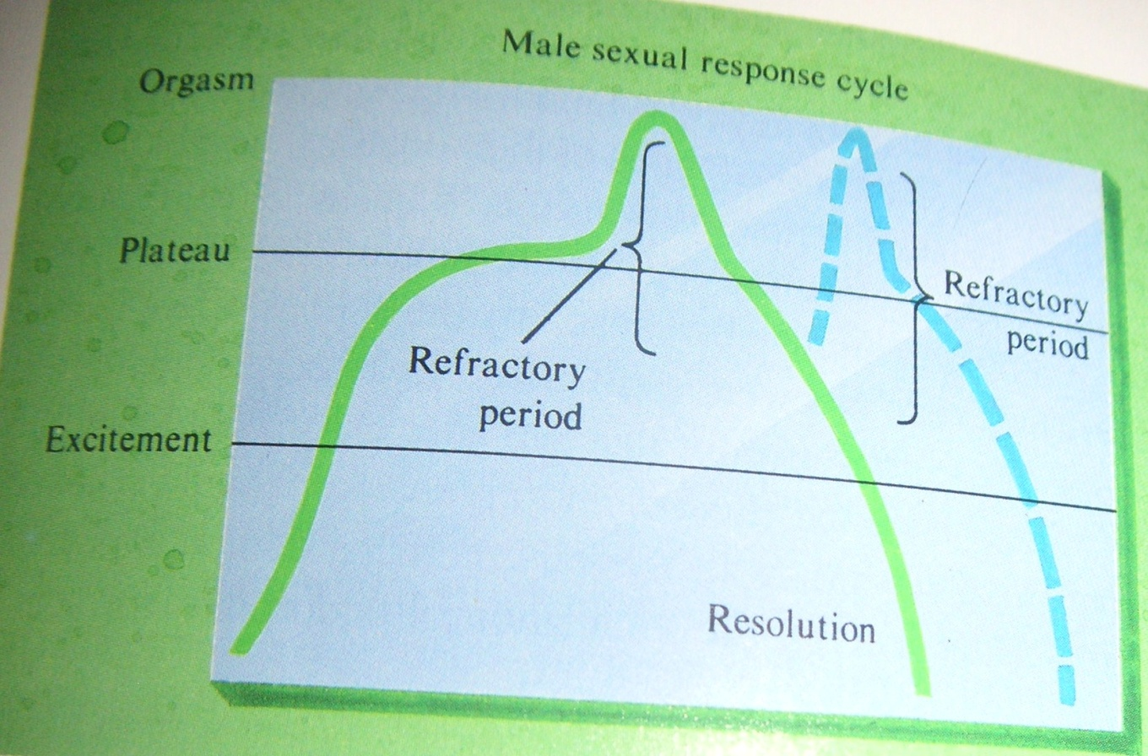
Male sexual response cycle

Slide 39
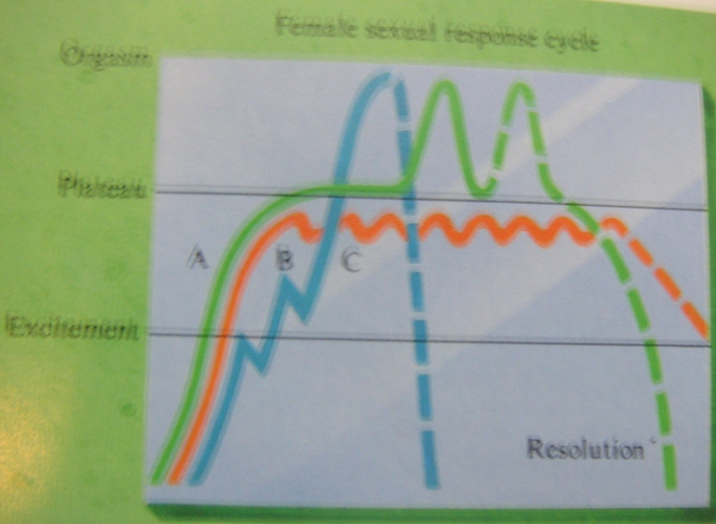
Female sexual response cycle

Slide 40
Specific Suggestions/strategies
Behaviour therapy-
Self Exploration and directed masturbation
Sensate focus for couples
Kegel’s Pelvic floor exercises
Sexual fantasies
Lubricants

Slide 41
Therapy of some common conditions- Failure of genital response in women
Investigate factors that may inhibit arousal- Partner Arousal tecniques, Lack of privacy, tiredness, beliefs and cultural practices (FGM)
Psychoeducation- female sexual and physiological anatomy, the female sexual response cycle, the use of lubricants
Use of erotic material-

Slide 42
Therapy of some common conditions- Failure of genital response in men
Erectile failure
Investigate- childhood- socialisation religious moralistic sexual attitude- punishment for sexual play,
Adolescence sexual experiences
Performance anxiety may be related to premature ejaclution
Psychosexual education-
Self and partner stimulation
Use of erotic material-
The use of viagra- cause a relaxation of penile blood vessels and increasing blood flow
Other forms of physical treatment- penile prosthesis, prostaglandin E1 injection

Slide 43
Orgasmic dysfunction in women
Treatment- rule out other sexual disorders
Psycho-education- female sexual response cycle
Behaviour therapy- Exercises- directed masturbation
Sensate focus for couples
Kegel’s Pelvic floor exercises
Sexual fantasies

Slide 44
Sensate focus for couples
Sensate focus for couples- partner exploration. Starts with non genital caressing progresses to genital and eventually sexual intercourse
Concentration should be on pleasurable feelings rather than striving for erections and and orgasms

Slide 45
Kegel’s pelvic floor exercises
Repeated contraction, holding and relaxation of the pelvic muscles
Strengthens the pelvic floor muscles and increase womens‘ ability to recognise sensations in this area

Slide 46
Fantasy
Permission giving in the use of sexual fantasies
Use of erotic literature and media material

Slide 47
Premature ejaculation
inability to control ejaculation adequately for both partners to enjoy sexual interaction- ejaculation before or just after penetration
usually primary- men who never learnt how to control ejaculation
May be a history of rapid frequent masturbation associated to guilt
Reaction – anger, frustration, accusations/ condemnations which make condition worse
Happens to all men sometimes and is normal.
Can also be secondary in times of stress, anxiety or long periods of abstinence

Slide 48
Premature ejaculation- therapy
Psycho-education- myths and beliefs- issues that contribute to performance anxiety
Specific exercises
Seman’s technique- stop start technique ( arousal and pauses) with graded approach starting with sensate focus – genital stimulation & eventually penetration
The squeeze technique- can be started at failure of above squeeze the head of penis- 10-20 seconds until the urge to ejaculate goes down
Sensate couple focus

Slide 49
Non orgasmic vaginismus
Penetration is impossible or painful because of a spasmic contraction of the vaginal muscles- pelvic floor muscles:
Casues: fear of penetration and anticipation of pain
Previous sexual trauma
Religious and cultural beliefs-causing fear or guilt
Childhood punishment for masturbation
Fear of pregnancy or painful labour
In Vagimismus- penetration causes pain- vicious cycle or complete abstinence

Slide 50
Vaginismus- Therapy
Psychosexual education-
Treatment of underlying psychological disorders and dispelling myths
Giving permission- to enjoy sex
Relaxation technique- progressiver muscle relaxation- reduces generealised muscular tension
Kegel’s excercise- to teach control of the pelvic muscles
Teaching specific Strategies
Gradual progression from self exploration to sexual penetration
Self exploration
Insertion of graded trainers
Sensate couple focus
Graded penetration from object to penile
Sexual position- position in which woman can control penetration

Slide 51
Non organic dyspareunia
In men usually related to physical causes- common in men infections, scarring tight foreskin
In women may also be related to physical conditions or poor arousal response
Psychoeducation on arousal- important
Modification of intercourse positions- use positions with less penetration

