Slide 1
Suicide and deliberate self harm
Dr. Gitau

Slide 2
OUTLINE
Introduction
Epidemiology
Risk factors
Suicide and mental illness
Etiology
Assessment of suicide risk
Managament
Deliberate self harm

Slide 3
INTRODUCTION
The primary emergency for mental health professional.
A major public health problem:
More than 30,000 persons die by suicide in the USA each year.
More than 600,000 persons attempt suicide in the USA each year.
Suicide is almost always the result of a mental illness and is amenable to psychological and pharmacological treatment.
Thomas Browne (17th Century) coined the term suicide, meaning ‘self murder’
Aaron Beck : “wilfull self-inflicted life-threatening act resulting in death”
Notes:
Range from; ideas of suicide and never acting on; others plan for days, weeks, months or even years; others act on impulse; while others may be classified as chronic suicide.

Slide 4
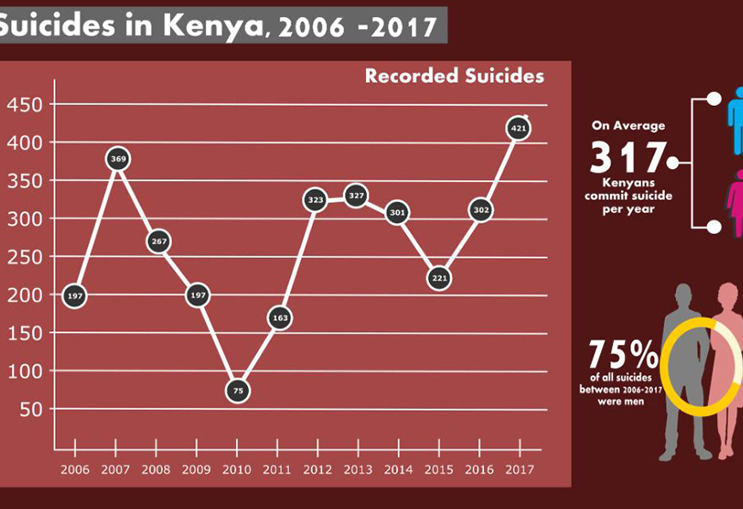
Epidemiology
Kenya’s suicide rate is at least 10.28 suicides per 100,000 people (WORLD HEALTH RANKINGS).
USA suicide death rates is 12.70 suicides per 100,000 people.
Completers are more often : male, have a psychiatric disorder, have made a plan and used a dangerous method

Slide 5
Risk factors
Gender differences:
Males complete suicides 4* more than females. While females are four * more likely to attempt suicide than males.
Age:
Incidence increases with age
There is a rise in rates among adolescents and elderly
40 per 100,000 suicides occur in men over-65-year-olds
20 % increase in suicide in 15-19-year-olds
young males (aged 15-24) -3rd commonest cause of death
suicide pacts more common in the elderly
Notes:
Rates are higher in men due to the methods that men use e.g. guns, hanging or jumping while females use poisons or overdose of prescription medicine.

Slide 6
Risk factors
Race:
Two of every three suicides are white males.
Higher suicide rates also among immigrants.
Religion:
Lower rates among Roman Catholics compared to protestants and Jews.
strong religious affiliation is a protective factor
Marital status
divorced > widowed > single

Slide 7
Risk factors
Employment :
unemployed / retired / living alone (social isolation)
Urban/ Rural :
urban > rural 5.
Social Class :
highest in lowest social groups
lowest in middle groups
rates are higher in social class V (unskilled workers) and social class I (professional)

Slide 8
Risk factors
Occupation :
Higher risk groups are doctors, lawyers, hotel and bar trade owners
Physical illness :
Terminal illness / malignancies
Debilitating illness and disability
Disfigurement
Chronic pain
Renal dialysis / failed transplant
Peptic ulcer (x 2) – likely to be due to overlap with alcoholism
CNS disorders : i) Huntington’s disease ii) spinal cord injuries (x 4) iii) risk in epilepsy patients is 4 times general population
CVD
SLE

Slide 9
Risk factors
Prison population :
prisoners convicted of murder/ violent/ sexual crimes
long sentence for serious offence
1/3 of have previous psychiatric history,
½ occur in first 3 months of imprisonment 11.
Other associations : family history of affective disorder / alcoholism / suicide, birth trauma, death of a parent in childhood, suicide by a friend or colleague and recent bereavement
Homicide :
In the USA 5 % of homicides end in suicide and 2 % of all suicides also involve homicide

Slide 10
Risk factors
Inpatients are at highest risk:
First week of admission
Early stages of recovery
Between shifts of staff
On leave (patients and staff)
discharge (premature)
risk is increased in the month after discharge
Two-thirds of people consult their doctor in the previous month and 40 % do so in the previous week.

Slide 11
Suicide and mental illnesses
Almost 95% of all persons who complete or attempt suicide have a diagnosed mental disorder.
Depressive disorders account for 80% and schizophrenia accounts for 10% while dementia accounts for 5%.
15% of all alcohol-dependent persons complete suicide.
A high proportion of those who complete suicide have various personality difficulties or disorders.
Uncompleted suicide attempts are made in 20% of patients with panic disorder and social phobia.
Notes:
Those with personality disorders have difficulties in relationships and social adjustment which further contributes to substance use and depressive disorder and precipitates undesirable life events.

Slide 12
Etiology
This is divided into:
Sociological factors (Durkheim’s theory) :
Altruistic - For the good of country
Egoistic - Individual has lost social integration with the group
Anomic - society undergoing such change that it lacks ‘collective order’; breakdown of society’s standards and values.
2. Psychological factors ( Freud’s and Menninger’s Theory): An attack on internal hated object
3. Biological Factors : Neurochemical and Genetic factors.

Slide 13
Etiology
Genetics
suicidal behaviour clusters in family
MZ : DZ = 11.3 % : 1.8 % (Roy et al. 1991)
Neurochemical
Serotonin :
There was serotonin deficiency – suicide completers had lower CSF serotonin metabolite 5-HIAA (5- hydroxyindoleacetic acid) than attempters.
Decreased CSF 5-HIAA is the most consistent finding in patients with DSH (Mann et al. 1992)
Post-mortem autoradiography shows decreased 5-HT receptors in the frontal cortex and hippocampus 2.
Opiate : Increased receptor density
Noradrenaline : Decreased cortical alpha-1-noradrenergic receptor density
Notes:
Out of 176 twin pairs 62 were MZ pairs. 9 pairs had completed suicide and 7 out of the 9 were MZ twins while 2 pairs were among 114 DZ twin pairs.

Slide 14
Assessment of suicidal risk
The Beck Suicidal Intent scale (>5 is significant)
Preparation a) planning in advance b) suicide note c) final acts
Circumstances a) alone b) intervention unlikely c) precautions against delivery
After the act a) didn’t seek help b) stated wish to die c) believed the act would result in death d) regrets its failure
1 in 100 people who express suicidal intent will complete a suicide.

Slide 15
SADPERSONS TOOL FOR SUICIDE ASSESSMENT
ITEM | SCORE | ITEM | SCORE
SEX = MALE | 1 | PSYCHOSIS | 2
AGE <19 >45 | 1 | SEPARATED/WIDOWED/DIVORCED | 1
DEPRESSION/HOPELESSNESS | 1 | SERIOUS ATTEMPT (HANGING, STABBING) | 2
PREVIOUS SUICIDE ATTEMPTS | 1 | NO SOCIAL SUPPORT | 1
EXCESSIVE ALCOHOL/DRUG USE | 1 | STATED FUTURE INTENT | 2

Slide 16
SADPERSONS TOOL FOR SUICIDE ASSESSMENT
SCORE < 6 : SAFE TO DISCHARGE HOME
SCORE 6-8: REFER FOR PSYCHIATRIC ASSESSMENT
SCORE > 8: URGENT ADMISSION.
(Patterson et al 1983)

Slide 17
MANAGEMENT OF SUICIDAL BEHAVIOUR.
SOMATIC
PSYCHOSOCIAL
Anti-depressants (SSRI) in depression & anxiety.
Benzodiazepines (short-term) – severe insomnia, agitation, panic attacks.
Trazodone (calming effect).
Low dose 2nd generation antipsychotics
Anticonvulsants eg like gabapentin/divalproex
Lithium
ECT
Interpersonal psychotherapy & CBT – Depression
Psychodynamic therapy and dialectical behavior therapy – borderline personality disorder
For self-harming behavior without suicidal intent – rapid interventions, follow-up outreach, problem solving therapy, brief psychological treatment, family/couple/group therapy (limited evidence for efficacy)

Slide 18
DELIBERATE SELF HARM
Non-fatal Deliberate Self Harm (DSH) : “Deliberate non-fatal act known to be potentially harmful, or if an overdose, that the amount taken is excessive”
Parasuicide : “Behavioural analogue of suicide without considering psychological orientation towards death”
Attempted Suicide: “Every act of self injury consciously aimed at attempts to kill themselves. But it acknowledges the gravity of the situation”
Deliberate self-poisoning : ‘deliberate self injury’ substituted for ‘attempted suicide’ because many patients ‘performed their acts in the belief that they were comparatively safe’

Slide 19
Risk factors
Age and Sex :
2/3 of DSH under 35 years
F:M = 1.5-2.5:1
Commonest in 15-24 year old females
Peak incidence later (mid 20s) for males
Marital status :
Divorced > single > widowed
marital problems is a risk factor

Slide 20
Risk factors
Urban/ Rural :
urban > rural
High rates in ‘inner city’ areas associated with overcrowding, lack of facilities, less social cohesion
Other associations :
poor health
long term problems
life event in last 6 months (risk x 6) ; 65 % are preceded by major life event and 50 % preceded by serious arguments with partner/ friend

Slide 21
DSH and mental illnesses
Definite psychiatric illness is found in less than 1/3 of patients
Most common diagnoses are : • reactive depression • alcoholism • panic disorder • personality disorder has been reported in a third to half of self-harm patients – borderline personality disorder.
Repetition rates are around 15-25 % in the year after the act.
Suicide rate after DSH is 1-2 % (100 times the general population risk).
Greatest risk in first 6 months, risk remains high for 5 years then decreases if no DSH during this period
40 % have taken alcohol in the six hours before the act.

Slide 22
Predictors of DSH
Number of previous episodes of DSH
Features of personality disorder
History of violence
Criminal record
Unemployment
Alcoholism
Unmarried
Lowest social class

Slide 23
Types of DSH
Deep self-cutters / suicidal : Serious attempt
Self-mutilators / psychotic : Schizophrenia acting on hallucinations
Superficial self-cutters : Younger (16-24) and injure self to relieve tension or sense of emptiness/ loss

