Slide 1
Acute burn management first 24 hours
13-11-2015 Dr. Wanjiru
Mmed Plastic, Reconstructive and Aesthetic surgery
Tutorial Fellow
University of Nairobi, Kenya

Slide 2
Objectives
Describe epidemiology of burn injury
Discuss causes of burn injury
Classify burn injuries
Discuss Pathophysiology of burn injury
Assessment of burn patient
Describe treatment plans for burn

Slide 3
Epidemiology
1% of the world population each year
USA ~ 2.4 million burn injuries/ yr & 10,000 death/yr
UK ~ 250,000 patients treated with burns & 700 deaths/yr.
TZ(MNH) 10% of admission in pediatric surgical ward
In Kenya Epidem not known but 5,000 deaths/yr
  53% males, 60% in <5yrsª ,KNH mediann age 7yrs, 50% children
Notes:
Study from tenwek

Slide 4
Age
  Scald - < 5 year of age
  flame, electrical & chemical burn - adult
Sex
  domestic burn - females
  occupational - males
Race
  No race predilection exists in burn injuries

Slide 5
Risks factors
Diseases e.g. epilepsy, diabetes
Children< 5years; Elderly > 75 years
Occupational – electricians/industrial
Alcoholism
Cold weather
Notes:
5
Elderly,reduced mobility,dexterity,slowed reaction

Slide 6
Burns carry
High morbidity and mortality
emotional & psychological

Slide 7
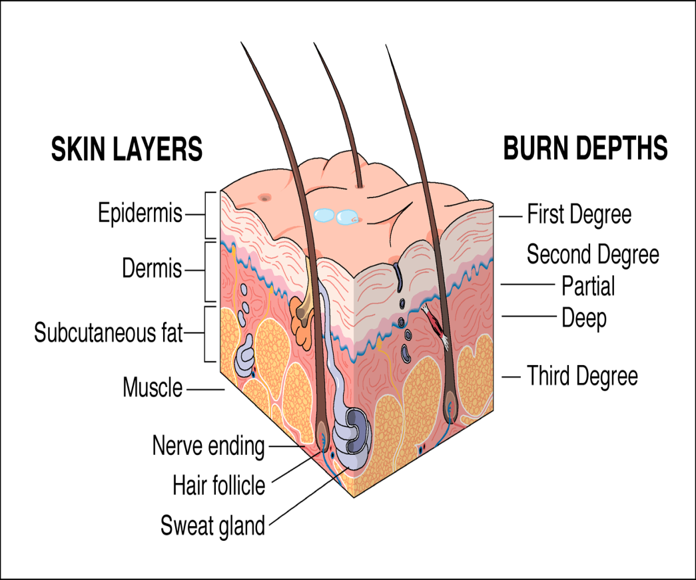
Anatomy
Skin
  The epidermis
    derived from ectoderm
    it can regenerate.
  The dermis
    from mesoderm
    cannot re-generate,

Slide 8
  AETIOLOGY
  Thermal injuries
      Scald
      Flame
      Flash
      Contact
  Chemical injuries
  Electrical injuries
  Radiation injuries
  Cold injuries

Slide 9
Classification
    Type /cause
    Body site
    Degree/Depth
    Size/extent
    Severity

Slide 10
Burn Depth
  Superficial burn
    Epidemal
    Dermal
  Deep burn
    Dermal
    Full thickness
  Mixed burn

Slide 11
Degree of tissue injury
  First degree burn
  Second degree burn
      2nd Degree Superficial (superficial Dermal)
      2nd Degree Deep (deep Dermal)
  Third degree burn
  Fourth degree burn

Slide 12
Size/Extent
  Total body surface area (TBSA) burned
severity of burn
  Minor burn
  Moderate burn
  Major burn

Slide 13
PATHOPHYSIOLOGY
Burn injuries result in:-
  local response
  systemic response

Slide 14
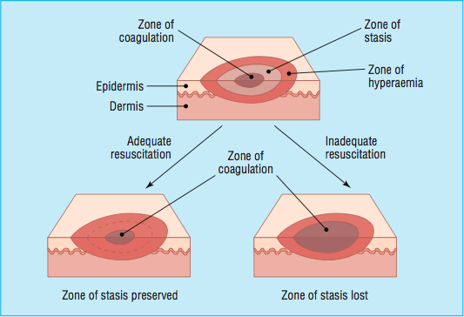
Pathophysiology
LOCAL RESPONSE
Inflammation
Jackson zones (1947)
    coagulation /necrosis
    Stasis/ischaemia
    hyperemia
Notes:
Zone of coagulation—This occurs at the point of maximum
damage. In this zone there is irreversible tissue loss due to coagulation of the constituent proteins.
Zone of stasis—The surrounding zone of stasis is characterised by decreased tissue perfusion. The tissue in this zone is potentially salvageable. The main aim of burns resuscitation is to increase tissue perfusion here and prevent any damage becoming irreversible. Additional insults—such as prolonged hypotension, infection, or oedema—can convert this zone into an area of complete tissue loss.
Zone of hyperaemia—In this outermost zone tissue perfusion is increased. The tissue here will invariably recover unless there is severe sepsis or prolonged hypoperfusion.
These three zones of a burn are three dimensional, and loss of tissue in the zone of stasis will lead to the wound deepening as well as widening.

Slide 15
Pathophysiology
SYSTEMIC RESPONSE:-
Significant burn → massive release of inflammatory mediators, both in the wound and other sites.
Notes:
Significant burn >25% adults
>15% children

Slide 16
Following burn injury, neutrophils,monocytes & platelets migrate into burn wound
Capillary permeability → locally & in distinct organs.
Plasma oncotic pressure
Interstitial oncotic pressure due to increased capillary permeability → protein loss → edema in burned & un-burned tissues

Slide 17
Burn Assessment

Slide 18
Clinical assessment
History
Physical examination
  General
  Local
  Systemic
Notes:
Patient characteristics
age , occupation,intoxication,epilepsy
History of injury
Time of burn
Place of burn
Nature of injury Intentional,Unintentional,Undetermined
Associated inhalation injuries
Associated clothing ignition
Associated injuries

Slide 19
General Exam
  Body weight
  Shock
  Level of consciousness
  Dyspnoea
  In pain
  Restless ± gasping
  Anaemic
  Dehydration
Local Exam
Examine the wound
  Body region burned
  Extent of burn
  Burn depth
  Severity of burn
Systemic Exam

Slide 20
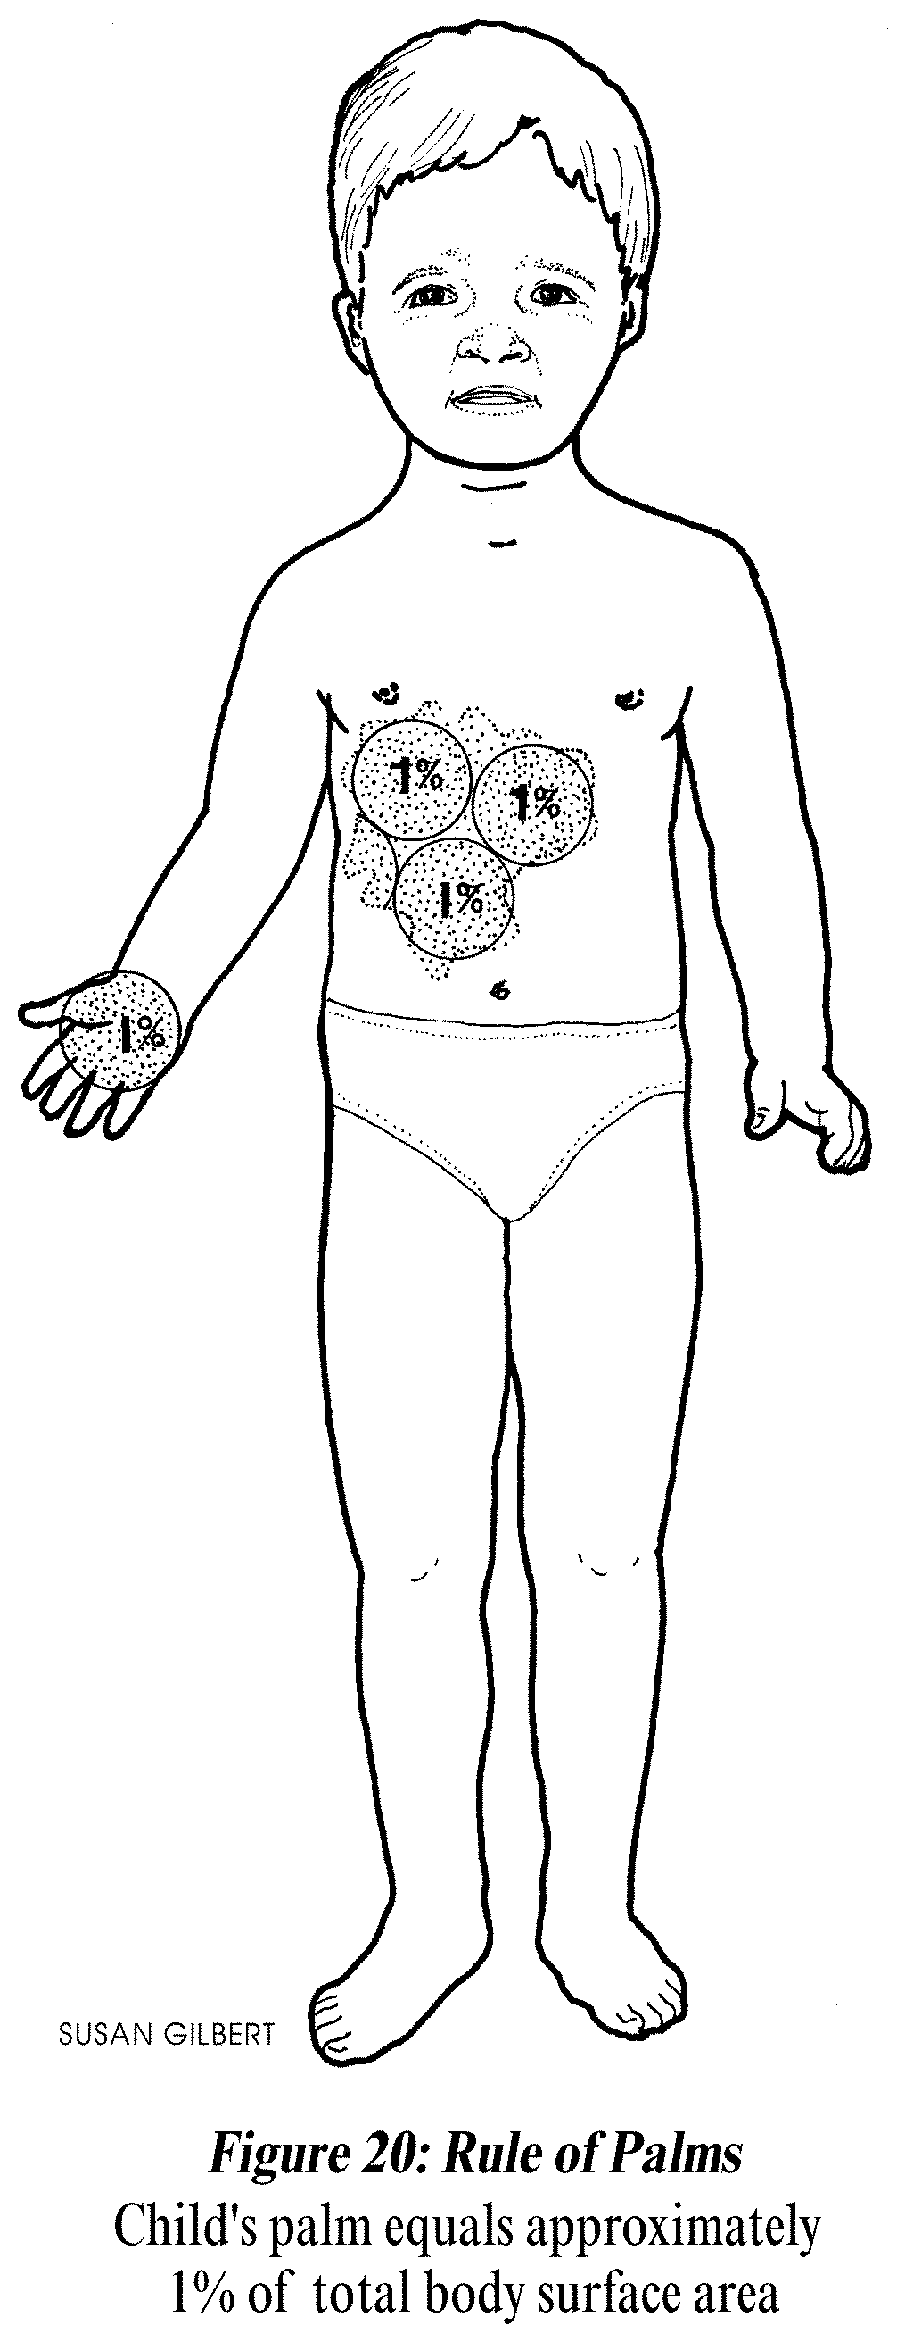
Extent of burn
    Palmar Method
  A quick method to evaluate scattered or localized burns
  Patient’s palm = 1 % TBSA

Slide 21
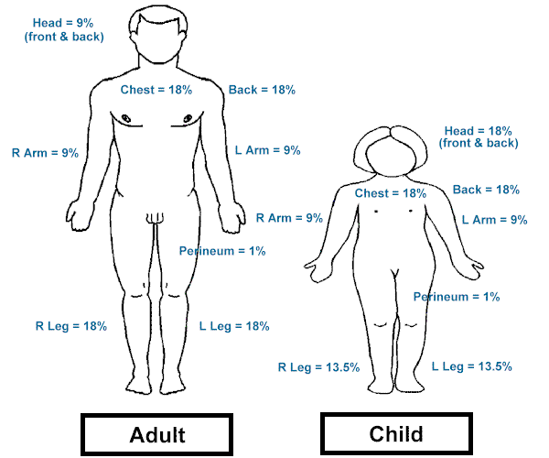
    Rule of Nines (Wallace’s)
A quick method to evaluate the extent of burns
Major body surface areas divided into multiples of nine
Modified version for children and infants (Rule of Sevens )

Slide 22
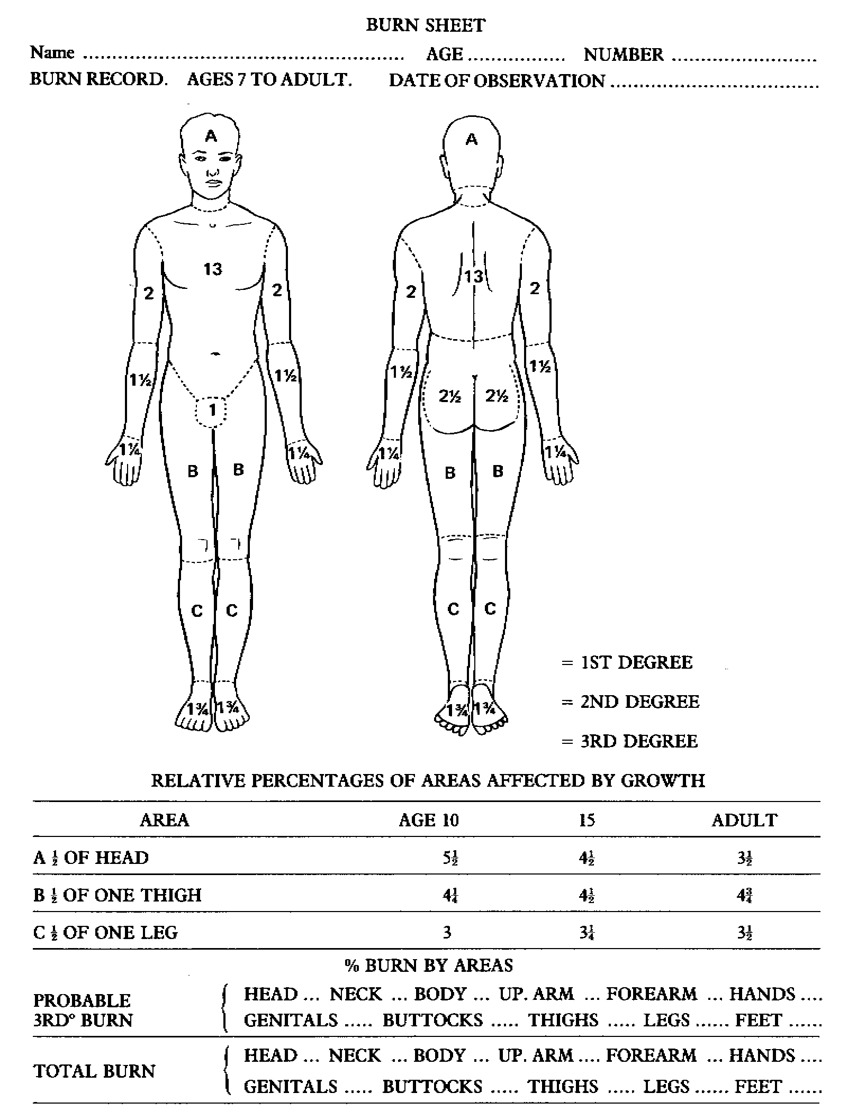
Lund-Browder Method

Slide 23
Burn Depth assessment
Notes:
Be

Slide 24
Usually an experience burn surgeon may need to make this assessment
Technologies Laser Doppler scan is a more objective way
Assessment important due to its bearing on management

Slide 25
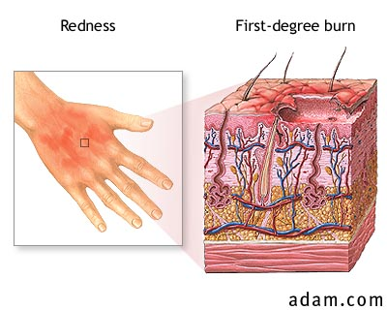
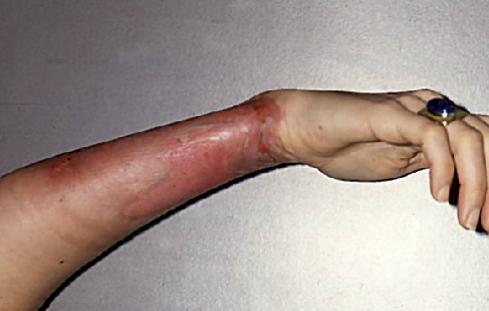
first degree burn
Epidermis
Wound Appearance:
  Red to pink (light skin)
  Mild edema
  Dry and no blistering
  Pain / hypersensitivity to touch
    i.e. Classic sunburn
  Desquamation occurs 2-3 days
Wound Healing
  Wound Healing spontaneous
  Duration 3 to 5 days
  No scarring / other complications
25

Slide 26
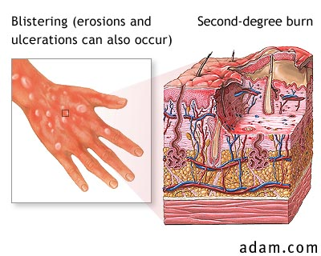
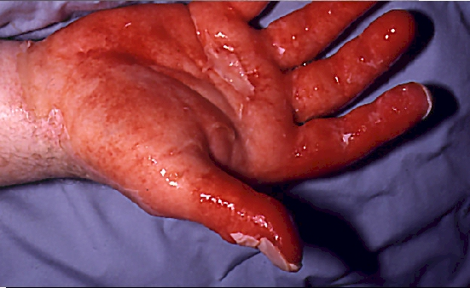
Superficial second degree burn
upper 1/3 of dermis
Wound Appearance
  Red to pink
  Wet and weeping wounds
  Thin-walled, fluid-filled blisters
  Mild to moderate edema
  Extremely painful
Wound Healing
  In 2 weeks (spontaneous)
  Minimal scarring; minor pigment
  Discoloration may occur

Slide 27
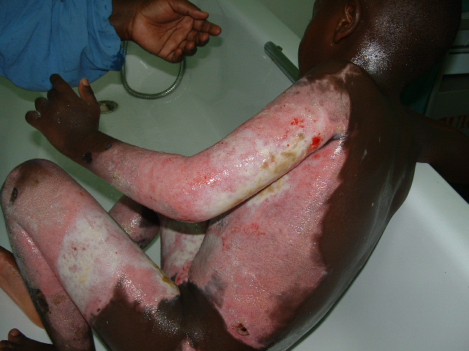
Deep second degree burn
deep dermis layer
Wound Appearance
  Mottled: Red, pink, to white surface
  Moist
  Moderate edema
  Painful; usually less severe than superficial 2nd Degree superficial.
  No blisters
Wound Healing
  May heal spontaneously 2-6 weeks
  If so Hypertrophic scarring / formation of contractures
Wound Management:
  Treatment of choice→ surgical excision & skin grafting

Slide 28
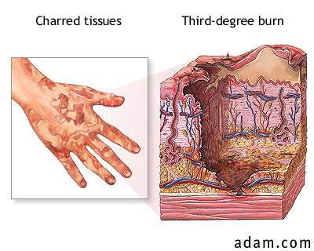
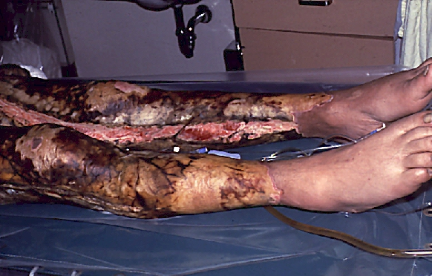
Full thickness third degree burn
Entire epidermis and dermis→Subcutaneous fat
Wound Appearance
  Dry, leathery and rigid
  + Eschar (hard and in-elastic)
  Red, white, yellow, brown or black
  Severe edema
  Painless & insensitive to palpation

Slide 29
Burn Management

Slide 30
Management Aims
Prevent fluid and electrolyte imbalance
Rapid and painless healing
Prevent complications
Rehabilitation

Slide 31
Burn team
Surgeons –reconstructive (plastic), General or trauma surgeon, Paediatric surgeon
Nurses
Anesthetist
ICU team
Physiotherapist
Occupational therapist
Social workers
Psychologists
Psychiatrist
Nutritionists

Slide 32
Criteria for admission
Type of burn
  Inhalation
  Electrical
  Chemical
  Lightening
%TBSA
  >15% in adult
  >10% in children
Body site affected: face, hands, perineum, genitalia
Associated injuries
Circumferential burns of the limbs or chest
Suspected child abuse

Slide 33
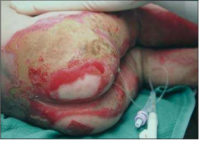
Notes:
Doughnut sign child abuse

Slide 34
Treatment
Begins with the ATLS protocol
  Primary Survery
  ABC’s
  Have high index of suspicion for inhalation burn
  Secondary survey
Base line Investigations
  FHG,LFT,U/E/CR’S GXM,BGAs,HBCo,ECG
  C-xray
Base line bronchoscopy for inhalation burn
Notes:
Inhalation, Sooty cough,soot stained lips,singes nose hair,hoarse voice
Also think of Carbon monoxide poisoning. 100% 02 for treatment. Present with headaches and nausea! Later on coma!
HBCO carboxy hemoglobin

Slide 35
Fluid Resuscitation
Aim, Maintain tissue perfusion to the zone of stasis and so prevent the burn from deepening
Maintain other organ perfusion
Indication= peads 10%, adult 15%
Fluid resuscitation formula
  no ideal formula
  guidelines
success relies on adjusting the amount of resuscitation fluid ↔ against monitored physiological parameters

Slide 36
Parkland formula for the 1st 24 hours
  4mls x KgBwt x %TBSA→1st 24hrs
  crystalloid formula (ringers lactate)
  For burn >50% TBSA, use 50% for calculation (to prevent fluid overload)
  ½ given in 1st 8 hrs & ½ →next 16hrs.
Add the maintenance fluid to the above
Notes:
Maintainance is usually in sschilder and it is dns, glycogen store poor in children

Slide 37
Resuscitation
After 1st 24 hrs, colloid infusion is started at a rate of:-
    0.5 ml× (%TBSA)×(Bwt in kg) and
Maintenance crystalloid (usually DNS) is continued at a rate of
    1.5mlsx%TBSAxBwt
End point to aim is a urine output of:-
    0.5-1.0 ml/kg/hr in adults
    1.0-1.5 ml/kg/hr in children

Slide 38
Resuscitation
Colloid use is controversial:
    some units start colloid after 8 hrs( as the capillary leak begins to shut down)
    whereas others wait until 24 hrs
  FFP is often used in children,
  albumin or synthetic high molecular weight in adults.

Slide 39
Supportive care phase
Analgesics
Haematenics
Ulcer prophylaxis
Systemic antibiotics against ß- hemolytic streptococcus (Controvertial)
Tetanus toxoid
NGT for pts with > 20%TBSA
Maintain body Temp
Nutrition support
Elevate limbs
Notes:
Ulcer prophylaxix contoversial: best is to fee patient if not sucralfate. Ppi/h2 blockers reserved

Slide 40
Nutrition support
Very critical in burns
  Hyper catabolic states
  Supplementation enterally
  Involve Nutritionists very early on
Caloric requirements can be calculated
Vitamins and trace element supplementation increase wound healing
Notes:
Vits a,c,e,b complex
Elements. Zn,Fe,folate

Slide 41
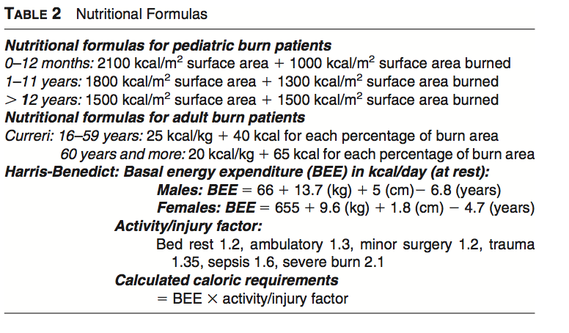
Notes:
Harris ben equation underestimate,
Currei over estimates hence take an average
50% cho,20 prots,30 fat

Slide 42
Burn Wound treatment
Debridement
  Dirty,septic wounds
Blisters
  Rupture them (still controversial)
Apply burn dressing
Surgical treatment
  Early burn excision and grafting
    Deep superficial/full thickness burns

Slide 43
Wound care
Dressing
Skin grafting
Debridement
Escharotomy (if necessary)
Fasciotomy
Splinting
Application of autograft

Slide 44
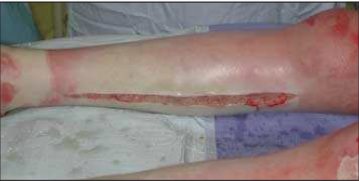
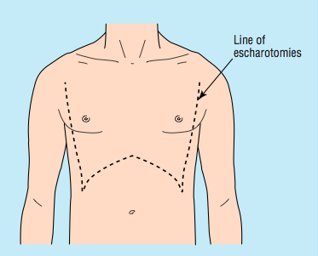

Slide 45
Other supportive measures
Psychosocial
Physiotherapy

Slide 46
Thank you very much!!

