Slide 1
COLORECTAL MALIGNANCIES
DR D. KIPTOON
27TH SEPTEMBER 2016

Slide 2
LECTURE OUTLINE
Epidemiology
Risk factors
Symptoms
Investigations
Staging
Management
Screening

Slide 3
INTESTINAL TUMORS
Epithelial tumors of the intestines:
major cause of morbidity and mortality worldwide
Colon, including rectum:
host to most primary neoplasms in the body
MOST COMMON MALIGNANCIES (IN DECREASING FREQUENCY)
  COLORECTAL CA
  PANCREATIC TUMORS
  ESOPHAGEAL CA
  GASTRIC TUMORS
  CCAS
  HEPATOMAS
  SMALL BOWEL TUMORS
Non-neoplastic Polyps
Hyperplastic polyps
Hamartomatous polyps
Juvenile polyps
Peutz-Jeghers polyps
Inflammatory polyps
Lymphoid polyps
Neoplastic Epithelial Lesions
Benign polyps
Adenomas
Malignant lesions
Adenocarcinoma
Squamous cell carcinoma of the anus
Other Tumors
Gastrointestinal stromal tumors
Carcinoid tumor
Lymphoma

Slide 4
EPIDEMIOLOGY
Occurs worldwide
Highest incidence in the “West”
4th most common cancer
2nd highest cause of cancer mortality
Slight male preponderance 3:2
Peak incidence 60-70 years
?Rising incidence locally/ lower age

Slide 5
RISK FACTORS
Age → 90% of patients above 50yrs
Polyps (adenomas)
Family history of CRC
Hereditary syndromes (FAP coli/Polyposis Coli Syndrome, Non-Polyposis colon cancer syndrome/Lynch Syndrome)
Inflammatory bowel disease (UC/ Crohn’s)
Sedentary lifestyle
Obesity
Diet: High fat, High CHO, low fiber diet
Black race
Ashkenazi Jews
Smoking
Alcohol

Slide 6
PROGRESSION OF COLORECTAL CANCER
Loss of
APC
Activation
of K-ras
Deletion of 18q
Loss of
TP53
Other
alterations
Normal
epithelium
Hyper-
proliferative
epithelium
Early
adenoma
Inter-
mediate
adenoma
Late
adenoma
Carcinoma
Metastasis

Slide 7
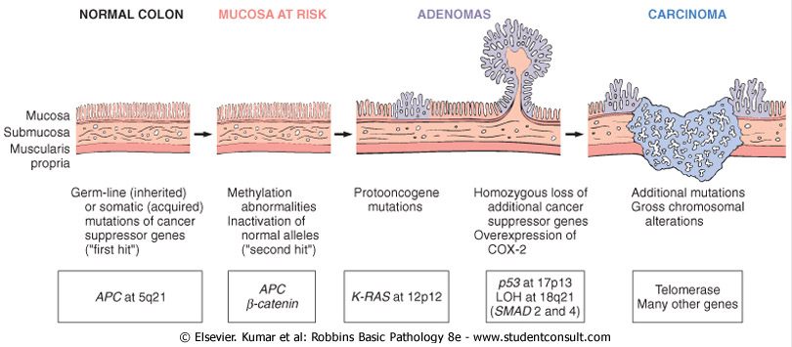
CARCINOGENESIS:
Chromosome instability pathway

Slide 8
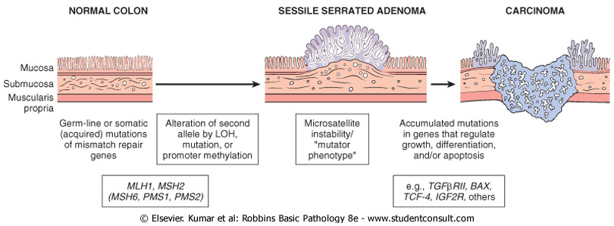
CARCINOGENESIS:
Mismatch repair (microsatellite instability) pathway

Slide 9
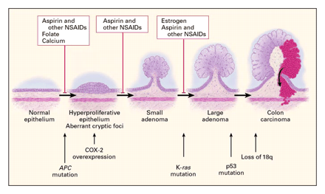

Slide 10
MORPHOLOGY
Microscopy: Adenocarcinoma
Macroscopic:
1. Annular
2. Tubular
3. Ulcer
4. Cauliflower

Slide 11
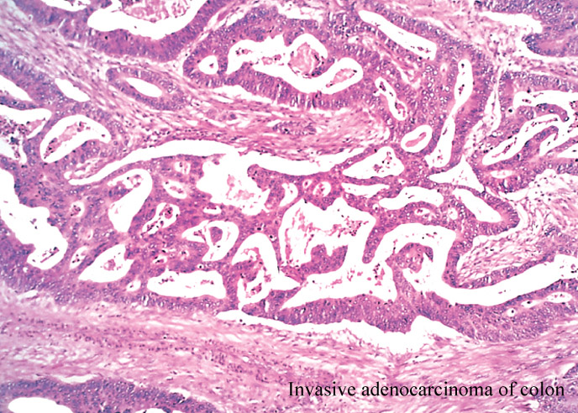
MORPHOLOGY
All colorectal carcinomas → microscopically similar
Almost all → adenocarcinomas
Range from well-differentiated to undifferentiated, frankly anaplastic masses
Many tumors produce mucin
Cancers of the anal zone are predominantly squamous cell in origin

Slide 12
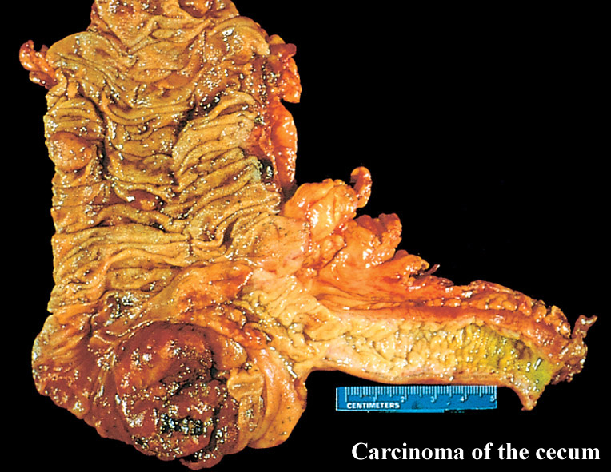
MORPHOLOGY
tumors in the proximal colon: polypoid, exophytic masses that extend along one wall of the cecum and ascending colon (ulcer or cauliflower)
Tend to bleed → present with anemia

Slide 13
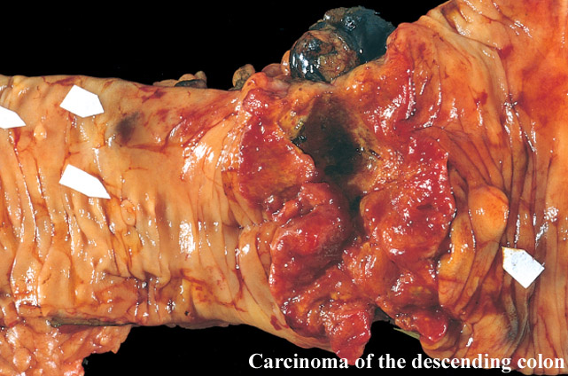
MORPHOLOGY
In the left colon: annular, encircling lesions that produce “napkin-ring” constrictions of the bowel and narrowing of the lumen (annular or tubular). Both forms of neoplasm eventually penetrate the bowel wall and may appear as firm masses on the serosal surface
Tend to obstruct since the left colon is narrower and the contents in the left colon are solid.

Slide 14
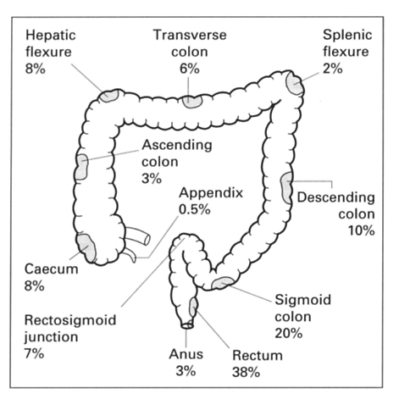

Slide 15
CLINICAL PRESENTATION: EARLY
Non-specific symptoms
Insidious onset
General malaise/fatigue
Asthenia
Weight loss
IDA

Slide 16
CLINCAL PRESENTATION: LATE
Rectal bleeding (Frank or occult)
Change in bowel habit
Mucoid stool
Abdominal mass
Abdominal pain (Vague, dragging flank)
Tenesmus → rectal tumors
Intestinal obstruction → About 20-25% of CRA present as emergency intestinal obstruction.
Perforation/ peritonitis
Ascites
Weight loss

Slide 17
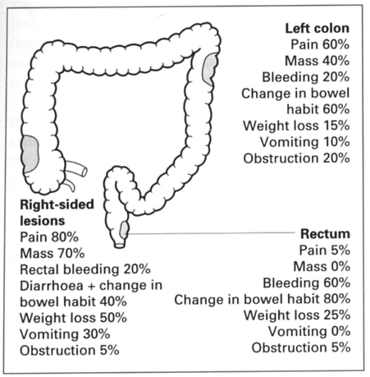
Tenesmus 50%

Slide 18
WORK UP
Thorough history
Careful examination: DRE
Investigations

Slide 19
INVESTIGATIONS
Proctoscopy
Sigmoidoscopy
Colonoscopy
Endo-luminal ultrasound
CT scan
MRI
Adjunct investigations
Carcinoembryonic antigen (normal is <5) → monitors response to therapy
Double Contrast Barium enema

Slide 20
STAGING INVESTIGATIONS
Abdominopelvic CT scan
CXR/CT chest
PET scan
Endoluminal ultrasound → Early rectal cancer
MRI pelvis → Late rectal cancer

Slide 21
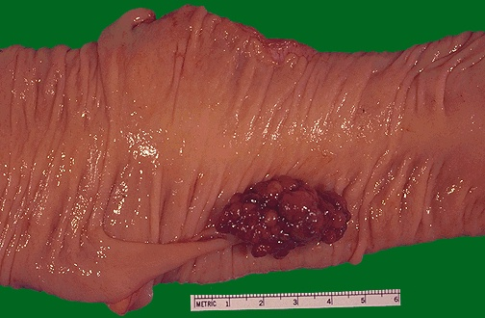

Slide 22
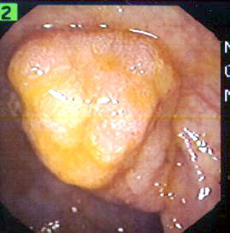

Slide 23
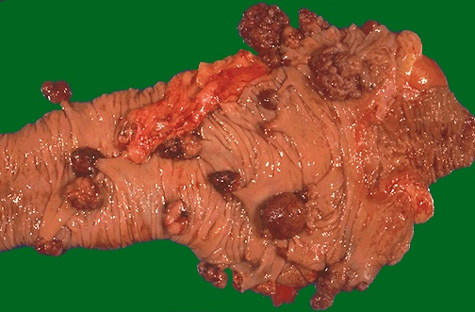

Slide 24
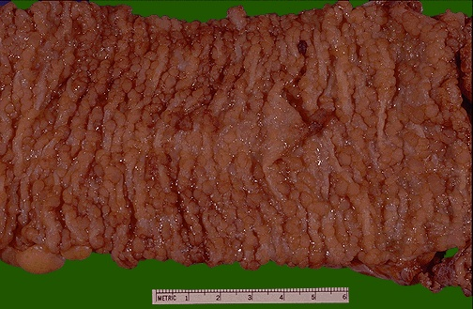

Slide 25
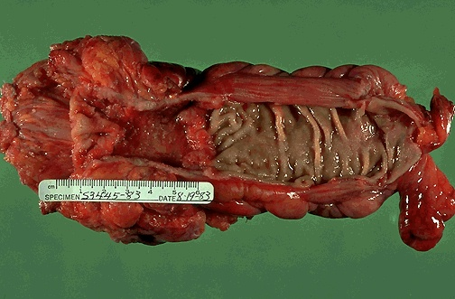

Slide 26
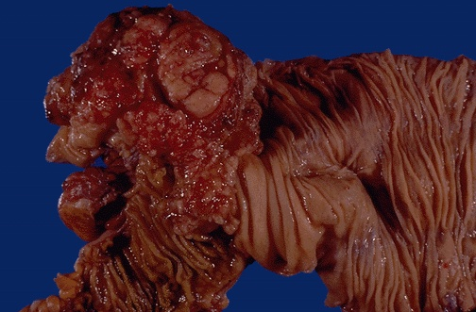

Slide 27
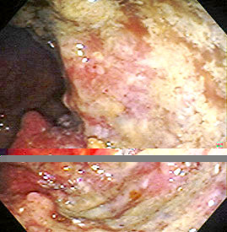

Slide 28
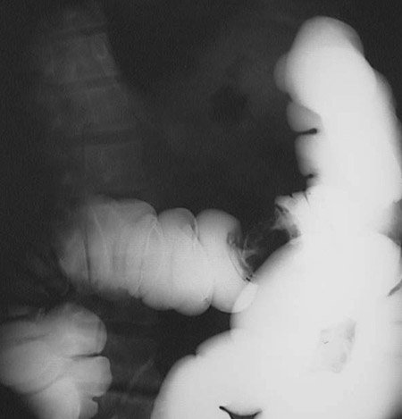
On Barium swallow → apple core appearance

Slide 29
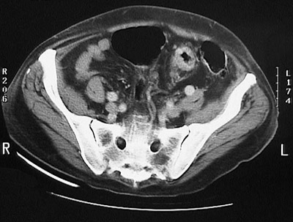

Slide 30
STAGING: MODIFIED DUKE’S
A → Mucosa
B → Into or through Muscularis propria
C1 → Into Muscularis propria + LN
C2 → Through M. propria to serosa + LN
D → Distant metastatic spread

Slide 31
Staging of CRC
TNM system
Primary tumor (T)
Regional lymph nodes (N)
Distant metastasis (M)

Slide 32
T STAGING – AMERICAN JOINT COMMITTEE ON CANCER SYSTEM (AJCC/TNM)
T CATEGORIES describe the extent of spread of the primary tumor (T) through the layers of the tissue that form the wall of the colon and rectum:
Tx → Primary tumor cannot be assessed.
Tis → Cancer is in its earliest stage, has not grown beyond mucosa. Also known as carcinoma in situ or intra-mucosal carcinoma. This includes cancer cells confined within the glandular basement membrane (intraepithelial) or lamina propria (intramucosal) with no extension through the muscularis mucosae into the submucosa.
T1 → Cancer has grown through the mucosa and ecxtends into the sub-mucosa
T2 → Cancer extends into muscularis propria
T3 → Cancer has spread to subserosa but not any nearby organs or tissues
T4 → Cancer has spread completely through wall of the colon or rectum into nearby tissues or organs. Direct invasion includes invasion of other segments of the colorectum by way of the serosa; for example, invasion of the sigmoid colon by a carcinoma of the cecum.

Slide 33
TNM Classification
Tis T₁ T₂ T₃ T₄
Extension
to an adjacent
organ
Mucosa
Muscularis mucosae
Submucosa
Muscularis propria
Subserosa
Serosa

Slide 34
TNM
N0 → No nodes involved
N1 → 1-2 LN involved
N2 → 3 or more nodes
M0 → No metastases
M1 → Mets present

Slide 35
Sites of metastasis
Via blood
Via lymphatics
Local spread
Liver
Lung
Brain
Bones
Lymph nodes
Abdominal wall
Trans-coelomic
Nerves
Vessels

Slide 36
MANAGEMENT
Depends on stage & site
Surgery
Chemotherapy
Radiotherapy

Slide 37
Screening
What is screening?
a public health service in which members
of a defined population are examined to
identify those individuals who would benefit
from treatment
to benefit:
to reduce the risk of a disease or its
complications

Slide 38
Types of Screening
fecal occult blood test (FOBT)
Chemical test for blood in a stool sample.
Annual screening by FOBT reduces colorectal cancer deaths by 33%
Flexible sigmoidoscopy
Can detect about 65%–75% of polyps and 40%–65% of colorectal cancers.
Rectum and sigmoid colon are visually inspected
Colonoscopy
Whole colon is inspected

Slide 39
Current Screening Guidelines (US)
regular screening for all adults aged 50 years or
older is recommended
FOBT every year
flexible sigmoidoscopy every 5 years
total colon examination by colonoscopy
every 10 years or by barium enema every
5–10 years

Slide 40
Take home message
CRC is a leading cause of death
Early stages are curable
Early stages can be detected by simple screening tests

Slide 41
Thank you

