Slide 1
OBSTRUCTIVE UROPATHY.
OLIECH J S
UNIVERSITY OF NAIROBI
BOX 19676 Code 200202
NAIRBI.
E-Mail=jsoliech@yahoo.com or oliech@uonbi.ac.ke
Phone +254722521697.

Slide 2
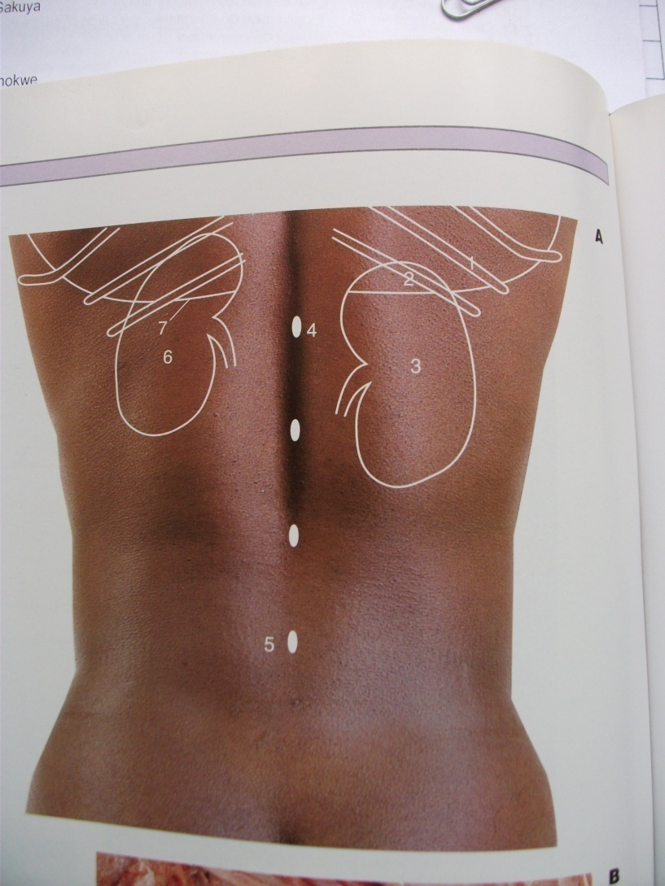
BACK POSITION OF BOTH KIDNEYS

Slide 3
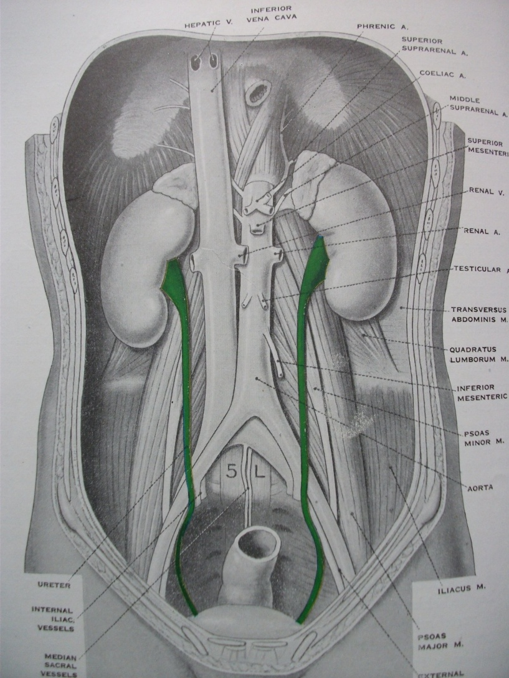
ANATOMY U.T. FRONT

Slide 4
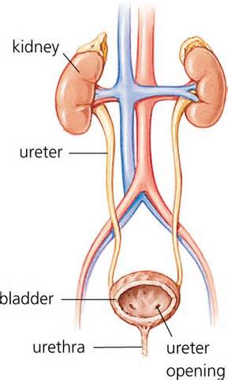
HUMAN URINARY TRACT SYSTEM (F).

Slide 5
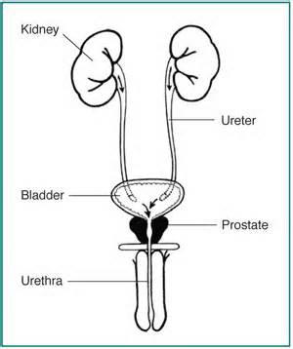
HUMAN URINARY SYSTEM (M).

Slide 6
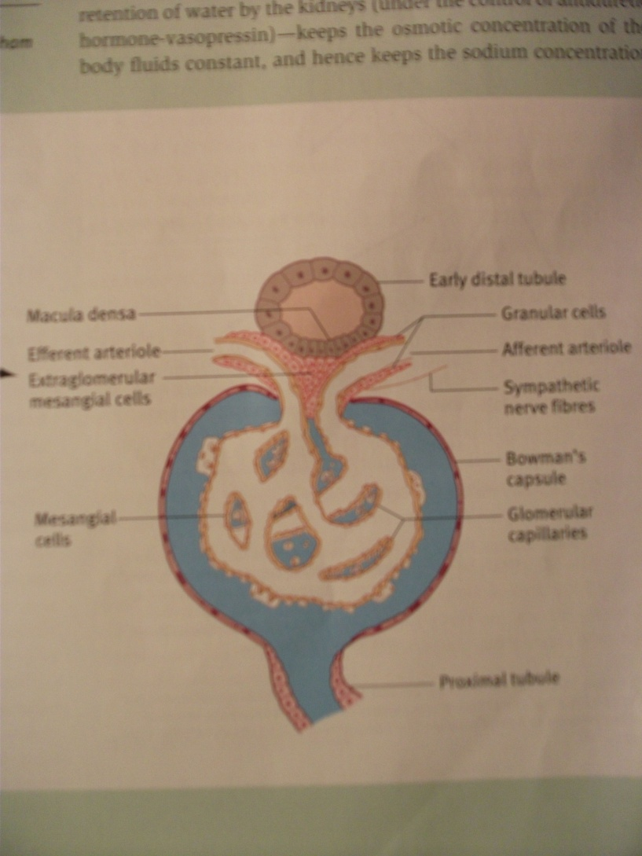
GLOMERULUS.

Slide 7
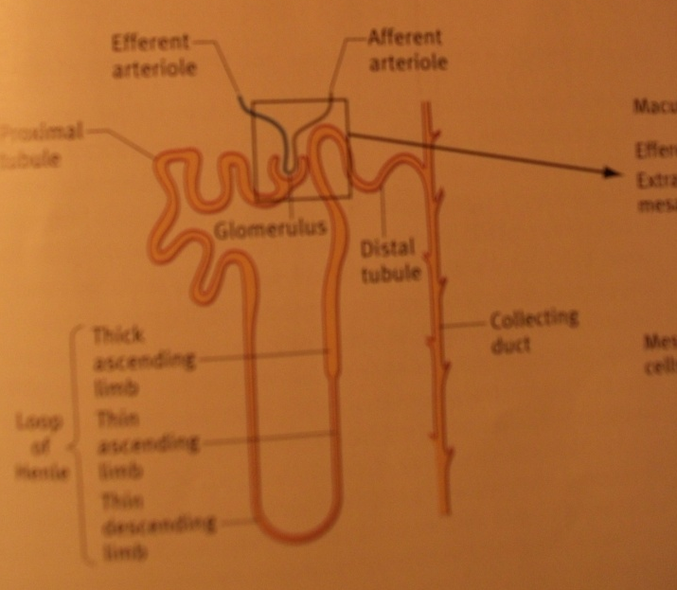
THE NEPHRON/DISTAL TUBULE.

Slide 8
COMMON SITES OF OBSTRUCTION.
Pelvi-ureteric junction.
Ureter at pelvic- brim.
Uretero-vesical junction.
Bladder neck.
Urethral section esp.meatus.

Slide 9
OBSTRUCTIVE UROPATHY
SIMPLE CLASSIFICATION
In the lumen of urinary tract
In the wall of urinary tract,
Pressure from outside the wall.
Three or two occurring together.

Slide 10
COMMONEST OF THE THREE.
IN THE LUMEN;
Blood clot
Renal calculus (i)
Growths (cancers)
Congenital abnormalities.

Slide 11
MOST DIFFICULT TO TREAT SURGICALLY.
IN THE WALL;
At the level of URERTER,
Why :thin wall , poor blood supply.
At the level of BLADDER NECK,
Why: Poor access, vital crowded organs.

Slide 12
LEVEL: CAUSES OF UROPATHY
CONGENITAL:level
Renal, ureter,bladder,bladder neck,urethra,meatus.
ACQUIRED:level
Renal, ureter,bladder bladder neck/prostate,urethra,meatus.

Slide 13
CAUSES AT URETER LEVEL.
Duplex ureter,retrocaval,polycystic kidneys , horseshoe kidneys , aberrant vessels.PUJ obstruction.
Strictures/granulomas/retroperitoneal fibrosis.
Urinary stone disease-uric/calcium.
Intramural ureter conditions: =Shistosomiasis(h/m),Tb,strictures,stone
Common areas PUJ jt and U/V jt.

Slide 14
BLADDER/ NECK LEVEL/URETHRA
Congenital = ectopia , post.u. valves ,ect.
Acquired=trauma,infections,tumours,prostate enlargement diseases , neurogenic bladder . STONES ,blood clots.
Specially PROSTATE BPH,CANCER of Prostate , Prostatisis / bladder neck stenosis.
Urethral causes=congenital (p.valves),epi/hypospadias,meatal stenosis,phimosis.Acquired = strictures ,stones.

Slide 15
FACTORS IN OBSTRUCTIVE UROPATHY.
Onset of obstruction.
Duration of obstruction.
Level of obstruction.
Severity of obstruction.
Presence or absence of infection.
Back pressure to the NEPHRON=reversible or irreversible damage or RF.

Slide 16
TOWARDS DIAGNOSIS.
Good history taking;
Patient’s details& identification.
History of illness &details of it.
Systemic surveys/inquiries.
Past history , family , occupation and social.
Physical Examinations;
General, Specific areas,
Provisional diagnosis , differentials.

Slide 17
INVESTIGATIONS.
Urine analysis = sp/gr , pH, proteins ,casts , cells microbiology , Clinical chemistry on urine.
Blood for Urea/Electrolytes . BUN.
Haematology , Clinical chemistry.
Imaging= Plain Xrays, U/S contrast CT Scan , MRI, PET Scan.
Others-IVU,MCU, Retrograde pyelography / urethrography ,Urodynamics ,Angiography ,Endoscopic diagnosis.

Slide 18
TREATMENT OR MANAGEMENT.
Medical treatment-use of drugs to treat blockage.
Surgical treatment –noninvasive and invasive procedures.
Follow up treatment or counseling.

Slide 19
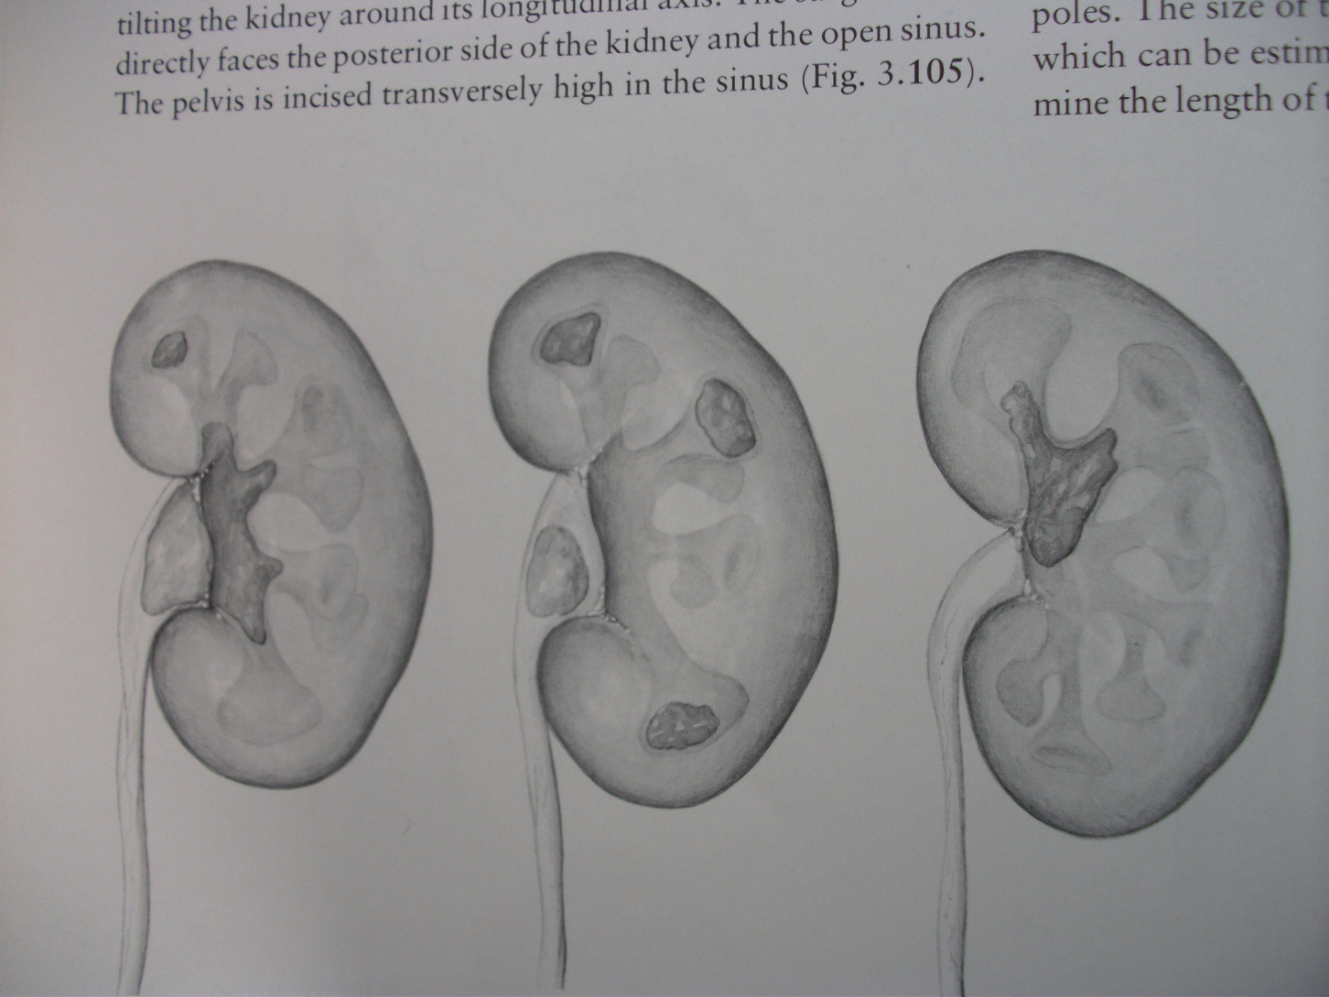
SOME EXAMPLES =STAGHORN CALCULI

Slide 20
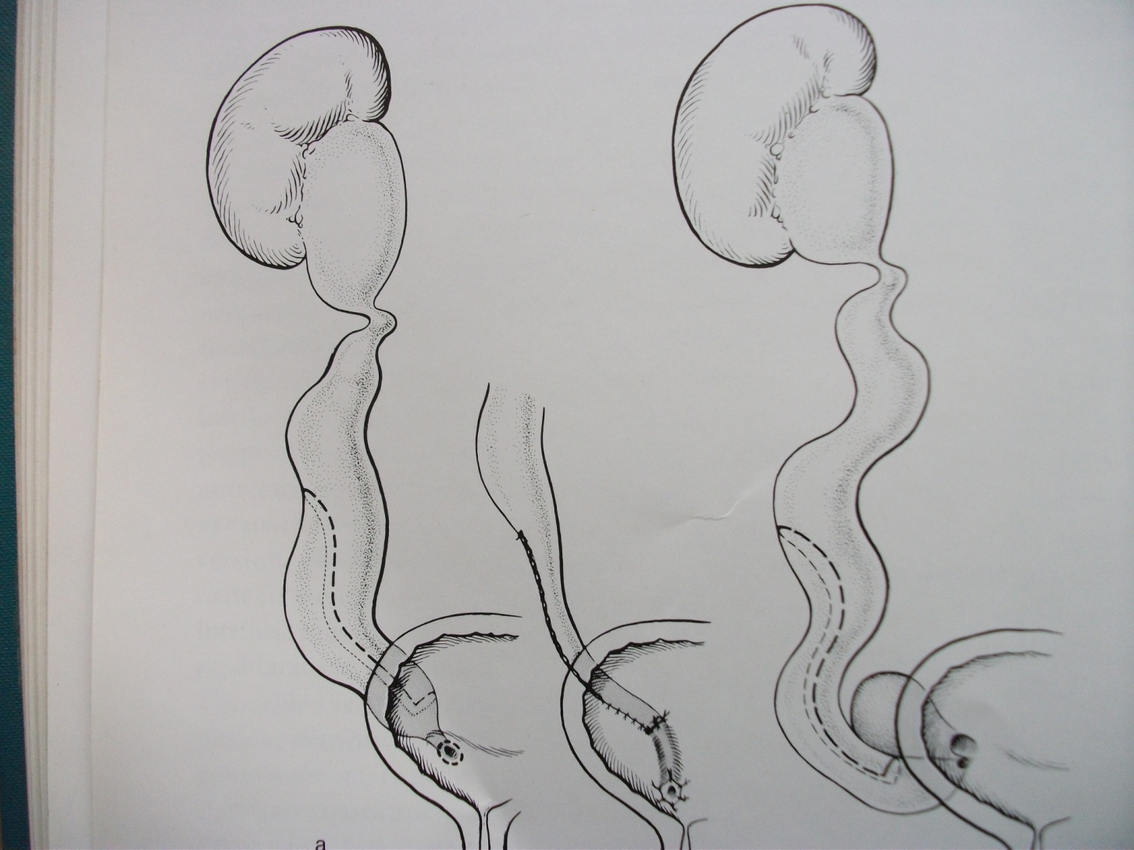
MEGA URETERS

Slide 21
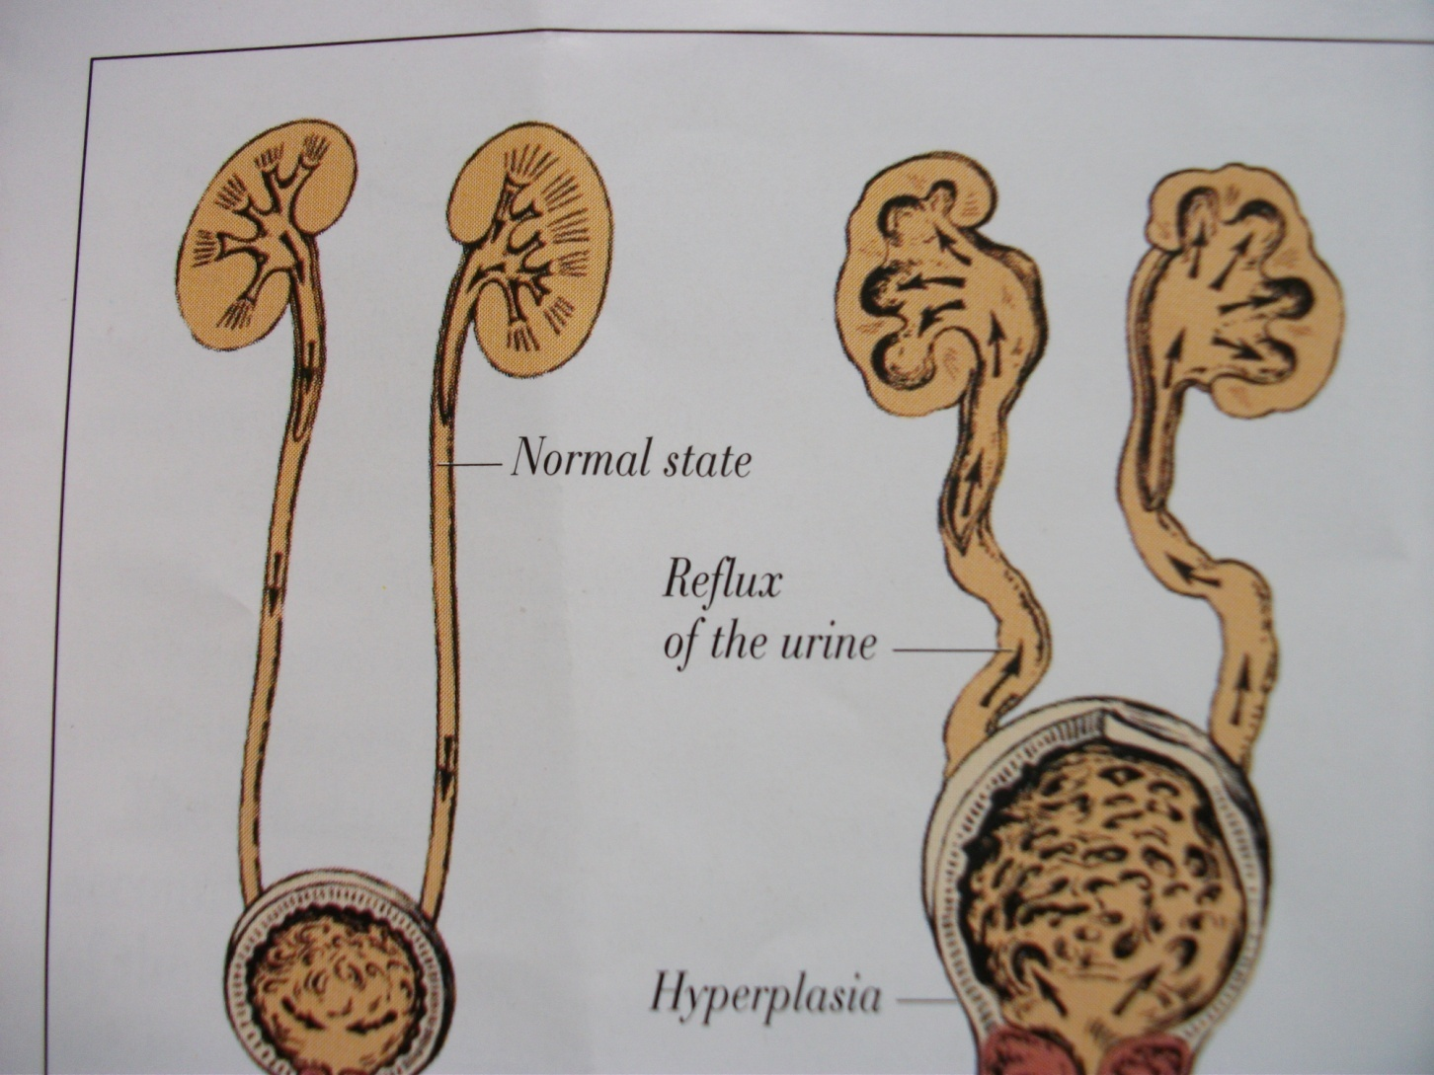
URINARY TRACT

Slide 22
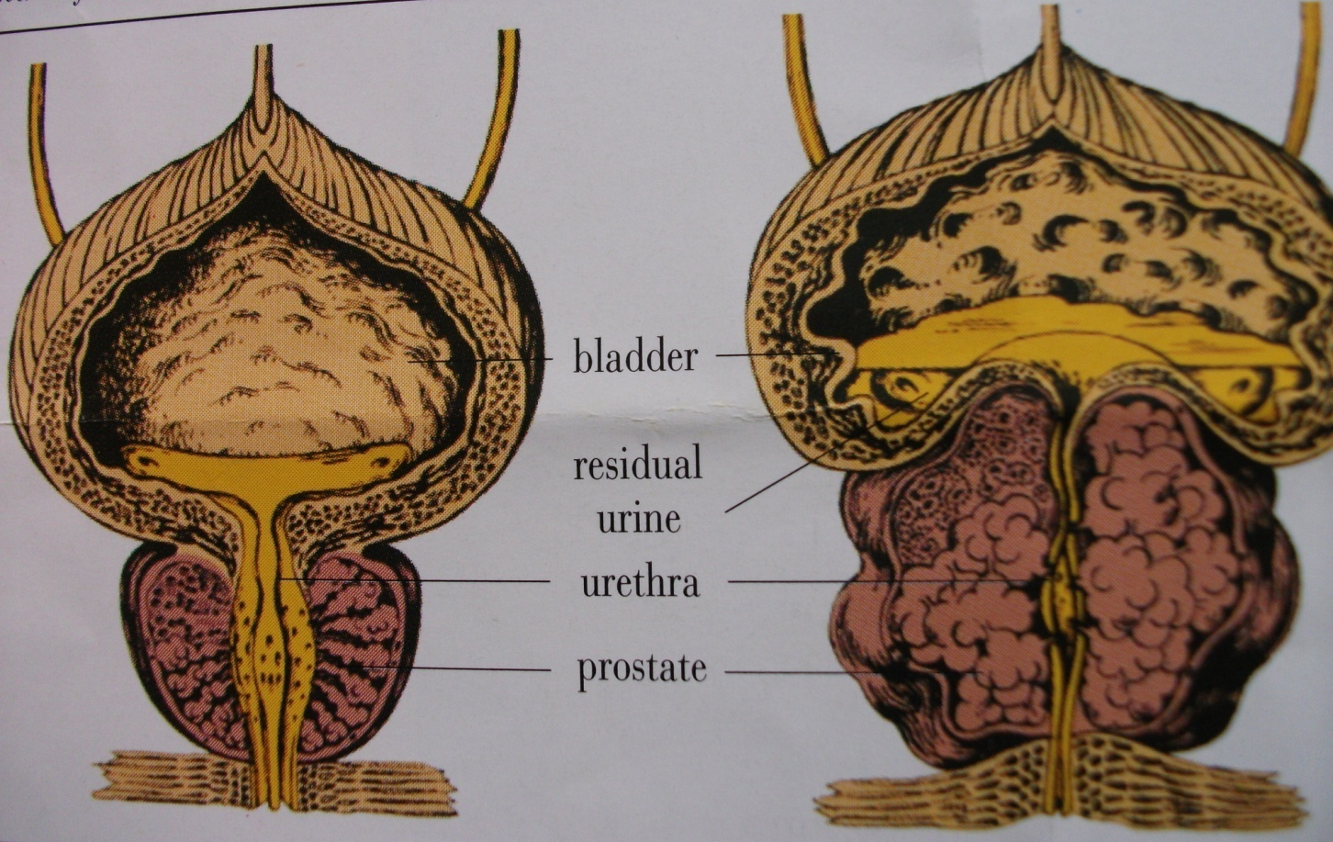
BPH

Slide 23
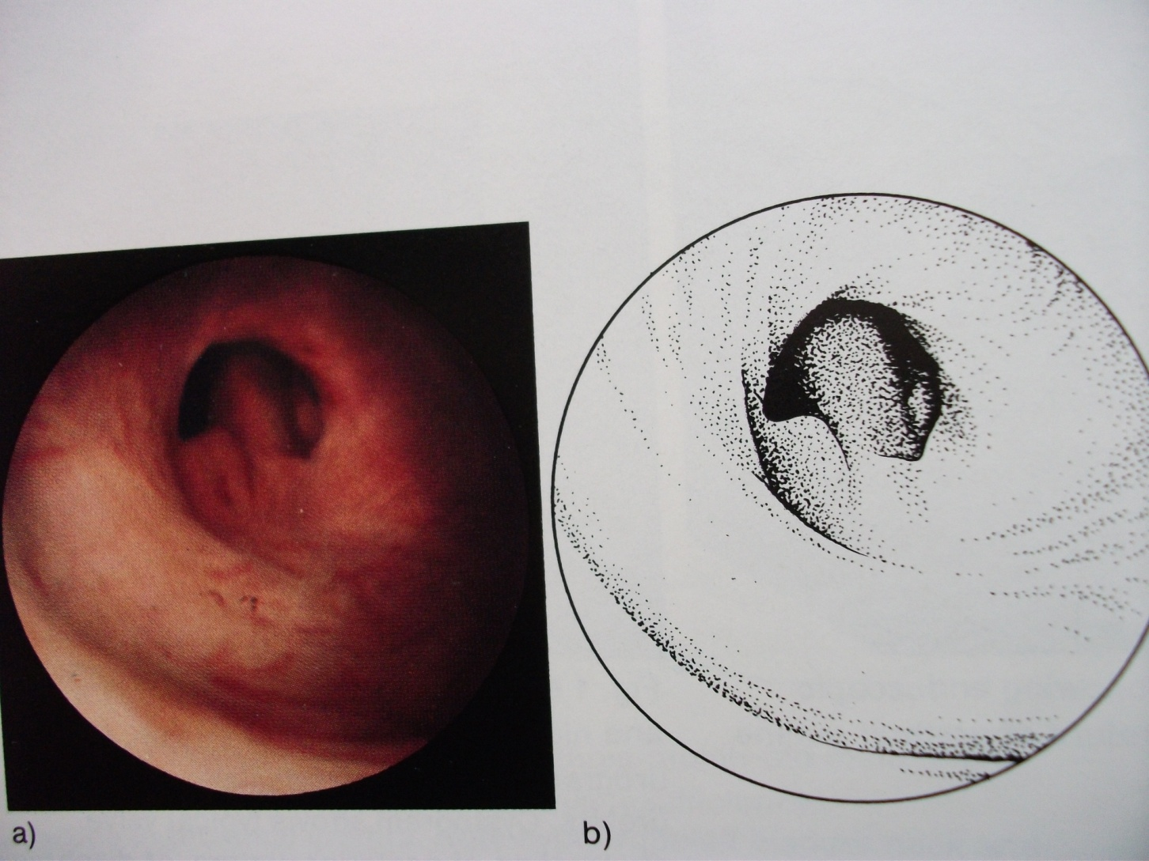
POSTERIOR URETHRAL VALVES

Slide 24
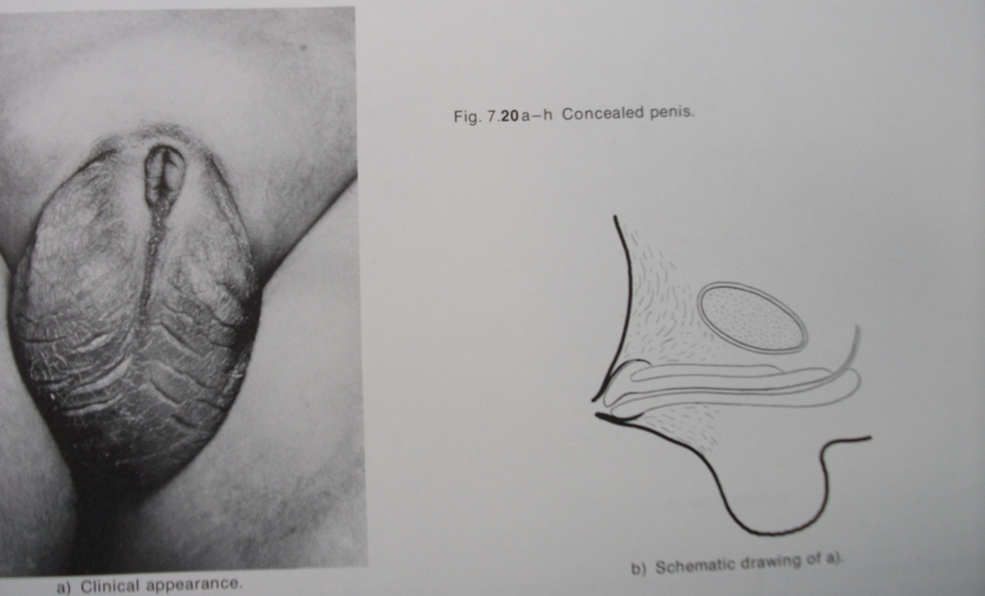
CONCEALED PENIS

Slide 25
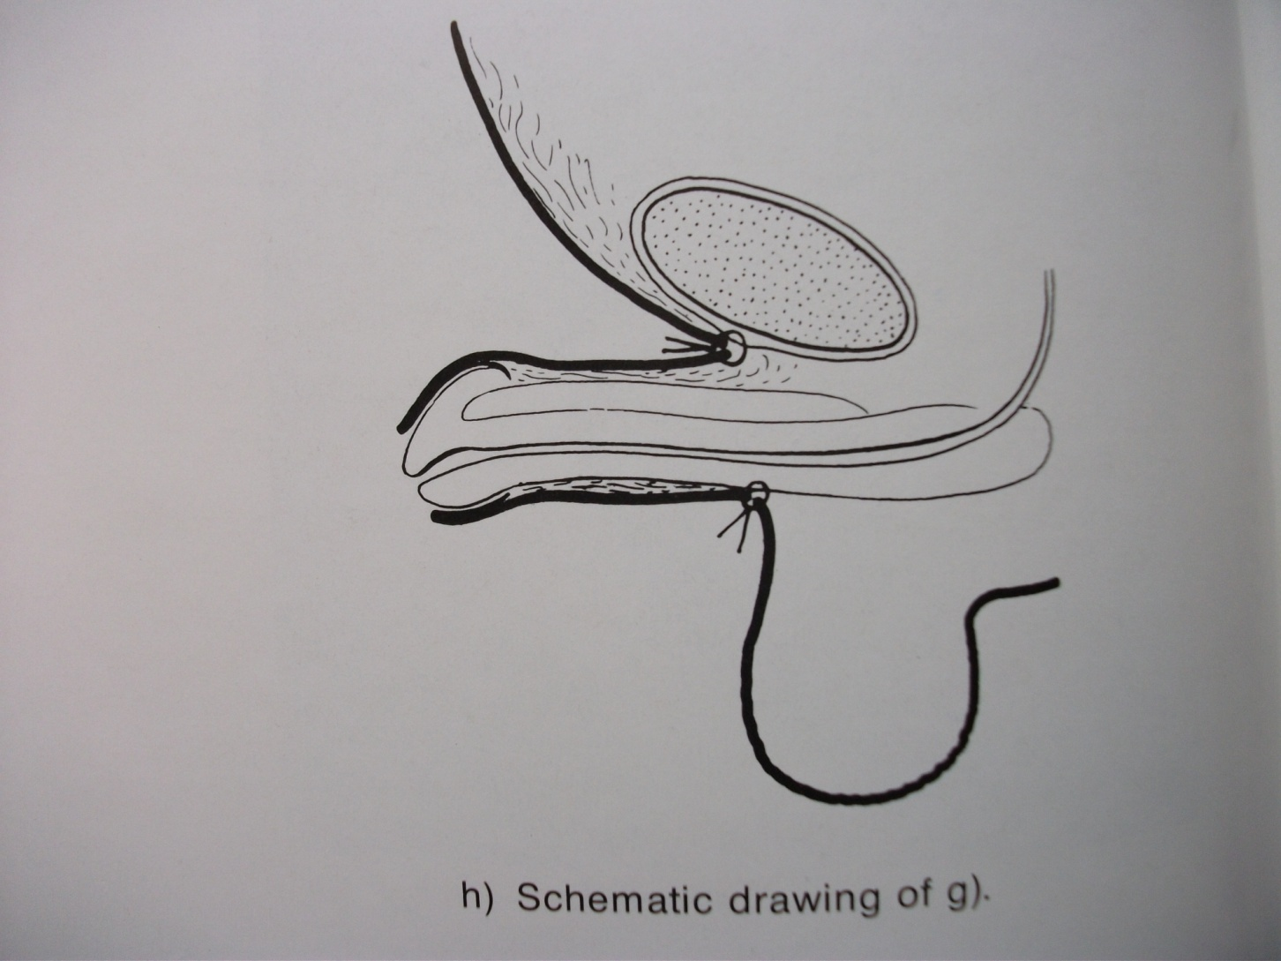
CONCEALED PENIS CORRECTION

Slide 26
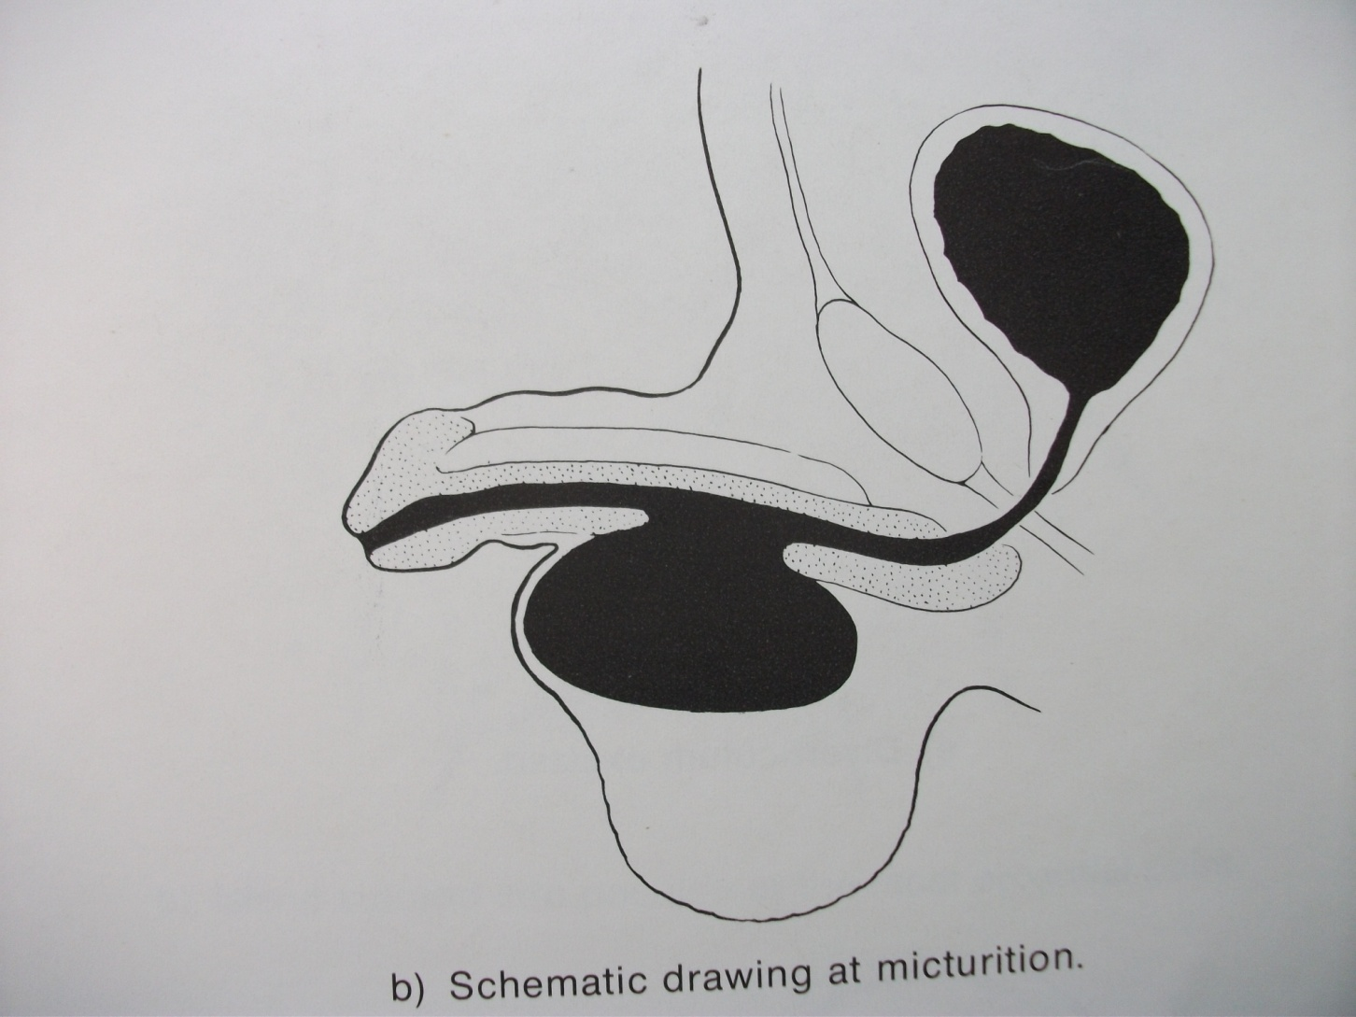
URETHRAL DIVERTICULUM

Slide 27
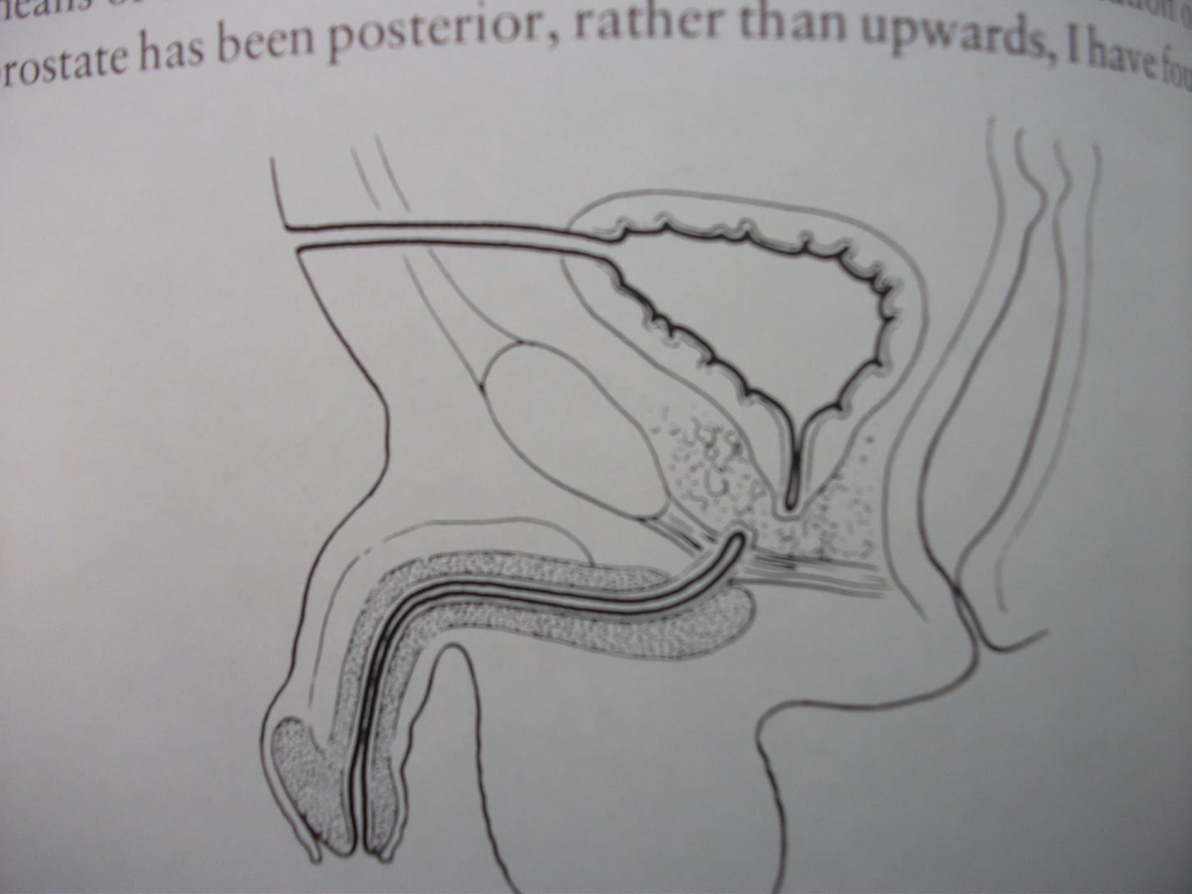
SUPRA PUBIC CYSTOSTOMY

Slide 28
The end.

Slide 29
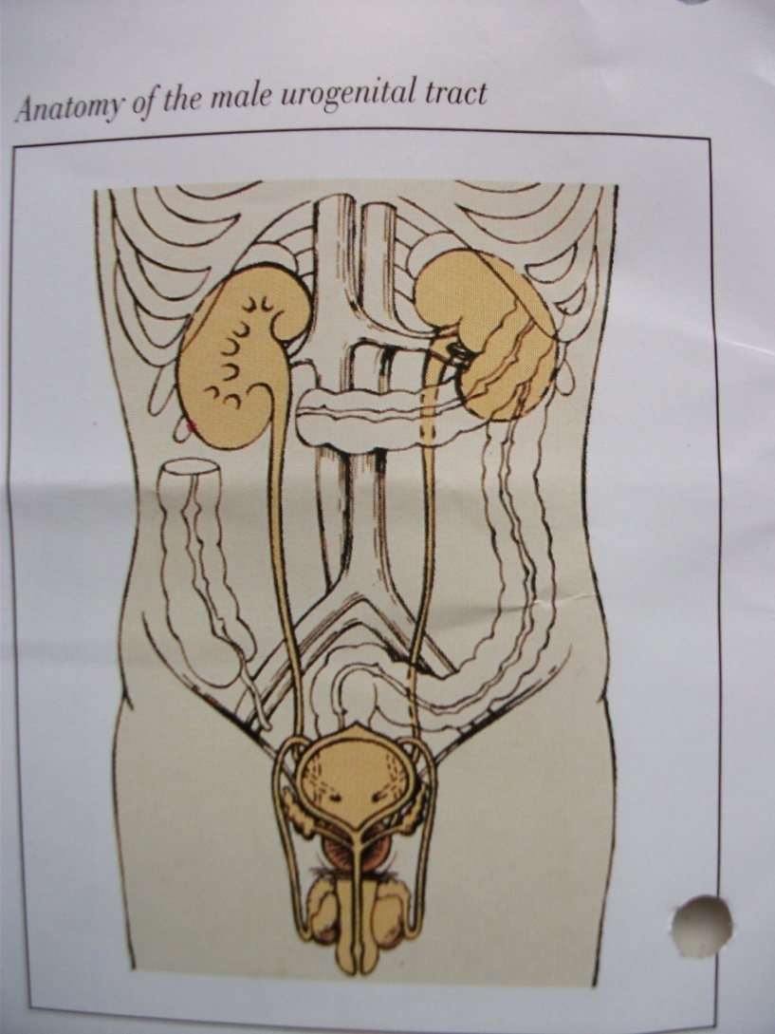
ANATOMY U.T. FRONT

