Slide 1
BENIGN PROSTATIC HYPERPLASIA & URINARY RETENTION
BY: PROF. PETER NDAGUATHA
DATE: 15/9/2016

Slide 2
DEFINITIONS
PROSTATIC ENLARGEMENT
BENIGN PROSTATIC ENLARGEMENT
Clinical diagnosis (on DRE)
BENIGN PROSTATIC HYPERPLASIA
Pathological diagnosis

Slide 3
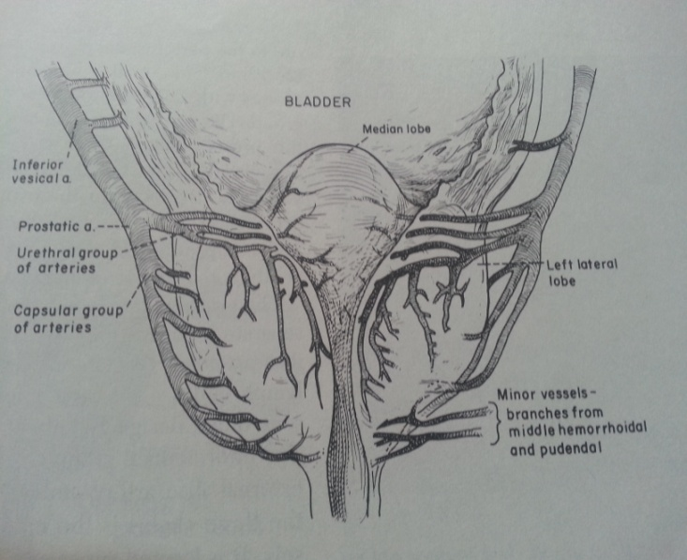
ANATOMY OF THE PROSTATE EMBRYOLOGY & GROSS ANATOMY
It is below the gall bladder
Encloses the posterior part of the urethra i.e.
bladder neck
Prostatic urethra
Membranous urethra

Slide 4
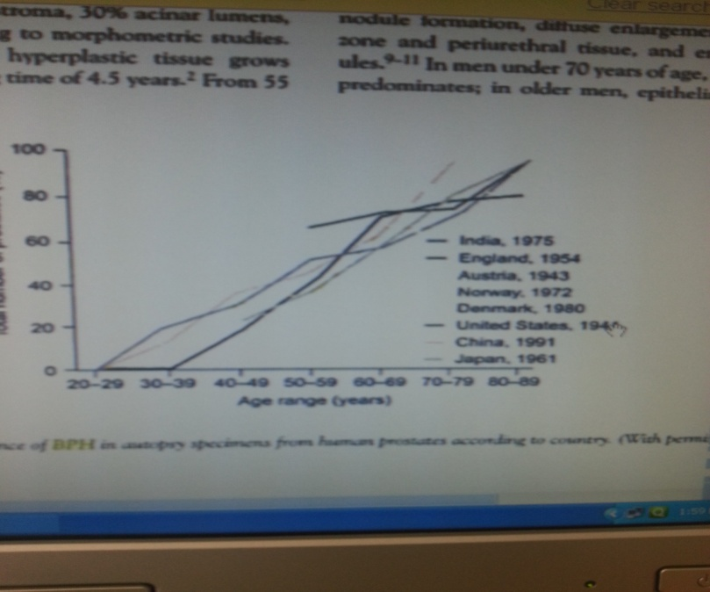
INCIDENCE AND EPIDEMIOLOGY
Age-related
Linear progression as one ages
Autopsy findings confirm that:
20% → 41-50
50% → 51-60 years
90% → 80 -90 years
Clinical signs and symptoms
About 25% in age group 50 – 55 years
About 50% in over 70 years

Slide 5
ETIOLOGY
Age-related
Genetic
Hormonal
Those with a problem with 5-alpha reductase rarely develop BPH or prostatic cancer

Slide 6
PATHOLOGY
Central zone growths compressing the peripheral zones (prostate proper)
Compression is in a centrifugal manner
Prostatectomy is actually a misnomer. It should be adenomyomectomy/partial prostatectomy
Radical prostatectomy is removal of all of the prostatic tissue + seminal vesicles
Hyperplasia occurs in nodules
Prostatic enlargement may constrict the prostatic urethra resulting in increased intra-cystic pressure to aid voiding of urine.

Slide 7
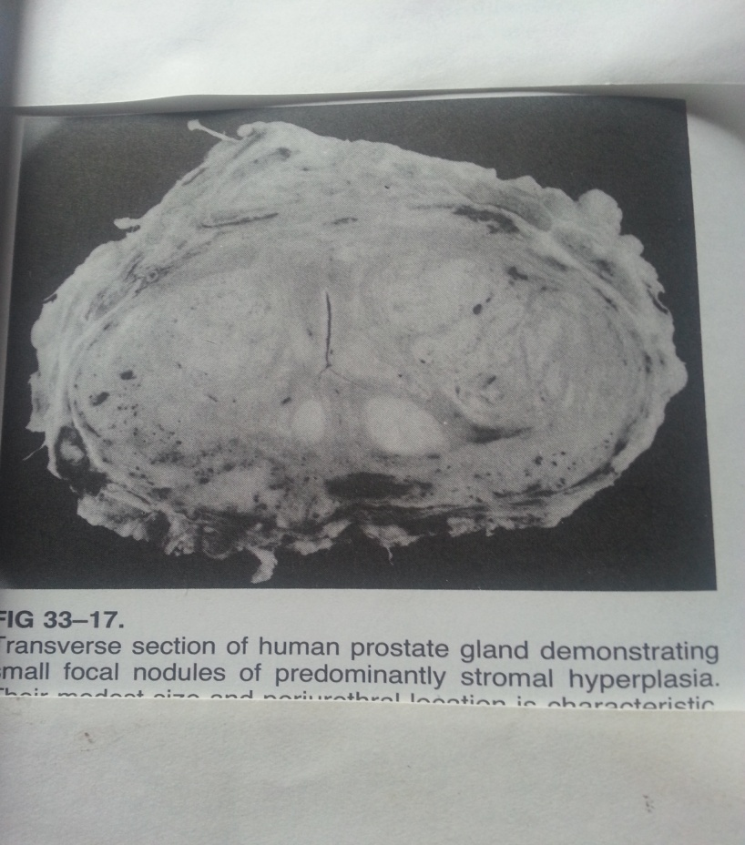
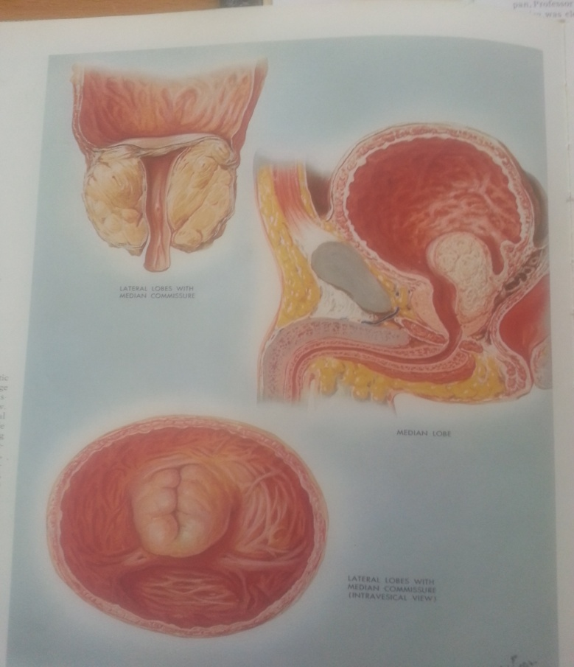
CENTRAL ZONE GROWTHS COMPRESSING THE PERIPHERAL ZONES

Slide 8
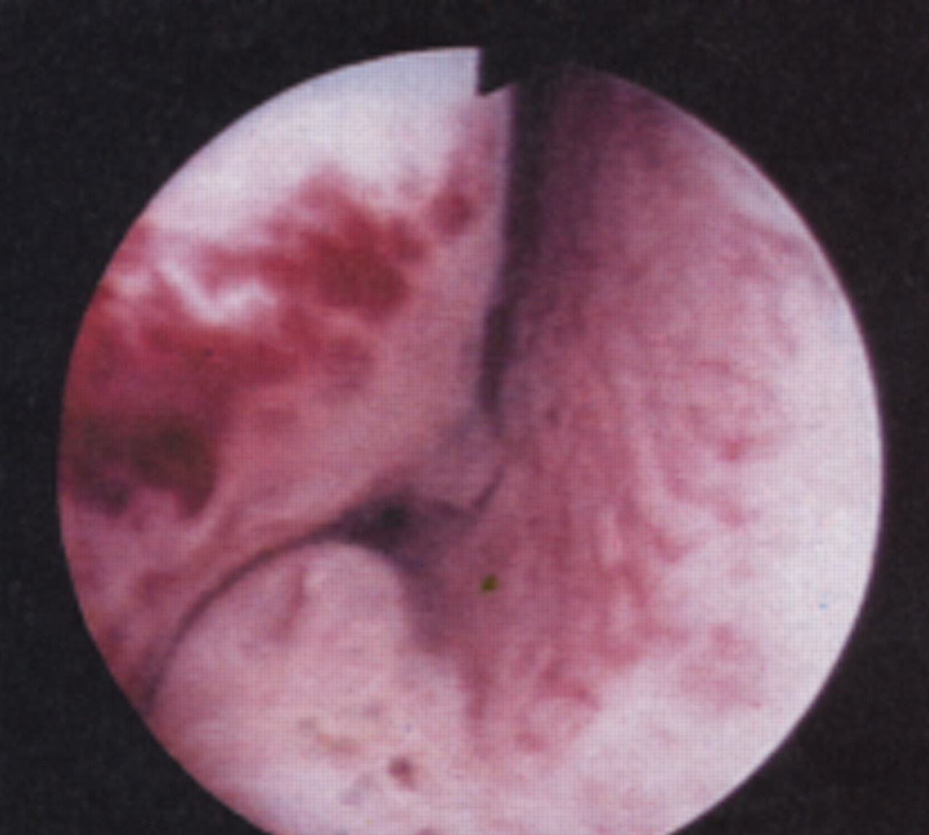

Slide 9
DISTRIBUTION OF MICTURITION PHASES FILLING AND EMPTYING PHASES
Filling phase
Irritative or bothersome symptoms
Frequency, nocturia, urgency +/- urge incontinency
Emptying phase (obstructive symptoms – static and dynamic)
Poor urine flow (force, caliber)
The bladder cannot empty completely
Hesitancy – delay in voiding urine
Overflow incontinency and recent nocturnal enuresis
Straining, intermittency, forking, prolongation of voiding
Intermittency → dribbling of urine; can occur continually, initially, mid-stream or at the end of micturition
Residual urine volume → incomplete urine voiding
Retention – AUR/chronic retention
There is no synergy
These symptoms are referred to as Lower Urinary Tract Symptoms

Slide 10
LUTS CAUSES OF FNU (FREQUENCY, NOCTURIA, URGENCY) +/- URGENCY INCONTINENCE
Non-neurological disorders
BPH
UTI
Bladder stones
Interstitial cystitis
Prostate cancer
Bladder cancer
Chronic cystitis
Vesical schistosomiasis
Diabetes Mellitus
Neurological disorders
CVA Brian tumors
Internal hydrocephalus
Parkinsonism
Spinal tumors
MS Peripheral neuropathy

Slide 11
OBSTRUCTIVE SYMPTOMS - DIFFERENTIALS
BPH
Urethral strictures
Carcinoma of the prostate
Bladder cancer
Bladder stones
Phimosis
Paraphimosis
Neurogenic bladder
Meatal stenosis

Slide 12
URINARY RETENTION
Acute urinary retention
Chronic retention

Slide 13
ACUTE URINARY RETENTIONS
Sudden inability to urinate in spite of the desire to do so
Pain is severe, bursting, felt in the supra-pubic area (supra-pubic cystotomy)
The bladder is full and over-distended due to complete obstruction
Relieved by catheterization
Pathophysiology
Increased urethral resistance i.e. bladder outlet obstruction
Low bladder pressure i.e. impaired bladder contractility
Interruption of sensory or motor innervations to the bladder

Slide 14
CAUSES
Men
BPE due to BPH
Carcinoma of the prostate
Urethral stricture
Prostatic abscess
Women
Pelvic prolapse (cystocele, rectocele, uterine)
Urethral stricture
Urethral diverticulum
Post-surgery for ‘stress’ incontinence
Pelvic masses e.g. ovarian masses
General
Hematuria – clot retention
Drugs (sympatholytics)
Pain
Sacral nerve compression or damage (cauda equina compression)
Radical pelvic surgery
Pelvic fracture with urethral rupture
Neuropathy

Slide 15
MANAGEMENT
Initial – urethral or supra-pubic catheterization
Employ all the aseptic techniques
Have a catheterization tray and a medium – sized catheter depending on the age of the patient.
Use sterile gloves and mild antiseptic lotions
Use a lubricant mixed with a LA on the catheter to avoid any friction on the urethral mucosa that may result in urethral strictures
Be gentle as you advance the catheter up the urethra. DO NOT USE FORCE!
NEVER USE SPIRIT
It is painful and can cause epithelial excoriation
If it is difficult to pit it in, opt for a supra-pubic urethra
Late – treat the underlying cause

Slide 17
CHRONIC URINARY RETENTION
Obstruction develops slowly, the bladder is distended (stretched) very gradually over weeks/months, so pain is not a feature
Presentation
Urinary dribbling
Overflow incontinence
Palpable lower supra-pubic mass
Usually associated with
Reduced renal function
Upper tract dilatation → hydroureter/hydronephrosis
Treatment is directed to renal support
The bladder drainage should be done at a slow rate to avoid sudden decompression which might lead to relative low BP and hematuria → POST-OBSTRUCTIVE DIURESIS
Put the urinary bag at the same level of the patient’s left atrium if he/she is lain supine on bed.
Use a wide bore needle for venous access and slowly infuse the patient with crystalloids (ringer’s lactate or NS) to pre-empt the hypotension.
Late treatment of the cause.

Slide 18
PATHOPHYSIOLOGY
CUR due to BOO
Effect back pressure
Bladder dilatation and hypertrophy and trabeculation
Ascending infection
Hydeo-uretero-nephrosis
Renal insufficiency
Disturbance of micturition phases
Filling phase
Frequency, nocturia, urgency +/- urge incontinency
Nocturia → reduced hours of sleeping (quality of life interfered?); sexual history?
Emptying phase
Obstructive symptoms – static and dynamic
Poor urine flow (force, caliber)
Hesitancy
Overflow incontinence and recent nocturnal enuresis
Straining, intermittency, forking, prolongation of voiding
Retention → AUR/Chronic retention

Slide 19
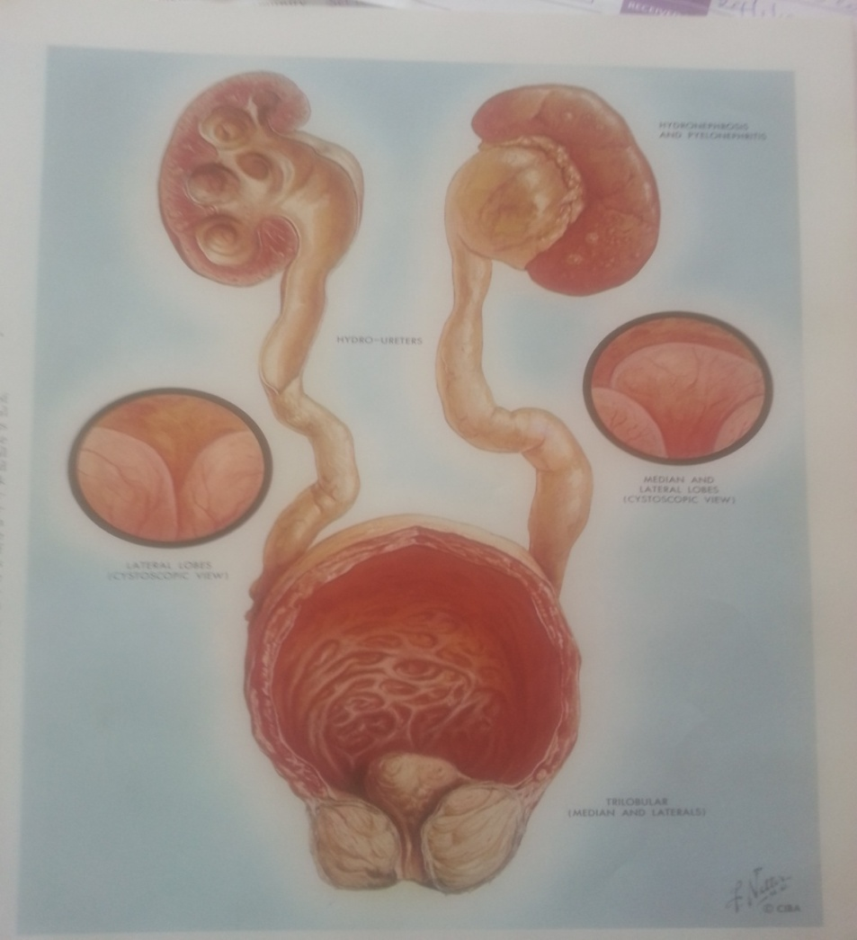

Slide 20
INVESTIGATIONS
Focused history taking + symptom scoring
International prostate scoring system (IPSS)
< 7 → Mild
8-18 → Intermediate
19 – 35 → Severe
PE
Lab
Urine specimen → MSSU
Urinalysis
Microscopy
C/S
Blood specimen
TBC
U/E
Cr
PSA ALP
Imaging
U/S
Intra-Venous Urogram (IVU) → rarely done
Complications
If metformin → lactic acidosis may be precipitated
Pain
Dehydration → diagnosis may be missed

Slide 21
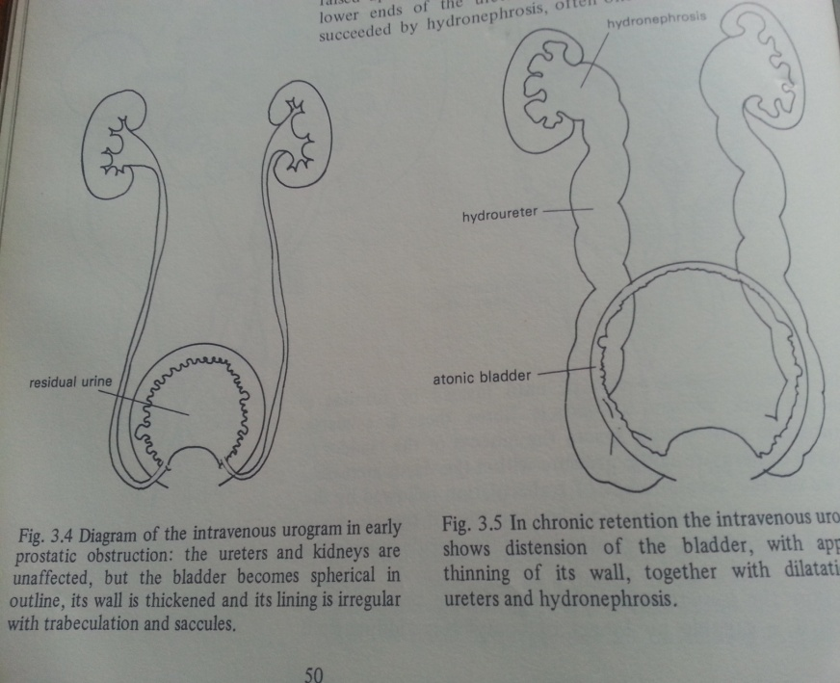
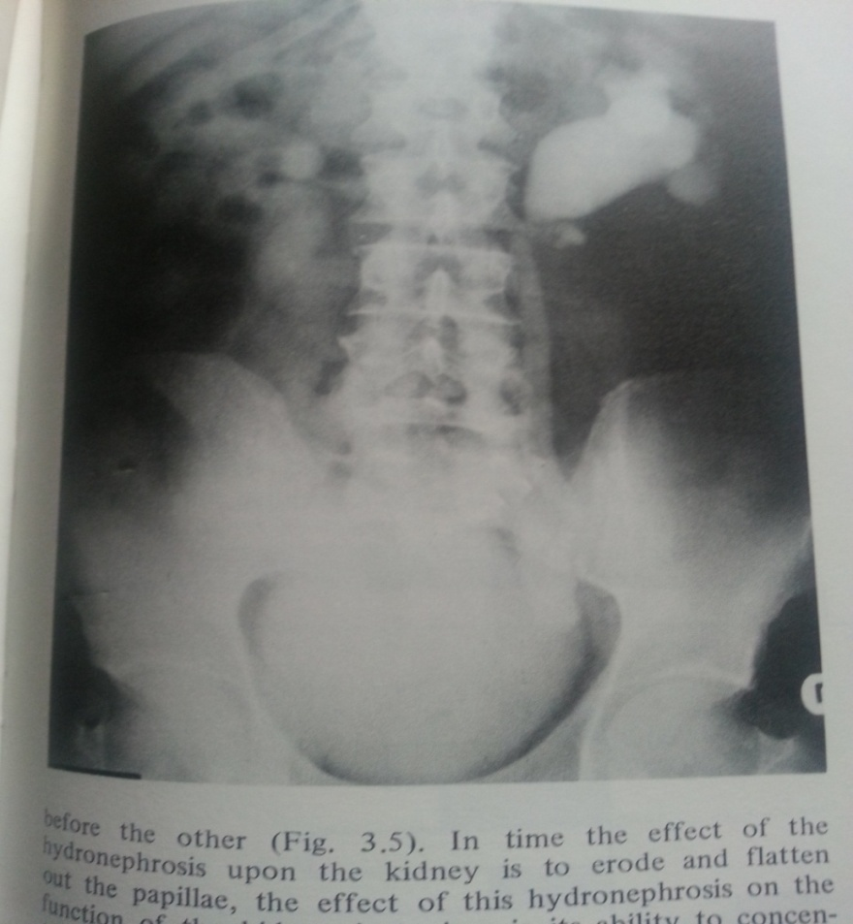
IVU

Slide 22
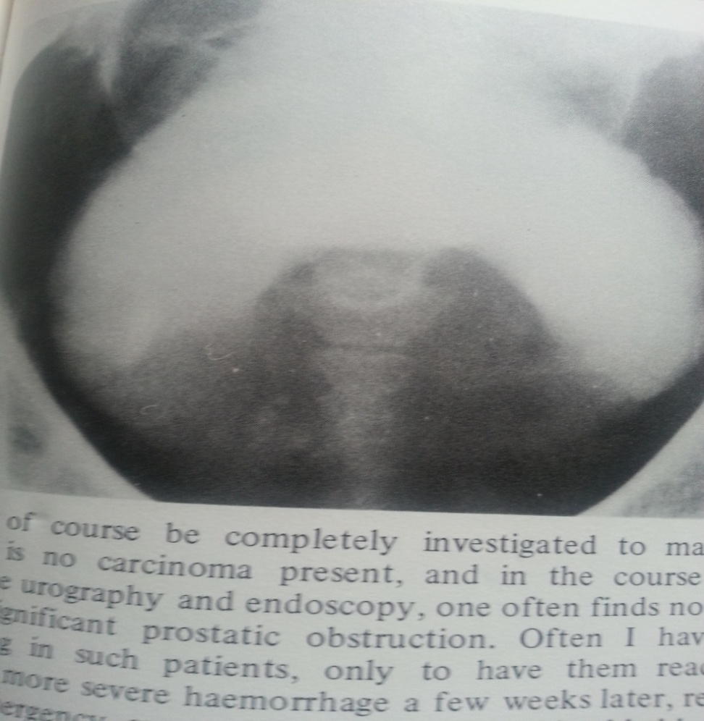
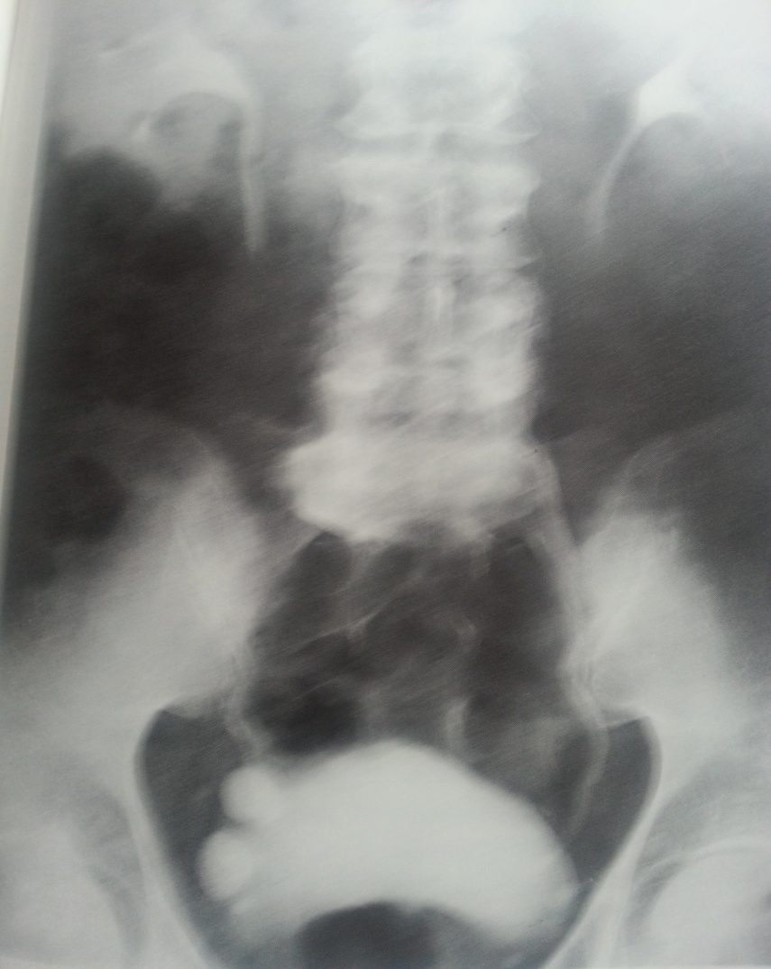
BPE → EFFECTS OF INCRASED PROSTATIC SIZE AND INTRAVESICAL PRESSURE

Slide 23
TREATMENT OF BPH
Medical
Alpha adrenergic receptor blockers (selective and non-selective)
Surgical
Minimally invasive
Invasive
Open retro-pubic,
Trans-vesical prostatectomy (FRAYER’S PROSTATECTOMY)
Retro-pubic prostatectomy (MILLIN’S PROSTATECTOMY)
Endoscopic
Trans-Urethral Resection of the Prostrate (TURP)
Trans-Urethral Microwave Therapy (TUMT)
Trans-Urethral Laser Prostatectomy (TULP)
Trans-urethral Laser Incision of the Prostate (TULIP)

