Slide 1
Fluid and electrolytes
Dr Ojuka

Slide 2
Objectives
Revision of fluid compartments
Osmotic/oncotic pressure / osmolality
Fluid shifts in disease
Prescribing fluids

Slide 3
Introduction
The metabolic functions of the body takes place in a milieu of fluid and at times it self results in fluid.
Therefore it is critical for that milieu to kept constant both on volume and contents.
Disturbance both in content and volume results in reactions that undermine the functions of the body and therefore the health of the individual

Slide 4
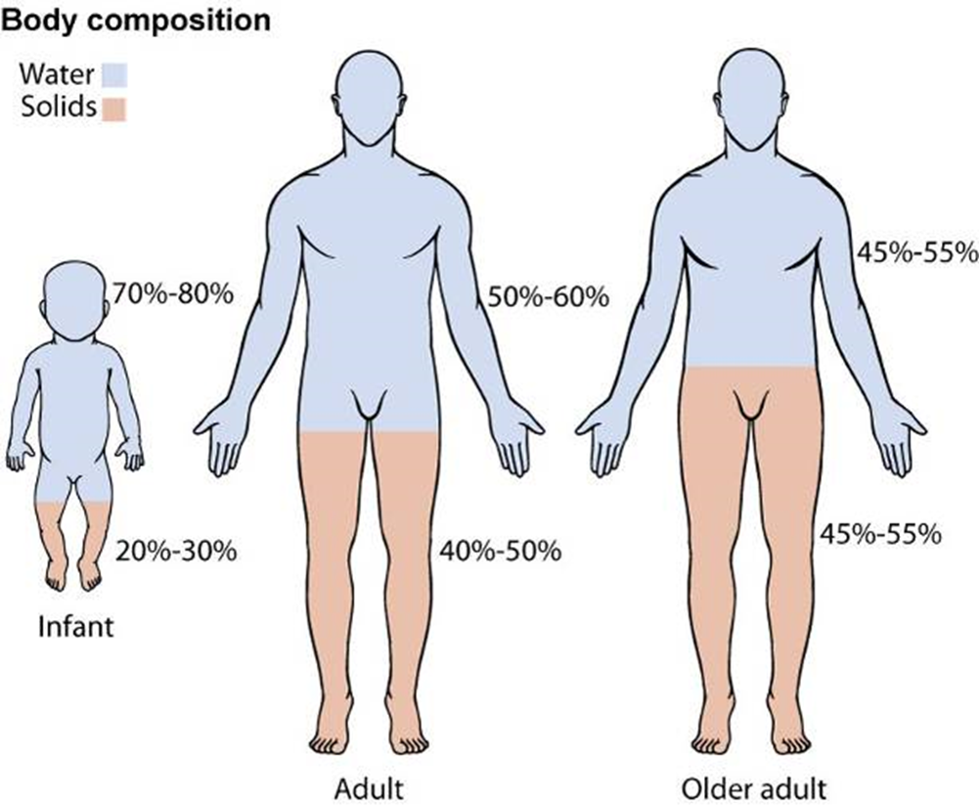
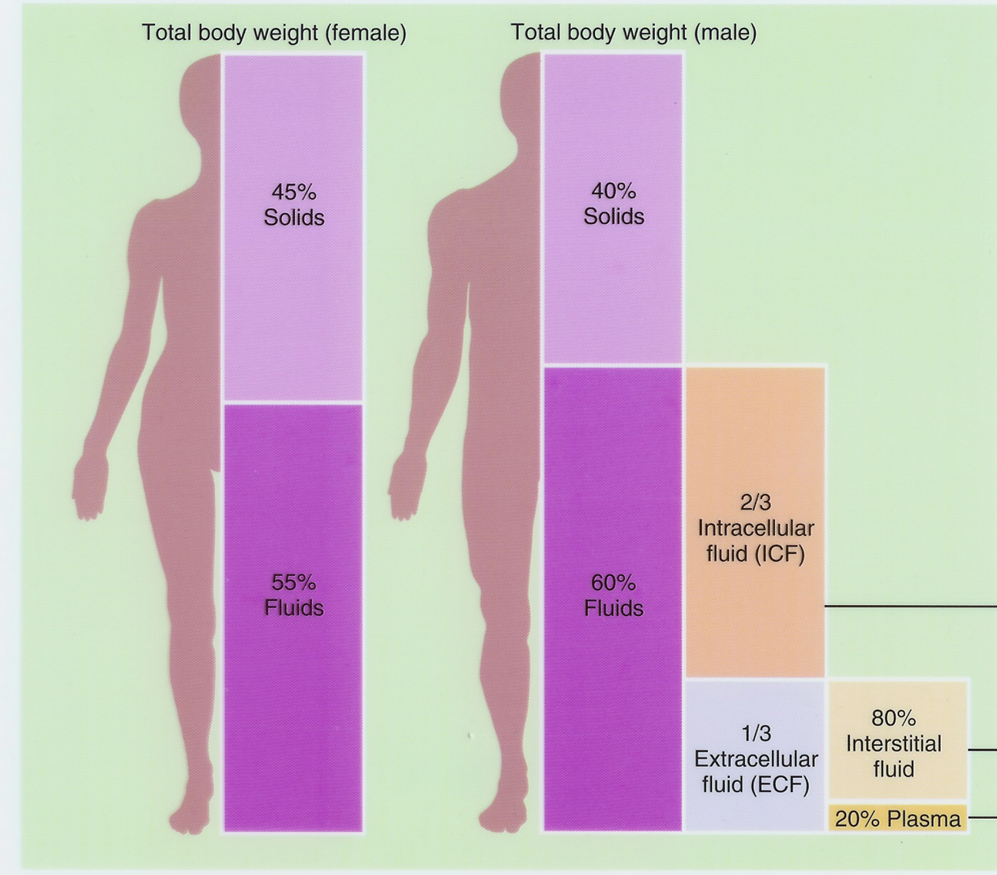
Physiology of Fluids
Notes:
Water makes up around two thirds of our total body mass. To be exact, men are 60% water, whilst women are slightly less at 55%. A 70 kg. man will therefore contain about 42 litres, and a 70 kg. woman nearer 38 litres. The reason for this difference between the sexes is that women contain an extra 5% adipose tissue; the difference is only occasionally of clinical significance.
2/3 (65%) of TBW is intracellular (ICF)
1/3 extracellular water
25 % interstitial fluid (ISF)
5- 8 % in plasma (IVF intravascular fluid)
1- 2 % in transcellular fluids – CSF, intraocular fluids, serous membranes, and in GI, respiratory and urinary tracts (third space)

Slide 5
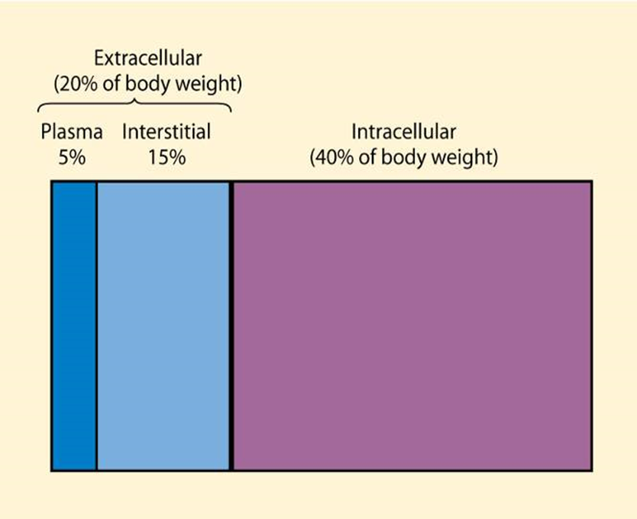
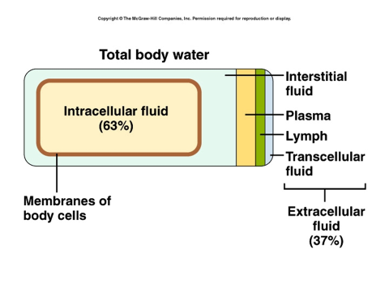
Physiology of Fluids
Notes:
Fluid compartments are separated by membranes that are freely permeable to water.
Movement of fluids due to: hydrostatic pressure / osmotic pressure
Capillary filtration (hydrostatic) pressure
Capillary colloid osmotic pressure
Interstitial hydrostatic pressure
Tissue colloid osmotic pressure

Slide 6
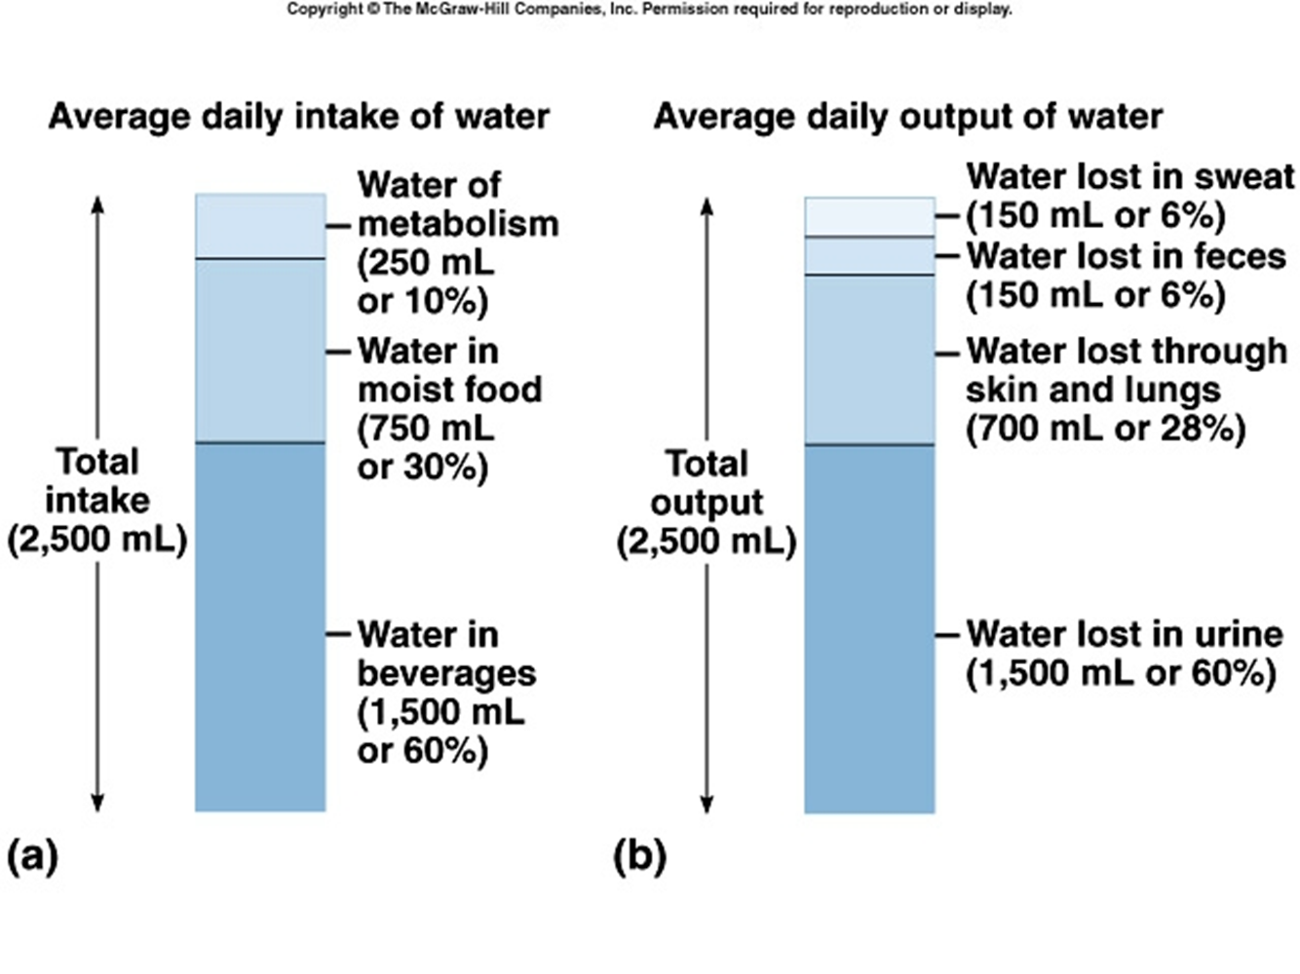
Notes:
The majority of our total body water is locked within our cells; this is the intracellular compartment. Bathing our cells, and occupying extracellular spaces such as the pleural cavity, joint spaces etc., is a smaller amount of interstitial water. Our intravascular compartment holds the smallest amount of water at around 3 litres ( a further 2 litres of red cells makes up our total blood volume ). The interstitial and intravascular compartments make up our extracellular space.
Water moves freely between these compartments, but in our day to day use, fluids can only be given into, or taken from the vascular space.
Fluid losses occur mainly from the vascular compartment as well. We lose water through our renal and gastrointestinal tracts, and this can be seen and measured. The water we lose from our skin and respiratory tract can not be measured with ease, and makes up our insensible losses. These amount to 500 ml a day in health ( on average ), and increase in sickness, particularly when febrile.

Slide 7
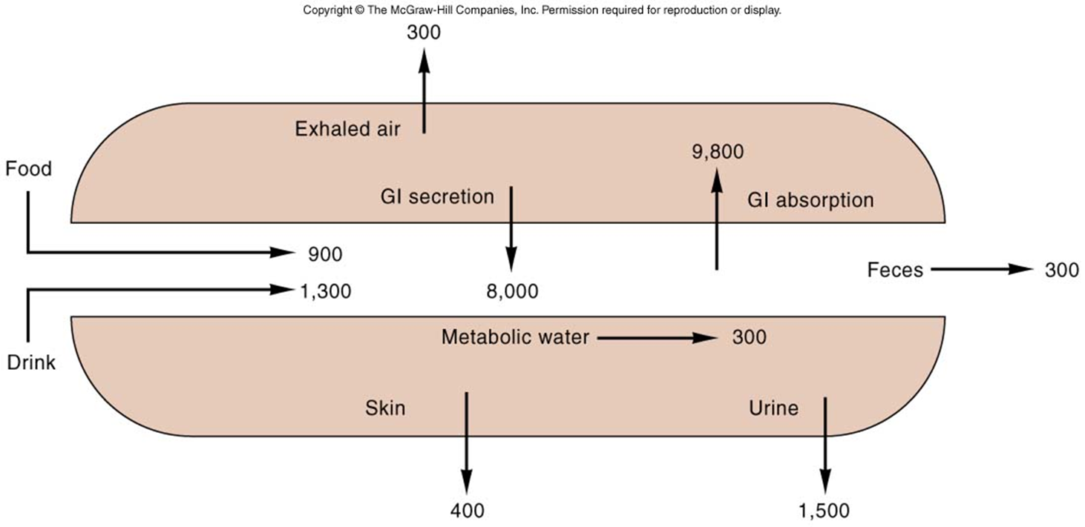
Notes:
Fluid and electrolyte homeostasis is maintained in the body
Neutral balance: input = output
Positive balance: input > output
Negative balance: input < outpu

Slide 8
Osmotic / oncotic pressure
Na⁺
Na⁺
PP
Intracellular
Interstitial
Intravascular
Notes:
The distribution of water throughout the body is dictated partly by the size of the compartment available, but mainly by tonicity. Water balance is adjusted to maintain osmolality at a constant throughout all three compartments. Furthermore, oncotic pressure generated by large molecules like plasma proteins ( PP ) add to the forces that retain water within the vascular space.
Sodium moves freely between the vascular and interstitial spaces, but is actively extruded from the intracellular space; it is therefore the principle extracellular cation. It is also the cation that we most frequently administer by giving intravenous saline ( NaCl ). When we do this, we increase extracellular tonicity and water must move from the intracellular space to normalise osmolality.

Slide 9
Calculation of osmolality
Difficult: measure & add all active osmoles
Easy = [ sodium x 2 ] + urea + glucose
Normal = 280 - 290 mosm / kg
Notes:
Normal serum osmolality is 280 - 290 mosm / kg. Measured osmolality uses analysers that measure all active " osmoles ", but a calculated osmolality is often very close. As sodium is the major extracellular cation, the majority of extracellular anions will be equal to its concentration. Urea and glucose make up the remaining significant osmoles, and calculated osmolality is therefore ( 2 x [ Na+ ] ) + [ urea ] + [ glucose ]. It is easy to see that in conditions such as hypernatraemia, renal failure ( raised urea ) or hyperglycaemia, osmolality is raised.
Homeostasis maintained by:
Ion transport
Water movement
Kidney function

Slide 10
Tonicity
Isotonic
Hypertonic
Hypotonic
Notes:
Electrolytes – charged particles
Cations – positively charged ions
Na⁺, K⁺ , Ca⁺⁺, H⁺
Anions – negatively charged ions
Cl⁻, HCO₃⁻ , PO₄³⁻
Non-electrolytes - Uncharged
Proteins, urea, glucose, O₂, CO₂
Body fluids are:
Electrically neutral
Osmotically maintained
Specific number of particles per volume of fluid

Slide 11
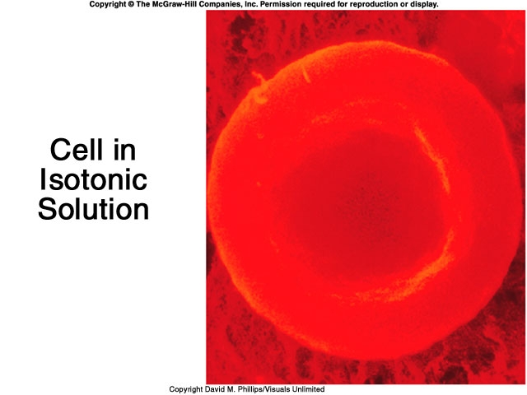

Slide 12
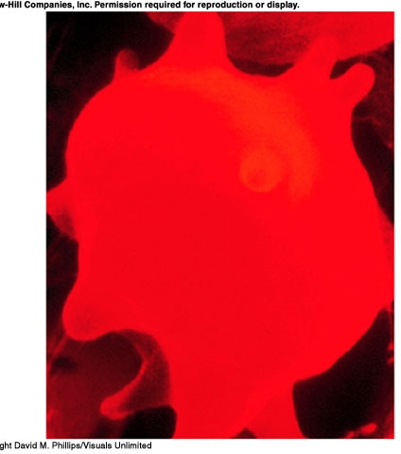
Cell in a hypertonic solution

Slide 13
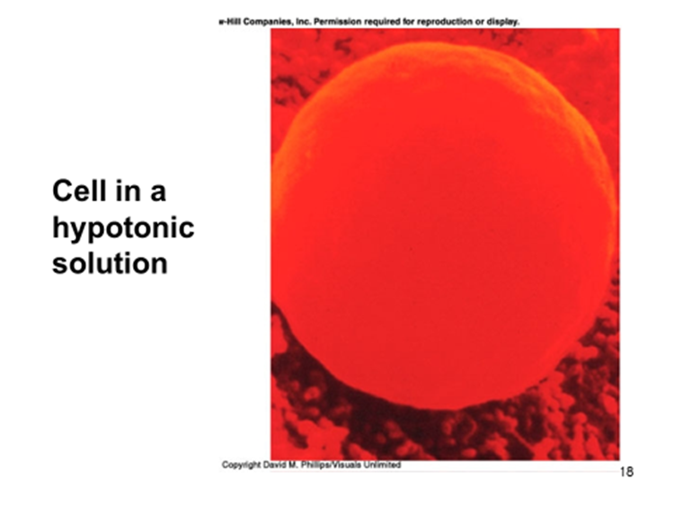

Slide 14
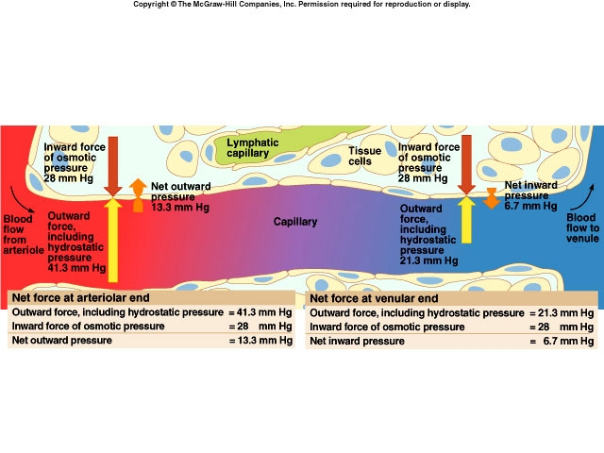
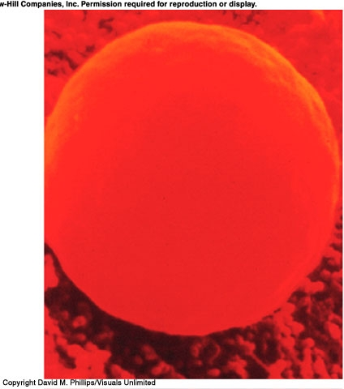
Cell in a hypotonic solution

Slide 15
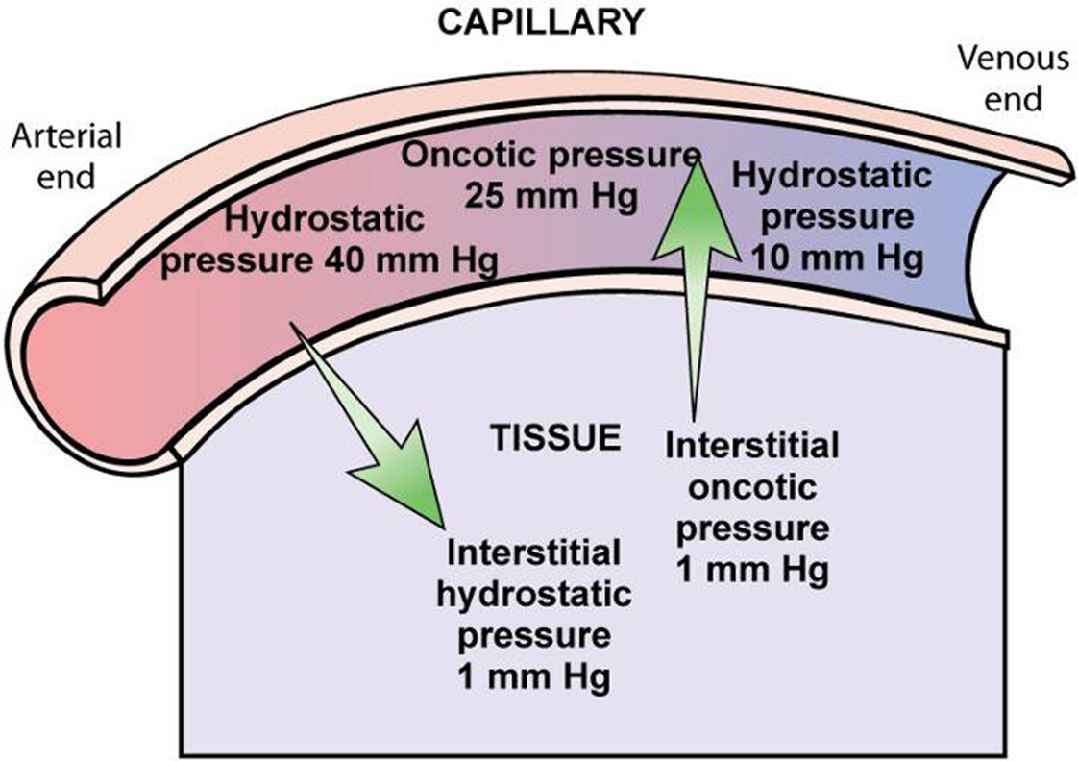

Slide 16
Regulation of body water
ADH – antidiuretic hormone + thirst
  Decreased amount of water in body
  Increased amount of Na+ in the body
  Increased blood osmolality
  Decreased circulating blood volume
Stimulate osmoreceptors in hypothalamus
ADH released from posterior pituitary
Increased thirst

Slide 17
The role of ADH:
ADH = urinary concentration
ADH = secreted in response to ⇑ osmo;
= secreted in response to ⇓ vol;
ADH acts on DCT / CD to reabsorb water
Acts via V2 receptors & aquaporin 2
Acts only on WATER
Notes:
The principle mechanism by which osmolality is maintained is by changes in ADH secretion from the posterior pituitary. Anti-diuretic hormone secretion results in pure water reabsorption from the collecting duct of the nephron via a pathway that involves the V2 receptor and aquaporin 2.
A rise in plasma osmolality increases ADH secretion, whilst a decrease causes ADH secretion to fall.
ADH secretion is also influenced by volume receptors, so that hypovolaemia stimulates ADH secretion and water reabsorption. In the paradoxical situation where hypovolaemia is accompanied by a fall in osmolality, ADH secretion will increase - ie. the major stimulant is maintenance of normovolaemia.

Slide 18
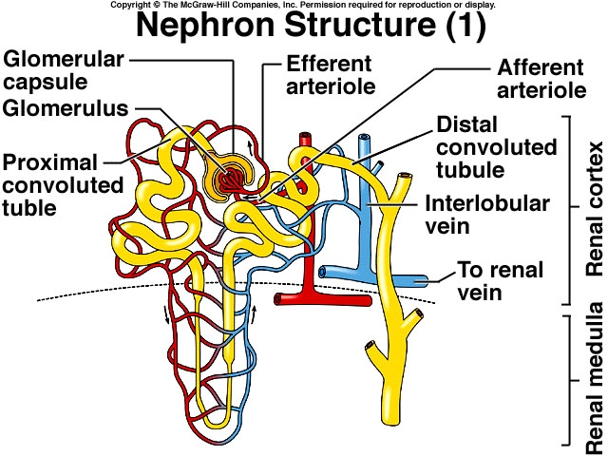
Notes:
Result:
increased water consumption
increased water conservation
Increased water in body, increased
volume and decreased Na+ concentration

Slide 19
  Dysfunction or trauma can cause:
  Decreased amount of water in body
  Increased amount of Na⁺ in the body
  Increased blood osmolality
  Decreased circulating blood volume

Slide 20
Edema is the accumulation of fluid within the interstitial spaces.
Causes:
increased hydrostatic pressure
lowered plasma osmotic pressure
increased capillary membrane permeability
lymphatic channel obstruction
Notes:
Increased capillary permeability:
Inflammation
immune responses
Lymphatic channels blocked:
surgical removal
infection involving lymphatics
lymphedema
Fluid accumulation:
increases distance for diffusion
may impair blood flow
= slower healing
increased risk of infection
pressure sores over bony prominences
Psychological effects
Edema of specific organs can be life threatening (larynx, brain, lung)
Water is trapped, unavailable for metabolic processes. Can result in dehydration and shock. (severe burns)

Slide 21
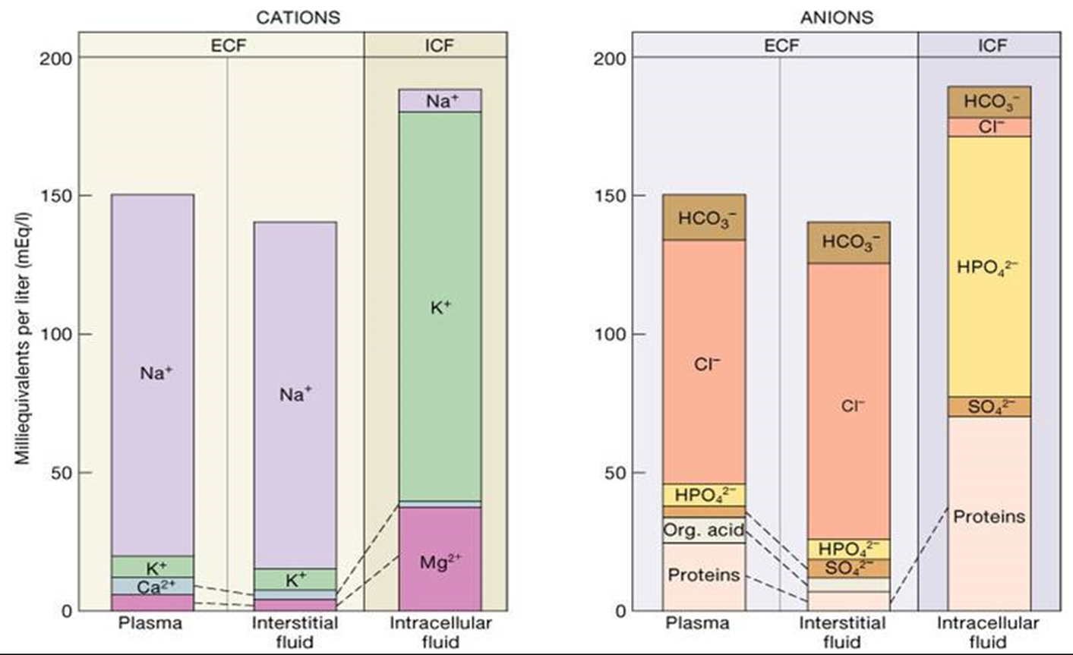
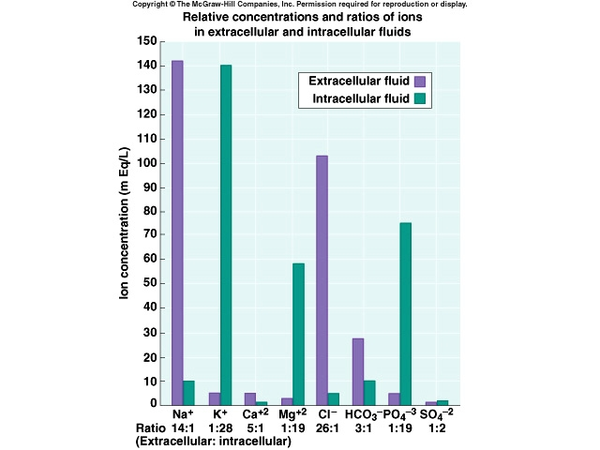

Slide 22
Electrolyte balance
Na ⁺ (Sodium)
  90 % of total ECF cations
  136 -145 mEq / L
  Pairs with Cl⁻ , HCO₃⁻ to neutralize charge
  Low in ICF
  Most important ion in regulating water balance
  Important in nerve and muscle function

Slide 23
Regulation of Sodium
Renal tubule reabsorption affected by hormones:
  Aldosterone
  Renin/angiotensin
  Atrial Natriuretic Peptide (ANP)

Slide 24
Potassium
Major intracellular cation
ICF conc. = 150- 160 mEq/ L
Resting membrane potential
Regulates fluid, ion balance inside cell
pH balance

Slide 25
Regulation of Potassium
Through kidney
  Aldosterone
  Insulin

Slide 26
Isotonic alterations in water balance
Occur when TBW changes are accompanied by = changes in electrolytes
  Loses plasma or ECF
  Isotonic fluid loss
    ↓ECF volume, weight loss, dry skin and mucous membranes, ↓ urine output, and hypovolemia ( rapid heart rate, flattened neck veins, and normal or ↓ B.P. – shock)
Notes:
Isotonic fluid excess
Excess IV fluids
Hypersecretion of aldosterone
Effect of drugs – cortisone
Get hypervolemia – weight gain, decreased hematocrit, diluted plasma proteins, distended neck veins, ↑ B.P.
Can lead to edema (↑ capillary hydrostatic pressure) pulmonary edema and heart failure

Slide 27
Electrolyte imbalances: Sodium
Hypernatremia (high levels of sodium)
  Plasma Na+ > 145 mEq / L
  Due to ↑ Na + or ↓ water
  Water moves from ICF → ECF
  Cells dehydrate
Notes:
Hypernatremia Due to:
Hypertonic IV soln.
Oversecretion of aldosterone
Loss of pure water
Long term sweating with chronic fever
Respiratory infection → water vapor loss
Diabetes – polyuria
Insufficient intake of water (hypodipsia)

Slide 28
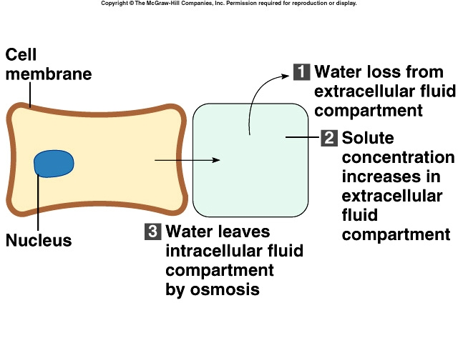

Slide 29
Clinical manifestations of Hypernatremia
Thirst
Lethargy
Neurological dysfunction due to dehydration of brain cells
Decreased vascular volume

Slide 30
Treatment of Hypernatremia
Lower serum Na+
  Isotonic salt-free IV fluid
  Oral solutions preferable

Slide 31
Hyponatremia
Overall decrease in Na+ in ECF
Two types: depletional and dilutional
Depletional Hyponatremia
  Na+ loss:
  diuretics, chronic vomiting
  Chronic diarrhea
  Decreased aldosterone
  Decreased Na+ intake
Notes:
Dilutional Hyponatremia:
Renal dysfunction with ↑ intake of hypotonic fluids
Excessive sweating→ increased thirst → intake of excessive amounts of pure water
Syndrome of Inappropriate ADH (SIADH) or oliguric renal failure, severe congestive heart failure, cirrhosis all lead to:
Impaired renal excretion of water
Hyperglycemia – attracts water

Slide 32
Clinical manifestations of Hyponatremia
Neurological symptoms
  Lethargy, headache, confusion, apprehension, depressed reflexes, seizures and coma
Muscle symptoms
  Cramps, weakness, fatigue
Gastrointestinal symptoms
  Nausea, vomiting, abdominal cramps, and diarrhea
Tx – limit water intake or discontinue meds

Slide 33
Hypokalemia
Serum K⁺ < 3.5 mEq /L
Beware if diabetic
  Insulin gets K⁺ into cell
  Ketoacidosis – H⁺ replaces K⁺, which is lost in urine
β – adrenergic drugs or epinephrine
Notes:
Causes
Decreased intake of K⁺
Increased K⁺ loss
Chronic diuretics
Acid/base imbalance
Trauma and stress
Increased aldosterone
Redistribution between ICF and ECF

Slide 34
Clinical manifestations of Hypokalemia
Neuromuscular disorders
  Weakness, flaccid paralysis, respiratory arrest, constipation
Dysrhythmias, appearance of U wave
Postural hypotension
Cardiac arrest
Others – table 6-5
Treatment-
  Increase K⁺ intake, but slowly, preferably by foods

Slide 35
Hyperkalemia
Serum K+ > 5.5 mEq / L
Check for renal disease
Massive cellular trauma
Insulin deficiency
Addison’s disease
Potassium sparing diuretics
Decreased blood pH
Exercise causes K+ to move out of cells

Slide 36
Clinical manifestations of Hyperkalemia
Early – hyperactive muscles , paresthesia
Late - Muscle weakness, flaccid paralysis
Change in ECG pattern
Dysrhythmias
Bradycardia , heart block, cardiac arrest
Notes:
Treatment of hyperkalemia
If time, decrease intake and increase renal excretion
Insulin + glucose
Bicarbonate
Ca⁺⁺ counters effect on heart

Slide 37
Calcium Imbalances
Most in ECF
Regulated by:
  Parathyroid hormone
    ↑Blood Ca⁺⁺ by stimulating osteoclasts
    ↑GI absorption and renal retention
  Calcitonin from the thyroid gland
    Promotes bone formation
    ↑ renal excretion

Slide 38
Hypercalcemia
Results from:
  Hyperparathyroidism
  Hypothyroid states
  Renal disease
  Excessive intake of vitamin D
  Milk-alkali syndrome
  Certain drugs
  Malignant tumors – hypercalcemia of malignancy
    Tumor products promote bone breakdown
    Tumor growth in bone causing Ca⁺⁺ release
Notes:
Effects:
Many nonspecific – fatigue, weakness, lethargy
Increases formation of kidney stones and pancreatic stones
Muscle cramps
Bradycardia, cardiac arrest
Pain
GI activity also common
Nausea, abdominal cramps
Diarrhea / constipation
Metastatic calcificatio

Slide 39
Hypocalcemia
Hyperactive neuromuscular reflexes and tetany differentiate it from hypercalcemia
Convulsions in severe cases
Caused by:
  Renal failure
  Lack of vitamin D
  Suppression of parathyroid function
  Hypersecretion of calcitonin
  Malabsorption states
  Abnormal intestinal acidity and acid/ base bal.
  Widespread infection or peritoneal inflammation

Slide 40
Hypocalcemia
Diagnosis:
  Chvostek’s sign
  Trousseau’s sign
Treatment
  IV calcium for acute
  Oral calcium and vitamin D for chronic

Slide 41
Fluid shifts in disease
Fluid loss:
  GI: diarrhoea, vomiting, etc.
  renal: diuresis
  vascular: haemorrhage
  skin: burns
Fluid gain:
  Iatrogenic:
  Heart / liver / kidney failure:
Notes:
Numerous routes exist by which the body can lose or gain fluid. In theory, it is possible to gain or lose pure water, but in most cases, fluid moves along with electrolytes, and the result is determined by the balance of water gains and losses, versus solute gains and losses.
Do not underestimate the potential for fluid movement. Diarrhoeal illnesses, certain diureses, & fluid retaining states may result in gains or losses of tens of litres of fluid.

Slide 42
Prescribing fluids:
Crystalloids:
  3%, 4.5% ,0.45% , 0.9% saline - normal saline
  5%/10% dextrose
  0.18% saline + 0.45% dextrose
  Ringers' lactate
  Hartmann solution
Colloids:
  Blood
  plasma / albumin
  Haemacel
  Gelofusine
Notes:
Therapeutic fluids that we prescribe for intravenous administration, can be divided into 2 basic types. Crystalloids are simple solutions of small solutes, whilst colloids are suspensions of macromolecules, or in the case of blood, cells.
The most commonly used crystalloids are saline and dextrose, where the dissolved solutes are sodium-chloride and glucose respectively.
The standard saline solution is 0.9% saline, often referred to as " normal saline ", which contains 150 mmol/l of NaCl, and is therefore not normal, being slightly hypertonic, and hypernatraemic.
Dextrose is usually given as 5% dextrose, which means that it contains 5 grams of glucose per 100 ml of water. This solution is roughly isotonic to serum, but the glucose is rapidly utilised, leaving behind pure water.
A host of other crystalloids exist and are beyond the scope of these notes.
Multiple colloid preparations are available, but the essential ones are either natural, such as blood, human albumin or plasma, or synthetic, where the macromolecule is manufactured. Common synthetic colloids are " haemaccel "and " gelofusine ", in which hydrolysed gelatin is suspended in saline.

Slide 43
The rules of fluid replacement:
Replace blood with blood
Replace plasma with colloid
Resuscitate with colloid
Replace ECF depletion with saline
Rehydrate with dextrose
Notes:
What IV fluid to give, in what situation is dealt with in the next series of slides. There are some basic rules though:
1. Someone with serious intravascular volume depletion, hypotension and reduced cardiac output is shocked, be it from blood loss ( eg. haemorrhage ), plasma loss ( eg. major burns ), or water loss. The aim here is to restore intravascular volume with a fluid that remains in the vascular compartment, and may even draw water from the intracellular space, into the blood system. A fluid with a high oncotic pressure would do this job. Blood remains the fluid of choice to treat someone with blood loss. Colloid is the fluid of choice in resuscitation when blood loss is not pronounced, or whilst waiting for blood.
2. Any crystalloid will enter the vascular space, then distribute around the other compartments. By containing sodium, the main extracellular cation, saline will expand the interstitial and intravascular compartments more than will dextrose, most of which will enter the intracellular space.
Several examples follow.

Slide 44
Crystalloids & colloids
2 litres of
blood
30 litres
9 litres
3 litres
Notes:
Giving 2 litres of blood to someone, will expand their intravascular compartment by 2 litres. None of this fluid will escape across the blood vessel walls ( in the short term at least ) and the other compartments are unaffected.
This is the right treatment for blood loss.
( See next slide for results. )

Slide 45
Crystalloids & colloids
30 litres
9 litres
5 litres

Slide 46
Crystalloids & colloids
2 litres of
colloid
30 litres
9 litres
3 litres
Notes:
Giving colloid into the vascular space results in an immediate expansion of the intravscular compartment by 2 litres, as does blood.
( See next slide. )

Slide 47
Crystalloids & colloids
30 litres
9 litres
5 litres
Notes:
Colloid does not escape from the vascular space, but does increase oncotic pressure markedly ....
( See next slide )

Slide 48
Crystalloids & colloids
29 litres
8 litres
7 litres
Notes:
... causing water to be drawn into the vascular space from the interstitial and intracellular reservoirs. Giving colloid therefore not only expands the vascular space itself, but does so by moving water from other spaces.

Slide 49
Crystalloids & colloids
2 litres of
0.9% saline
30 litres
9 litres
3 litres
Notes:
Saline being a crystalloid, does not remain within the vascular space, but will diffuse into the interstitial space. The sodium it carries will not enter the intracellular space however, because of active sodium extrusion from the cell.
Saline will therefore .... ( see next slide )

Slide 50
Crystalloids & colloids
30 litres
9 litres
5 litres
Notes:
.... cause immediate expansion of the intravsacular volume, followed by .... ( see next slide )

Slide 51
Crystalloids & colloids
29 litres
10.5 litres
4.5 litres
Notes:
.... equilibration between the vascular and interstitial spaces, the osmolality of which are equal, but are now slightly greater than that of the intracellular space, due to the increased sodium load. This results in water movement from the intracellular space in order to equalise osmolality throughout all three compartments.

Slide 52
Crystalloids & colloids
2 litres of
5% dextrose
30 litres
9 litres
3 litres
Notes:
5 Dextrose is isotonic to plasma. Giving 2 litres of 5% dextrose will cause the immediate expansion of the vascular compartment .... ( see next slide )

Slide 53
Crystalloids & colloids
31 litres
9.7 litres
3.3 litres
Notes:
.... but, as its glucose content is rapidly metabolised, the remaining water will distribute itself between all compartments and very little will remain within the blood space. For this simple reason, dextrose is not a fluid of resuscitation.

Slide 54
How much fluid to give ?
What is your starting point ?
  Euvolaemia ? ( normal )
  Hypovolaemia ? ( dry )
  Hypervolaemia ? ( wet )
What are the expected losses ?
What are the expected gains ?
Notes:
The aim of fluid administration is the maintenance of organ perfusion by keeping total body water at 55 - 60% - this is the euvolaemic state.
Hypovolaemia, when total body water is deficient is not compatable with normal organ perfusion; hypervolaemia, when body water is in excess, is occasionally necessary for organ perfusion, but is usually deleterious.
In order to assess how much fluid to give to someone, we need to know what their level of hydration is, what losses they may expect, and what gains they may receive.

Slide 55
Signs of hypo / hypervolaemia:
Signs of …
Volume depletion Volume overload
Postural hypotension Hypertension
Tachycardia Tachycardia
Absence of JVP @ 45º Raised JVP / gallop rhythm
Decreased skin turgor Oedema
Dry mucosae Pleural effusions
Supine hypotension Pulmonary oedema
Oliguria Ascites
Organ failure Organ failure
Notes:
The signs of volume depletion or overload can be subtle. Note that some appear in both columns - especially tachycardia.
Postural hypotension, where blood pressure falls on standing or sitting up is a reliable early sign of hypovolaemia, which is often not checked.

Slide 56
What are the expected losses ?
Measurable:
  urine ( measure hourly if necessary )
  GI ( stool, stoma, drains, tubes )
Insensible:
  sweat
  exhaled
Notes:
Fluid losses in disease and in health are those that can be seen and measured, and those that cannot; the latter are insensible losses.
Any fluid lost from the body is potentially in need of replacement, be it urine, stool, or fluid from drains, or other tubes. If possible, measuring these losses is a great help.
Insensible losses make up about 500 ml a day in health. In febrile illnesses, insensible losses increase by 100 ml / day / degree centigrade.

Slide 57
What are the potential gains ?
Oral intake:
  fluids
  nutritional supplements
  bowel preparations
IV intake:
  colloids & crystalloids
  feeds
  drugs
Notes:
Fluid gains are simple; anything that is taken in is a potential gain, be it intravenous, oral or other.
Remember that a large amount of food is broken down, or melts into water, so this may need to be counted as well.

Slide 58
Examples:
What follows is a series of simple - and some more complex fluid-balance problems for you
Answers are in the speakers notes.

Slide 59
Case 1:
A 62 year old man is 2 days post-colectomy. He is euvolaemic, and is allowed to drink 500ml. His urine output is 63 ml/hour:
1. How much IV fluid does he need today ?
2. What type of IV fluid does he need ?
Notes:
This man has a normal total body water content, and you aim is to maintain that.
A urine output of 63 ml / hr gives him a total daily urine loss of 1.5 litres. His insensible losses are likely to be 500 ml. He therefore needs a total fluid intake of 2 litres to balance his losses. He is only allowed to drink 500 ml.
He therefore needs 1.5 litres of fluid IV today.
As he is euvolaemic, this man does not need resuscitation, so he should only receive crystalloid. His losses will include water and electrolytes. Giving him just 5% dextrose will cause osmolality to fall and hyponatraemia to follow. Giving him just 0.9% saline will cause gradual hypernatraemia and hypertonicity.
This man needs a mixture of crystalloids. He is getting water orally which might help to offset the sodium load of saline. Even so, it is reasonable to use saline and dextrose in a 2:1 ratio; this proportion can be changed in response to changes in his clinical state and serum sodium.

Slide 60
Case 2:
3 days after her admission, a 43 year old woman with diabetic ketoacidosis has a blood pressure of 88/46 mmHg & pulse of 110 bpm. Her charts show that her urine output over the last 3 days was 26.5 litres, whilst her total intake was 18 litres:
1. How much fluid does she need to regain a normal BP ?
2. What fluids would you use ?
Notes:
The hyperglycaemia of diabetic ketoacidosis causes glycosuria which results in an osmotic diuresis. This causes high losses of water and dehydration occurs if fluid balance is not attended to.
In this case, the lady has lost 26.5 litres of urine plus at least 1.5 litres insensible losses over the last 3 days; her input has been 18 litres. This equals a deficit of 10 litres, and it is not suprising that she appears to be hypovolaemic with hypotension and tachycardia.
Assuming that she was euvolaemic to start with, she needs to gain 10 litres in order to regain a normal BP.
As she has a low BP, we can assume that her blood volume is low, and that organ perfusion is at risk. She therefore needs to be resuscitated. The initial fluids to use would be colloid in order to normalise BP and pulse. There is no need to use only colloid; indeed, this would cause intravascular overload and heart failure. After using perhaps 1 or 2 litres of colloid, her remaining fluids should be crystalloid. As she has lost mainly water, a large part of this should be dextrose, and serum [ Na+ ] should be monitored in order to assess the need for IV saline.

Slide 61
Case 3:
An 85 year old man receives IV fluids for 3 days following a stroke; he is not allowed to eat. He has ankle oedema and a JVP of +5 cms; his charts reveal a total input of 9 l and a urine output of 6 litres over these 3 days.
1. How much excess fluid does he carry ?
2. What would you do with his IV fluids ?
Notes:
This man has become hypervolaemic with interstitial oedema and intravscular excess, becuase he has received 3 litres more fluid than he has passed out in his urine. Remember however that he loses 500 ml / day insensible losses.
His total fluid excess is therefore around 1.5 litres.
Although he is not drinking, he is overloaded and his IV fluids should be stopped. After a day without IV fluids, he should be euvolaemic, and IV fluids can be recommenced at 2.5 litres a day without overloading him.

Slide 62
Case 4:
5 days after a liver transplant, a 48 year old man has a pyrexia of 40.8ºC. His charts for the last 24 hours reveal:
urine output: 2.7 litres
drain output: 525 ml
nasogastric output: 1.475 litres
blood transfusion: 2 units (350 ml each)
IV crystalloid: 2.5 litres
oral fluids: 500 ml

Slide 63
Case 4 cont:
On examination he is tachycardic; his supine BP is OK, but you can’t sit him up to check his erect BP. His serum [ Na+ ] is 140 mmol/l.
How much IV fluid does he need ?
What fluid would you use ?
Notes:
This is a bit more complex !
As is often the case with complex surgical patients, this man has multiple sources of luid loss. In each case, urine, drain or tube, the fluid lost will be a mixture of fluid and solutes. Indeed, drain fluid will have an electrolyte content very similar to plasma.
His obvious losses ( urine + drain + NG tube ) total 4.7 litres.
His insensible losses are higher than normal because of his fever, and will be about 800 ml, giving a total loss of 5.5 litres.
His total intake was 3.7 litres, and he is therefore deficient by 1.8 litres.
Assuming that his total losses for this day are similar to those of the day before, he will need about 7.3 litres in order to become euvolaemic.
He will almost undoubtedly need a mixture of fluids. He will need colloid or further blood in order to fill the intravascular compartment and maintain organ perfusion. He will need saline to replace water and solute losses, and will need some dextrose in order to prevent hypernatraemia.
In practice, a case of this complexity will require repeated re-evaluation, adjustment of his fluids throughout the day with serial blood tests in order to guide you.
If you can follow this one, you've cracked it !

