Slide 1
Introduction to GIT bleeding
Dr Ojuka

Slide 2
Objectives
Definitions
Aetiology
Initial resuscitation
Investigating the definitive cause

Slide 3
Introduction
GIT bleeding could be acute or chronic.
It is common with diverse causes and presentation
It could be trivial or massive and can orginate from any region of GIT
The upper bleed origins proximal to ligament of Treitz and account for 80% of significant GIT bleed while lower is distal to ligament of Treitz

Slide 4
Introduction
Incidence in USA is about 170/100000 adults, it increases with age and affect men more than women.
Management is multidisciplinary; gastroenterologist, intensive care provider, radiologist, emergency medicine, general surgeon.
5-10% may require surgery

Slide 5
Introduction
Most bleed stop sponatanoeusly , 15% however will require emergent resucitaion, evaluation and treatment.
Early endoscopy and direct therapy reduces LOS.
Obscure bleeding is one that persist after negative endocsopy

Slide 6
Initial assessment
Airway
Breathing
Circulation
Severity of bleed
  Clinical presentation of shock
Initiate monitoring
Laboratory evaluation

Slide 7
Risk stratification
Age > 60 years
Cormobid diseas
    Renal failure
    Liver disease
    Respiratporty insufficiency
    Cardiac diseas
Magnitude of bleeding
    SBP <100
    Transfusion requirement
    Altered mental status
    Prothrombin time 1.2 X control
    Ongoing bleed
Persistent/recurrent bleed
Onset in hospital
Need for surgery

Slide 8
Resucitaion
Severe bleed/ ongoing loss indication for intravenous bolus crystalloids 2L NS/Ringers
Note the response
Group and cross match , hematocrit, platelet, coagulation profile, liver function test
Foleys catheter
Suplememtal oxygen

Slide 9
Transfusion
Depend on
  Response
  Age
  Whether bleed continoues
Packed red blood cell are preferred

Slide 10
History and physical examination
Charcateris the bleed
      Time of onset
      Volume
      Frequency
      Melena hematemsis
      Hematochezia
Identify risk factors
      Antecedent vomiting
      Weight loss
      Age
      Drug history
Abdominal examination

Slide 11
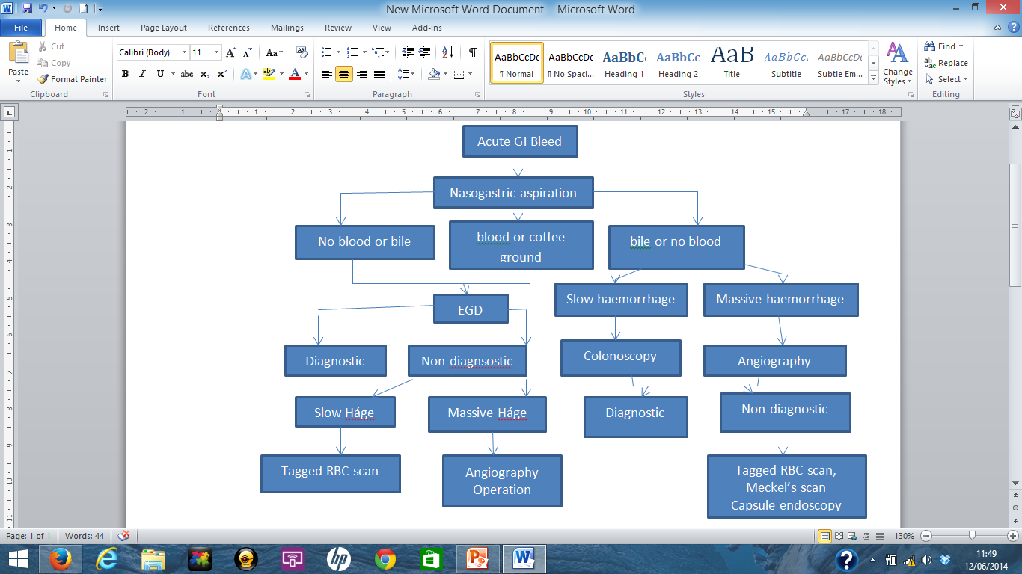
Localization

Slide 12
Causes :Upper GI bleed
Peptic ulcer disease
Gastroesophageal varices
Malory weis tears
Gastritis / duodenitis
Esophagistis
AVM
Tumors
Hypertensive portal gastropathy
Isolated gastric varices

Slide 13
Causes :Upper GI bleed
Diverticular diseas
Ischemia
Anorectal diseas
Neoplasia
Infectious colitis
Postpolypectomy
IBD
Angiodysplasia
Radiation colitis/proctitis
Aortoenteric fistual

Slide 14
Therapy
Pharmacologic
Endoscopic
Angiographic
Surgical

