Slide 1
SHOCK
Dr. Ojuka

Slide 2
KEY ISSUES
Recognize inadequate tissue perfusion / oxygenation
Identify the cause
Hemorrhagic vs. non-hemorrhagic
Hemorrhage most common cause in trauma patients
Treatment
STOP THE BLEEDING!
RESTORE VOLUME!

Slide 3
SHOCK
Definition
Abnormality of circulatory system that results in inadequate organ perfusion & tissue oxygenation.

Slide 4
At Cellular Level
Inadequate perfusion & oxygenation
Loss of Cell Membrane gradient
Damage to Organelle
Cell Death
Isotonic Electrolyte Solutions administration counter this process
Notes:
Organelles: Swelling of ER → mitochondrial damage → lysosomal rupture → cellular swelling → Ca++ deposition intracellularly → progressive damage → apoptosis

Slide 5
CARDIAC PHYSIOLOGY
CO = SV x HR
CO = Cardiac Output (ml/min)
SV = Stroke Volume (ml)
HR = Heart Rate (beats/min)
SV is determined by:
Preload
Myocardial contractility
Afterload – systemic vascular resistance

Slide 6
Preload - determined by venous capacitance, volume status, & pressure differential (mean venous systemic pressure – RA pressure).
Blood in the venous (capacitance) system has 2 components:
- “residual” volume
- venous volume that contributes to mean systemic venous pressure (component reduced by blood loss)

Slide 7
Myocardial Contractility
End Diastolic Volume determines myocardial muscle fiber length which in turn relates to contractility according to Starling’s Law

Slide 8
Compliance
Relationship between venous volume & venous pressure

Slide 9
Blood Loss
Pathophysiology:
Hemorrhage
Early circulatory response
Vasoconstriction
Tachycardia

Slide 10
Blood Loss
Release of Catecholamines
Vasoconstriction
Diastolic BP
Narrowed Pulse Pressure
IMPORTANT To Restore Volume !
Notes:
Catecholamine-mediated increase in the peripheral vascular resistance causes a reduction in the “residual” volume in the venous (capacitance) system in an attempt to preserve venous return.

Slide 11
INITIAL PATIENT ASSESSMENT
NB: Sole reliance on systolic blood pressure (SBP) as an indicator of shock results in DELAYED recognition of the shock state
Compensatory mechanisms may preclude a measurable fall in SBP until the patient has lost up to 30% of their blood volume

Slide 12
INITIAL PATIENT ASSESSMENT
Profound circulatory shock (inadequate perfusion of the skin, kidneys, and central nervous system) is EASY to recognize
After Airway (A) and Breathing (B), careful evaluation of the patient’s circulatory (C) system is next
TACHYCARDIA and CUTANEOUS VASOCONSTRICTION are the early signs

Slide 13
INITIAL PATIENT ASSESSMENT
Tachycardia:
>160 infants
>140 preschool child
>120 school age/puberty
>100 adults (beware elderly pts/ athletes/ beta blockers)
Vasoconstriction= cool, decreased CRT
Tachypnea
Narrowed Pulse Pressure
BEWARE: Hb/Hct is unreliable

Slide 14
Tachycardia
AGE | Heart Rate
Infant | > 160
Preschool | > 140
School age | > 120
Adult (beware elderly, athletes, drugs) | > 100

Slide 15
ETIOLOGY OF SHOCK
HEMORRHAGIC-MOST COMMON cause after injury
Both Hemorrhagic and nonhemorrhagic shock respond partially or briefly to volume resuscitation
Begin treating as if from hypovolemia then look for other etiologies in a SMALL NUMBER of patients

Slide 16
NONHEMORRHAGIC SHOCK
CARDIOGENIC:
Blunt myocardial injury(rapid deceleration), myocardial infarction, air embolus.
Tamponade (penetrating trauma): tachycardia, muffled heart tones, engorged neck veins, hypotension resistant to fluid Rx
ECG monitoring, ECHO

Slide 17
NONHEMORRHAGIC SHOCK
TENSION PNEUMOTHORAX (PTX):
- Ball-valve leak allows are to enter the pleural space but prevents its escape
- Intrapleural pressure rises causing total lung collapse and a shift of the mediastinum
- Impaired venous return and fall in cardiac output

Slide 18
TENSION PNEUMOTHORAX
- Signs/Sxs: SQ emphysema, absent breath sounds & hyper-resonance to percussion over hemithorax, tracheal shift, acute respiratory distress, hyptotension
- TRUE EMERGENCY
- Warrants diagnosis and thoracic decompression WITHOUT waiting for XRays

Slide 19
NONHEMMHORAGIC SHOCK
NEUROGENIC: ISOLATED HEAD INJURY DOES NOT CAUSE SHOCK!
- Spinal cord injury: hypotension due to loss of sympathetic tone (thoraco-lumbar outflow), usually w/o tachycardia / vasoconstriction / narrowed pulse pressure
- Beware: may have additional injuries therefore RX initially for hypovolemia
-Management: Fluids, Trendelenberg, CVP monitoring, Vasopressors (ephedrine)

Slide 20
NON- HEMMHORHAGIC SHOCK
SEPTIC SHOCK:
Uncommon early manifestation
May occur in penetrating abdominal injuries
Early Septic Shock:
Modest tachycardia.
Warm, pink skin.
SBP – near normal.
Wide pulse pressure.

Slide 21
HEMORRHAGIC SHOCK
Definition: acute loss of circulating blood volume
Normal adult: 7% of ideal weight (70kg man has 5 liters of blood)
Child: 8%-9% of ideal weight (80-90cc/kg)

Slide 22
Intravascular Blood Volume
Premature 100 cc/kg
Term Infant 90 cc/kg
Child 80 cc/kg
Adult 70 cc/kg
Example: 3 kg term infant has blood volume=270cc 70 kg person= 4,900 cc blood volume
General Rule: Blood loss of 30% blood volume needs blood replacement

Slide 23
CLASSIFICATION OF HEMORRHAGE
Class I-IV
Clinical guide ONLY
Subsequent RX determined by PATIENT RESPONSE
Patient’s age, severity, type & anatomic location of injury, time lapse from injury to initiation of RX, prehospital Mx, and patient’s medications all impact vascular dynamics

Slide 24
CLASS I HEMORRHAGE Blood donation
Loss of up to 15% BV (<750cc)
Clinical Sxs are minimal: minimal tachycardia (<100), NO change in BP, RR, pulse pressure
In an otherwise healthy patient this does not require volume replacement

Slide 25
CLASS II HEMORRHAGE Uncomplicated
Loss of 15%-30% BV (750cc-1500cc)
Clinical Sxs: tachycardia (>100), tachypnea, decreased pulse pressure, subtle CNS changes (anxiety, fright, hostility)
UO = 20cc-30cc/hour (mildly affected)
CRYSTALLOID FLUID RESUSCITATION IS REQUIRED (may need blood)

Slide 26
CLASS III HEMORRHAGE Complicated
Loss of 30%- 40% BV (1500cc-2000cc)
Classic signs: marked tachycardia (>120), tachypnea, significant CNS changes, FALL IN SBP, narrow pulse pressure
Urine Output = 5cc-15cc/hour
Crystalloid Fluids and USUALLY BLOOD IS REQUIRED
Usually surgery is required

Slide 27
CLASS IV HEMORRHAGE Pre-terminal
Loss of > 40% BV (>2000cc)
IMMEDIATELY LIFE-THREATENING
Clinical Sxs: marked tachycardia (>140), significant decrease in BP, very narrow pulse pressure (or nonexistent diastolic BP), markedly depressed CNS, skin is cool and pale
UO is negligible
Requires IMMEDIATE AND RAPID crystalloid/blood
Requires IMMEDIATE surgical intervention

Slide 28
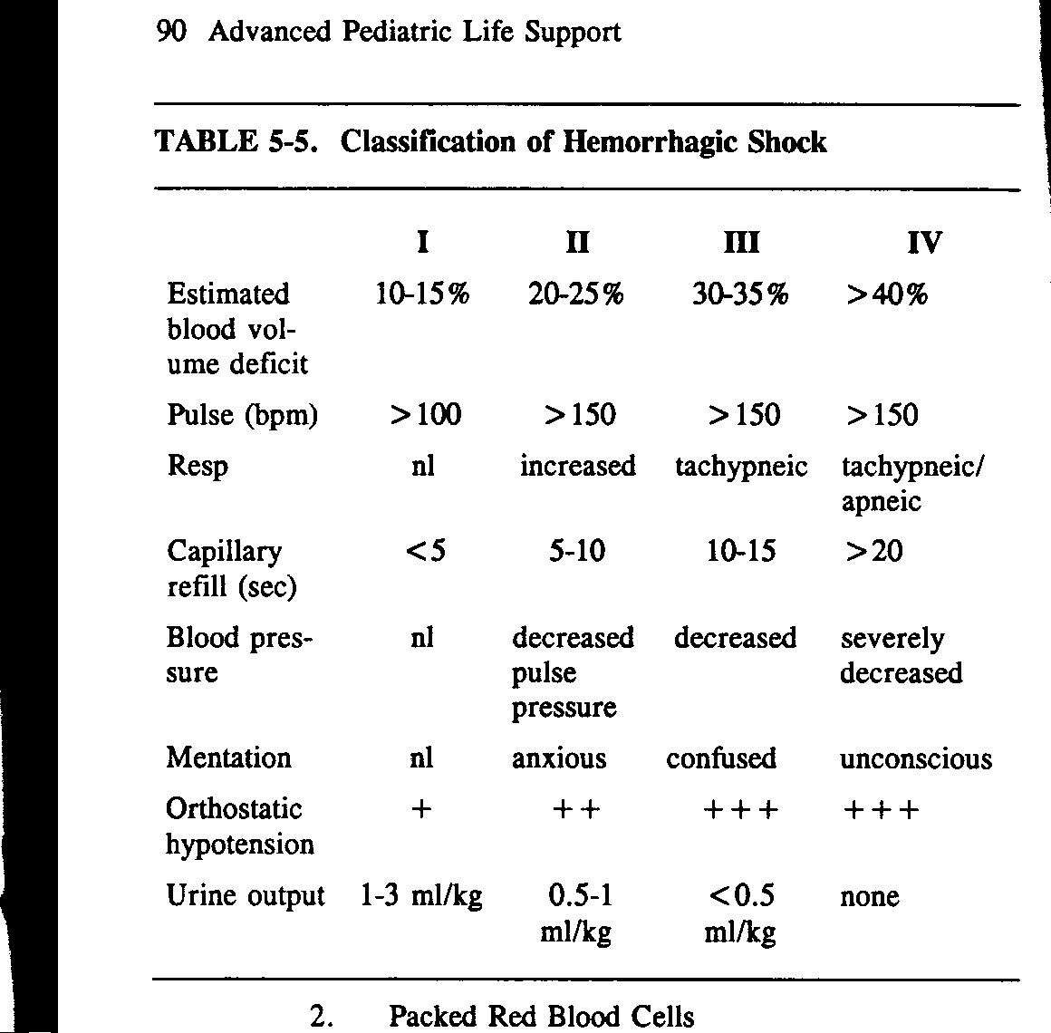

Slide 29
FLUID SHIFTS: SOFT TISSUE INJURY
1) Blood Loss into the injury site (esp fractures)
Tibia/humerus #s up to 750cc
Femur #s up to 1500cc
Pelvic #s –several liters (retroperitoneal)
2) Obligatory tissue edema
Inflammatory mediators increase vascular permeability

Slide 30
(Simultaneous)ASSESSMENT AND MANAGEMENT
RECOGNIZE SHOCK!
STOP THE BLEEDING!
Replenish intravascular volume
Restore organ perfusion
Immediate diagnosis of life-threatening injuries
Airway and Breathing: O2 - maintain SaO2>95%
Circulation (Assess, Control,Treat-ACT)
Disability (cerebral perfusion/GCS)
Exposure/Environment (prevent hypothermia)
Adjuncts: gastric decompression, urinary catheter (haematuria / UO)

Slide 31
VASCULAR ACCESS
2 large bore peripheral IVs (16 g in adults)
Antecubital/forearm veins
Central access (femoral, jugular, subclavian)
Cutdown of saphenous/forearm veins
Intraosseous (<6 yrs)
As IVs are placed draw blood for labs, cross match
Notes:
Poiseuille’s Law: Rate of flow proportional to r4/l

Slide 32
FLUID THERAPY
Isotonic crystalloid solution ie. Lactated Ringer’s, Normal Saline (NS), Hartmans, (warm if possible)
Rapid fluid bolus
Adult 1-2 liters
Child 20cc/kg
Guide: replace every cc blood loss with 3cc of crystalloid (3:1 rule)
MONITOR RESPONSE TO INITIAL RX

Slide 33
RE-EVALUATE ORGAN PERFUSION
Monitor:
Vital signs (HR, BP, pulse pressure)
CNS status (GCS)
Skin perfusion
URINARY OUTPUT
0.5cc/kg/hr (30cc-50cc/hr) for an adult
1cc/kg/hr for a child
2cc/kg/hr for an infant
(Pulse oximetry)

Slide 34
Acid / Base Balance
Early: respiratory alkalosis (tachypnea)
Later: mild metabolic acidosis (anaerobic metabolism)
Late: Persistent acidosis
There is no role for the routine use of NaHCO3

Slide 35
RESPONSE TO INITIAL FLUID RESUSCITATION
Response is key to determine subsequent RX
Identifies those with greater than estimated blood loss, and those with ongoing bleeding who require operative control of internal hemorrhage

Slide 36
RESPONSE TO INITIAL FLUID RESUSCITATION
A) Rapid Responders:
- respond rapidly and remain hemodynamically normal
- blood loss <20%
- need for blood: low
- need early surgical evaluation: surgery may still be necessary

Slide 37
RESPONSE TO INITIAL FLUID RESUSCITATION
B) Transient Responders:
- responds to initial fluid bolus BUT, show some deterioration of perfusion indices as fluids are slowed to maintenance
- indicates ongoing blood loss or inadequate resuscitation
- blood loss 20%-40%
- need more fluid and blood transfusion
- need early surgical evaluation: likely to need surgery

Slide 38
RESPONSE TO INITIAL FLUID RESUSCITATION
C) Minimal or Non-Responders:
- failure to respond to crystalloid and blood transfusions
- blood loss >40%
- needs IMMEDIATE blood transfusion
- needs IMMEDIATE operative intervention
- (rarely due to pump failure ie. cardiac tamponade, tension PTX, blunt cardiac injury)

Slide 39
BLOOD REPLACEMENT
Goal: restore O2 carrying capacity
Fully cross-matched blood is preferable
Type specific can be used (takes less time)
Compatible with ABO and Rh blood types
Type O blood (for exsanguinating hemorrhage)
Preferably O-Neg for women of child-bearing age
Consider auto-transfusion (major haemo-thorax)
Warm all fluids/blood if possible

Slide 40
SPECIAL CONSIDERATIONS IN SHOCK
Extremes of age:
Pediatrics: good ability to compensate then, rapid decompensation
Elderly: less ability to mount a significant tachycardia, less pulmonary, cardiac, renal reserve
Athletes:
Great ability to compensate
Pregnancy:
Hyper-volemic state
Medications:
Beta-blockers, Ca-channel blockers, diuretics (hyper-kalemia), NSAIDS (platelet function)
Hypothermia:
Often develop a coagulopathy

Slide 41
SUMMARY
HYPOVOLEMIA is the cause of shock in most trauma patients
Management requires immediate hemorrhage control and fluid resuscitation
Goal of Rx: to restore organ perfusion
Monitor success of resuscitation using NORMALIZING parameters (vital signs, mental status, UO)
Identify transient or minimal/non-responders who require immediate intervention (blood, surgery)

