Slide 1
Urological trauma
Mungai ngugi

Slide 3
introduction
The genitourinary system is involved in an estimated 10% of trauma cases and these injuries can be associated with considerable morbidity and even mortality
Isolated injuries of individual urological organs may also occur

Slide 4
introduction
In trauma, the multidisciplinary approach has been shown to improve patient outcomes
Patients with major trauma managed initially in local hospitals are 1.5- to 5-times more likely to die than patients transported directly to trauma centres
Rationalisation of care to specialist trauma units reduces mortality by 25% and length of stay by 4 days

Slide 5
introduction
Penetrating renal trauma made up 40% of renal traumas and 94% of all renal traumas were managed non-operatively
Bladder and ureteric injuries were mostly iatrogenic in nature
Urethral trauma was due to pelvic fractures or direct crush injury.
Testicular injuries were mainly due to sporting activities.

Slide 6
Renal trauma
Renal trauma is a disease of the young; the mean age in large retrospective series is 20–30 years
more males involved
Although this difference has been attributed to male involvement in high-risk activities (e.g. high-speed motor vehicle crashes, contact sports, violent crime), in one study the difference in prevalence of renal injury between genders existed even when controlling for mechanism, age and injury severity score

Slide 7
renal
The vast majority of renal injuries result from blunt mechanisms, although there is some geographical variation.
Motor vehicle crashes and falls account for most kidney trauma in the developed world
The proper use of seat belts and other preventive measures could have a major impact on the incidence of renal trauma
Penetratinginjuries are much more likely to cause severe renal injuries requiring operative intervention and nephrectomy
The reported proportion of renal injuries from penetrating mechanisms is 4.6–87%

Slide 8
renal
Most renal injuries are minor
Significant renal injuries, including lacerations and vascular injuries, account for 27–68% of patients with a penetrating mechanism compared to 4–25% for blunt
May occur with preexisting dseases

Slide 9
Preexisting lesions
With decreasing frequency, the following types of renal lesions were found: hydronephrosis (PUJ, stone, reflux), cysts, tumours and abnormal kidney position.
In all cases patients were unaware of the underlying disorder at the time of the accident.
The cause of the predisposition has been attributed to reduced tissue strength in hydronephrotic kidneys, altered tissue deformation of renal cortex in the presence of a fluid-filled lesion (cyst, hydronephrosis),
The relatively larger body proportion of paediatric kidneys, and their lesser protection from the more pliable thoracic cage, weaker abdominal musculature and less perirenal fat

Slide 10
Classification of renal injuries
*Advance one grade for bilateral injuries up to grade III. Accessible online at http://www.aast.org/injury/injury.html.
I i | Contusion | Microscopic or gross haematuria, urological studies normal
 | Haematoma | Subcapsular, not expanding with no parenchymal laceration
II | Haematoma | Not expanding perirenal haematoma confirmed to renal retroperitoneum
 | Laceration | <1.0 cm parenchymal depth of renal cortex with no urinary extravasation
III | Laceration | >1.0 cm parenchymal depth of renal cortex with no collecting system rupture or urinary extravasation
IV | Laceration | Parenchymal laceration extending through renal cortex, medulla and collecting system
 | Vascular | Main renal artery or vein injury with contained haemorrhage
V | Laceration | Completely shattered kidney
 | Vascular | Avulsion of renal hilum which devascularizes kidney

Slide 11
evaluation
Urinalysis
Ultrasound
Ct scan
MRI
Retrograde pyelography
Exploration

Slide 12
Treatment
Mostly conservative
Intervention only when life threatening

Slide 13
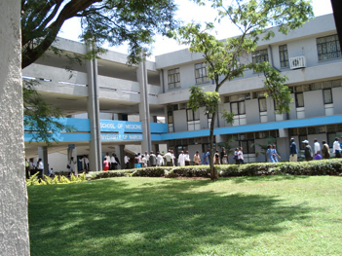
University of Nairobi medical school
Kenyatta National hospital

Slide 14
Bladder injuries
Bladder injuries occur as a result of blunt or penetrating trauma.
The probability of bladder injury varies according to the degree of bladder distention; therefore, a full bladder is more likely to become injured than an empty one.
La law of laplace

Slide 15
Although uniformly fatal in the past, a timely diagnosis with appropriate medical and surgical management now offers an excellent outcome.

Slide 16
Bladder injuries
Early clinical suspicion, appropriate and reliable radiologic studies, and prompt surgical intervention, when indicated, are the keys to successful diagnosis and management.

Slide 17
Bladder injuries
Patients with signs and symptoms suggestive of a bladder injury have a history typical for pelvic trauma, which is fairly straightforward for motor vehicle accidents, deceleration injuries, or assaults to the lower abdomen.

Slide 18
Bladder injuries
If the patient is unconscious, family members or, more often, emergency services personnel can provide the history

Slide 19
Bladder injuries
Bladder injury from a motor vehicle accident may occur from direct impact with the car or indirectly from the steering wheel or seatbelt.

Slide 20
Bladder trauma
Deceleration injuries of the urinary bladder usually result from falling from a great height and landing on unyielding ground
Assault to the lower abdomen by a sharp kick or blow may result in a bladder perforation
Penetrating injuries to the bladder usually result from high-velocity gunshots or sharp stab wounds to the suprapubic area.

Slide 21
Blunt trauma
Deceleration injuries usually produce both bladder trauma (perforation) and pelvic fractures.
Approximately 10% of patients with pelvic fractures also have significant bladder injuries.
The propensity of the bladder to sustain injury is related to its degree of distention at the time of trauma.

Slide 22
Penetrating trauma
Assault from a gunshot or stabbing typifies penetrating trauma.
Often, concomitant abdominal and/or pelvic organ injuries are present.

Slide 23
Frequency
Frequency of bladder rupture varies according to the following mechanisms of injury:
External trauma (82%)
Iatrogenic (14%)
Intoxication (2.9%)
Spontaneous ( <1%)

Slide 24
Types of injuries
Of all bladder injuries, 60-85% are from blunt trauma and 15-40% are from a penetrating injury.
The most common mechanisms of blunt trauma are motor vehicle accidents (87%), falls (7%), and assaults (6%).
In penetrating traumas, the most frequent culprit is gunshot wounds (85%), followed by stabbings (15%).

Slide 25
Bladder trauma
Approximately 10-25% of patients with a pelvic fracture also have urethral trauma. Conversely, 10-29% of patients with posterior urethral disruption have an associated bladder rupture.

Slide 26
Traumatic bladder ruptures
Of traumatic ruptures, extraperitoneal bladder perforations account for 50-71%,
intraperitoneal accounts for 25-43%, and
combined perforations account for 7-14%.
Incidence of intraperitoneal bladder ruptures is significantly higher in children because of the predominantly intra-abdominal location of the bladder prior to puberty

Slide 27
Bladder trauma
Combined intraperitoneal and extraperitoneal ruptures account for approximately 10% of all traumatic bladder-perforating injuries.
Mortality rates in these patients approach 60%, as compared to 17-22% overall, reflecting the severity of concomitant injuries associated with combined bladder ruptures.

Slide 28
Associated bowel injuries
Incidence is reportedly as high as 83% in patients with gunshot wounds.
Colon injuries are reported in 33% of patients with stab wounds, and vascular injuries are reportedly as high as 82% in patients with a penetrating trauma (with a 63% mortality rate).

Slide 29
Etiology
Main causes of bladder injury are penetrating and blunt trauma.
Iatrogenic causes include surgical misadventures from gynecologic, urologic, and orthopedic operations near the urinary bladder.
Less common causes involve obstetric trauma. Spontaneous or idiopathic bladder injuries without an obvious underlying pathology constitute the remainder.

Slide 30
Pathophysiology
Bladder contusion is an incomplete or partial-thickness tear of the bladder mucosa.
A segment of the bladder wall is bruised or contused, resulting in localized injury and hematoma.

Slide 31
Pathophysiology
Contusion typically occurs in the following clinical situations:
Patients presenting with gross hematuria after blunt trauma and normal imaging studies
Patients presenting with gross hematuria after extreme physical activity (ie, long-distance running

Slide 32
Pathophysiology
The bladder may appear normal or teardrop shaped on cystography. Bladder contusions are relatively benign, are the most common form of blunt bladder trauma, and are usually a diagnosis of exclusion. Bladder contusions are self-limiting and require no specific therapy, except for short-term bed rest until hematuria resolves. Persistent hematuria or unexplained lower abdominal pain requires further investigation

Slide 33
Extraperitoneal bladder ruptures
Traumatic extraperitoneal ruptures usually are associated with pelvic fractures (89-100%).
Previously, the mechanism of injury was believed to be from a direct perforation by a bony fragment or a disruption of the pelvic girdle.

Slide 34
Extraperitoneal bladder ruptures
It is now generally agreed that the pelvic fracture is likely coincidental and that the bladder rupture is most often due to a direct burst injury or the shearing force of the deforming pelvic ring.

Slide 35
Extraperitoneal bladder ruptures
These ruptures usually are associated with fractures of the anterior pubic arch, and they may occur from a direct laceration of the bladder by the bony fragments of the osseous pelvis.

Slide 36
Extraperitoneal bladder ruptures
The anterolateral aspect of the bladder typically is perforated by bony spicules.
Forceful disruption of the bony pelvis and/or the puboprostatic ligaments also tear the wall of the bladder.
The degree of bladder injury is directly related to the severity of the fracture

Slide 37
Extraperitoneal bladder ruptures
Some cases may occur by a mechanism similar to intraperitoneal bladder rupture, which is a combination of trauma and bladder overdistention.

Slide 38
Extraperitoneal bladder ruptures
The classic cystographic finding is contrast extravasation around the base of the bladder confined to the perivesical space; flame-shaped areas of contrast extravasation are noted adjacent to the bladder.
The bladder may assume a teardrop shape from compression by a pelvic hematoma. Starburst, flame-shape, and featherlike patterns also are described

Slide 39
Extraperitoneal bladder ruptures
With a more complex injury, the contrast material extends to the thigh, penis, perineum, or into the anterior abdominal wall.
Extravasation will reach the scrotum when the superior fascia of the urogenital diaphragm or the urogenital diaphragm itself becomes disrupted.

Slide 40
Extraperitoneal bladder ruptures
If the inferior fascia of the urogenital diaphragm is violated, the contrast material will reach the thigh and penis (within the confines of the Colles fascia).
Rarely, contrast may extravasate into the thigh through the obturator foramen or into the anterior abdominal wall.
Sometimes, the contrast may extravasate through the inguinal canal and into the scrotum or labia majora.

Slide 41
Intraperitoneal bladder rupture
Classic intraperitoneal bladder ruptures are described as large horizontal tears in the dome of the bladder.
The dome is the least supported area and the only portion of the adult bladder covered by peritoneum.
The mechanism of injury is a sudden large increase in intravesical pressure in a full bladder.
When full, the bladder's muscle fibers are widely separated and the entire bladder wall is relatively thin, offering relatively little resistance to perforation from sudden large changes in intravesical pressure.

Slide 42
Intraperitoneal bladder rupture
Intraperitoneal bladder rupture occurs as the result of a direct blow to a distended urinary bladder.

Slide 43
Intraperitoneal bladder rupture
Resulting increase in intravesical pressure causes a horizontal tear along the intraperitoneal portion of the bladder wall.
This is the weakest part of the bladder, since its muscle fibers are most widely separated.
This type of injury is common among patients diagnosed with alcoholism or those sustaining a seatbelt or steering wheel injury

Slide 44
Intraperitoneal bladder rupture
Since urine may continue to drain into the abdomen, intraperitoneal ruptures may go undiagnosed from days to weeks.
Electrolyte abnormalities (eg, hyperkalemia, hypernatremia, uremia, acidosis) may occur as urine is reabsorbed from the peritoneal cavity.
Such patients may appear anuric, and the diagnosis is established when urinary ascites are recovered during paracentesis.

Slide 45
Intraperitoneal bladder rupture
Intraperitoneal ruptures demonstrate contrast extravasation into the peritoneal cavity, often outlining loops of bowel, filling paracolic gutters, and pooling under the diaphragm.
An intraperitoneal rupture is more common in children because of the relative intra-abdominal position of the bladder.
The bladder descends into the pelvis usually by the age of 20 years

Slide 46
Combination of intraperitoneal and extraperitoneal ruptures
Cystogram reveals contrast outlining the abdominal viscera and perivesical space.
External penetrating injuries deserve special mention.
A penetrating injury of the urinary bladder results from a high-velocity bullet traversing the bladder, knife wounds, or impalement by various sharp objects.
These may result in intraperitoneal, extraperitoneal, or a combined bladder injury

Slide 47
Combination of intraperitoneal and extraperitoneal ruptures
The high incidence of associated injury to abdominal viscera and vascular structures mandates surgical exploration in virtually every case.

Slide 48
Combination of intraperitoneal and extraperitoneal ruptures
Often, the cystogram is bypassed, and the diagnosis is made during an exploratory laparotomy.
Cystogram results may be falsely negative in patients with penetrating bladder injuries secondary to small-caliber bullet wounds.
In such patients, these injuries may not be appreciated until exploratory surgery is performed.

Slide 49
Presentation
Clinical signs of bladder injury are relatively nonspecific; however, a triad of symptoms is often present (eg, gross hematuria, suprapubic pain or tenderness, difficulty or inability to void).

Slide 50
Presentation
Most complain of suprapubic or abdominal pain, and many can still void
the ability to urinate does not exclude bladder injury or perforation.
Hematuria invariably accompanies all bladder injuries.
Gross hematuria is the hallmark of a bladder rupture. More than 98% of bladder ruptures are associated with gross hematuria, and 10% are associated with microscopic hematuria; conversely, 10% of patients with bladder ruptures have normal urinalyses

Slide 51
Presentation
An abdominal examination may reveal distention, guarding, or rebound tenderness.
Absent bowel sounds and signs of peritoneal irritation indicate a possible intraperitoneal bladder rupture.

Slide 52
Presentation
In the setting of a motor vehicle accident or a crush injury, bilateral palpation of the bony pelvis may reveal abnormal motion indicating an open-book fracture or a disruption of the pelvic girdle

Slide 53
Presentation
If blood is present at the urethral meatus, suspect a urethral injury.
Perform a retrograde urethrogram to assess the integrity of the urethra before attempting to blindly pass a Foley catheter
Blood at the urethral meatus is an absolute indication for retrograde urethrography.
Approximately 10-20% of men with a posterior urethral injury have an associated bladder injury; therefore, do not place a urethral

Slide 54
presentation
Do not place a urethral catheter in these patients. Passage of a urethral catheter may convert a partially disrupted urethra into a complete tear.

Slide 55
presentation
Place a Foley catheter only after urethral injuries are excluded.
In the setting of a posterior urethral injury, insert a percutaneous suprapubic catheter.

Slide 56
CT scan
This is often the first test performed in patients with blunt abdominal trauma.
The CT scan of the pelvis provides information on the status of the pelvic organs and osseous pelvis and has replaced conventional cystography as the most sensitive test for bladder perforation.

Slide 57
CT scan
Once the urethra has been cleared by a retrograde urethrogram, a urethral catheter can be placed.
Dilute Cysto-Conray is then passed through the urethral catheter, and an abdominal/pelvic CT scan is performed.
Subtle perforations are often revealed, and the intraperitoneal and extraperitoneal nature of these ruptures can be determined.

Slide 58
Ct scan extra-peritoneal bladder rapture

Slide 59
Cystogram
The criterion standard for imaging a suspected bladder injury is a well-performed cystogram.
Although it is preferable to perform the examination under fluoroscopy, clinical circumstances often do not permit this.
A static cystogram is satisfactory, even when performed at the bedside with portable equipment

Slide 60
Cystogram extra-peritoneal bladder rapture

Slide 61
Cystogram
Most patients have multiple injuries and require abdominal or pelvic CT scans as part of their trauma evaluation.
This does not preclude obtaining a separate contrast cystogram if the bladder findings of the CT scan are equivocal.

Slide 62
cystogram
A properly performed cystogram consists of an initial kidney-ureter-bladder (KUB),
followed by anteroposterior (AP)
and oblique views of the bladder filled with contrast,
plus another AP film obtained after drainage

Slide 63
Cystogram intra-peritoneal rapture

Slide 64
Treatment
Untreated uniformly fatal,
Timely evaluation and proper management are critical for optimal outcomes.
Gross hematuria is the hallmark of bladder injury.

Slide 65
Treatment
have a high index of suspicion for urologic injury, especially bladder and urethral injuries.
Almost all extraperitoneal bladder ruptures are associated with pelvic fractures.
Most extraperitoneal ruptures can be treated conservatively with catheter drainage alone;.

Slide 66
immediate exploration and repair in the operating room
Intraperitoneal,
combined intraperitoneal and extraperitoneal ruptures, and
penetrating injuries

Slide 67
RENAL TRAUMA
Renal trauma accounts for approximately 3% of all trauma admissions and as many as 10% of patients who sustain abdominal trauma
Non-operative or expectant management has increased, even in the most seriously injured kidneys, replacing the past tendency toward aggressive renorrhaphy

Slide 68
Renal trauma
Most renal trauma occurs as a result of blunt trauma.

Slide 69
renal
Renal injuries may be generally divided into 3 groups:
renal laceration,
renal contusion,
renal vascular injury.

Slide 70
Renal trauma
All subsets of renal trauma require a high index of clinical awareness and prompt evaluation and management

Slide 71
renal
Renal trauma accounts for approximately 3% of all trauma admissions and as many as 10% of patients who sustain abdominal trauma.

Slide 72
Mechanisms of injury
Penetrating (eg, gunshot wounds, stab wounds)
Blunt (eg, pedestrian struck, motor vehicle crash, sports, fall)
Iatrogenic (eg, endourologic procedures, extracorporeal shock-wave lithotripsy, renal biopsy, percutaneous renal procedures)
Intraoperative (eg, diagnostic peritoneal lavage)
Other (eg, renal transplant rejection, childbirth [may cause spontaneous renal lacerations

Slide 73
presentation
Complaints of flank or abdominal pain.
Urinalysis, both gross and, if necessary, microscopic, should be performed in patients who are thought to have renal trauma.
Based on these initial measures, radiographic or operative investigation may follow.

Slide 74
renal
Most blunt renal injuries are low-grade;
Treatment with observation and bed rest alone.
Penetrating trauma is more likely to be associated with more severe renal injury,
more often associated with other abdominal injuries requiring laparotomy, thus providing the opportunity for intraoperative renal staging and/or repair.

Slide 75
exploration
Indications for emergent exploration include
Those with hemodynamic instability.
Expanding hematomas or active hemorrhage suggesting the possibility of high-grade renal injury.

Slide 76
exploration
Patients with penetrating trauma who are stable and do not require urgent laparotomy for other possible intra-abdominal injuries may be observed without immediate renal exploration.
Unrelenting gross hematuria may require urgent exploration
Urinalysis provides rapidly available information in patients who may have a renal laceration

Slide 77
Imaging Studies
Intravenous pyelogram
Computed tomography
Angiography
Ultrasonography

Slide 78
Surgical Therapy Operative treatment
The goals of operative therapy for renal laceration incorporate the 2 basic principles of
hemorrhage control
renal tissue preservation, which must be balanced for each individual patient.
One study documented that 80% of patients with renal laceration had other associated injuries. In that same study, 47% of the patients with renal laceration had an associated injury that required immediate laparotomy.

Slide 79
Operative technique
Operative technique can play a significant role in renal salvage.
One study documented a decrease in the nephrectomy rate from 56% to 18% when a systematic approach was used for central control of the renal vessels at their junction with the aorta and cava

Slide 80
Operative technique
In this manner, vascular control is obtained outside of the Gerota fascia prior to entry into the zone of injury.
Without both the arterial and venous systems isolated, the decompression of the renal hematoma that occurs during exploration tends to lead to a higher incidence of nephrectomy.

Slide 81
Operative technique
Nephrectomy - Shattered kidney, multiple concurrent injuries, and uncontrolled hemorrhage
Partial nephrectomy - Avulsed fragments, polar penetrating mechanism, and collecting system repair
Adjuncts - Absorbable mesh wrap, topical thrombostatic agents, and omentum

Slide 82
Ureteral Trauma
Ureteral injuries due to external trauma are rare.
The ureter is well-protected in the retroperitoneum by the bony pelvis, psoas muscle, and vertebrae.

Slide 83
ureter
As a result, any damage to the ureter must come from a significant traumatic event that almost always occurs with collateral injury to other abdominal structures.
Much of the presentation and management of ureteral injuries are dictated by the severity and management of the associated injuries

Slide 84
External Trauma
The ureter is involved in less than 1% of all genitourinary injuries caused by external trauma.
The ureter can be injured by penetrating (ie, gunshot wounds, stab wounds) or blunt trauma.

Slide 85
ureter
Blunt trauma may result in ureteral injury from several mechanisms.
These mostly involve deceleration or acceleration mechanisms with sufficient force to disrupt the ureter from either the ureteropelvic or ureterovesical junctions.
Repair accompanied by diversion usually by stent

Slide 86
Ureteral injury
Ureteral involvement associated with external trauma may not be obvious.
Patients with such injuries are usually critically ill and have multiple associated injuries.
The diagnosis of a ureteral injury may be delayed as other critical injuries are addressed.
High index of suspicion for ureteral involvement must be maintained.

Slide 87
Evaluation
Imaging studies to evaluate for potential ureteral injuries should be performed in patients who are hypotensive on presentation

Slide 88
evaluation
In stable patients with penetrating injuries and in those with blunt trauma due to rapid deceleration, radiographic studies provide information on the ureter and on associated injuries to other organs.
CT scan
IVU

Slide 89
Missed injuries
Indicated by signs such as fever, leukocytosis, local peritoneal irritation, and leakage of urine from the wound.
These should be evaluated with CT scanning, but Retrograde Pyelogram may ultimately be necessary

Slide 90
treatment
Management of ureteral injuries is dictated by
the location,
type,
extent,
timing of presentation,
medical history, overall status of the patient, including associated injuries, and prognosis.

Slide 91
urethra
Trauma to the male urethra must be efficiently diagnosed and effectively treated to prevent serious long-term sequelae.
Patients with urethral stricture disease from poorly managed traumatic events are likely to have significant voiding problems and recurring need for further interventions.

Slide 92
urethra
Many of these men have significant orthopedic and neurologic injuries as well.
Rehabilitation requires reconstruction of the urinary tract in a manner that does not interfere with the healing process

Slide 93
Urethral injuries
Most urethral injuries are associated with well-defined events, including major blunt trauma such as caused by motor vehicle accidents or falls.

Slide 94
urethra
Penetrating injuries in the area of the urethra may also cause urethral trauma.
Straddle injuries may cause both short- and long-term problems.

Slide 95
Types of injuries
Urethral injuries can be classified into 2 broad categories based on the anatomical site of the trauma.
Posterior urethral injuries are located in the membranous and prostatic urethra.
These injuries are most commonly related to major blunt trauma such as motor vehicle accidents and major falls.
They are most commonly associated with pelvic fractures. Injuries to the anterior urethra are located distal to the membranous urethra.
Most anterior urethral injuries come from blunt trauma to the perineum (straddle injuries), and many have delayed manifestation, appearing years later as a stricture

Slide 96
Urethral injuries
2. External penetrating trauma to the urethra is rare, but iatrogenic injuries are quite common in both segments of the urethra.
Most are related to difficult urethral catheterizations

Slide 97
Urethral injury
Urethral injury should be suspected in patients with pelvic fracture, traumatic catheterization, straddle injuries, or any penetrating injury near the urethra.

Slide 98
presentation
Symptoms include hematuria or inability to void.
Physical examination may reveal blood at the meatus or a high-riding prostate gland upon rectal examination.
Extravasation of blood along the fascial planes of the perineum is another indication of injury to the urethra.
"Pie in the sky" findings revealed by cystogram usually indicate urethral disruption

Slide 99
urethrogram

Slide 100
uerethrogram

Slide 101
Posterior urethral injury
The traditional intervention for men with posterior urethral injury secondary to pelvic fracture is placement of a suprapubic catheter for bladder drainage and subsequent delayed repair.

Slide 102
treatment
This is the safest approach because it establishes urinary drainage and does not require either urethral manipulation or entrance into the hematoma caused by the fracture of the pelvis.
This allows a formal repair to be carried out several weeks later under controlled circumstances and after resolution of the hematoma

Slide 103
Well shaved perineum

Slide 104
perineum

Slide 105
Suprapubic area with cystostomy site

Slide 106
Hold scrotum with stitches

Slide 107
Infiltrate with jungle juice

Slide 108
Midline incision

Slide 109
Open the perineal membrane

Slide 110
Place retractor

Slide 111
Mobilize the urethra

Slide 112
Identify stricture site

Slide 113
Use clutton sound to mobilize urethra

Slide 114
Divide urethra at stricture site

Slide 115
Hemostasis after urethra is divided

Slide 116
Divided urethra

Slide 117
Fix prox urethra

Slide 118
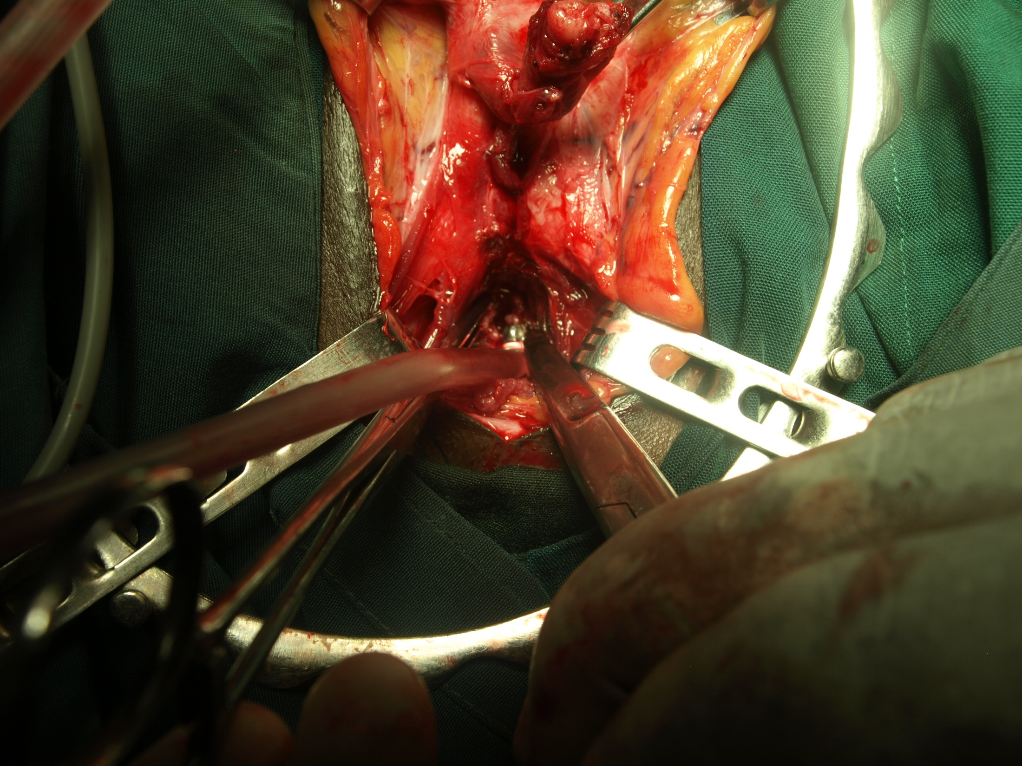
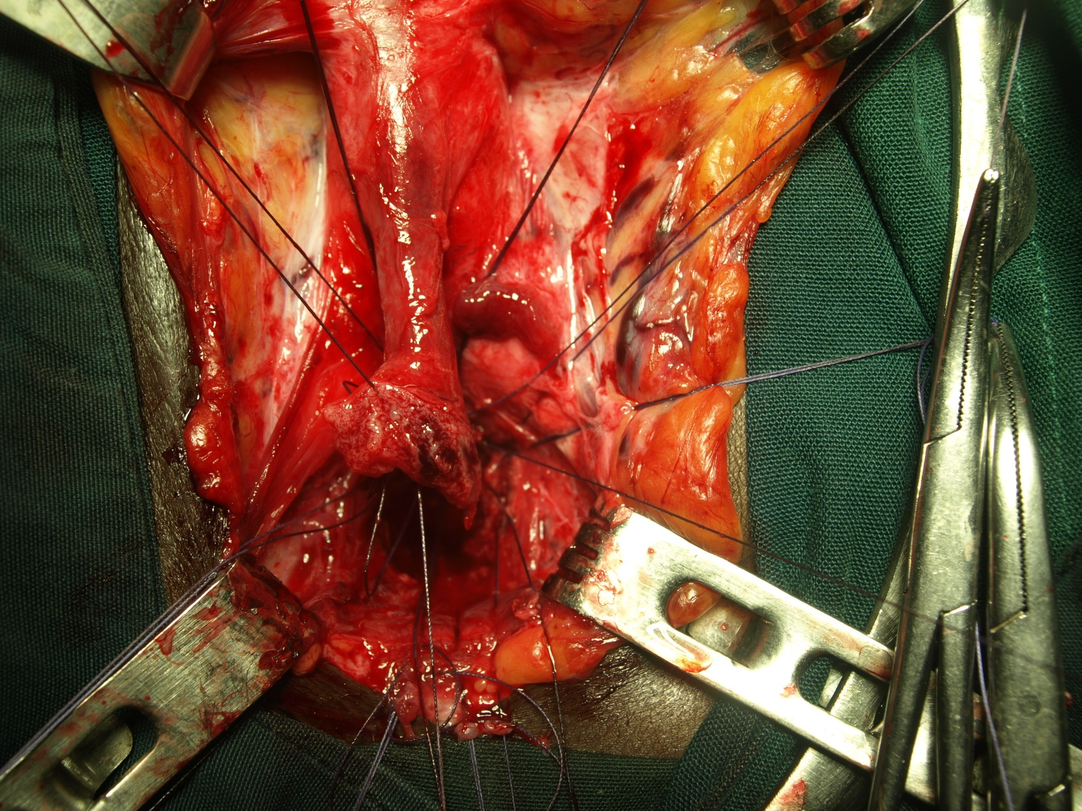
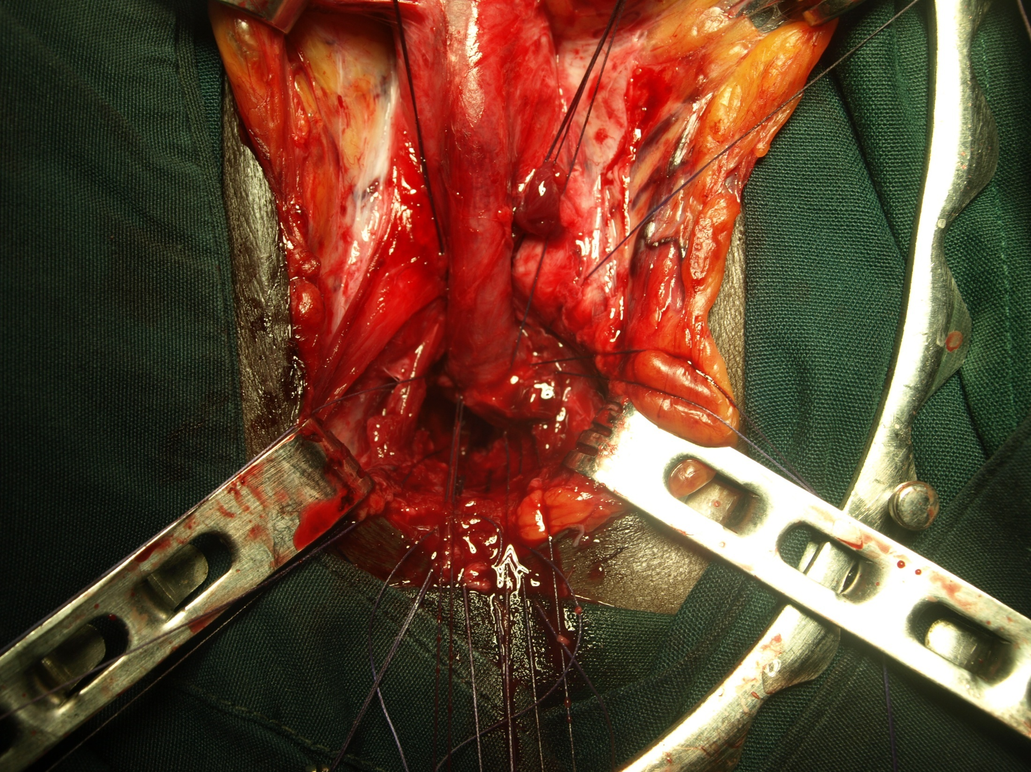
anastomosis

Slide 119
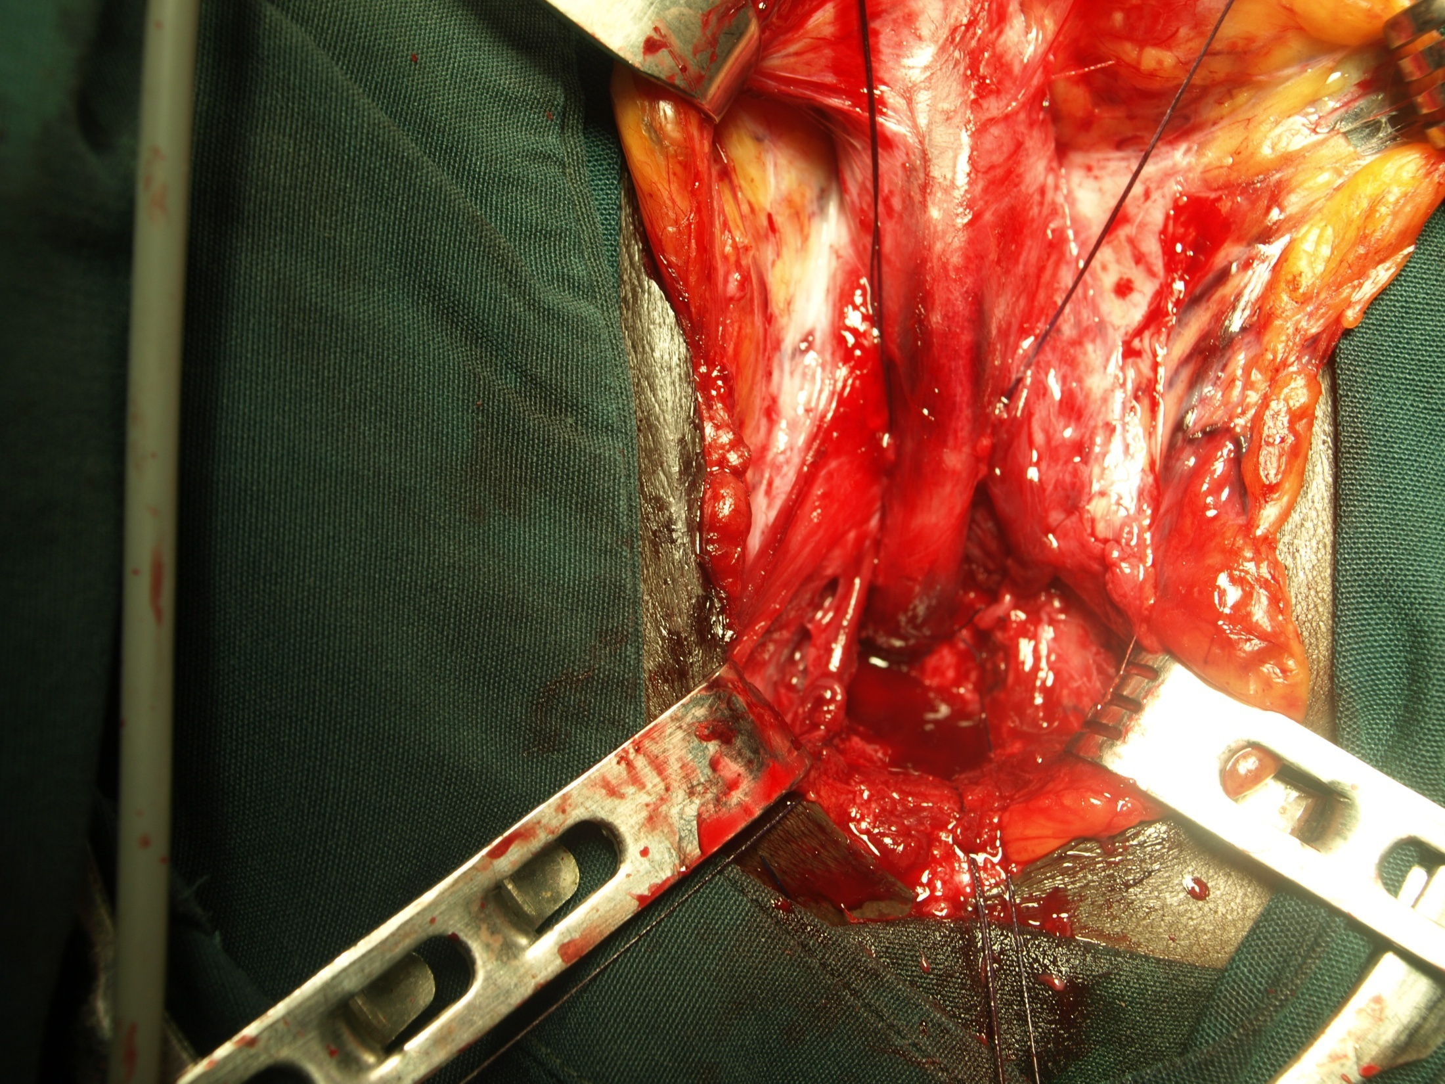

Slide 125
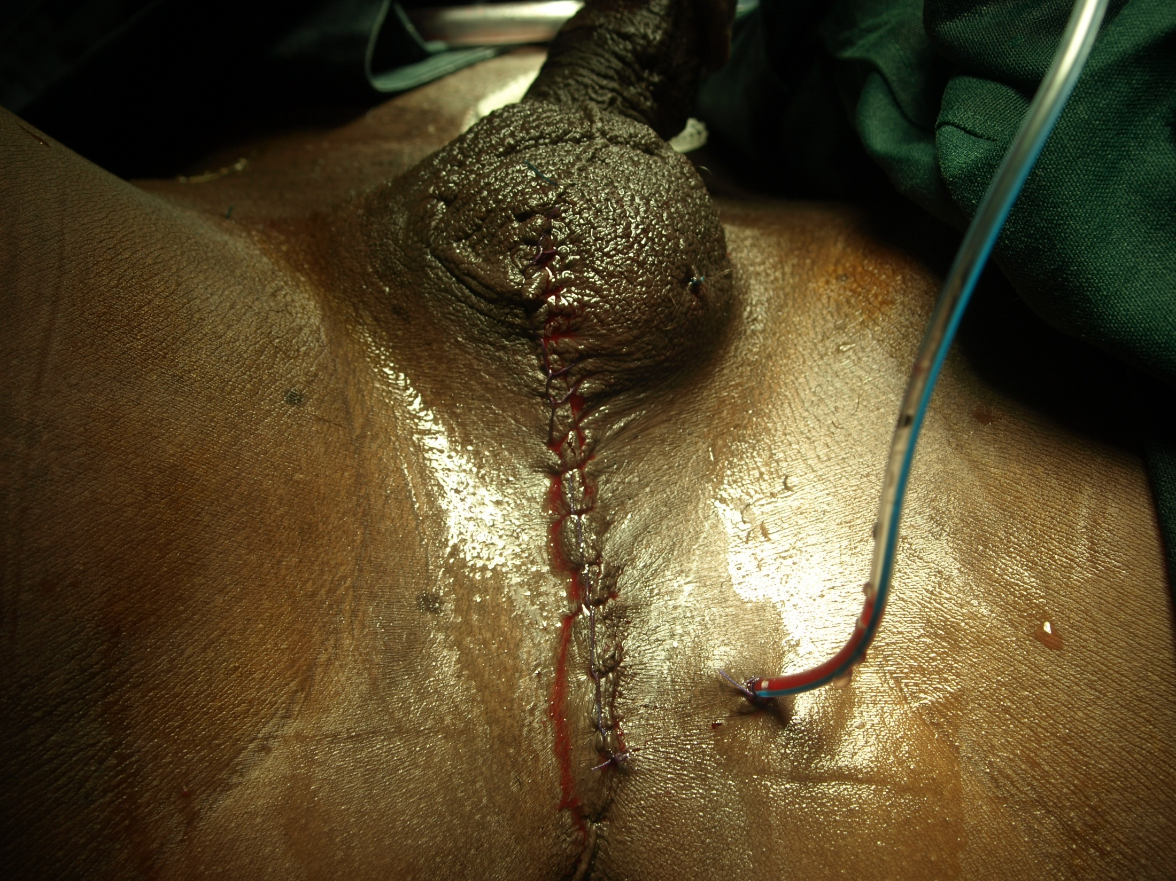

Slide 126
Be blessed
Nakuru kenya 2008

