Slide 1
COMMUNICABLE DISEASES PREVENTION AND CONTROL
Dr Dismas Ongore MBChB, MPH, PhD (Liverpool)

Slide 2
PRINCIPLES OF COMMUNICABLE DISEASES PREVENTION AND CONTROL

Slide 3
OUTLINE
DISEASE TERMINOLOGIES
CONCURRENCE
COMMUNICABLE DISEASES
COMMUNICABLE DISEASE PROCESS
MAJOR POINTS IN COMMUNICABLE DISEASE PROCESS
POINTS IN PREVENTION AND CONTROL

Slide 4
DISEASE TERMINOLOGIES
Infectious
Contagious
Tropical

Slide 5
Disease terminologies
Infectious disease
  Historical diseases
  Conventionally indirectly transmitted – cause unknown
  1 Samuel 4, 5 and in particular 6:3-5

Slide 6
Disease terminologies
Contagious disease
  Contact – contagiore
  Dreaded diseases
  Transmitted directly or nearly so by contact

Slide 7
Disease terminologies
Tropical
  More common in the tropics
  Prevailing factors – social, economic, environment

Slide 8
Better terminology/Sensu stricto
Communicable

Slide 9
Concurrence/similarities
  Due to specific agent
  Agent in reservoir
  Exit of agent from reservoir
  Transmission of that agent
  Entry of agent into host
  Host agent interaction

Slide 10
Communicable disease
“A communicable disease can be said to be one due to a specific agent or its products that arises through the transmission of that agent or its products from a reservoir to a susceptible host. The transmission is either directly or indirectly through the agency of an intermediate host, vector or inanimate environment”.

Slide 12
Major points; agent
Cause of the disease
  Chiefly a micro-organism
  Also helminthes
Capable of producing the disease

Slide 13
Major points; reservoir
Human, animal or arthropod
Soil or inanimate matter
  Normal habitat of agent
  Optimal conditions necessary for
    Multiplication, Survival
    Reproduction of agent

Slide 14
Major point; escape
The respiratory route
  Natural function of breathing, or coughing.
Gastro-intestinal route
  Fecal mater
Genital route
  Transmitted sexually
Urinary route
  Agents appear in the urine
Abnormal route
  No physiological function

Slide 15
Major point; transmission
Agent
  In natural secretions, discharges or evacuations
  In medium of biting insect.
  Most vulnerable
Length of route between hosts crucial
Time and space important
Survival mechanisms
  Bacteria form spores
  Protozoa form cysts.

Slide 16
Transmission; direct
Reservoir to the new host
  Sexually transmitted diseases
  Respiratory diseases
Physical environmental conditions important
Proximity of people

Slide 17
Indirect transmission, passive
Vehicle
  Contaminated material or objects
    Handkerchiefs, toys, soiled clothes, bedding,
    Water, food or milk
    Biological products such as blood.
Intermediate means of transport
Agent may or may not multiply

Slide 18
Indirect transmission, active
Another host utilized by agent
Definitive host
  Adult or sexually mature forms
Intermediate host
  Intermediate forms

Slide 19
Major point; entry of agent
Routes of entry
  Virtually the same as those of escape of the agent
Portal of entry and development of the disease synonymous
  Pulmonary tuberculosis
  Gastrointestinal tuberculosis

Slide 20
Major point; development of disease
Host susceptibility
  Host resistance or immunity
Agent factors
  Infectivity, virulence, pathogencity and antigenicity
Pathogenic infection.
Incubation period

Slide 21
Agent
Reservoir Host
1 2 3 4 5
A = Agent
R = Reservoir
H = Host

Slide 22
Major points in a communicable disease process except
Agent inside the reservoir
Escape of the agent from the reservoir
Transmission of the agent
Entry of the agent into a new host
Agent host interaction

Slide 23
Possible levels of prevention or control of communicable diseases.
1. At the level of the reservoir
2. Exit from the reservoir
3. In the mechanism of transmission
4. At the level of entry into the host.
5. Host agent interaction.

Slide 24
At the level of the reservoir
Depends on
  The disease
  The reservoir
Destruction of the reservoir
  E.g. rodents for plague
Treat the reservoir with drugs
  E.g. Tuberculosis

Slide 25
Exit from reservoir
Few measures feasible
Physiological processes by the reservoir
Abnormal route exception.

Slide 26
Mechanisms of transmission
Many public health measures taken in combination or separately depending on mode of transmission.
Direct – anatomic, socio-economic, cultural factors important
Decontamination of the vehicle of spread
  Treatment of water with chlorine
Interference with the life-cycle of vectors and intermediate host.

Slide 27
Entry into the host
Interrupt entry of the organisms
Barrier methods
  ITNs,
  House screening
  Wearing of shoes

Slide 28
Level of susceptible host
General health of the body
Specific immunity for specific diseases:
  Specific antigens administered
  Produce antibodies against the diseases
Specify drugs capable of prevention of development of diseases
  Taken before a specified agent gets inside the body
  Chemoprophylactic agents

Slide 29
Public health control measures
Several measures applied
  More than one level at the same time.
Measure chosen will depend on
  Type of agent
  Mode of transmission
  Host susceptibility
  Socio-economic factors.

Slide 30
TRANSMISSION OF COMMUNICABLE DISEASES

Slide 31
OUTLINE
DIRECT TRANSMISSION
INDIRECT TRANSMISSION AND ITS CONTROL
INDIRECT TRANSMISSION BY VECTORS
VECTOR BIOLOGY
VECTOR BIONOMICS
ADULT BIOLOGY AND BEHAVIOUR

Slide 32
Direct transmission
Agent goes directly from one reservoir to the new host.
Sexually transmitted diseases
Respiratory disease
Anatomic and physiological considerations are important.
Also sociological, economic and cultural factors important.

Slide 33
Indirect transmission: vehicle
Indirect transfer the agent passes through another host, usually referred to as a vehicle which
Usually contaminated material.
A method of control of such transmission is decontamination.
There are several methods of decontamination used to kill or remove micro-organisms

Slide 34
Control of transmission by vehicles:Sterilization
A process used to achieve sterility
Absolute term meaning absence of all viable micro-organisms.
Refers to the freeing of an article from all living organisms
Include viruses, bacteria ad their spores, and fungi and their spores.
Several methods are used for sterilization

Slide 35
Heat
The only method of sterilization that is both reliable and widely applicable
Heating above 100 degrees C to ensure bacterial spores are killed.
There is some concern that even this temperature is insufficient to destroy prions

Slide 36
Ionizing radiation
Employed in the sterilization of single use disposable items
Include needles and syringes, latex catheters and surgical gloves
Also in the food industry to reduce spoilage and remove pathogens.

Slide 37
Filtration
Used to remove bacteria and all larger micro-organisms from liquids that are liable to be spoiled by heat e.g. blood serum and antibiotic solutions
Industrial scale filtration is widely used to reduce bacterial load and remove cysts of protozoa which are not killed by chlorination in the production of drinking water.

Slide 38
Disinfection
Aprocess which reduces the number of contaminating micro-organisms, particularly those liable to cause infection
To a level which is deemed no longer harmful to health.
Term used to denote the freeing of an article from some or all of its burden of contaminating organisms

Slide 39
Decontamination
A general term for the treatment used to make equipment safe to handle
Includes microbiological, chemical, radioactive and other contamination.

Slide 40
Indirect transfer: intermediate host or vector
Agent passes through another mechanism of transfer, usually referred to as an intermediate host or vector, before it gets to the final host.
Host in which the adult or sexually mature forms of parasite are found is referred as the definitive host.
Host in which the intermediate forms are found is referred as the intermediate host.

Slide 41
Transmission vectors
Many diseases conveyed by blood-sucking vectors
Referred to as vector-borne disease.
Vector acts as an agent of dissemination or inoculation or both of a parasite.

Slide 42
Biological transmission by vectors
Transmission by a vector is said to be biological
When an essential part of the life-cycle of the parasite takes place in the body of the vector.
An interval of time elapses before the vector can transmit the parasite to another host.
This period is known as the extrinsic incubation period and is temperature dependent.

Slide 43
Introduction: vectors
Agents of dissemination or inoculation of parasite.
Association between insects and humans
  Recognized from antiquity
  Religious texts, Bible Exodus

Slide 44
Association between insects and ill health
  Fedtschenko in 1868
    Dracunculus medinesis and Cyclops.
  Patrick Manson, phsician and parasitologist in 1877
    Fiariasis, Wuchereria bancrofti and Culex quinquefasciatus).
  Ronald Ross in 1897
    Anopheles and malaria.

Slide 45
Effects of insects on human health
Transmit diseases
Nuisance and annoyance
Induce allergies
True parasites - live in the superficial layers of the skin

Slide 46
Methods of disease transmission
Biological or cyclical
  Transformation/ multiplication of agent in vector
  Extrinsic incubation period (7-21 days)
Mechanical vectors
  Accidental vectors
  Carry agents on their bodies
  No obvious morphological changes or development
    Example: Housefly in dysentry.
  Transovarial transmission.
  Pathogens actually penetrate the ovaries
  Immature stages from eggs infected,
  Infection persists to the adult stage.

Slide 47
Insect-human contact
Relatively short periods
  Biting flies such as mosquitoes
Longer while taking blood-meals
  Triatomine bugs
Several days
  Some species of ticks
Emerge at night rest during the day
  Bedbugs.

Slide 48
Insect-human contact
Spend much longer periods on host
  Fleas
True ectoparasites, permanently attached
  Head, body and pubic lice
Live in the surface layer of skin
  Specialised myiasis-producing flies

Slide 49
Vector biology: General characteristics.
Numerous segments
Cuticle
  Covers entire body
  Protective exoskeleton
    Chemically hardened
Three regions
  Head, thorax and abdomen.

Slide 50
Head
Pair of compound eyes
A pair segmented antennae
Pair of palps
  Near the mouthparts
  Chemoreceptors which detect smell and taste.
The mouthparts
  Consist of a number of components.
  Vary greatly according to the feeding habits of the insects.

Slide 51
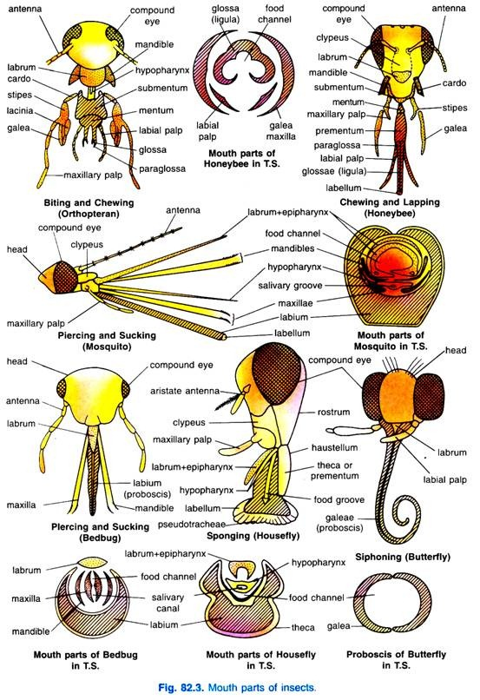
Insect mouthparts

Slide 52
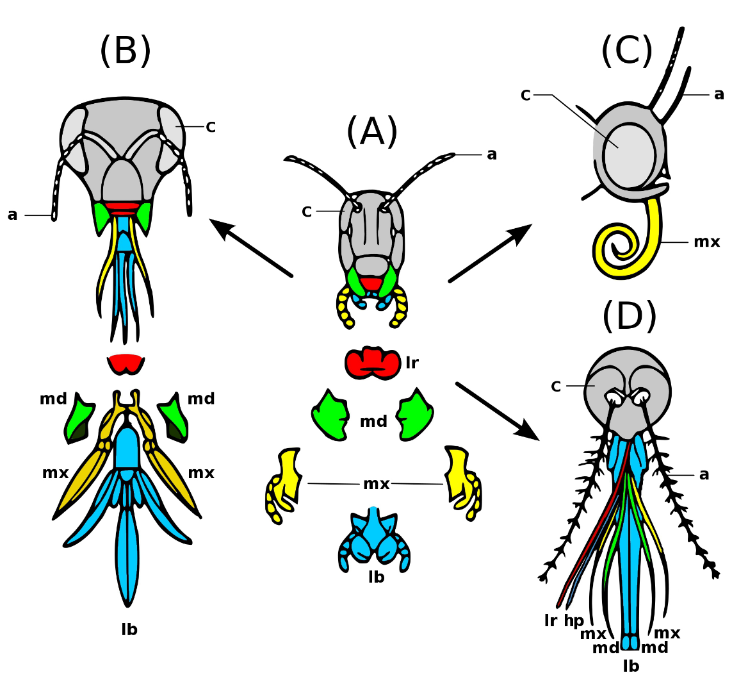
Insect mouthparts

Slide 53
Thorax
Walking legs
Wings
  A pair of fore and hind wings
  Halteres
    A pair of knob-like structures
    Sensory organs
    Flight orientation and balance.

Slide 54
General characteristics contd…
Abdomen
  Usually sub-cylindrical
  Upto eleven segments
Hairs and scales
  Cover body
  Impart color to head, thorax, abdomen, legs and wings

Slide 55
Respiratory system
Direct gaseous diffusion of oxygen to tissues
Spiracles
  Small circular openings on cuticle
  Allow air to enter the body.

Slide 56
Special sensory organs
Special sensory organs
  Compound and simple eyes (ocelli).
  Antennae, halteres and palps and also various receptors
Respond to temperature, humidity, food stimuli and host odours.
Blood-sucking insects, such as tse-tse flies and tabanids,
  Sight is important in locating hosts

Slide 57
Alimentary canal
Mouthparts
  Structure, size and formation
  Complex and varied
Three regions
  Fore, mid and hind gut.

Slide 58
Alimentary canal
The fore gut
  Mouth and leads to the buccal cavity
  Pharynx
  Oesophagus
  Proventriculus (gizzard).
    The muscular
    Acts as a valve
    Prevents food being regurgitated

Slide 59
Alimentary canal contd…
A pair of salivary glands
  Ventrally in the thorax
The composition of the saliva
  Varies according to the insects
  Contains anticoagulins
    Prevent blood sucked from the host from clotting a
    Contains allergens

Slide 60
Alimentary canal contd…
Localised swelling, itching and irritation
  Host reaction to saliva injected into the skin
  Severity of irritation depends on
    Species of blood-sucking insect
    Individual reaction of the host.

Slide 61
Reproductive system
Females reproductive organs
  A pair of ovaries with several egg-tubes or ovarioles
    Within which the eggs are developed
Paired oviducts,
Common oviduct or the uterus
One or two pairs of accessory glands
  Secrete a mucous cement-like substance
  Deposited on the eggs as laid

Slide 62
Reproductive system contd…
Accessory glands produce water-proofing agent or an adhesive
  Glues the eggs to variuos substrates
  Provide material for the formation of the egg-pod

Slide 63
Reproductive system contd…
Spermatheca
  Lined with cuticle
  Consists of one to three receptacles
  Filled with spermatozoa from the male during copulation.
    Fertlizes each egg as passes down the oviduct
Insects need mate only once

Slide 64
Reproductive system contd…
Spermatheca
  Lined with cuticle
  Consists of one to three receptacles
  Filled with spermatozoa from the male during copulation.
    Fertlizes each egg as passes down the oviduct
Insects need mate only once

Slide 65
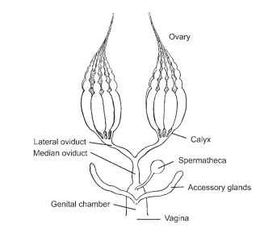
Spermatheca

Slide 66
Vector bionomics: Quiescence.
Quiescence.
  Temporarily cease to develop or become active
  Resist environmentally unfavorable periods.

Slide 67
Vector bionomics: Hibernation and aestivation
Hibernation
  Quiescence to resist cold conditions such as during winter
Aestivation
  Quiescence to resist drought or high temperatures

Slide 68
Vector bionomics: Diapause
Development of the egg, larva, nymph or adult arrested
  May last a few weeks or several years
Initiated by many external factors including changes in day length and temperatures
Must be subjected to appropriate stimuli to ‘break’ the diapause.
Eggs of many Aedes mosquitoes enter diapause
Allows various stages of insects to survive under adverse conditions.

Slide 69
Blood-feeding
Blood meal required for
  Successful completion of the reproductive cycle.
Anaautogenous development.
  Blood-meal is necessary to obtain nutrients for the development of the eggs
Speed of digestion of the blood-meal depends
  On temperature and
  Most tropical species is 2-3 days.

Slide 70
Blood-feeding
Searches for suitable larval habitat for oviposition
Takes another blood-meal and after 2-3 days
Further batch of eggs is matured
Gonotrophic cycle
  The process of blood-feeding and egg-maturation, followed by oviposition
  Repeated several times

Slide 71
Oviposition.
After mating and blood-feeding vectors
Preferred larval habitat sought
Many different types preferred
  Large and more or less permanent habitats
  Small and often temporary breeding places
  Habitats with or without acquatic vegetation
  Exposed sunlit waters
  More shaded breeding places

Slide 72
Adult biology and behaviour
Crepuscular or nocturnal
  Blood-feeding and oviposition occur in the evenings, at night or early in the morning around sunrise.

Slide 73
Adult biology and behaviour
Anthrophilic
  Species that usually bite human
Zoophilic
  Feed mainly on other animals
Ornothophilic
  Feed mainly on birds

Slide 74
Feeding behavior
Endophagic
  Enter houses to feed
Exophagic
  Bite their hosts outside

Slide 75
Resting behaviour
Endophilic
  Rest inside houses after feeding
Exophilic
  Rest outdoors after feeding

Slide 76
Adult biology and behaviour
The biting behavior
  Important in the epidemiology of disease transmission.
The resting behavior
  Important consideration in planning control measures.

Slide 77
THANK YOU!
ANY QUESTIONS?

