Slide 1
MALARIA
DIARRHOEAL DISEASES
HELMINTHS
Dr. Dismas Ongore MBChB, MPH, PhD

Slide 2
MALARIA
Italian mal’aria or “bad air”
paludism, latin for ‘palus’ or marsh.
Most important cause of fever-related morbidity and mortality in most of sub-Saharan Africa.

Slide 3
Geographical distribution
Deeply entrenched
Tropical Africa
South east Asia
Parts of the Indian sub continent
Much of central and south America.

Slide 4
Geographical distribution
Previously eradicated from
  The whole of Europe
  Most of North America including the whole of the USA
  Most of the Carribean
  Large parts of northern and southern South America
  Australia
  Singapore, Japan, Korea and Taiwan.

Slide 5
Impact
Significant impediment to human development in poor countries.
450 – 500 million clinical episodes
Over 400,000 million deaths annually mainly in children in Africa.
6% of their GDP as a result of the disease.

Slide 6
Agent
Protozoan parasites of the genus Plasmodium.
Four species infect humans under natural conditions.
Plasmodium falciparum, P.ovale, P.vivax and P.malariae.
The life cycle alternating
  sexual
  asexual cycles
Mosquito and in human respectively.

Slide 7
Asexual cycle
Initiated by sporozoites
Undergoes process of schizogony in two phases
Tissue or exo-erythrocytic schizogony which takes 5-15 days
Hypnozoites - dormant for upto 10 months
Responsible for true relapses seen in P.vivax and P.ovale.

Slide 9
Asexual cycle
Erythrocytic shizogony
Merozoites - Trophozoites
Asexual schizogony
Schizonts
Merozoites
6-32 per schizonts
48 to 72 hours
Gametocytes

Slide 10
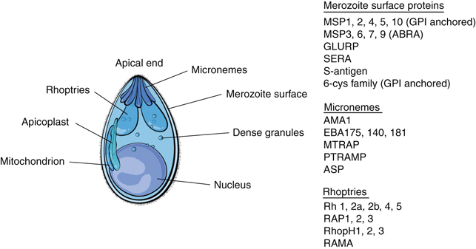
Merozoite

Slide 11
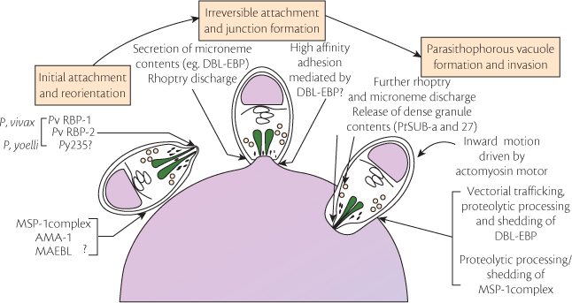
Erythrocyte invasion

Slide 12
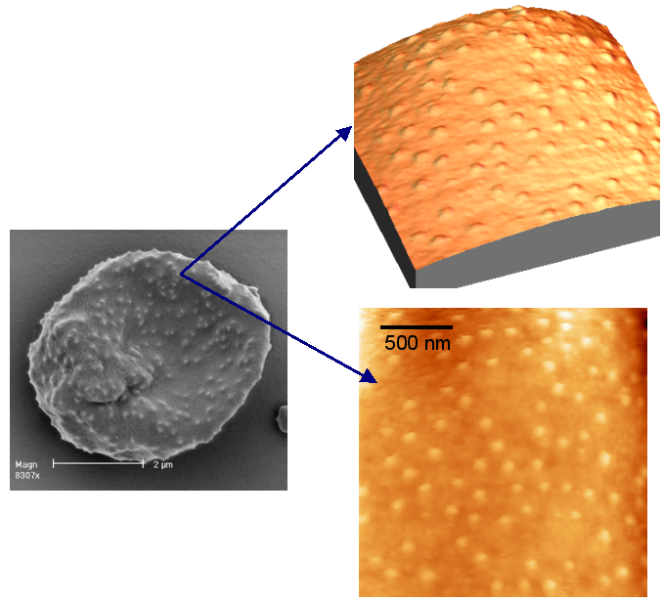
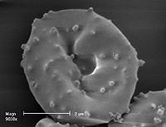
P. falciparum and expression of Pf erythrocyte
Membrane binding protein (PfEMP1)

Slide 14
Sexual phase.
Gametocytes transform into gametes
Fertilization occurs
Rounded zygote formed
Transforms into elongated ookinete
Oocyst.
Asexually sporogony
Sporozoites.
Temperature dependent
8-16 days
Does not occur below 15.6⁰C.

Slide 15
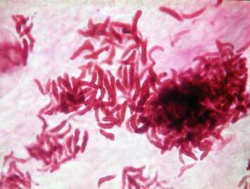
Sporozoites - The Infective Stage

Slide 16
Species | E-E Schizogony (days) | Merozoites/ tissue schizont | Hypnozoites | Periodicty (hours) | Merozoites per erythrocytic schizont
P.falciparum | 5.5 | 40,000 | NIL | 48 | 8-32
P.vivax | 8 | 10,000 | Present | 48 | 8-24
P.ovale | 9 | 15,000 | Present | 48 | 6-12
P.malariae | 15 | 15,000 | NIL | 72 | 6-12

Slide 17
Reservoir
Humans
Children
Especially infants who are the major gametocyte carriers.
P.malariae
  Common to humans and the great apes

Slide 18
Transmission
Natural transmission
Bite of certain species of Anopheles mosquitoes.
Blood transfusion with unscreened blood
Syringe transmission by intravenous drug users.
Therapeutic

Slide 19
Anopheles mosquito
Mosquitoes of genus Anopheles
Have world wide distribution.
The genus has 416 species
40 can transmit malaria
Only 15 are major vectors of malaria.

Slide 20
Life cycle
Adult mosquitoes emergence from the pupa and mate shortly after wards
One mated the female stores enough sperm in spermtheca
Females produces eggs in masses which are fertilized by the sperms from the spermatheca

Slide 21
Gonotrophic cycle cont.
In the tropical, digestion takes 3 days and during this time the eggs are mature- 24 hours half gravid, 72 hours full gravid
A gravid mosquito leaves the resting place either indoor or out door to look for a suitable oviposition site
After laying the eggs the mosquito seeks another blood meal, after which it also rest for 3-4 days to digest the blood meal, develop eggs and lay

Slide 22
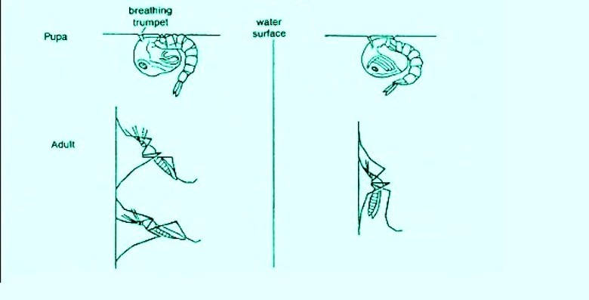

Slide 23
The vector
Anopheles gambiae complex
Major vector
Widespread sub-Saharan Africa
World’s most efficient malaria vector.
Larvae in temporary habitats
Pools, puddles, hoof prints and borrow pits, but also rice fields.

Slide 24
Vector
Predominantly feeds on humans - anthrophilic
Comes inside houses to feed - endophagic
Rests predominantly indoors after feeding - endophilic

Slide 25
Vector
An.funestus
Other major vector in sub-Saharan Africa.
Widespread in Africa south of the Sahara
Breeds in more or less permamnent waters,
Vegetation, such as swamps, marshes, edges of streams, rivers and ditches.
Overhanging shade

Slide 26
Vector A funestus
Predominantly feeds on humans - anthrophilic
Comes inside houses to feed - endophagic
Rests predominantly indoors after feeding - endophilic

Slide 27
Pathogenesis
All the manifestations of malarial illness are caused by the infection and subsequent destruction of the red blood cells by the asexual forms of the malaria parasite
All types of malaria manifest with common symptoms such as fever.
Severe malaria and death is more often seen in cases of P. falciparuminfection

Slide 28
Pathogenesis
Invasion and subsequent destruction the red cells basis of pathogenesis
Cyclic rupture of RBC, release of lipid ‘toxins’ and induction of pro-inflammatory cytokine production by host endothelial cells.
Fever is common to all malaria parasites.

Slide 29
Pathogenesis - fever
Toxic products of the parasite
Taken up by leukocytes
Endogenous pyrogens from leukocytes.
Act on the hypothalamus
Release prostaglandins
Act upon the posterior hypothalamus
Sympathetic vasoconstriction
Decrease heat dissipation
Classical rigor.

Slide 30
Pathogenesis: anaemia
Haemolysis of parasitized red cells
Haemolysis of non-parasitized red cells
Dyserythropoiesis
Anemia is often out of proportion to the degree of haemolysis.

Slide 31
Pathogenesis: cerebral malaria
Common feature Plasmodium falciparum.
Pathological changes seen in the brain
Blocking of the capillaries with parasitized red cells
Necrotic lesions in the cerebral tissues
Stasis in the cerebral circulation
Stickiness of the erythrocytes
Adhesions to the capillary endothelium
Obstruction of the small vessels

Slide 32
P. falciparum and expression of Pf erythrocyte
Membrane binding protein (PfEMP1)

Slide 33
P. falciparum sequesters in deep vascular beds

Slide 34
Natural immunity
Alterations in the structure of hemoglobin or in certain enzymes have been found to confer protection against either the infection or its severe manifestations and these traits are often found in areas of high malaria transmission.
Duffy negativity in red cells protects against P. vivax infection.
It is found to be widely prevalent in Africa and this may be responsible for the virtual elimination of this parasite from the continent.

Slide 35
Natural immunity
Certain thalassemias (50% reduction in infection), homozygte hemoglobin C (90% reduction), hemoglobin E, and ovalocytosis carrier status hav ebeen reported to confer protection against P. falciparum or P. vivax.
Glucose 6 phosphate dehydrogenase deficiency (50% protection) and sickle cell hemoglobin (90% protection) confer protection against severe malaria and related mortality.

Slide 36
Acquired immunity
In areas with stable endemic malaria and intense malaria transmission acquired immunity develops slowly.
Children born to immune mothers are protected against disease during their first half year of life by maternal antibodies.
The risk of clinical disease increases after 6 months of age and infants become susceptible to severe disease and death.

Slide 37
Immunity
Due to repeated and frequent infections, the frequency of clinical disease begins to diminish and the risk of mortality sharply decreases
By about 5 years the risk of clinical disease and death decreases
By adulthood, most inhabitants generally possess semi-immunity and severe clinical disease is uncommon even in the presence of infection.
Parasites are not completely eliminated

Slide 38
Immunity
Circulating antibodies produced against the blood-borne forms
Cannot eliminate the erythrocytic stage
Parasites escape from the cytocidal action of humoral antibody
Parasites continue altering their antigenic construction by a process of antigenic variation
After protective antibodies appear new antigens are synthesized

Slide 39
Immunity
Parasite escapes by changing to a further variant.
Malaria continue to infect the host
So that in hyper endemic areas for malaria children subjected to repeated attacks for first few years of life
Until immunity against a significant proportion of the antigenic variants achieved

Slide 40
P. falciparum and expression of Pf erythrocyte
Membrane binding protein (PfEMP1)

Slide 41
Epidemiology
Natural transmission depends on the presence and relationship between
  Host
  Agent
  Environment.
Interact to provide varieties in the epidemiology of malaria.

Slide 42
Prevention and control: malaria survey
Control preceded by evaluation of amount and conditions of transmission
Involves collection of data on
  Human host
  Insect vector
  Environment

Slide 43
Malaria survey: human host
Large number of people, especially infants and children
Examined by several methods
Classically estimation of the spleen rate
Proportion of children aged 2-10 years
Palpable enlarged spleens
Spleen may be palpated with the child standing or lying.

Slide 44
Malaria survey: human host
Basis of malaria endemicity
  Hypoendemic malaria with spleen rate of 0-10%
  Mesoendemic malaria with spleen rate of 11-50%
  Hyperendemic malaria with spleen rates consistently over 50%. The spleen rate in adults is also high
  Holoendemic malaria with spleen rate consistently over 75%. The spleen rate in adults is low; the strongest adult tolerance is found.

Slide 45
Alternate classification: Parasite rates
Hypo endemic: Parasite rate in children aged 2-9 years is less than 10%
Meso endemic: Parasite rate in children aged 2-9 years is 11-50%
Hyper endemic: Parasite rate in children aged 2-9 years is 50-75%
Holo endemic: Parasite rate in children aged 2-9 years is constantly more than 75%.

Slide 46
Malaria control
Control achieved by action against
  Adult mosquitoes with insecticides
  Larvae by attacking the breeding places
    Antilarval measures
  Environmental control
    Decreasing human-mosquito contact.

Slide 47
Control directed against adults
Personal protection
Mosquito nets
Mosquito proof screening
  Houses, hospitals and other buildings
  Windows, doors and ventillators
Suitable insect repellents in the form of oils, creams or aerosols
  Provide temporary protection
  Preparations contain
    Diethyltoluamide (DET)
    Dimethyl phthalate (DMP).
    Applied to exposed areas of skin
    Avoid the eyes

Slide 48
Control directed against adults: rresidual house-spraying
Control focused on the adults.
Application of residual insecticides
Interior surface of walls, ceilings and roof of houses.
Effectiveness of residual spraying depends on the indoor resting habits of the mosquitoes.

Slide 49
Control directed against adults: genetic control
Aims at rearing large numbers of mosquitoes
Genetic make up altered.
Released into the environment
Successfully compete with natural populations.
Sterile-male release techniques fall in this category.
More difficult to implement than the conventional insecticidal measures.

Slide 50
Control directed against larvae
Physical, mechanical or environmental control
Filling in, source reduction and drainage
  Water-filled tree holes, ponds and small marshes
Removal of container habitats
  Abandoned cans, metal drums, canoes, pots, tyres etc can be removed and the breeding sources greatly reduced or eliminated.
Draining swamps and marshes and filling in habitats
  Impracticable against vectors in temporary small pools and puddles.

Slide 51
Control directed against larvae
Habitat changes
Alter aquatic habitats
  Cutting down overhanging vegetation to increase sunlight
  Planting vegetation near water for sun-loving species.
Impoundments
  Excavate marshy areas
  Well-defined vertical banks
    Completely alters the habitat
    Unsuitable for mosquitos

Slide 52
Larval control: chemical control
Paris green (a copper aceto-arsenite)
  Earlier chemicals used to prevent mosquito breeding
  Applied to the water surface as fine dusts
  Stomach poison.
Larvicidal oils used consistently
  Reduced malaria transmission in localised areas.
Diesel oils and fuel oils or kerosene used.
    Sprayed on the water larvae
    Physical blocking their tracheae and suffocating them
Habitats to be treated every 7-10 days
Larvae hatching are killed before they pupate.

Slide 53
Larval control: biological control
Do not cause any chemical pollution
Advocated as a better approach than insecticidal methods.
Predatory fish have reduced larval populations
Debatable whether broken transmission cycle
Predators not specific
May eat harmless and beneficial insects.

Slide 54
Larval control: pathogens and parasites
Include
  Viruses (iridescent and cytoplasmic polyhedrosis viruses)
  Bacteria (e.g. Bacillus thuringiensis var israelensis), protozoa (e.g.Thelohania)
  Fungi (e,g,Coelomomyces)
Increase larval mortality

Slide 55
Larval control: B.thuringiensis var isrealensis
B.thuringiensis var isrealensis most useful pathogen
Easy to mass-produce
Formulated as a powder to be sprayed on water
Kill mosquito larvae when ingested.

Slide 56
Malaria Vaccines background
One of the greatest challenges of medicine has been the development of an effective and safe vaccine against malaria.
Despite the persistent efforts for more than a century the malaria vaccine has remained elusive.
Confident promise of researchers in the mid-1980s that an effective vaccine against P. falciparum would be available within a decade remained elusive

Slide 57
Vaccine Types
The pre-erythrocytic vaccines
Anti-disease vaccination
The erythrocytic stage vaccines
Asexual Blood-Stage Vaccines
Transmission-Blocking Vaccines

Slide 58
Current approved malaria vaccine
The only approved vaccine as of 2015 is RTS,S.
It requires four injections, with a26–50% efficacy
Not recommend in babies between 6 and 12 weeks of age
Currently the first malaria vaccine provided to young children in selected areas of three sub-Saharan African countries (Ghana, Kenya, and Malawi) through a Malaria Vaccine Implementation Programme (MVIP)

Slide 59
The RTS,S malaria vaccine
RTS,S is the most recently developed recombinant vaccine.
It consists of the P. falciparum circumsporozoite protein (CSP) from the pre-erythrocytic stage.
The CSP antigen causes the production of antibodies capable of preventing the invasion of hepatocytes
Additionally elicits a cellular response enabling the destruction of infected hepatocytes.
RTS,S/AS01 (RTS,S; trade name Mosquirix™) is an injectable vaccine that provides partial protection against malaria in young children.
Specifically, RTS,S is designed to prevent the malaria parasite from infecting, maturing, and multiplying in the liver

Slide 60
The RTS,S malaria vaccine
RTS,S is a scientific name given to this malaria vaccine candidate and represents its composition.
The ‘R’ stands for the central repeat region of Plasmodium (P.) falciparum circumsporozoite protein (CSP);
The ‘T’ for the T-cell epitopes of the CSP; and the ‘S’ for hepatitis B surface antigen (HBsAg).
These are combined in a single fusion protein (‘RTS’) and co-expressed in yeast cells with free HBsAg.
The ‘RTS’ fusion protein and free ‘S’ protein spontaneously assemble in ‘RTS,S’ particles.
RTS,S also contains the AS01 adjuvant system, and in scientific papers is usually referred to as ‘RTS,S/AS01’.

Slide 61
DIARRHOEAL DISEASES

Slide 62
Diarrhoeas
An important cause of morbidity and mortality in the tropics.
Likely to occur in epidemics.
Pointer to socio-economic development

Slide 63
Categorization of diarrheas
  Be important in making a tentative diagnosis where especially when diagnostic facilities are limited.
  May assist in deciding the possible epidemic potential
  May be a pointer to management strategies for the outbreak

Slide 64
Important features
Course and duration of the diarrhoea
  Acute, chronic or acute on chronic course
    Important for diagnosis and management.
Nature of the diarrhoea important
  Bloody, watery or bloody-mucoid
    Implications for diagnosis and management

Slide 65
Important features
The presence or absence of fever another important feature
  Pointer to the possible cause of the diarrhoea
  May also influence management.

Slide 66
Important features
Pain may accompany certain diarrhoeas
  Implications for diagnosis and management.

Slide 67
Presence of features
Different combinations
With different types of diarrhoeas.

Slide 68
 | Cholera | Shigellosis | Amoebiasis | Typhoid
Acute
Chronic
Acute on chronic
Watery
Bloody
Bloody mucoid
Fever
Pain

Slide 69
Cholera

Slide 70
Agent
The Cholera vibrio
First discovered by Koch in Egypt in 1883.
Generally curved like a comma, hence its name.
Flagella distinguishable, active spirillum-like movements.
Gram-negative.

Slide 71
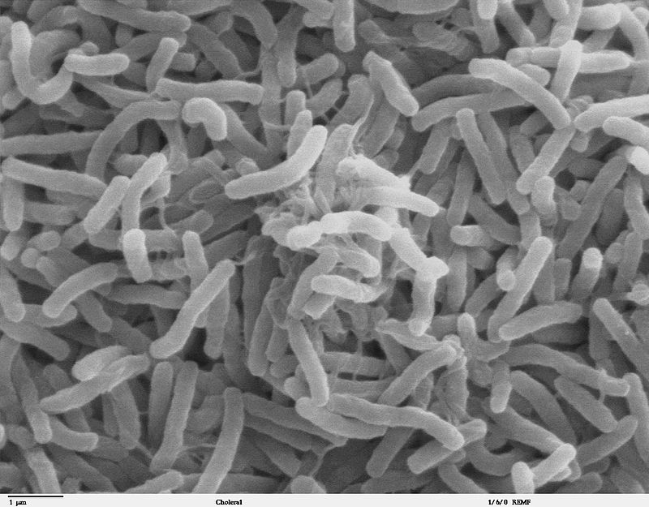
Cholera bacteria SEM

Slide 72
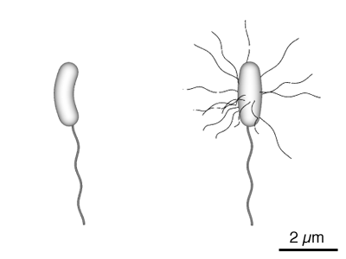
Diagram of the bacterium, V. cholerae

Slide 73
Reservoir
Carriers sources of infection
Prevalence amongst the healthy population is under 1%
Rises rapidly during the cholera season.
Acute carriers are important in the maintenance of transmission
Occur following asymptomatic or mild cases and outnumber cases by five or ten to one
More in the case of El Tor vibrios.

Slide 74
Disease reservoir
Zooplankton have been found to house the bacterium Vibrio cholerae, causative agent of cholera, by allowing the cholera vibrios to attach to their chitinous exoskeletons.
This symbiotic relationship greatly enhances the bacterium's ability to survive in an aquatic environment, as the exoskeleton provides the bacterium with an abundant source of carbon and nitrogen.

Slide 75
Transmission
Fecal oral route from contaminated water.
Source of the water may be rivers, wells, tanks or aquatic reservoirs
No significant animal reservoir though Vibrios may be maintained in salt water shellfish
Infective dose is high in healthy adults with normal gastric acidity
Food-borne cholera due to contamination of food by polluted water.
Direct person-to-person transmission unusual

Slide 76
Pathogenesis
Cholera produces a toxin, Cholera toxin activates the adenylate cyclase enzyme in cells of the intestinal mucosa
Leading to increased levels of intracellular cAMP, and the secretion of H₂0, Na⁺, K⁺, Cl⁻, and HCO₃⁻ into the lumen of the small intestine.

Slide 77
Clinical features
Most cases are asymptomatic
Result in an acute carrier state
Acute secretory diarrhoea
Loss of fluid and electrolytes from the body
Death from dehydration.
The incubation period is 3-6 days.
The onset is sudden
Florid painless diarrhoea with profuse watery stools

Slide 78
Clinical features
Vomiting, profuse rice-water material
Agonizing cramps attack the extremities and abdomen
Depletion of chlorides and hypocalcaemia
Patient may rapidly pass into a state of collapse.
Death may ensue at any time from 2-30 hours
Usually in from 10-12 hours.

Slide 79
Management; Diagnosis
Index of suspicion.
Profuse watery discharge, dehydration together with high mortality should alert the physician.
The stool should be examined microscopically for Vibrios
Detected by their scintillating rotatory movements in a hanging-drop preparations

Slide 80
Diagnosis
Stool samples are collected in the filed before treatment can be started.
Specimens so obtained should then be transported to a laboratory in a special transport media.
Alkaline sea salt fluid (Venkartraman Ramakrishnan (VR) medium);
Cary-Blair medium
Taurocholate-tellurite-peptone medium

Slide 81
Treatment
The aim of treatment
Restore the fluid and electrolyte balance
Remove the vibrios from the alimentary canal.
Rehydration and electrolyte replacement mainstay
Immediate replacement of fluid and electrolytes
Correction of the acidosis

Slide 82
Treatment
Antimicrobial agents
Shortens the duration of diarrhoea and the excretion of vibrios in the stool.
Doxycycline in a single dose of 300 mg is as effective as tetracycline.
Chemotherapy of carriers and contacts is used in the management of an epidemic.

Slide 83
Management of an epidemic
The basis of management
Treatment of cholera cases, carriers and contacts.
Vaccination of the population…
Treatment organized in temporary hospitals
The provision of intravenous and oral fluids arranged on a mass basis.
Proper attention to this organization reduces the mortality from 30% to 1%.
Mass chemotherapy of contacts and carriers has been undertaken with varying success.

Slide 84
Prevention and control
Most control measures aimed at preventing secondary transmission
Methods used include control of water supplies and sanitation.
Prophylactic vaccination has not proved adequate.

Slide 85
Prevention and control
Long-term control has been achieved with a combination of improved water supplies and sanitation
Investigation and surveillance of all enteric and diarrhoel diseases
Construction of sanitation facilities to keep pace with social and industrial development and with growth of tourism and trade.

Slide 86
Oral cholera vaccines
Currently there are 3 WHO pre-qualified oral cholera vaccines: Dukoral®, Shanchol™, and Euvichol®.
All 3 vaccines require 2 doses for full protection .
Dukoral® is administered with a buffer solution that, for adults, requires 150 ml of clean water.

Slide 87
Oral cholera vaccines
As access to clean water is often limited in areas with cholera epidemics, Dukoral® is mainly used for travellers.
Dukoral® provides approximately 65% protection against cholera for 2 years.
Shanchol™ and Euvichol® are essentially the same vaccine produced by 2 different manufacturers.

Slide 88
Oral cholera vaccines
They do not require a buffer solution for administration, which makes them easier to administer to large numbers of people in emergency contexts.
There must be a minimum of 2 weeks delay between each dose of these 2 vaccines.

Slide 89
Oral cholera vaccines
However, 1 dose of vaccine will provide some protection with the second dose given at a later date.
Individuals vaccinated with Shanchol™ or Euvichol® have approximately 65% protection against cholera for up to 5 years following vaccination in endemic areas.

Slide 90
HELMINTHS

Slide 91
 | Ascaris | Hookworm | The beef tapeworm
Introduction
Agent
Reservoir
Transmission
Main feature
Complication
Predisposing factor
Epidemiology
Prevention and control

Slide 92
 | Ascaris | Hookworm | The beef tapeworm
Introduction | One of the commonest human infections. Estimated that 1 in 4 worldwide are infected with a worldwide distribution. | One of the commonest causes of anaemia in the tropics | Has a worldwide distribution where beef is eaten undercooked or raw. Especially common in Ethiopia and East Africa
Agent | Ascaris lumbricoides a large worm measuring 15-31 cm. | Ancylostoma duodenale and Necator americanus | Taenia saginata the beef tapeworm
Reservoir | Human is the sole reservoir | Human is the only reservoir of infection | The human is the only definitive host.
Transmission | Ingestion of eggs from contaminated soil. | Penetration of the skin by infective filariform larvae. | Eating raw or undercooked beef
Main feature | Intestinal colic with heavy infection | Hookworm anaemia and hookworm disease. | Most cases are asymptomatic. Appearance of segments in the stool
Complication | Intestinal obstruction PEM | CCF | Epigastric or umbilical pain, often like hunger pain. Nauseau and a feeling of epigastric distension
Predisposing factor | Seeding of soil around houses regularly with droppings of little children | Transmission enhanced walking barefoot Transmission enhanced by cultural defecation and agricultural practices | Transmission is favoured by eating raw or undercooked/roasted meat infected
Epidemiology | The prevalence and intensity highest in pre-school children. | The prevalence and intensity highest adults. | Eating raw beef particularly when the practice is part of traditional norms and practices.
Prevention and control | Personal and public hygiene Environmental control Health education. Mass chemotherapy targeting children with a broad spectrum anthelminthic | Proper disposal of faeces Health education Reduce soil contamination Provision of shoes | Proper inspection of beef Adequate cooking and roasting of meat ensures protection. The critical temperature for boiling is 56 ⁰C .

Slide 93
THANK YOU!

