Slide 1
Topic 3: Rates, Ratios & Proportions
Dr. Sam W. Wafula
School of Public Health [SPH]
E-mail: sam.wangila@gmail.com

Slide 2
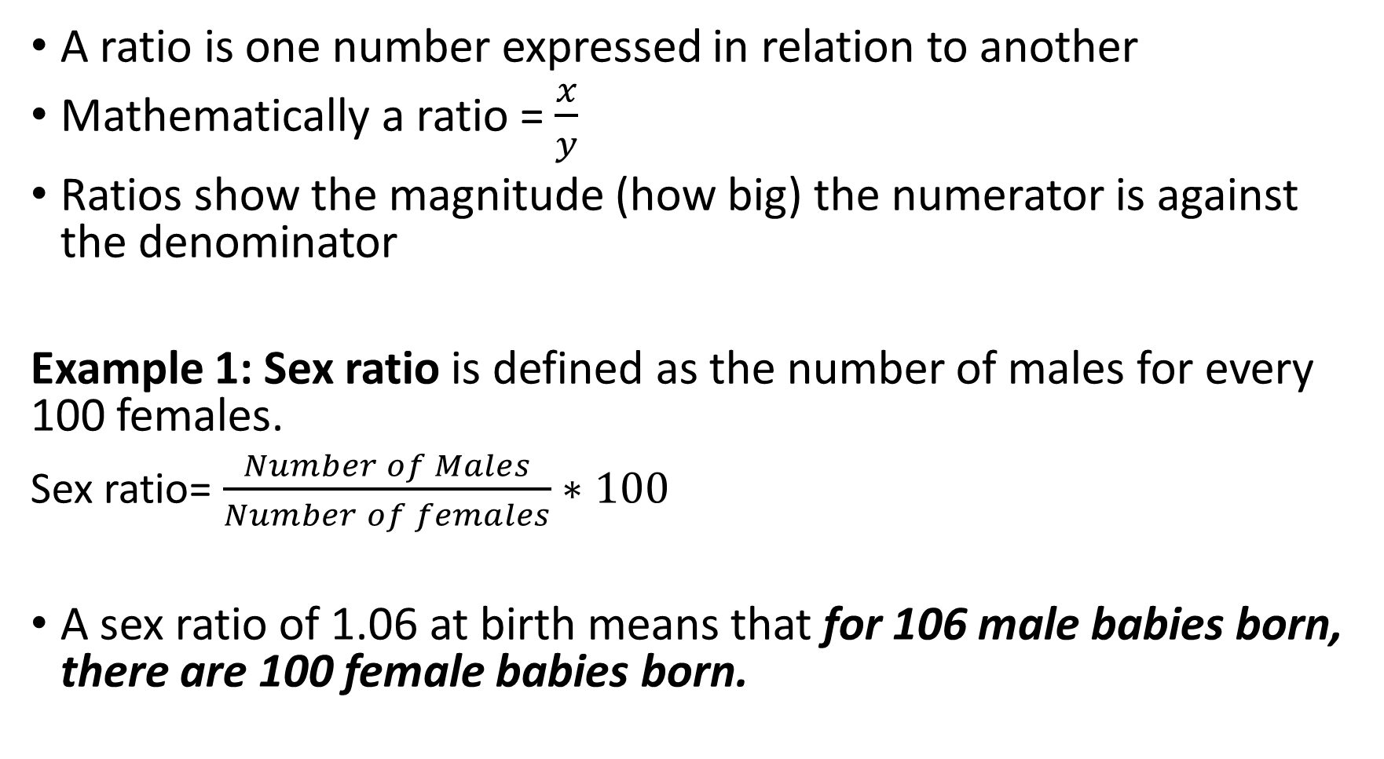
Ratios

Slide 3
Sex Ratio [2]
Changes with age: Higher at very young ages estimated at around 102-107 at birth. Also sometimes called the masculinity ratio.
Gap narrows with increasing age & goes <100 by middle age
Desirable to consider separately for important components e.g. by County, ethnic group, education, employment
Sex Ratio at birth < 100 →More female than male births
= 100 → Same number of male and female births
> 100 → More male than female births

Slide 4
Quiz: The following table shows the distribution of males and females for East Timor. Calculate the sex ratio for the various age groups. Comment on your answer.
Age group | Males | Females | Sex ratio
0-4 | 77720 | 73024 | ??
5-9 | 66661 | 62759 | ??
10-14 | 61422 | 57225 | ??
15-19 | 47953 | 47321 | ??
20-24 | 37640 | 38061 | ??
25-29 | 28366 | 28772 | ??

Slide 5
Trends in sex ratio for East Timor, Year XX

Slide 6
Comments on the sex ratio changes for East Timor
Between ages 0-19 years, there are more males than females
The ratio of males to females peaked at ages 10-14 and drops drastically thereafter.
There are more females than males between ages 20-29 years

Slide 7
Example 2: Child Dependency Ratios
This is the number of people aged 0-14 divide by those aged 15-64 years.
  Child Dependency ratio = 0-14 years x 100
15-64 years
Interpretation: Every person in the working population [15-64 years] economically supports XX number of children below 15 years old. The higher the figure, the higher the dependency and vice versa.

Slide 8
Old age Dependency Ratio
This is the number of the elderly (those aged 65+ years) divide by the working population (15-64 years).
  Old age Dependency ratio = 65 + years x 100
15-64 years
Interpretation: Each person in the working age group (15-64 years) supports XX number of the elderly (65+ years)

Slide 9
Example 2: The Age Dependency Ratio
Number of people under age 15 plus the number aged 65 and above divided by the number of people 15 to 64.
Age Dependency ratio = 0-14 years + 65 + years x 100
15-64 years
Interpretation: For every XX number of working population, there are YZ dependents OR For every dependent, there are XX workers. The higher the value of the age dependency ratio, the bigger the economic burden on the working population and vice versa
Is the age dependency a true ratio?

Slide 10
Is Age Dependency Ratio a true ratio?
Are all people between 15-64 years working? NO!
Are all people above 65 truly dependants? NO!
Dependency ratio is a crude measure of dependency that assumes age defines your economic contribution.

Slide 11
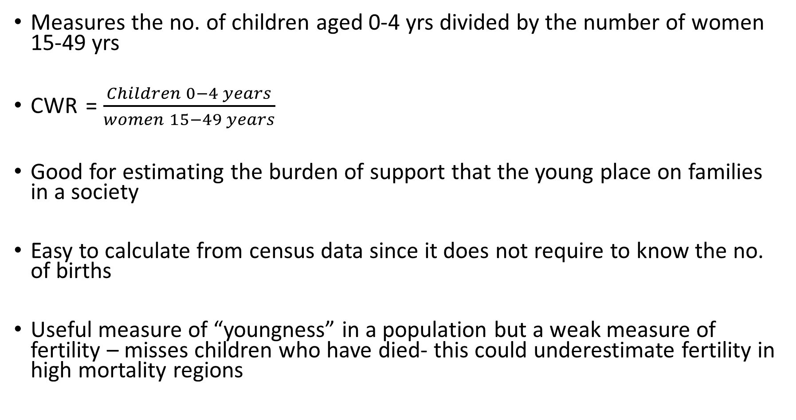
Example 3: Child Woman Ratio (CWR)

Slide 12
CWR [2]
Not a true measure of fertility – does not require one to know the number of births
Usually below 1…even in high fertility regions, it is slightly <1 because the high number of children are usually offset by the high number of young women with no children and also older women (those approaching menopause 45+) with no children 0-4 years.

Slide 13
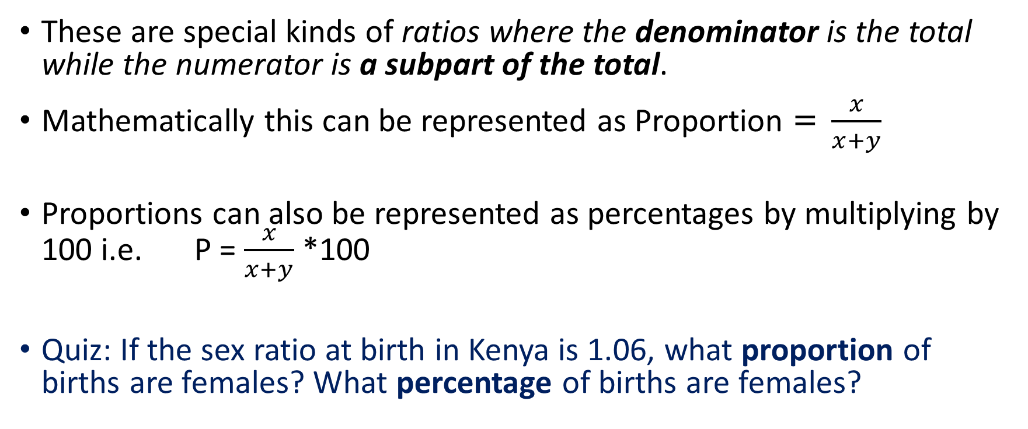
Proportions

Slide 14
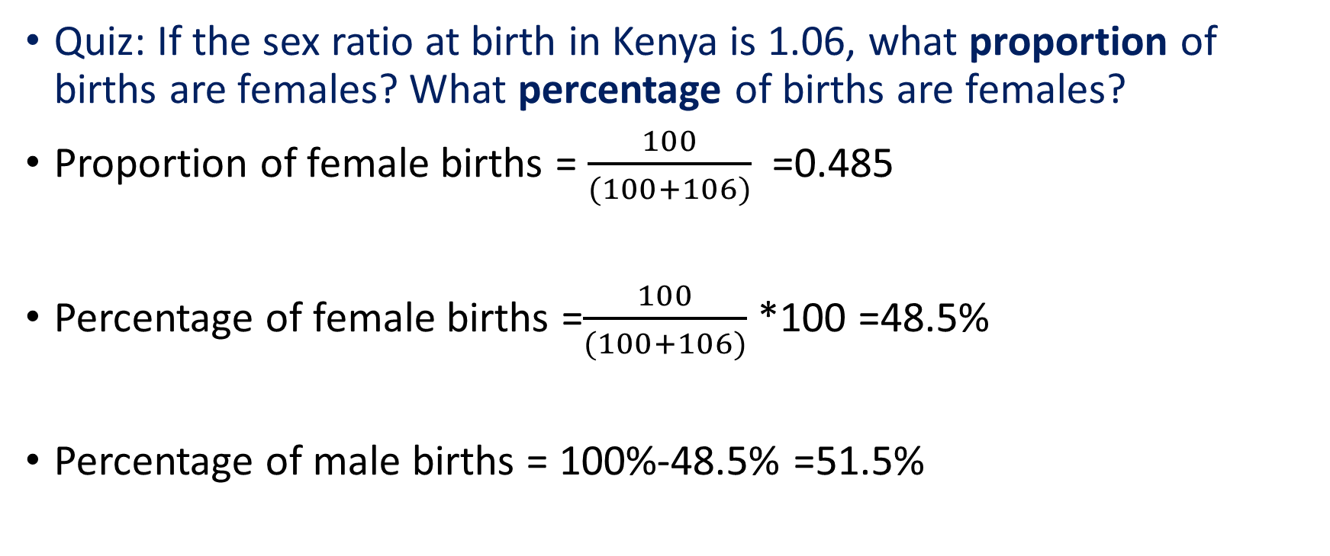
Solution to the Quiz

Slide 15
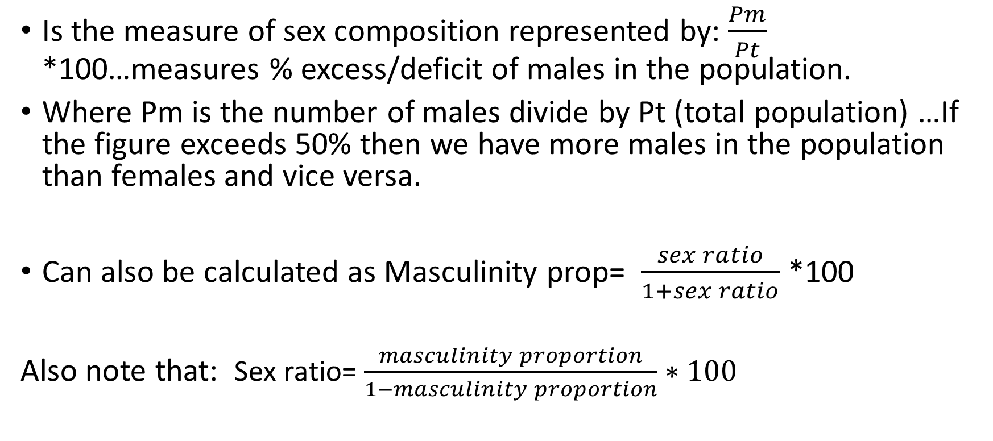
Masculinity proportion (Mp)

Slide 16
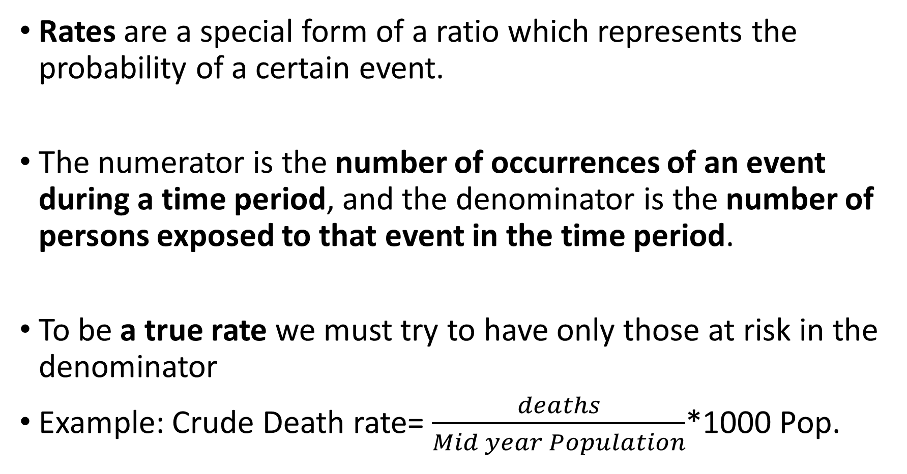
Rates

Slide 17
Quiz: In Eastern Kenya, 3825 people died in 2015 and the estimated population for Eastern Kenya on July 1, 2015 was 275,045 People. Calculate the CDR. Is CDR a true rate? Give reasons for your answer.

Slide 18
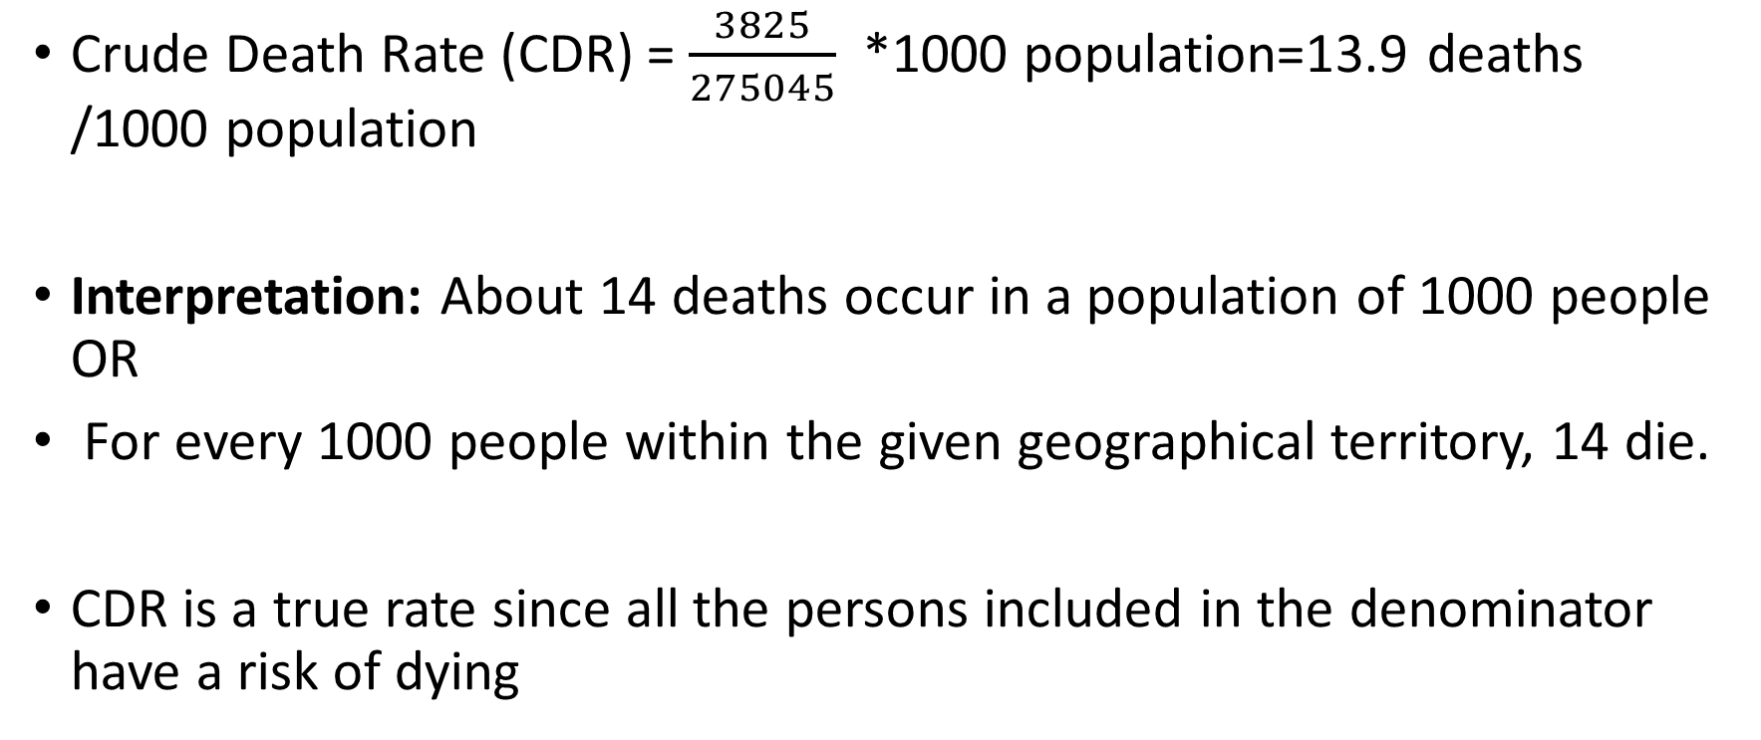
Solution

Slide 19
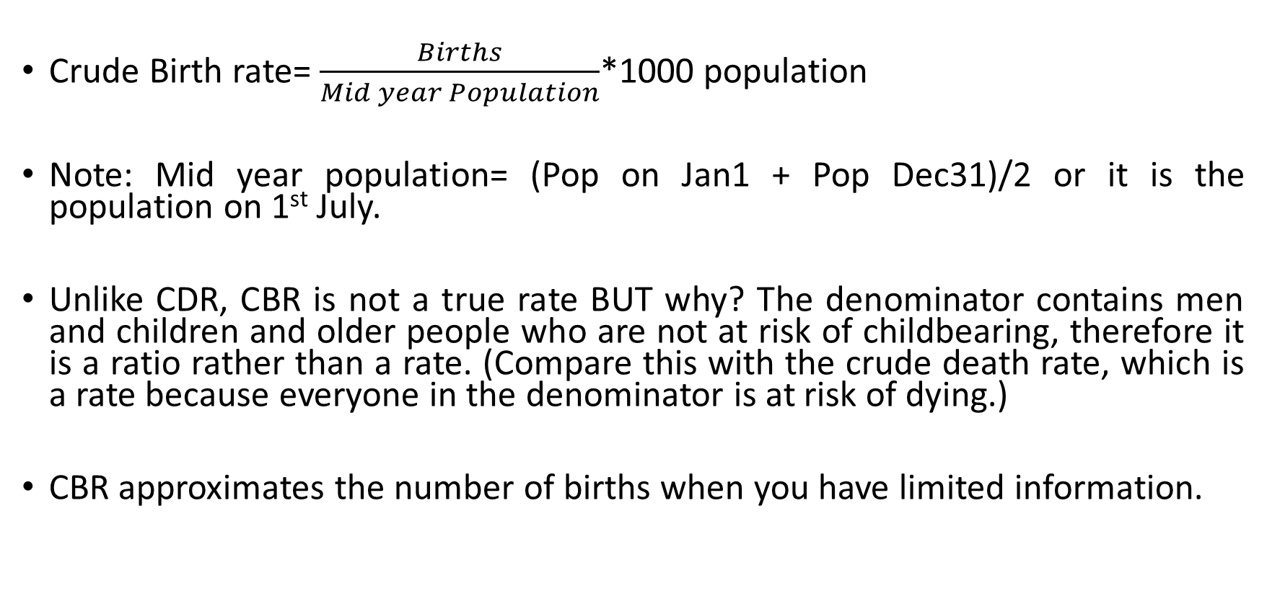
Example 2: Crude Birth Rate (CBR)

Slide 20
CBR [2]
The Crude Birth Rate is an important measure because of its place in the balancing equation/Demographic accounting equation (Pt =P0+births-deaths+I-O).
Accurate where there is complete vital registration system (provides figures for the numerator) and population census data (Denominator).
Disadvantages: Considers the total population in the denominator and treats all ages equally. BUT the driver of production of births is ONLY women aged 15-49 years and this group of women vary considerably in size between populations. Thus CBR “is confounded by age structure”. Because of this the CBR is not used as an accurate measure of fertility by demographers.
Still a useful measure because trends in the CBR will mirror actual fertility in a country
Values of the CBR range between 10 per thousand and 50 per 1000 population

Slide 21
Example 3: crude rate of natural increase (CRNI)
The crude rate of natural increase is the difference between the crude birth rate and the crude death rate
i.e. CRNI=CBR-CDR.
Since births normally exceed deaths, CRNI is usually positive. Unlike CBR and CDR which are expressed per 1000 population, the rate of natural increase is usually expressed as a percentage. A rate of natural increase of 18 per thousand is expressed as 1.8%.
i.e. = 18/1000*100 =1.8%.
Generally CDR and CBR in developing countries are much higher than in Developed countries. This is also true for crude rate of natural increase.

Slide 22
Extra notes(ignore)
Ratio- sex ratio, child dependency ratio, old age dependency ratio, age dependency ratio, child women ratio
Proportion - Masculinity Proportion- 3 formulas
Rates- CBR, CDR, CRNI

