Slide 1
Sources of demographic Data
Sam Wafula (PhD)
E-mail: swangila@yahoo.com

Slide 2
Learning objectives
Be familiar with the different sources of demographic data and their application in the medical field
Be knowledgeable on how different sources of data are collected
Know the strengths and weaknesses of each source of data

Slide 3
Population census
A complete enumeration of all persons in a given geographical space
One of the most complex undertakings by any country- a meticulous process with many steps
UN definition: Total process of collecting, compiling & publishing demographic, economic & social data pertaining at a specified time or times, to all persons in a country or delimited territory.”
Four attributes of a census
  Individual enumeration;
  Universality;
  simultaneity
  & periodicity (UN 1978).
Done decennially in most countries due to high cost
Must have a reference date e.g. in Kenya it is usually 24st August of the census year (e.g. 2009)
Censuses should give small area data, although coverage is not always certain

Slide 4
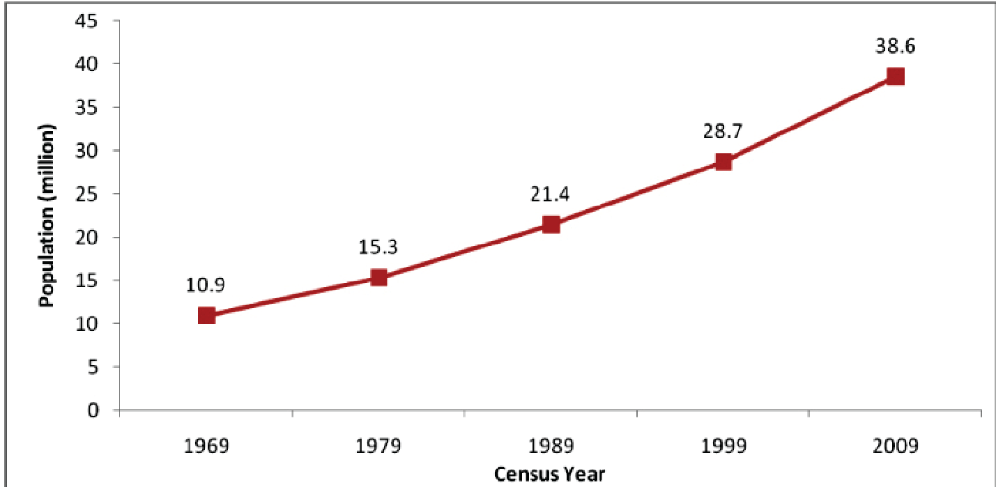
Post independence Censuses in Kenya

Slide 5
Examples of Data collected in a census
  Number of household members by gender,
  Relationship to the household head,
  age lived,
  Tribe,
  Religion,
  Marital status,
  Children ever born
  Place of residence
  Disability
  Economic activity,
  labour force participation rates,
  educational level,
  births last one year,
  deaths last one year, etc

Slide 6
Two approaches of carrying out a census
De jure
  Counting individuals at their legal residence without regard to whether or not they are physically present at the time of the census. “Your usual place of residence.”
De facto
Counting individuals wherever they actually are on the day of census. “Where you were on the census night?” It is much easier and economic.
Both of these fronts/approaches are critical in determining migration patterns.

Slide 7
Advantages of a population census
  Useful in making population projections- useful for planning and forecasting
  Important for indirect estimates of vital events (births, deaths and migration)
  Gives characteristic features of the population….is the population young? Is it ageing? ….etc….can be done by constructing a population pyramid...structure ish
  Can indicate any historical events that may have impacted on the population

Slide 8
Advantages [2]
Provides frame for later sample surveys
  Example: In Kenya we have a master sampling frame called the Fifth National Sample Survey and Evaluation Programme (NASSEP V). This is a frame that the KNBS currently operates to conduct household-based surveys throughout Kenya.
Provides population denominators
  Example: How do you calculate the adult HIV prevalence in Kenya or Maternal mortality rate?...You must know the denominator of the population at risk!

Slide 9
Disadvantages [1]
  Deficient in measuring rapid population change since it is taken decennially...a lot can happen in 10 years
  Not easily comparable between countries and sometimes within countries due to lack of standard data
  Information on internal migration is even more incomplete- does not capture more than one migration flow
  Expensive to carry out
    (China released 2010 census results (1.3 billion) and it used 10 million workers to successfully carry out the census---equivalent to the entire population of Belgium!)

Slide 10
Disadvantages [2]
Hard to count all people due to the mobile nature of people - but demographers have advanced ways of correcting under coverage or /under enumeration or over coverage/over enumeration
Too much time required for processing census data-may not fulfil immediate data needs due to delays between field work and results
Only a limited number of questions can be asked- lacks details
Sometimes politicized
Some countries take only a partial census e.g. Indonesia, determines her population based on just 10% of the population hence carries out a partial census.

Slide 11
Surveys
A [representative] subset of the population or count
Able to provide vital information within a much shorter period as compared to the census
More detailed than census hence can collect more data on demographic events e.g. fertility, fertility behaviour and preferences, mortality and migration, educational patterns, Female Genital cutting/Mutilation, Gender and domestic violence, etc
Can produce more timely results to inform decision making

Slide 12
Types of Surveys
check this ish????
 Single-round retrospective
- Census-type household surveys
- Focused, e.g. Contraceptive
Prevalence Survey (CPS)
- Birth/Maternity history (World Fertility
Survey (WFS), Demographic and Health
Survey (DHS)
  Multi-round follow-up (prospective)

Slide 13
Examples of demographic surveys done in Kenya
Kenya Fertility survey (KFS 1977/78)
Kenya Contraceptive Prevalence Survey (1984)
Kenya Demographic and Health Surveys 1989, 1993, 1999, 2003, 2008/09, 2014/2015
In the KDHS 2014/15, Demographic statistics were computed at regional level and analysis can be done at county level and thus can allow for comparisons

Slide 14
Discussion question:
What are the strengths and limitations of demographic surveys?

Slide 15
Advantages
 Single-round retrospective
- Can be quick
- Relatively inexpensive
- Flexible
- Can include detailed data
- Needs little continuity effort

Slide 16
Advantages
 Multi-round prospective
- Some control on coverage and content
errors
- Follow-up allows control for sampling
distortion

Slide 17
Disadvantages
 Single-round retrospective
- Coverage and content errors
- Misses certain types of events
 Multi-round prospective
- Slow
- Needs continuity of effort over extended time
- High cost

Slide 18
Summary
 Surveys are done to obtain information
from a sample representative of some
population
 Surveys are of a smaller size than a
census, which allows for collection of more
in-depth information that can then be
generalized
 There are many types of surveys

Slide 19
Summary
 The sampling method used in surveys is
often multistage (e.g., household within
cluster, themselves taken within strata)
 Surveys are less expensive than censuses
and civil registration (smaller size allows for
quick collection of more in-depth
information than any of the other two
systems)
 They have advantages and disadvantages

Slide 20
Civil registration
Relatively modern concept in its present format
Churches especially in the Western world have long maintained baptism and burial registries
  E.g. analysis of Parish registers
Entails a continuous, permanent, compulsory and universal recording of the occurrence and characteristics of vital events (e.g. live births, deaths, marriages and divorces) pertaining to the population as provided through decree or regulation in accordance with the legal requirements of a country.

Slide 21
Civil/ vital registration system
Recording of vital events as they occur (births, deaths, migrations, marriage, etc) often through a central government agency.
For statistical purposes, the standard of completeness of birth and death registration has been arbitrarily set at 90 percent or more BUT the Method of determination of completeness is left to individual countries?????
Characteristics – Continuous & Universality

Slide 22
Civil/ vital registration system
Purpose of Civil Registraton is primarily administrative but can also be for purposes of health programming e.g. in Kenya there is the ongoing promotion of MNCH services through linking MNCH services with CRVS.
Helps in understanding demographic Characteristics of different populations at different points in time
Collects data on livebirths, deaths, marriage and divorce as they occur
All live-born infants should be registered and counted as such irrespective of gestational age or whether alive or dead at
time of registration, and if they die at any time following birth they should also be registered and counted as deaths

Slide 23
Live birth registration
Date of occurrence
Place of occurrence
Date of registration
Type of birth/delivery
Names of the child and parents
Sex of the child

Slide 24
Other challenges -VR
Systems weak and incomplete in most LDCs
  UNICEF (2012) estimates that 51 million children per year are not registered at birth
  Incomplete
    Small proportion of births occur in a health facility setting
    Most marriages are customary/traditional hence no certificates issued
    Not all burials have death certificates; A large proportion of children do not have birth certificates
Low utilization of vital statistics by policy decisions
Limited access to registration facilities
Limited knowledge by public on the importance of VR
Low political will ---inadequate funding of VR
Weak monitoring and supervision mechanisms

Slide 25
How can VRS coverage be improved?
Strengthen partnerships:- jointly organize CR campaigns with other health promotions e.g. Polio/IMCI campaigns, etc
Train CHWs / CHEWs to collect info. on vital events
Collaboration with the KNBS to pilot a Community Population Register
Use of mass media e.g. mobile phones (SMS) to increase public awareness on the importance of VRS
Computerize the system of collection/storage of vital events
Training and scaling up of verbal autopsy nation-wide

Slide 26
Service data or statistics
Health facility Data
  Number of patients seen by location, age, gender, etc
  Under-five children treated for Malaria, diarrhea, etc
  Number of mother’s visiting the clinic for ANC, health facility deliveries, etc
Problems with service data /statistics
  Poor record keeping
  Very little analysis if any, is done to inform decision making at the facility level
  No automation hence no real time summaries

Slide 27
Population registers
These are detailed records of all persons often done by a central government agency.
Registration is done of all events of a person e.g. sex, race, age, marriage, occupation, etc.
System keeps personal registers and updates them continuously as events occur.
Requires accurate addresses systems for all persons in a geographical location
Done in Japan, Taiwan, Israel and some Scandinavian countries (Denmark, Netherlands, etc). Not common in other countries.
Expensive to maintain & also difficult and tedious to administer

Slide 28
International sources of data
UN demographic year books
Human Development Index
Immigration data
WHO statistics
Demographic surveillance sites – Matlab site in Bangladesh; INDEPTH network

