Slide 1
Measures of fertility and reproduction
Rithaa Gilbert
School of Public Health; UON
E-mail: rithaag@gmail.com

Slide 2
Learning objectives
Understand the various approaches of measuring fertility
Calculate the common measures of fertility
Be able to discern the advantages and disadvantages of each measure of fertility

Slide 3
Fertility measures
Crude Birth Rate CBR
Child Woman Ratio CWR
General Fertility Rate GFR
Age-specific Fertility Rates ASFRs
The Total Fertility Rate TFR
Parity Progression Ratios PPR

Slide 4
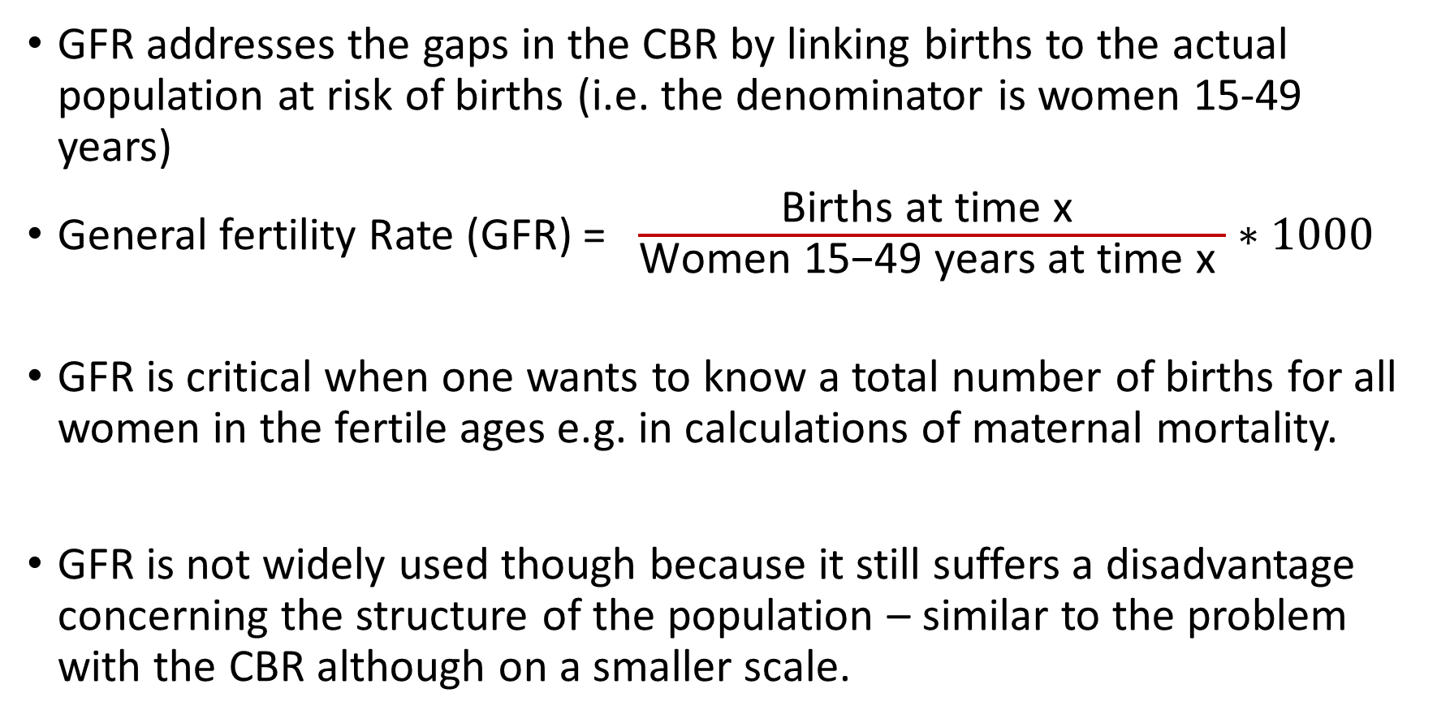
General Fertility rate (GFR)
GFR addresses the gaps in the CBR by linking births to the actual population at risk of births (i.e. the denominator is women 15-49 years)
General fertility Rate (GFR) = $\frac{\text{Births} \text{at} \text{time} \text{x} }{\text{Women}\text{ 15−49 }\text{years} \text{at} \text{time} \text{x} }∗1000$
GFR is critical when one wants to know a total number of births for all women in the fertile ages e.g. in calculations of maternal mortality.
GFR is not widely used though because it still suffers a disadvantage concerning the structure of the population – similar to the problem with the CBR although on a smaller scale.

Slide 5
GFR [2]
Problem: Fertile ages are nominally 15-49 years – is 35 years wide but within that range there can be substantial differences in age structure between populations. Because fertility is concentrated at certain ages populations can appear to have different levels of fertility simply because they have different age structures between ages 15-49 years.
For international or secular comparisons one wants to have a measure that is independent of age structure and the GFR is not quite there.

Slide 6
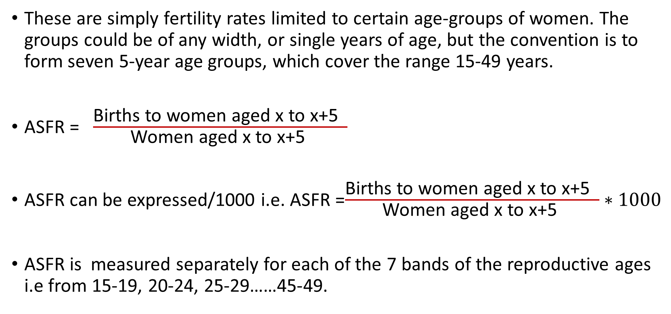
Age specific fertility rate [ASFR]
These are simply fertility rates limited to certain age-groups of women. The groups could be of any width, or single years of age, but the convention is to form seven 5-year age groups, which cover the range 15-49 years.
ASFR = $\frac{\text{Births} \text{to} \text{women} \text{aged} \text{x} \text{to} \text{x}\text{+5 }}{\text{Women} \text{aged} \text{x} \text{to} \text{x}\text{+5 }}$
ASFR can be expressed/1000 i.e. ASFR =$\frac{\text{Births} \text{to} \text{women} \text{aged} \text{x} \text{to} \text{x}\text{+5 }}{\text{Women} \text{aged} \text{x} \text{to} \text{x}\text{+5 }}∗1000$
ASFR is measured separately for each of the 7 bands of the reproductive ages i.e from 15-19, 20-24, 25-29……45-49.

Slide 7
Quiz: The table below shows the population of Uganda in 1991. Calculate the ASFRs & comment on your answer
Age Group | Number of Women | No. of Live births | ASFR
15-19 | 936480 | 133901 | ??
20-24 | 815627 | 250361 | ??
25-29 | 673084 | 204436 | ??
30-34 | 479915 | 122778 | ??
35-39 | 353079 | 67755 | ??
40-44 | 280223 | 24475 | ??
45-49 | 233088 | 6089 | ??

Slide 8
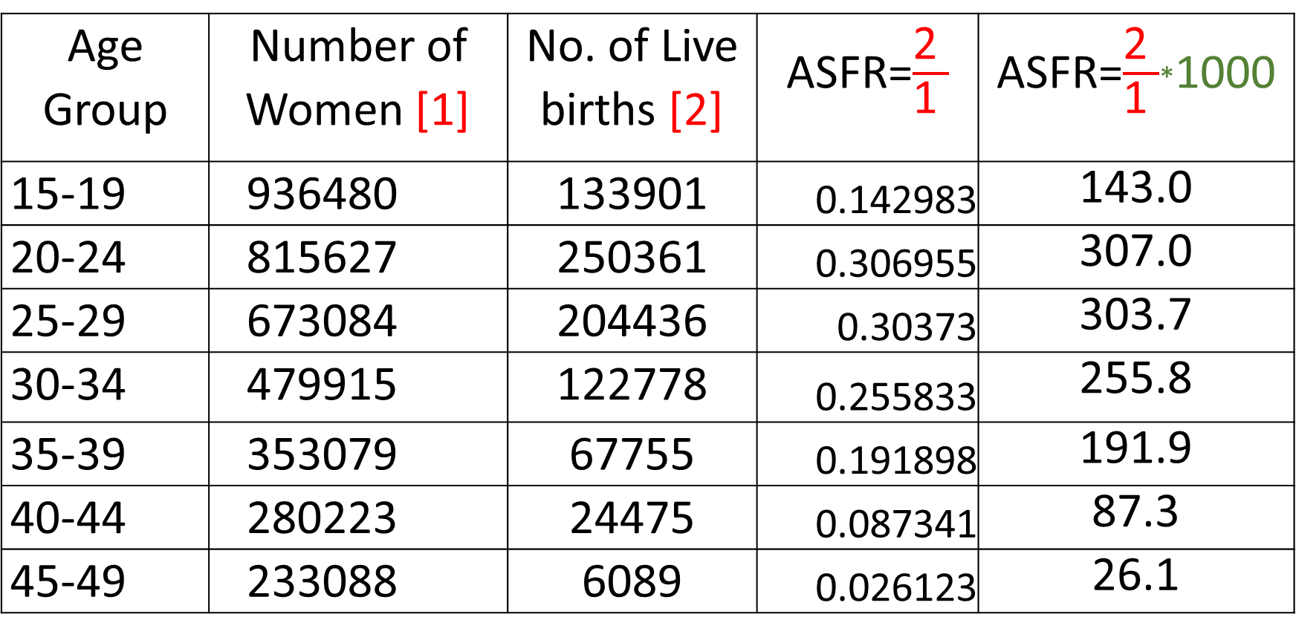
Quiz: The table below shows the population of Uganda in 1991. Calculate the ASFRs & comment on your answer
Age Group | Number of Women [1] | No. of Live births [2] | ASFR=$\frac{\text{2 }}{\text{1 }}$ | ASFR=$\frac{\text{2 }}{\text{1 }}$*1000
15-19 | 936480 | 133901 | 0.142983 | 143.0
20-24 | 815627 | 250361 | 0.306955 | 307.0
25-29 | 673084 | 204436 | 0.30373 | 303.7
30-34 | 479915 | 122778 | 0.255833 | 255.8
35-39 | 353079 | 67755 | 0.191898 | 191.9
40-44 | 280223 | 24475 | 0.087341 | 87.3
45-49 | 233088 | 6089 | 0.026123 | 26.1

Slide 9
…Sets of ASFRs and their associated graphs are commonly known as fertility schedules

Slide 10
Fertility peaks up at 20-24 and 25-29 years worldwide

Slide 11
Uses of ASFR
Is a measure of the age pattern of fertility, i.e. it tells us which age of women is contributing more to childbearing and vice versa. Hence allows us to compare fertility behavior at different ages
It is a useful first step in the computation of the Total Fertility Rate (TFR)
Allows comparison of fertility at different ages over time
Can compare fertility across countries/populations

Slide 12
Total Fertility Rate
TFR is the total number of children a woman would have if she lived through her reproductive life and experienced the ASFRs of the period in question.
The phrase "would have" suggests the measure is theoretical – and indeed it is! It is an example of a synthetic cohort meaning it is not the experience of a real cohort moving from year to year. The measure (usually) relates to a single year.
TFR is a very useful measure since it is not affected by the age structure of the population
In fact it is the best single measure for comparing populations across regions
Does not give a measure of actual number of births any woman will have all through her reproductive years

Slide 13
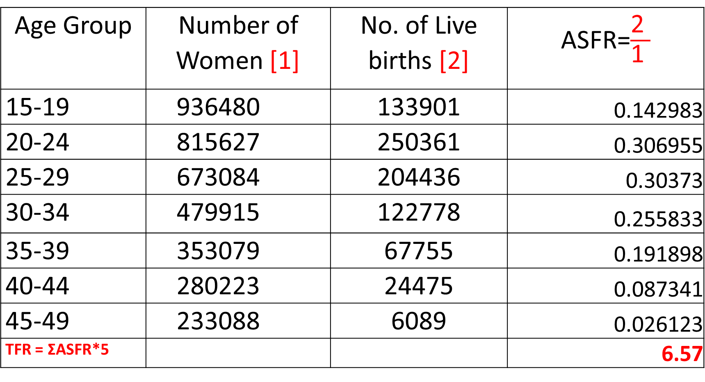
Total Fertility Rate [TFR]
Age Group | Number of Women [1] | No. of Live births [2] | ASFR=$\frac{\text{2 }}{\text{1 }}$
15-19 | 936480 | 133901 | 0.142983
20-24 | 815627 | 250361 | 0.306955
25-29 | 673084 | 204436 | 0.30373
30-34 | 479915 | 122778 | 0.255833
35-39 | 353079 | 67755 | 0.191898
40-44 | 280223 | 24475 | 0.087341
45-49 | 233088 | 6089 | 0.026123
TFR = ΣASFR*5 |  |  | 6.57

Slide 14
Class Assignment
1. What is the current TFR according to the Kenya Demographic and Health Survey of 2014?
2. Which county has the lowest TFR in Kenya?
3. Which County has the highest TFR in Kenya?

Slide 15
INDICATORS OF REPRODUCTION

Slide 16
Gross Reproduction Rate (GRR)
Average number of daughters that would be born to a woman during her lifetime if she passed through her child-bearing years conforming to the age specific fertility rates of a given year.
Note: GRR is exactly like TFR, except that it counts only daughters and literally measures “reproduction”– a woman reproducing herself in the next generation by having a daughter.
Let B^{f} = Number of female births
B^{m+f} = Number of male and female births i.e. all births

Slide 17
GRR Cont’d
GRR = TFR ∗ (Proportion of female births)
GRR = TFR * Proportion of female births

Slide 18
GRR Cont’d
GRR, like TFR, assumes that the hypothetical cohort of women pass from birth through their reproductive life without experiencing mortality.
This assumption is satisfactory when one wants to compare levels of fertility and/or gross reproduction across populations and over time.
But, for a more realistic assessment of the reproductive potential of a population, taking into account mortality, one needs to calculate the Net Reproduction Rate (NRR).

Slide 19
Net Reproduction Rate (NRR)
NRR is the average number of daughters that would be born to a woman if she passed through her life-time from birth to the end of her reproductive years conforming to the age-specific fertility and mortality rates of a given year
NRR is always lower than GRR, because it takes into account the fact that some women will die before entering and completing their child-bearing years.
Correspondingly NRR will be less than half the magnitude of the TFR.
NRR=GRR*SURVIVAL PROBALITIES AT AGES 15-49 YEARS

Slide 20
NRR
If the GRR is 3.2 and the survival probability of a woman aged 15 years to age 50 is 0.87, what is the net reproductive rate?
NRR = 3.2* 0.87 =2.8
INTERPRETATION: On average, a set of 10 women will give birth to 28 daughters by the time they complete their reproductive life taking into account the effect of mortality.

Slide 22
Replacement Fertility
Replacement Level Fertility is said to have been reached when NRR=1.0
– Surviving women in the hypothetical cohort have exactly enough daughters (on average) to replace themselves in the population
At this time GRR>1 and TFR>2. (Roughly, this is when couple have an average of two children.)
Replacement level fertility is normally estimated at 2.1 livebirths

Slide 23
Relationship between Reproduction Measures and Population Growth
Population momentum is the propensity for a population to grow for many years after fertility declines to reach the replacement level of the “two-child family”. (TFR ~2.1 and NRR=1.0).
This population momentum during the fertility transition is a function of young age structure of the population due to high levels of fertility in the past.

