Slide 1
ENVIRONMENTAL HEALTH
Topic: Global Warming
Students: MBCHB V
Facilitator: Mary Kinoti
Date: 4th /06/2020
Venue: Online
Time: 11.30 am - 12.30 pm

Slide 2
Objectives
By the end of the lesson the learner will be able to:
Define the term global warming
Outline layers of the atmosphere and their xteristics
List the green house gases
Describe the process of global warming
Explain the direct and indirect effects of global warming

Slide 3
Definition
Gradual increase in the overall temperatureof the earth’s atmosphere attributed to the green houses gaseseffect caused by increased anthropogenic activities

Slide 4
Structure of the atmosphere
LAYER | ALTITUDE(km) | TEMPERATURE(Oc)(KM above sea level | COMPOSITION
TROPHOSPHERE | 16 at the equator and 8 at the poles | TEMP DECREASE WITH ALTITUDEAT 6.5 DEGREES CELSIUS /KM | mainly molecules e.g water, and cpds e.glead oxide etc.
STRATOSPHERE | 12(16) – 50 | At about 20kms temperature increases with altitude | gases, OZONE water vapour , methane
MESOSPHERE | 50- 90 | TEMPERATURE DECREASES WITH ALTITUDE
THERMOSPHERE | 90+ | TEMPERATURE INCREASES WITH ALTITUDE | ions

Slide 5
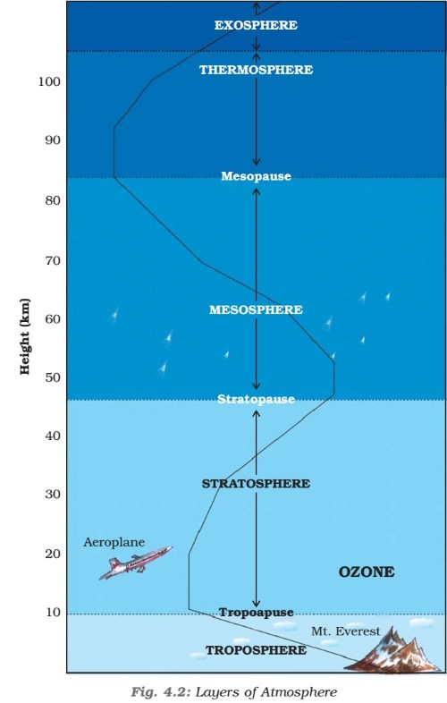
Vertical structure of the atmospherehttps://images.search.yahoo.com/yhs/search;_ylt

Slide 6
Green House Gases
Carbon dioxide
Methane
Water Vapour
CFCs

Slide 7
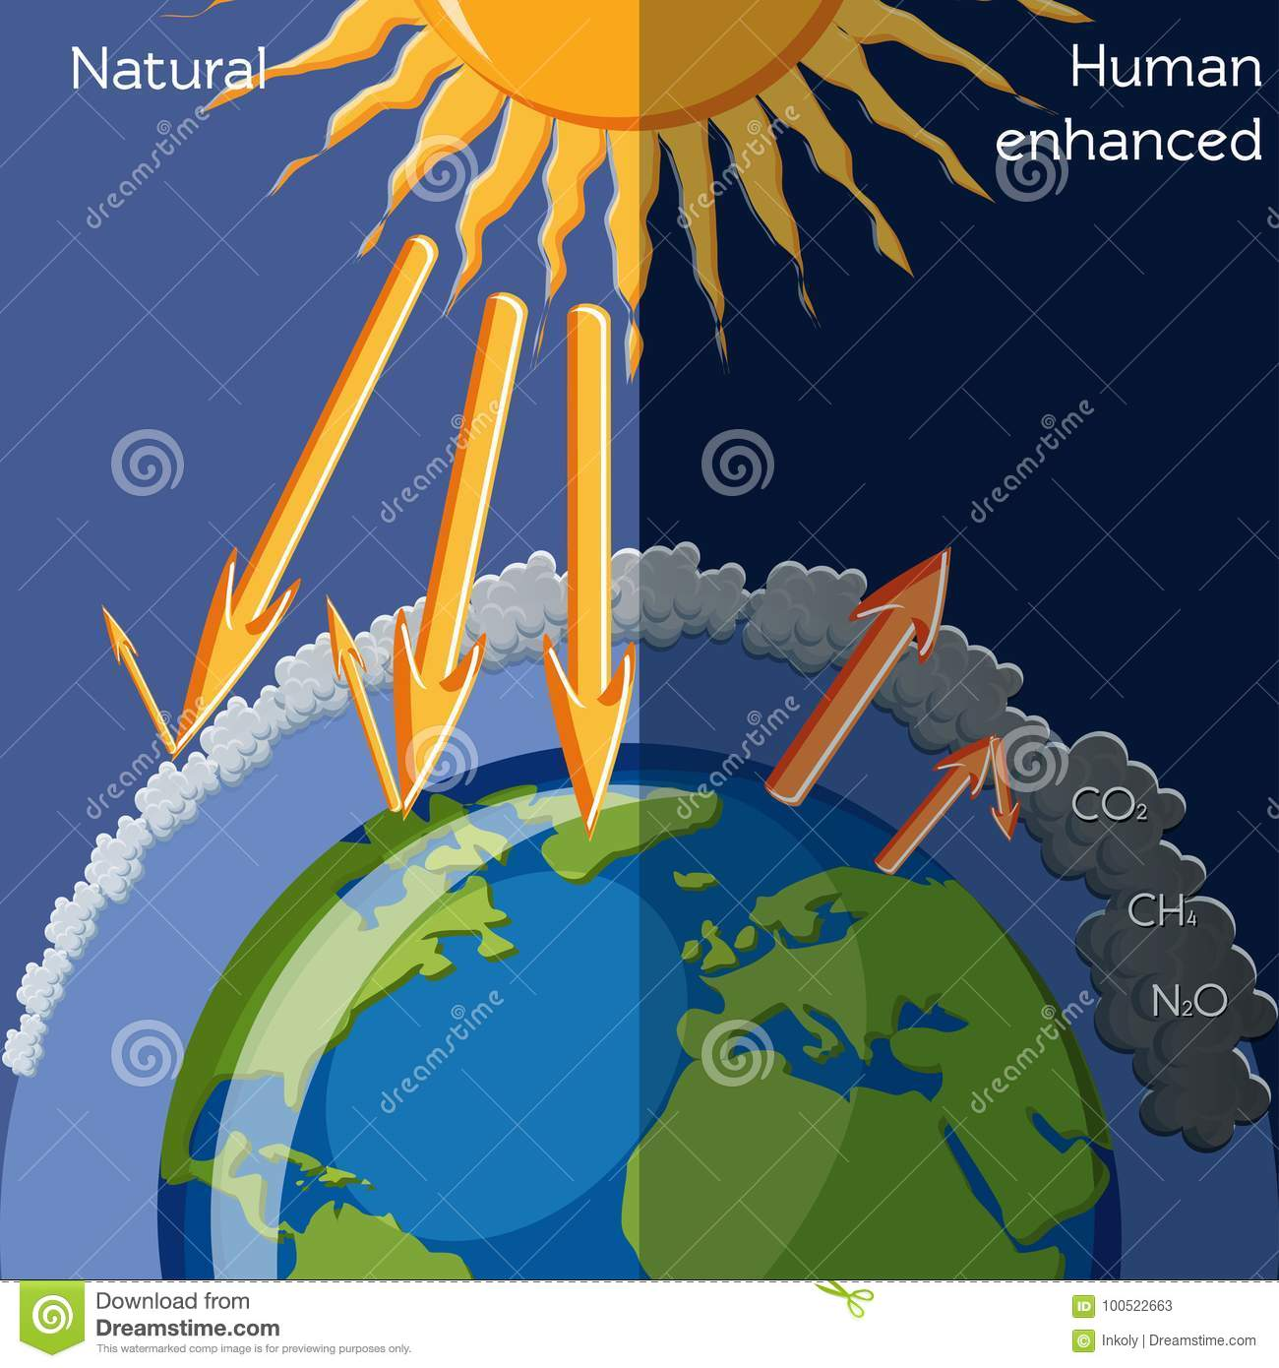
Global warming process: https://images.search.yahoo.com/yhs/search;_ylt=AwrC4SvOFthe33QApwYPxQt.;

Slide 8
Impacts of global warming
Melting of Ice leads to increase in sea level Flooding
Drought Famine
Heat waves- heat exhaustion , strokes agravite medical conditions.
Increase in wild fires- threat to wildlife
Increase in vectors of Diseases(eg. Anopheles mosquitoes)increase in malaria
Increase in crop pests – food insecurity – malnutrition
Change in weather predicability

Slide 9
Mitigations against & adaptation and Mitigation of Global Warming
When it comes to tackling climate change to prevent the impacts it causes in the different systems of the planet, the human being applies two types of measures: mitigation and adaptation Mitigation
efforts to reduce or prevent emission of greenhouse gases: either by reducing sources of these gases (for example, the burning of fossil fuels for electricity, heat or transport) or enhancing the “sinks” that accumulate and store these gases
Adaptation
reducing vulnerability to the effects of climate change.

Slide 10
Mitigations against & adaptation and Mitigation of Global Warming
Mitigation:
Reducing emission of GHS
Upscaling sinks that accumulate theses gases
Adaptation
Reducing vulnerability by disaster preparedness
R &D for pest resistant crops
Aradiction of malaria(vaccine)

Slide 11
Questions

Slide 12
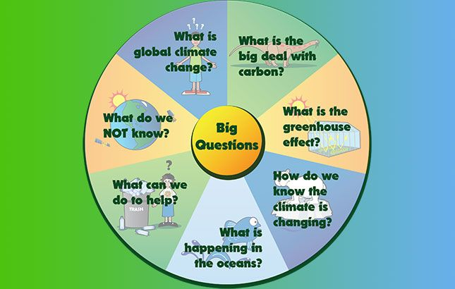
Questions Continued

