Slide 1
ENVIRONMENTAL HEALTH
BY: Mary K. Kinoti
TOPIC: Housing and Health
STUDENTS: MBCHB II
DATE: 31th March, 2011
Class: MBCHB II
VENUE: MH II (Chiromo)

Slide 2
Definitions
Health is a state of complete physical, mental and social well-being and not merely the absence of disease or infirmity" (WHO definition, 1948).Housing conditions, do affect physical, mental and social well-being of residents

Slide 3
Definitions cont’d
What is healthy housing?
Healthy housing is a broad concept and WHO takes a holistic and interdisciplinary approach. There is no universally agreed definition of healthy housing, but it does not mean a specially designed visionary house, it simply means a home that provides an environment that is safe, comfortable and hygienic.

Slide 4
Facts and figures
According to WHO(1992) report, 600m urban dwellers and >1000M rural inhabitants, live in life-threatening houses and conditions.Studies in U.S have shown that:
11 million injuries annually
4m occurring in homes.
Highest among 1-4 yr olds
<yr old, 93.5% of all deaths due to injury occuring in homes
<5yrs and elderly at highest risk.

Slide 5
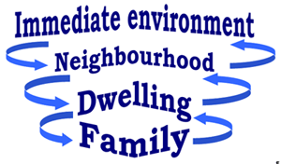
Four Dimensions of Housing(WHO, 1992)

Slide 6
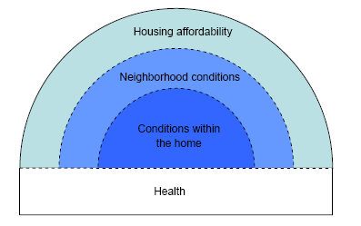
Research in housing and health(Commission on health .org) by Robert Wood Johnson foundation

Slide 7
Conditions within homes (Robert Wood Johnson study) Cont’d
Good physical and mental health depends on having homes that are safe and free from physical hazards. When adequate housing protects individuals and families from harmful exposures and provides them with a sense of privacy, security, stability, and control, it can make important contributions to health. In contrast, poor quality and inadequate housing contributes to health problems such as infectious and chronic diseases, injuries, and poor childhood development.

Slide 8
Conditions within homes (Robert Wood Johnson study) Cont’d
e.g
Lead poisoning irreversibly affects brain and nervous system development,resulting in lower intelligence and reading disabilities. An estimated 310,000 children ages one to five have elevated blood lead levels.
Substandard housing conditions such as water leaks, poor ventilation, dirty carpets and pest infestation can lead to an increase in mold, mites and other allergens associated with poor health. Indoor allergens and damp housing conditions play an important role in the development and exacerbation of respiratory conditions including asthma, which currently
affects over 20 million American

Slide 9
Conditions within homes (Robert Wood Johnson study) Cont’d
Housing can be a source of exposure to various carcinogenic air
pollutants. Radon, a natural radioactive gas released from the ground, has been associated with lung cancer; an estimated one in 15 homes has elevated radon levels. Residential exposure to environmental tobacco smoke, pollutants from heating and cooking with gas, volatile organic compounds and asbestos have been linked with respiratory illness and some types of cancer.

Slide 10
Conditions within homes (Robert Wood Johnson study) Cont’d
Each year, injuries occurring at home result in an estimated 4 million emergency-department visits and 70,000 hospital admissions. Contributing factors include structural features of the home such as steep staircases and balconies, l

Slide 11
Conditions within homes (Robert Wood Johnson study) Cont’d
Residential crowding has been linked both with physical illness, including infectious diseases such as tuberculosis and respiratory infections and with psychological distress among both adults and children; children who live in crowded housing may have poorer cognitive and psychomotor development or be more anxious, socially withdrawn, stressed or aggressive.

Slide 12
Neighborhood conditions and health Robert Wood Johnson study) Cont’d
The social, physical, and economic characteristics of neighborhoods have been increasingly shown to affect short- and long-term health quality and longevity. A neighborhood’s physical characteristics may promote health by providing safe places for children to play and for adults to exercise that are free from crime, violence and pollution.

Slide 13
Neighborhood conditions and health Robert Wood Johnson study) Cont’d
Access to grocery stores selling fresh produce–as well as having fewer neighborhood liquor and convenience stores and fast food outlets—can make it easier for families to find and eat healthful foods

Slide 14
Neighborhood conditions and health( Robert Wood Johnson study) Cont’d
Social and economic conditions in neighborhoods may improve health by affording access to employment opportunities and public
resources including efficient transportation, an effective police force, and good schools. Neighborhoods with strong ties and high levels of trust among residents may also strengthen health.

Slide 15
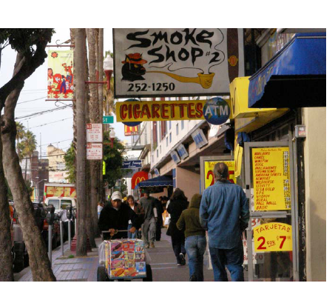
Conditions in the neighborhood detrimental to health(Robert Wood Johnson study)

Slide 16
Housing affordability and health
The shortage of affordable housing limits families’ and individuals’ choices about where they live,often relegating lower-income families to substandard housing in unsafe, overcrowded neighborhoods with higher rates of poverty and fewer resources for health promotion (e.g., parks, bike paths, recreation centers and activities). The
financial burden of unaffordable housing can prevent families from meeting other basic needs including nutrition and health care, and is particularly significant for low income families

Slide 17
Housing affordability and health
Housing is commonly considered to be “affordable” when a family spends less than 30 percent of its income to rent or buy a residence. An estimated 17 million households in the United States pay more than 50 percent of their incomes for
housing.24 It is important to note that a given percentage of income can reflect very different burdens depending on a family’s overall level of financial resources— having 50% of a $200,000 annual salary left to spend after covering housing costs provides a very different set of options than having 50% of a $19,000 annual salary left.

Slide 18
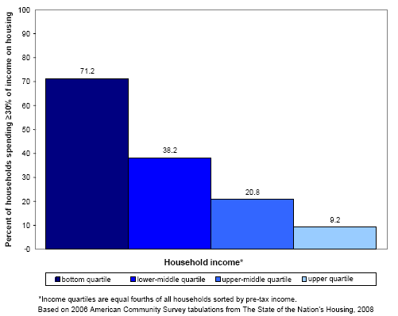

Slide 19
Negative Effects of poor housing
Poor design or construction of homes cause many accidents.
Indoor pollutants or mould cause asthma, allergies or respiratory diseases. Use of the proper building materials and construction might prevent these diseases.
Every tenth lung cancer case results from radon in the patient’s home in US. Appropriate design can prevent both exposure and the risk to health.
reduce health problems associated with exposure to allergens, neurotoxins, and other dangers in the home by allowing families to access better quality housing;
increase residential stability, allowing families to avoid unwanted moves that lead children to change schools, which may impair their educational progress;

Slide 20
Negative Effects of poor housing
Increase in residential crowding and other sources of housing-related stress that lead to negative developmental and educational outcomes for children.
experience of multiple housing deprivation increased the risk of severe ill-health or disability across the life course by 25% on average.
homelessness and unstable housing "increase the risk of HIV acquisition and transmission and adversely affect the health of people living with HIV." ….. "homelessness should be treated as a major public health issue

Slide 21
Features for Adequate Housing(WHO,1992)
The structure of the shelter
Adequate provision water provision
Adequate provision for waste disposal
Safe housing structure
Overcrowding
Absence of Indoor air pollution
Food safety standards
Absence of vectors and hosts of disease
Home as a workplace

Slide 22
WHO Features Continued
The structure of the shelter
Includes the extent to which the shelter protects the occupants from extremes of heat , cold, noise, invasion of dust, rain, insects and rodents e.g. Transmission of chagas disease.
Infection most often occurs in low income families in rural areas where poor housing conditions provide breeding sites for the disease vector.risk to infection can be reduced by spraying insecticide and housing improve housing e.g. by plastering to reduce resting and breeding sites of the vectors.

Slide 23
Adequate water supplies
qualitatively
Waterbone diseases
quantitatively
- water washed diseases

Slide 24
Adequate provision for waste disposal
Liquid, excreta and solid wastes
Diseases such as Leptospirosis (mosby`s medical die 1990 ) i.e acute infectious disease caused by several serotypes of spirochette leptospira interrogaus transmitted in the urine of wild or domesticated animals especially rats and dogs.

Slide 25
Quality of housing site
Extent to which it is structurally safe for housing and provision is made to protect it from flooding, collapse and landslides.

Slide 26
overcrowding
The highest incidence of T.B tends to be among population living in the poorest of areas where families are usually large, overcrowded houses and nutrition levels low. overcrowded housing conditions and poor ventilation often means that T.B infection is transmitted to more than half of the family members.
Meningococcal meningitis is also an air-bourne infection in which overcrowding is probably a contributing factor.

Slide 27
indoor pollution from domestic fuel used
Combustion of biomass((wood, logging wastes, sawdust, animal dung, grass e.t.c ) produces hundreds of chemical cpd`s including suspended particulate matter, co, NOx, HC`s , aldehyds, benzene, phenol, toluene, PAHs e.t.c.
Respiratory symptoms and CO poisoning including respiratory cancer where women who spend 2-4 hours a day exposed are at a higher risk.
Respiratory infection-enhances susceptibility to inflammatory effects of smoke and fumes. (emphysema andchronic obstruction pulmonary disease {OPD})

Slide 28
Food safety standards
having adequate provision for storing food to protect it against spoilage and contamination

Slide 29
domestic and peridomestic disease vectors
The livig environment should have novectors of diseases, cockroaches, mosquitoes, midges and flies, sand flies e.t.c

Slide 30
Housing as a work place
Occupational health issues arise e.g
-use and storage of toxic or hazardous substances, and injuries from equipments
Exposure to noise and other occupational hazards,

Slide 31
Other housing features
Other housing features with a bearing on the state of health of occupants are:
Costs of housing-income inability to pay rent- migration to cheaper unfit housing
House/home tenure- stress caused by insecure tenure
Social aspects- influence sense of well-being and especially mental health & other psychosocial problems.

