Slide 1
Women’s health in the context of Social Development Goals
Prof. Joyce Olenja
School of Public Health
University of Nairobi
14 May 2018

Slide 2
What are Sustainable development Goals (SDGs)?
A framework of 17 goals and 169 targets across social, economic and environmental areas of development for the next 15 years(2015-2030)
They are about people-centred development and inclusivity-
    Leaving no one behind as the overarching principle
The 2030 agenda includes targets and reference to gender equality and women’s/and girls empowerment, sexual and RH rights-- going beyond the commitments of MDGs
Make specific reference to FP in goal 3(Health) and Gender equality and women’s empowerment in goal 5
In Kenya the SDGs are implemented through the existing planning framework - Vision 2030’s Medium Term Plans

Slide 3
The Regional Context
Africa has the highest burden of maternal ad child deaths
Health systems struggle to provide safe care for mothers and children
High population suffers from malnutrition
Climate change responsible for widespread famine
These challenges Cast a cloud on Africa’s ability to meet SDG3.

Slide 4
Kenya Policy Environment
Aligned to SDG Agenda 2030
Alignment to the constitution and vision 2030 through the social pillar
– aimed at transforming the country into a globally middle- income economy by the year 2030. In this strategic policy document, the role of the health sector is underscored – in ensuring a healthy and productive population for the economic development of the country.
Reproductive Health Policy(2017 under revision)
National Adolescent Sexual and Reproductive Health Policy
NCD prevention and control strategic plan (2015- 2020)
Cancer Prevention and Control Strategy (2017-2022)
Treatment guidelines for cancer and cardiovascular diseases as key strategic documents to guide the fight against NCDs in the country.

Slide 5
Kenya Policy Environment
The Kenya Health Policy 2012-30, which was developed in line with the Constitution of Kenya 2010 and the Kenya Vision 2030, highlights six priority policy objectives
  Eliminating communicable diseases
  Reducing the burden of non-communicable diseases
  Reducing the burden of injuries from violence and accidents
  Providing essential health services
  Reducing the health risk exposures
  Strengthening health sector collaboration with other sectors

Slide 6
What do SDGs mean for women’s health?
Women’s health is affected by each of the 17 SDGs
Health is both a determinant and outcome of sustainable development interventions
Women’s health intersects with all the SDGs- thus achieving the goals of SDGs would also mean an overall improvement in women’s health
    Many women, children and adolescents worldwide still have little or no access to essential, good-quality health services, education, clean air and water, adequate sanitation and good nutrition.
Yet- Women and girls can/will be key in achieving each of the SDGs based on their traditional roles as:
  Caregivers/nurturers
  Producers in agriculture- food security
  Investment in programmes that enhance access to relevant services and participation by women is key

Slide 7
SDG2- End hunger and secure food security
Globally, almost one third of employed women work in agriculture(more than 60 per cent of all working women in South Asia and Africa are in agriculture)
Only 13 per cent women are landholders.
Not having equal access to land or credit, technology and markets leaves many on the margins of subsistence agriculture.
When times are tough, gender discrimination means women and girls may be the first to eat less, even as they work harder to secure food for their households.
For pregnant and lactating women, inadequate food and poor nutrition imposes a risk of anaemia, a leading cause of death during childbirth.
  This calls for leveraging on the mutually reinforcing nature of SRH and nutrition programming to increase access to iron and folic acid, nutrition education and counselling services

Slide 8
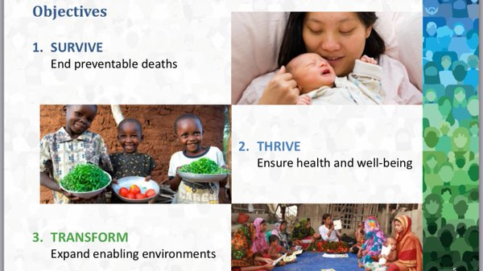
Women Health and Sustainable Development Goals

Slide 9
Sustainable Development Goal 3
  Ensure healthy lives and promote well-being for all at all ages
Targets(13)
  By 2030, reduce the global maternal mortality ratio to less than 70 per 100,000 live births
  By 2030, reduce neonatal mortality to at least as low as 12 per 1,000 live births
  End epidemics of AIDS, TB, malaria, NTDs combat hepatitis, waterborne diseases and other communicable diseases
  Achieve Universal health coverage

Slide 10
Women Health and Sustainable Development Goals

Slide 11
Global maternal mortality
Regional maternal mortality

Slide 12
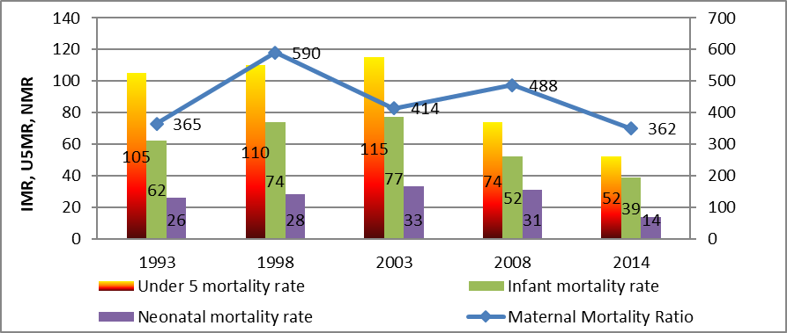
Trends in Maternal and Child Health Indicators
Kenya Health Policy 2014-2030

Slide 13
Maternal Health
Childbearing begins early in Kenya, with almost one-quarter of women giving birth by age 18 and nearly half by age 20.
Adolescents are least likely to have discussed family planning either with a fieldworker or at a health facility (KDHS 2014).
A majority of mothers in Kenya are adolescents who receive least RH information

Slide 14
Percent of Kenya women using a modern contraceptive method
Modern contraception use has increased by 24 percentage points in two and a half decades.
In 2017 alone, 1,472,000 unintended pregnancies were averted due to modern contraceptive use

Slide 15
Funding is insufficient to implement policies
The Kenya RMNCAH Investment Framework outlines a strategy to increase contraceptive use among married women to 70% and decrease teenage pregnancies to 11% by 2020
The plan estimated 3.5 Billion KSH was needed to implement the FP activities in 2017/18, however the national government only allocated 293 million KSH for FP in that fiscal year

Slide 16
County action is needed to achieve National FP Goals
All 47 counties expected to have a costed implementation plan (CIP) and FP budget line by 2020.
Among 11 counties surveyed in DSW’s 2017 FP budget analysis, only 2 of the counties have a budget line for FP and 9 counties have CIPs

Slide 17
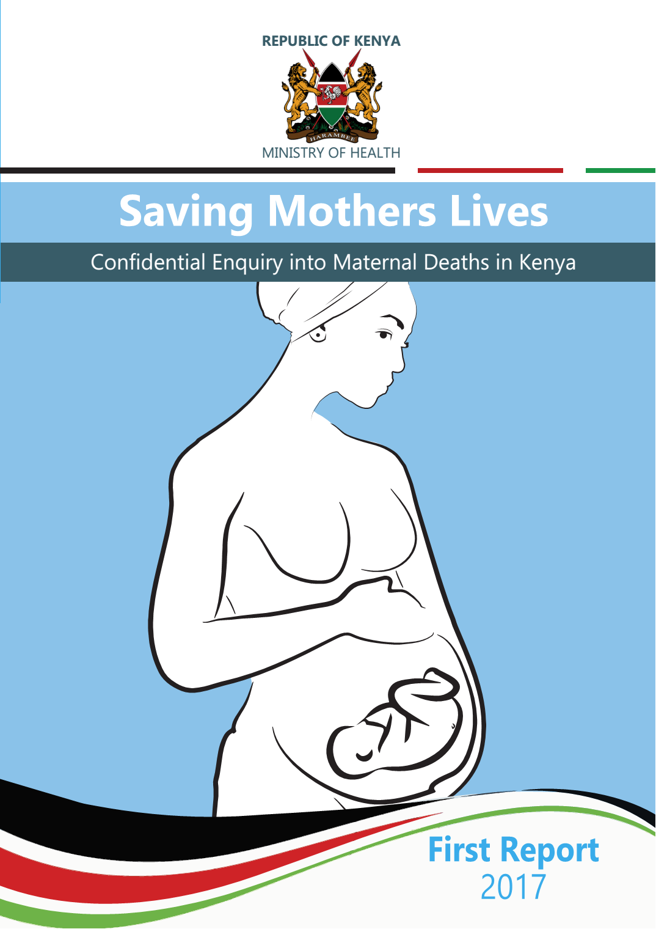
Confidential Enquiry into Maternal Deaths
For maternal deaths that occurred in 2014

Slide 18
Underlying causes of Maternal Death
Notes:
What is killing our women?

Slide 19
Assessment of quality of care

Slide 22
Non-Communicable Diseases
First National Survey on NCD Risk Factors (STEPs survey) in 2015.
25% of the population is neither on treatment or unknowingly living with high blood pressure and other heart diseases
Cervical cancer screening has remained quite low. In the KDHS 2014, only 18.8% of women 25-49 years had ever had cervical cancer screening.
In STEPS 2015, cervical cancer screening coverage rates were similarly low, with 14.2% of women 25-49 years ever screened.
Integrated Delivery of Care for NCDs Kenya Country Initiative; a guideline that adopts a multi-sectoral approach towards combating NCDs to be piloted in Trans-Nzoia,Uasin Gishu and Busia Counties in the next three years(Launched in March 2018).
    For lifestyle diseases(related to diet) women can play a key role in
    prevention- as primary decision-makers in food selection and preparation

Slide 23
SDG5: Gender Equality
A stand alone goal- this is significant
It is also crosscutting/intersecting with all the other SDGs
Many of the targets (9) under Goal 5 of the SDGs are embedded in cultural and social norms and values which pose a challenge to change.
Women’s empowerment as a pre-condition for addressing key challenges: poverty(SDG1), inequality and violence against women
Enhancing gender equality and empowering women is critical to achieving a broad range of the sustainable development
Empowering women and girls through education also allows them to be involved in decisions at all levels and influence the allocation of resources

Slide 24
Goal 5: Gender Equality
Aim
Issues to address
To empower women and girls to reach their full potential which requires eliminating all forms of discrimination and violence against them, including harmful practices.
Seeks to ensure that they have every opportunity for sexual and reproductive health and reproductive rights;
Harmful practices
  FGM- male driven
  Early marriage
  Sexual Gender based violence
  Food taboos/disproportionate division of food at household level by gender
Unmet need for FP
Teenage pregnancy

Slide 25
SDG 7: Access to affordable, reliable and sustainable energy
Women are primary energy managers in the household
At one level women contribute to deforestation/environmental destruction in search of energy but also suffer the consequences of poor energy
    Globally, more than 3 billion people cook with wood, dung, coal and other solid fuels on open fires or traditional stoves.
Africa continues to largely depend on unsustainably harvested traditional biomass energy in the form of charcoal and firewood as cooking fuels, both of which result in many deaths from indoor air pollution.
  responsible for respiratory infections among children
  Indoor pollution is also responsible for increased pregnancy loss
Indoor air pollution from using combustible fuels for household energy caused 4.3 million deaths in 2012, with women and girls accounting for 6 out of every 10 of these(UN Women, 2018)

Slide 26
Advocacy for clean energy
    If 50 per cent of people who use solid fuels indoors gained access to cleaner fuels, health-system cost savings would amount to US$165 million annually.
    Gains in health-related productivity would range from 17 to 62 per cent in urban areas and 6 to 15 per cent in rural areas
As part of rural technology that works for women:
    Advocate for clean energy: cooking gas, electricity
    More apt- Invest in solar energy for cooking (solar jiko) and lighting
    Investment in clean energy is a plus for women’s health and frees time for engagement in productive activities
    Clean energy safeguards the environment to halt deforestation (SDG 15)

Slide 27
What Opportunities to improve women’s health?
Universal health care- but what does this mean for women?
  Engagement with the county government for accountability
Advocacy
    Health literacy
    Advocacy for food security and good nutrition
Investment in FP as a ‘best buy intervention’ in development and health outcomes(SDG 3/5
Social Protection programmes
  Access to Government Procurement Opportunities (AGPO) - what do we do to ensure access?
Free Education- but what must we do to keep girls in school to improve transition and retention?(SDG4)
Gender responsive budgeting- to assure inclusivity(SDG 5)

Slide 28
What needs to be done
While the SDGs provide a framework for action, the capacity to use them to deliver results at the national level will depend on various factors, including:
    Political commitment and resource mobilization
    Allocation of adequate resources and the implementation of effective policies and programmes.
    Monitoring in order to ensure that global commitments become a reality for women and girls on the ground:
      A clear implementation and monitoring framework needs to be in place so that “no one is left behind”
Building and strengthening health system accountability:
    more efficient and inclusive health accountability systems
    Develop platforms for advocacy to improve health literacy among community members
    Investment in Improving health system data capacity

