Slide 1
DEVELOPMENT AND CONGENITAL ABNORMALITIES OF THE GENITAL TRACT
DR LUCY KABARE

Slide 2
GENDER IDENTITY
A-Normal sexual development and Gender identity is the end result of
Genetic
Hormonal
Morphological influence of the individual environment

Slide 3
B-Gonadal differentiation
Gonadal development starts 5th and 6thweek of embryonal life
Extragonadal primordial germ cells migrate 6th week from the wall of yolk sac to the gonadal ridges.
If it fails gonads do not develop

Slide 4
CONT- GONADAL DIFFERETIATION
Seven weeks gonads are indifferent but bipotential
Mesonephric duct system exist
Wolffian and mullerian ducts exist side by side
External genitalia are undifferentiated [7th week]
Male sexual differentiation requires influence of testes determining factor (TDF)

Slide 5
TESTES
Differentiation begins at 7 weeks spermatogenic cords,
and then seminiferious tubules form. 8th week – formation of laydig cells.
Recognition of male fetus
Regression of primitive mullerian ducts – 9th week
Differential of male external genitalia 10th week
testosterone biosynthesis occurs at 9 weeks peak levels at 16 weeks
HCG/LH of syncytiotrophoblast stimulates fetal laydig cells to secrete testosterone
NB: Testosterone – is the regulator of male differentiation of wolffian ducts, urogenital sinus and external genitalia

Slide 6
OVARIES
Lack of the Y chromosome - bipotential gonad develop to an ovary at 9 weeks. Purely genetic
11th – 12weeks – germ cells in the ovary enter meiotic prophase characteristic transition of oogonia into oocytes which marks the onset of ovarian differentiation
Meiotic division stops at the diplotene stage, the chromosome enters a resting stage until meiosis is completed just before ovulation.
The formation of primodial follicles reaches a maximum at 20 weeks – 25 weeks when the gonad has morphologic characteristics of a definitive ovary.
At birth one to two millions germ cells remain

Slide 7
DUCT SYSTEM DIFFERENCIATION
The wolffian and mullerian ducts temporarily co-exist during the undifferentiated period.
During the third fetal month one duct system persists while the other disappears.
In the early testicle, androgens are produced by medullary cells (fore-runners of leydig cells).
It stimulates development of the wolffian duct system to form the epididymis, vas deferens and seminal vesicles.
Mullerian inhibiting factors (MIF) is responsible for the regression of the mullerian duct system in the male
Shortage leads to no regression

Slide 8
DUPLICATION AND ATRESIA OF THE UTERINE CANAL
Uterus is formed by fusion of the caudal parts of mullerian ducts (paramesonephic ducts)
Unified body is formed by 10th week of gestation.
Resorption of Midline tissues occur by 20th week of pregnancy giving rise to uterus, cervix and fallopian tubes.

Slide 9
Differentiation OF EXTERNAL GENITALIA
In the bipotential state (8th fetal week) the external genitalia consist of a urogenital sinus two lateral labioscrotal swellings and a genital tubercle
External genitalia are neutral able to develop into either male or female, depending on gonadal steroid hormonal signals.
Genital tubercle – forms penis
Labio-scrotal folds undergo fusion to form the scrotum.
Penile urethra develops from folds of the urogenital sinus.
Mascullinisation of external genitalia starts at 10 weeks.
To achieve morphological changes all external genitalia target tissues cells must be able to convert testosterone to dihydrotestosterone (DHT) using 5B reductase enzyme- Lack of them leads to ambiguity

Slide 10
DHT in the male mediates
Development of external genitalia and prostate
Growth of facial and body hairs
Development of acne and temporal hairline recession.
Exposure to androgens at critical time periods can lead to different degrees of musculinization.
Androgens can superimpose and influence the variable external ambiguity of the basic female phenotype causing clitoral hypertrophy, hyposperdia and fusion of the labia.
Insufficient local androgen secretion by the 12th week in the male will lead to incomplete musculinization of external genitalia – leading to ambiguity.

Slide 11
CONGENITAL ABNORMALITIES OF THE GENITAL TRACT
Uterine malformations makes 5% in the population
Among women with unexplained recurrent miscarriages before 14 weeks 10-23%
Above 25% in women with late abortions and immature deliveries.
Gross abnormalities of the uterus and vaginal are often associated with congenital anomalies of urinary tract (25% risk)
It’s thus essential to perform intravenous pyelogram on these patients to exclude abnormalities of kidneys and ureters.

Slide 12
CLASSIFICATION OF UTEROVAGINAL ANORMALIES
Class 1: Dysgenesis of mullerian duct derivatives
Features: Agenesis or hypoplasia of mullerian duct derivative
Involves tubes, uterus, cervix and or upper portion of vaginal.
Class 2: disorders of Vertical fusion
Features: Failed fusion of the mullerian system with the sinovaginal bulb
Example is cervical dysgenesis and obstructive and non-obstructive transverse vaginal septum.

Slide 13
CONT
Class 3; Disorders of lateral fusion
Features: Impaired fusion and or septal resorption of fusing mullerian ducts attempting to form the tubes, uterus cervix and upper vagina.
Results in a duplicated or partially duplicated reproductive tract.
Types - examples
Didelphic uterus
Bicornuate uterus
Unicornuate uterus etc

Slide 14
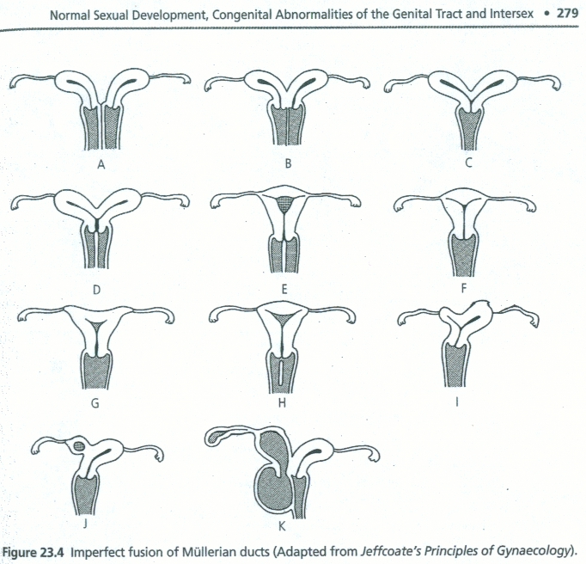
Class 4: Unusual configurations and combinations of defects

Slide 15
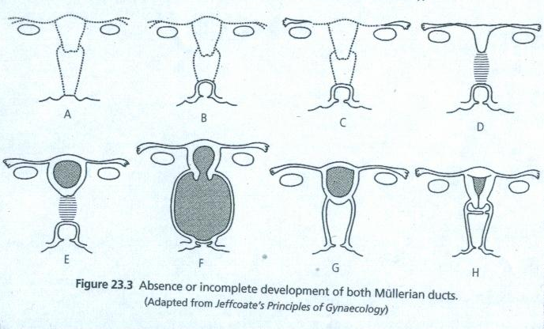
Obstructed labour
Hemametra??

Slide 16
Abnormalities of the Vulva
absence, gross underdevelopment, duplication ,
  Hypoplasia
Bifid clitoris – this can be associated with a defect of lower abdominal wall, ectopia vesicae and a split pelvis
Hypertrophy of the clitoris
Hyper/hypotrophy of labia minora - no treatment or simple plastic operation if necessary
Asymmetry of labia minora - Surgical correction can be done where necessary.

Slide 17
Abn of the vulva contd.
Developmental errors of the cloaca. Defects in the proper partition of cloaca into hindgut and urogenital sinus result in; persistent cloaca with common opening for the bladder, vaginal and bowel.
Fistulas connecting, anus, vagina, rectum and bladder may exist.
A perineal, vestibular or vaginal anus
Imperforate anus.

Slide 18
Abnormalities of the hymen
  May be absent
  Firm membranous tissue making normal penetration impossible
  Imperforate hymen – refer to the presence of an imperforate lower transverse vaginal septum which may lead to hemotocolpos during puberty. Should be drained by cruciate incision under anesthesia.

Slide 19
ABNORMALITIES OF VAGINA
Absence – complete or pouch is present can be associated with intersex
XX - appear as normal women
XY - often normal breast development, scanty public and auxiliary hair and only a vaginal pouch. These condition is due to androgen insensitivity.
Where cryptomenorrhea is present, plastic operation to connect upper vaginal and uterus to lower vagina and introitus. Creating a vagina for coital purposes should be delayed until the patient becomes sexually active – a space is dissected between bladder and rectum and lined with skin graft

Slide 20
Vagina abn continued
Hypoplasia
Vaginal canal short and narrow with shallow fornixes, and a thin epithelium. Can be caused by absent estrogen stimulus from ovaries
Always associated with uterine hypoplasia
Estrogen therapy is useful
Other abnormalities - congenital atresia, stricture, septate and subseptate vagina

Slide 21
COMPLICATIONS IN PATIENTS WITH MULLERIAN DUCT ABNORMALITIES
  Menstrual symptoms
    Cryptomenorrhea
    Spasmodic dysmenorrhea
    Menorrhagia.
Coital symptoms; dysparunia, bleeding
Obstetric complications
  Uterine rapture in pregnancy and labor secondary to surgical scars for corrective surgery.
  Twins occupying different horns of the uterus.
  Sacculation of the uterus
  Abortion and preterm labour
  Mal presentation of the fetus
  Obstructed labor
  Inefficient uterine contractions
  Infertility

Slide 22
Diagnosis
  History
  Examination
  Ultra – sound
  HSG
  Laparascopy
  MRI
.

Slide 23
TREATMENT OF PATIENTS WITH UTERINE ABNORMALITIES
  Depends on exact state of deformity and on symptoms produced
  Each case requires individual consideration
  Many are best left untreated
  Vagina septa are generally resected
  Rudimentary horns requires excision
  Recurrent abortions in bicornuate uterus requires plastic operation
  Septum resection can also be done hyteroscopically
  Symmetrical double uterus has an excellent reproductive performance after surgical unification

Slide 24
THANK YOU

