Slide 1
Benign Lesions of the Vulva and Vulva Dystrophy
Dr. Konya Walter P.
Obstetrician and Gynaecologist
Gynaecological Oncology Fellow

Slide 2
Introduction
Conditions that lead to changes to vulva cells, but that are not cancerous.
They are not usually life-threatening.
Vulva symptoms are common and cause considerable distress for women.
Symptoms often are chronic and can affect quality of life including sexual function.

Slide 3
Anatomy of the Vulva

Slide 4
Common presentation vulva disorder
Pruritis / Itching
Most common to many of these conditions, often intense
Pain (Vulvodynia)
Generalized
Localized (vestibulodynia, clitorodynia, hemivulvodynia)
May be Provoked (sexual, nonsexual) or unprovoked
Ulceration
Masses
Abnormal colouration
White colouration
Dicreased vascularity, Increase in Keratin, Loss of Melanin
Dark colouration
Increased Melanin
Redness
Thinning of epidermis, Ulceration, Inflammation, Neovascularisation

Slide 5
Classification based on pathogenesis
Infectious disorders
Viruses
Bacteria
Fungi
Benign cystic tumors
Benign solid tumors
Non-neoplastic epithelial disorders
Inflammatory disorders
Blistering disorders
Pigmentary disorders
Ulcerative disorders
Vulval atrophy
Developmental abnormalities

Slide 6
1). Infectious Disorder
Viruses
Herpes genitalis
Herpes zooster
Molluscum contagiosum
Condylomata

Slide 7
Herpes Genitalis
Most caused by Herpes simplex Virus type 2
10% caused by Herpes simplex Virus type 1
Usually sexually transmitted.
Clusters small painful blisters that ulcerate
Reactivate causing recurrences often for life
Diagnosis
Typical clinical manifestations
Serology for HSV-2
Management
Loose cotton underwear
Keep area clean and dry
Anti-inflammatory analgesics
Topical treatment : Calamine, Acyclovir
Early treatment with Antiviral
Limits duration of primary infection, recurrences
Acyclovir 200mg five times daily for 5-7days)
Prophylactic Antiviral for frequent recurrences
Prevention by Safe sex and practices

Slide 8
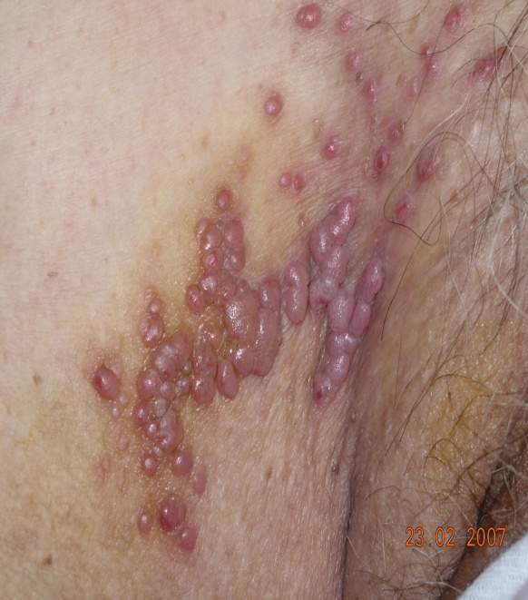
Herpes Zoster / Varicella Zoster
Caused by Herpes Zoster Virus
1º infection is followed by a latent infection
Lies dormant in a sensory nerve ganglion.
Reactivation associated with low immunity
Pain, pruritus, or tingling in a dermatome
Clusters of papules appear and change into vesicles with an erythematous base.
Postherpetic neuralgia can be a sequelae
Management
Local topical applications
Acyclovir cream, Calamine , Aluminium acetate
Antiretrovirals :
Acyclovir 800mg five times daily for seven days.
More effective if started within 72 hours of onset.
Pain management.
Analgesic medicines
Topical lidocaine
May add Amitryptiline

Slide 9
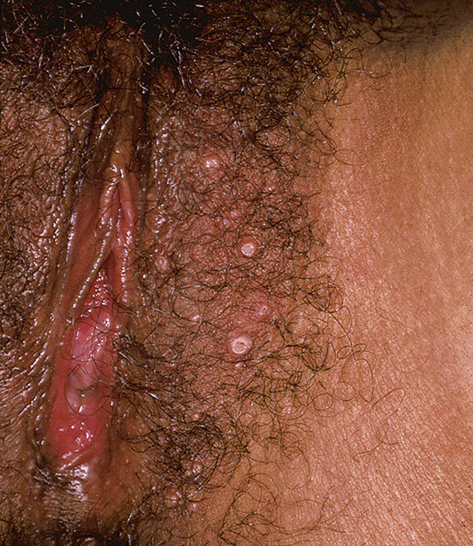
Molluscum Contagiosum
Contagious, a DNA poxvirus
related to intimate/sexual contact
Common among HIV positive
small, multiple smooth papules, 3-6 mm, with a central umbilication
Diagnosis is clinical, not require
Intracytoplasmic inclusion bodies (Henderson–Patterson bodies) on Cytology confirms diagnosis
Management
Regress Spontaneous, 6–12 months
Cryosurgery
Bichloroacetic acid

Slide 10
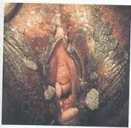
Condyloma acuminate / Genital warts
Infection with HPV types 6 and 11
Form cauliflower-like warty growths
Flat condylomata may occur
Can grow into huge masses
10-15% regress spontaneously
Association with HIV infection
Management
Local applications to the warts
25% Podophyllin
0.5% Podophyllotoxin (Podofilox. Condylox)
Imiquimod cream: Aldara, Zyclara
Trichloracetic acid (TCA)
Surgical excision
Electrosurgery
Laser surgery
Cryotherapy

Slide 11
Bacteria
Staphylococcal Infections
Affect hair-bearing areas: labia majora and pubis
Warmth, moisture ideal environment for infection.
Occlusion, depilation predispose to infection
Suppurative Folliculitis
Furunculosis (boils)
Blisters or pustules
Bullous Impetigo
Abscess in glands and ducts
Streptococcal Infections
Superficial cutaneous infection
Necrotizing fasciitis
Tuberculosis

Slide 12
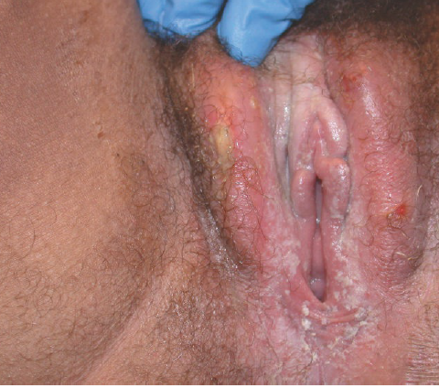
Fungi
Candidiasis
Fungal dermatitis
Tinea Vesicolor
Tinea Cruri
Treatment
Antifungal cream
Oral antifungal

Slide 13
2). Benign cystic tumors
Caused by blockage of ducts
Exclude Chlamydia and gonococcal infection
Have a tendency to become infected
May arise from the
Minor and Major vestibular glands
Remnants of mesonephric duct
Remnants of the urogenital sinus
Common cysts
Bartholin cyst
Skene duct cyst
Epidermal inclusion cyst
Gartner’s Cyst

Slide 14
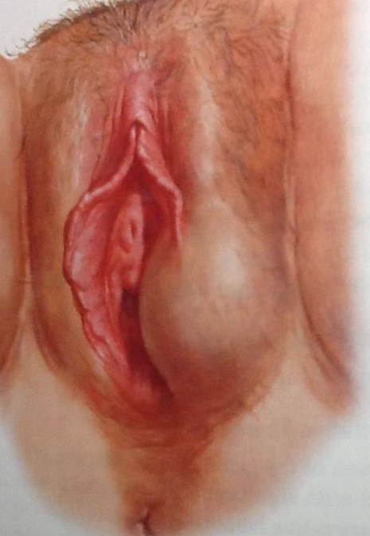
Bartholin’s Cyst
Bartholin’s glands are major vestibular glands
Situated at 5 and 7 o’clock
Results from duct blockage
painless lump next to the vaginal opening near anus.
contain mucoid material
If an abscess develops the lump is painful.

Slide 15
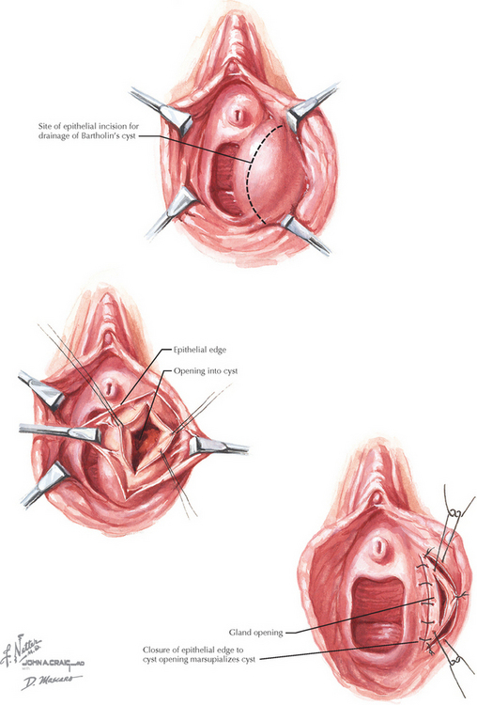
Bartholin’s Cyst - Management
Incision & Drainage
Infected Cysts
Marsupialization
for cysts that persist
Surgical excision
Recurring cysts
in older patients
Give antibiotics
if infected

Slide 16
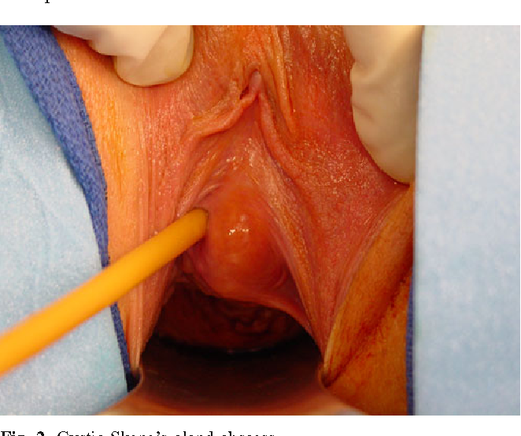
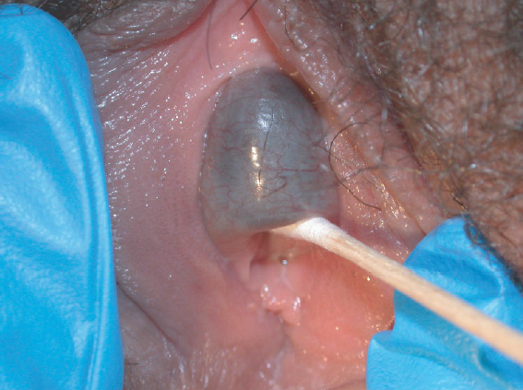
Skene’s Cyst
Skene’s glands are next to the opening of the urethra
result of ductal occlusion.
form a subepithelial masses
Some may be pedunculated
Presents with pain, problems urinating, UTI.
May disappear spontaeously
Treatment, if needed is by Surgical excision.

Slide 17
Gartner’s Cyst
An embrological remnant
Found on anterolateral walls of the vagina
Contains mucinous material
Managed by surgical excision

Slide 18
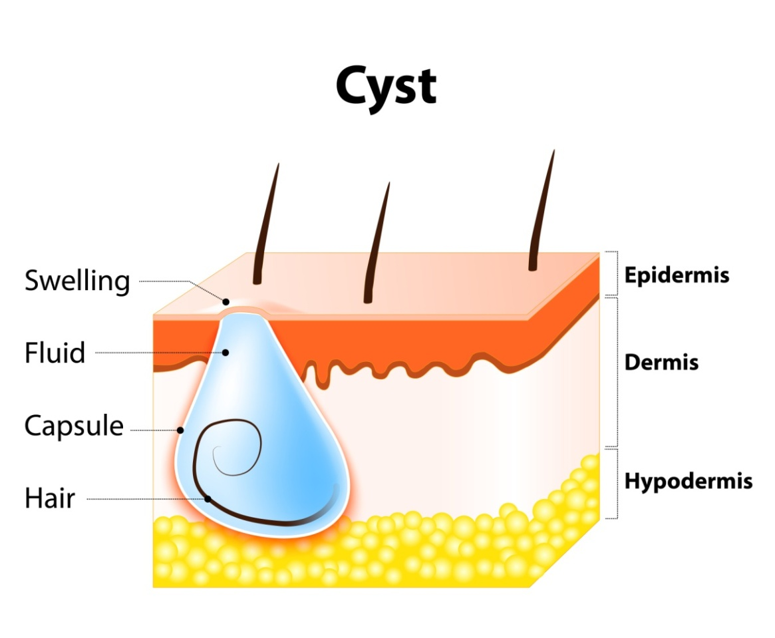
Epidermoid cysts
Occur as masses in hair-bearing areas
Areas have sebaceous, apocrine (scent) and eccrine (sweat) glands.
Main types of epidermoid cysts
Sebaceous cyst
Keratinous cyst
Inclusion cyst

Slide 19
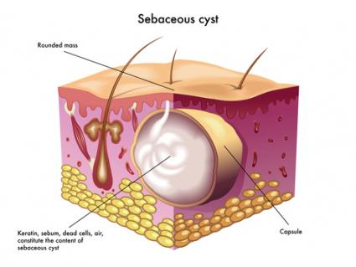
Sebaceous Cyst
Caused by obstruction of sebaceous gland
cyst adherent to overlying skin and has a punctum.
lined by keratotic squamous epithelium.
Contain greasy grey material
Contents cause foreign body type granulomatous reaction.
When infected causes pain

Slide 20
Inclusion cysts
Causes include
Trauma and in-folding of skin edges
Tears of vulva
Episiotomy repair
Female genital mutilation
Fusion of epidermal structures at embryogenesis.

Slide 21
Management of Epidermoid Cysts
Complete surgical excision
To treat the tumors
For histological diagnosis
To rule out malignancy.
Antibiotics if infected

Slide 22
3). Benign solid tumors
Non-cancerous tumors of the vulva
Common benign solid tumors are
Lipomas
Fibromas
Haemangioma
Skin Tags
Hymenal tags
Excisional biopsy often performed
To treat the tumors
To diagnose the tumours
To rule out the possibility of cancer.

Slide 23
Lipomas
may be sessile or pedunculated
are soft, rounded and lobulated
mostly found in labia majora
unlike sebaceous cysts
not tetherd to overlying skin
there is no punctum
Histology
formed by mature fat cells and fibrous tissue.
Treatment is by excision.

Slide 24
Fibromas
Usually on the labia majora.
Composed of dense collagen and fibroblasts
Occur as sessile or exophytic projections
Vary in size, Pedunculated can reach >10 cm
Present with discomfort or pain when sitting or coitus.
Treatment is by excision.

Slide 25
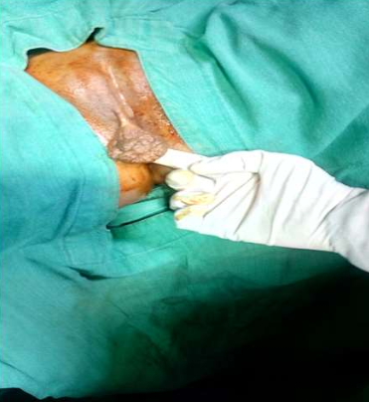
Haemangiomas
Start in the blood vessels
They are of various sizes
Usually don’t need treatment
Trauma may cause bleeding
Bleeding can be controlled by
Suture
Excision
Laser therapy
Sclerosing agents
Cryotherapy

Slide 26
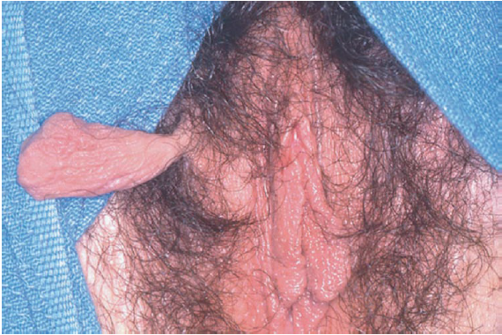
Vulva skin tags
Present as pedunculated or sessile polyp
in areas subject to irritation
Common in obese patients
Soft flesh fibroepithelial like structures
Have a vascular core, can bleed if pulled off.
Lesions irritating and painful
Managed by ligation and excision

Slide 27
Hymenal remnants
Vary in size and shape
Can occur as normal after childbirth.
Do not usually cause any symptoms
Can become swollen and painful.
Surgical removal may be required

Slide 28
4). Non-neoplastic Epithelial Disorders
Vulva atrophy
Often found among the elderly
Abnormalities represent a physiologic process related to advanced age
Atrophic Dystrophy
Skin is thinned
Cigarette paper like or Cellophane appearance
e.g Lichens Sclerosus
Hypertrophic Dystrophy
Secondary to chronic irritation
Skin thickens and hyperkeratotic, appears white
e.g Lichen Simplex Chronicus

Slide 29
Atrophic Skin

Slide 30
Hypertrophic (Hyperkeratosis) skin

Slide 31
Lichen sclerosus
Skin is thin, cigarette paper like.
Patchy, diffuse or whole labia
Etiology unknown - ?Autoimmune ? Genetic ? Enviromental ? hormonal
Associated with trauma, friction, chronic infection, and irritation
Familial occurrence in 22%
Prevalent in postmenopausal age
Get itch, burning pain, dyspareuina
May lead to adhesions and Stenosis
5% get cancer of Vulva in12 years
Biopsy and very close follow-up
Management :
Corticosteroid creams
Immunomodulators
Surgery
if Severe, recurrent, malignant change

Slide 32
Lichen chronicus
A localized neurodermatitis
End stage of itch-scratch-itch cycle by any itching disease of the vulva
Initial stimulus may be dermatitis, vaginal discharge, tinea, psoriasis etc
Irritant may have been transient
Bilateral, discoloured, thickened skin
Excoriation, 2º bleeding or infection
Management
Remove the trigger
Manage the itch
Antihistamines esp at night
Topical Corticosteroids
Betamethasone
Sitz baths
Clip the nails

Slide 33
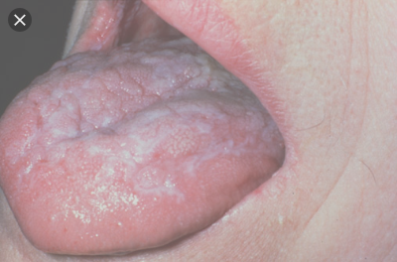
Lichen Planus
Can be acute or chronic
Affects skin, mucous membranes
on flexor surface and buccal area
Lesions may be hypertrophic
Vulval lesions with associated adhesions and yellow exudate,
Cause is unknown,
May be T-cell Autoimmune Ds
Some drugs induce lichen planus type eruptions.eg ACE inhibitors
Management
Remove irritant
Corticosteroids

Slide 34
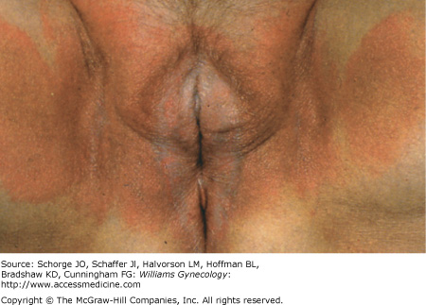
Primary dermatitis
Pruritus and irritation in the absence of any immune reactivity
Chemical agents that remove surface lipids, denature epidermal keratins, or damage cell membranes causing irritation.
Obsessive cleaning of the vulva area may cause irritation.
Irritation may arise as a result of friction from tight clothing,
Synthetic fabrics traps moisture
Activities such as cycling and horseback riding.
Common irritants include
perfumed soaps, bubble baths, bath oils,
hygiene products : tampons, pads, diapers, wipes, deodorant sprays, colored or scented toilet paper
detergents, fabric softeners,
physically abrasive contactants : face cloths, sponges
body secretions : urine, semen

Slide 35
Allergic / Atopic dermatitis
inflammatory disorder from local contact with agent to which previously sensitized,
Result of a delayed, cell-mediated, type IV hypersensitivity reaction.
develops 12-48 hrs after exposure.
Pruritus may coincide with generalized allergic symptoms.
May have a personal or family history of asthma, hay fever, eczema
Allergens include hygiene products
Clothing dyes
Lotions and moisturizers - Lanolin
Nail polish
Soaps, and cleansers
Sanitary towels
Perfumes - Balsam
Latex Rubber - Gloves, Condoms, diaphragms
Antiseptics - Hexachlorophene
Nickel – snaps, zippers in jeans, underwear
Antibiotics - tetracycline, sulfonamides,

Slide 36
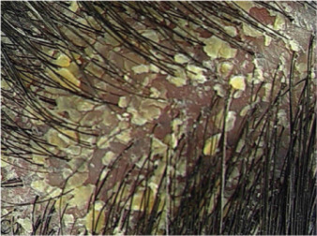
Seborrheic dermatitis
Affects hair-bearing parts with active sebaceous glands
less common in the vulva
Erythematous inflammation with loose yellow-white or gray flakes
pruritus, irritation, dry feeling
Cause is unknown.
Associated factors
Androgens activity
Yeasts : Pityrosporum Malassezia
HIV infection
Emotional stress,
Zinc deficiency
Management
Anti-fungal anti-proliferative shampoos
have pyrithione zinc, ciclopirox, selenium sulfide, ketoconazole
Corticosteroids
Keratolytic (salicylic acid) ointments

Slide 37
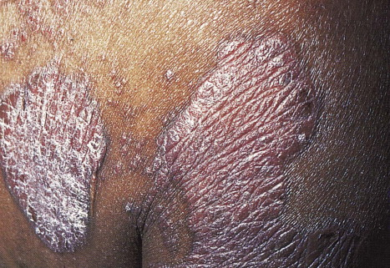
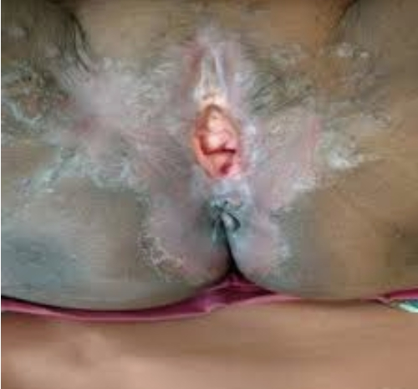
Psoriasis
Hereditary disorder of the skin
2º excessive cell turnover
Thickened erythematous red plaques
on skin covered by silver-white scales
Rarely vulva involvement occurs
Sites of repetitive trauma, and skin folds
eg scalp, elbows, forearms, knees, hands
Triggered or exacerbated by local factors
irritation from scratching, irritant soaps,
bacterial or yeast superinfections
heat and humidity
Tight synthetic clothing
sanitary napkins., menses
nervous stress
Pruritus may be minimal or absent,
diagnosed by skin findings alone.
Lesions persistent
(don’t come and go as observed in Eczema)

Slide 38
Treatment of Psoriasis
Topical corticosteroids
Vitamin D analogues
Phototherapy with UV light
Photochemotherapy
Immunomodulators
Efalizumab, Infliximab, Alefacept
Newer, lack data on long-term safety and efficacy

Slide 39
Blistering disorders
Autoimmune disorders
antibodies to elements of the skin
Types
Familial pemphigus
Bullous pemphigoid
Cicatricial pemphigoid
Pemphigus vulgaris
Erythema multiforme
Epidermolysis bullosa
Characterised by recurrent eruptions of vesicles and blisters
Mostly occur in the anogenital area
Vulva problems are be common
Trigger factors :
friction, infections, irritants, increased temperature, humidity, UV light

Slide 40
Pigmentary changes
Acanthosis nigricans
Lentigo and lentiginosis,
Benign vulvar melanosis
Melanocytic nevus
Postinflammatory hyperpigmentation
Postinflammatory hypopigmentation
Scleroderma
Vitiligo
Vulvar melanosis

Slide 41
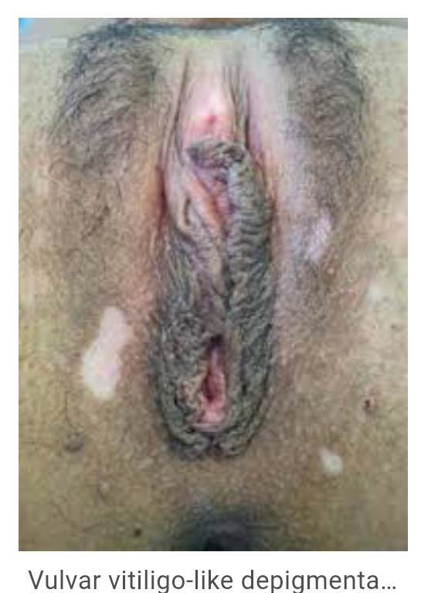
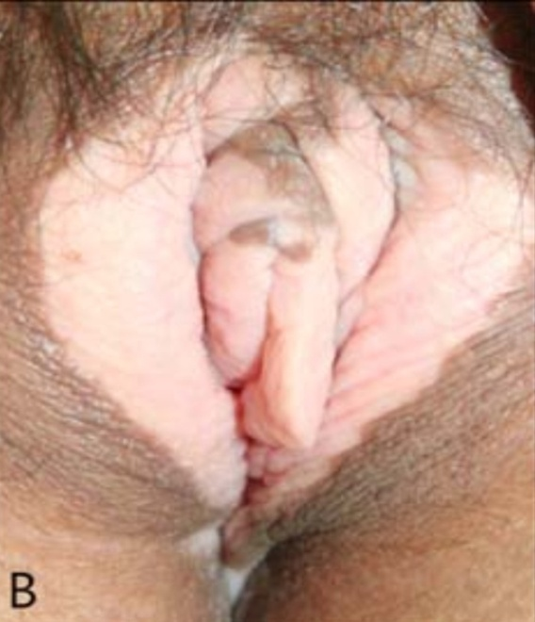
Pigmentary changes
Vitiligo
Acquired loss of pigmentation
Secondary to immunologically mediated melanocyte damage.
Genital involvement common
Other body parts also affected

Slide 42
Melanosis and Melanocytic Nevus
Vulva nevi are fairly common
Nevus cells derived from the neural crest migrate into skin during embryogenesis and collect in basal cell layer
The cells proliferate in small nests in dermis.
Appear as dark lesions
Can progress to Melanoma
Biopsy if Nevus has irregular border, variable colour

Slide 43
Physiologic and Post inflammatory Hyper- and Hypo - pigmentation
Observed within healing scar tissue
May clear spontaneously

Slide 44
5). Ulcerative disorders
Example
Syphilis, Chancroid, Granuloma inguinale, LG Venerum
Primary Syphilis
highly contagious STI
by spirochete Treponema pallidum
coinfection with HIV recognized.
Primary lesions (chancre) is painless indurated, shallow, clean solitary ulcers with raised edges.
LNs enlarged, firm, not tender
Labs
Positive RPR,VDRL,Dark stain
Management
Benzathine Penicillin

Slide 45
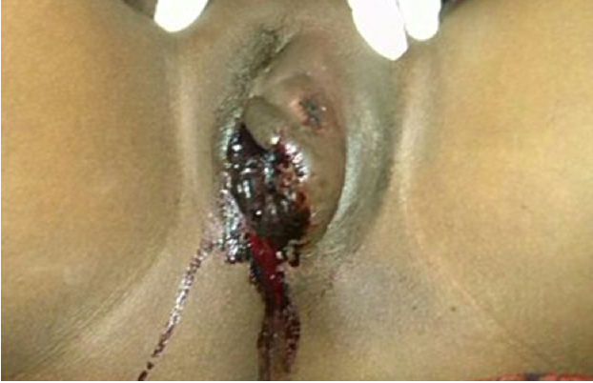
6). Other conditions
Vulva Hematoma
Often from Trauma
Management
Incision & drainage
Foley catheter
Ice compresses
Rest
Resolves in 2-3 wks

Slide 46
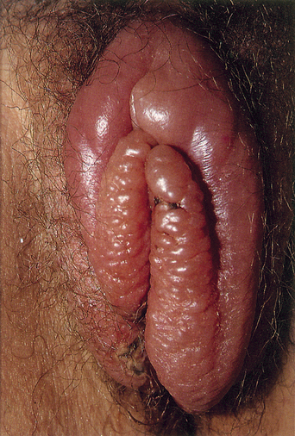
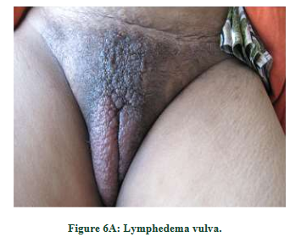
Vulva Oedema
Causes include
2º to medical conditions
CCF
Portal hypertension
Obesity
Contact dermatitis
Tropical diseases
Following surgery
STI
Manage underlying cause

Slide 47
Systemic diseases with vulva manifestations
Lupus Erythematosus
Pemphigus
Contact dermatitis
Dermatitis medicamentosa
Psoriasis
Diabetes Mellitus Vulvitis
Behcets Syndrome
Leukemias
Acanthosis Nigricans

Slide 48
Diagnosis
History
Ascertain whether the lesion is vulval, vaginal or perianal
Complaints : Pain, discomfort, irritation, itch, dyspareunia, discharge
Whether symptoms sudden or gradual in onset., recurrence
What worsens, symptoms? What improves Symptoms?
Symptoms ? when : through out, sitting, during coitus.
Whether the partner has any similar complaints.
Other Complaints : Dysuria, urinary frequency
Current problems such as psoriasis, chickenpox
History of trauma
Review irritants
Hygiene, Soaps, Douching, Pads, Shampoos, creams, Dyes
Detergents, Scented Perfumes, Foods
Spermicides, Latex Condoms, Exposure to Semen
Personal or family history of atopy : eczema, asthma,
Recent use Medications, of antibiotics
History of chronic illness : Diabetes, Crohn's
Review PMHx. Surgical Hx,OBS Hx, Gyn Hx, Menstrual Hx

Slide 49
Examination
Thorough examination with adequate lighting
Systematic physical exam of abnormal lesions
Boarder asymmetry
Number
Color
Distribution
Examination of the rest of the body, including
Mouth, scalp, elbows, knees, Nails, conjunctiva
Lymph nodes r/o TB or malignancy.
Systems Exam

Slide 50
Investigations
Vaginal swab
Urinalysis
STIs
HIV test
Blood sugars
Colposcopy
Vulva biopsy
Indications
Lesions not responding to medical treatment
Hypertrophied lesion
Non-healing ulcerative lesions
Excisional, wide biopsy
Incisional, full thickness

Slide 51
Management
Stop irritant
Scented soaps, Perfumes, Detergents, fabric softeners, Chlorine
Products with multiple ingredients
Talc Powder or use natural
Douching, Latex, Petroleum lubricants, use water based or silicon
Trim nails to reduce scratching and reduce bacteria
Wash vulva area with clean plain water
Use cushion over bikes seats and horse saddles
Loose fitting cloths, wear cotton or avoid underwear
Weight control
Treat underlying disease: DM
Antipruritics
Antihistamines
Cortecosteroids
Betamethasone
Clobetasol
Surgical excision

Slide 52
THANK YOU

