Slide 1
Precancerous lesions of the cervix AND CERVICAL CANCER
PROF. EUNICE J. CHESEREM
OBS/GYN. DEPT.
UON

Slide 2
Outline
Introduction
Cervical carcinogenesis
Screening and follow-up

Slide 3
Introduction: Cervical cancer
2nd most common cause of cancer related mortality in women worldwide-Kenya it is leading cause
Curable when detected early
Screening programmes have reduced the incidence of and mortality from CaCx in industrialized countries substantially.

Slide 4
Cervical carcinogenesis

Slide 5
Definitions
Metaplasia-(change in form) replacement of one differentiated cell type with another differentiated cell type
Dysplasia- (bad form) abnormality in the appearance of cells indicative of an early step towards transformation into a neoplasia
Neoplasia-(new growth) is abnormal, disorganized growth in a tissue or organ

Slide 6
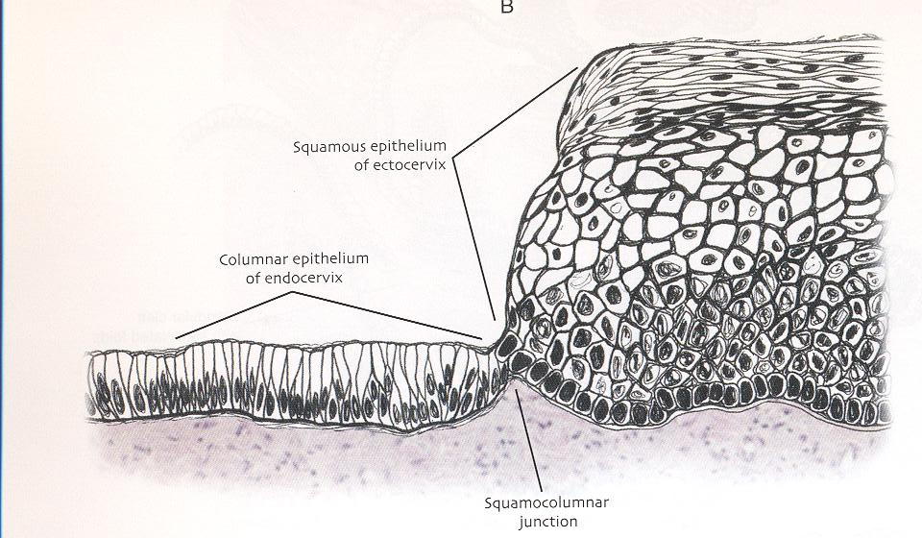
Slide to show the various changes in cells. Most important zone for pap smear

Slide 7
Transformation Zone and Original Squamo-collumnar junction
Cervical neoplasia almost invariably originates within the Transformation Zone
Original SCJ: Junction in fetal life between the stratified squamous epithelium of the vagina and ectocervix and columnar epithelium of endocervical canal- as puberty progresses there is eversion of this junction

Slide 8
New SCJ
Increased Estrogen secretion at puberty and 1st pregnancy causes eversion of endocervical columnar epithelium to an ectocervical location i.e. ectropion.
columnar epithelium exposed to damage by vaginal acidic environment- become squamous due to damage

Slide 9
Squamous metaplasia
Proliferation of stromal reserve cells beneath columnar epithelium eventually replacing columnar epithelium with stratified squamous metaplastic epithelium
The junction between the columnar and squamous epithelium is the new SCJ (seen at colposcopy)- always see the junction, main area for diagnosis if not seen then do a endocervical curettage

Slide 10
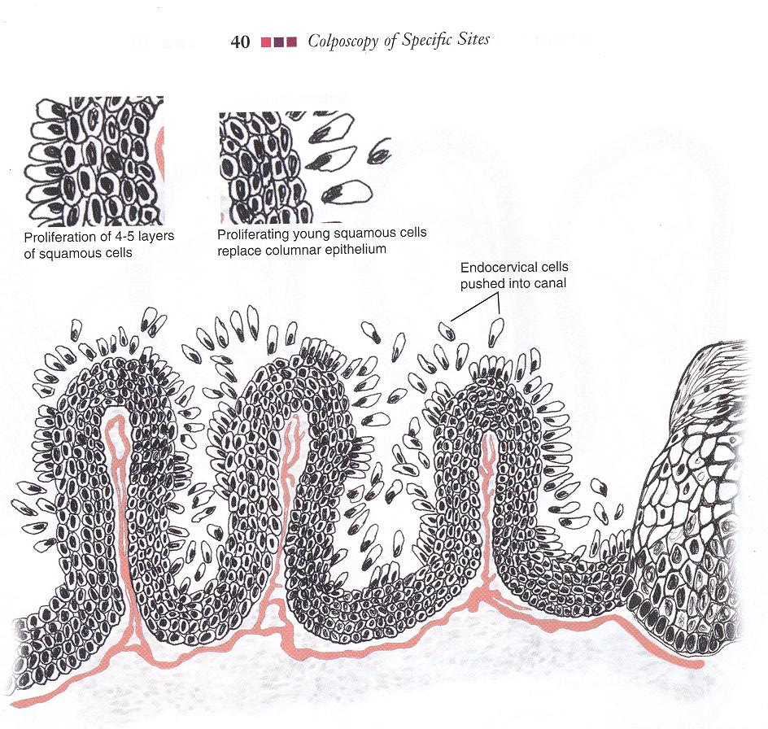
Notice the glandular nature

Slide 11
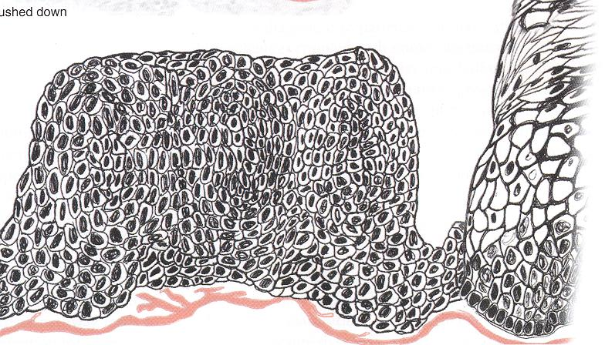

Slide 12
The cell cycle
Cancer is a disease of the cell cycle
The cell must pass 2 check-points at G1/S boundary and at G2/M boundary (Weinert and Hartwell 1989)

Slide 13
HPV
HPV should be considered as cause of cervical cancer*
Vaccines used to reduce this incidence
At 35 years 60% of women exposed to hpv (also men)
*International Agency for Research on Cancer (IARC) and the World Health Organization (WHO), 1991

Slide 14
HPV
Biology
Members of the papovaviridae family
Non-enveloped virus, eicosahedral structure
Closed, circular double stranded DNA ~7900 base pairs
Species specific
Among HPV >100 types described

Slide 15
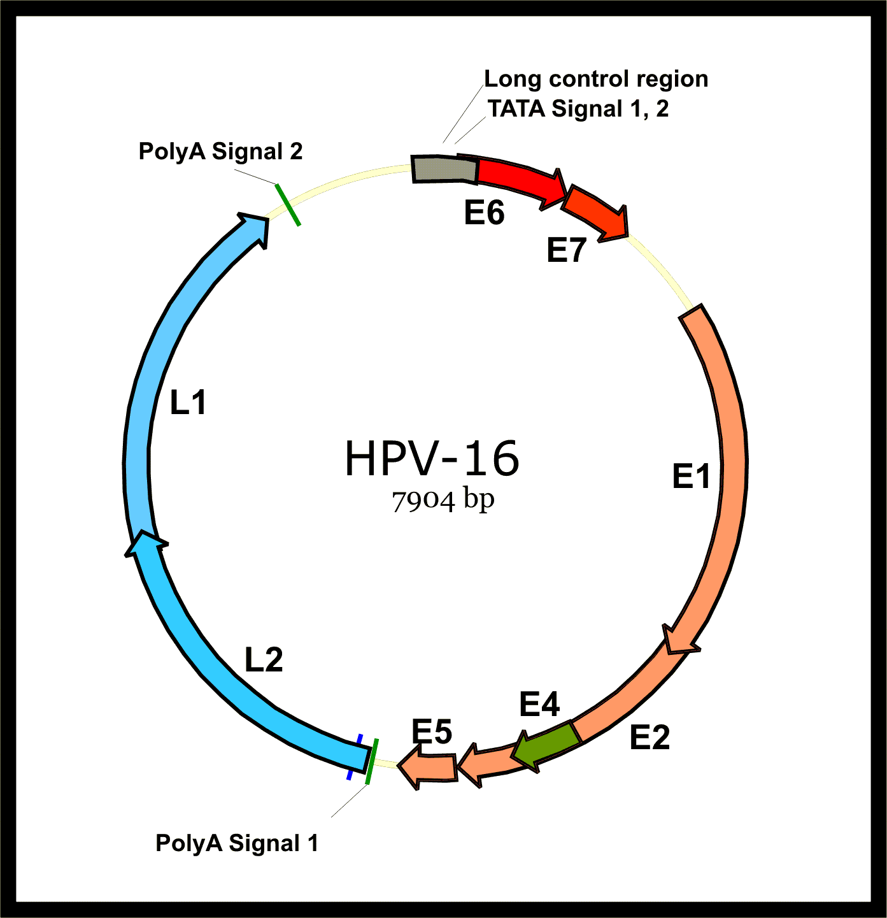

Slide 16
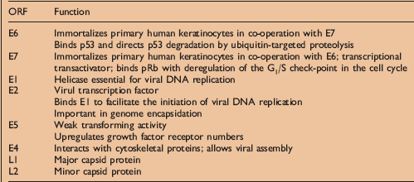

Slide 17
HPV
True incidence of HPV infection not known but is commonest STI with 60% of women <35 exposed.
Male condom use is not protective so make sure vaccine is given

Slide 18
HPV and cervical dysplasia
Oncogenic HPVs interfere with cell-cycle control and DNA repair mechanisms
promotes genetic instability and the accumulation of mutations in HPV infected cells
transit time to invasive cancer is variable, taking as little as 12-18 months or as long as several decades.

Slide 19
HPV integration
Genome of HPV usually found as a viral episome independent of host cell DNA in the nucleus of infected cells (low risk types)
In high grade CIN lesions and especially in cancer (>90%) HPV genome is integrated into host DNA

Slide 20
HPV types by risk of carcinogenicity
Pap smear should tell what type of hpv was found that will direct the management
RISK | HPV type
Low risk | 6, 11, 40, 42, 43, 44, 54, 61, 70, 72, 81
Probably high risk | 26, 53, 66
High risk | 16, 18, 31, 33, 35, 39, 45, 50, 51, 53, 55, 56, 58, 59, 64, 68

Slide 21
Role of p53 in cell cycle
p53 has many anti-cancer mechanisms:
activate DNA repair proteins
hold the cell cycle at the G1/S regulation point on DNA damage recognition
initiate apoptosis if the DNA damage proves to be irreparable
Point mutations of p53 is commonest mutation in solid tumors
Apparently too difficult for us to remember and all

Slide 22
HPV and p53: E6 binding promotes p53 degradation removing the p53 dependent control of the host cell-cycle

Slide 23
Retinoblastoma gene (Rb)
In response to DNA damage halts cell growth or induces apoptosis
Rb renders E2F transcription factor inactive (E2F normally promotes DNA synthesis)
When E7 binds Rb protein E2F is left to allow unchecked cell growth in presence of genomic instability that may lead to malignant change``1

Slide 24
HPV and pRb: the HPV 16 E7 protein binds pRb inactivating its tumor suppressor function

Slide 25
HPV and cervical cancer
Of the millions of women infected by HPV only a small subset actually develop cervical cancer
HPV is likely limited in most women by cell-mediated immunity

Slide 26
Role of other HPV proteins
E1- regulate DNA replication and maintain virus in episomal form
E2- regulates E6 and E7 expression
E5- regulates cell growth, may prevent apoptosis after DNA damage

Slide 27
Risk factors: Genetics
genetics do not play major role in cervical carcinogenesis
However, some association noted with particular MHC alleles: HLA-DQ3 and HLA-DR6*
*Helland A, Borresen AL, Kaem J: HLA antigens and cervical carcinoma. Nature 356:23, 1992

Slide 28
Risk factors: Cigarette smoking
Risk factor for cervical and vulvar cancer
Breakdown products of cigarette smoke e.g. nicotine, cotinine and tar have been found in cervical secretions
found to have mutagenic activity in cervical cells similar to that found in lung cells.

Slide 29
Other microbial infections
HPV and cervical neoplasia common in those with multiple sexual partners
reparative metaplasia associated with acute cervicitis due to Chlamydia, GC, HSV and TV may increase susceptibility to HPV- due to epithelial damage

Slide 30
Hormonal influences
Condyloma accuminata increase in size and number in pregnancy
? Maternal oestrogen status
? Immunosuppression of pregnancy
Increased detection of HPV in cervical cytologic samples in pregnancy

Slide 31
Hormonal influences
CIN and CaCx more common in women of higher parity and those on oral contraceptive pills (OCP) independent of sexual activity
However no value in stopping OCP in management of CIN

Slide 32
Immunosuppression
Renal transplant recipients have 16 times more CIN
HIV: increased risk of CIN and treatment failures.
Also Hodgkins disease, leukaemia and Collagen Vascular diseases

Slide 33
HIV
In 1993 CDC included invasive cervical cancer in the case definition of AIDS
10 fold increase in CIN
Rx of CIN has high failure rate
Recurrence associated with CD4 and T lymphocyte counts
Have more advanced cancer with poor prognosis with death from CaCx not AIDS

Slide 34
Dietary factors
Higher levels of dietary intake of Vitamin A and carotenoids leads to >50% reduction in persistence of high-risk HPV
Effect not consistent

Slide 35
Screening

Slide 36
Pap smear
Most cost-effective cancer screening test devised.
Has reduced incidence of cervical cancer in US by 79% and mortality by 70%.
False negative rate of 15-30% for HGL (CIN 2 and 3)
Good skill is needed to carry out a pap smear, capture cells from the junction.
The brush can get 10 million cells

Slide 37
Pap smear
Sample collection: no douching, pv meds, intercourse for 48h (educate the woman prior to get cells of cervix instead of semen)
Best results with Ayre’s spatula and cytobrush (only rotate 180⁰)- approx. 5 rotations
Smear on slide and fix immediately- swipe brush on either half of the slide, not smear like butter
LBC (Thin prep) Improved detection of HGL of 16-100%

Slide 38
Pap Smear guidelines- ACOG
Initial:
21 years or 3 years after vaginal sex
Follow-up:
yearly
2-3 yearly for >30 years with 3 consecutive normals
Discontinue:
70 years if 3 consecutive normals in 10 years

Slide 39
Classification
ASCUS: Atypical squamous cells of undetermined significance
ASC-H: Atypical squamous cells – cannot exclude HSIL
LSIL:Low grade squamous intraepithelial lesion
CIN 1
HSIL: High grade squamous intraepithelial lesion
CIN 2
CIN 3
Squamous cell carcinoma
Atypical Glandular Cells not otherwise specified (AGC-NOS)
Atypical Glandular Cells, suspicious for AIS or cancer (AGC-neoplastic)
Adenocarcinoma in situ (AIS)

Slide 40
HIV patients (CDC)
All should have Pap smear- actually all pts with immunosuppression as a pap smear is life saving
If 1st Pap smear normal repeat in 6m, then annually.
If 1st Pap smear has severe inflammation with reactive squamous cells repeat in 3m
For ASCUS and SIL do colposcopy

Slide 41
Other tests
VIA/VILI- visual inspection using acetic acid/ lugol iodine… the difference in colour helps with guiding where to get the sample from
HPV DNA testing
Check how its done….

Slide 42
Colposcopy
Microscope with a light source to examine lower genital tract- start from the vulva i.e. vulval lesion which may be missed or so, then proceed to the cervix
3 standard solutions:
Saline,- remove dead tissue, an should not be overused as u may loose the affected cells in the process.. Usually a stepped that is skipped in clinical practice
Acetic acid (3-5%)
Lugol’s iodine (Schiller’s test)

Slide 43
Colposcopic findings of CIN
Acetowhite epithelium
Abnormal vascular patterns: punctation and mosaicism
Atypical blood vessels
*PHOTODOCUMENTATION

Slide 44
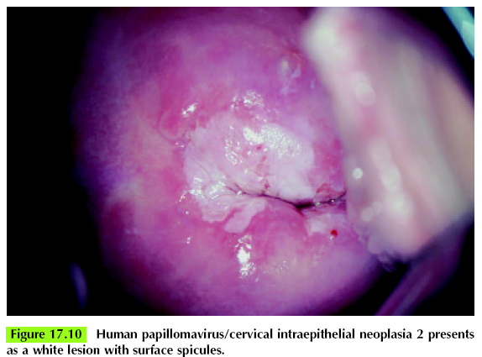

Slide 45
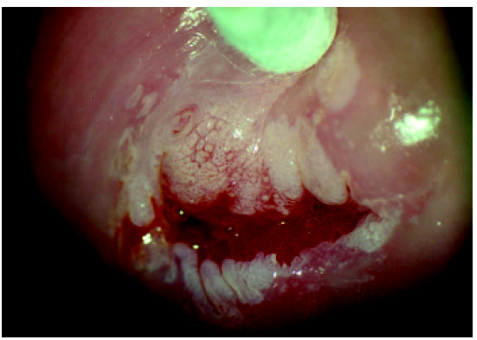
Notice some punctation, also there is mucus

Slide 46
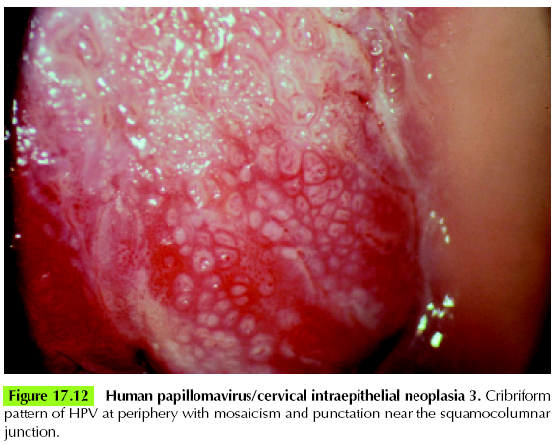

Slide 47
Follow-up

Slide 48
Follow-up (ASCCP 2001)
Atypical squamous cells
a) repeat Pap smear in 4-6 months
b) Immediate colposcopy
c) HPV testing

Slide 49
LSIL/HSIL
Immediate colposcopy and directed biopsy!

Slide 50
ALTS *
Multicentre RCT comparing triage options for ASCUS and LSIL to detect CIN 3.
Immediate colposcopy, HPV testing, repeat Pap smear
HPV testing as sensitive as immediate colposcopy in picking CIN 3 and referred only half as many women for colposcopy
*ASCUS LSIL Triage Study (ALTS) Group

Slide 51
Treatment of CIN
All CIN 2 and 3 lesions require treatment
LEEP (preferred, provides tissue for HPE)- main mode of treatment, use the right loop for adequate removal of specimen in one block and not in pieces
Cryotherapy (Nitrous oxide or Carbon dioxide) each procedure 3 mins and done 3 times
Laser ablation (expensive)- not yet in knh
Conization (if limits of lesion can’t be seen)

Slide 52
We didn’t cover cervical cancer.

Slide 53
CERVICAL CANCER

Slide 54
Cancer of the cervix
Mean age: 52 years
Bimodal age distribution: 35-39 years and 60-64 years

Slide 55
Risk factors
Young age at first intercourse
Multiple sexual partners
Cigarette smoking
Race
High parity
Low socioeconomic status
? Oral contraceptive pills
Immunosuppression

Slide 56
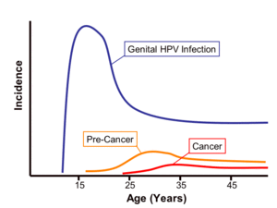
Natural History

Slide 57
Symptoms of cervical cancer
ASYMPTOMATIC in early stages
Vaginal bleeding- usually postcoital
Foul smelling vaginal discharge
Weight loss
Obstruction of the urinary system

Slide 58
Treatment of cervical cancer
Early stages: Surgery, Radiotherapy
Late stages: Radiotherapy
Results similar for surgery and radiotherapy

Slide 59
Cervical cancer
Curative treatment of cervical cancer usually includes a combination of external pelvic irradiation and brachytherapy
The goal of radiotherapy is to eliminate cancer in the cervix, paracervical tissues and regional lymph nodes
All these areas can be included in a pelvic radiation field

Slide 60
Results of treatment
Radiation therapy is extremely effective in the treatment of stage IB1 producing central and pelvic disease control rates of > 98% and >95% respectively and disease-specific survival rates of about 90%
Recent studies have demonstrated a marked improvement in pelvic disease control and survival when cisplatin-containing chemotherapy is given concurrently

Slide 61
Adjuvant pelvic radiation therapy after radical hysterectomy
For patients with IB and IIA treated with RHLND, node involvement is the strongest predictor of recurrence and death
Patients with node involvement have survival rates only 50-60% those of patients with negative nodes
Parametrial involvement and involvement of surgical margins also predict a high rate of pelvic recurrence and are considered to be indications for postop irradiation

Slide 62
Complications
Late complications occur in 5-15% and are related to the size of the dose per fraction, the total dose administered and the volume irradiated
Bladder: haematuria, fibrosis, contraction, fistulas
Rectosigmoid or terminal ileum: bleeding, stricture, obstruction or perforation

